Slide 1

Byzantine Pyxis with Mythological and Combat Scenes,
4th quarter of the 10th century, Ivory, 11.5x41.5x17.5 cm, Musée de Cluny, Paris, France
Photo Credit: https://www.musee-moyenage.fr/collection/oeuvre/coffret-mythologie-combats.html

Slide 2
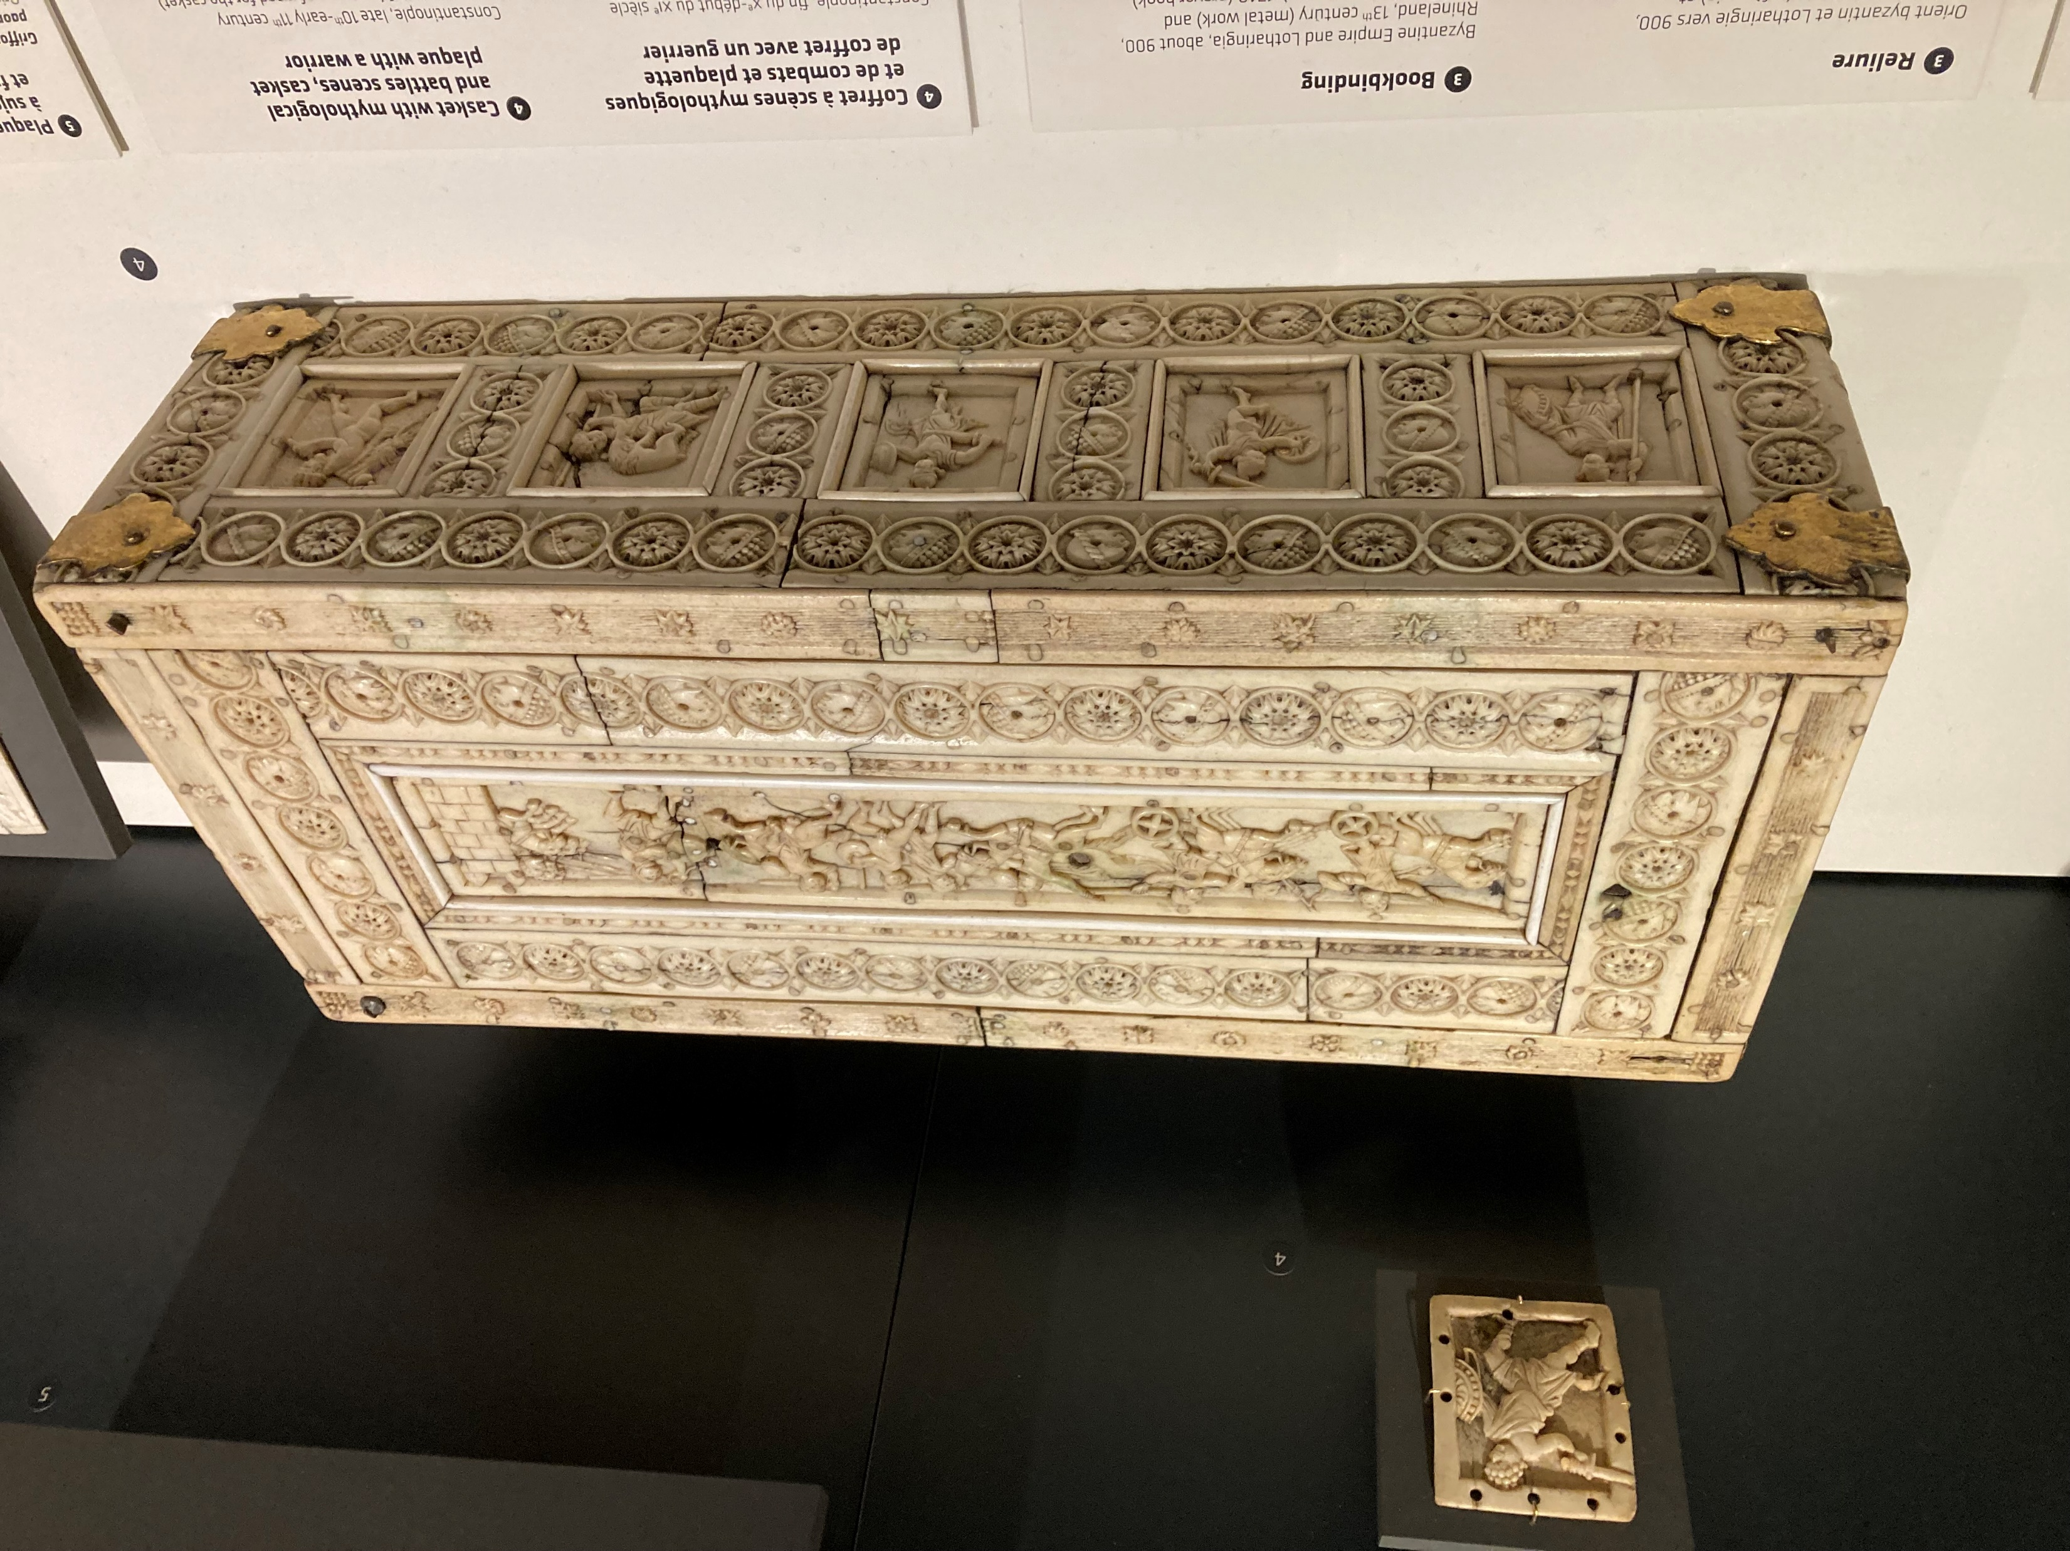

Slide 3
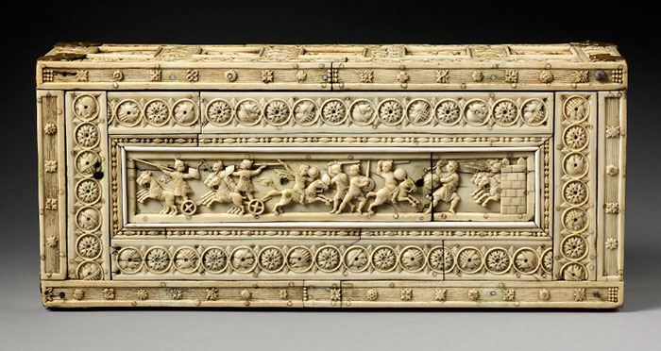

Slide 4
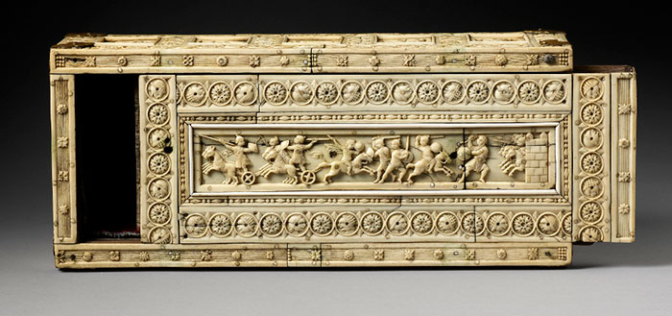

Slide 5
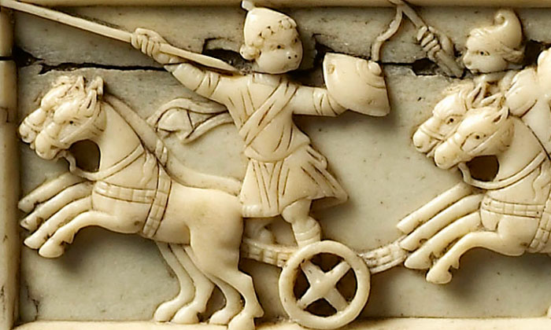

Slide 6
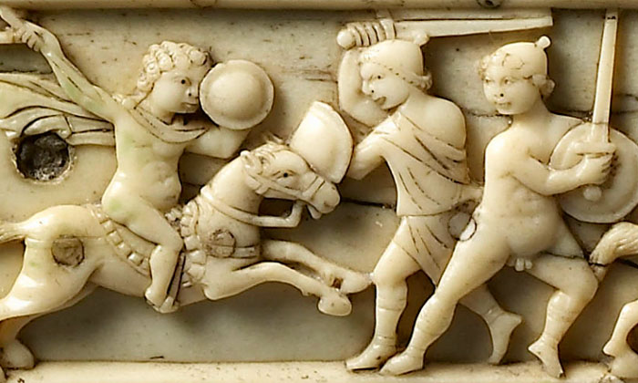

Slide 7
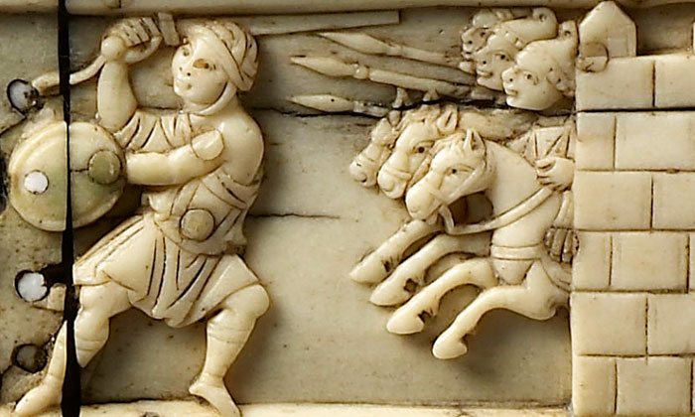

Slide 8
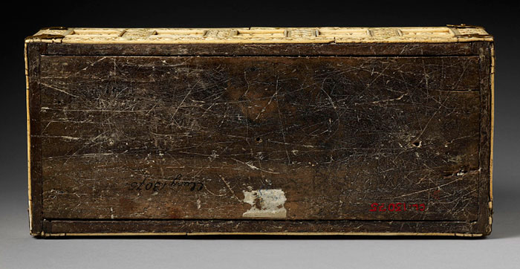

Slide 9
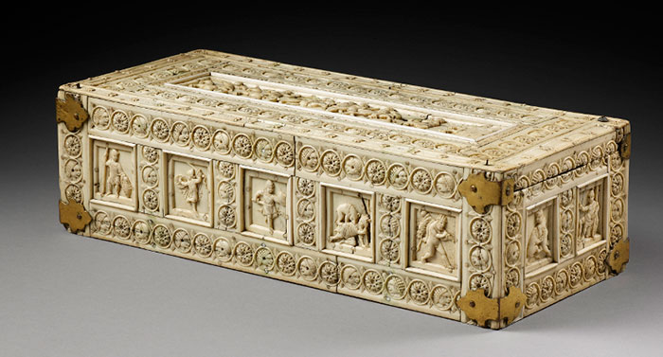

Slide 10
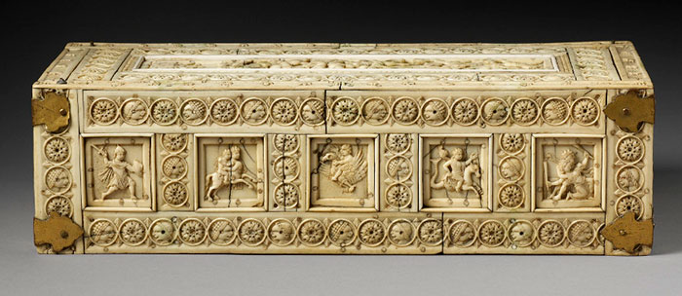

Slide 11
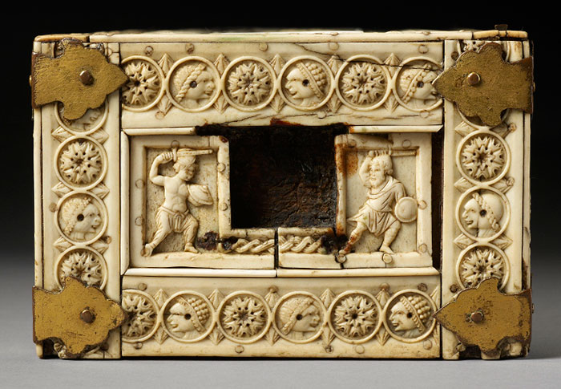

Slide 12
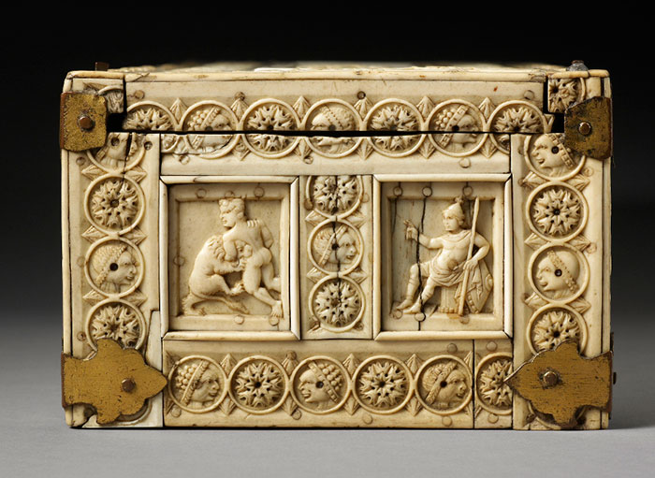

Slide 13
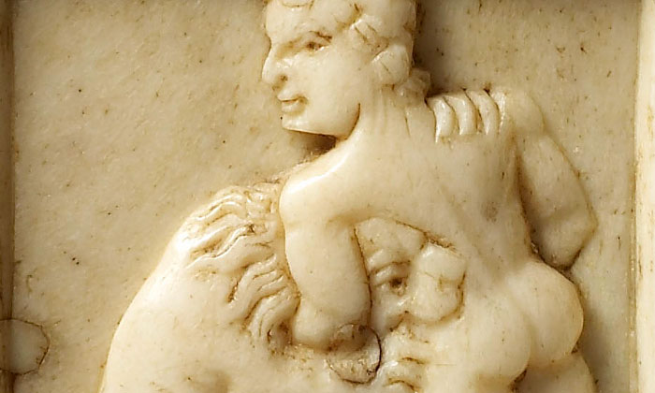

Slide 14
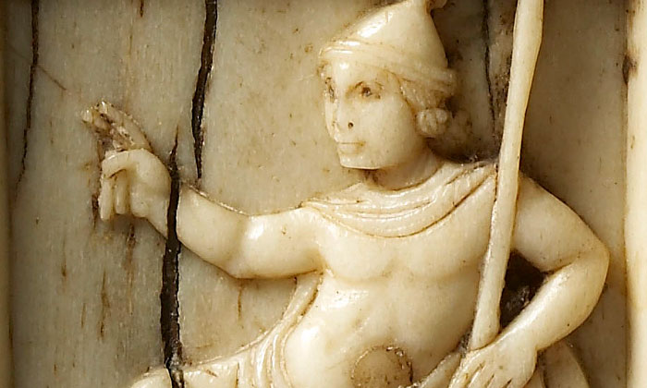

Slide 15
The End

