Slide 1
Francisco de Goya y Lucientes
1746-1828
Goya's Tapestries
Museo Catedral de Santiago

Slide 2
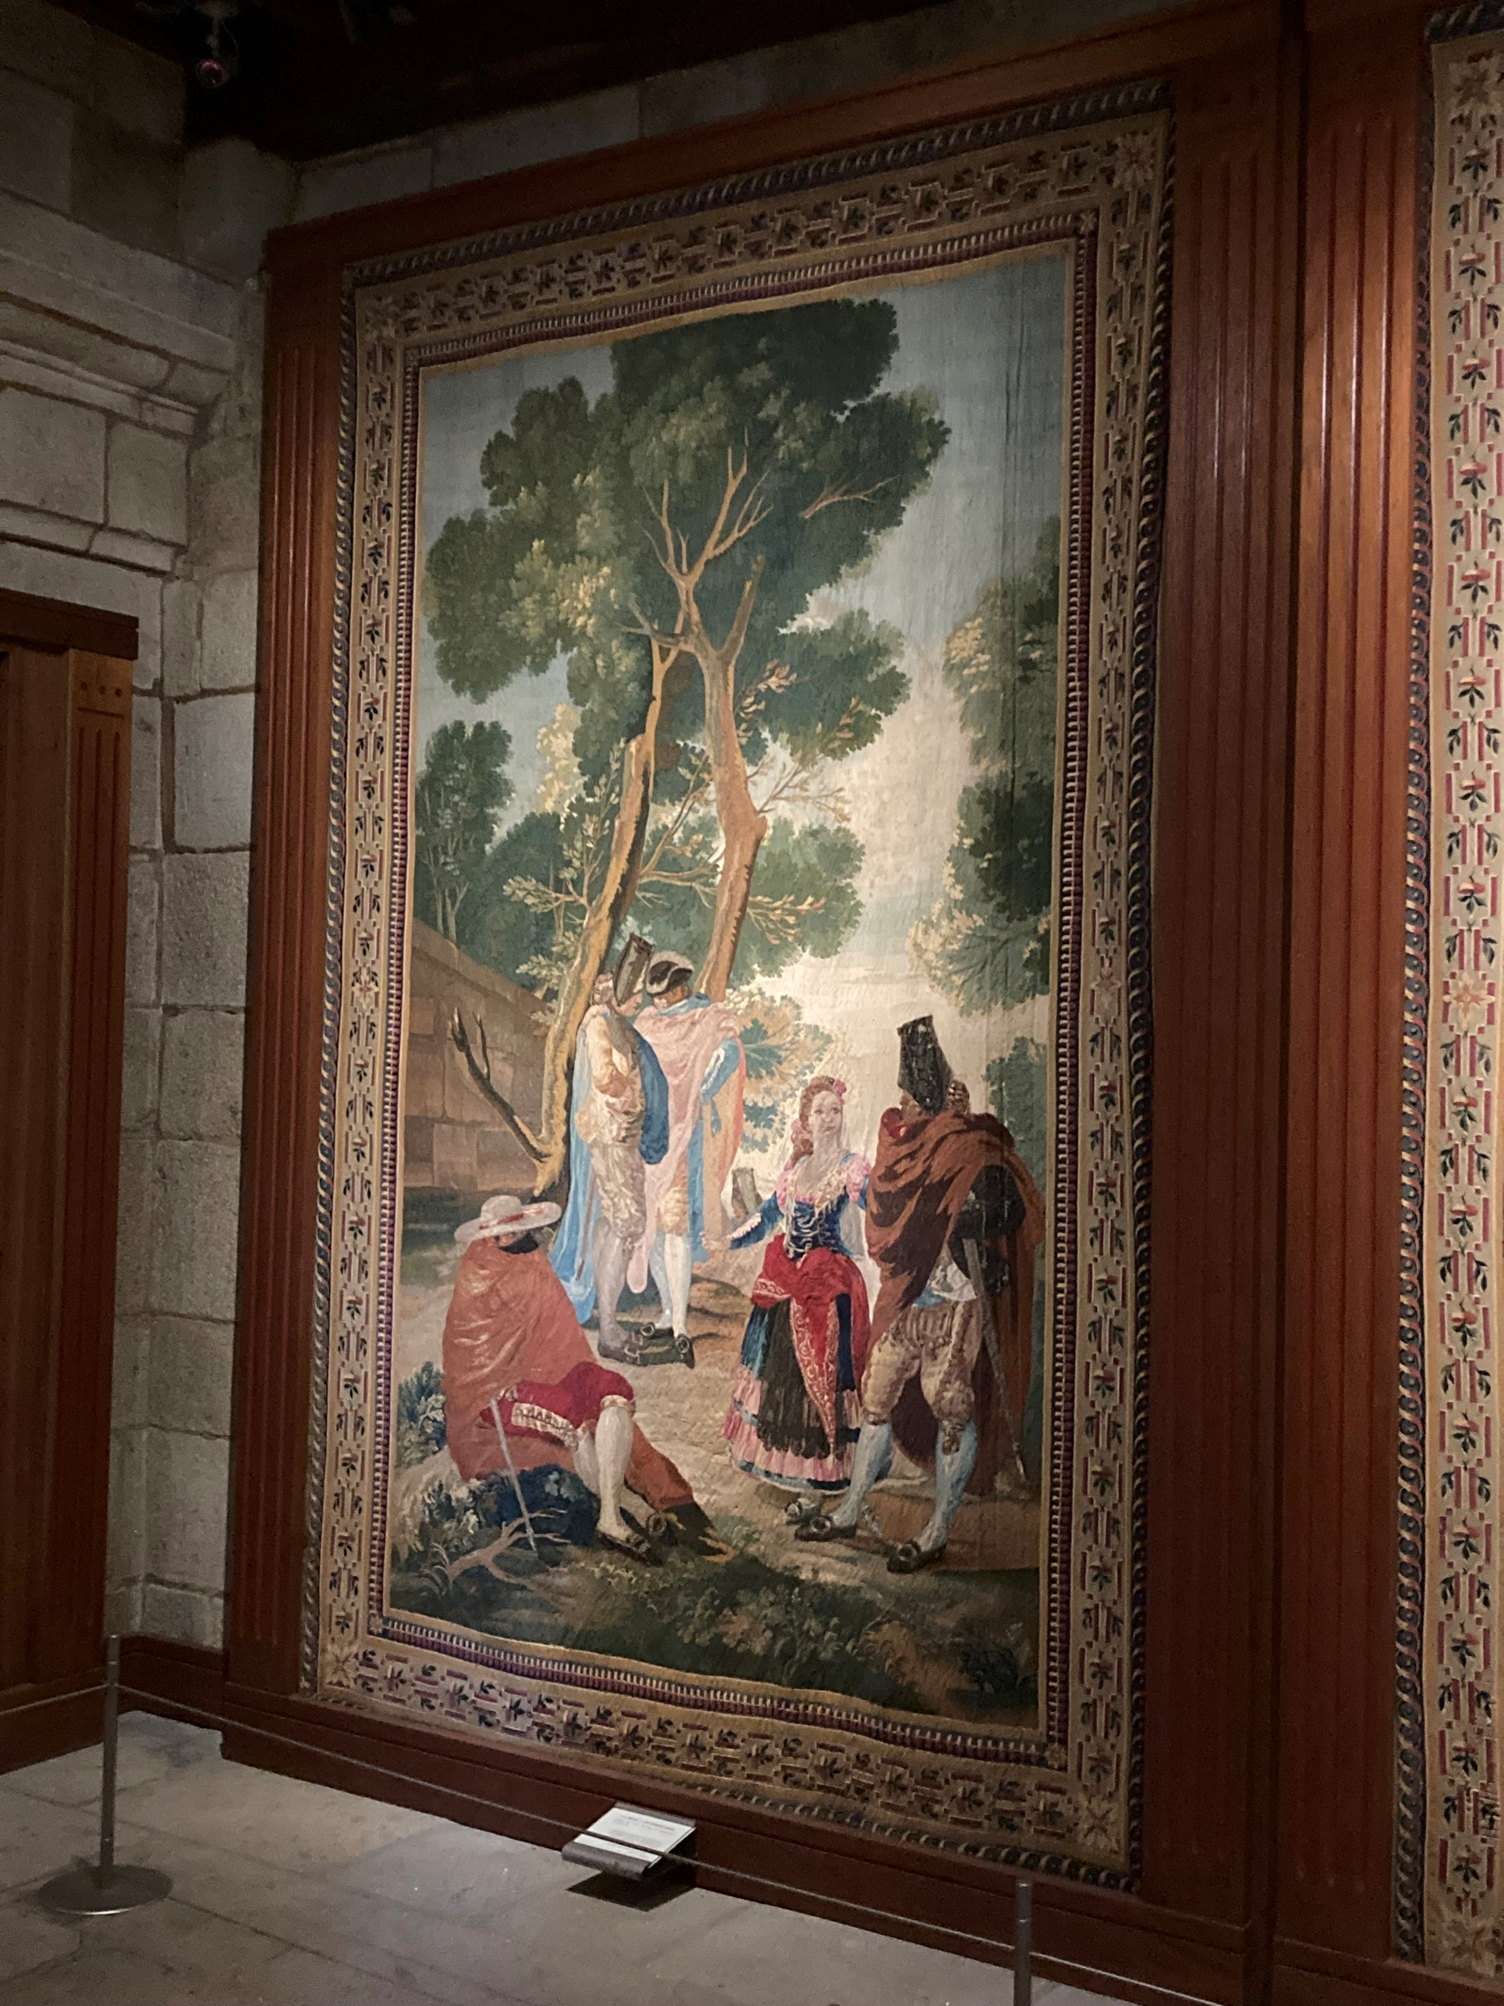
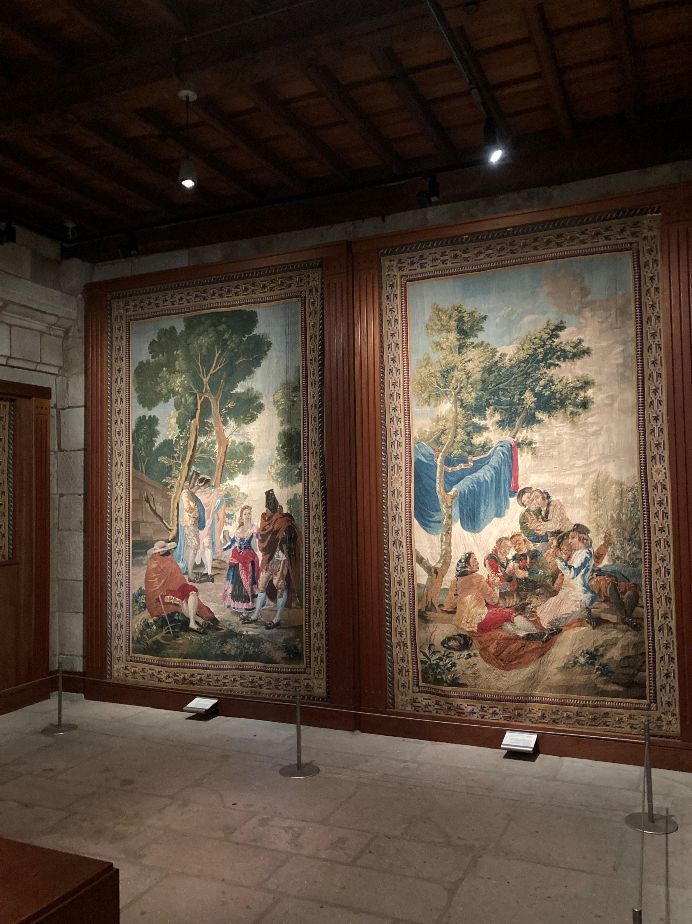

Slide 3
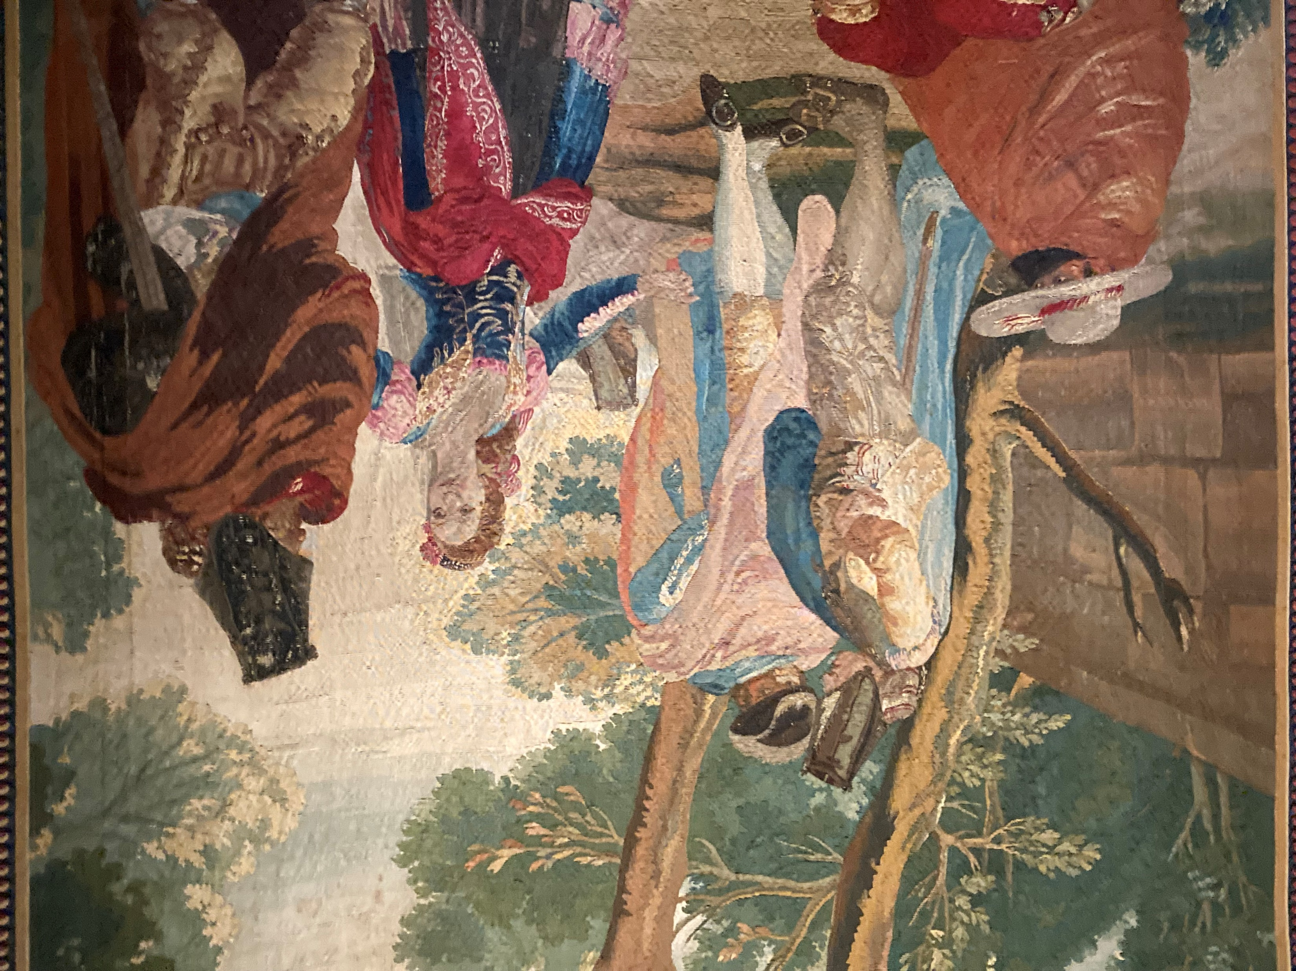

Slide 4
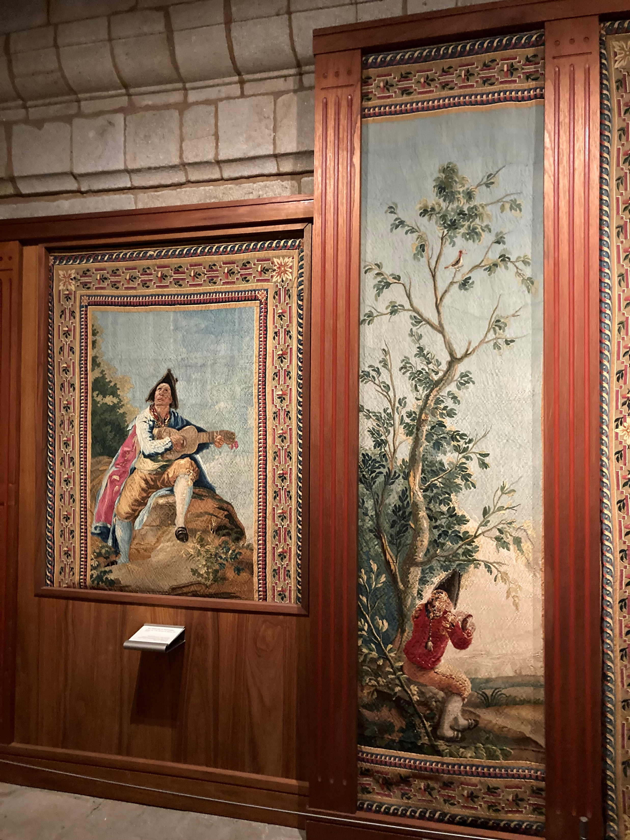
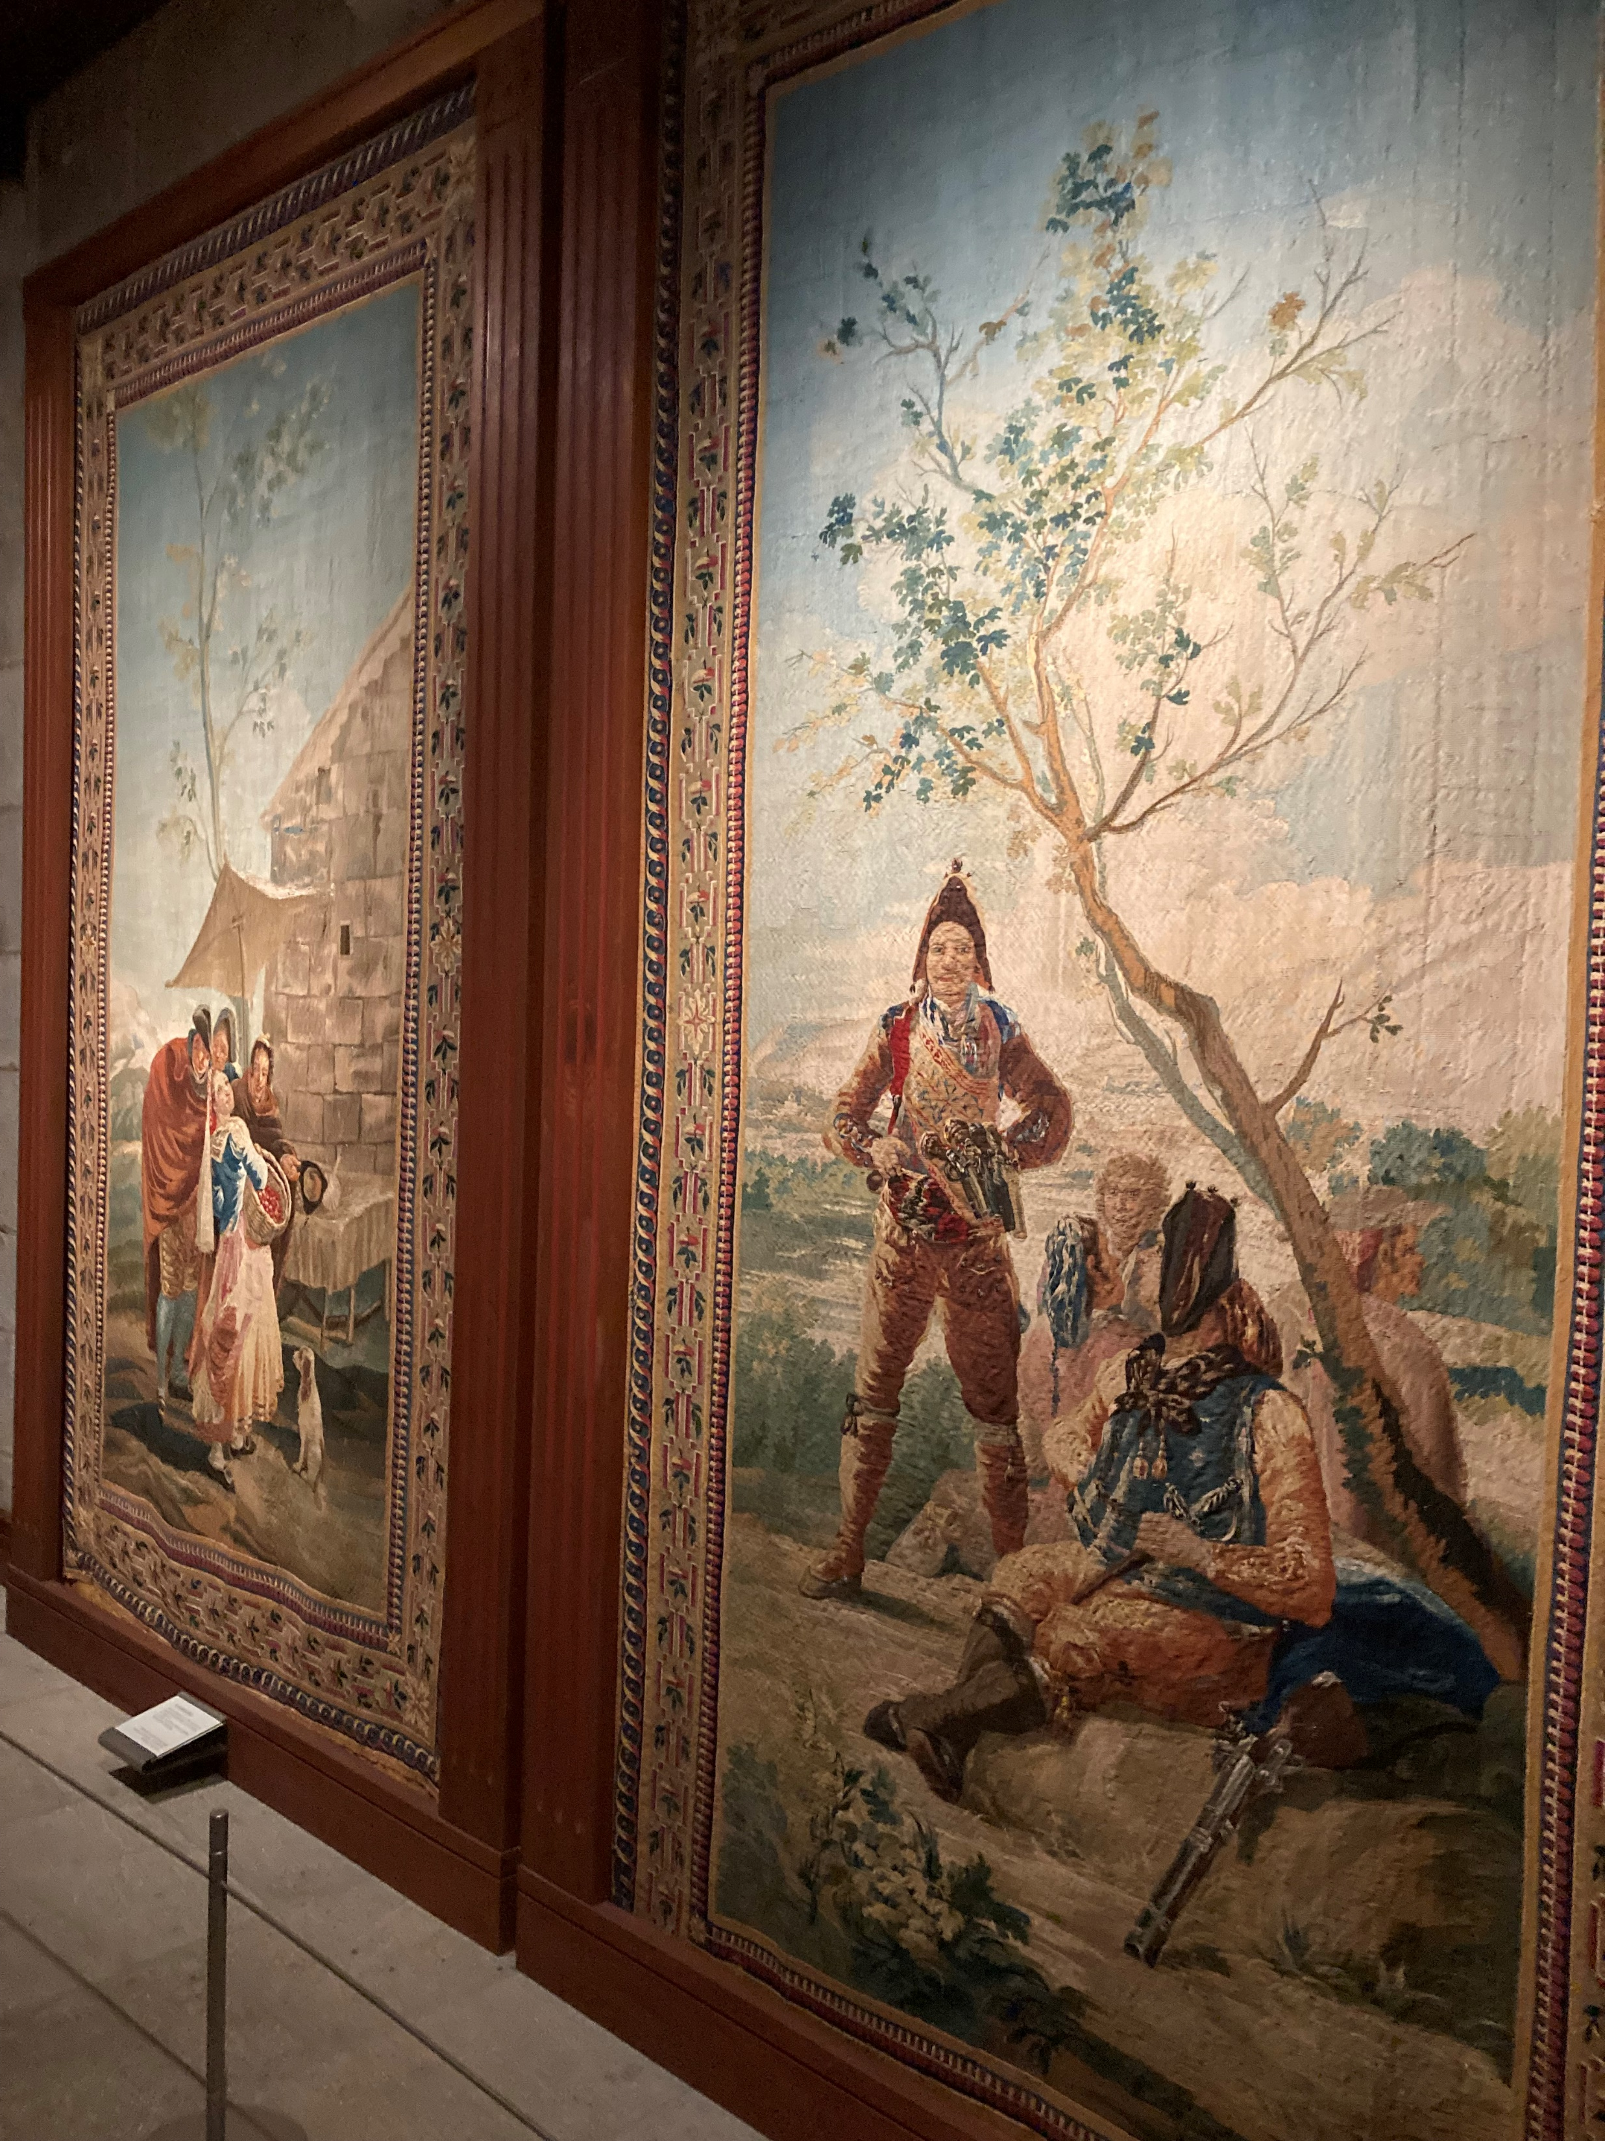

Slide 5
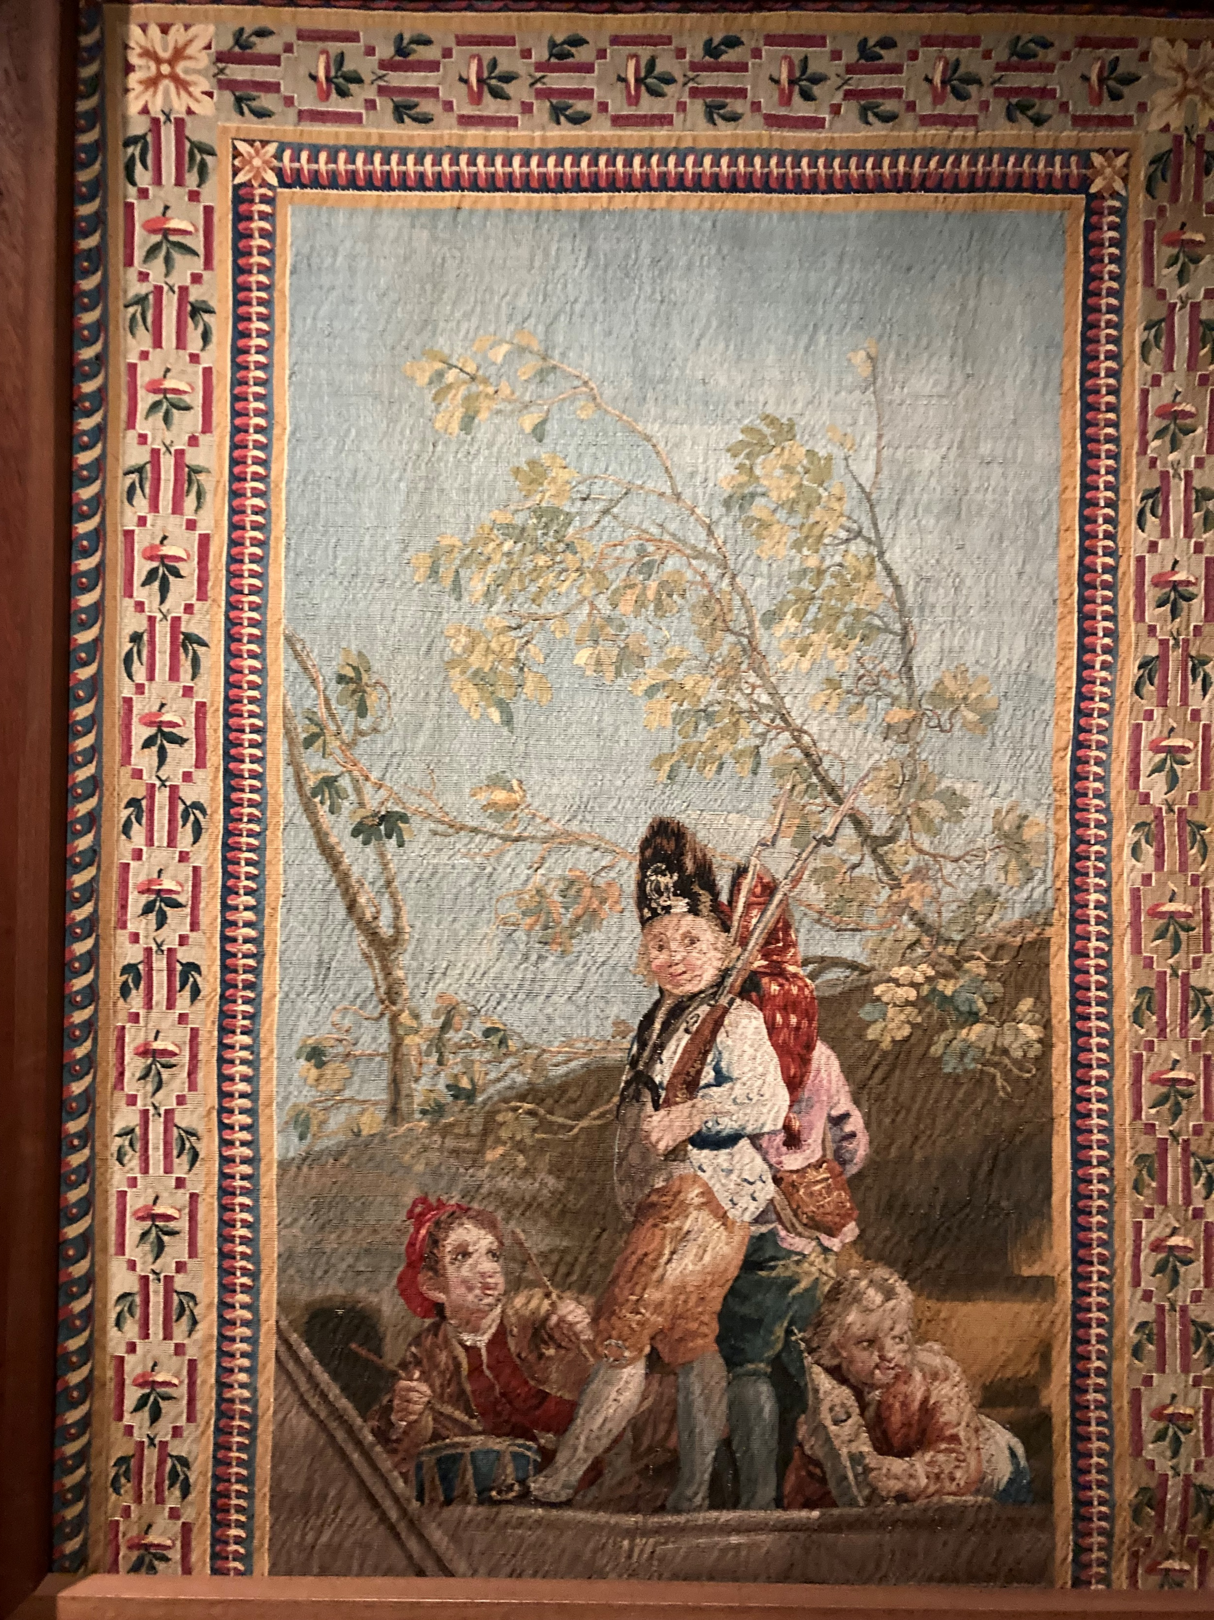

Slide 6
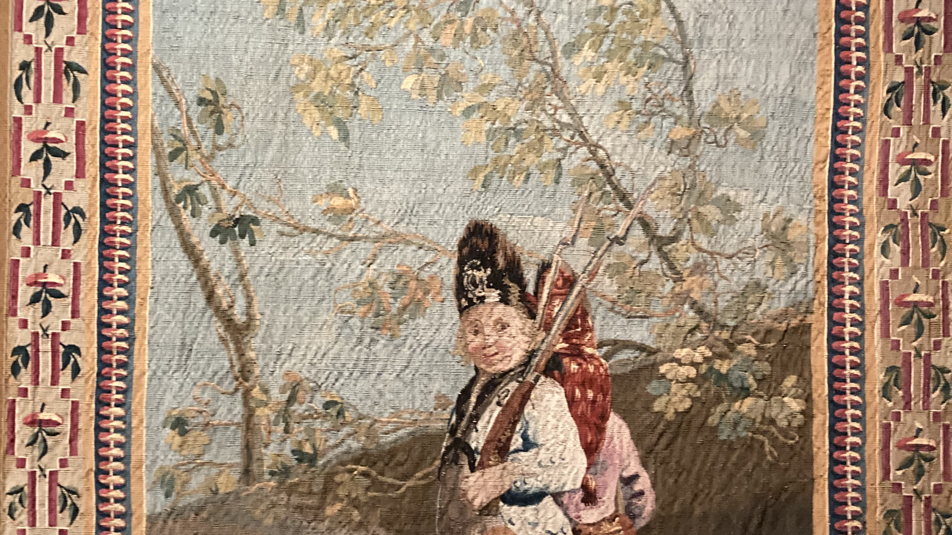

Slide 7
Photo Credit: Amalia Spiliakou
Santiago de Compostela, May 10, 2024

