Slide 1
Spain and the
Palaiolithic Age
2.5 million years – 10,000 years ago

Slide 2
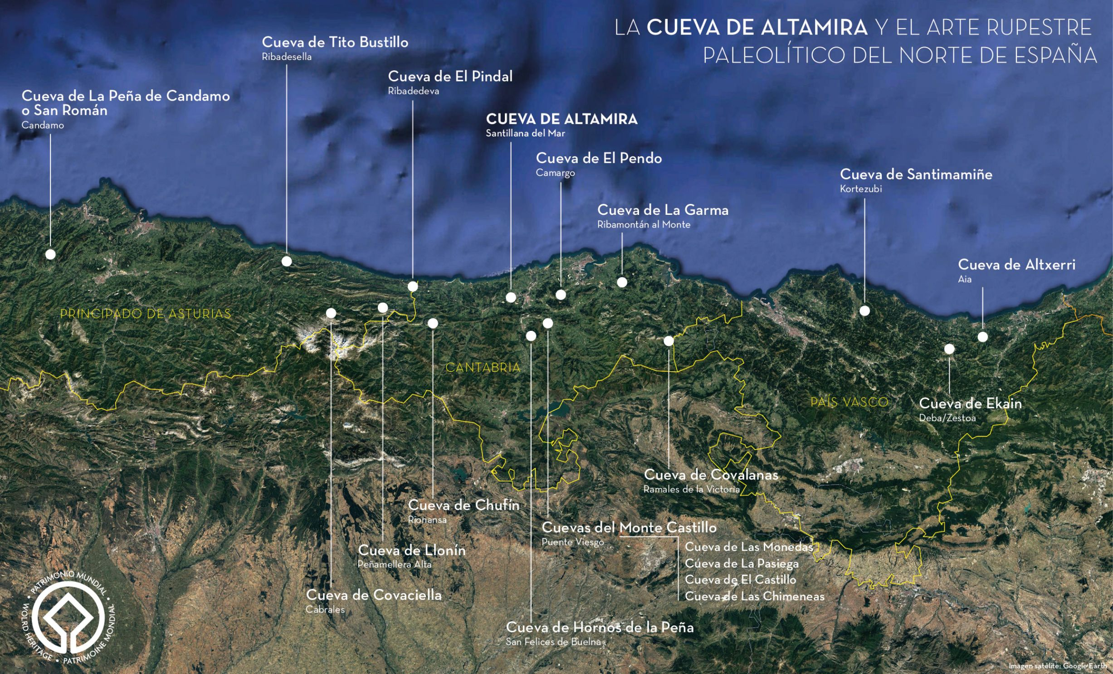

Slide 3
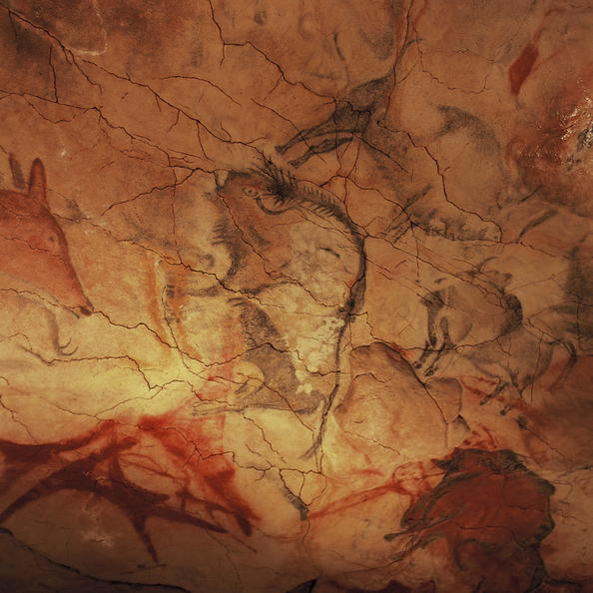
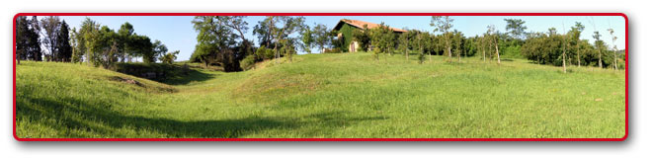
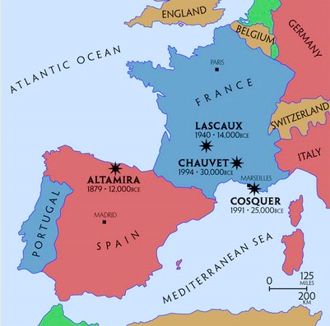
The Cave of Altamira, dating back to approximately 18,500 to 14,000 BC, is a renowned archaeological site in Spain celebrated for its Upper Paleolithic cave paintings. These extraordinary artworks include intricate drawings and vibrant polychrome paintings of wild mammals, such as bison, deer, and horses, as well as striking stenciled images of human hands. Located near the town of Santillana del Mar in Cantabria, Spain, the cave is situated about 30 kilometers west of the city of Santander. The art in Altamira offers a captivating glimpse into the lives and artistic capabilities of prehistoric humans, making it a significant cultural and historical landmark.

Slide 4
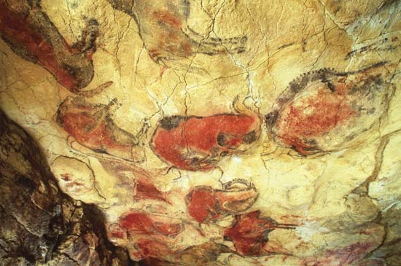
Altamira was the first cave where Cave Paintings were discovered, marking a groundbreaking moment in archaeology. When this discovery was made public in 1880, it sparked controversy among experts, many of whom doubted that prehistoric humans possessed the intellectual capacity for such artistic expression.

Slide 5
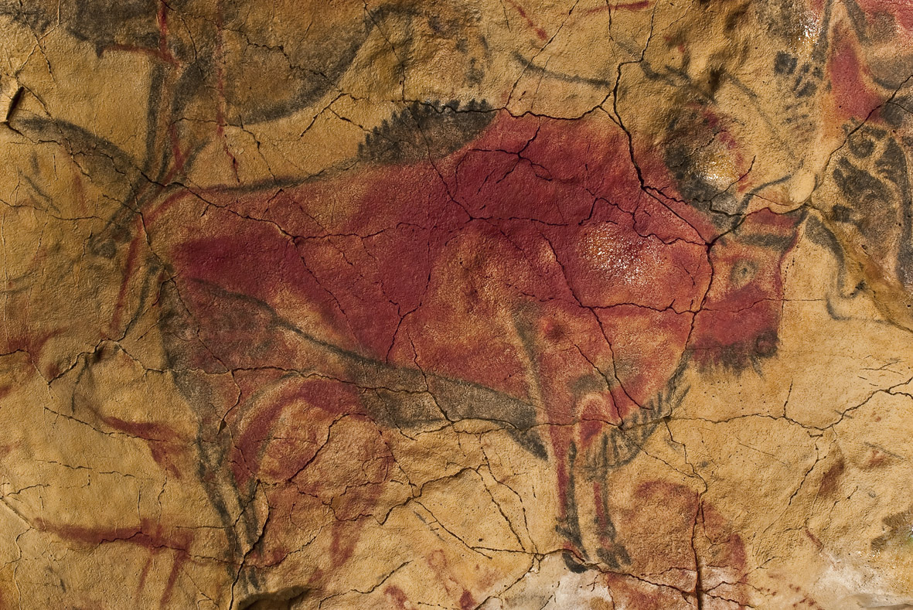
This debate continued into the early 20th century, with skepticism persisting until 1902, when the authenticity of the paintings was finally confirmed. This acknowledgment revolutionized the understanding of prehistoric humans, recognizing them as capable and sophisticated artists and altering the perception of their cognitive and cultural capabilities.

Slide 6
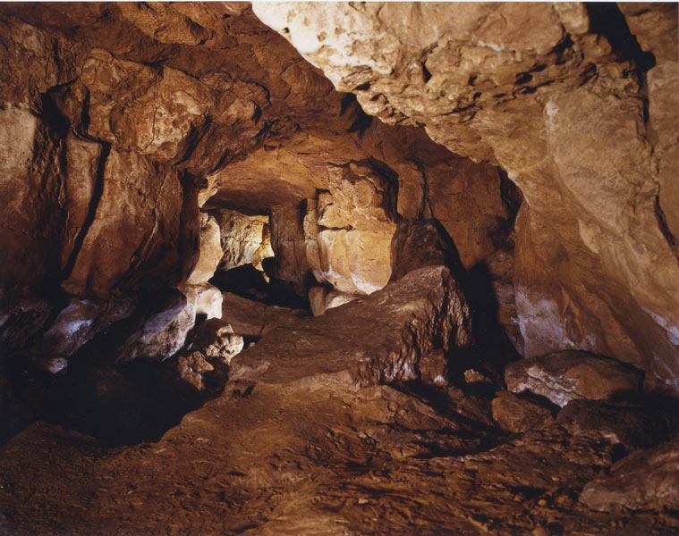
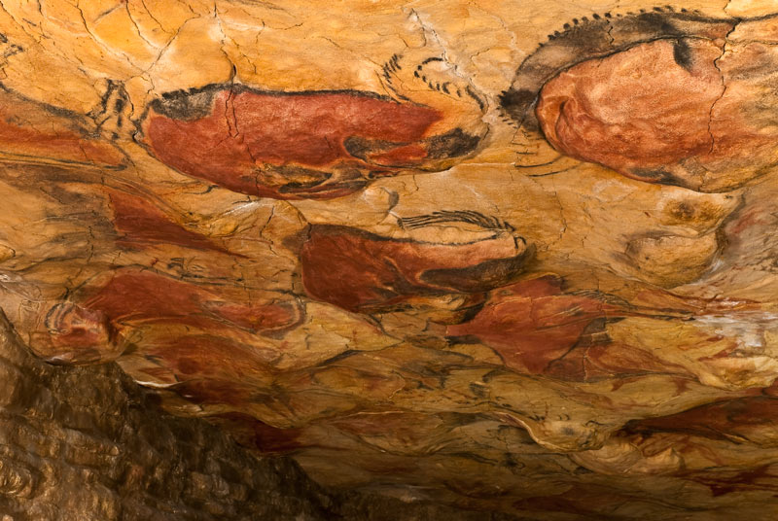
Altamira was described by Henri Moore in 1934 as the Royal Academy of Rock Art, a source of inspiration for the artists of The Altamira School, for Miró, Tapies, Millares, Merz and Miquel Barceló, who wrote of his art: Upon my first visit to Altamira, it struck me as like going back to the beginnings; it is the most fertile place. To believe that art has made much progress from Altamira to Cézanne is a Western pretension, vanity.

Slide 7
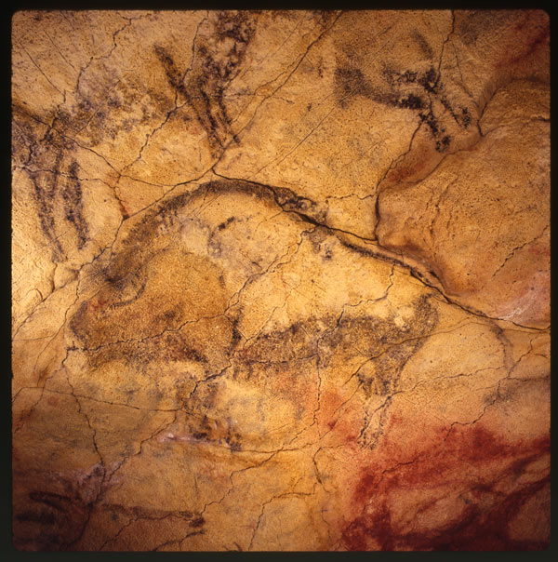
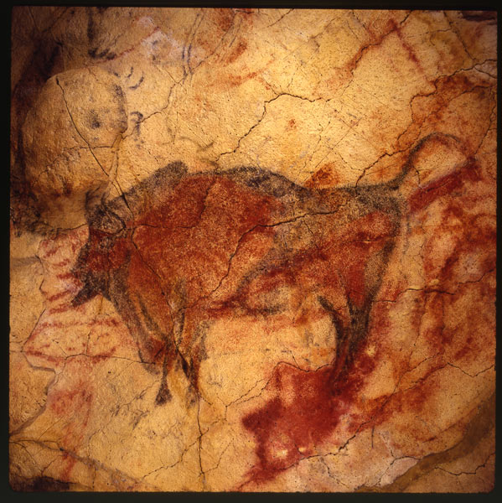
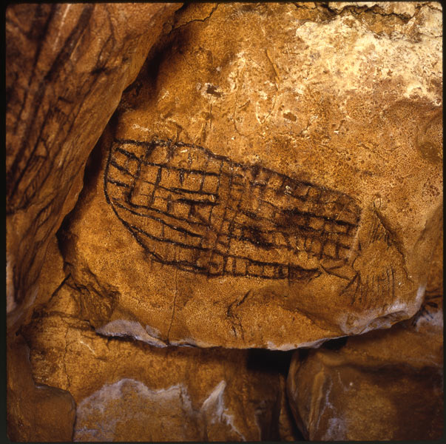
Over the span of 9,000 years, from 22,000 to 13,000 years ago, the inhabitants of the Cave of Altamira adorned its walls with captivating images of bison, horses, deer, human hands, and enigmatic symbols. These artworks, both painted and engraved, stretch across more than 270 meters of the cave's interior, showcasing a rich tapestry of prehistoric expression. Among these, the most renowned are the vibrant polychrome paintings, celebrated for their remarkable detail and color. Preserving the pristine condition of these ancient masterpieces poses a significant challenge for scientists and heritage managers, and it remains the primary mission of the Museum of Altamira to ensure their enduring legacy.

Slide 8
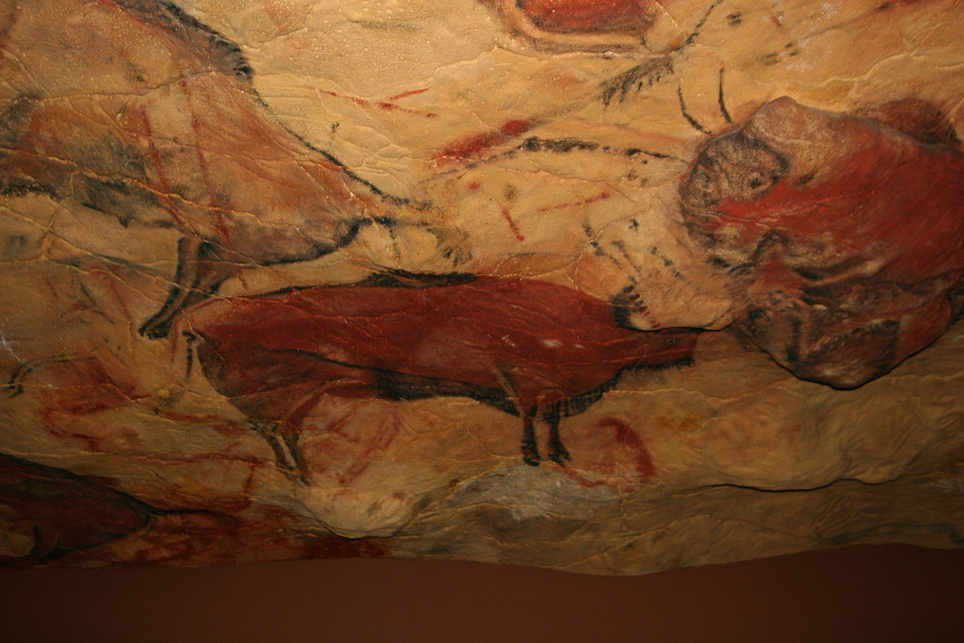
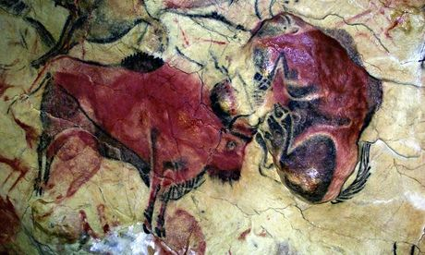
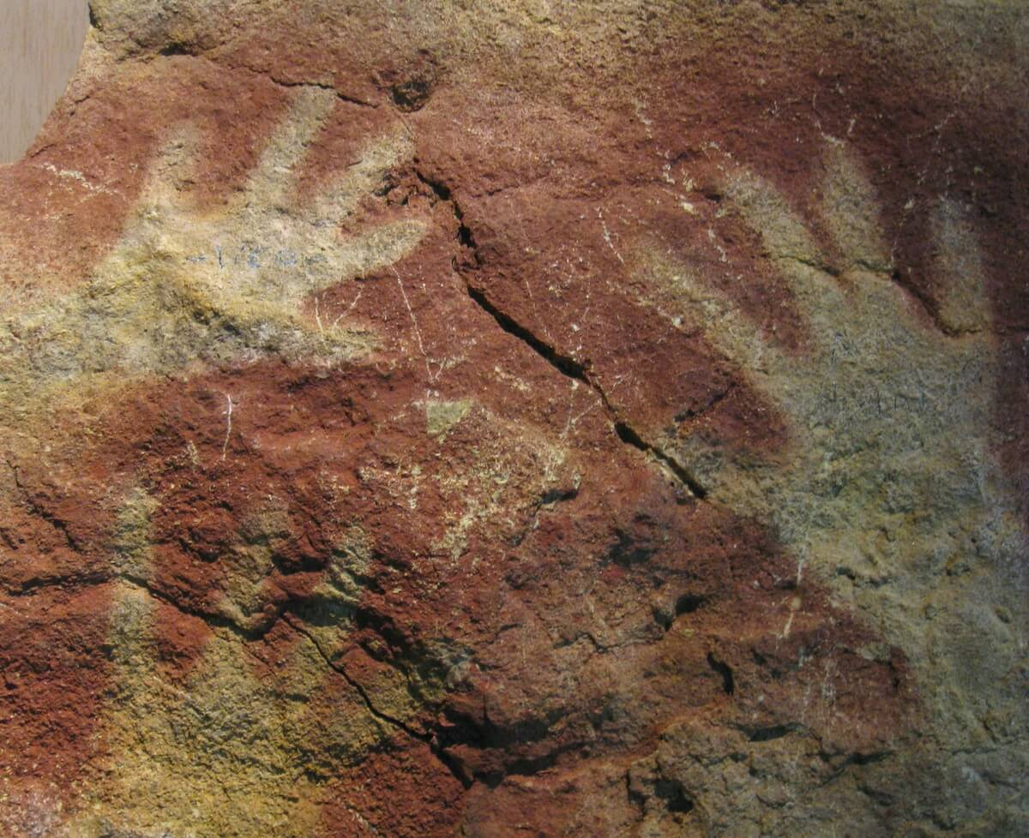

Slide 9
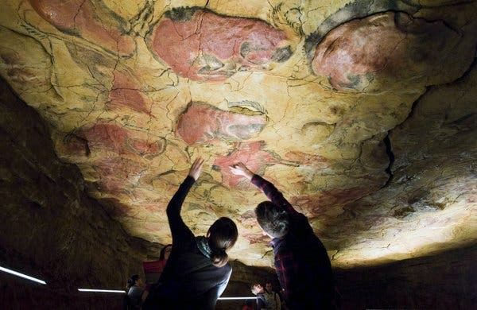
Tourists inside the replica of the cave of Altamira in northern Spain

Slide 10
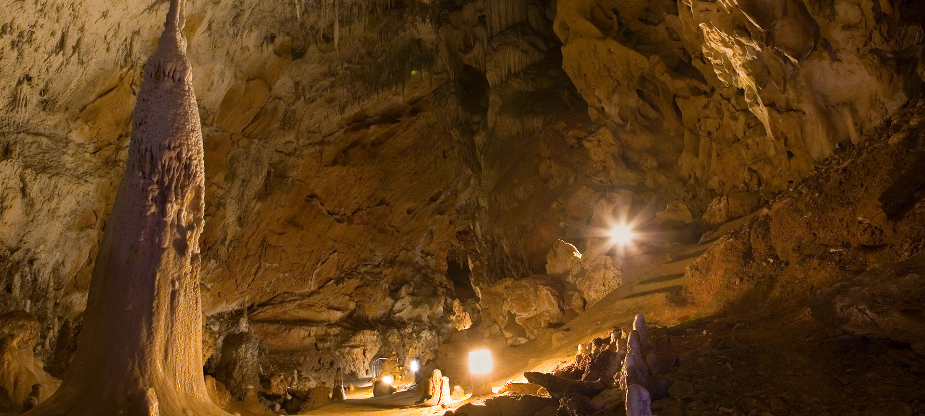
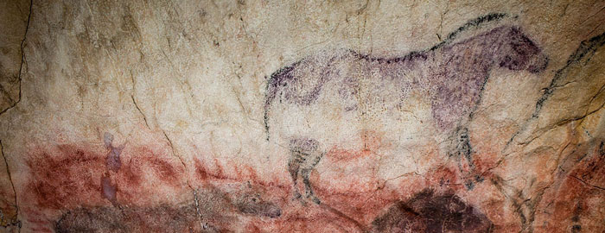
Tito Bustillo Cave stands as a remarkable site of Palaeolithic Cave Art, recognized globally for its historical significance. Initially celebrated in 1985 by the World Heritage Committee alongside the iconic Altamira Cave, this recognition was broadened on July 7, 2008, to include 17 additional caves in northern Spain, among them Tito Bustillo.

Slide 11
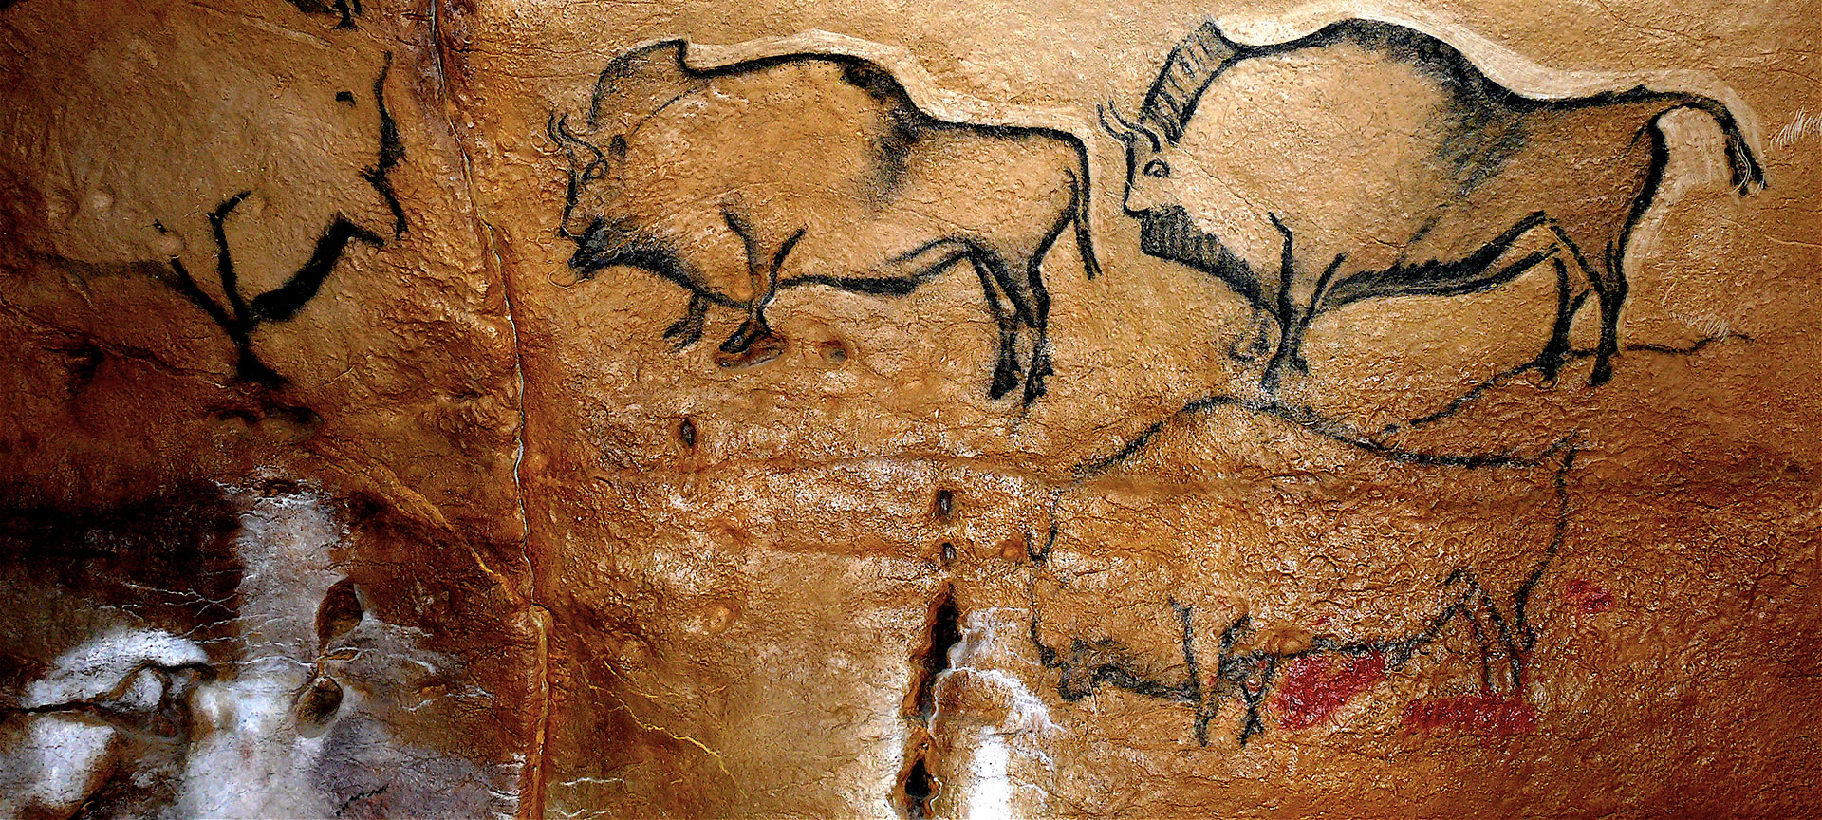
Discovered by chance in 1994, Covaciella Cave, it contains the best conserved representation of bison anywhere in Asturias, due to the fact that the cave was sealed up for thousands of years. Its 40-metre gallery has paintings dating back more than 14,000 years.

Slide 12
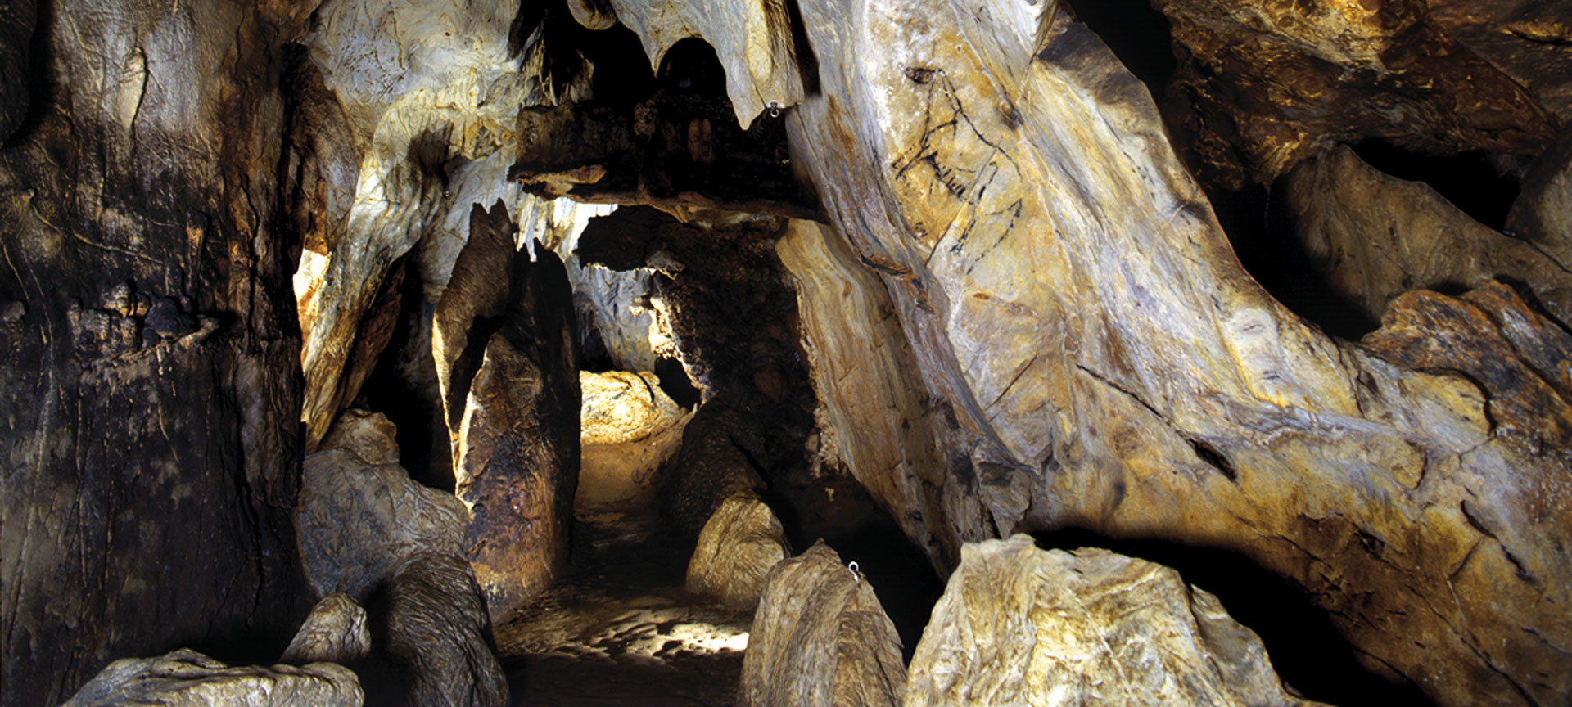
Las Monedas Cave, is the longest cave in the Monte del Castillo area. Its name comes from a cache of coins ("monedas") from the time of the Catholic Monarchs that was discovered inside the cave, one dating from 1563.

Slide 13
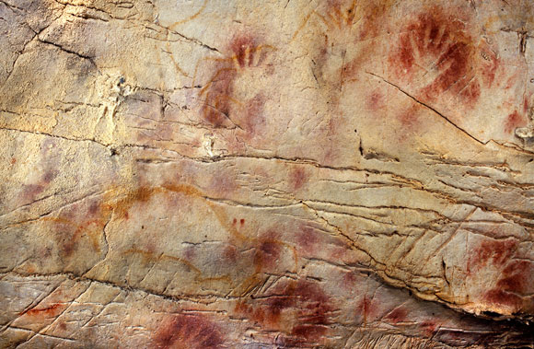
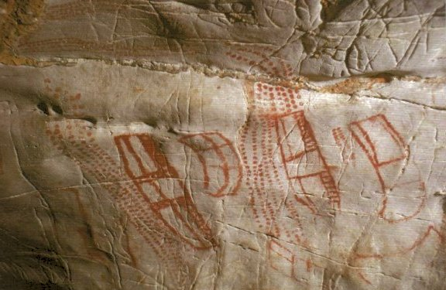
El Castillo Cave in northern Spain is renowned for its ancient hand stencils, with the oldest dating back at least 37,000 years. To put this in perspective, the earliest paintings in France's Chauvet Cave are 32,000 years old, while the famous Lascaux Cave paintings are approximately 20,000 years old. El Castillo offers a wealth of insights through its millennia-old drawings, including the enigmatic abstract figures known as tectiforms. These peculiar shapes have been variously interpreted as depictions of boats, maps, buildings, corrals, or even the products of hallucinations or shamanic trances. Despite the varied theories, it's clear that these figures held significant meaning and importance, as evidenced by their repetition and prominence within the cave's artwork.

Slide 14
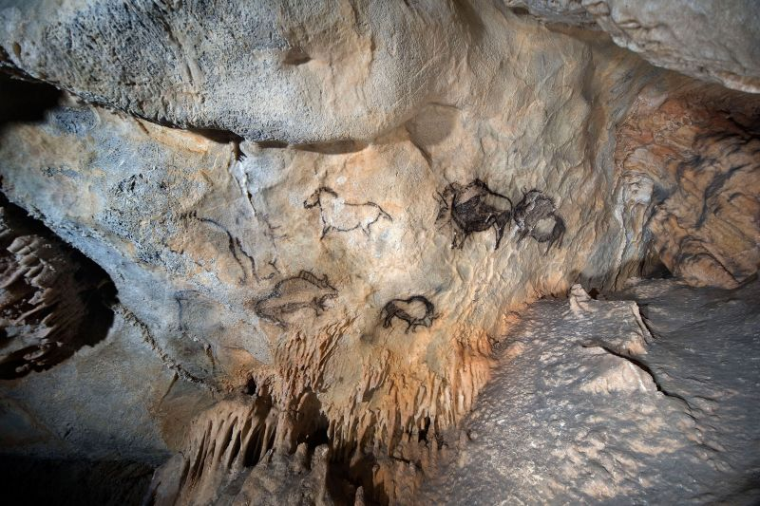
The Santimamiñe Cave, on the southern mountainside of Mount Ereñozar, is the most important archaeological site in Bilbao Bizkaia. It preserves the remains of human settlements dating back more than 14,000 years. Its interior has almost fifty cave paintings of animals such as bison, horses, bears and deer and even stalactite and stalagmite formations.

Slide 15
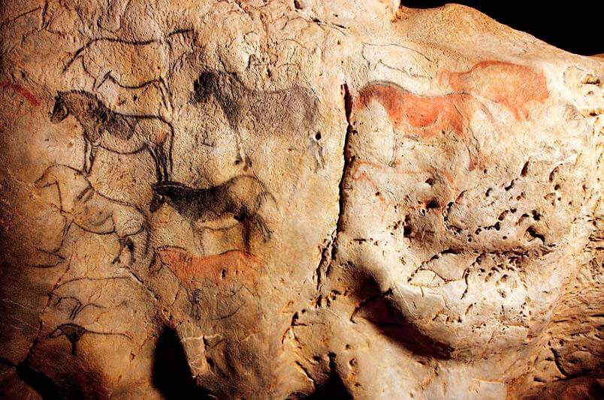
The Cave of Ekain is the most spectacular rock-art paintings of the Basque Coast, declared a World Heritage Site by UNESCO, in a journey of the senses to the origins of this land’s culture.

