Slide 1
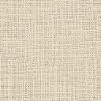
Luca della Robbia
1399/1400–1482
Labours of the Months
1450s

Slide 2
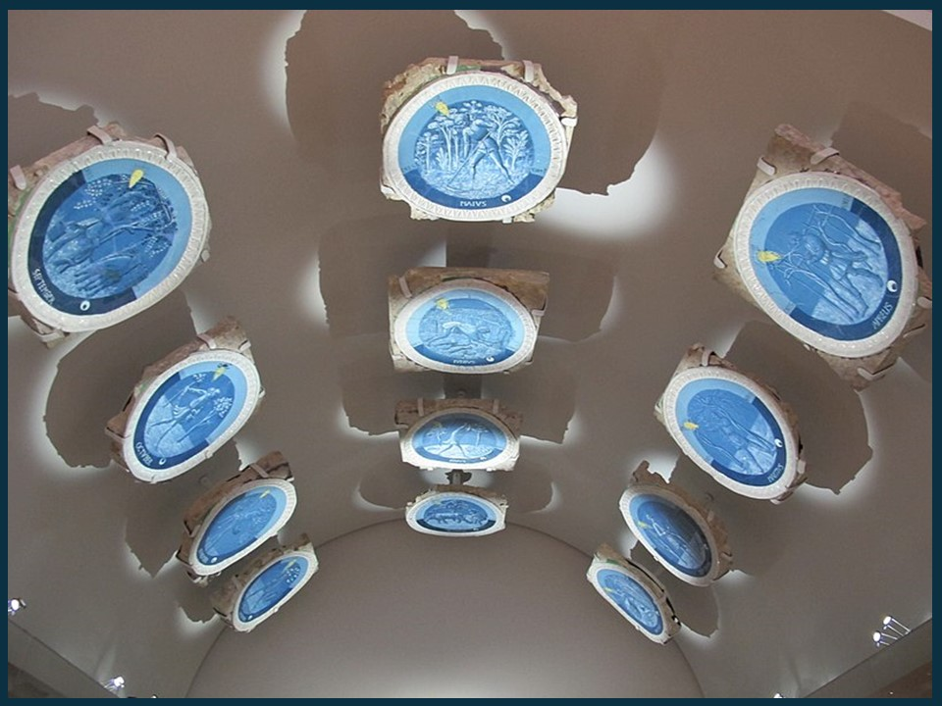
The Luca della Robbia roundels of the Labours of the Months as displayed in the Victoria and Albert Museum, London, UK https://commons.wikimedia.org/wiki/File:Luca_della_robbia,_volta_dello_studiolo_di_piero_de%27_medici.JPG

Slide 3
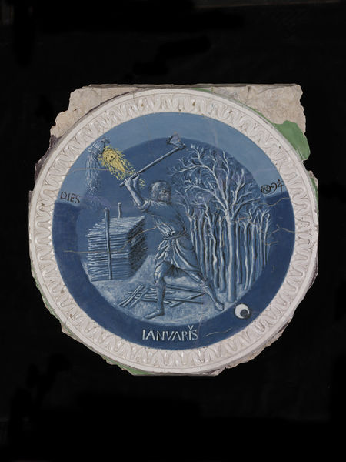
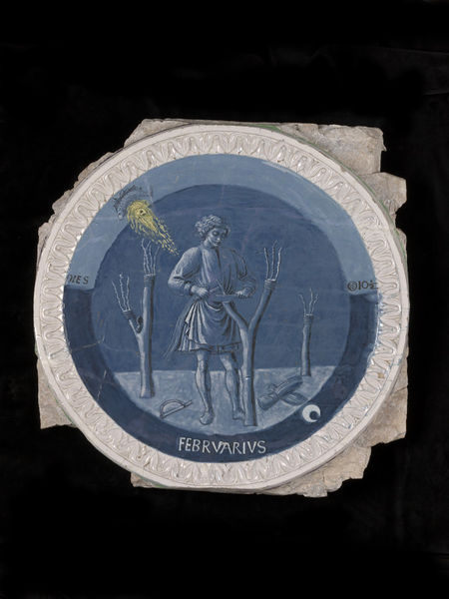
The Labours of the Months
January
February

Slide 4
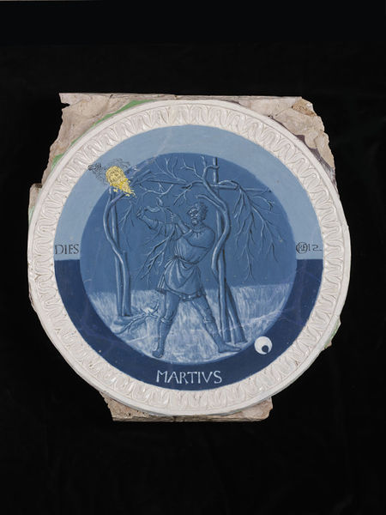
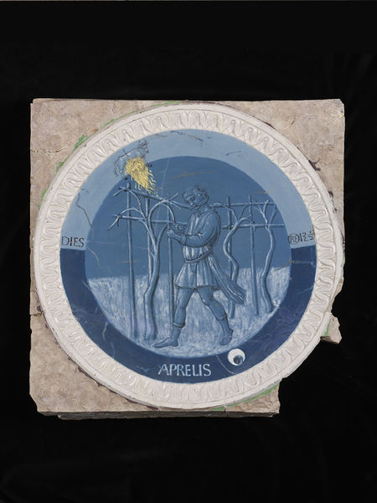
The Labours of the Months
March
April

Slide 5
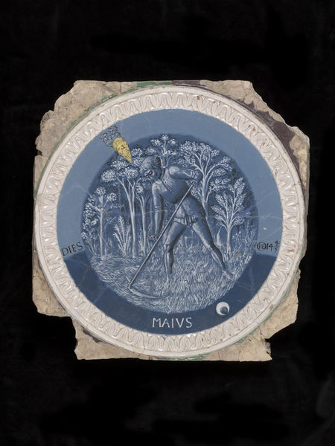
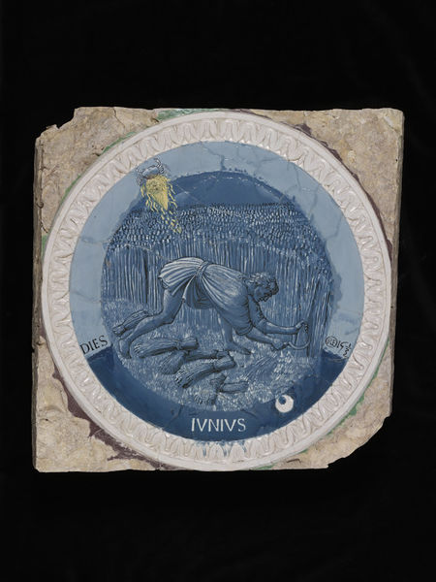
The Labours of the Months
May
June

Slide 6
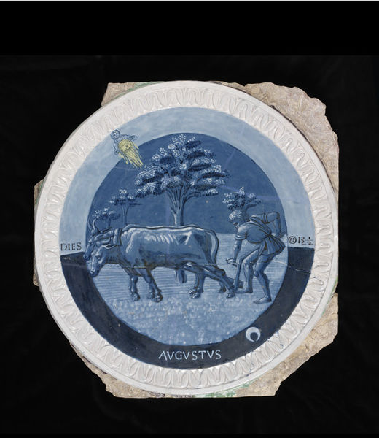
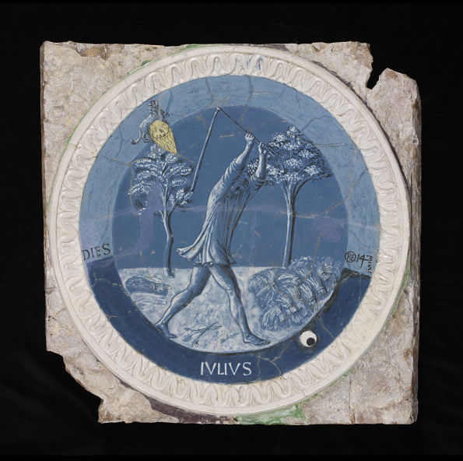
The Labours of the Months
July
August

Slide 7
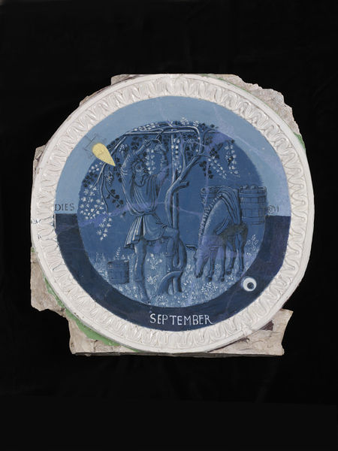
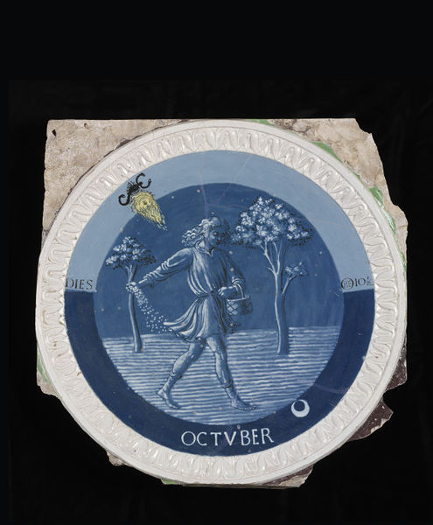
The Labours of the Months
September
October

Slide 8
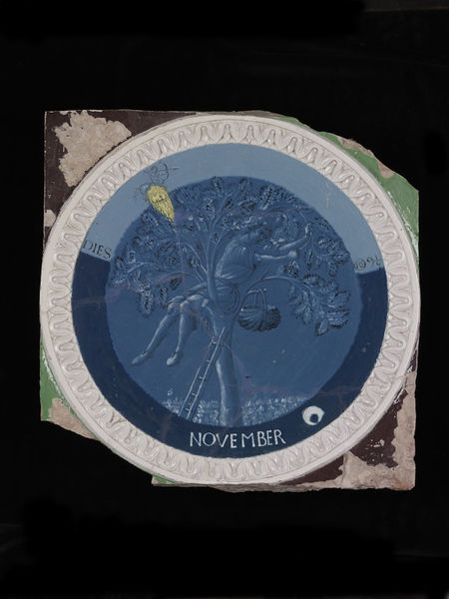
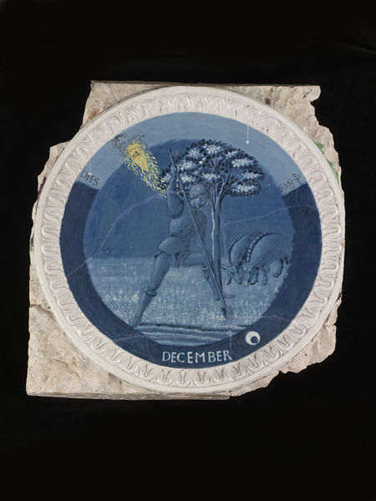
The Labours of the Months
November
December

Slide 9
Luca della Robbia, 1399/1400–1482
Labours of the Months, 1450s, Glazed terracotta, Victoria and Albert Museum, London, UK
Photo Credits: https://astrologyandart.wordpress.com/2013/06/07/luca-della-robbia-the-labours-of-the-months/

Slide 10
The End

