Slide 1
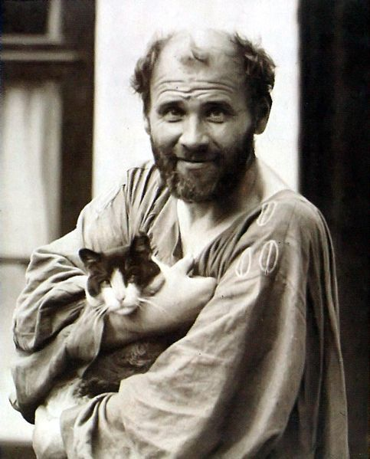
Gustav Klimt
1862-1918 https://www.wikiart.org/en/gustav-klimt

Slide 2
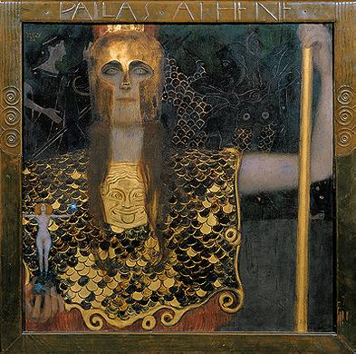
Pallas Athene, 1898, oil on canvas, 75 × 75 cm, Wien Museum Karlsplatz, Vienna, Austria https://sammlung.wienmuseum.at/en/object/102991-pallas-athene/

Slide 3
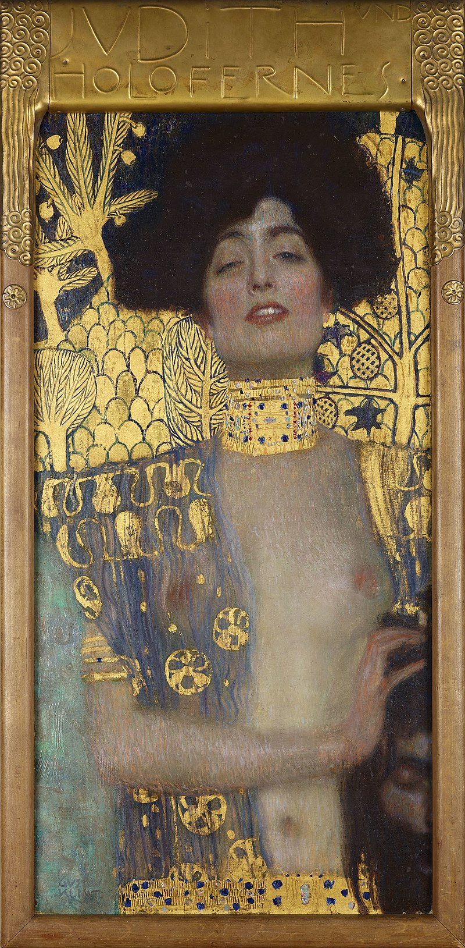
Judith and the Head of Holofernes, 1901, oil on canvas, 84 cm × 42 cm, Österreichische Galerie Belvedere, Vienna, Austria https://en.wikipedia.org/wiki/Judith_and_the_Head_of_Holofernes#/media/File:Judith_1_(cropped).jpg

Slide 4
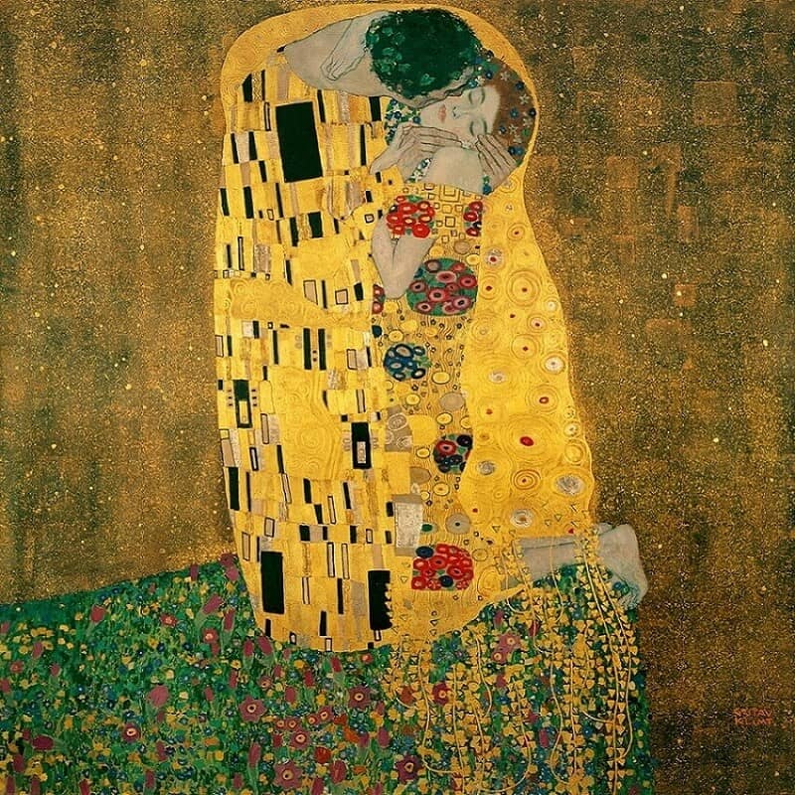
Th
The Kiss, 1907–08, oil on canvas, 180×180 cm, Österreichische Galerie Belvedere, Vienna, Austria https://www.gustav-klimt.com/The-Kiss.jsp

Slide 5
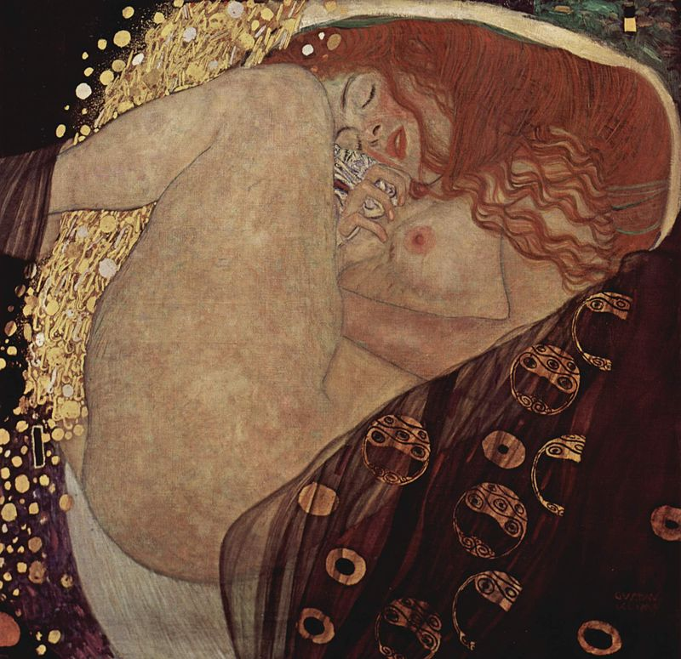
Danaë, 1907, oil on canvas, 77 cm × 83 cm, Galerie Würthle, Vienna, Austria https://el.wikipedia.org/wiki/%CE%94%CE%B1%CE%BD%CE%AC%CE%B7_%28%CE%93%CE%BA%CE%BF%CF%8D%CF%83%CF%84%CE%B1%CF%86_%CE%9A%CE%BB%CE%B9%CE%BC%CF%84%29#/media/%CE%91%CF%81%CF%87%CE%B5%CE%AF%CE%BF:Gustav_Klimt_010.jpg

Slide 6
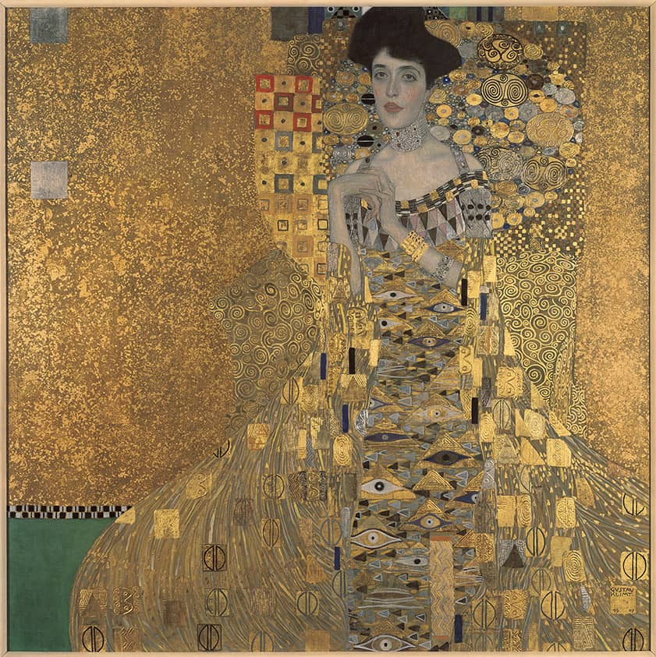
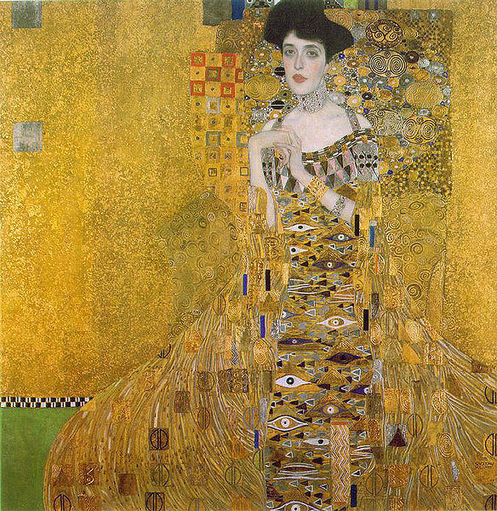
Portrait of Adele Bloch-Bauer,
1907, oil, silver and gold on canvas, 138 × 138 cm, Neue Galerie, NY, USA https://www.gustav-klimt.com/Portrait-Of-Adele-Bloch-Bauer-1.jsp

Slide 7
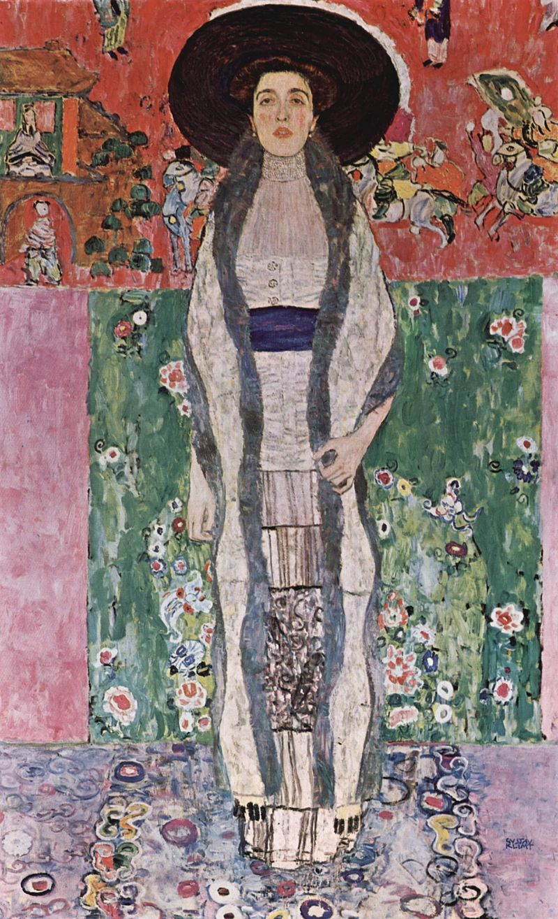
Portrait of Adele Bloch-Bauer II,
1912, oil on canvas, 190x120 cm, Private Collection https://en.wikipedia.org/wiki/Portrait_of_Adele_Bloch-Bauer_II#/media/File:Gustav_Klimt_047.jpg

Slide 8
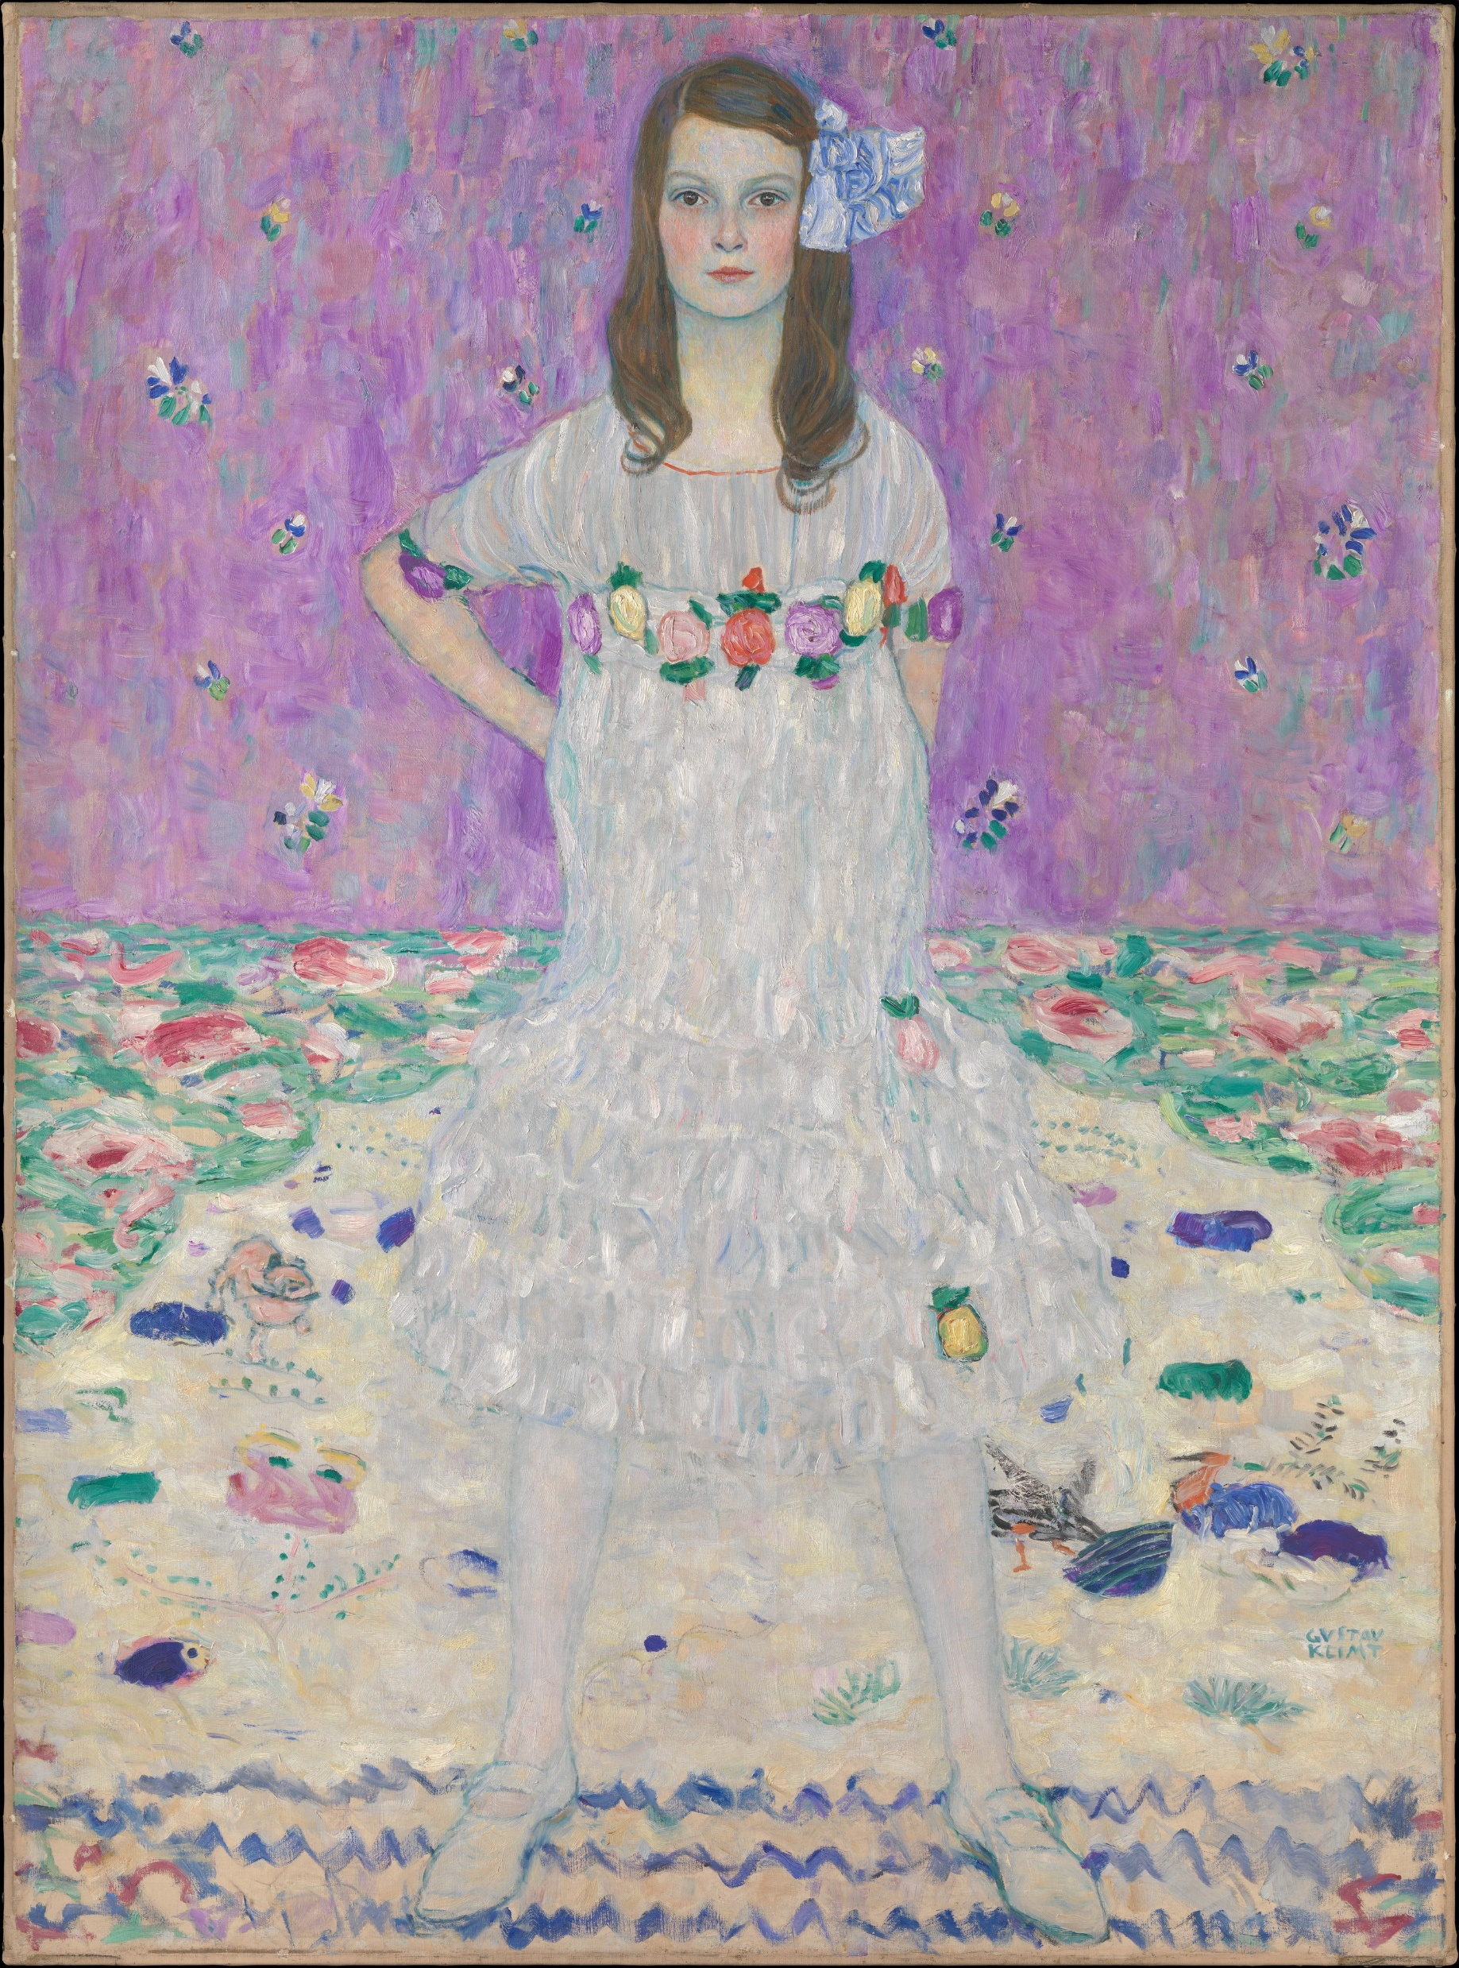

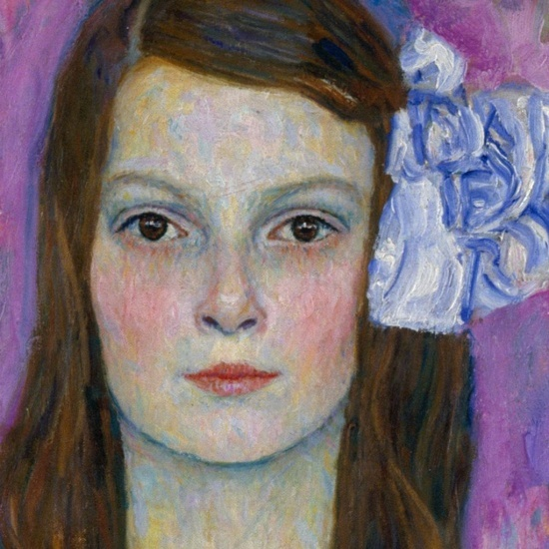
Mäda Primavesi, 1912, oil on canvas, 149.9 x 110.5 cm, the MET, NY, USA https://www.metmuseum.org/art/collection/search/436819

Slide 9
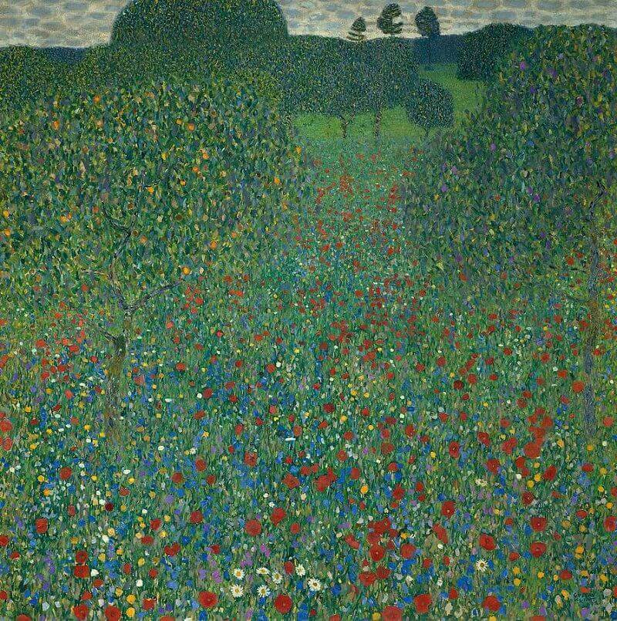
A Field of Poppies, 1907, oil on canvas, 110x110 cm, Österreichische Galerie Belvedere, Vienna, Austria https://www.gustav-klimt.com/Field-of-Poppies.jsp

Slide 10
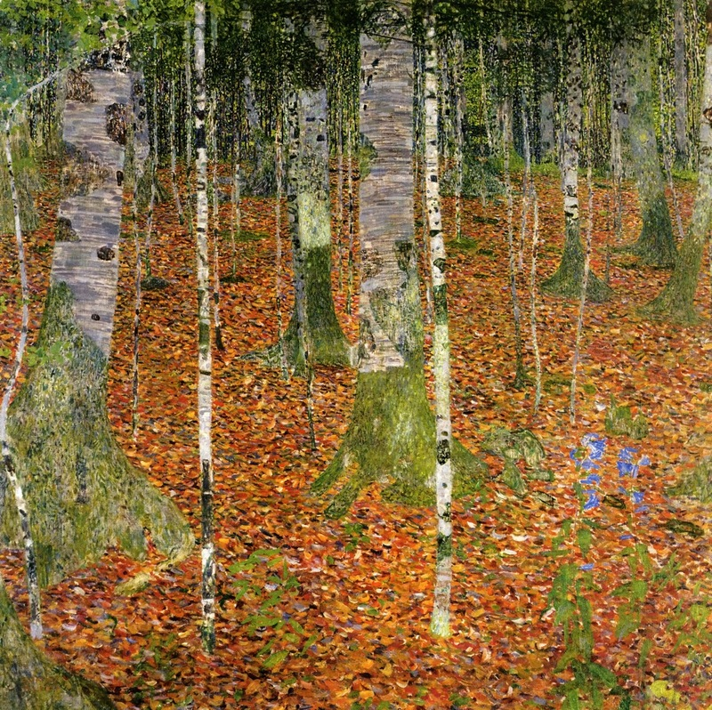
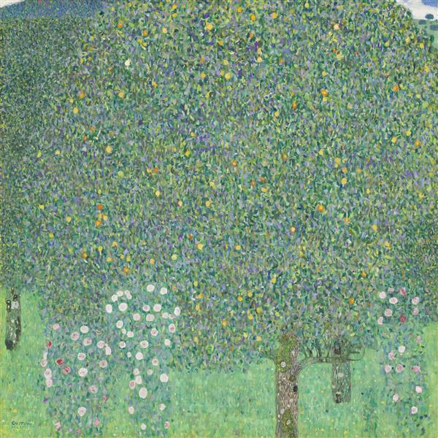
Farmhouse with Birch Trees, 1903, oil on canvas, 110x110 cm, Österreichische Galerie Belvedere, Vienna
Roses under the Trees, circa 1905, oil on canvas, 110x110 cm, Musée d'Orsay, Paris https://www.wikiart.org/en/gustav-klimt/farmhouse-with-birch-trees-1903 and https://www.wikiart.org/en/gustav-klimt/roses-under-the-trees

Slide 11
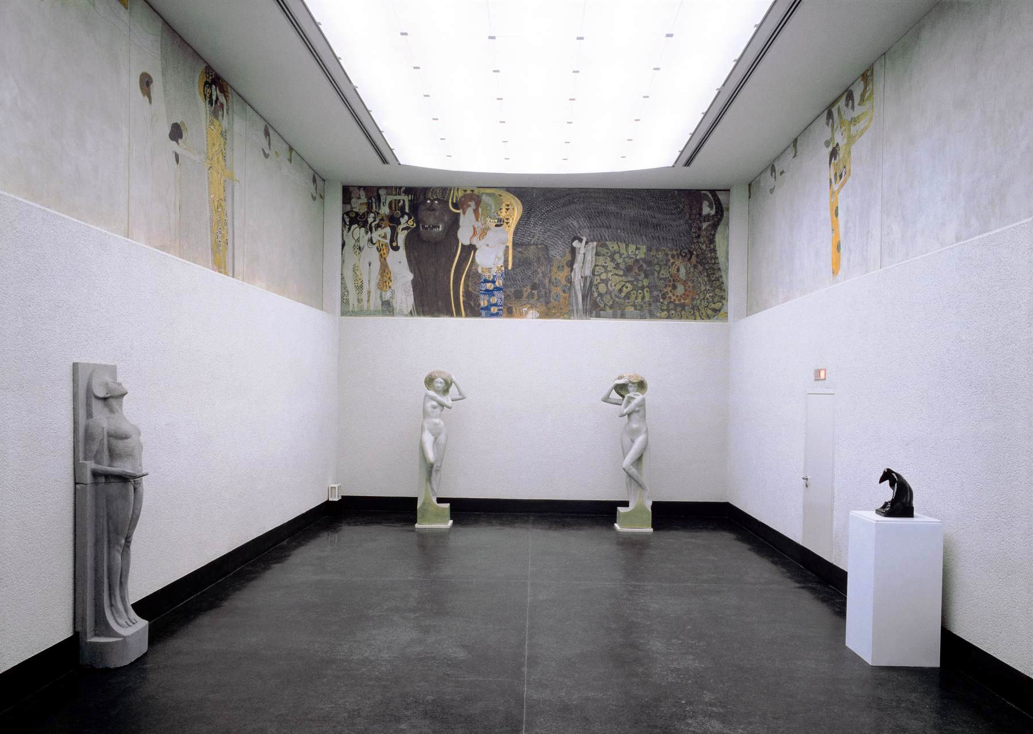
Beethoven Frieze, 1901, Secession Building, Vienna, Austria https://www.wga.hu/html_m/k/klimt/1/index.html

Slide 12
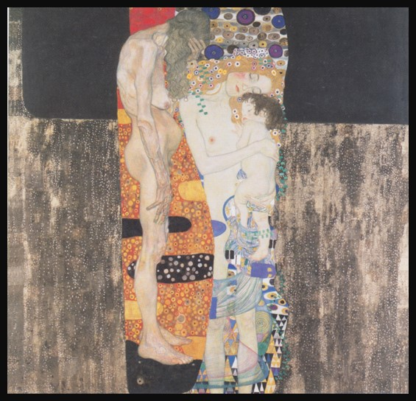
The Three Ages of the Woman, 1905, Oil on Canvas, 180 × 180 cm, Galleria Nazionale d'Arte
Moderna e Contemporanea, Rome Italy https://upload.wikimedia.org/wikipedia/commons/c/c8/Klimt_-_Die_drei_Lebensalter_der_Frau.jpeg

Slide 13
The End

