Slide 1
Apulian
Red-Figured
Pottery

Slide 2
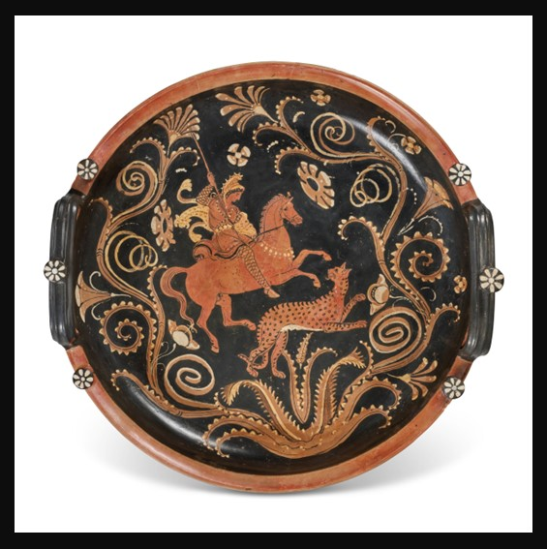
Apulian Red-Figured Knob-Handled Patera in the manner of the Lycurgus Painter, circa 2nd half of the 4th century BC, Terracotta and pigment, Diameter: 43.2 cm, Private Collection https://www.christies.com/lot/lot-6436519?ldp_breadcrumb=back&intObjectID=6436519&from=salessummary&lid=1

Slide 3
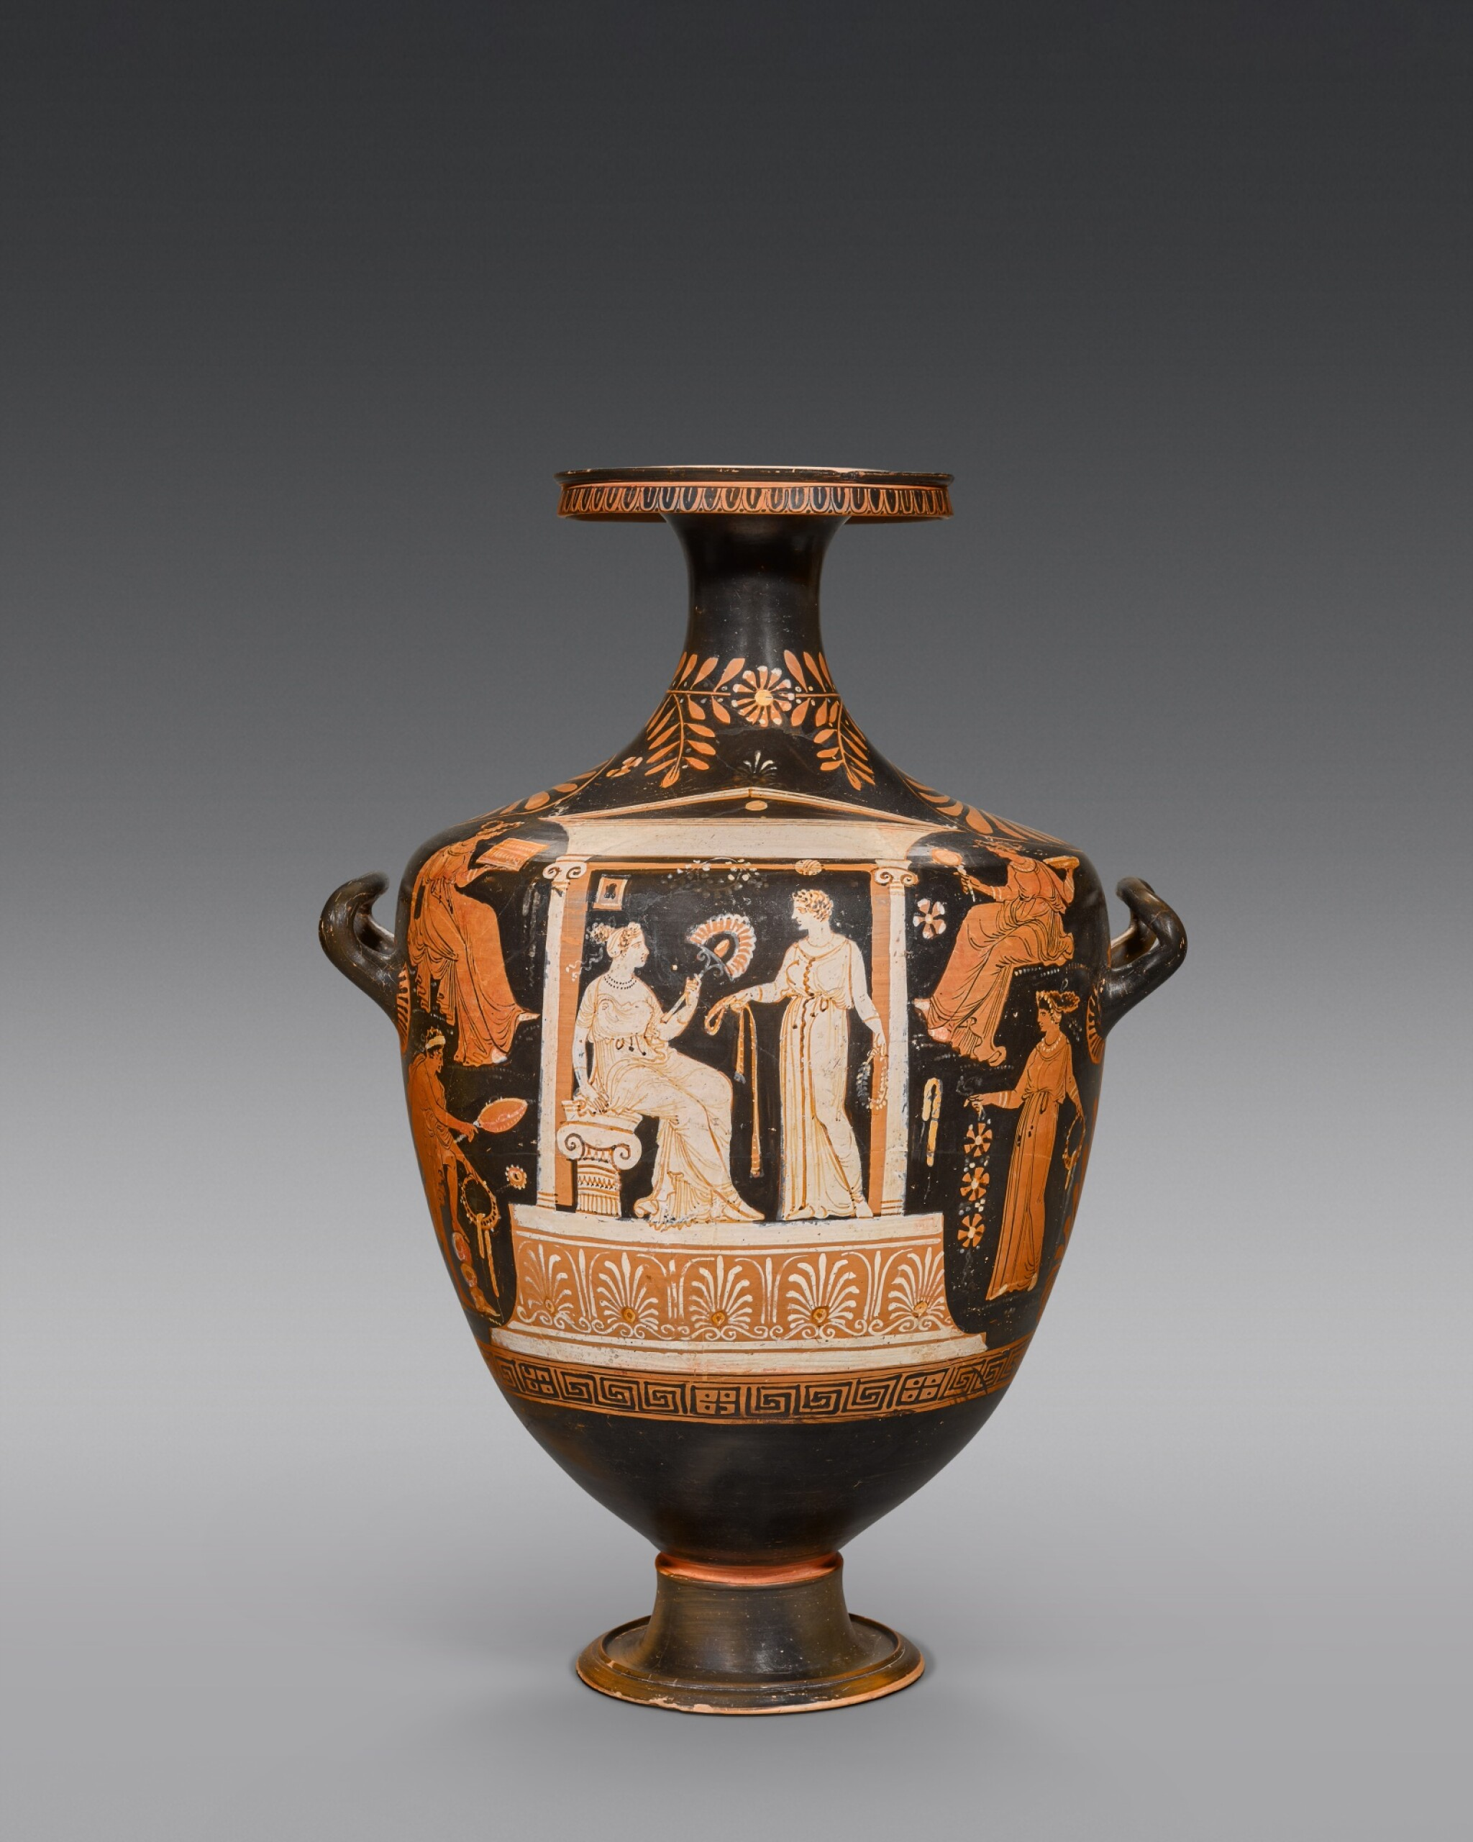
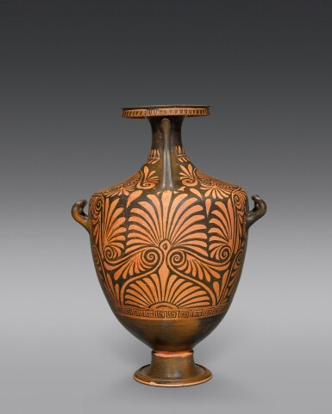
Apulian Red-figured Hydria, circa 350-330 BC, Terracotta and pigment, Height: 68.5 cm, Private Collection https://www.sothebys.com/en/buy/auction/2022/ancient-sculpture-and-works-of-art-part-ii/an-apulian-red-figured-hydria-circa-350-330-b-c

Slide 4
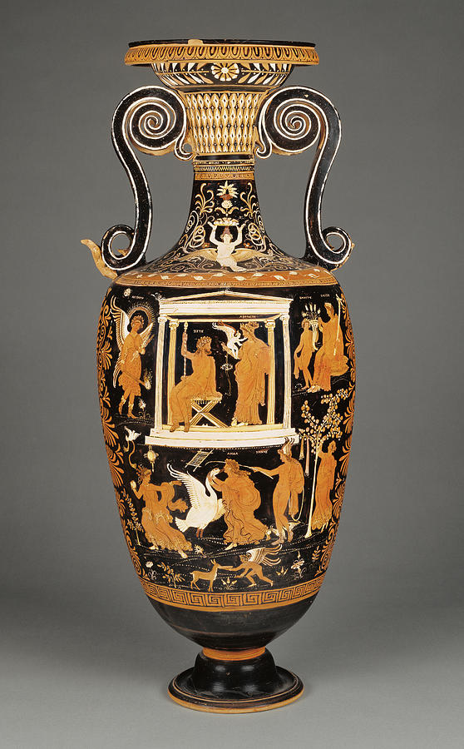
Apulian Red-figure Loutrophoros attributed to the Painter of the Louvre, about 330 BC, Terracotta and pigment, Height: 90.2 cm, Private Collection https://pixels.com/featured/apulian-red-figure-loutrophoros-attributed-to-painter-litz-collection.html

Slide 5
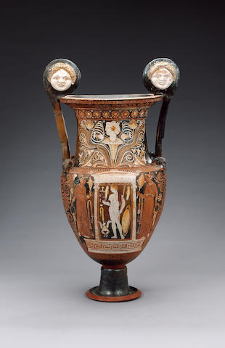
Large Apulian Red-Figured Volute Krater attributed to the Patera Painter, circa 4th century BC, Terracotta and pigment, Height: 71 cm, Private Collection https://www.bonhams.com/auctions/15216/lot/164/

Slide 6
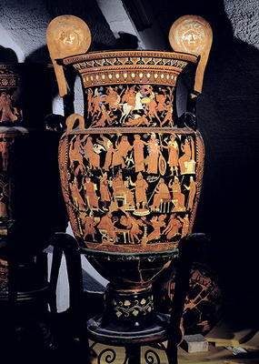
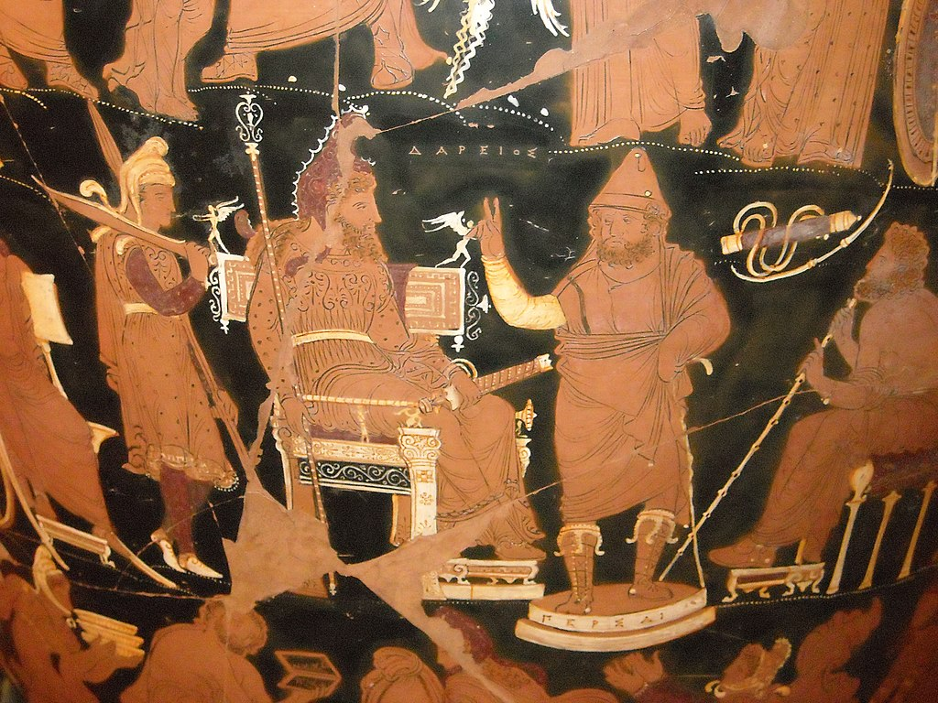
Apulian Red-Figured ‘Darius Vase’, between 340 and 320 BC, Terracotta and pigment, Height: 1.3 m, National Archaeological Museum, Naples, Italy https://www.myartprints.co.uk/a/dariuspainter/apulianred-figurevolute.html and https://en.wikipedia.org/wiki/Darius_Vase

Slide 7
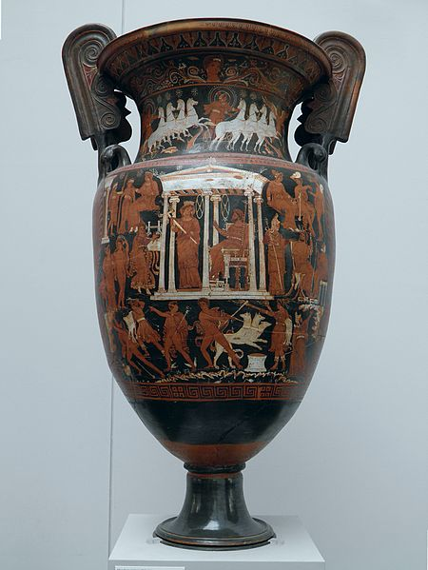
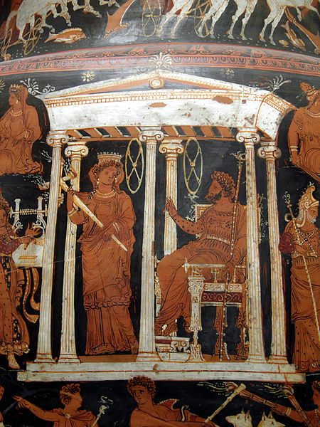
Apulian Red-Figured Volute Krater with scenes of the Underworld, c. 340-330 BC, Terracotta and pigment, Height: 97 cm, Staatliche Antikensammlungen, Munich, Germany https://commons.wikimedia.org/wiki/File:Apulian_Red_Figure_volute_krater_with_scenes_of_the_Underworld,_ca._340-330_BC,_Staatliche_Antikensammlungen,_Munich_(8956886411).jpg and https://commons.wikimedia.org/wiki/File:Apulian_Red_Figure_volute_krater_with_scenes_of_the_Underworld,_ca._340-330_BC,_Staatliche_Antikensammlungen,_Munich_(8958096384).jpg

Slide 8
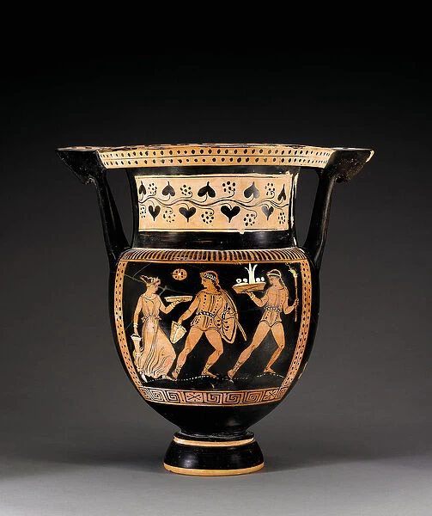
Apulian Red-Figured Column Krater attributed to the Letet Group, c.370-360 BC, Terracotta and pigment, Height: 42.2 cm; Private Collection https://www.mediastorehouse.com/fine-art-finder/artists/egon-schiele/apulian-red-figured-column-krater-22630148.html

Slide 9
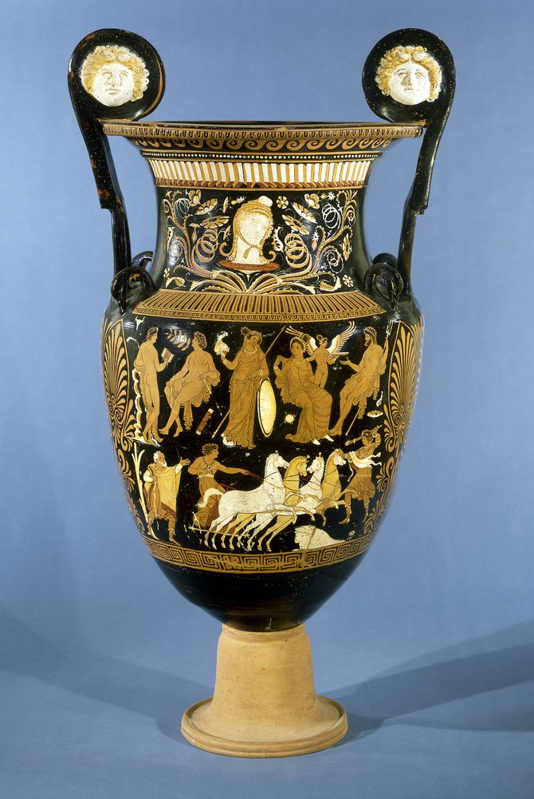
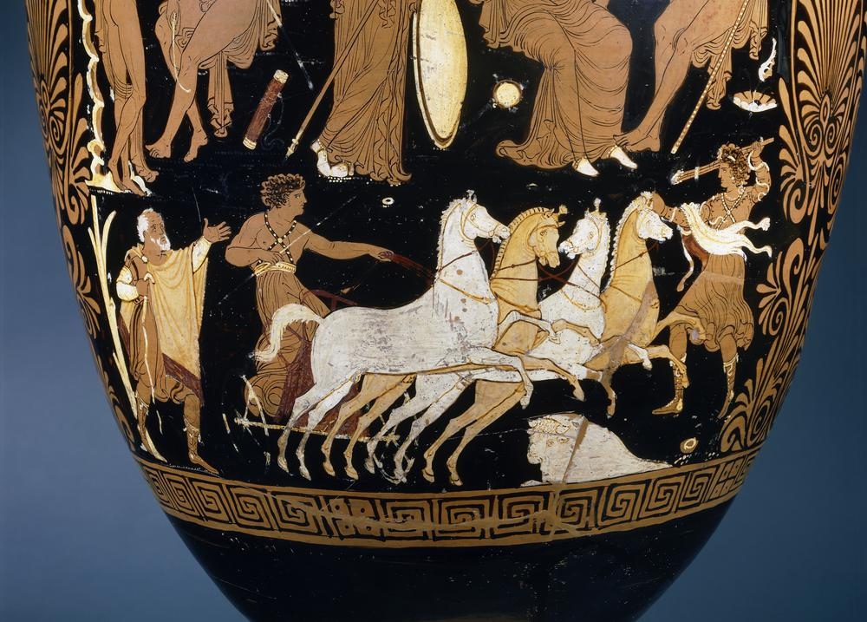
Apulian Red-Figured Volute Krater attributed to the Darius Painter, c. 340-320 BC, Terracotta and pigment, Height: 107.80 cm, the British Museum, London, UK https://www.britishmuseum.org/collection/object/G_1856-1226-1

Slide 10
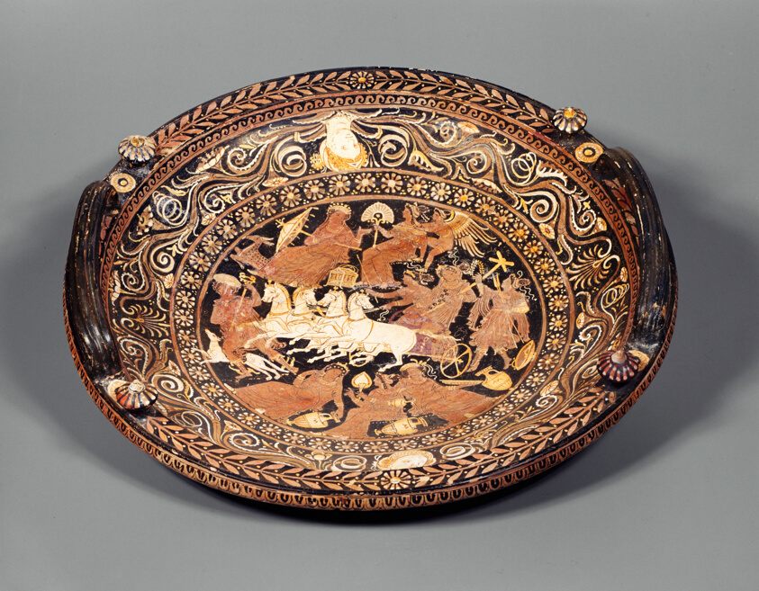
Apulian Red-Figured Knob-Handled Patera attributed to the Baltimore Painter, c. 330-320 BC, Terracotta and pigment, 17.7 × 67.3 × 68.5 cm , The Art Institute, Chicago, USA https://www.artic.edu/artworks/102081/knob-handled-patera-dish

Slide 11
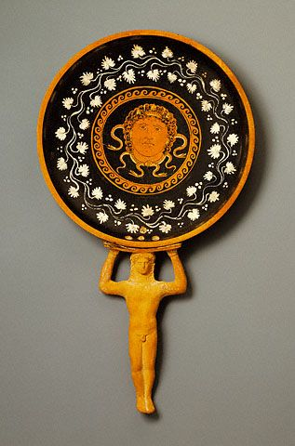
Apulian Red-Figured Patera with Anthropomorphic Handle attributed to the Circle of the Lycurgus Painter, about 350 BC, Terracotta and pigment, 47 × 26 cm, the Getty Museum, USA https://www.getty.edu/art/collection/object/10403X#full-artwork-details

Slide 12
The End

