Slide 1
Gentile Bellini
1460-1507

Slide 2
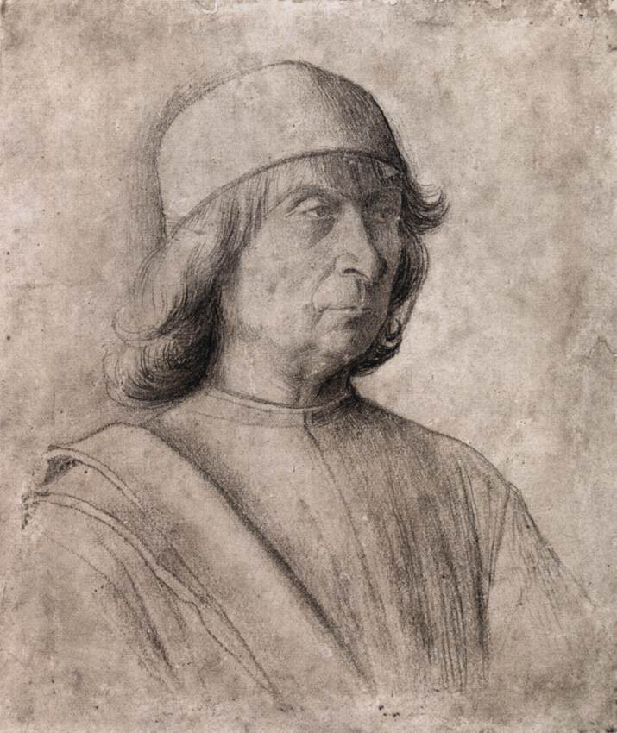
Self-Portrait, c. 1496, Charcoal on Paper, 23 x 194 mm, Staatliche Museen, Berlin, Germany https://www.wga.hu/frames-e.html?/html/b/bellini/gentile/index.html

Slide 3
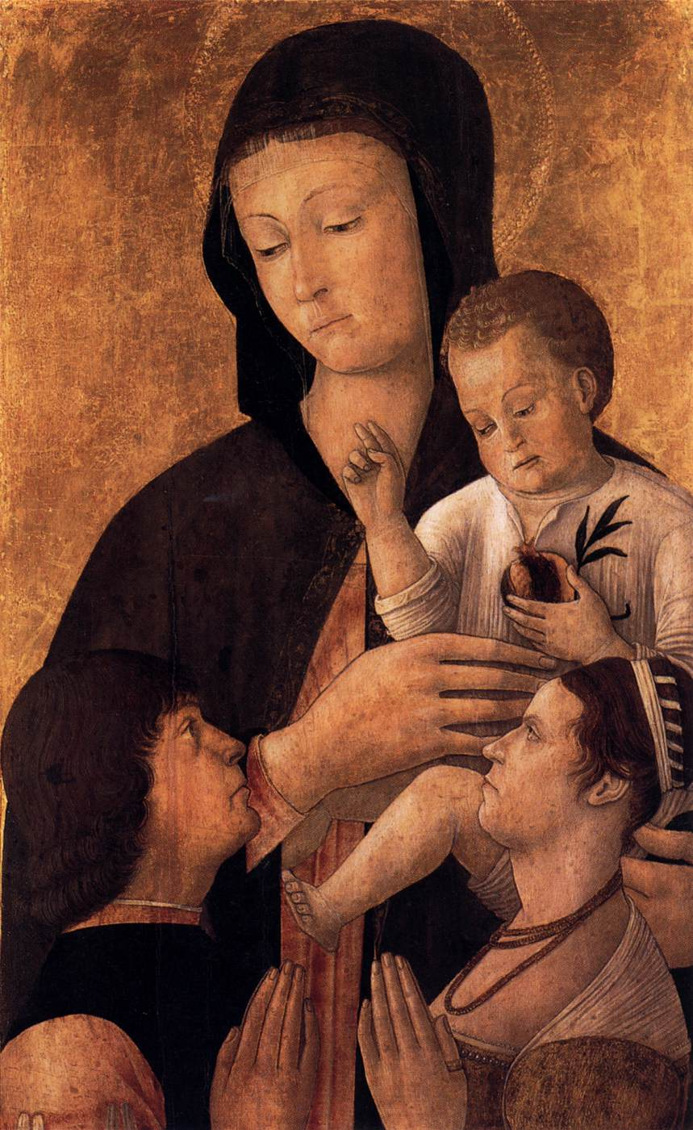
Madonna and Child with Donors, c. 1460, Panel, 74 x 46 cm, Staatliche Museen, Berlin, Germany https://upload.wikimedia.org/wikipedia/commons/9/9c/Gentile_bellini%2C_madonna_col_bambino_di_berlino.jpg

Slide 4
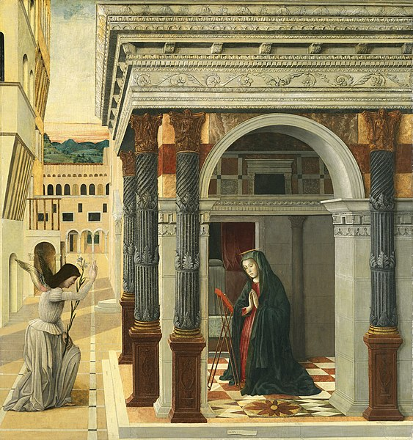
Annunciation, c. 1465, Tempera and Oil on Panel, 133 x 124 cm, Museo Thyssen-Bornemisza, Madrid, Spain https://en.m.wikipedia.org/wiki/File:Gentile_bellini,_annunciazione.jpg

Slide 5
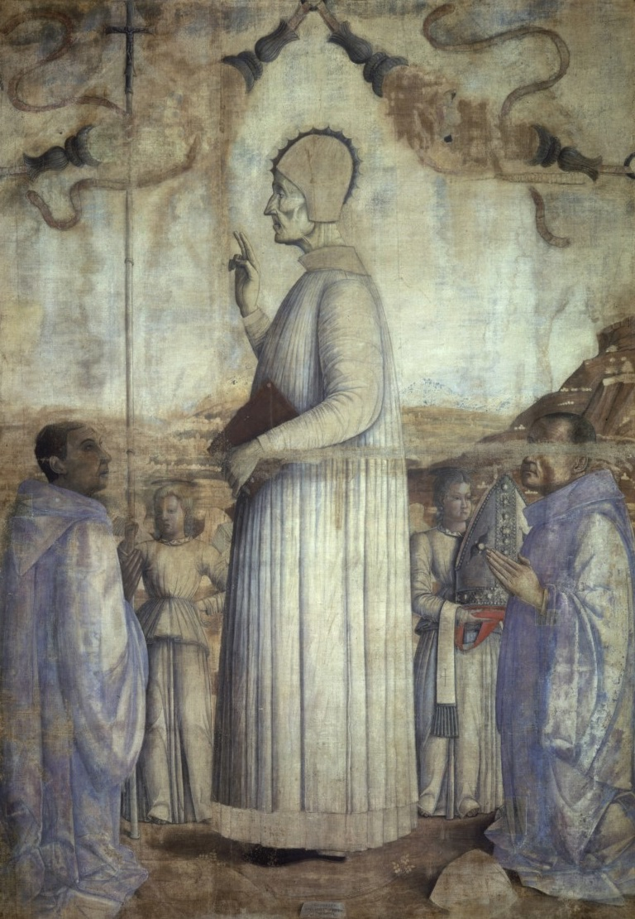
The Blessed Lorenzo Giustiniani, 1465, Tempera on Canvas, 221 x 155 cm,
Gallerie dell'Accademia, Venice, Italy https://www.gallerieaccademia.it/en/blessed-lorenzo-giustiniani#&gid=1&pid=1

Slide 6
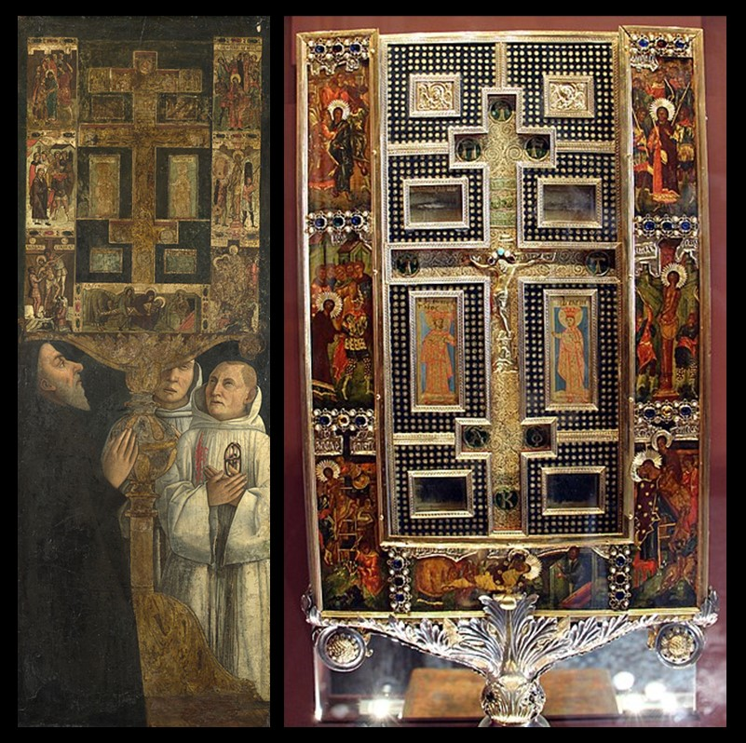
Cardinal Bessarion and Two Members of the Scuola della Carità in prayer with the Bessarion Reliquary, about 1472/3, Egg Tempera on Wood, 102.3 × 37.2 cm, The National Gallery, London, UK https://www.nationalgallery.org.uk/paintings/gentile-bellini-cardinal-bessarion-with-the-bessarion-reliquary
The Reliquary of Cardinal Bessarion, late 14th-early 15th cent., Wood, Silver, Enamel, Glass, and Precious Stones, Galleria dell'Accademia, Venice, Italy https://www.gallerieaccademia.it/en/reliquary-cardinal-bessarion

Slide 7
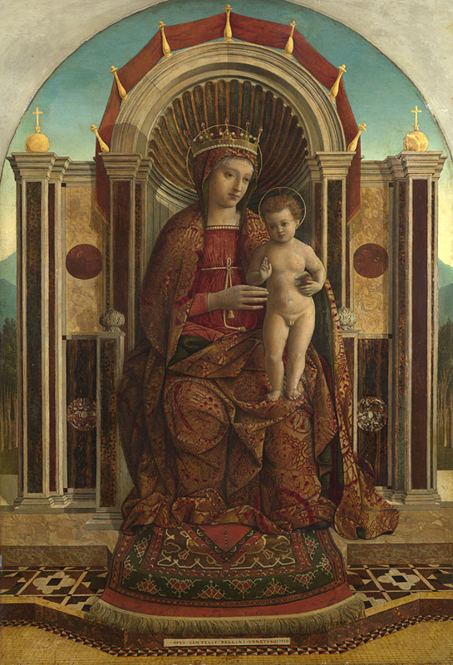
The Virgin and Child Enthroned, about 1475-85, Oil on Wood, 121.9 × 82.6 cm, The National Gallery, London, UK https://www.nationalgallery.org.uk/paintings/gentile-bellini-the-virgin-and-child-enthroned

Slide 8
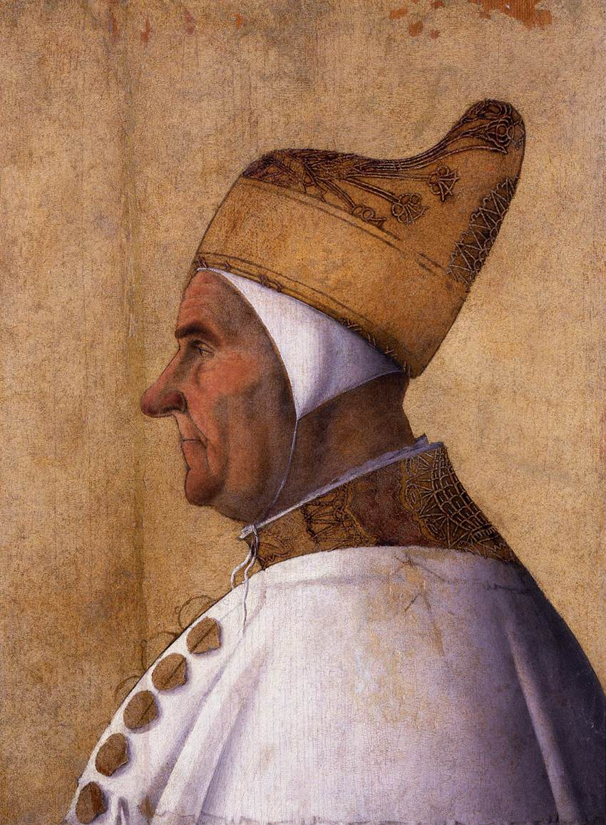
Portrait of Doge Giovanni Mocenigo, c. 1478, Tempera on Panel, 63 x 46 cm, Museo Correr, Venice, Italy https://www.wga.hu/frames-e.html?/html/b/bellini/gentile/index.html

Slide 9
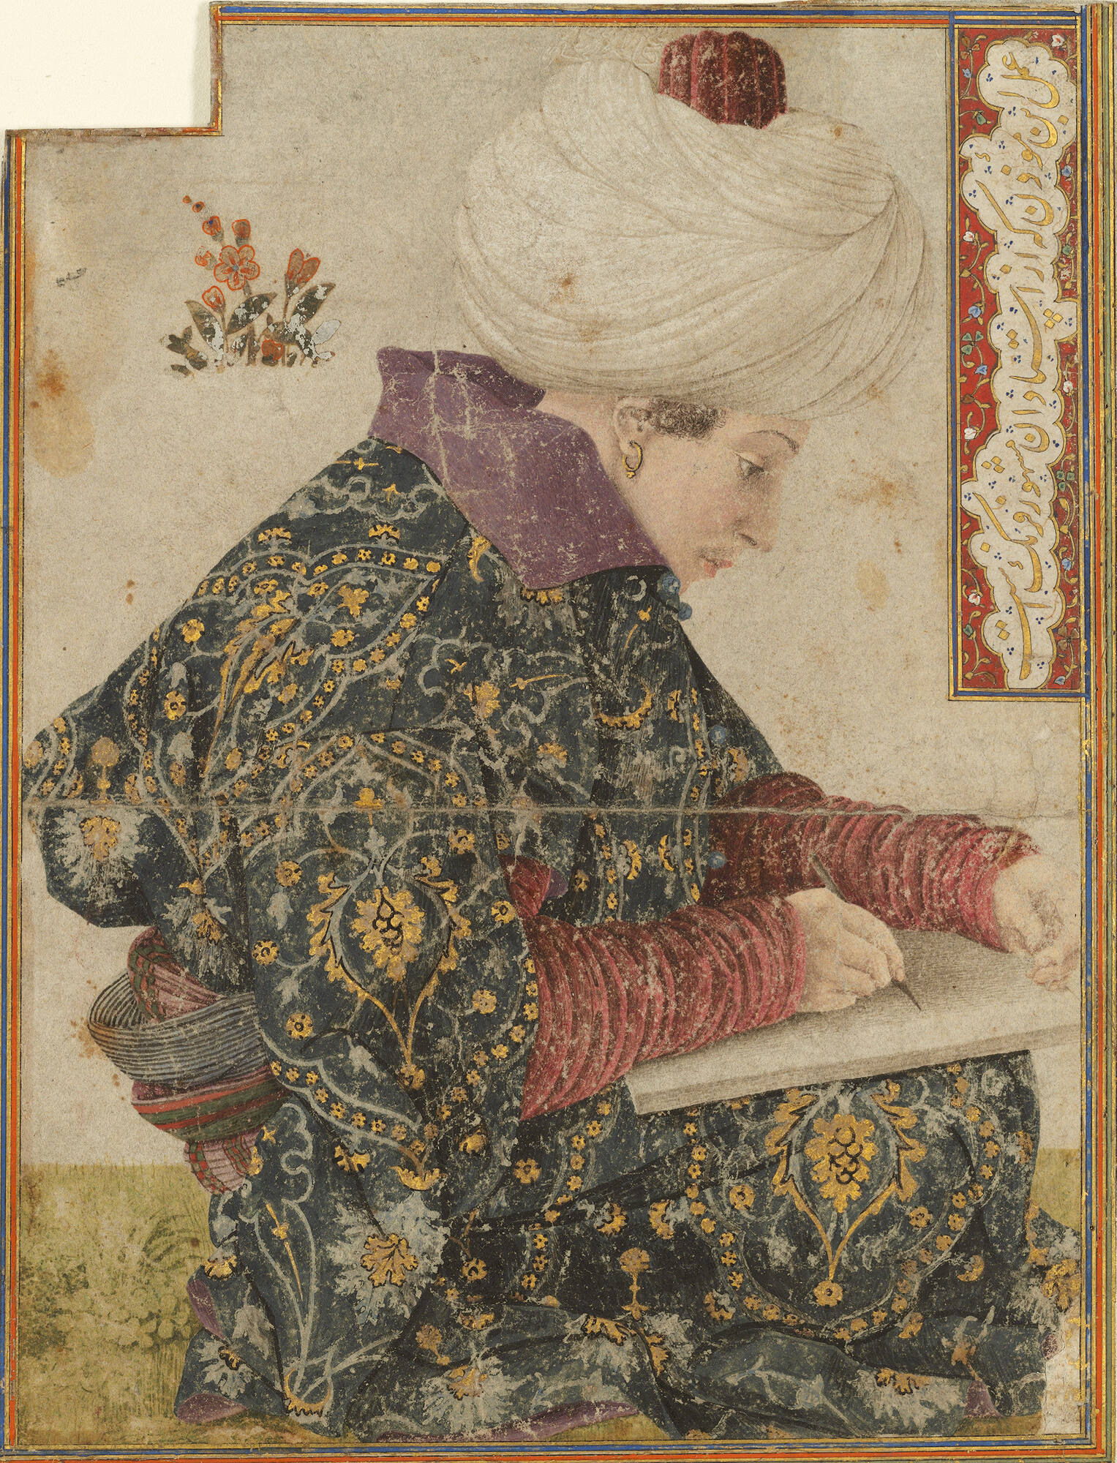
Seated Scribe, 1479-81, Pen in brown Ink with Watercolor and Gold on Paper , 18.2 x 14 x 2.6 cm Stewart Gardner Museum, Boston, USA https://www.gardnermuseum.org/experience/collection/10755

Slide 10
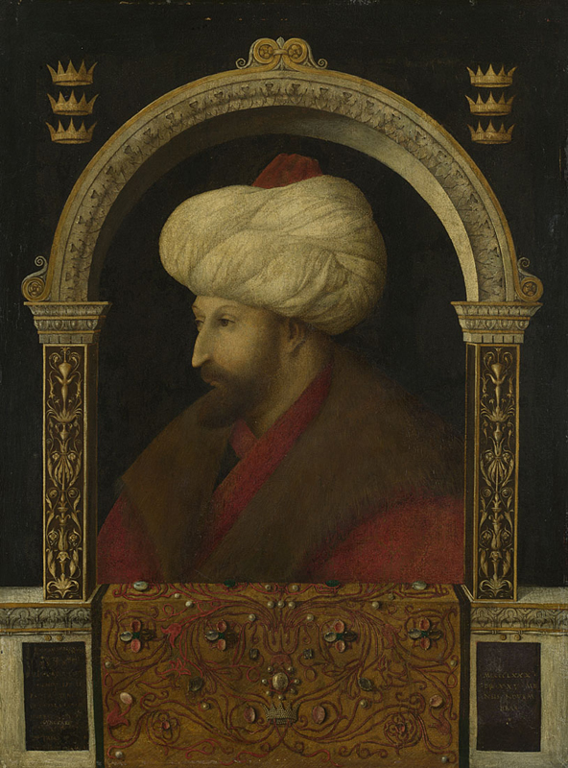
Mehmet II, 1480, Oil on Canvas, 70 x 52 cm, National Gallery, London, UK https://www.nationalgallery.org.uk/paintings/gentile-bellini-the-sultan-mehmet-ii

Slide 11
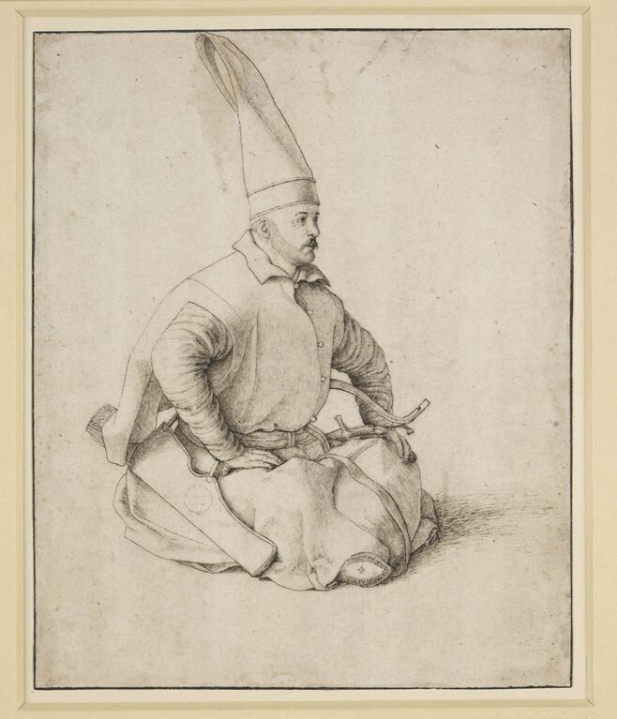
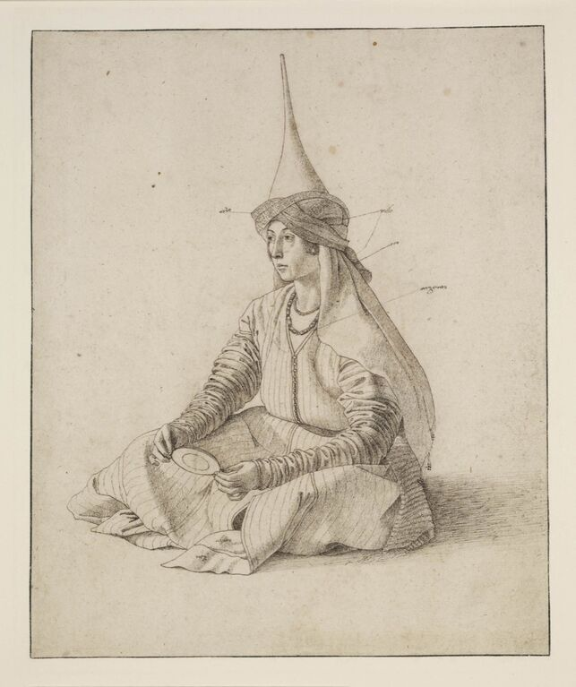
A Turkish Janissary, c. 1480, Pen and black Ink on Paper, 215x175 mm
A Turkish Woman, c. 1480, Pen and black Ink on Paper, 214x176 mm Both in The British Museum, London, UK https://www.artsy.net/article/artsy-editorial-renaissance-portrait-helped-war

Slide 12
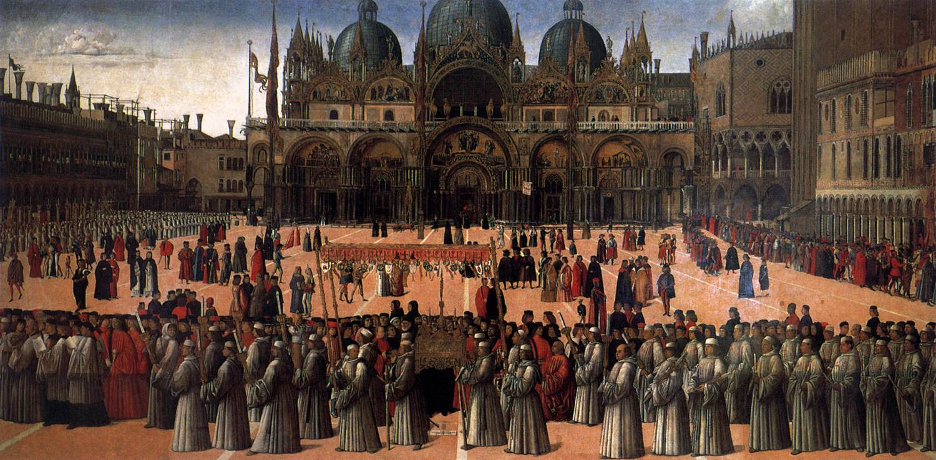
Procession in Piazza San Marco, 1496, Tempera and Oil on Canvas, 367 x 745 cm, Gallerie dell'Accademia, Venice, Italy

Slide 13
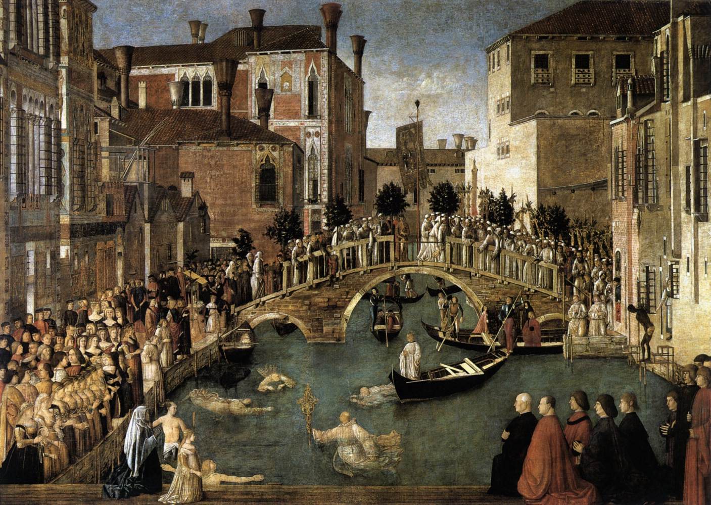
Miracle of the Cross at the Bridge of San Lorenzo, 1500, Tempera on Canvas, 323 x 430 cm, Gallerie dell'Accademia, Venice, Italy https://www.wga.hu/frames-e.html?/html/b/bellini/gentile/index.html

Slide 14
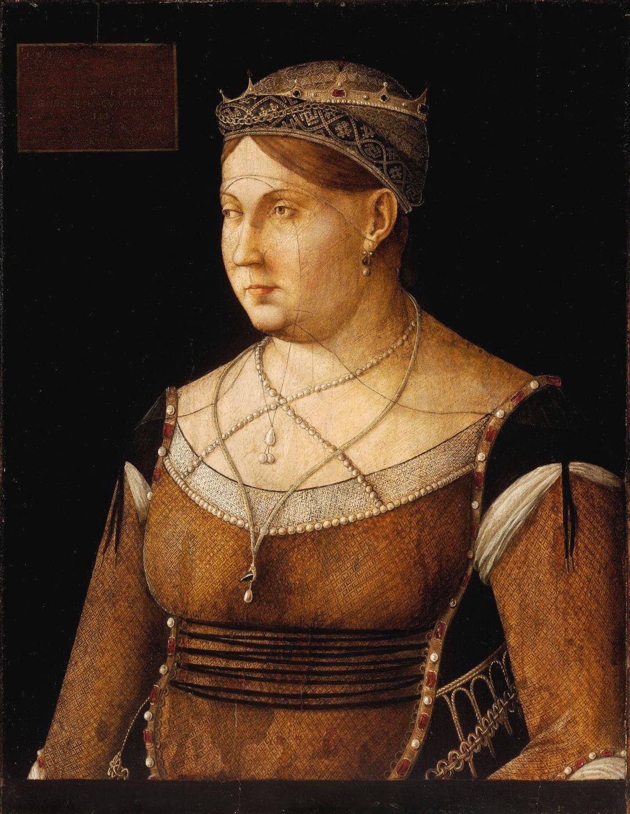
Portrait of Caterina Cornaro, Queen of Cyprus, c. 1500, Panel, 63 x 49 cm, Szépmûvészeti Múzeum, Budapest, Hungary https://upload.wikimedia.org/wikipedia/commons/0/0e/Gentile_Bellini_002.jpg

