Slide 1

Sir Lawrence Alma-Tadema,
1836-1912
Paintings of ‘Courtship’

Slide 2
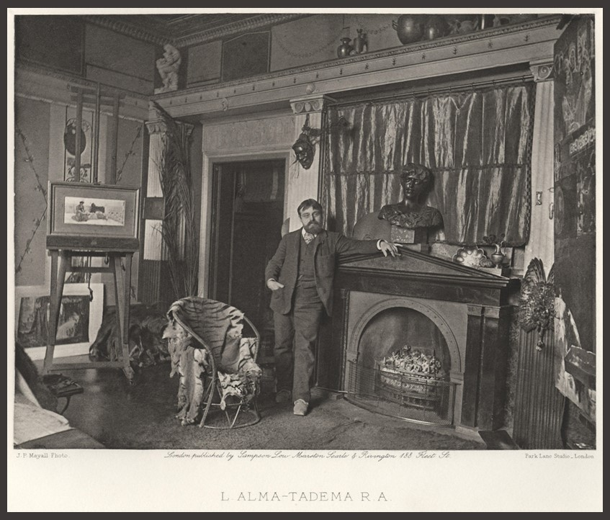
The photograph shows Alma-Tadema's studio at Townsend House, after its reconstruction following the destruction caused by an explosion on a barge on the Regent's Canal in 1874. Alma-Tadema decorated the small first floor studio in a Pompeian style, with a dark red ceiling and red and yellow wall panels with garlands and medallions. Over the fireplace can be seen a bronze bust of his wife backed by a curtain of cloth of gold. On the easel appears to be a variation of the watercolour 'A declaration' 1883 and just below it, on the floor, is a reproduction of 'Anthony and Cleopatra', 1883. The studio also housed Alma-Tadema's extensive collection of photographs. https://www.royalacademy.org.uk/art-artists/work-of-art/sir-lawrence-alma-tadema-r-a

Slide 3
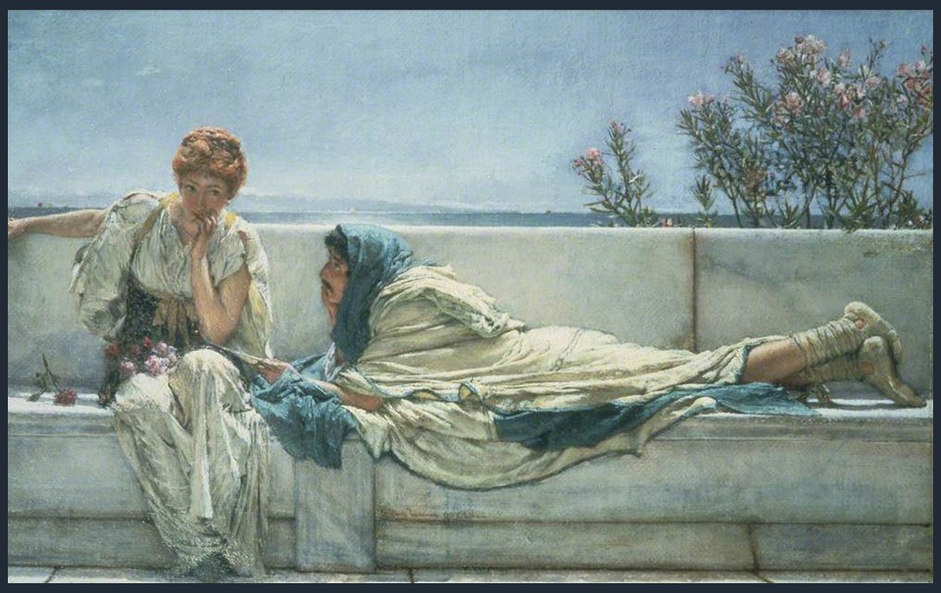
Pleading, 1876, oil on canvas, 22 x 36 cm, Guildhall Art Gallery, London, UK https://artuk.org/discover/artworks/pleading-51049/search/actor:alma-tadema-lawrence-18361912/page/2

Slide 4
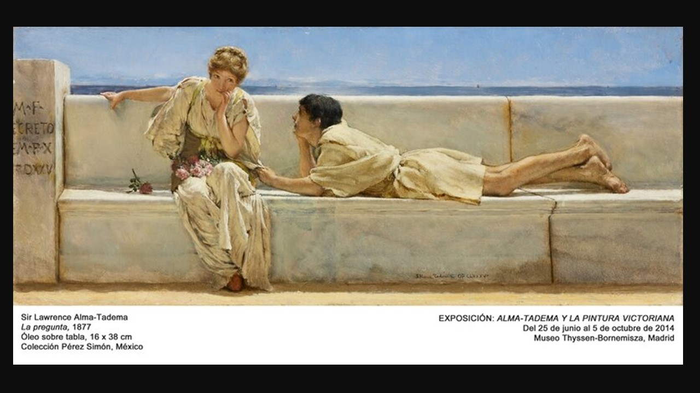

Slide 5
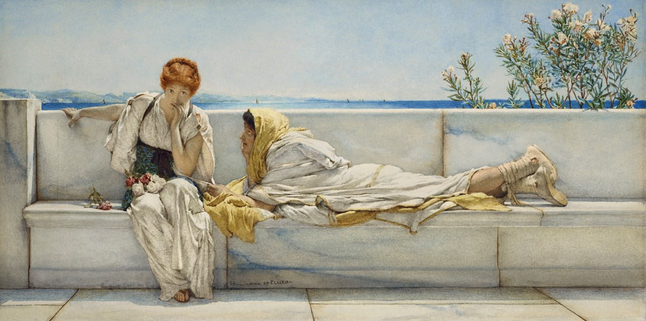
A Solicitation, 1878, pencil and watercolour on paper, 22.9 x 45.1 cm, Private Collection https://www.mutualart.com/Artwork/A-Solicitation/8FB915CF2DFA260B4CC9A753186F8298

Slide 6
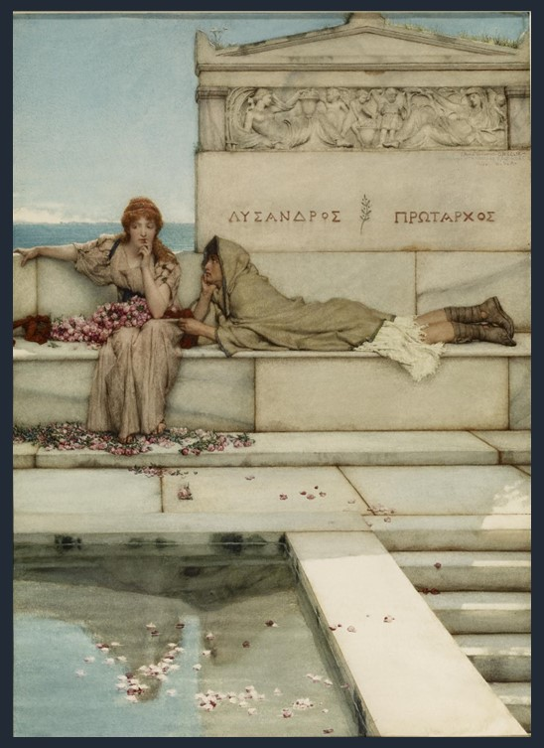
Xanthe and Phaon, 1883, watercolor on paper, 45.1 x 32.4 cm, Walters Art Museum, Baltimore, USA https://art.thewalters.org/detail/27156/xanthe-and-phaon/

Slide 7
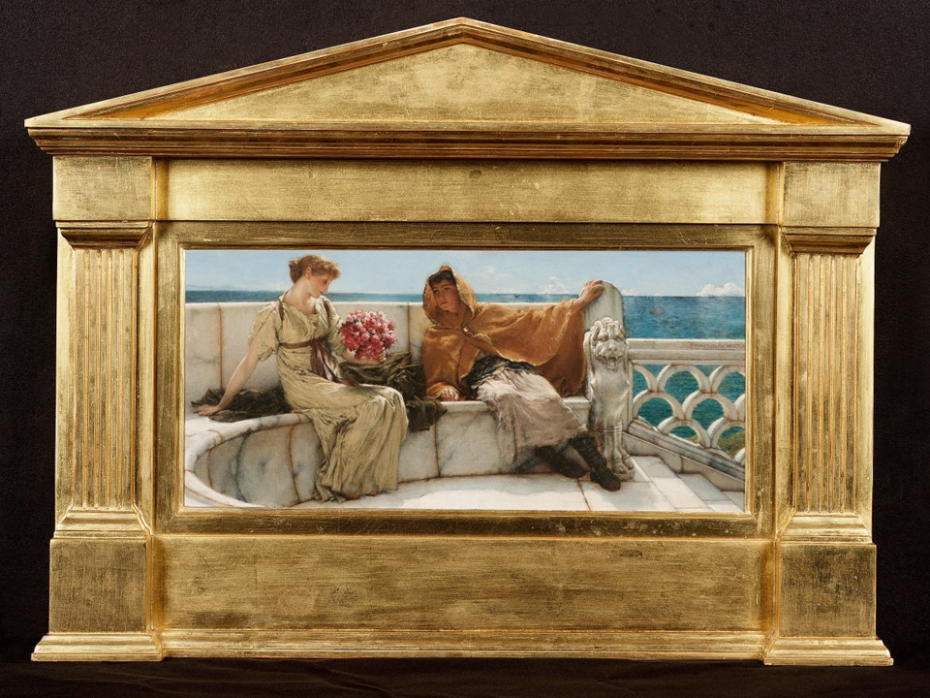
Amo te, ama me, 1883, oil on panel, 17.5 x 38 cm, Private Collection https://www.bonhams.com/auctions/11363/lot/152/

Slide 8
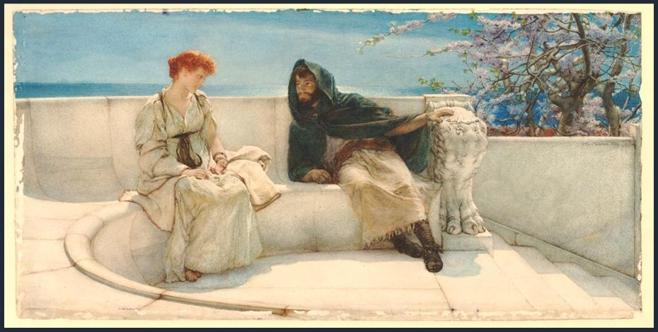
A Declaration, 1883, watercolor on paper, 227x465 millimetres, British Museum, London, UK https://www.britishmuseum.org/collection/object/P_1954-0508-33

Slide 9
The End

