Slide 1
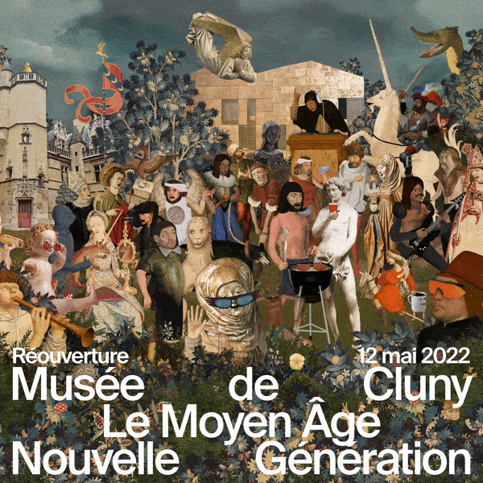
Musée de Cluny
The Lady and the Unicorn

Slide 2
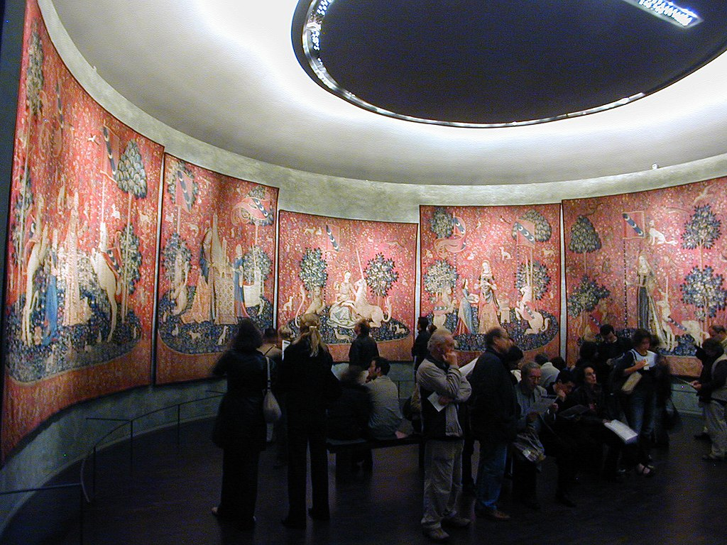
The Lady and the Unicorn, circa 1500, wool and silk, Musée de Cluny, Paris, France https://en.wikipedia.org/wiki/The_Lady_and_the_Unicorn#/media/File:(Toulouse)_Le_toucher_(La_Dame_%C3%A0_la_licorne)_-_Mus%C3%A9e_de_Cluny_Paris.jpg

Slide 3
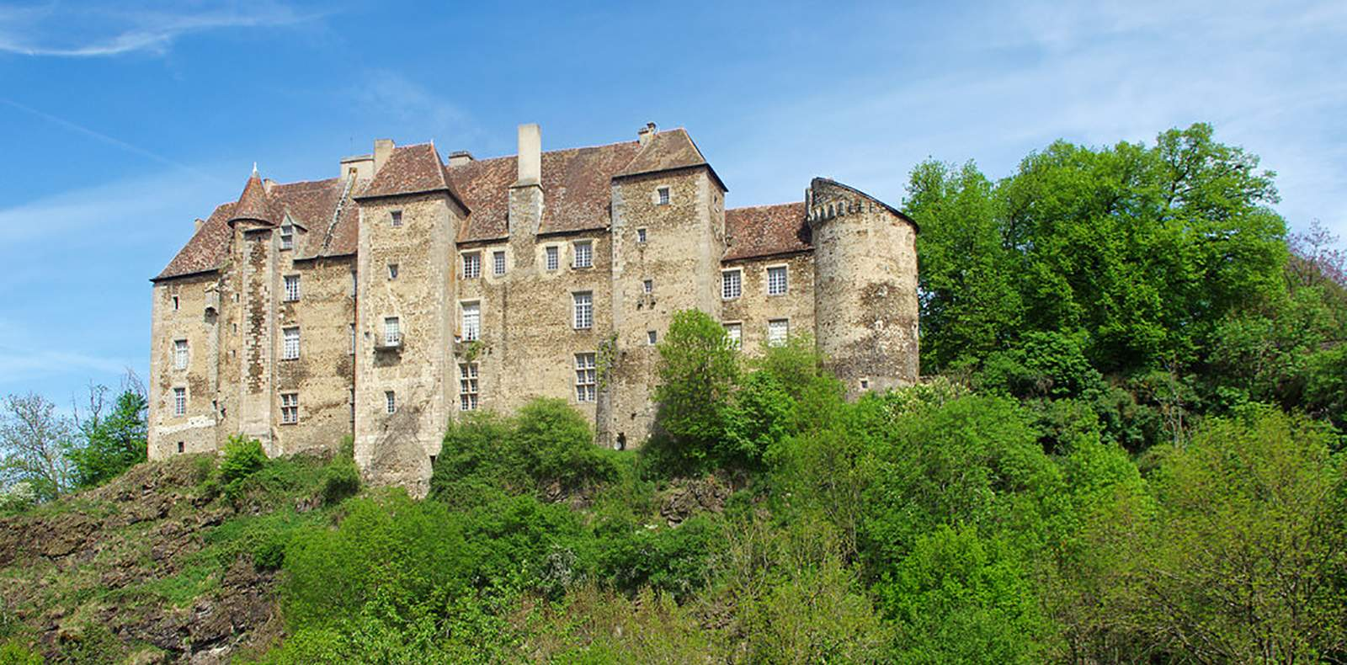
Château de Boussac, built during the 15th century by Marshall Jean de Brosse, companion of Jeanne d’Arc https://www.camping-de-poinsouze.com/en/region/3-chateau-de-boussac

Slide 4
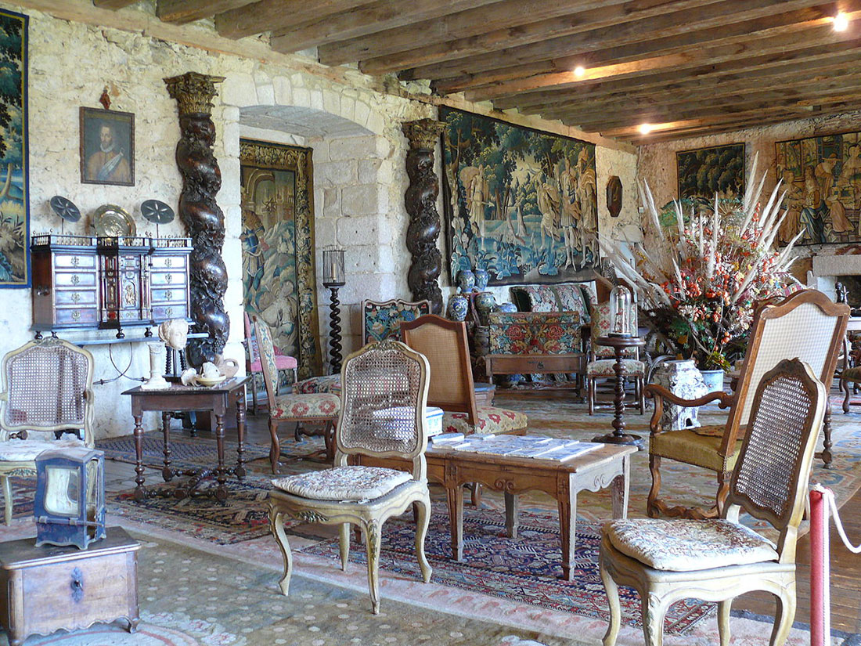
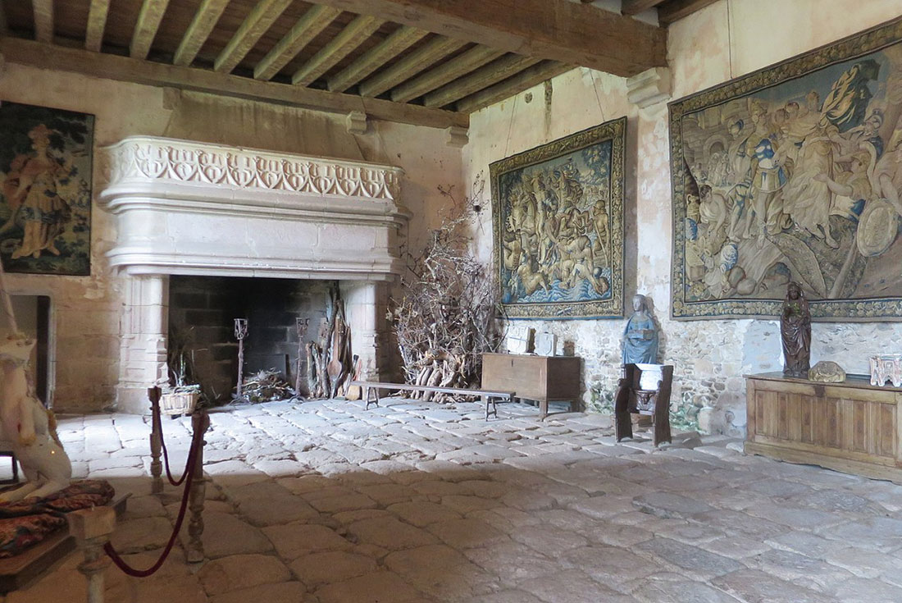
https://en.topvoyager.com/boussac-castle/

Slide 5
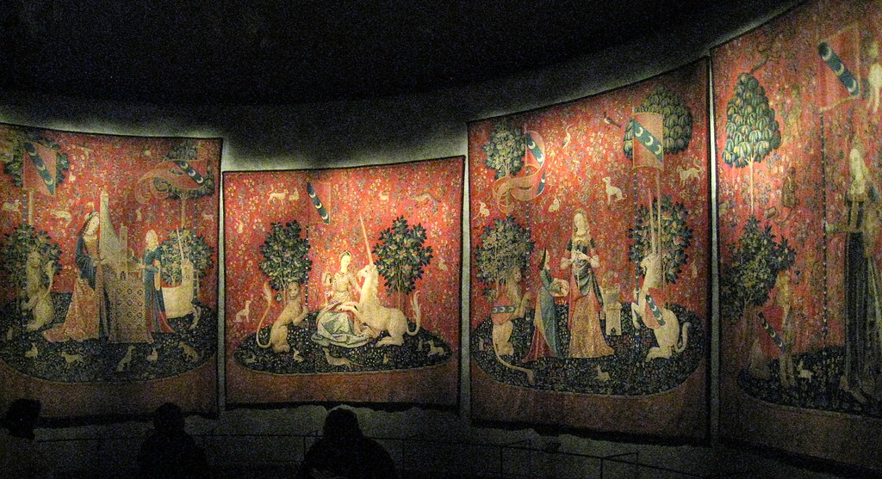
https://www.flickr.com/photos/hunky_punk/15895754150

Slide 6
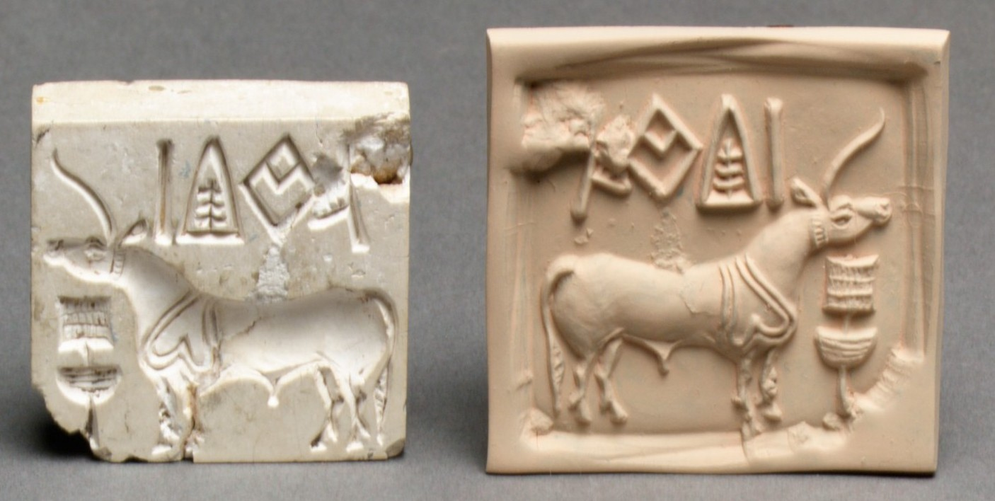
Indus stamp seal and modern impression, unicorn and incense burner or manger, 2600–1900 BC, Steatite, 3.8 x 3.8 x 1 cm, the MET, NY https://commons.wikimedia.org/wiki/File:Stamp_seal_and_modern_impression-_unicorn_and_incense_burner_(%3F)_MET_DP23101_(cropped).jpg

Slide 7
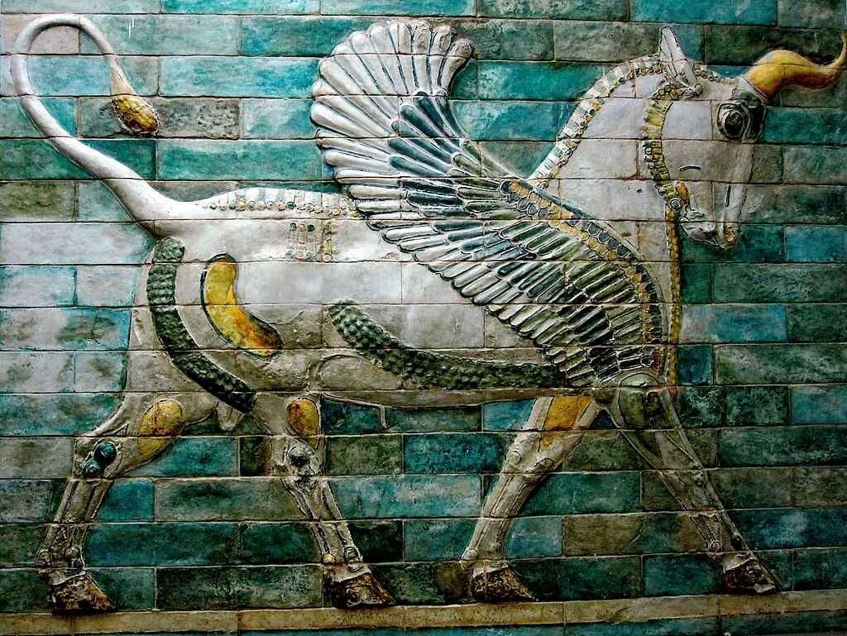
Winged bull, perhaps perceived as a unicorn, in Apadana, Susa, Iran https://commons.wikimedia.org/wiki/File:Unicorn_in_Apadana,_Shush,_Iran--2017-10.jpg

Slide 8
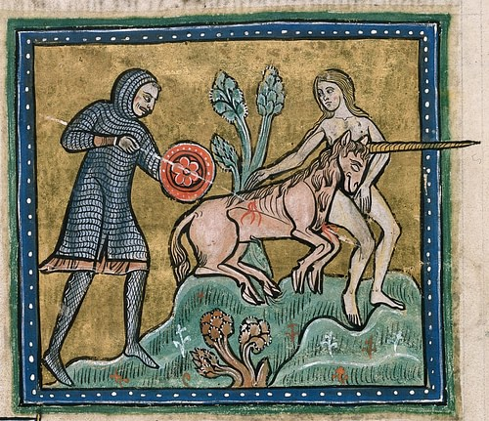
Medieval bestiary, Rochester Bestiary, c. 1230, British Library, London, UK https://www.worldhistory.org/image/12975/unicorn-from-the-rochester-bestiary/

Slide 9
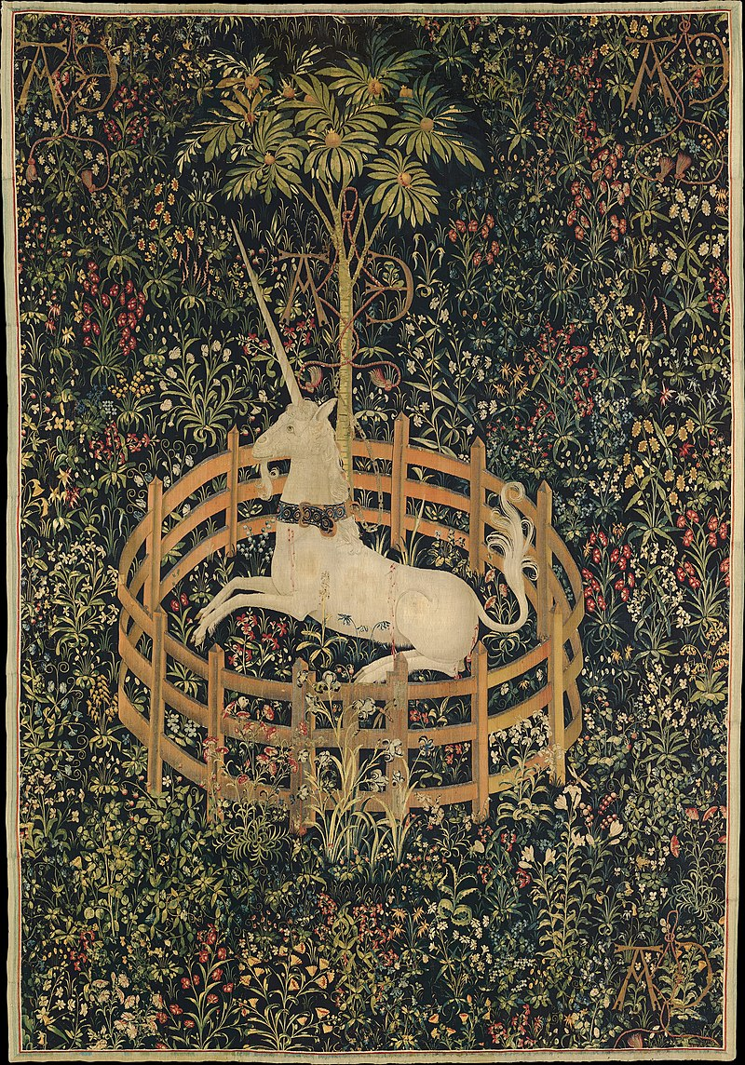
The Unicorn is in Captivity, one of The Hunt of the Unicorn tapestries, c. 1495–1505, Silver, silk and gilded wefts on tapestry, 368 x 251.5 cm, The Cloisters, NY, USA https://en.wikipedia.org/wiki/Unicorn#/media/File:The_Unicorn_in_Captivity_-_Google_Art_Project.jpg

Slide 10
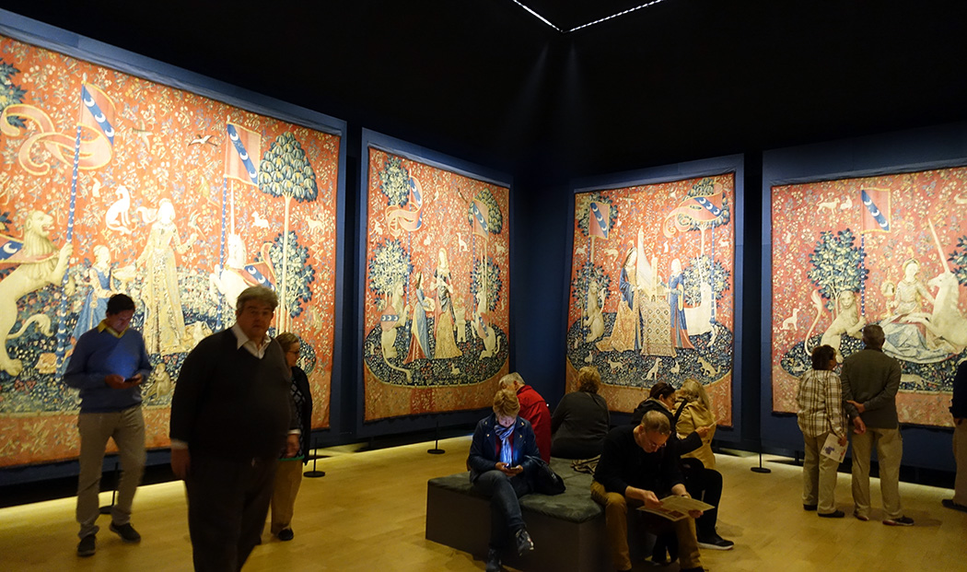
https://rebeccamezoff.com/blog/2019/8/5/visiting-the-lady-and-the-unicorn

Slide 11
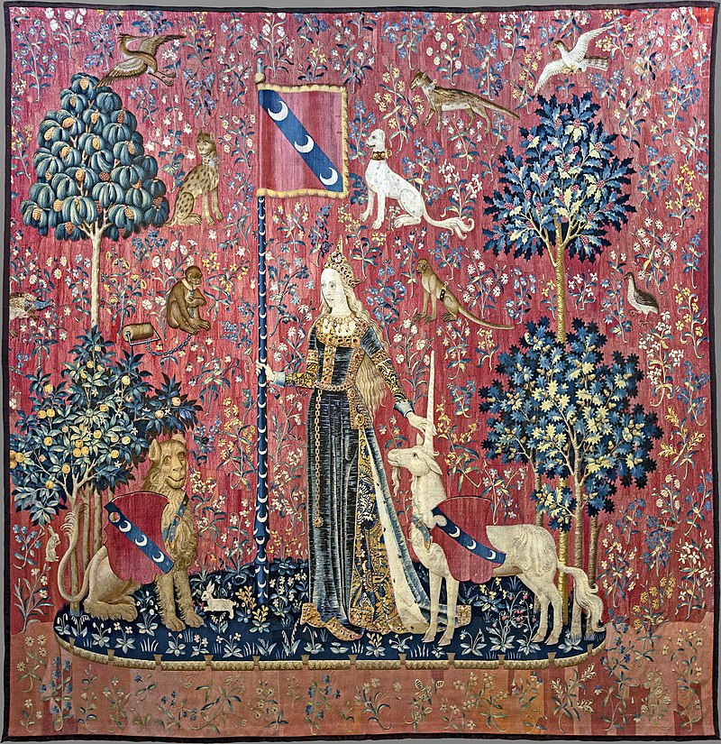
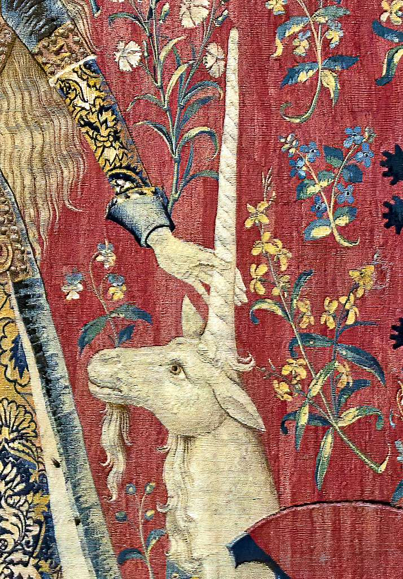
Touch, circa 1500, wool and silk tapestry, 3.15×3.5, Musée de Cluny, Paris, France https://en.wikipedia.org/wiki/The_Lady_and_the_Unicorn#/media/File:(Toulouse)_Le_toucher_(La_Dame_%C3%A0_la_licorne)_-_Mus%C3%A9e_de_Cluny_Paris.jpg and https://picryl.com/media/toulouse-le-toucher-la-dame-a-la-licorne-musee-de-cluny-paris-le-toucher-9fdfb6

Slide 12
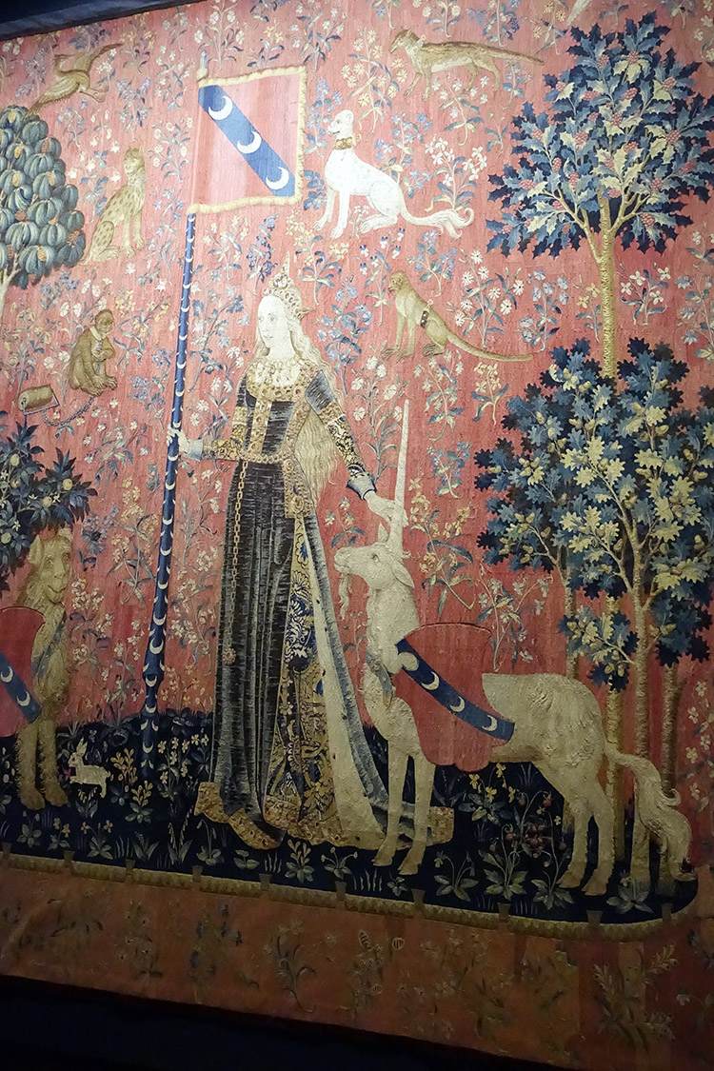
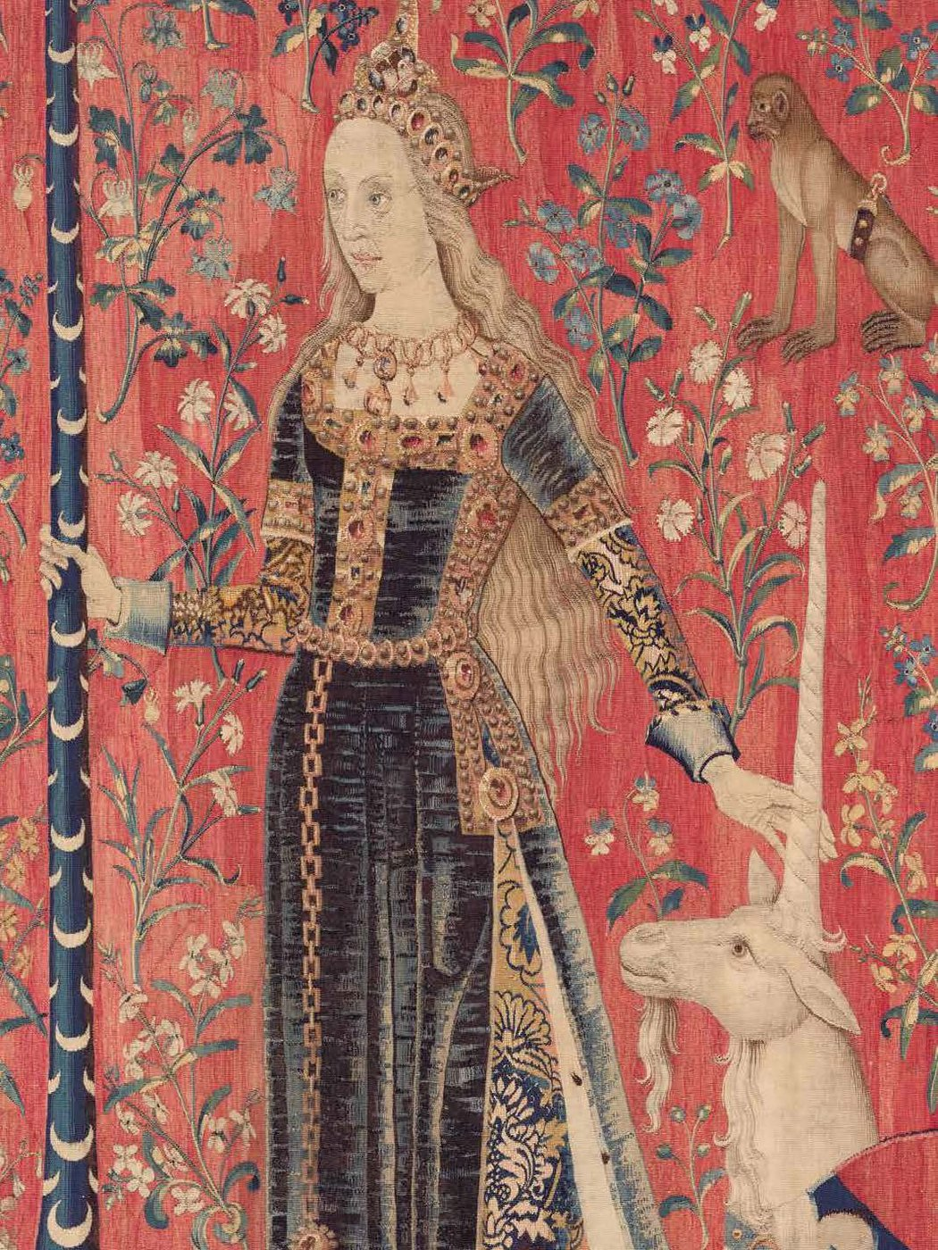
https://rebeccamezoff.com/blog/2019/8/5/visiting-the-lady-and-the-unicorn

Slide 13
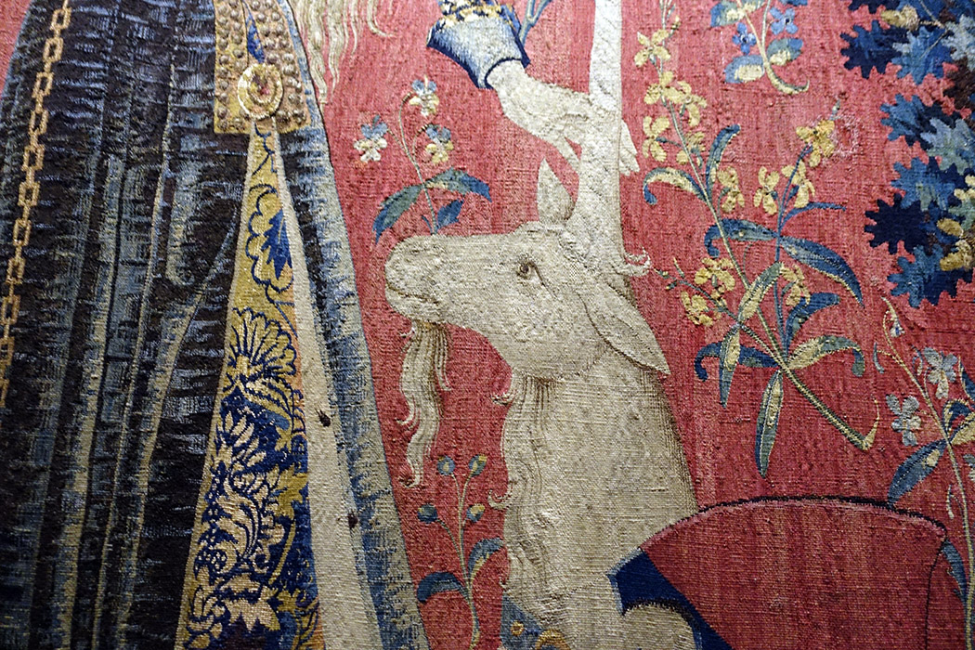
https://rebeccamezoff.com/blog/2019/8/5/visiting-the-lady-and-the-unicorn

Slide 14
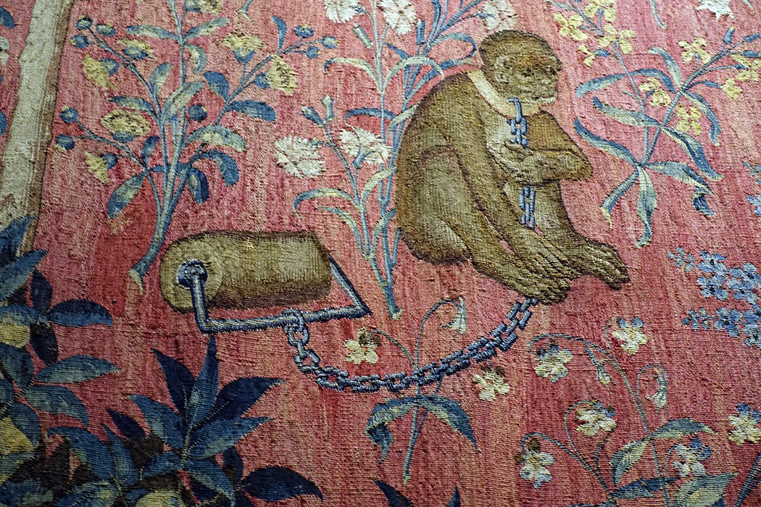
https://rebeccamezoff.com/blog/2019/8/5/visiting-the-lady-and-the-unicorn

Slide 15
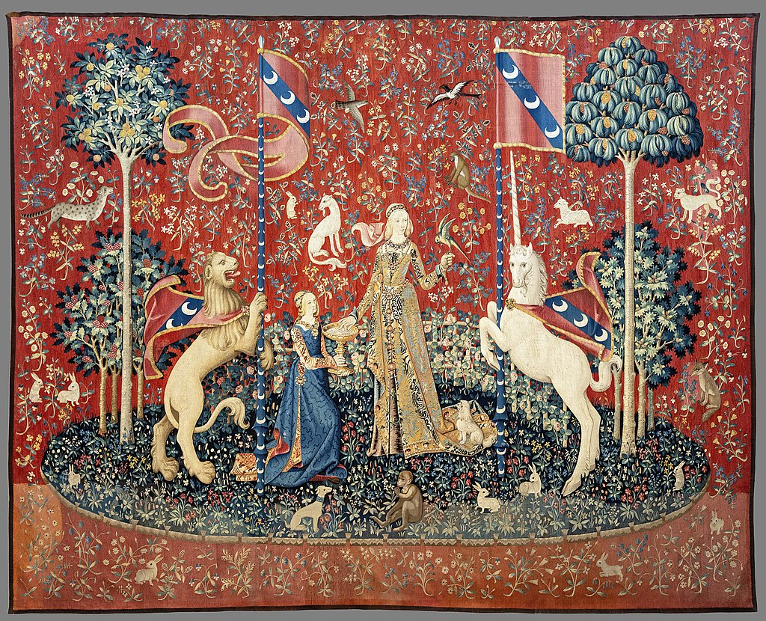
Taste, circa 1500, wool and silk tapestry, 3.75 ×4.60 m, Musée de Cluny, Paris, France https://en.wikipedia.org/wiki/The_Lady_and_the_Unicorn#/media/File:(Toulouse)_Le_Go%C3%BBt_(La_Dame_%C3%A0_la_licorne)_-_Mus%C3%A9e_de_Cluny_Paris.jpg

Slide 16
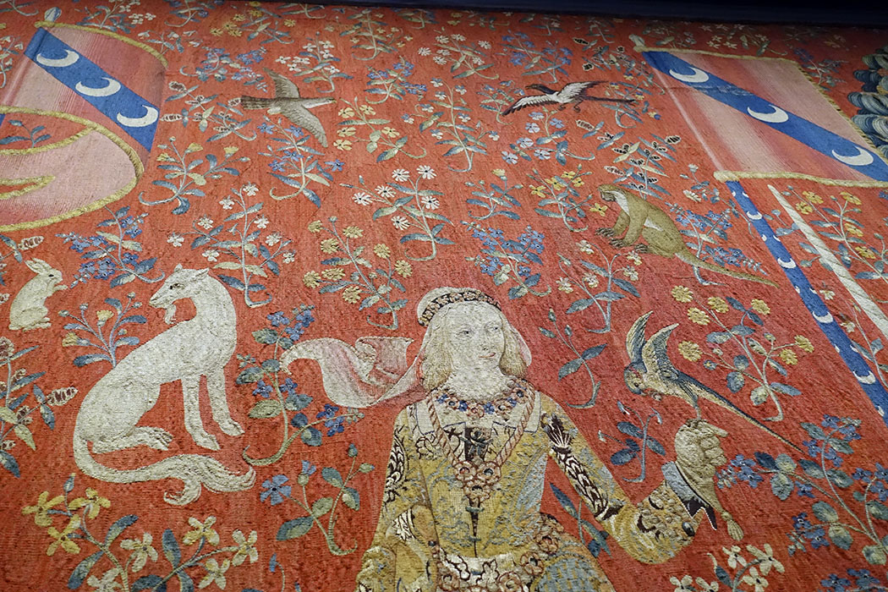
https://rebeccamezoff.com/blog/2019/8/5/visiting-the-lady-and-the-unicorn

Slide 17
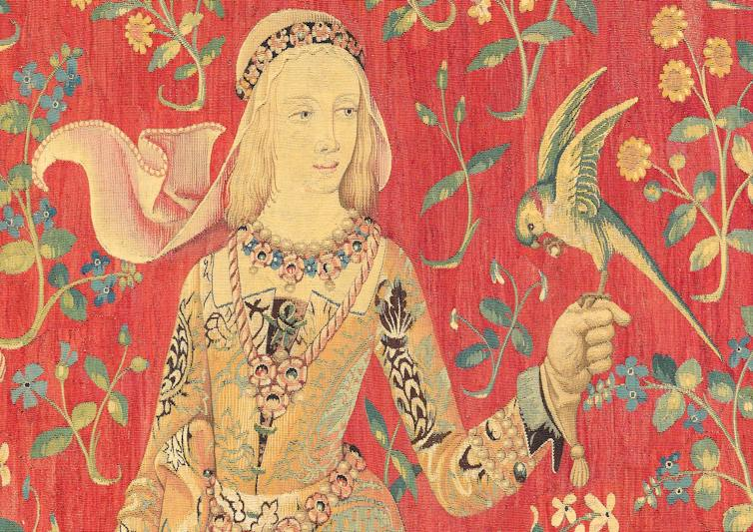
https://www.fleurdelystapestries.com.au/symbolism-of-the-lady-and-the-unicorn-tapestries/

Slide 18
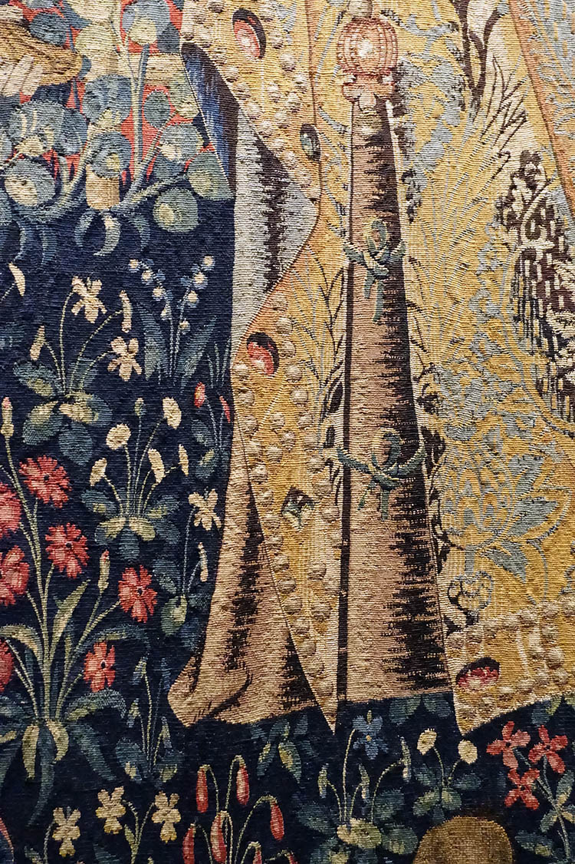
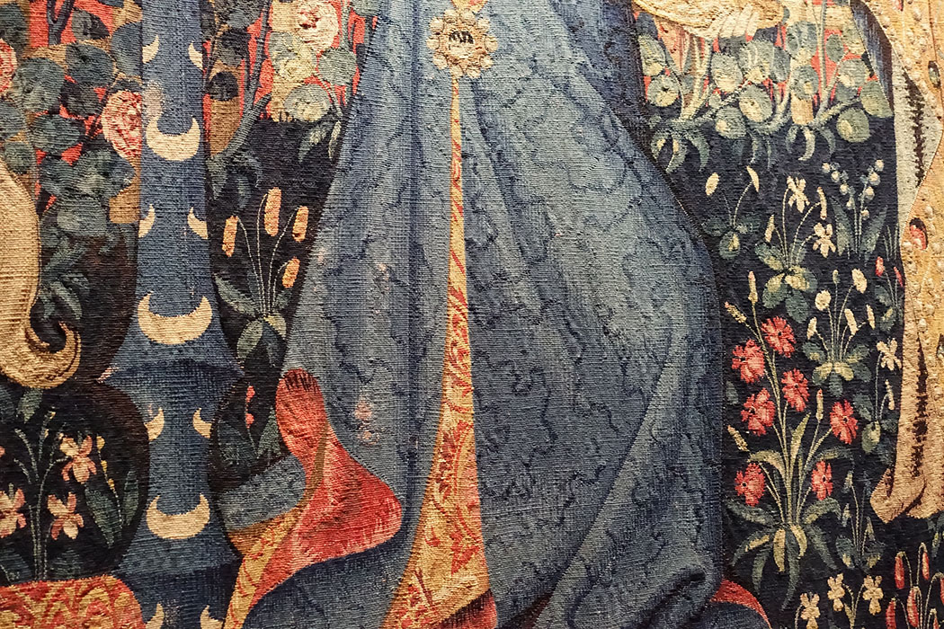
https://rebeccamezoff.com/blog/2019/8/5/visiting-the-lady-and-the-unicorn

Slide 19
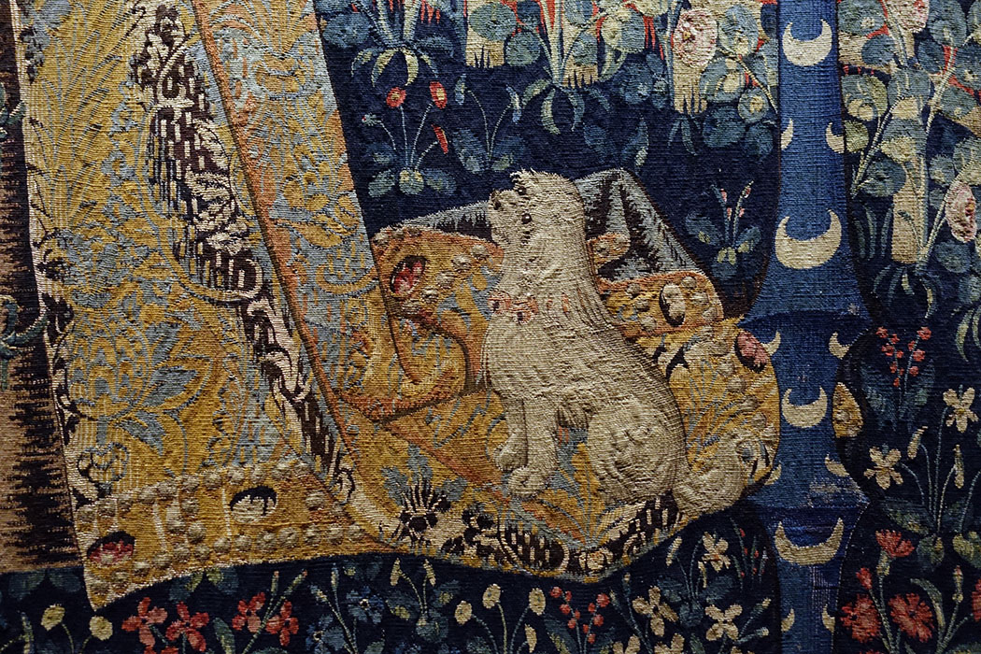
https://rebeccamezoff.com/blog/2019/8/5/visiting-the-lady-and-the-unicorn

Slide 20
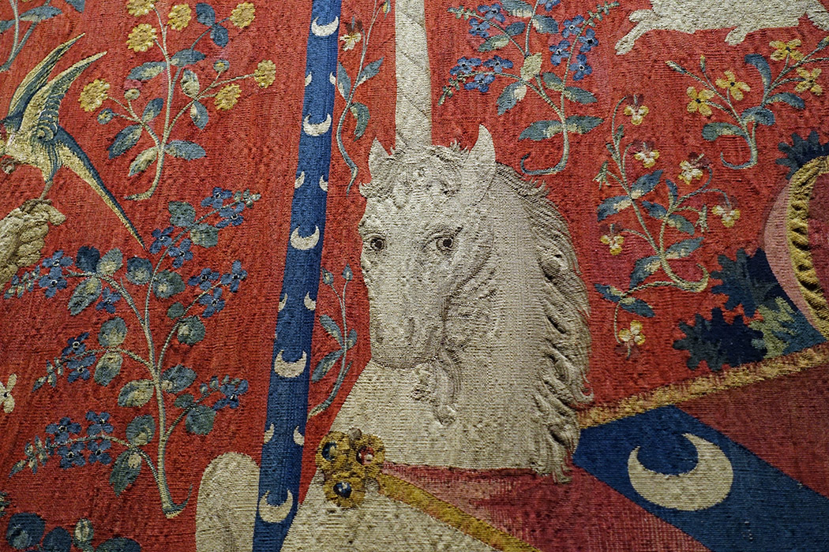
https://rebeccamezoff.com/blog/2019/8/5/visiting-the-lady-and-the-unicorn

Slide 21
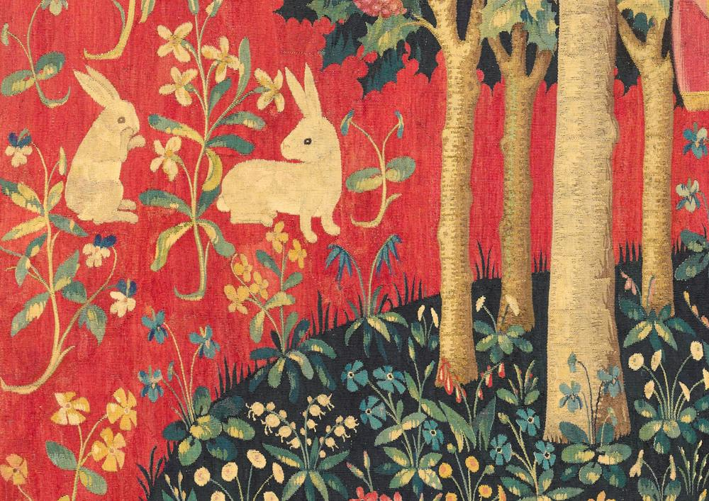
https://images.theconversation.com/files/205024/original/file-20180206-14104-19mms7i.jpg?ixlib=rb-1.1.0&q=45&auto=format&w=1000&fit=clip

Slide 22
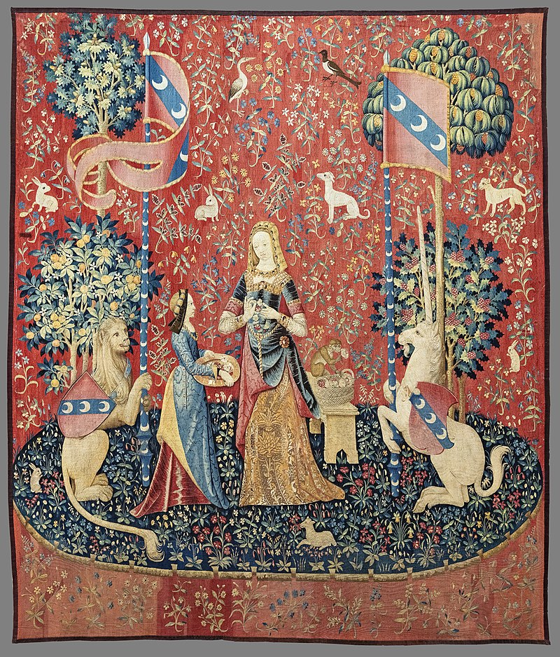
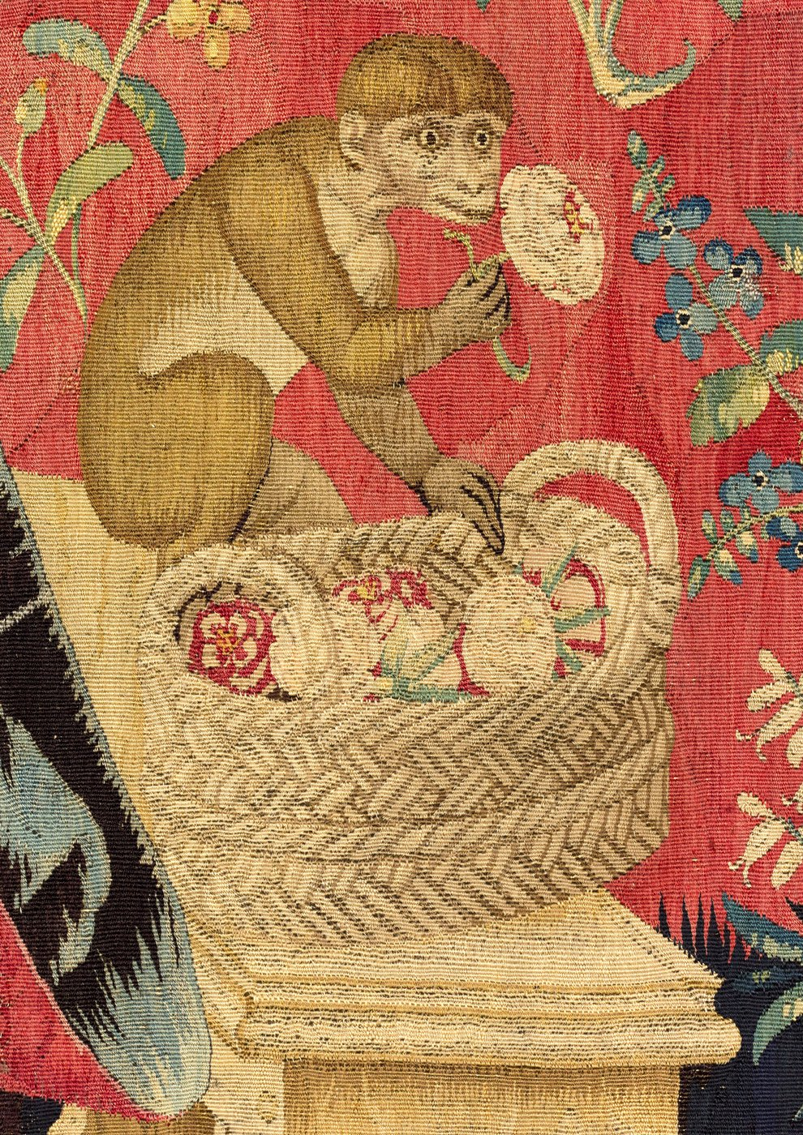
Smell, circa 1500, wool and silk tapestry, 3.67 ×3.22 m, Musée de Cluny, Paris, France https://en.wikipedia.org/wiki/The_Lady_and_the_Unicorn#/media/File:(Toulouse)_Le_Go%C3%BBt_(La_Dame_%C3%A0_la_licorne)_-_Mus%C3%A9e_de_Cluny_Paris.jpg https://www.artgallery.nsw.gov.au/artboards/theladyandtheunicorn/item/pyroo9/

Slide 23
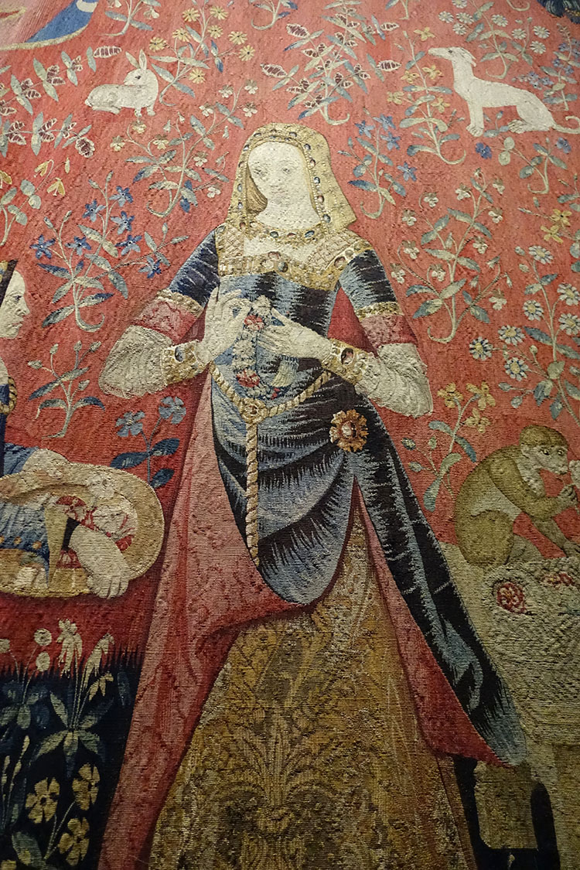
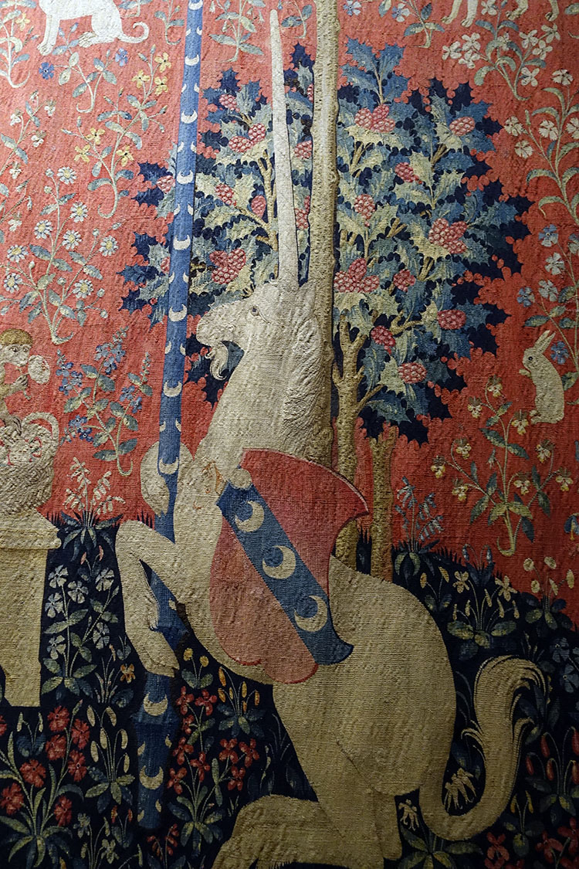
https://rebeccamezoff.com/blog/2019/8/5/visiting-the-lady-and-the-unicorn

Slide 24
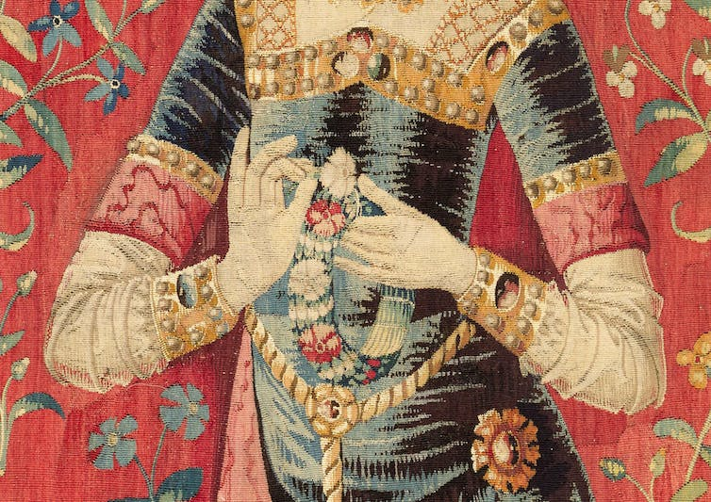
https://www.fleurdelystapestries.com.au/symbolism-of-the-lady-and-the-unicorn-tapestries/

Slide 25
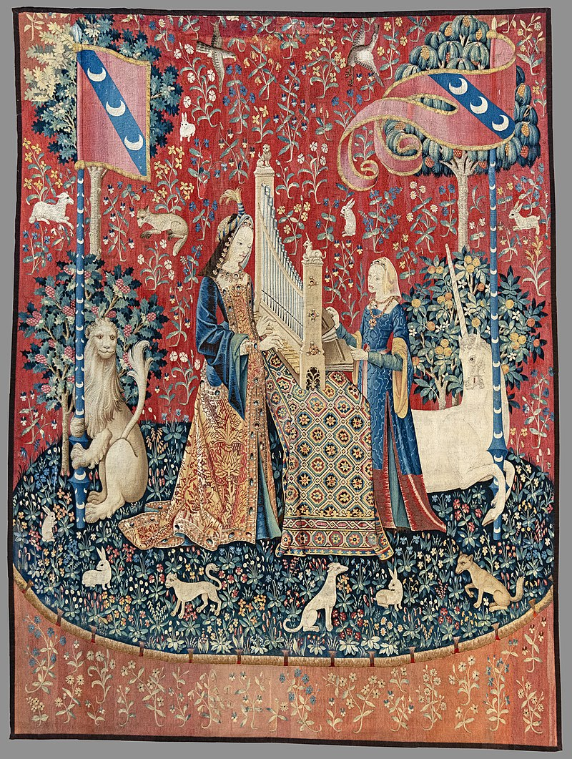
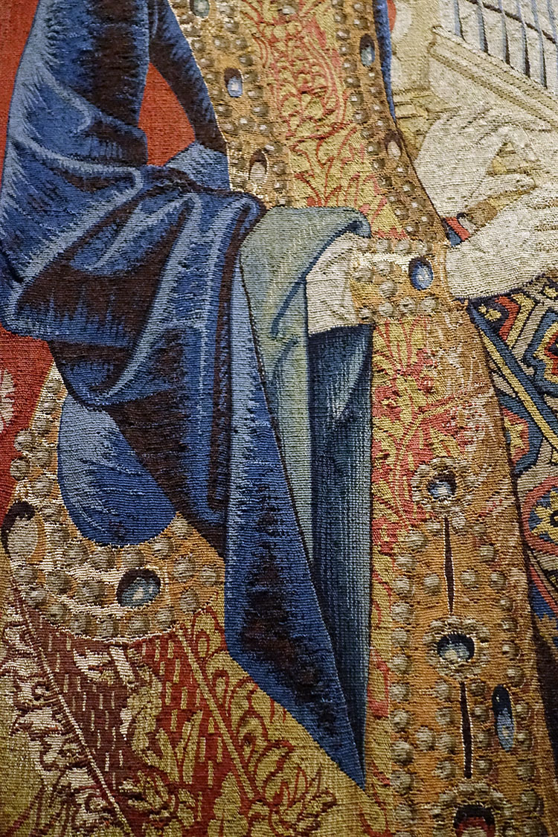
Hearing, circa 1500, wool and silk tapestry, 3.70 ×2.90 m, Musée de Cluny, Paris, France https://rebeccamezoff.com/blog/2019/8/5/visiting-the-lady-and-the-unicorn https://en.wikipedia.org/wiki/The_Lady_and_the_Unicorn#/media/File:(Toulouse)_L'Ou%C3%AFe_(La_Dame_%C3%A0_la_licorne)_-_Mus%C3%A9e_de_Cluny_Paris.jpg

Slide 26
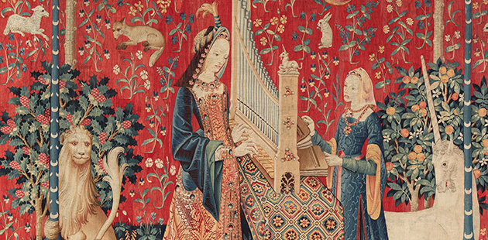
https://artsreview.com.au/the-lady-and-the-unicorn/

Slide 27
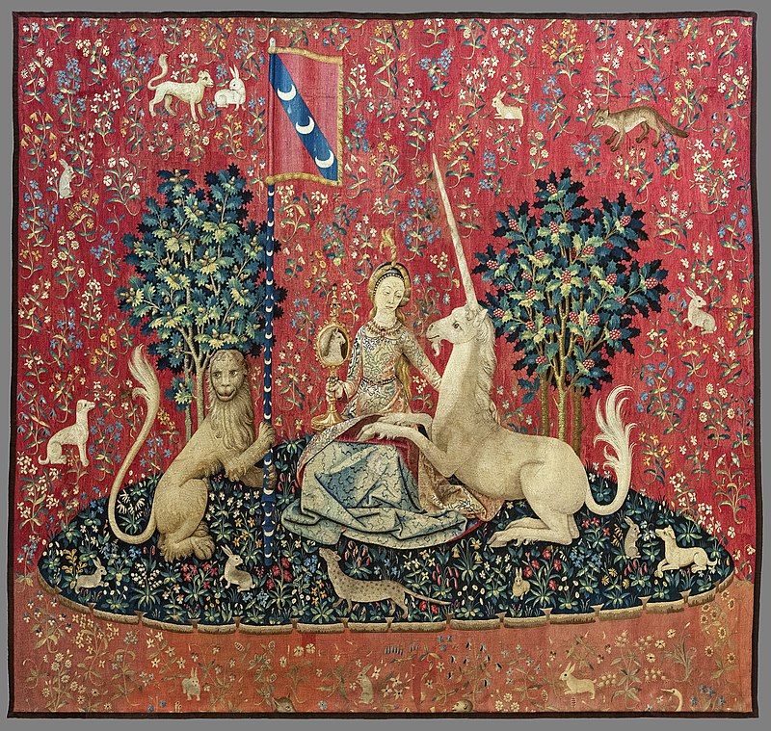
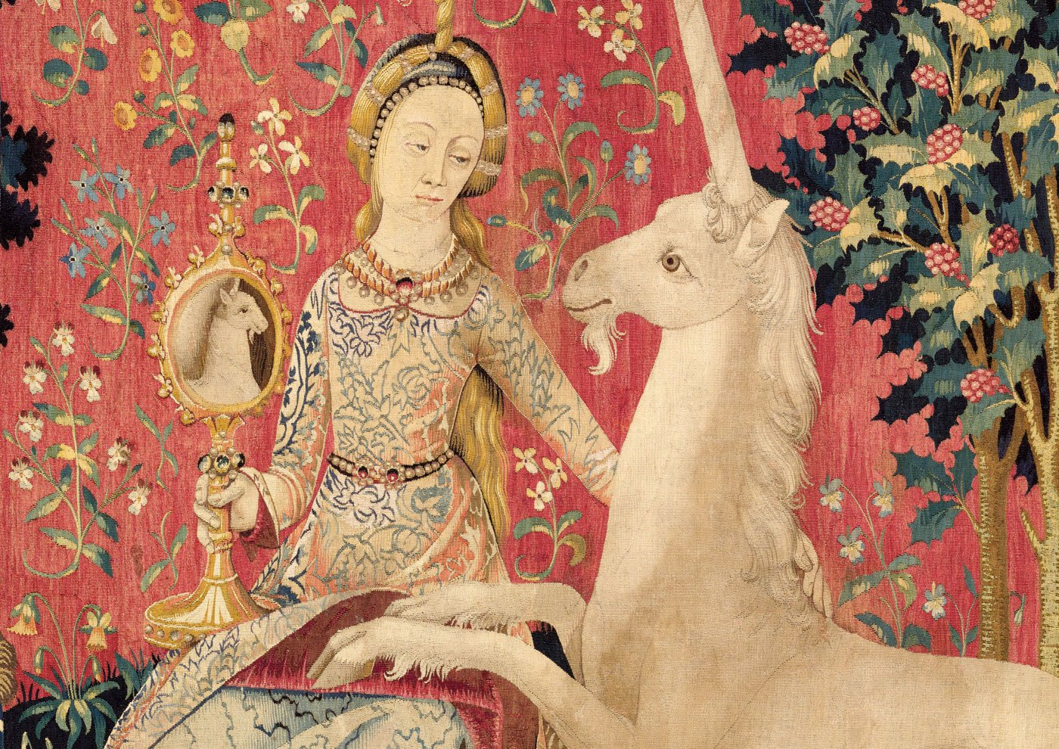
Sight, circa 1500, wool and silk tapestry, 3.10 ×3.30m, Musée de Cluny, Paris, France https://en.wikipedia.org/wiki/The_Lady_and_the_Unicorn#/media/File:(Toulouse)_Le_Vue_(La_Dame_%C3%A0_la_licorne)_-_Mus%C3%A9e_de_Cluny_Paris.jpg https://www.artgallery.nsw.gov.au/artboards/theladyandtheunicorn/

Slide 28
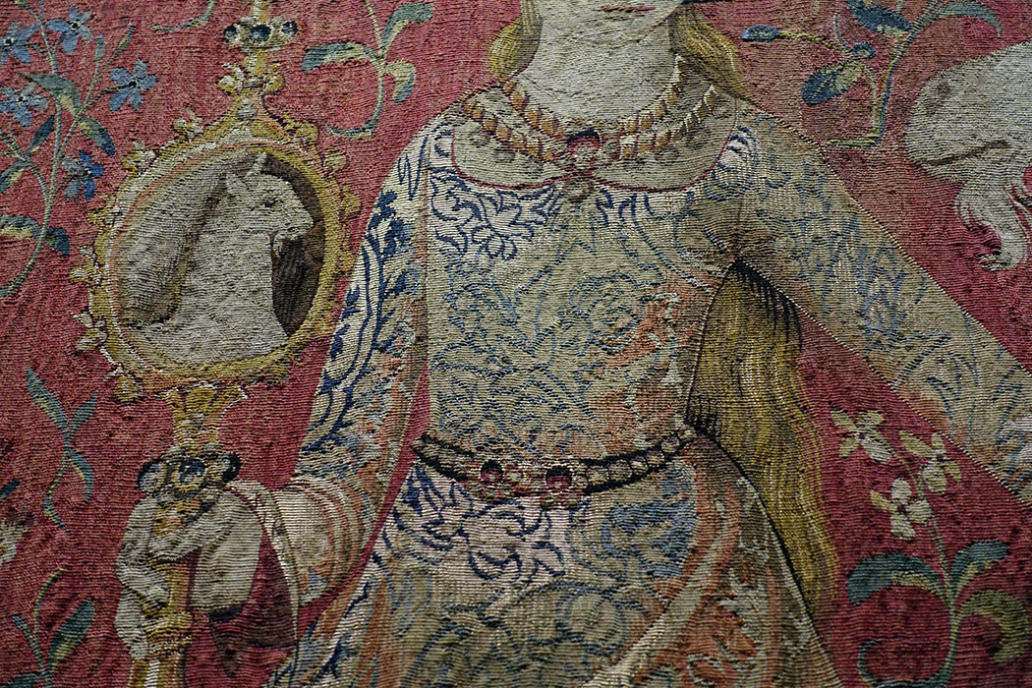
https://rebeccamezoff.com/blog/2019/8/5/visiting-the-lady-and-the-unicorn

Slide 29
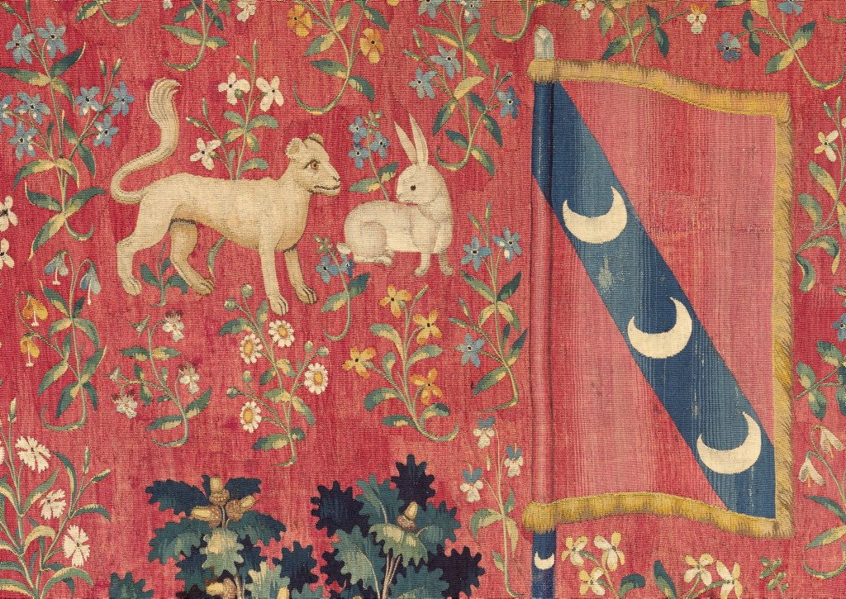
https://www.artgallery.nsw.gov.au/artboards/theladyandtheunicorn/who-were-they-made-for/item/uyem15/

Slide 30
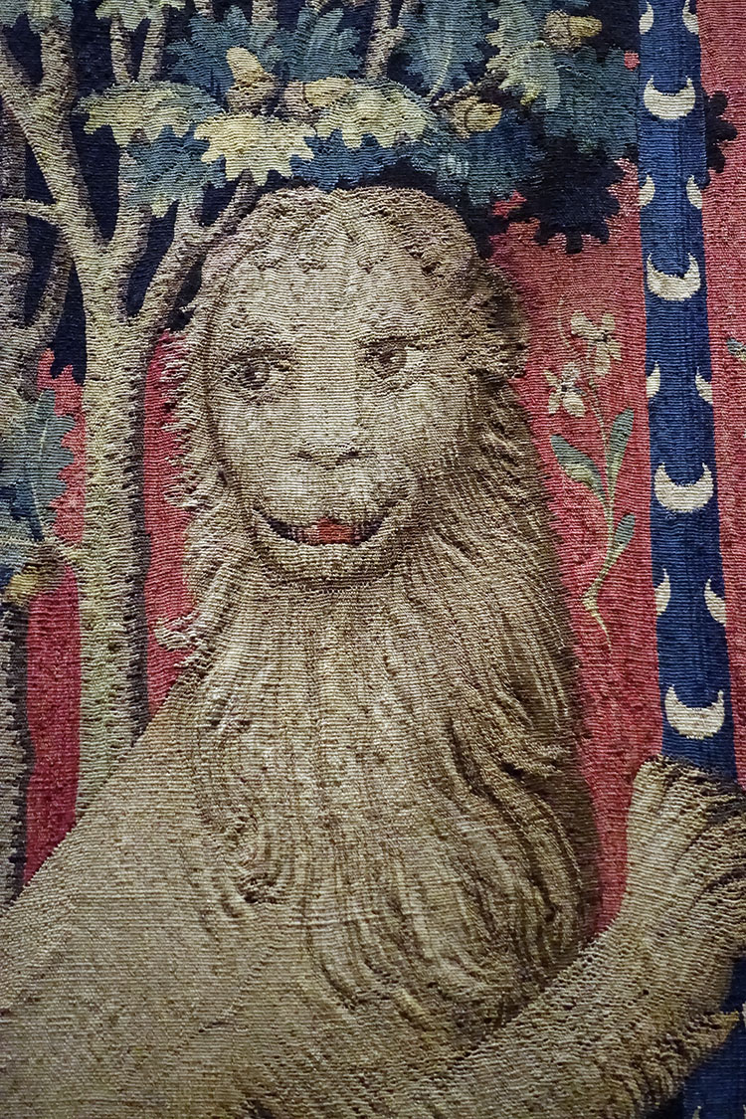
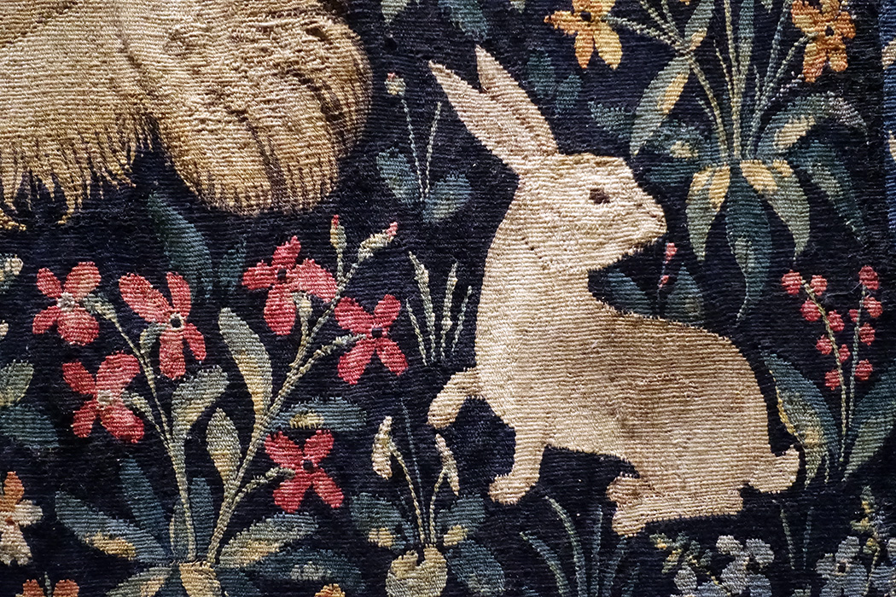
https://rebeccamezoff.com/blog/2019/8/5/visiting-the-lady-and-the-unicorn

Slide 31
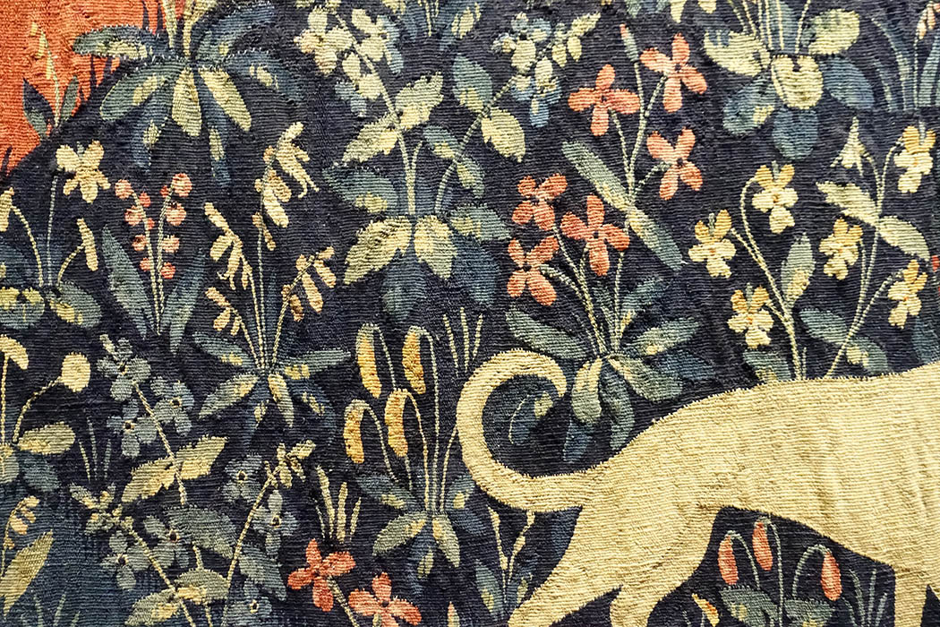
https://rebeccamezoff.com/blog/2019/8/5/visiting-the-lady-and-the-unicorn

Slide 32
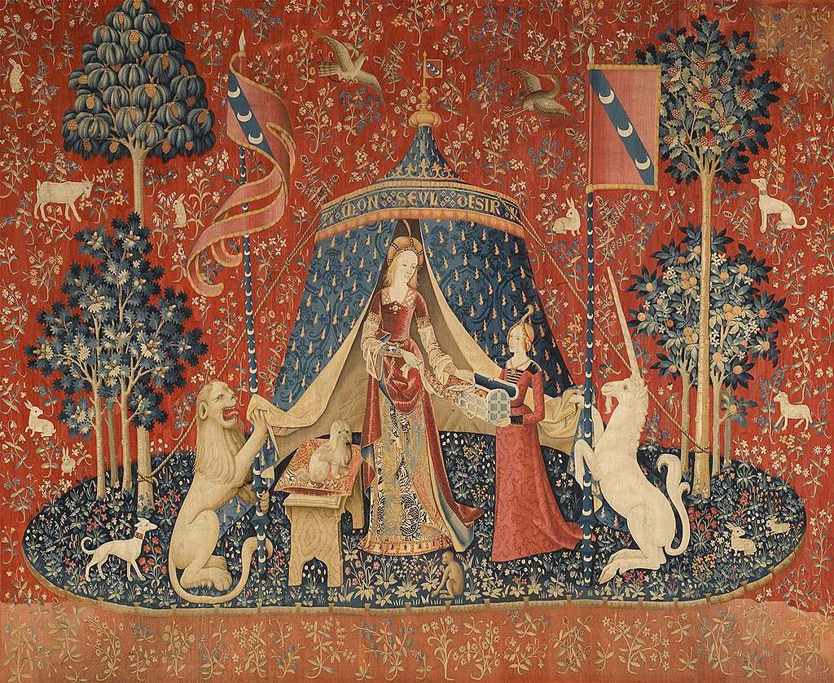
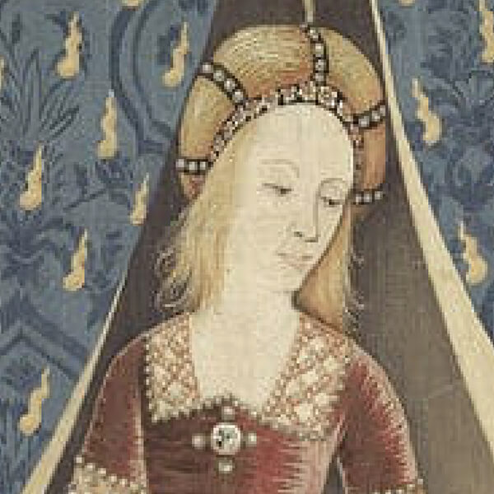
À Mon SeulDésir, circa 1500, wool and silk tapestry, 3.80 m ×4.64 m, Musée de Cluny, Paris, France https://en.wikipedia.org/wiki/The_Lady_and_the_Unicorn#/media/File:The_Lady_and_the_unicorn_Desire.jpg http://www.ladyandtheunicorn.com/

Slide 33
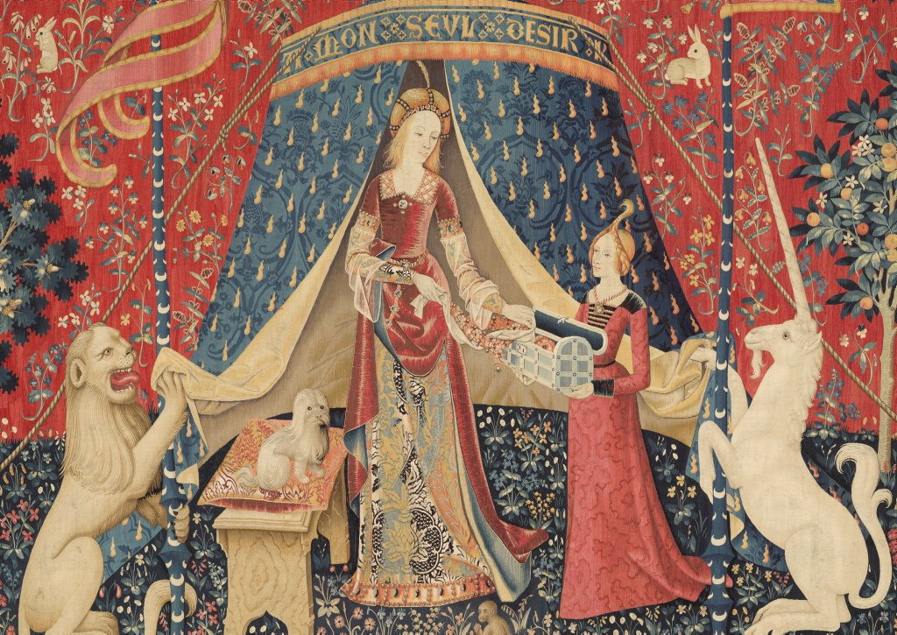
https://www.artgallery.nsw.gov.au/artboards/theladyandtheunicorn/who-were-they-made-for/item/qebj98/

Slide 34
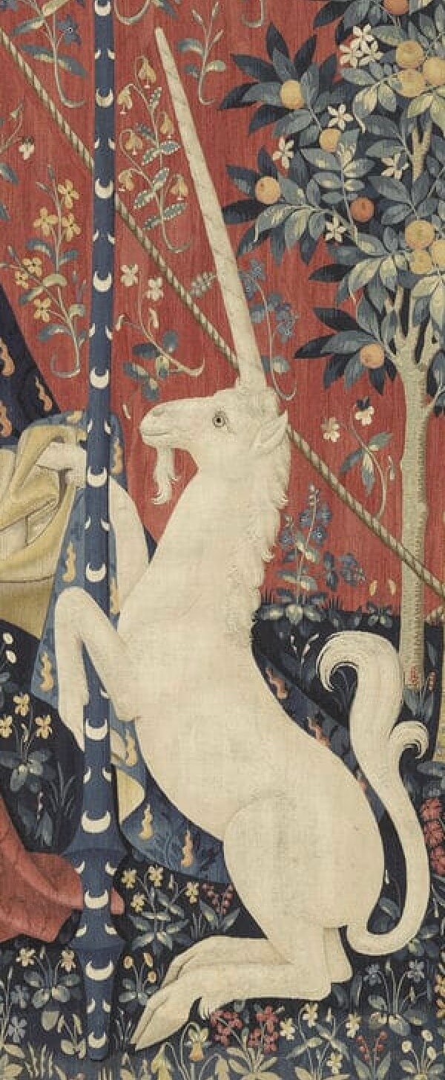
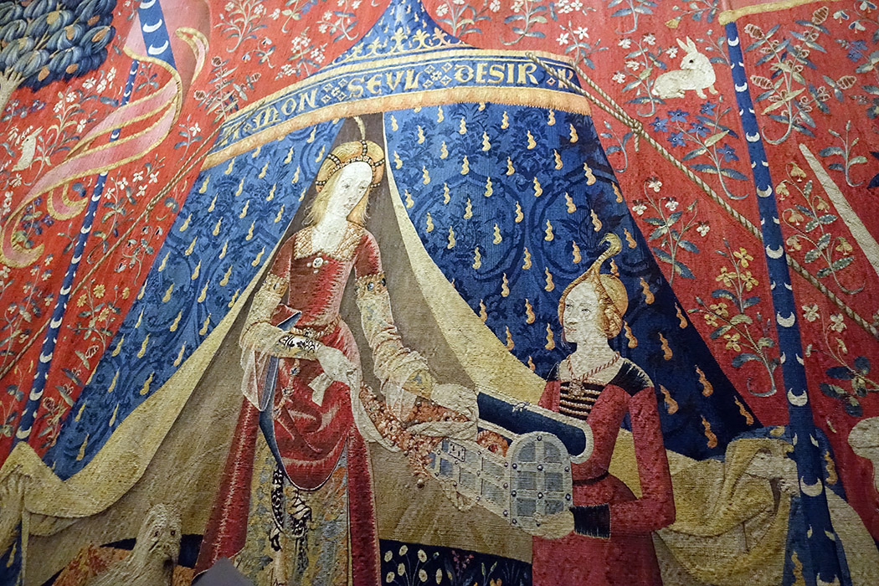
https://rebeccamezoff.com/blog/2019/8/5/visiting-the-lady-and-the-unicorn http://www.ladyandtheunicorn.com/

Slide 35
The End

