Slide 1
George Derville Rowlandson
1861-1918

Slide 2
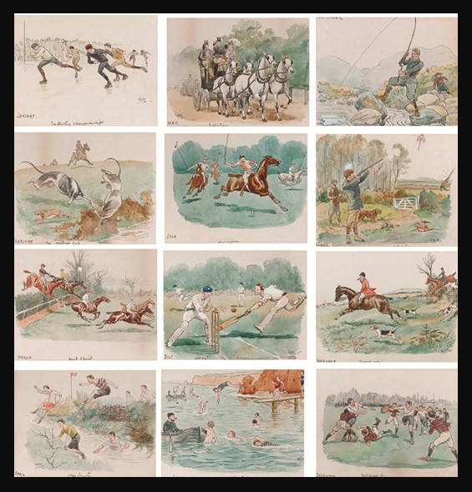
Every Month, a different Sporting Event, unknown date, pen & ink and w/c on paper, 11.4 x 14.9 cm, Private Collection https://www.christies.com/en/lot/lot-4210691

Slide 3
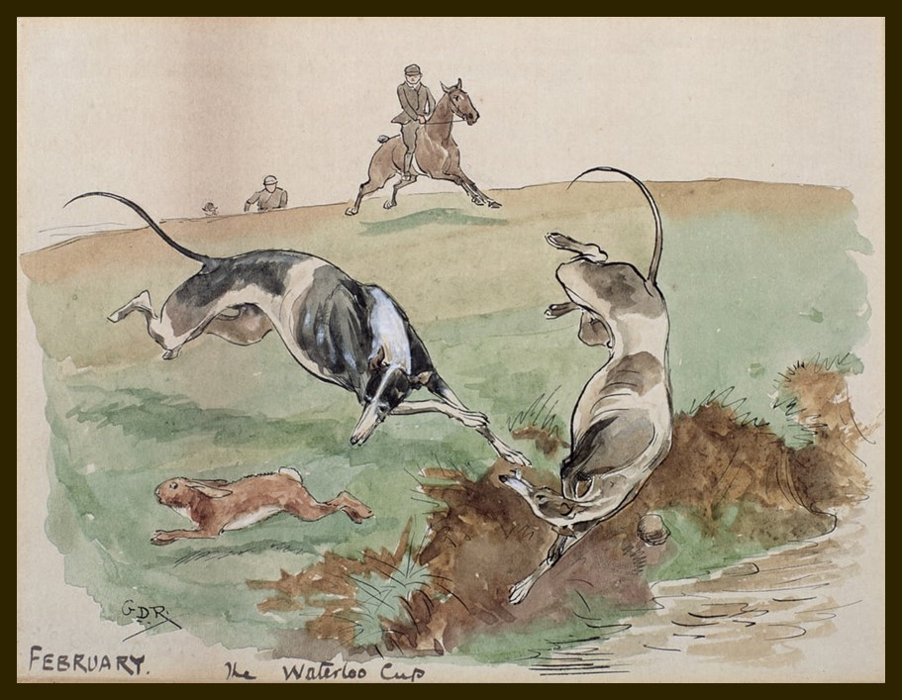
The Month of February: Coursing, the Waterloo Cup, unknown date, pen & ink and w/c on paper, Private Collection https://www.bridgemanimages.com/en/rowlandson/the-month-of-february-coursing-pen-ink-and-w-c-on-paper/pen-and-ink-and-watercolour-on-paper/asset/213301

Slide 4
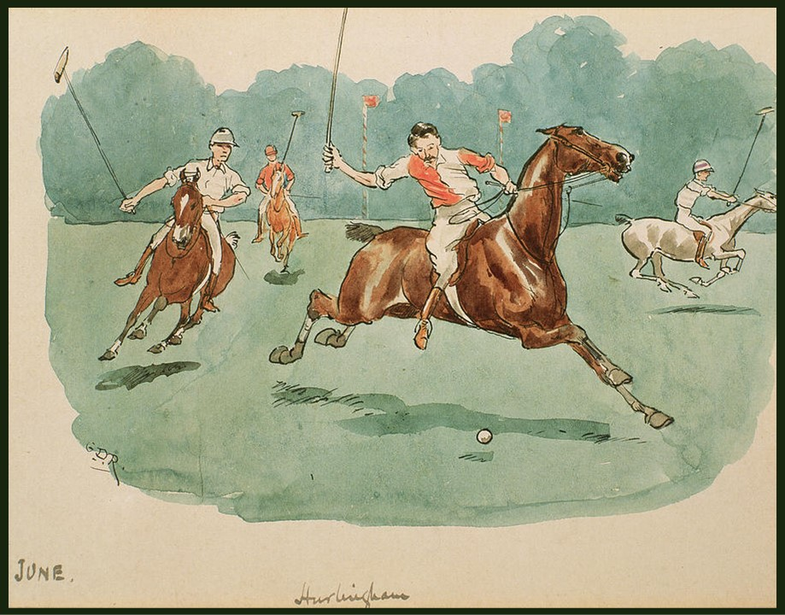
The Month of June: Hurlingham, unknown date, pen & ink and w/c on paper, Private Collection https://www.bridgemanimages.com/en/rowlandson/the-month-of-february-coursing-pen-ink-and-w-c-on-paper/pen-and-ink-and-watercolour-on-paper/asset/213301

Slide 5
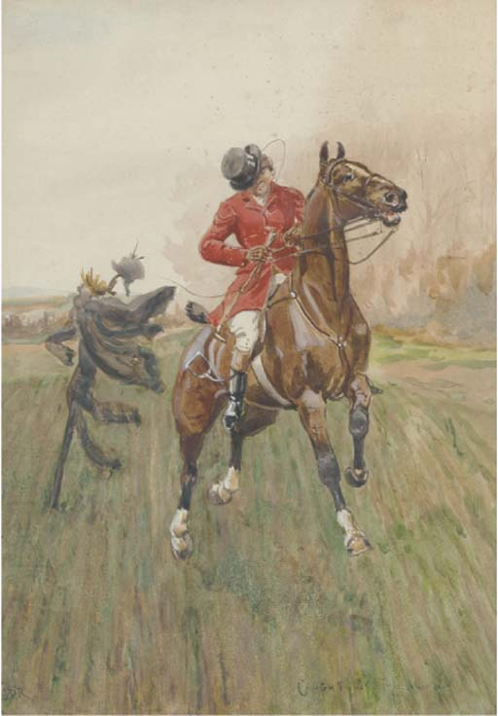
Caught by the wind, watercolour with bodycolour, 36.5 x 25.7 cm, Private Collection https://www.christies.com/en/lot/lot-4608652

Slide 6
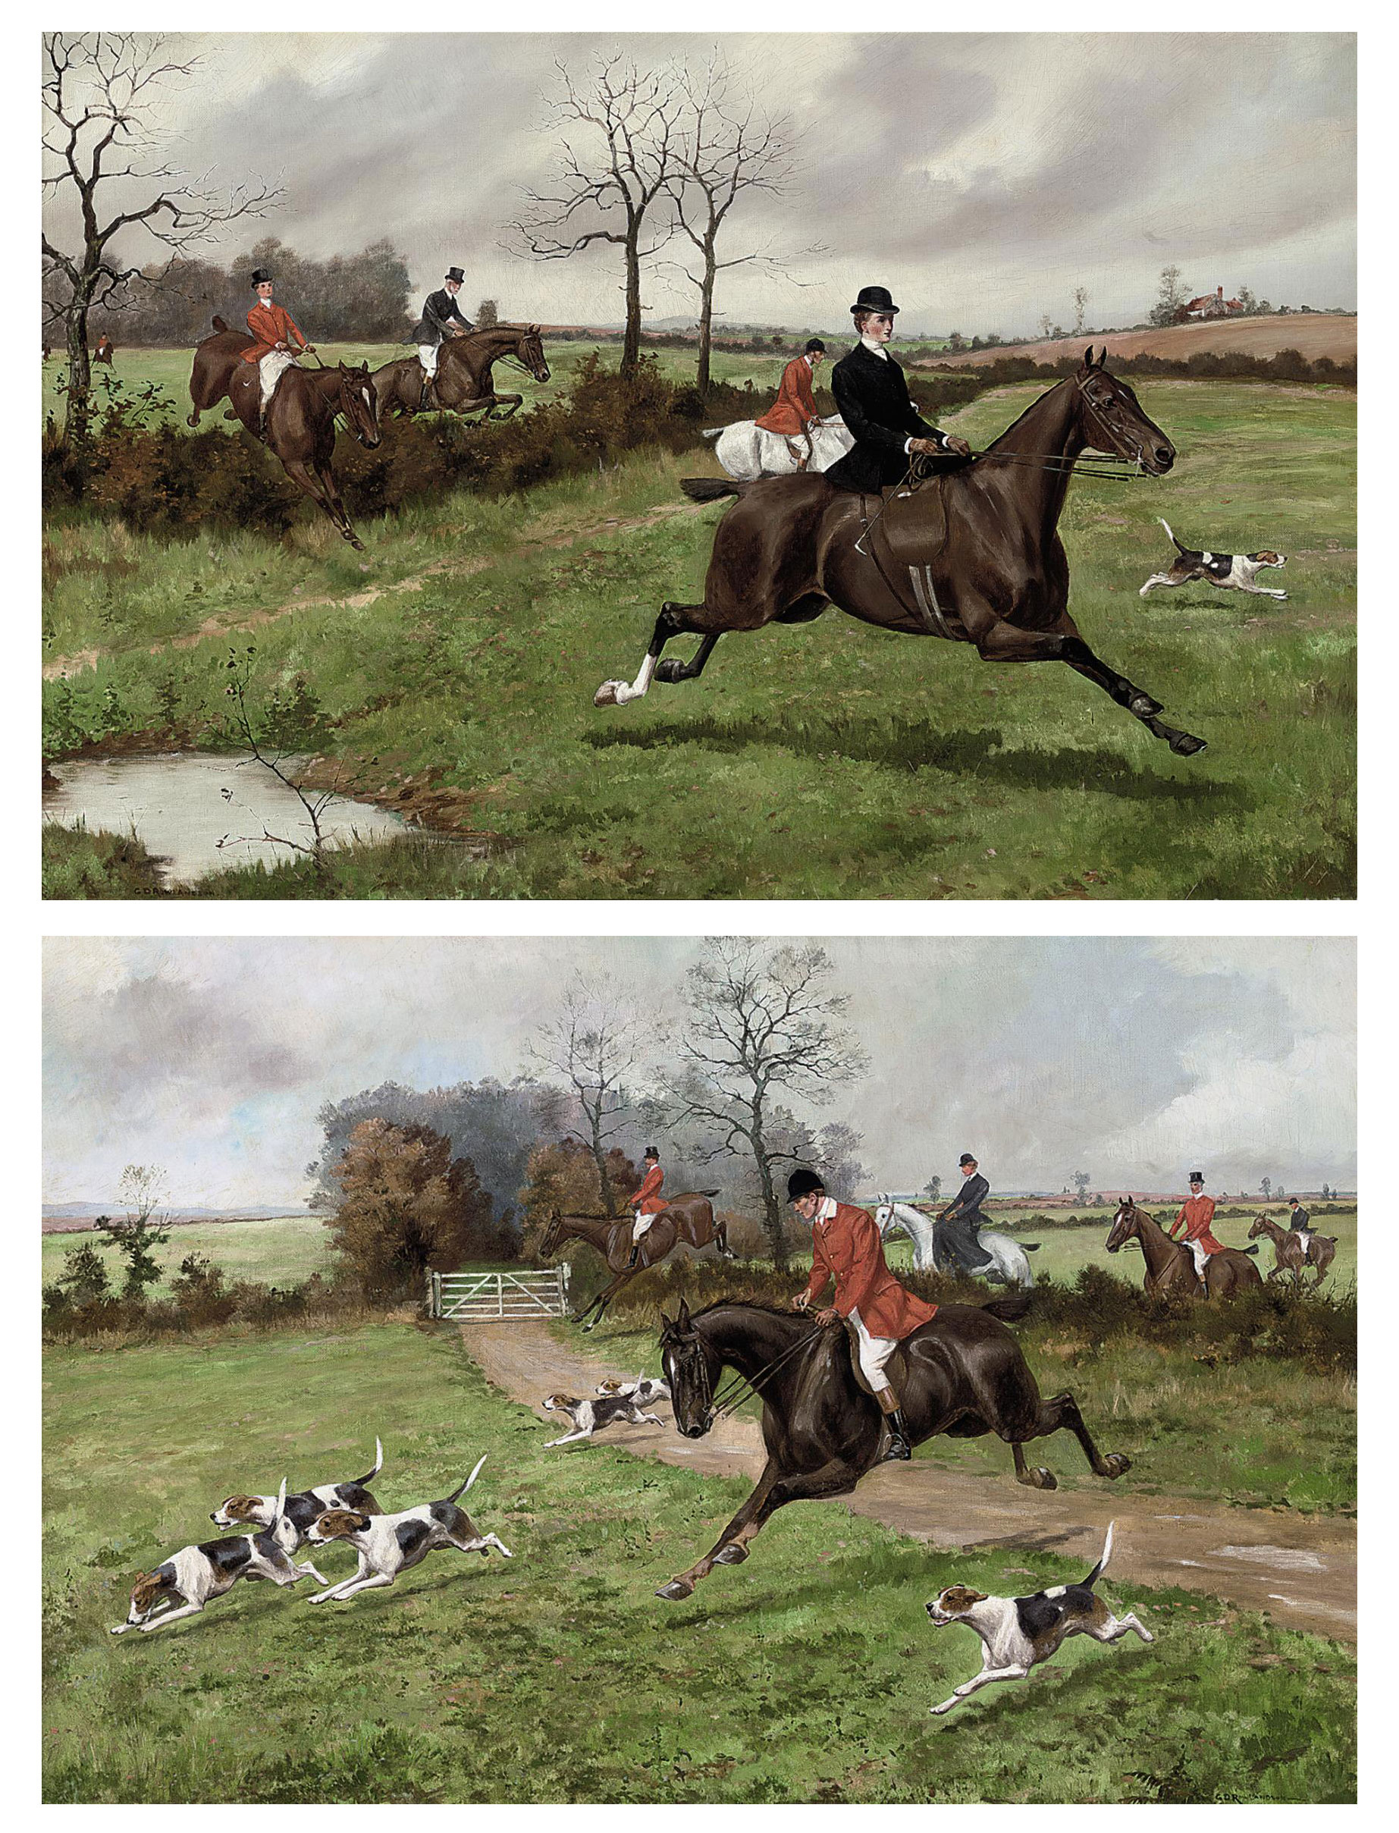
On the scent; and Clearing the hedge, oil on canvas, 61.2 x 91.8 cm, Private Collection https://www.christies.com/en/lot/lot-5367506

Slide 7
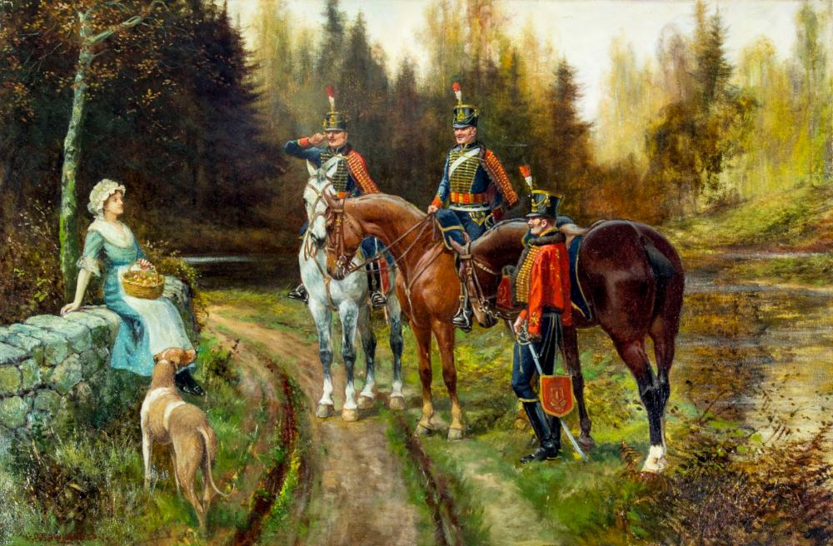
Three Soldiers and Peasant Woma, oil on canvas, Private Collection https://www.invaluable.com/artist/rowlandson-george-derville-e0i2gaza58/sold-at-auction-prices/

Slide 8
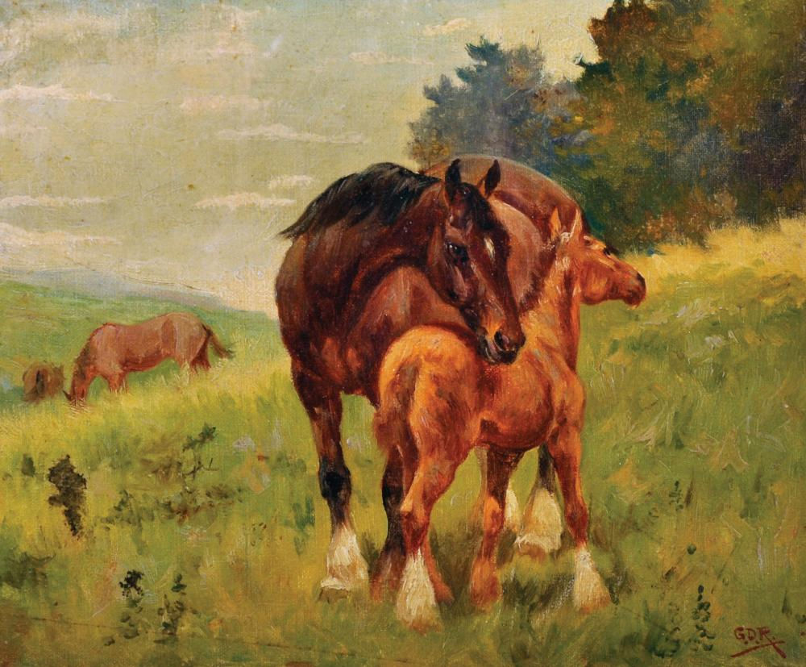
A Mare and Foal in a Field, Oil on Artist's Board, Private Collection https://www.invaluable.com/auction-lot/george-derville-rowlandson-1861-1930-british-a-ma-337-c-4994332aea

Slide 9
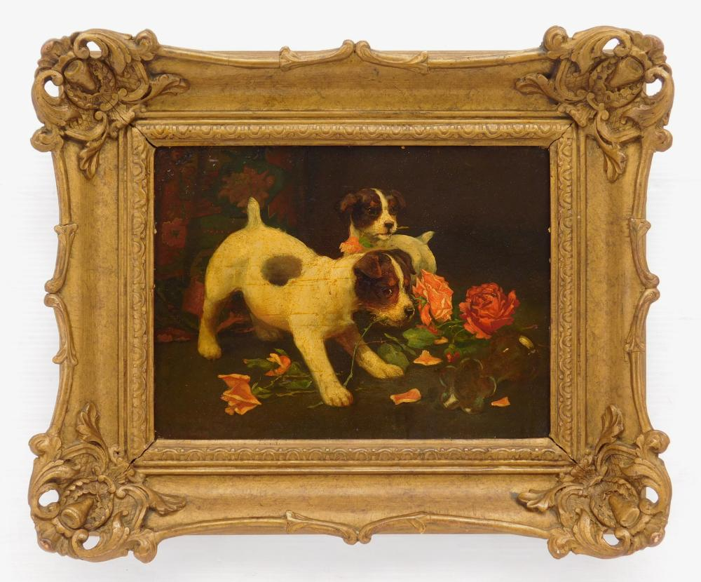
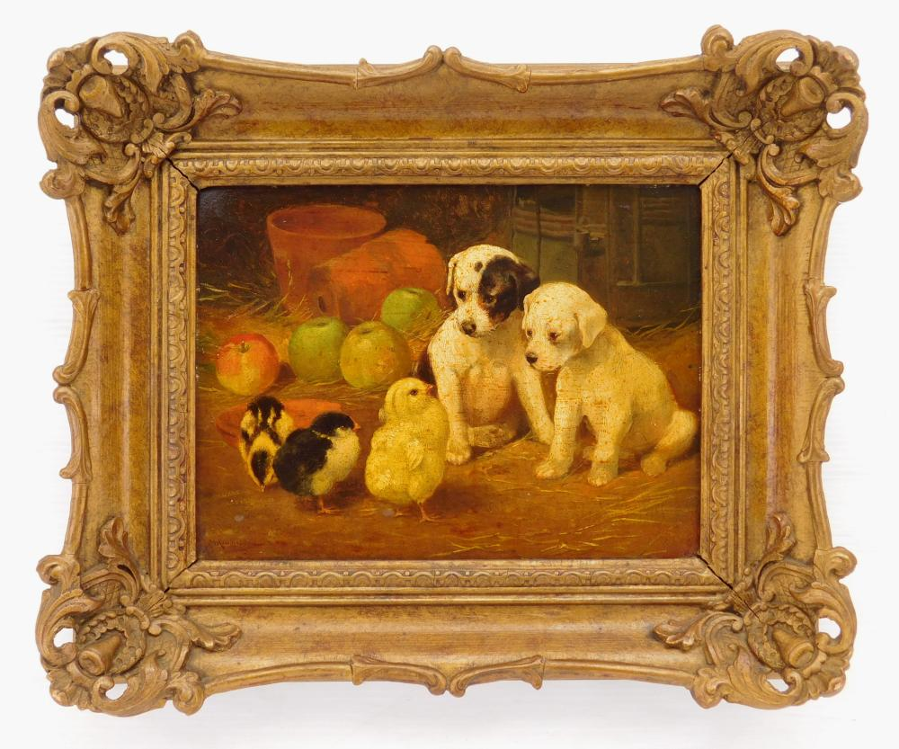
Puppies and Roses, oil on panel, Private Collection
Puppies and Chicks, oil on panel, Private Collection https://www.invaluable.com/artist/rowlandson-george-derville-e0i2gaza58/sold-at-auction-prices/

Slide 10
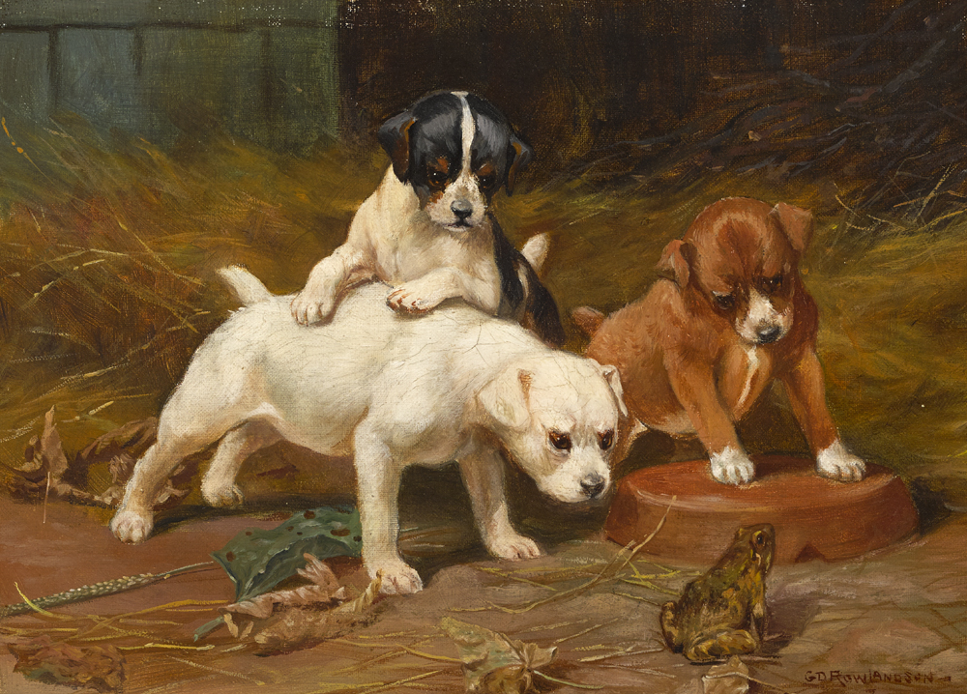
Puppies examining a Frog, oil on canvas, 25.40 x 35.56 cm, Private Collection https://www.whytes.ie/art/puppies-examining-a-frog-and-puppies-tearing-a-letter-a-pair/162735/

Slide 11
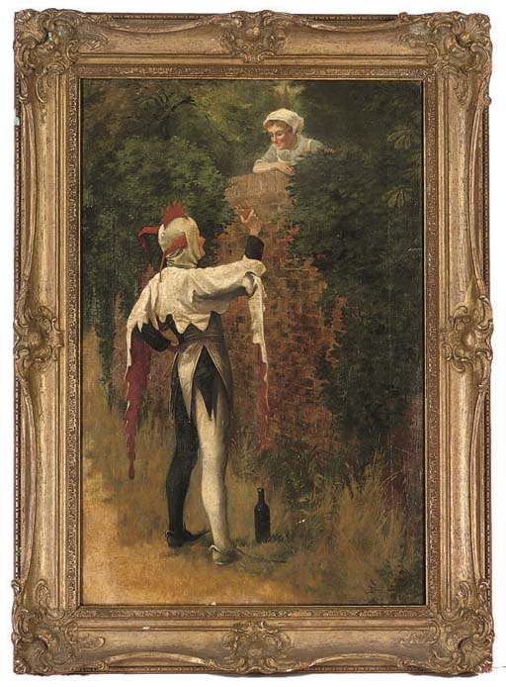
A jest and a flirt, oil on canvas, 61 x 40.6 cm, Private Collection https://www.christies.com/en/lot/lot-4946142

Slide 12
The End

