Slide 1
The Middle Ages - Western Europe
Monuments of the Gothic Period

Slide 2
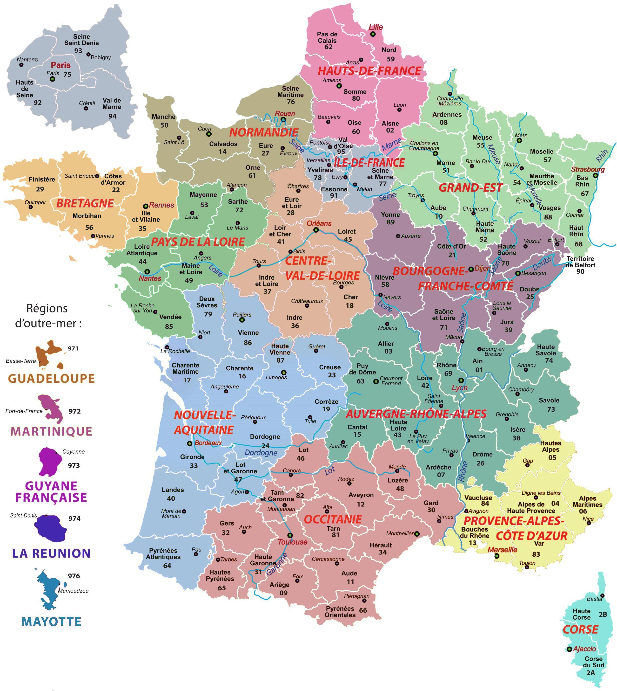
1. Abbey of Saint Denis, 1135-1140, Suburb of Paris, Gothic
1. Notre Dame, 1163-1260, Île de la Cité, Paris. Gothic
2. Rheims Cathedral, c. 1211, region of Grand Est, Gothic
3. Chartres Cathedral, 1194-1250, Centre-Val de Loire region, Gothic
4. Rouen Cathedral, consecrated on the 1st of October, 1063, in the presence of William the Conqueror, Gothic
1. Sainte-Chapelle, consecrated on 26th of April, 1248, Paris, Gothic
5. Abbey of Senanque, c. 1148, Provence, Romnesque/Gothic
6. Palais des Papes, 14th century, Avignon,, Gothic https://maps-france.com/maps-france-regions/political-map-of-france
4
2
1
3
5
6

Slide 3
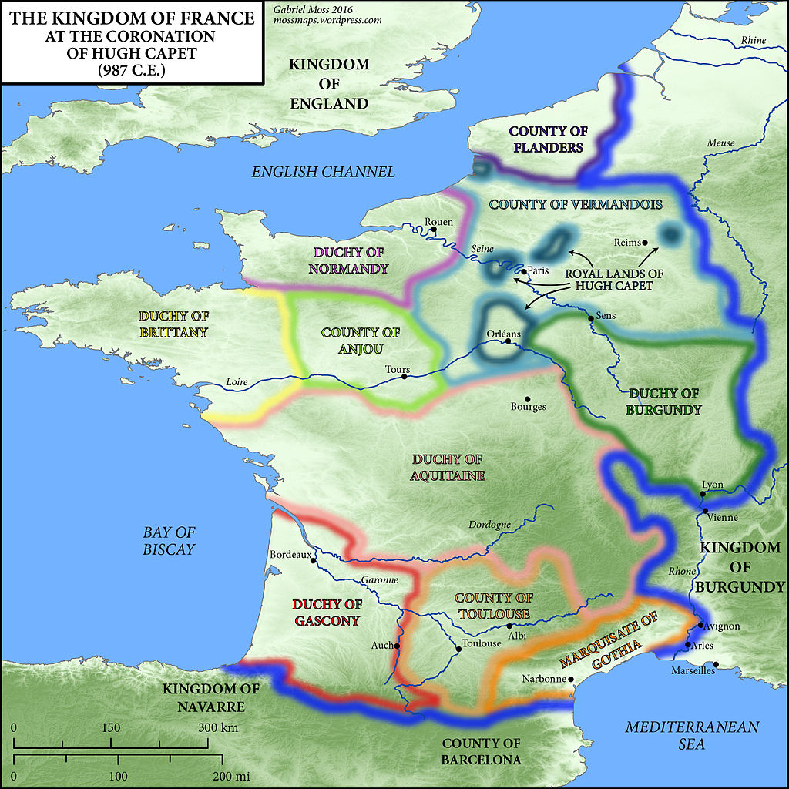
France c. 1000
Viking invasion and civil war lead to a severe decline in royal authority. Regional counts now rule as virtually independent princes. https://timemaps.com/history/france-1453ad/

Slide 4
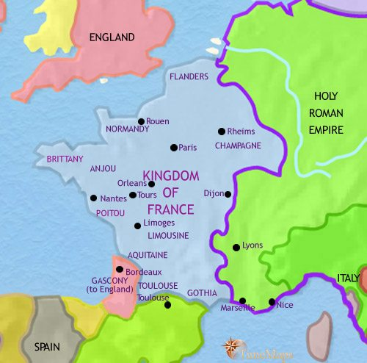
France
1215
Taking advantage of the mistakes of king John, Henry II’s son, he has seized most of John’s French possessions, and brought them under tight royal control. https://timemaps.com/history/france-1215ad/

Slide 5
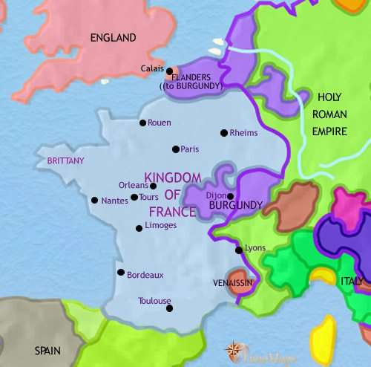
France
1453
Unresolved claims between the French and English kings lead to the Hundred Years War.
By 1453, the French Triumph with the remarkable role played by Joan of Arc, the English only have Calais left to them. https://timemaps.com/history/france-1453ad/

Slide 6
The Middle Ages
Western Europe
The Gothic Period
Mid. 12th to 15th cent.

Slide 7
Gothic Architecture

Slide 8
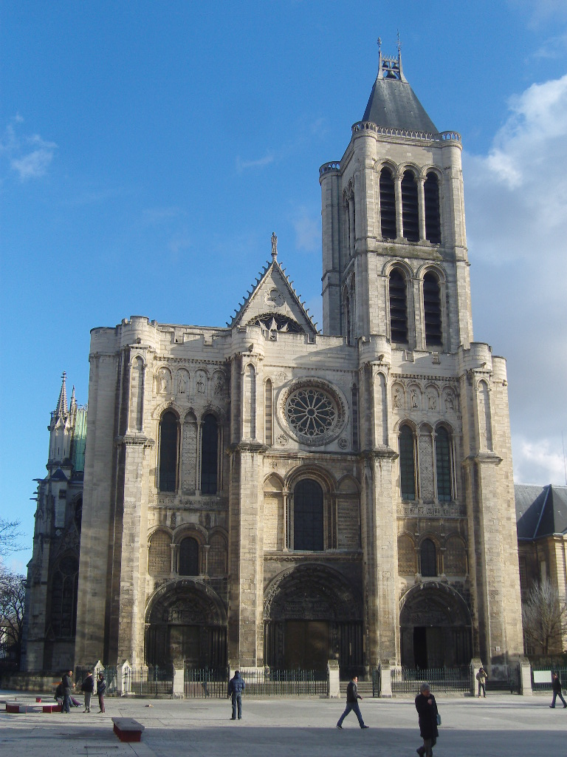
G
Gothic Church Architecture
Gothic architecture is a style of architecture that flourished in Europe during the High and Late Middle Ages. It evolved from Romanesque architecture and was succeeded by Renaissance architecture. Originating in 12th century France and lasting into the 16th century, Gothic architecture was known during the period as Opus Francigenum ("French work") with the term Gothic first appearing during the later part of the Renaissance.
Its characteristics include the
1. pointed arch
2. ribbed vault (which evolved from the joint vaulting of Romanesque architecture)
3. flying buttress.
Gothic architecture is most familiar as the architecture of many of the great cathedrals, abbeys and churches of Europe.
The west front at the Abbey of Saint Denis, 1135-1140, with its three deep portals https://www.historyofinformation.com/detail.php?entryid=3131

Slide 9
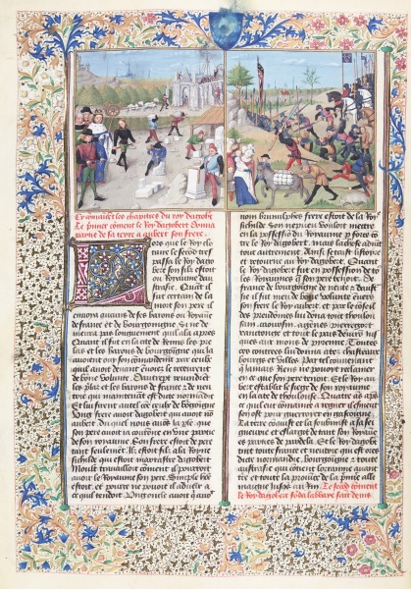
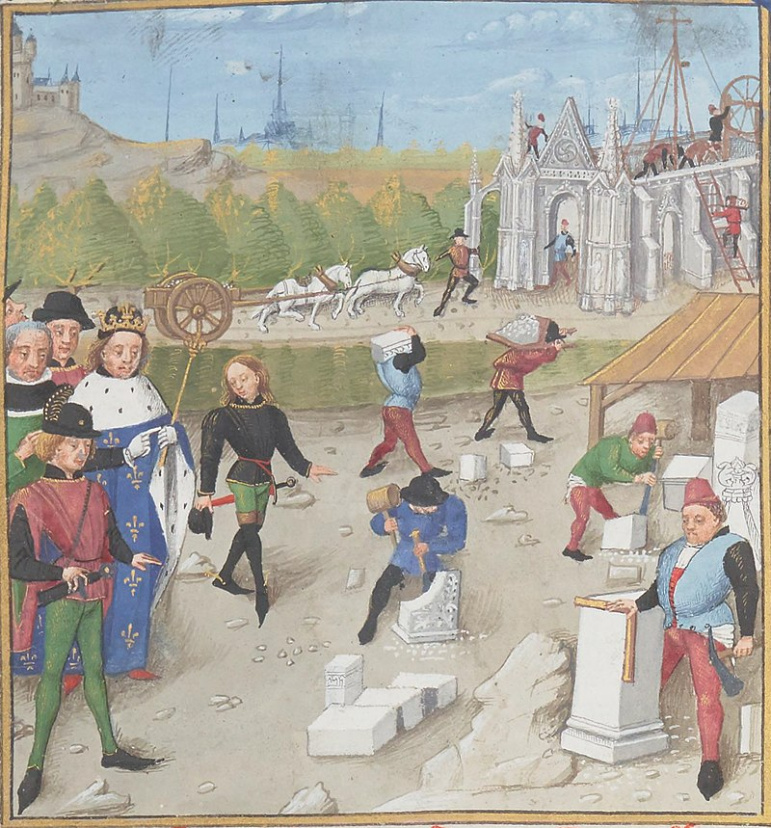
Robinet Testard, c. 1470-1531
Dagobert (7th century King of France) visiting the construction site of Saint-Denis, Les Grandes Chroniques de France (folio 60 v), 1471, Bibliothèque Nationale de France, Paris, France https://en.wikipedia.org/wiki/Basilica_of_Saint-Denis

Slide 10
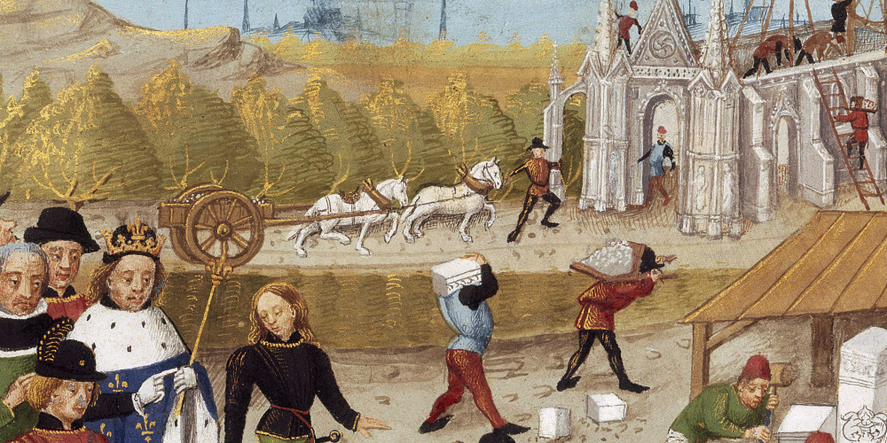
The abbey church was transformed under the impulse of Abbot Sugar in the 12th century https://passerelles.essentiels.bnf.fr/fr/image/97ba231a-d4f3-485c-8056-aeadfa99c9fb-dagobert-visitant-chantier-la-construction-saint-denis-1
"While we join the new chevet to the old facade
The middle of the sanctuary shines in its splendour. Shines in splendor what we unite splendidly,
And the magnificent work that floods a new light, shines,
It is I, Suger, who in my time enlarged this building
It was under my direction that it was done".
Abbé Suger, Inscription engraved in the church of Saint-Denis.

Slide 11
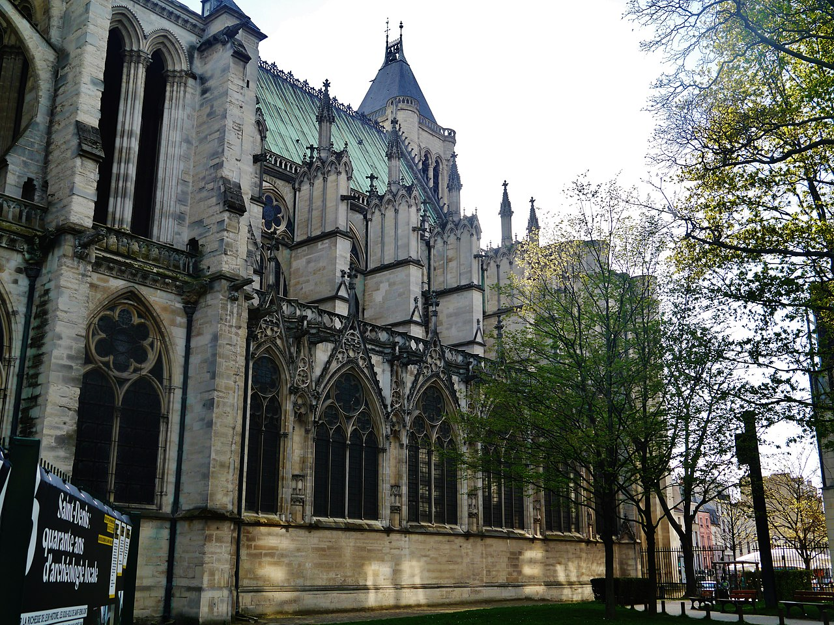
https://en.wikipedia.org/ wiki/Basilica_of_Saint-Denis

Slide 12
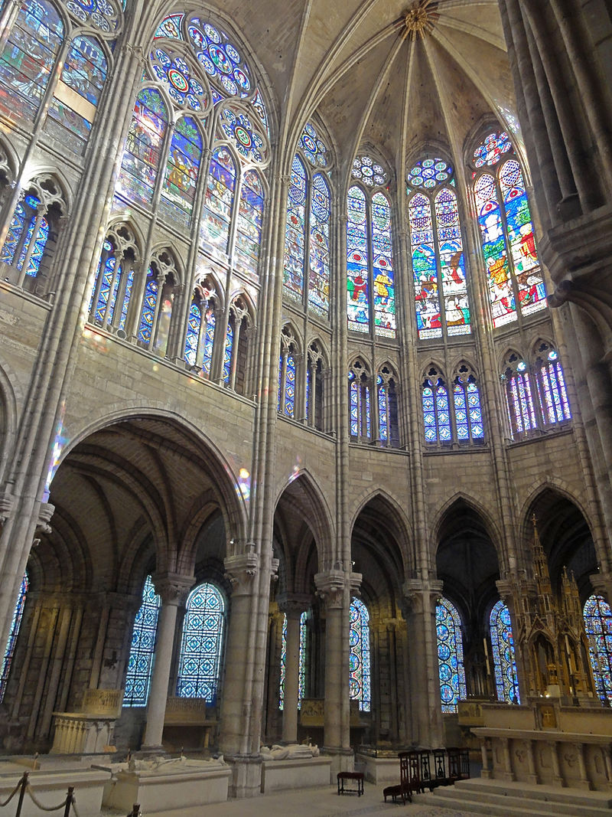
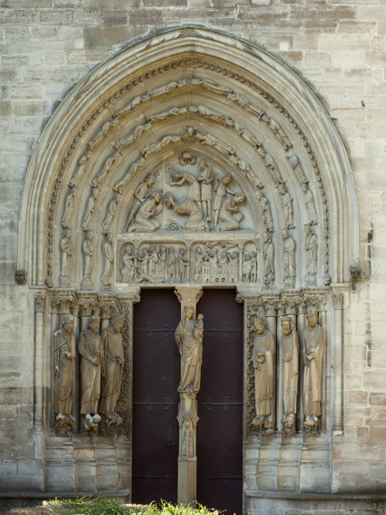
https://en.wikipedia.org/wiki/Basilica_of_Saint-Denis

Slide 13
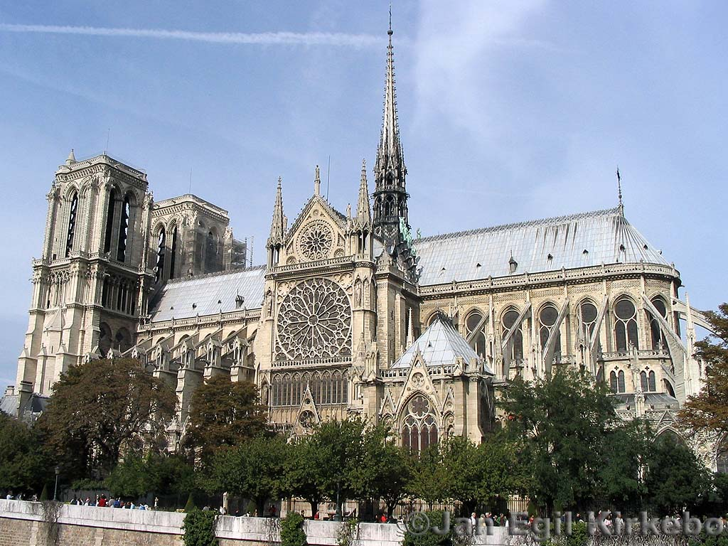
Notre Dame is the medieval Catholic cathedral on the Île de la Cité in Paris. https://commons.wikimedia.org/wiki/File:Notredame_Paris.JPG
The 12th century cathedral is widely considered to be one of the finest examples of French Gothic architecture, and it is among the largest and most well-known church buildings in the world.
Notre-Dame was among the first buildings in the world to use the flying buttress. They were originally designed to support the choir and nave but after the construction began, the thinner walls grew ever higher and stress fractures began to occur as the walls pushed outward. In response, the cathedral's architects built supports around the outside walls, and later additions continued the pattern.
Many small statues were placed around the outside to serve as column supports and water spouts. Among these are the famous gargoyles, designed for water run-off, and chimeras. The statues were originally colored as was most of the exterior. The paint has worn off. The cathedral was essentially complete by 1345. The cathedral as a narrow climb of 387 steps at the top of several spiral staircases; along the climb it is possible to view its most famous bell and a spectacular view across Paris when reaching the top.

Slide 14
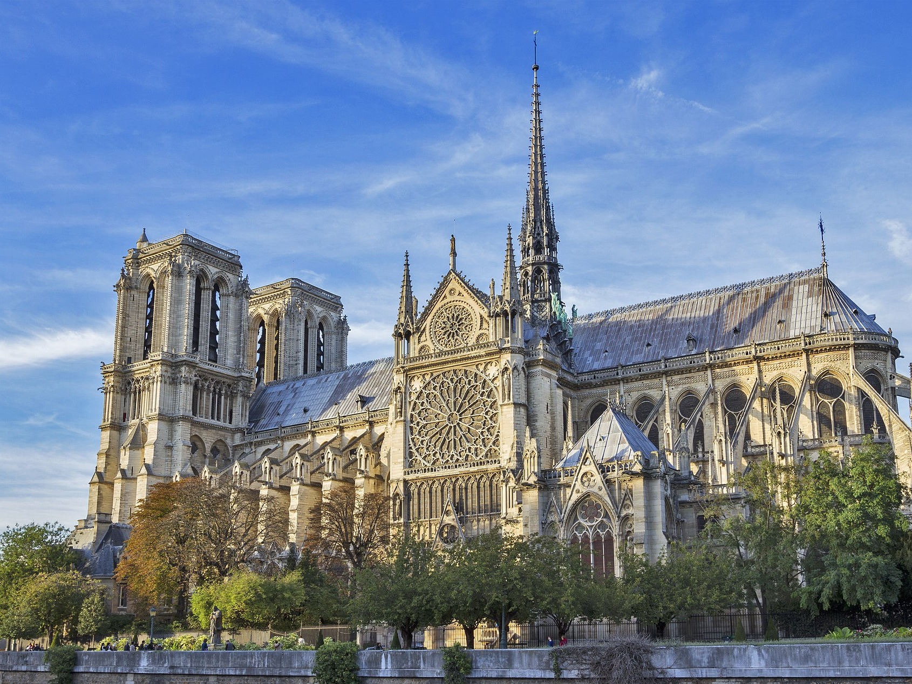
Notre-Dame de Paris
Construction of the cathedral began in 1163 under Bishop Maurice de Sully and was largely completed by 1260 https://en.wikipedia.org/wiki/Notre-Dame_de_Paris

Slide 15
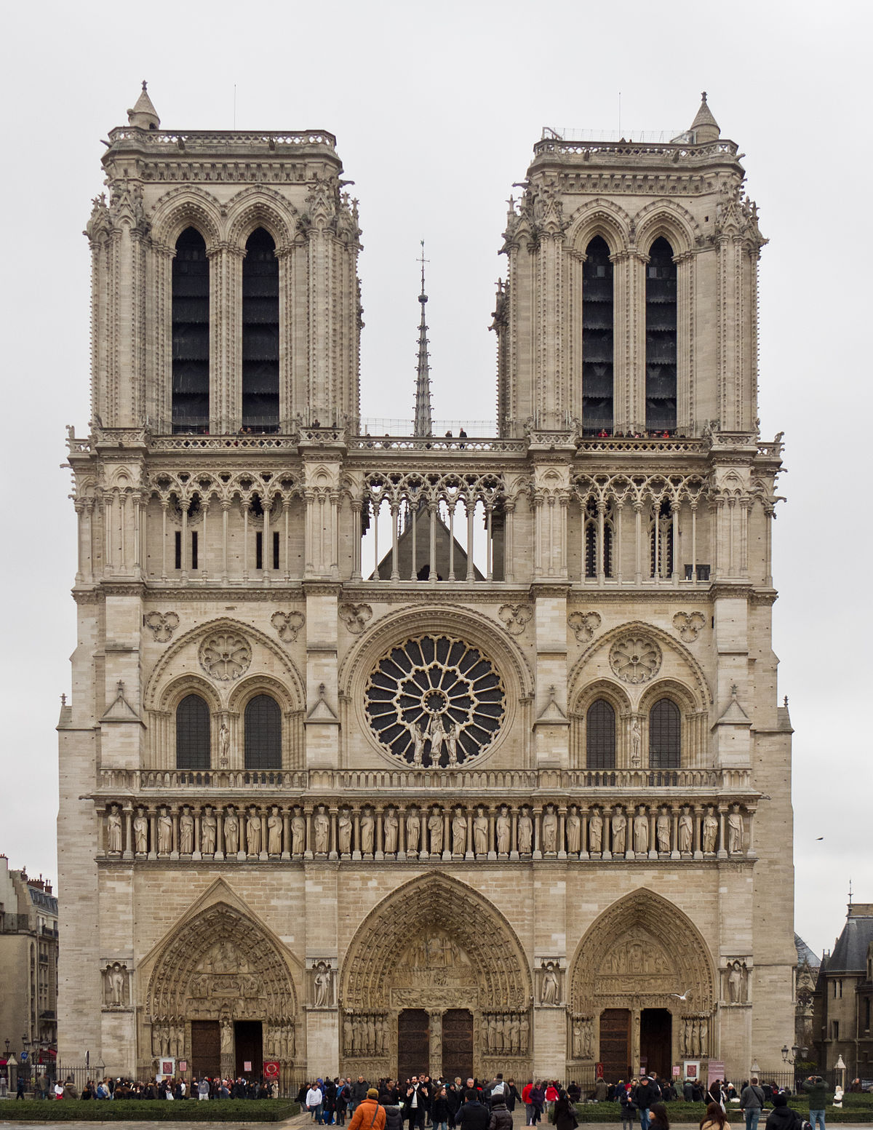
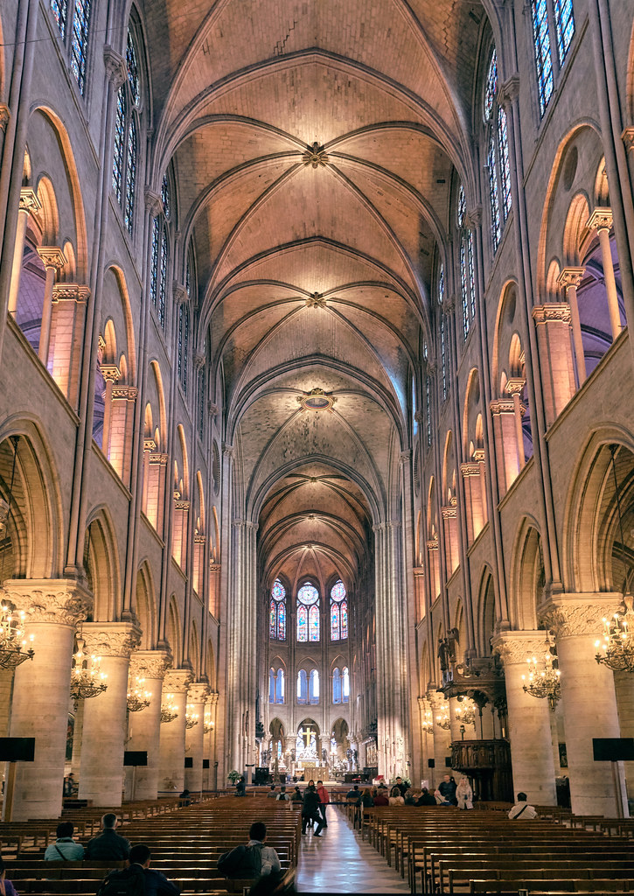
https://el.m.wikipedia.org/wiki/%CE%91%CF%81%CF%87%CE%B5%CE%AF%CE%BF:Cath%C3%A9drale_Notre-Dame_de_Paris_-_12.jpg https://www.flickr.com/photos/pedrosz/27319922577

Slide 16
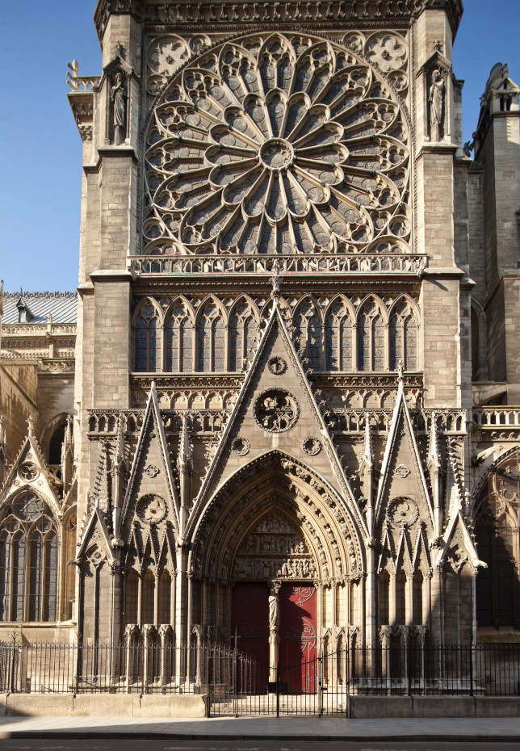
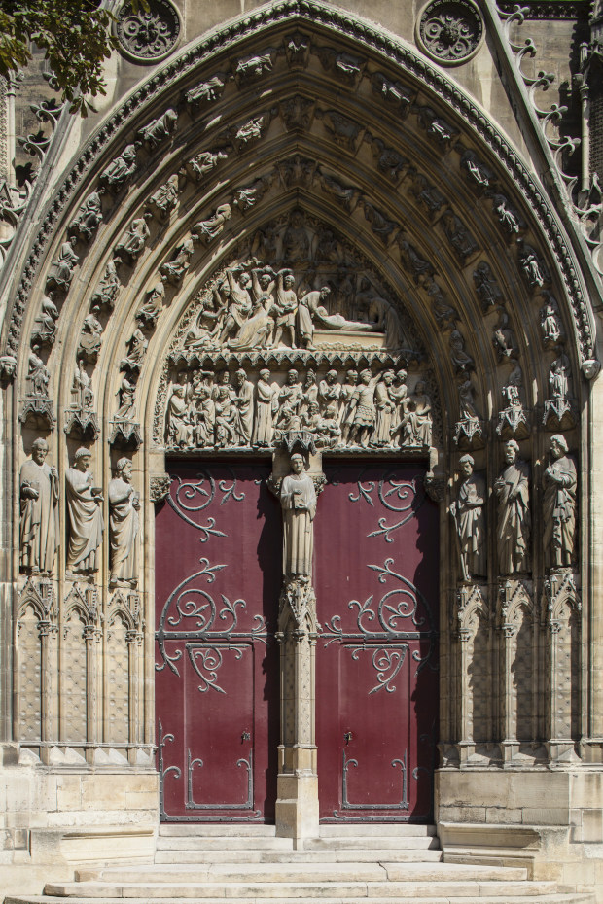
The north facade and the south transept portal of St Stephen, 13th century by Jean de Chelles taken up by Pierre de Montreuil https://www.notredamedeparis.fr/decouvrir/architecture/

Slide 17
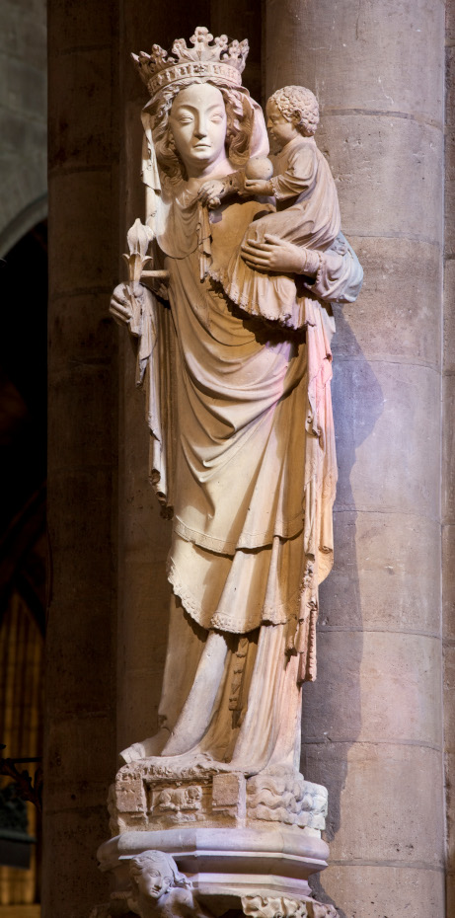
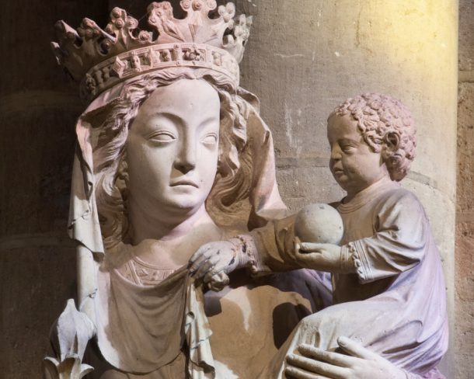
The Madonna and Child sculpture of the 14th century. This statue embodies the image of "Notre Dame de Paris.” https://www.notredamedeparis.fr/decouvrir/sculptures/notre-dame/ https://restorenotredame.org/gallery/virgin-of-the-pillar

Slide 18
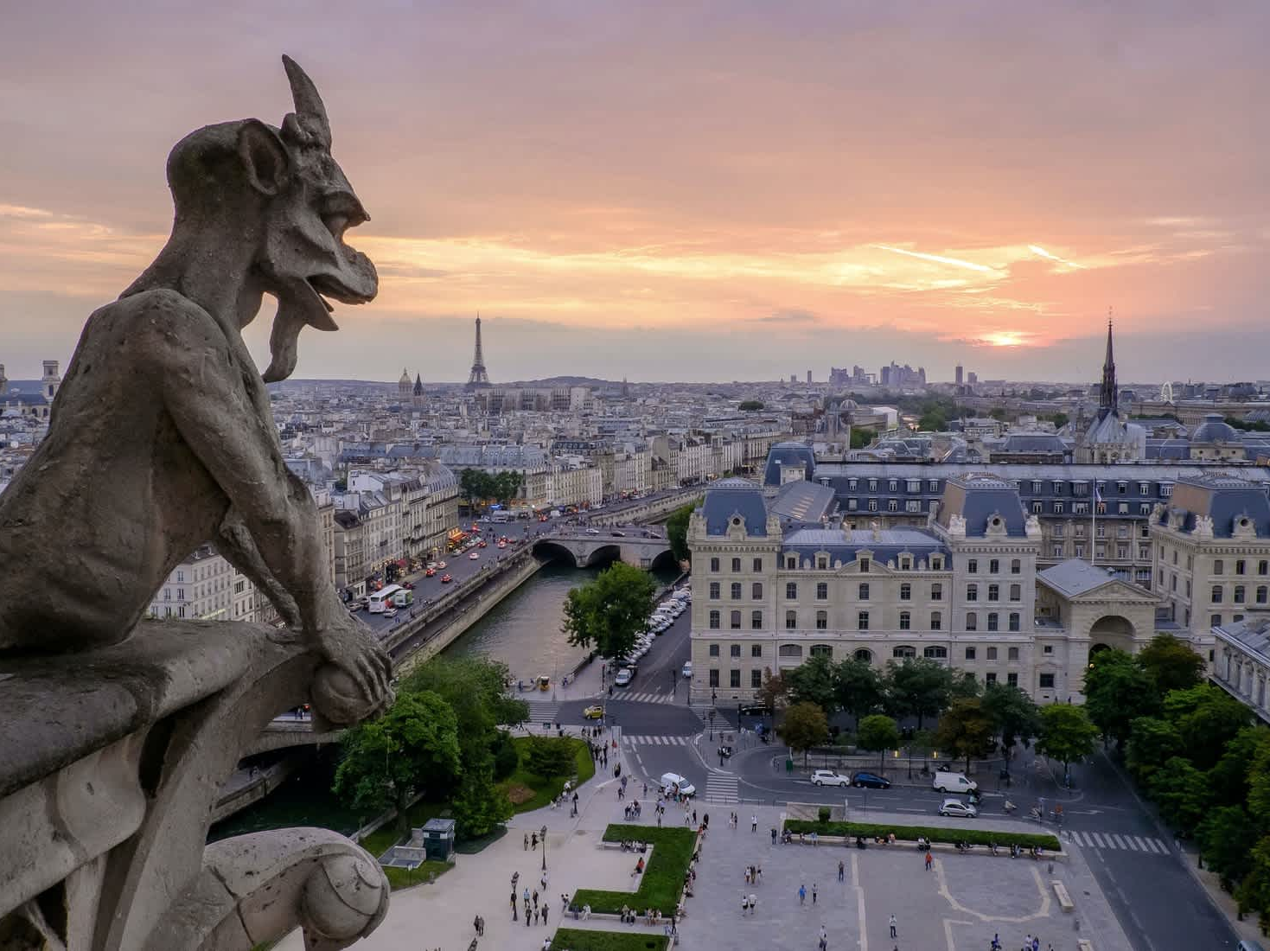
https://restorenotredame.org/about

Slide 19
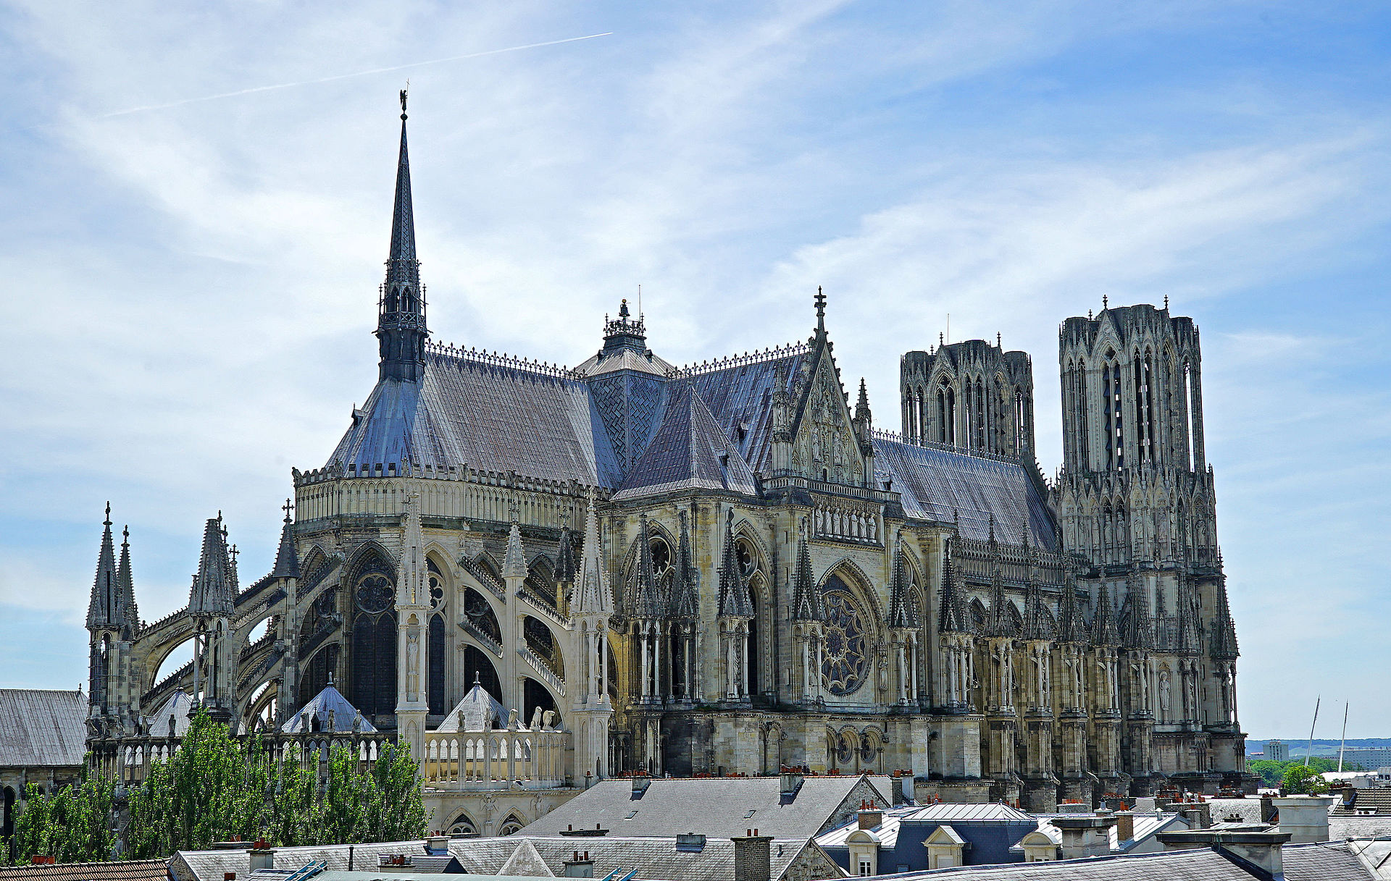
Rheims Cathedral, c. 1211
Notre-Dame de Reims was built in the High Gothic style. It is the seat of the Archdiocese of Reims, where the kings of France were crowned. The cathedral replaced an older church, destroyed by fire in 1211, that was built on the site of the basilica where Clovis was baptized by Saint Remi, bishop of Reims in AD 496. https://en.wikipedia.org/wiki/French_Gothic_architecture#/media/File:ReimsCathedral0116.jpg

Slide 20
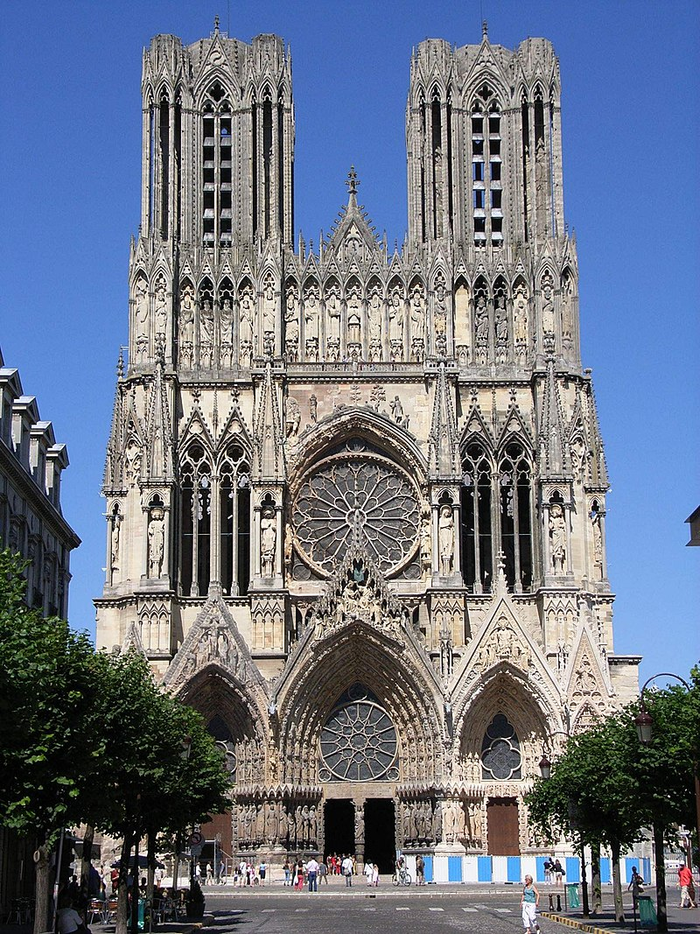
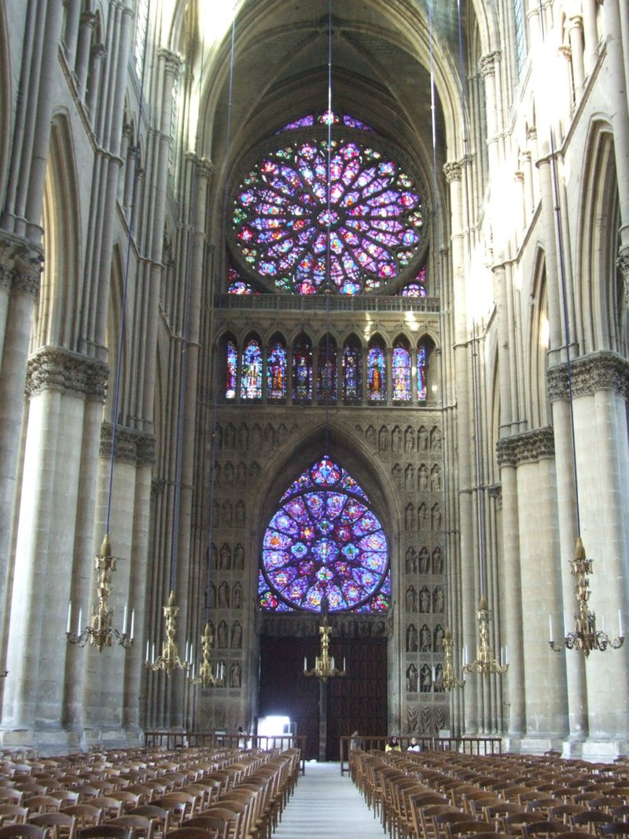
https://en.wikipedia.org/wiki/Reims_Cathedral

Slide 21
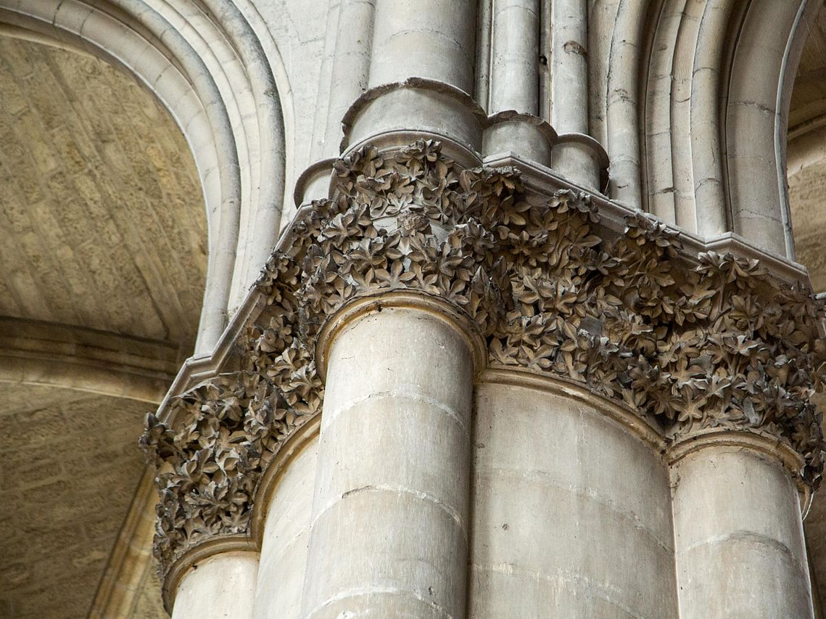
https://en.wikipedia.org/wiki/Reims_Cathedral

Slide 22
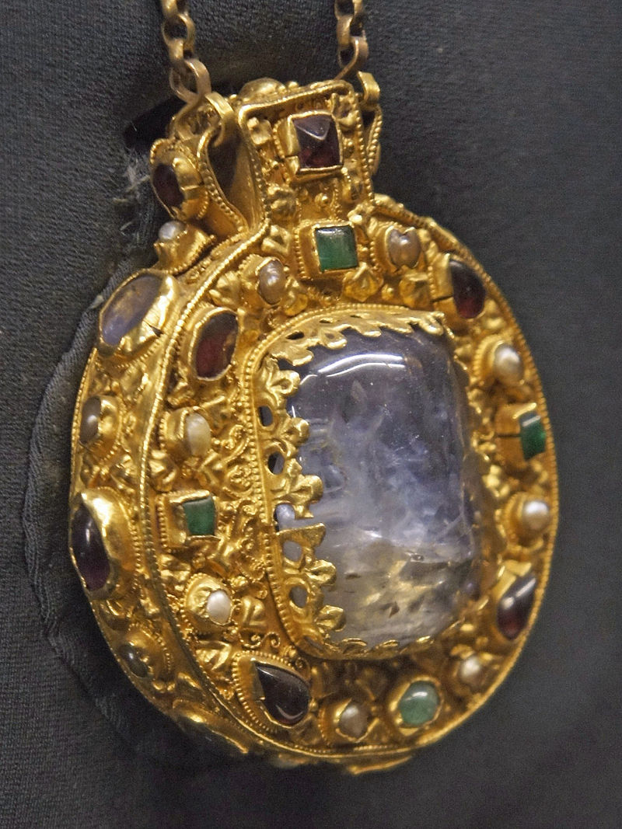
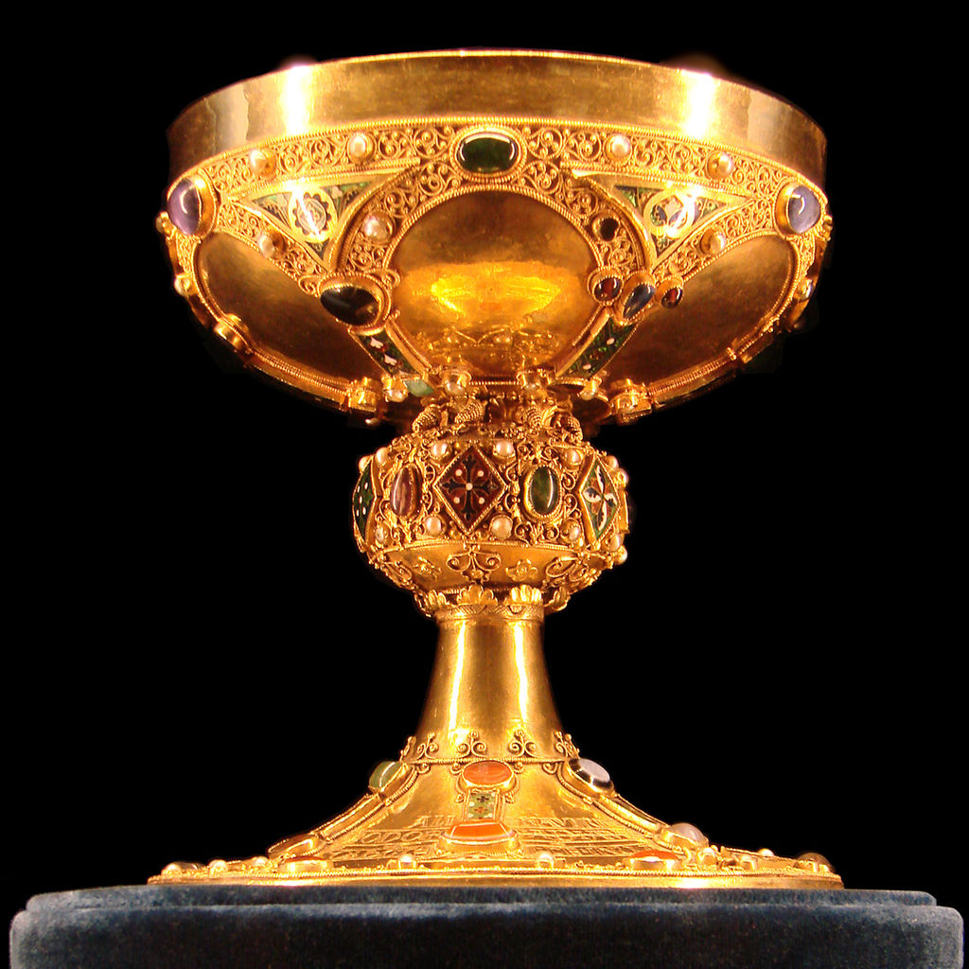
The Talisman of Charlemagne is a 9th-century Carolingian reliquary encolpion.
The Chalice of Saint Remigius, 12th century https://en.wikipedia.org/wiki/Talisman_of_Charlemagne https://en.wikipedia.org/wiki/Reims_Cathedral#/media/File:Calice_du_sacre_Tau.jpg

Slide 23
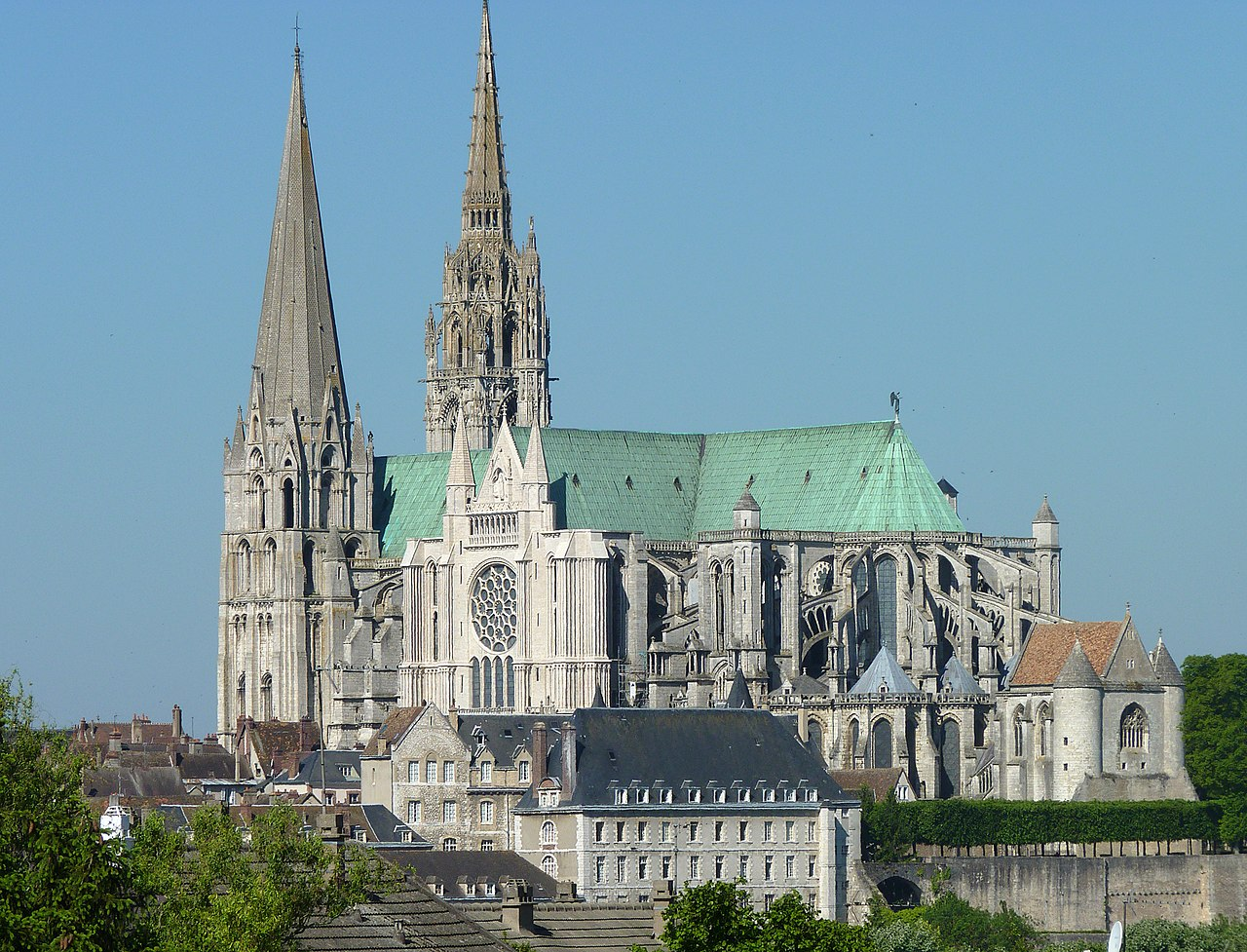
Chartres Cathedral, 1194 and 1250 https://en.wikipedia.org/wiki/Chartres_Cathedral
The current cathedral, mostly constructed between 1194 and 1220, is the last of five which have occupied the site since the town became a bishopric in the 4th century.
The cathedral has been well preserved. The majority of the original windows survive intact, while the architecture has seen only minor changes since the early 13th century. The building's exterior is dominated by flying buttresses which allowed the architects to increase the window size significantly, while the west end is dominated by two contrasting spires completed around
1160 and a 113metre early 16th-century
Flamboyant spire on top of an older tower.
Equally notable are the three great façades, each adorned with hundreds of sculpted figures illustrating key theological themes and narratives.

Slide 24
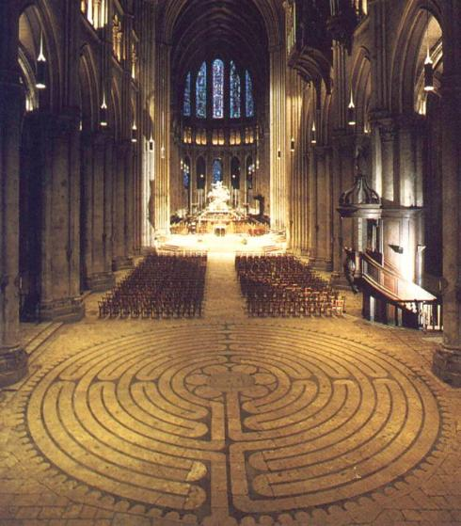
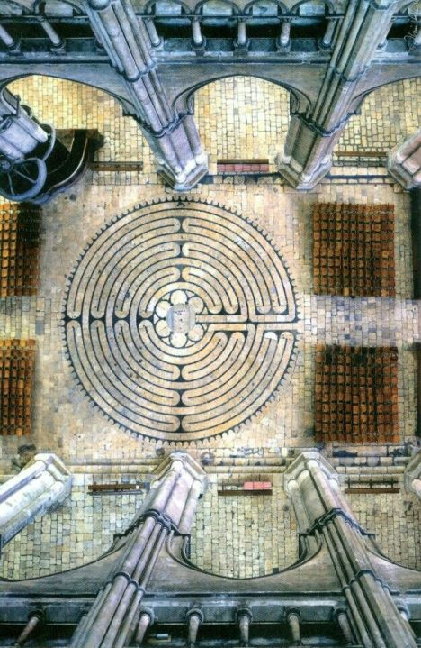
https://www.luc.edu/medieval/labyrinths/chartres.shtml https://gr.pinterest.com/pin/431008626842734902/

Slide 25
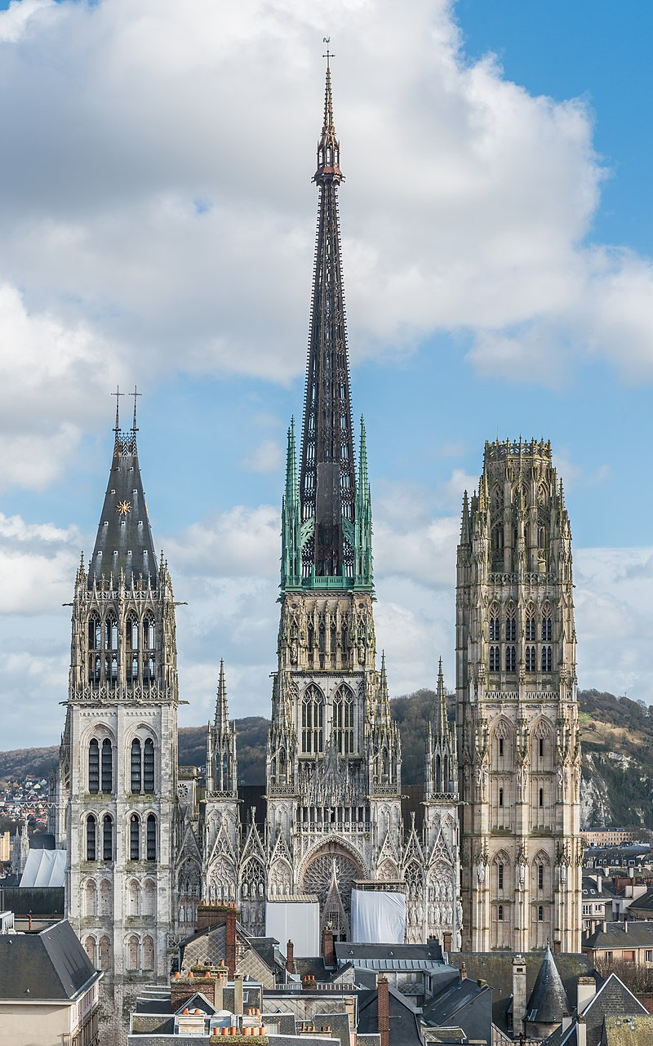
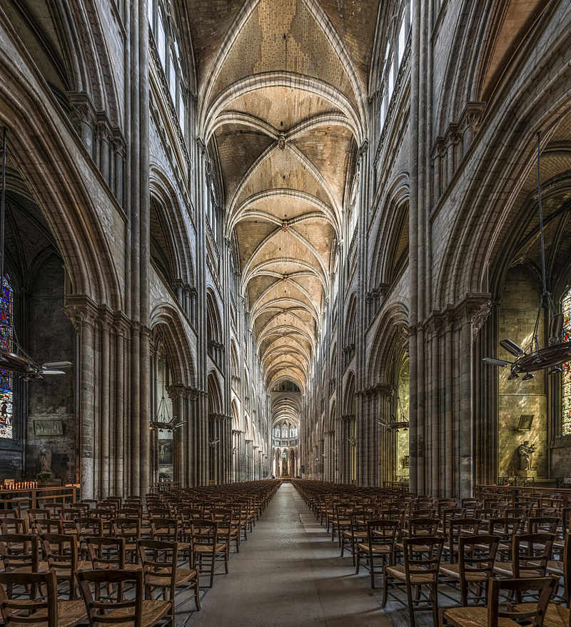
Rouen Cathedral, mid 12th century
Construction on the current building began in the 12th century in Early Gothic style for Saint Romain's tower, front side porches and part of the nave. https://en.wikipedia.org/wiki/Rouen_Cathedral#/media/File:Rouen_Cathedral_as_seen_from_Gros_Horloge_140215_4.jpg https://en.wikipedia.org/wiki/Rouen_Cathedral#/media/File:Notre-Dame_de_Rouen,_Nave_20140521_1.jpg

Slide 26
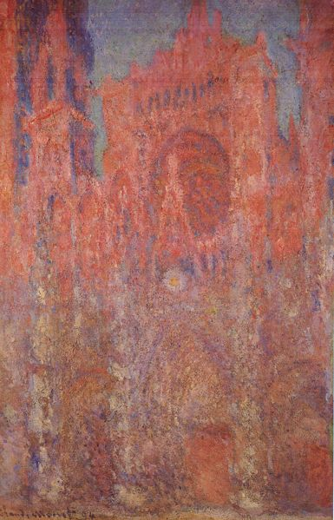
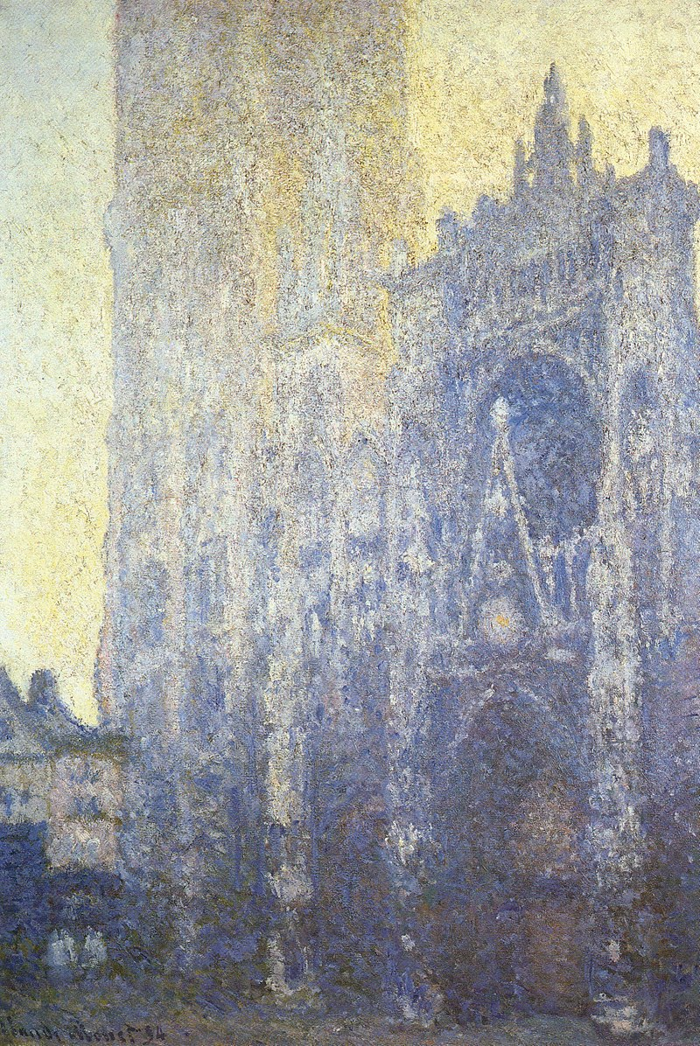
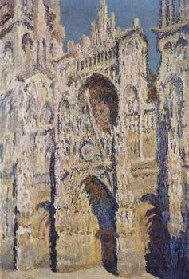
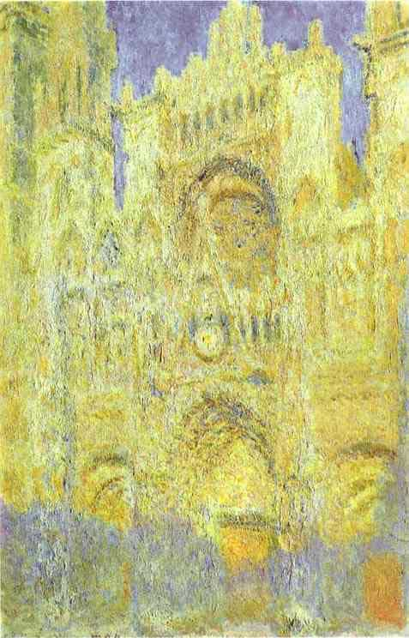
Three of Monet's famous paintings of Rouen Cathedral, 1893s
The most famous paintings of the cathedral were done by the Impressionist artist Claude Monet, who produced a series of paintings of the building showing the same scene at different times of the day and in different weather conditions. Other painters inspired by the building included John Ruskin, who selected it as an example of good architecture in The Seven Lamps of Architecture, and Roy Lichtenstein, who produced a series of pictures representing the cathedral's front. Mae Babitz, illustrated the Cathedral in the 1960s. https://en.wikipedia.org/wiki/Rouen_Cathedral_(Monet_series)#/media/File:Claude_Monet_-_Rouen_Cathedral,_Facade_I.jpg and https://en.wikipedia.org/wiki/Rouen_Cathedral_(Monet_series)#/media/File:Claude_Monet_-_Rouen_Cathedral,_Facade_and_Tour_d'AlbaneI.JPG and https://en.wikipedia.org/wiki/Rouen_Cathedral#/media/File:Claude_Monet_033.jpg

Slide 27
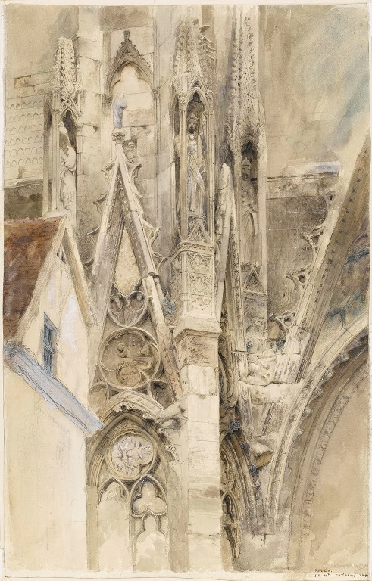
John Ruskin, 1819-1900
Entrance to South Transept of Rouen Cathedral, 1854, graphite, black chalk, pen and ink and wash, with some white on paper https://cockerel.fitzmuseum.cam.ac.uk/a-new-chapter/john-ruskin/

Slide 28
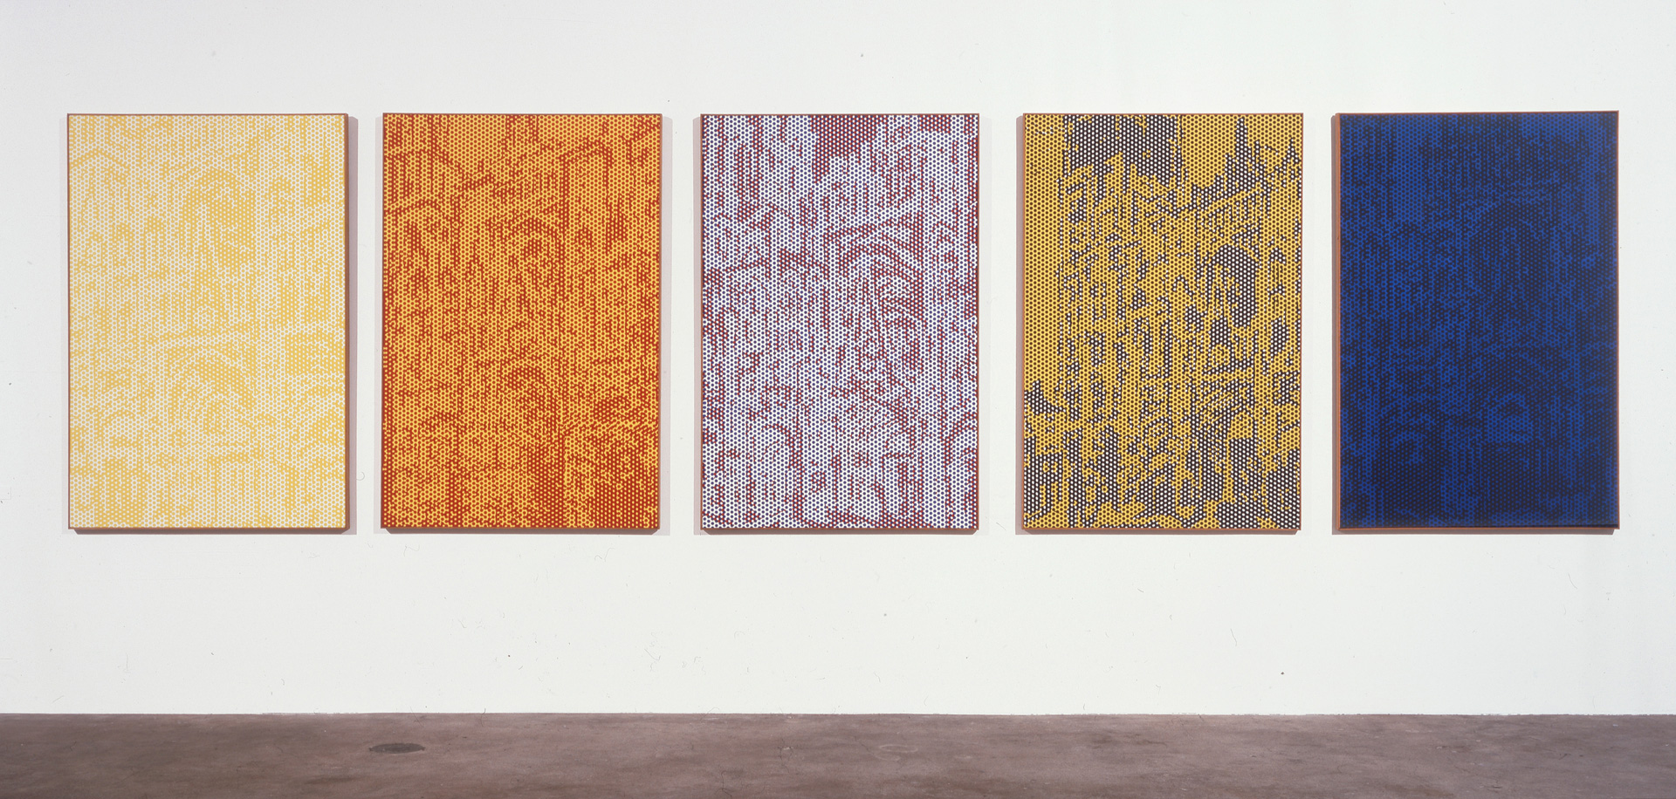
Roy Lichtenstein, 1923 - 1997
Rouen Cathedral Set 3, 1969, oil and magna on canvas, 5 canvases, 160 x 106.7 cm, The BROAD, CA, USA
Inspired by an exhibition of serial artworks that featured impressionist Claude Monet’s famous paintings of Rouen Cathedral, Roy Lichtenstein, never shy about appropriating a theme, embarked on his own Cathedral series. Unlike Monet, who painted at the site of the cathedral over the course of two years, observing the change of color and contours as light moved across the building’s surface, Lichtenstein did not paint from life. Monet’s quintessentially painterly approach stands in sharp contrast to Lichtenstein’s commercially influenced style. Yet, impressionism’s staccato brushwork and unmixed colors are a logical antecedent to Lichtenstein’s primary colors and benday dots — a cheeky update on a movement and an artist. https://www.thebroad.org/art/roy-lichtenstein/rouen-cathedral-set-3

Slide 29
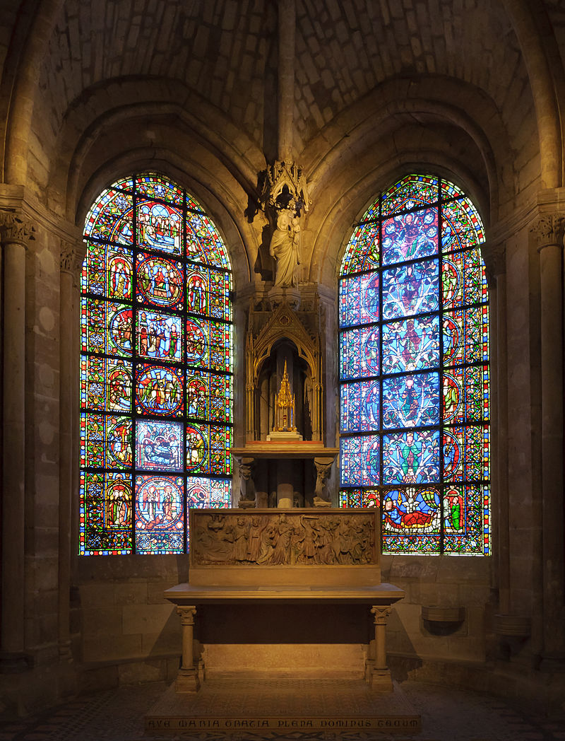
The beginning of the Gothic style is held by all modern historians to be in the first half of the 12th century at the Basilica of St Denis in the Ile-de-France, the royal domain of the Capetian kings rich in industry and the wool trade, because of the records he left during reconstruction of what he desired of this renovation, rather than the contemporary churches that explore some of the same ideas used at St. Denis.
Abbot Suger believed in the spiritual power of light and colour, following in the philosophy of the 3rd century pagan Dionysius the Areopagite, whose identity was fused with that of the patron saint of Paris, and leading him in the end to require large windows of stained glass.
Windows of the Chapel of the Virgin at the Basilica of Saint-Denis. The Tree of Jesse window is on the right https://en.wikipedia.org/wiki/French_Gothic_stained_glass_windows#/media/File:Basilique_Saint-Denis_chapelle_de_la_Vierge.jpg

Slide 30
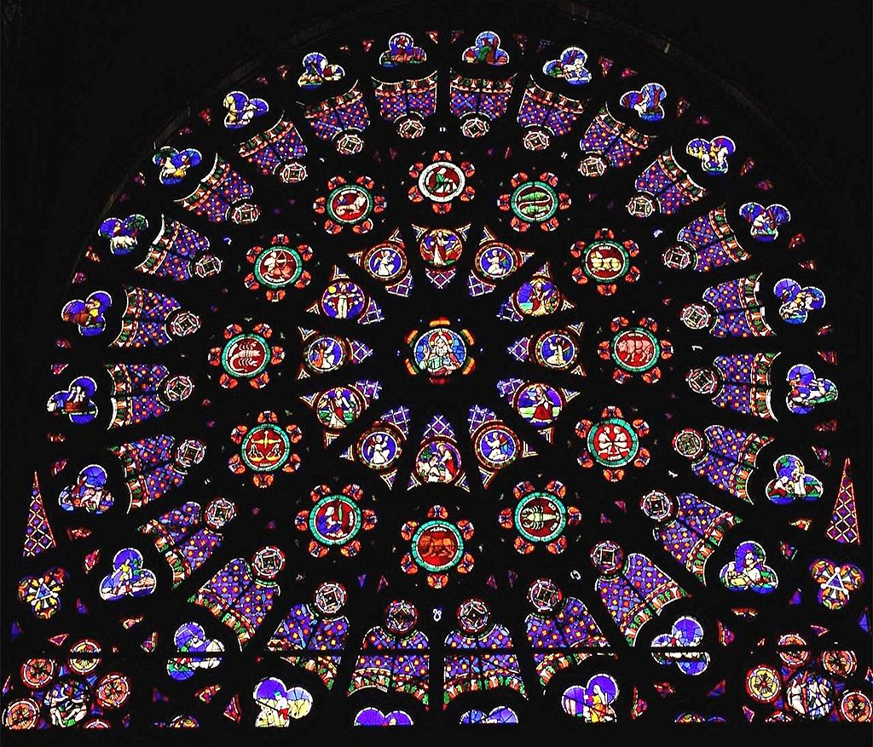
The Basilica of St Denis,
North transept Rose window, depicting the Creation, with God at the center the six days of Creation, the Zodiac representing the order of the heavens, the Labours representing the order of the earth, Adam and Eve eating the fruit and being expelled from Eden. https://commons.wikimedia.org/wiki/File:Basilica-of-Saint-Denis-Rayonnant-Rose-Window.jpg

Slide 31
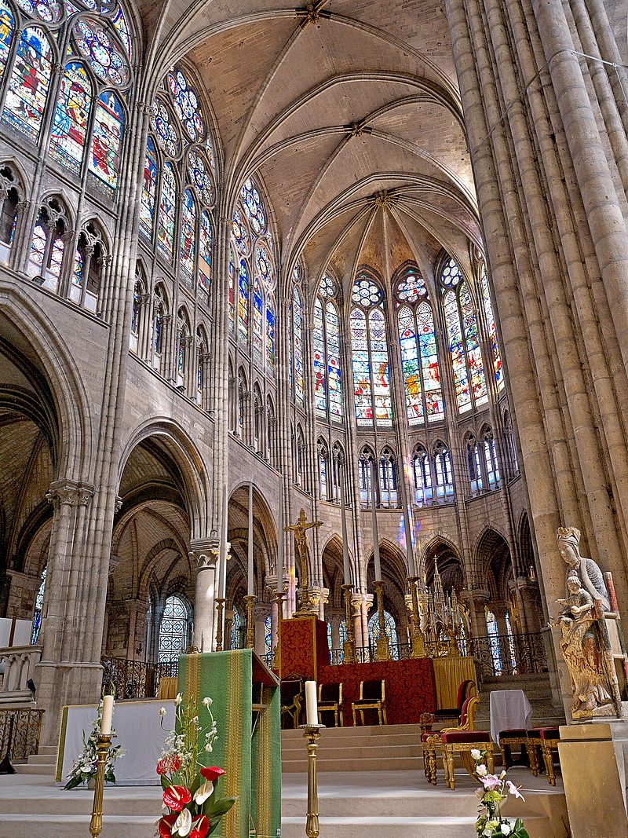
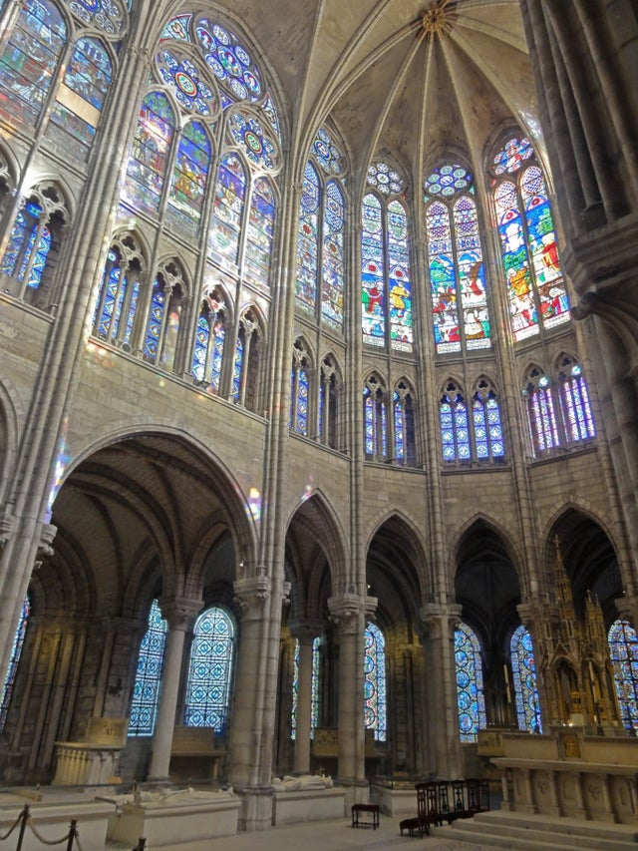
Saint Denis Choir Vitraux Windows https://www.reddit.com/r/Catholicism/comments/wb5rjz/free_friday_the_rayonnant_gothic_choir_of_the/ and https://dianadarke.com/tag/saint-denis/

Slide 32
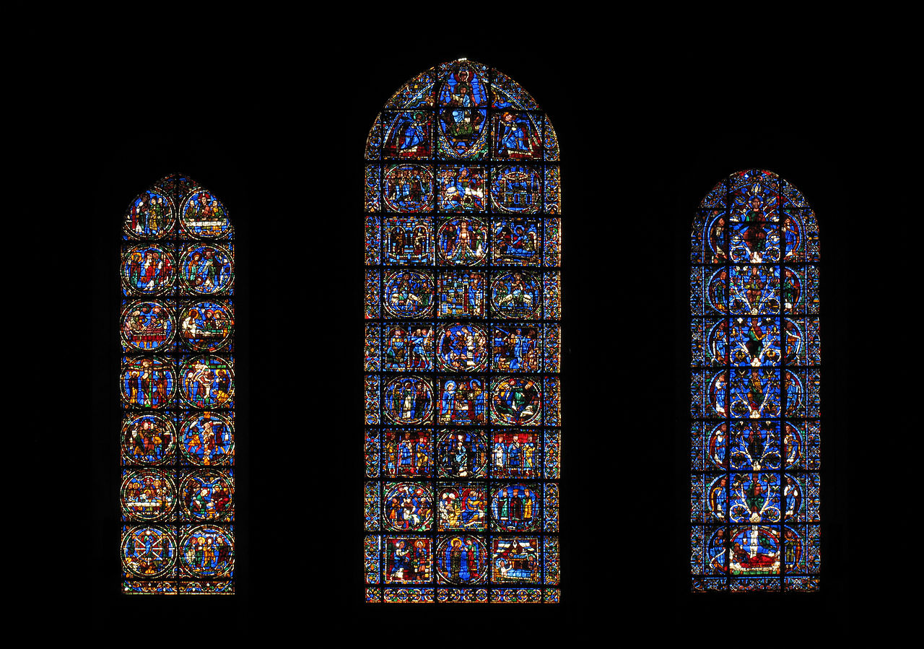
Chartres Cathedral
Lancet windows under the west Rose window; the Jesse Window or genealogy of Christ (right); Life of Christ (center), and the Passion of Christ (left), c.1150 https://en.wikipedia.org/wiki/Chartres_Cathedral

Slide 33
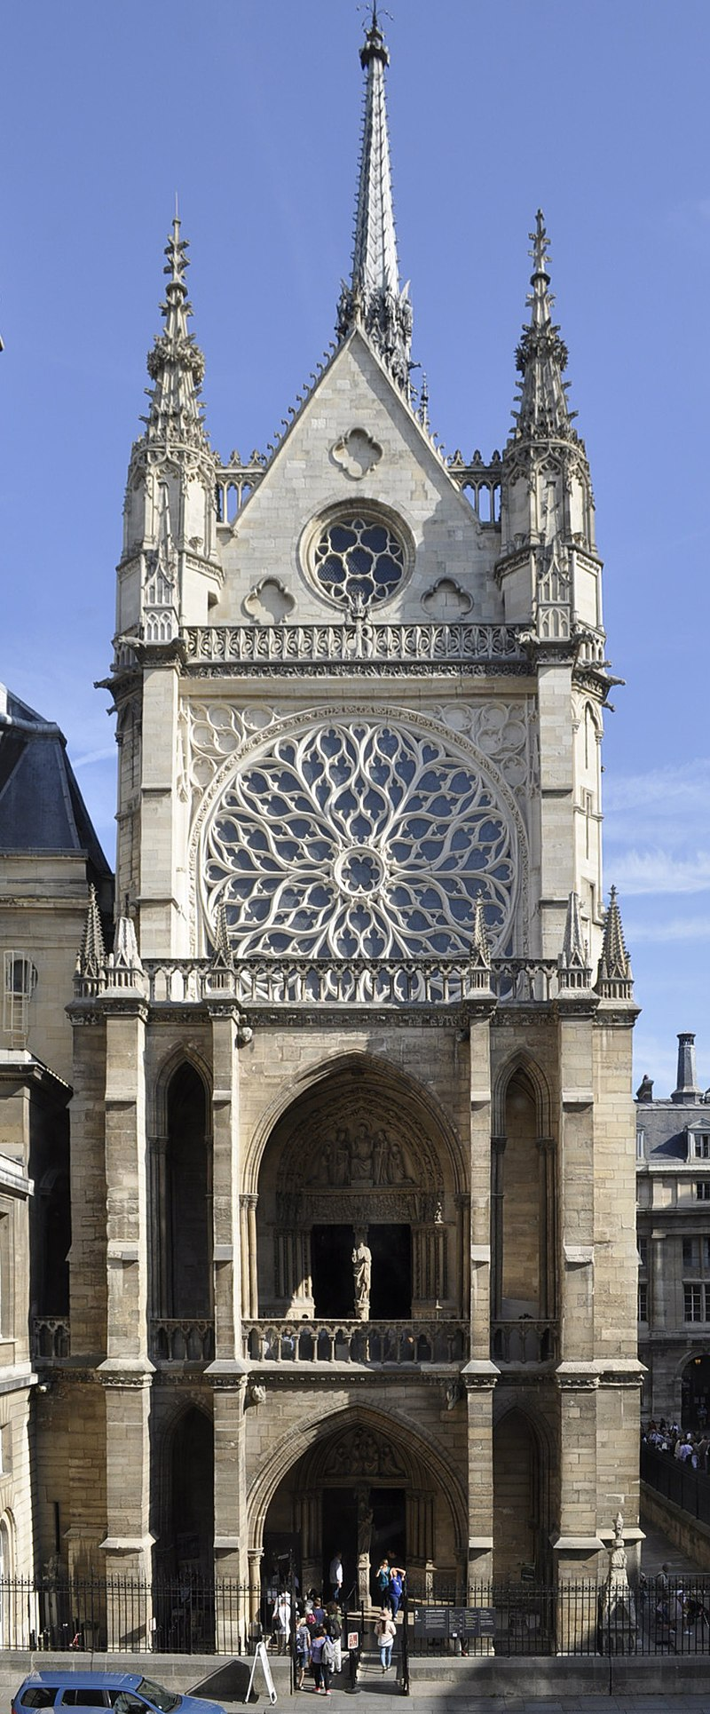
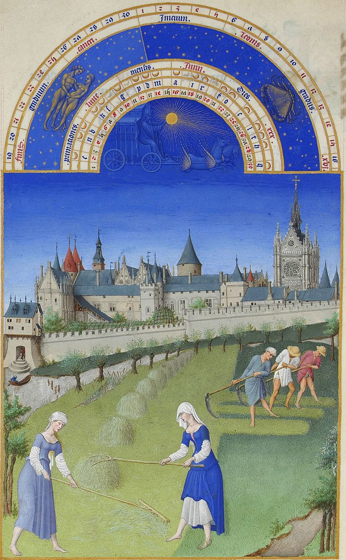
The Sainte-Chapelle is a royal chapel in the Gothic style constructed during the 13th century
Herman, Paul, and Johan Limbourg, c. 1385 – 1416
Très Riches Heures du Duc de Berry, the Month of June page, c. 1412-1416, manuscript illumination in vellum, 30 cm in height by 21.5 cm, Musée Condé, Chantilly, France. https://en.wikipedia.org/wiki/Sainte-Chapelle

Slide 34
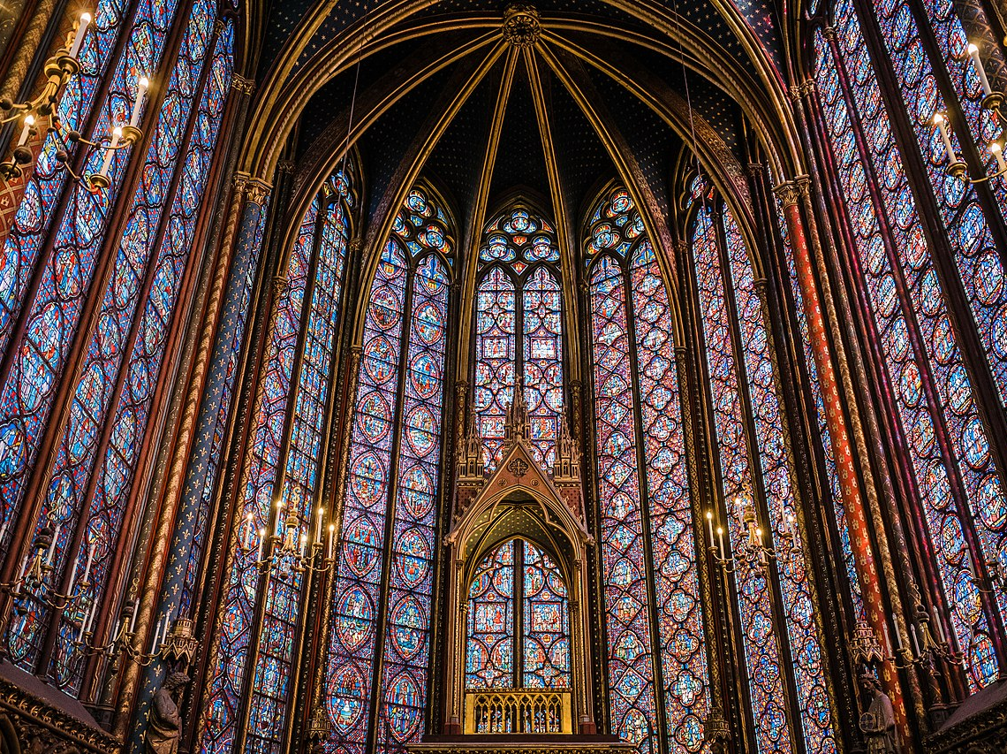
https://en.wikipedia.org/wiki/Sainte-Chapelle#/media/File:Sainte_Chapelle_Interior_Stained_Glass.jpg

Slide 35
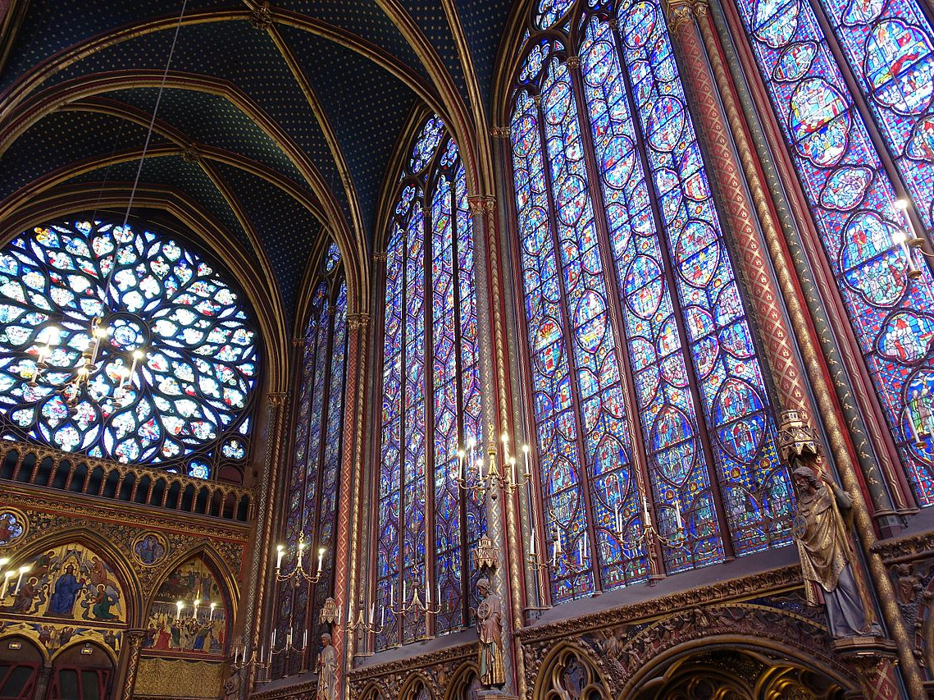
https://en.wikipedia.org/wiki/Sainte-Chapelle#/media/File:Chapelle_Haute_@_Sainte-Chapelle_@_Paris_(30029150036).jpg

Slide 36
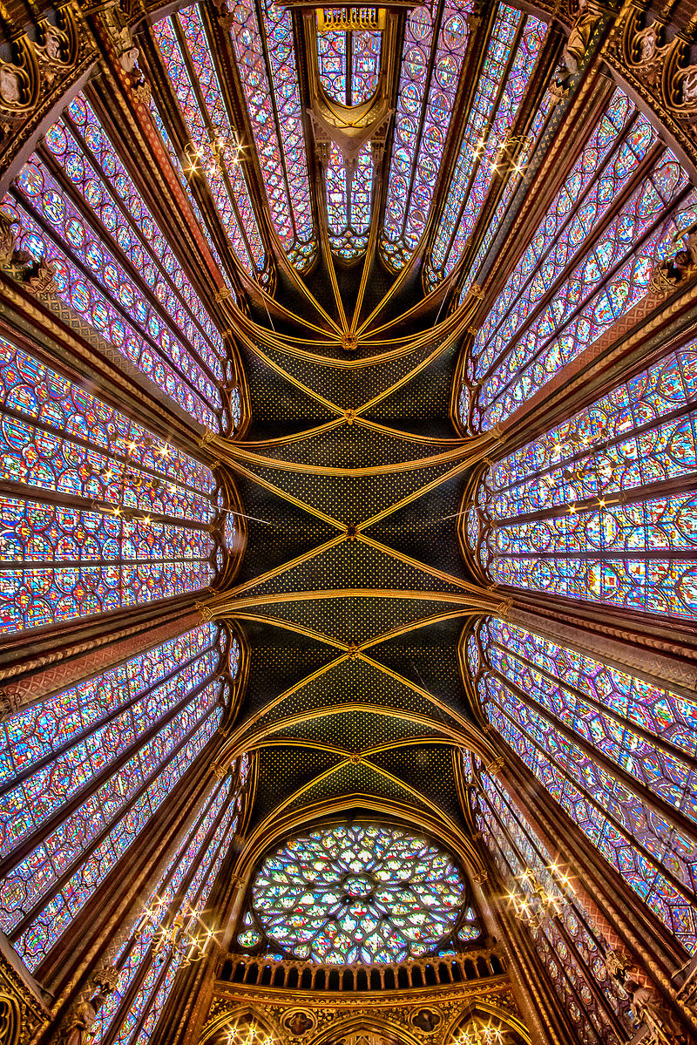
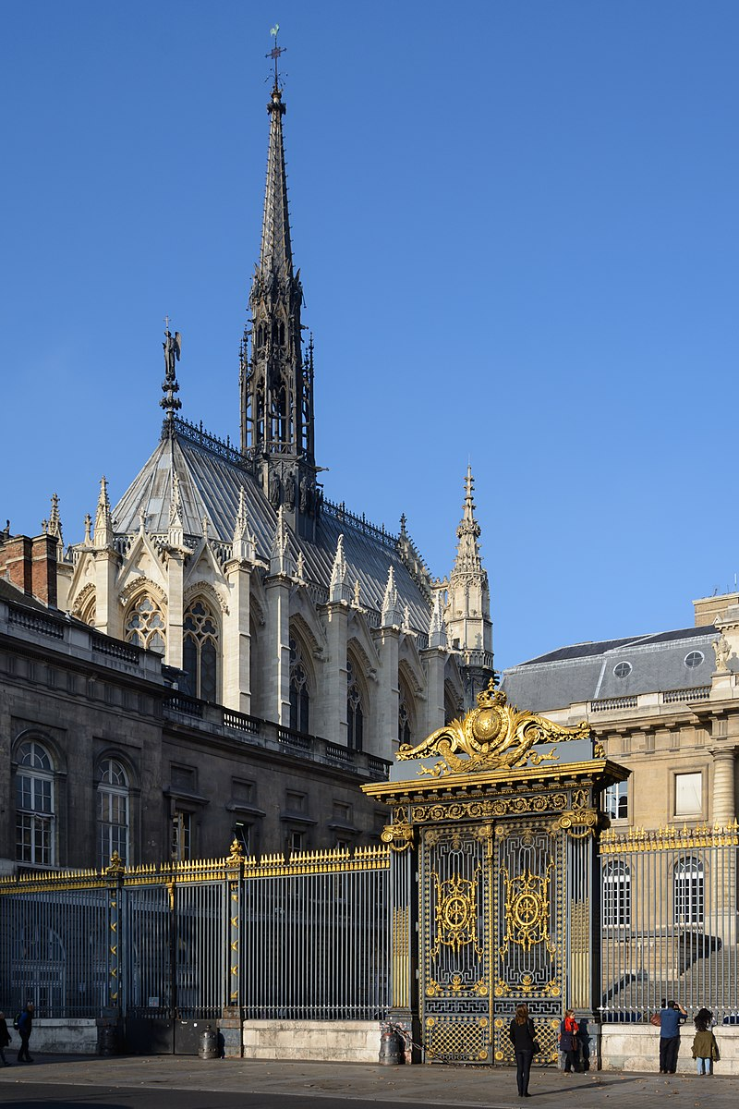
https://en.wikipedia.org/wiki/Sainte-Chapelle#/media/File:PA00086001_-_Sainte-Chapelle_-_7MC_3458+3461_-_HDR.jpg https://en.wikipedia.org/wiki/Sainte-Chapelle#/media/File:Paris_Sainte_Chapelle_East_View_02.JPG

Slide 37
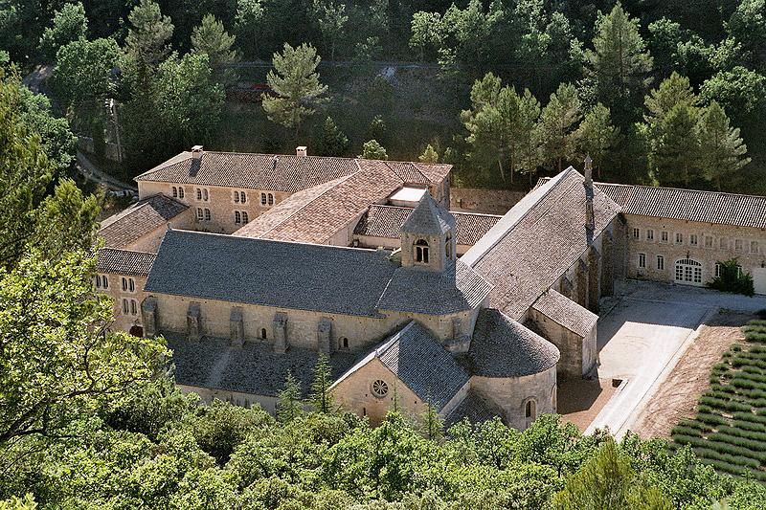
Abbey of Senanque, c. 1148, Provence, France,
Sénanque Abbey is a Cistercian Abbey near the village of Gordes in the département of the Vaucluse in Provence, France. https://www.youtube.com/watch?v=0PVnw_oE4Us https://www.youtube.com/watch?v=ZuyYDacly0Q

Slide 38
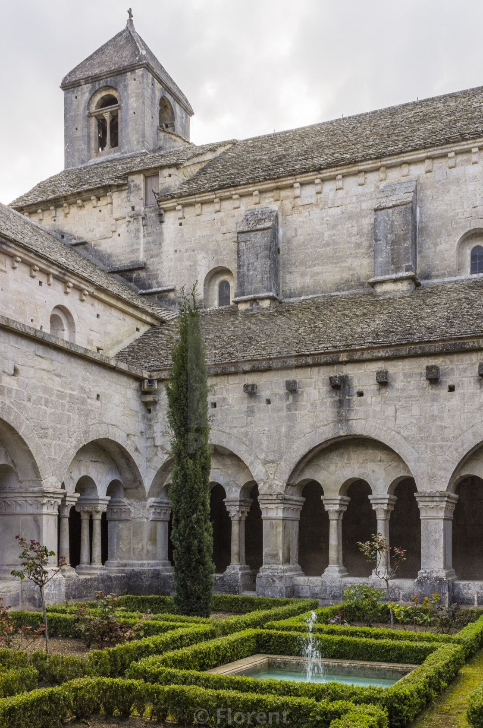


The monks who now live at Sénanque grow lavender and tend honey-bees https://www.picfair.com/pics/07881671-cloister-of-senanque-abbey-vaucluse-gordes-provence-france https://www.senanque.fr/en/ https://chateau-ferrassieres.fr/en/portfolio-items/senanque-abbey/

Slide 39

The façade of the Palais des Papes, 14th century, Avignon, France https://www.viator.com/en-IE/tours/Nice/Full-Day-Avignon-Private-Tour-of-Popes-Palace-and-Chateauneuf-du-Pape-from-Nice/d478-26158P36

Slide 40

The famous Avignon Bridge https://thegoodlifefrance.com/palais-des-papes-palace-of-the-popes-avignon-provence/

Slide 41

https://wild-about-travel.com/avignon-palais-des-papes-gothic-architecture-masterpiece/

Slide 42




The Palais des Papes decorated with Roses during the Rose Festival

Slide 43
Bibliography https://epopteia.gr/243/kanellopoulos-romanikos-gothikos-rithmos/?print=pdf https://archeologie.culture.gouv.fr/saint-denis/en https://en.wikipedia.org/wiki/Basilica_of_Saint-Denis

