Slide 1
Nikiphoros Lytras
1832-1904
14 Paintings

Slide 2
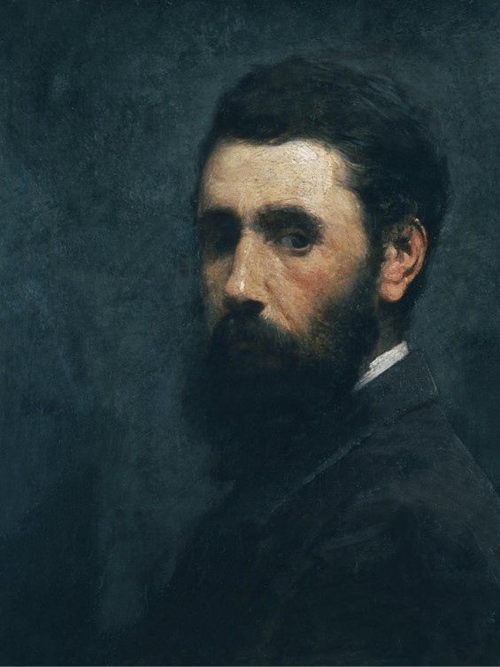
Nikiforos Lytras - Self-Portrait, Date: ?, Oil on Canvas, 51,5 x 43,5 cm, National Gallery - Alexandros Soutsos Museum, Athens, Greece https://www.nationalgallery.gr/en/artist/lytras-nikephoros/

Slide 3
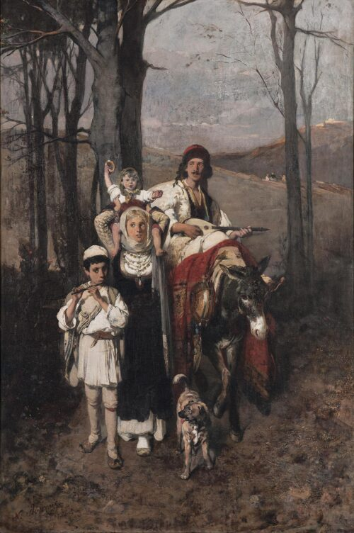
Return from the Fair, ca 1865-1872, Oil on Canvas, 100 x 66 cm, National Gallery - Alexandros Soutsos Museum, Athens, Greece https://www.nationalgallery.gr/en/artist/lytras-nikephoros

Slide 4
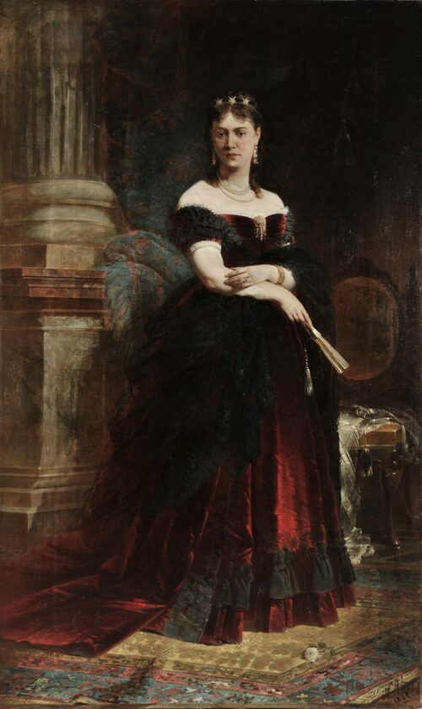
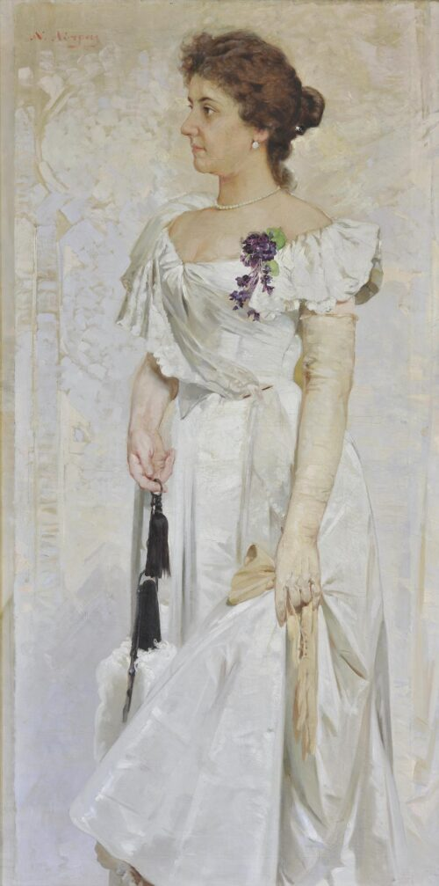
Portrait of Mrs Serpieri, 1869,
Oil on Canvas, 248 x 148 cm
Portrait of Marianthi L. Charilaou, ca 1895 – 1900, Oil on Canvas,
155 x 78 cm
National Gallery - Alexandros Soutsos Museum, Athens, Greece https://www.nationalgallery.gr/en/artist/lytras-nikephoros/

Slide 5
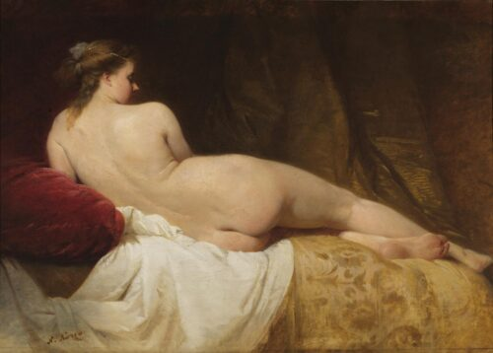
Nude, ca 1867-1870,
Oil on Canvas,
86 x 118 cm, National Gallery - Alexandros Soutsos Museum, Athens, Greece https://www.nationalgallery.gr/en/artist/lytras-nikephoros/

Slide 6
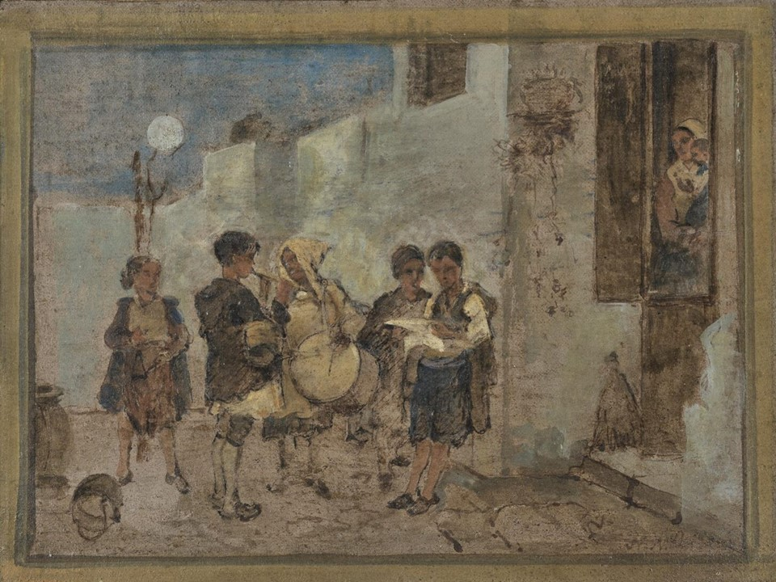
Study for Τα Κάλαντα (Carols), 1870s, Oil on Cardboard, 17,3 x 22,5 cm, National Gallery - Alexandros Soutsos Museum, Corfu Annex, Greece https://www.nationalgallery.gr/en/artwork/study-for-carols/

Slide 7
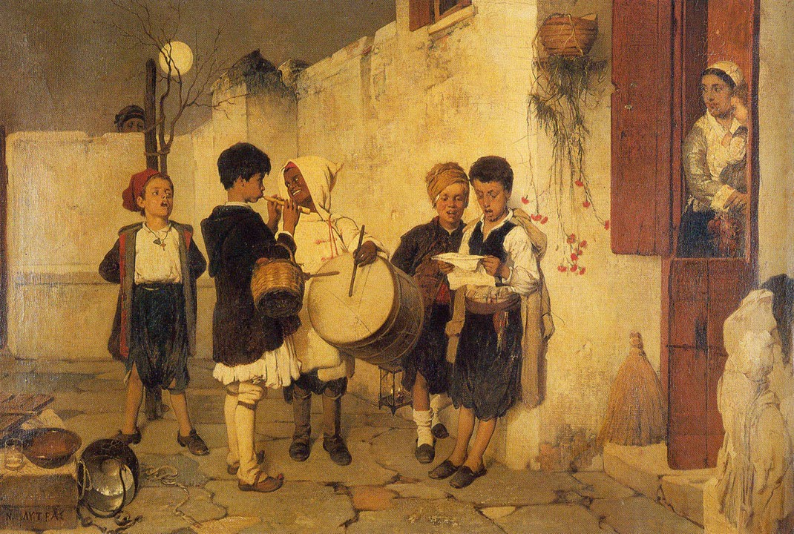
Τα Κάλαντα (Carols), 1870s, Oil on Canvas, 59x90 cm, Private collection https://commons.wikimedia.org/wiki/File:Lytras_Nikiforos_Carols.jpeg

Slide 8
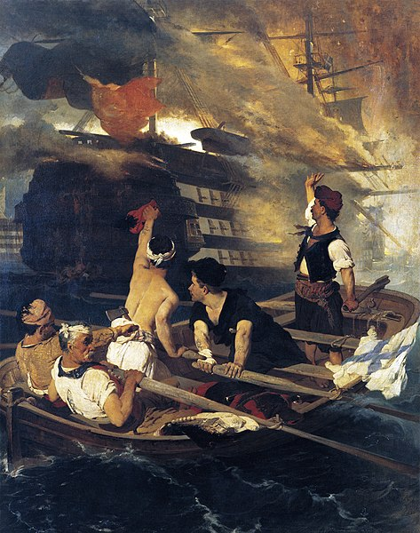
Τhe Burning of the Turkish Flagship by Kanaris, c. 1873, Oil on Canvas, Averoff Gallery, Metsovo, Greece https://el.m.wikipedia.org/wiki/%CE%91%CF%81%CF%87%CE%B5%CE%AF%CE%BF:Lytras-nikiforos-pyrpolisi-tourkikis-navarhidas-apo-kanari.jpeg

Slide 9
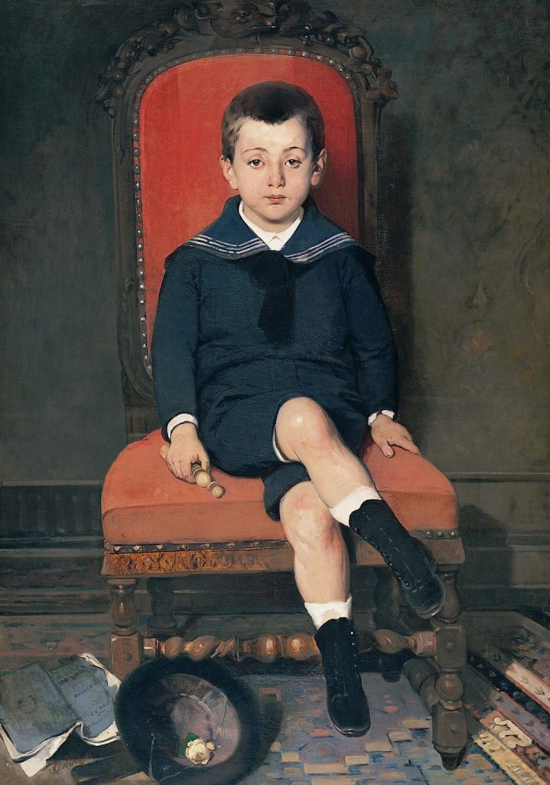
Portrait of Konstantinos M. Melas, 1879, Oil on Canvas, 117 x 83 cm, Katsigras Collection, Municipality Gallery of Larissa, Greece https://www.katsigrasmuseum.gr/uncategorized/%CF%83%CE%B1%CE%BD_%CF%83%CE%AE%CE%BC%CE%B5%CF%81%CE%B1-13-%CE%B9%CE%BF%CF%85%CE%BD%CE%AF%CE%BF%CF%85-1904-%CE%AD%CF%86%CF%85%CE%B3%CE%B5-%CE%B1%CF%80%CF%8C-%CF%84%CE%B7-%CE%B6%CF%89%CE%AE-%CE%BF/

Slide 10
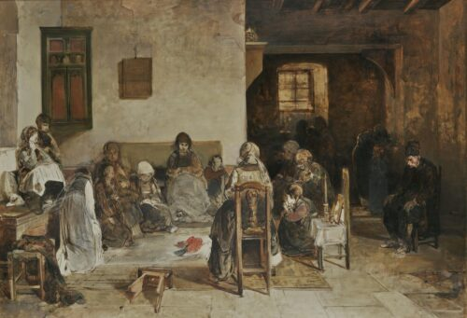
The Dirge in Psara, before 1888
Oil on Canvas, 97 x 140 cm, National Gallery - Alexandros Soutsos Museum, Athens, Greece https://www.nationalgallery.gr/en/artist/lytras-nikephoros/

Slide 11
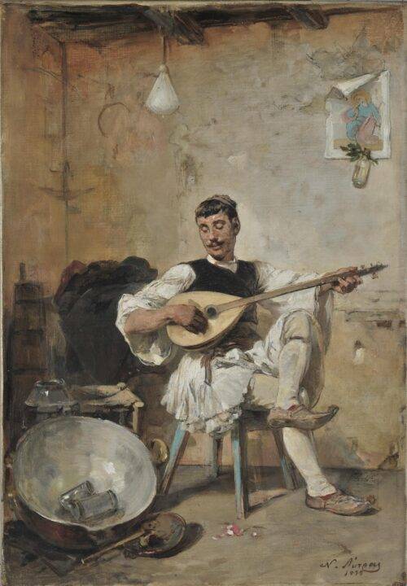
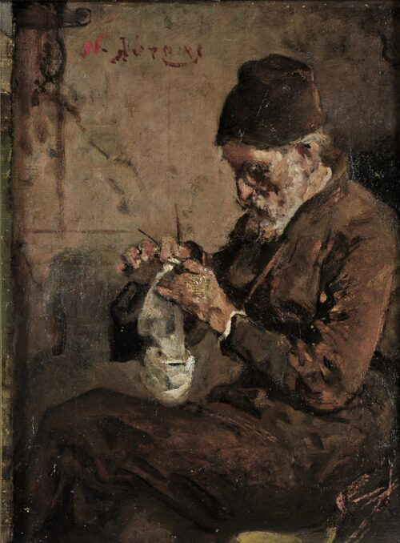
Milkman Resting, 1895
Oil on Canvas, 53 x 37 cm
Monk, ca 1900-1904,
Oil on Canvas, 25,5 x 19 cm
National Gallery - Alexandros Soutsos Museum, Athens, Greece https://www.nationalgallery.gr/en/artist/lytras-nikephoros/

Slide 12
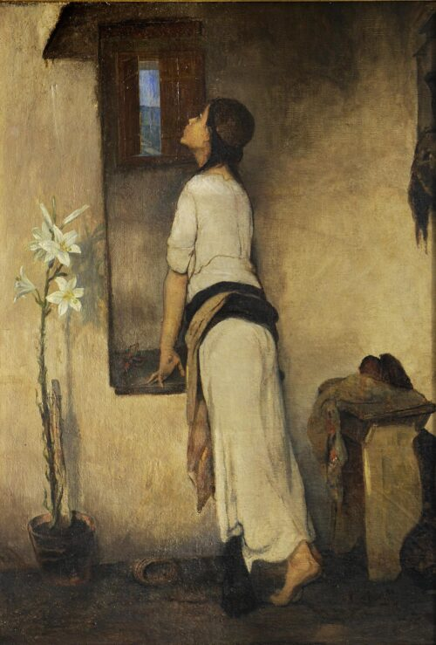
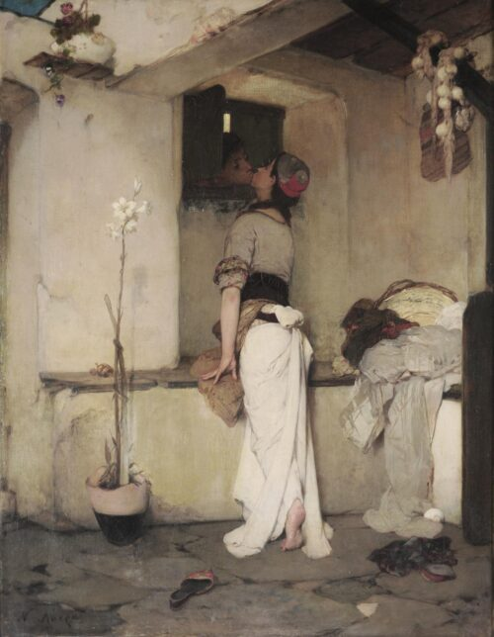
Awaiting, ca 1895 – 1900,
Oil on Canvas,
68 x 50 cm
The Kiss, before 1878,
Oil on Canvas,
79 x 69 cm
National Gallery - Alexandros Soutsos Museum, Athens, Greece https://www.nationalgallery.gr/en/artist/lytras-nikephoros/

Slide 13
The End

