Slide 1
Gold Glass Medallion Portraits

Slide 2
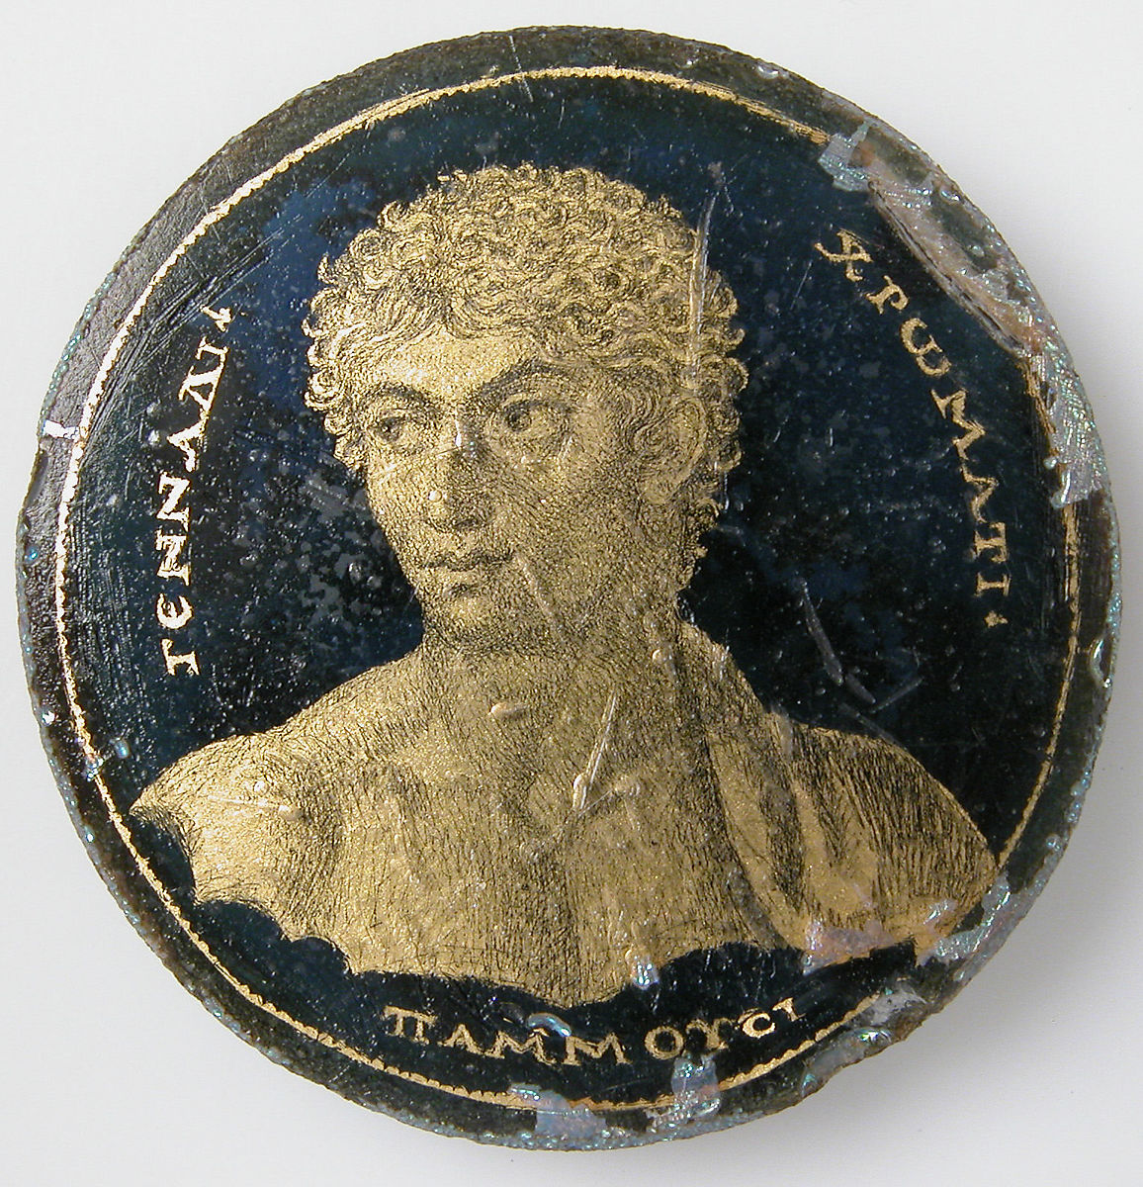

Slide 3
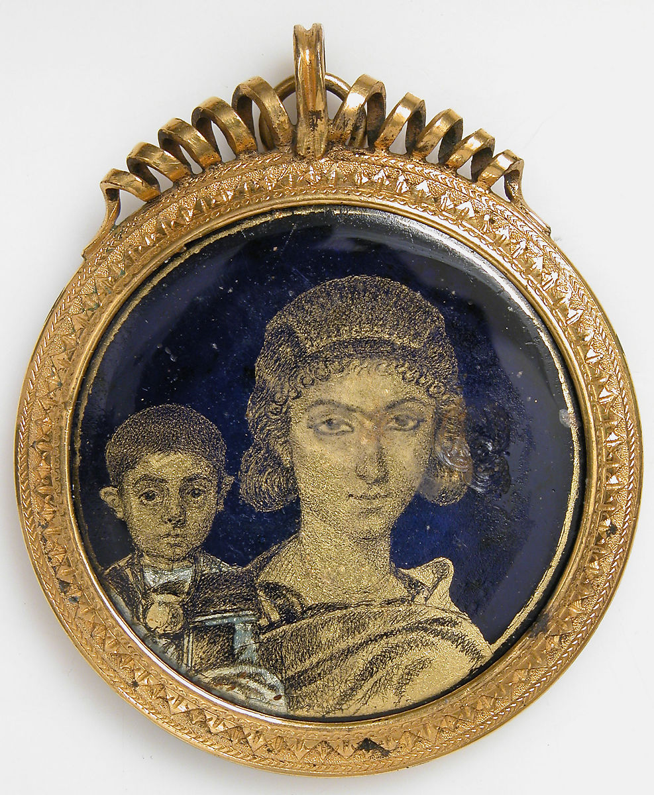

Slide 4
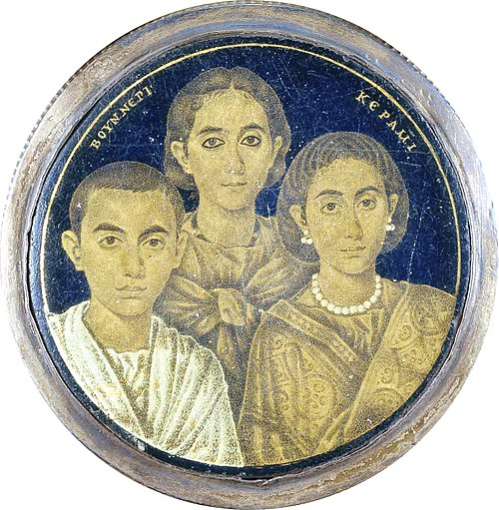

Slide 5
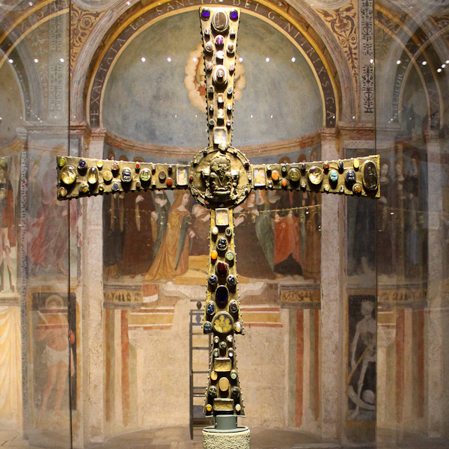
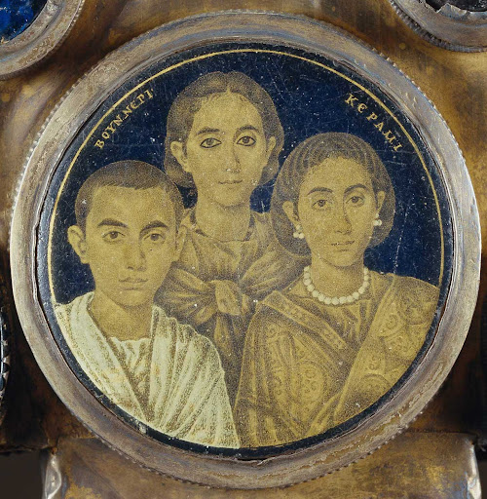

Slide 6
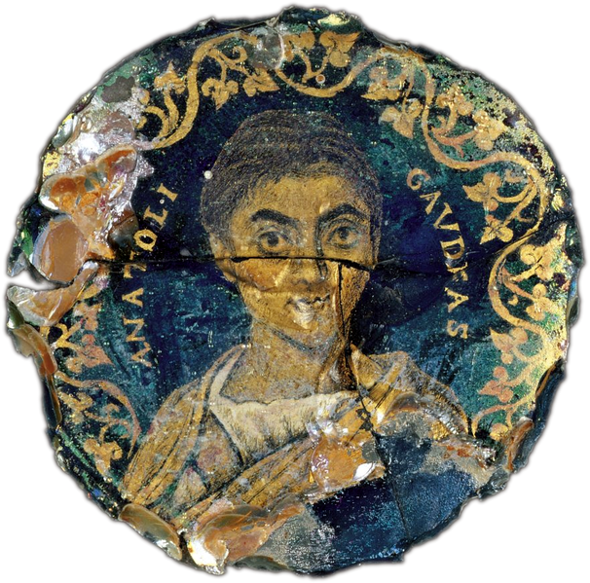

Slide 7
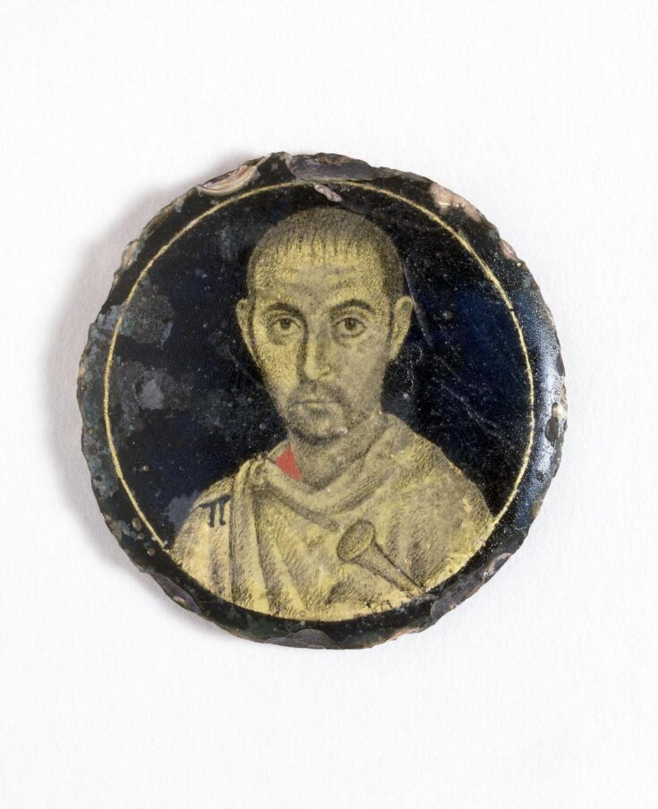

Slide 8
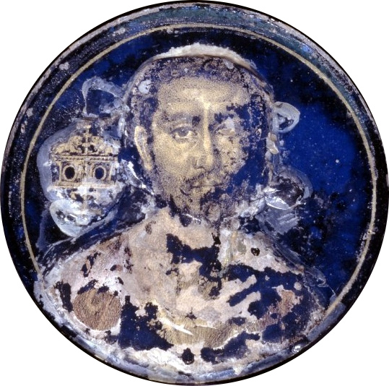

Slide 9
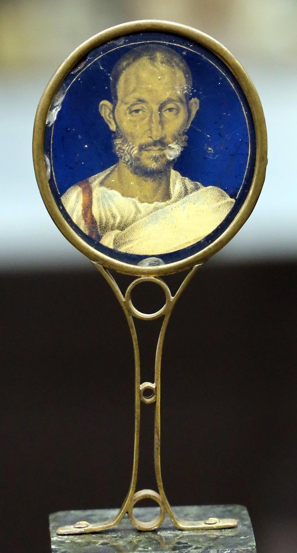

Slide 10
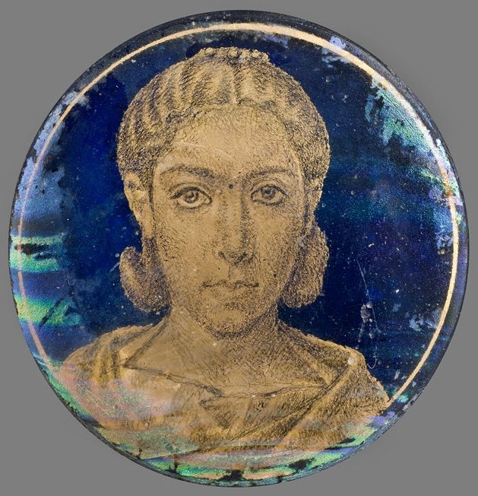

Slide 11
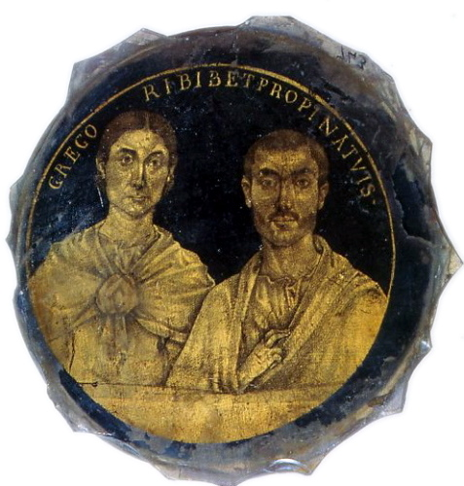

Slide 12
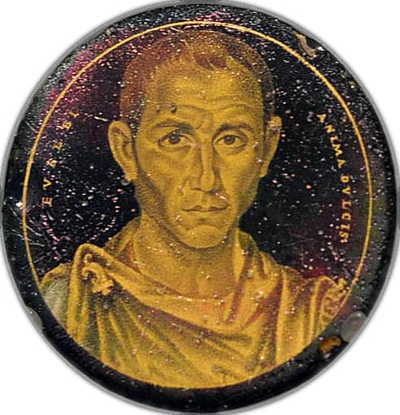

Slide 13
Slide 1
Introduction
Slide 2
Portrait Medallion of Gennadios, 250–300 AD, Gold Glass, D. 4.2 cm, the MET, NY, USA https://www.metmuseum.org/art/collection/search/466645
Slide 3
Gold Glass Medallion with a Mother and Child, early 4th century AD, Gold Glass, 4.8 x 0.5 cm, the MET, NY, USA https://www.metmuseum.org/art/collection/search/463989
Slide 4
The Brescia Portrait Medallion, 3rd century AD, Gold Glass, D. 6 cm, Civici Musei d’Arte e Storia, Museo di Santa Giulia in Brescia, Italy https://www.wikiwand.com/en/List_of_gold_glass_portraits
Slide 5
The Brescia Portrait Medallion is mounted on the Cross of Desiderius, Civici Mudei d’Arte e Storia, Museo di Santa Giulia in Brescia, Italy https://italiannotes.com/things-to-see-in-brescia/ and http://www.turismobrescia.it/en/punto-d-interesse/desiderius-cross
Slide 6
Portrait of a Woman, about 300 AD, Gold Glass, D. 4.9 cm, Corning Museum of Glass, NY, USA https://commons.wikimedia.org/wiki/File:Gold-glass_portrait_of_a_woman_(Corning_Museum_of_Glass).png
Slide 7
Medallion Portrait of a Man, 200-400 AD, Gold Glass, D. 44 mm, Victoria and Albert Museum, London, UK https://collections.vam.ac.uk/item/O119621/medallion-unknown/
Slide 8
Medallion Portrait of a Man, 3rd or 4th century AD, Gold Glass, D. 5.10 cm, British Museum, London, UK https://commons.wikimedia.org/wiki/File:Gold-glass_portrait_of_a_man_(British_Museum).jpg
Slide 9
Medallion Portrait of a Man, 200-250 AD, Gold Glass, 12.7 x 4.5 x 3.4 cm, Arezzo Archaeological Museum , Italy https://www.reddit.com/r/interestingasfuck/comments/msjtkh/a_roman_gold_glass_portrait_of_a_man_200250_ce/

Slide 14
Slide 10
Portrait Medallion of a woman, 3rd century AD, Gold Glss, D. 4.5 cm, Museo
Slide 11
Civico, Torino, Italy https://gr.pinterest.com/pin/565412928209880384/
Base of dish with a married couple, 3rd century A.D. from the cemetery of St. Pamphilus on the Via Salaria vetus, Gold Glss, D. 10.5 cm, Musei Vaticni, Rome, Italy https://en.wikipedia.org/wiki/List_of_gold_glass_portraits#/media/File:Gold-glass_portrait_of_husband_and_wife_(Biblioteca_Apostolica_Vaticana,_Museo_Sacro,_Inv._no._743).jpg
Slide 12
Portrait of a man, possibly named Eusebius, 3rd century AD, D. 4.8 cm, Musei Vaticani, Rome, Italy https://twitter.com/Classical_Arch/status/1382710806131970055
Slide 13
Identification and Photo reference/credit
Slide 14
Identification and Photo reference/credit

