Slide 1
Meissen
Porcelain
Menagerie

Slide 2
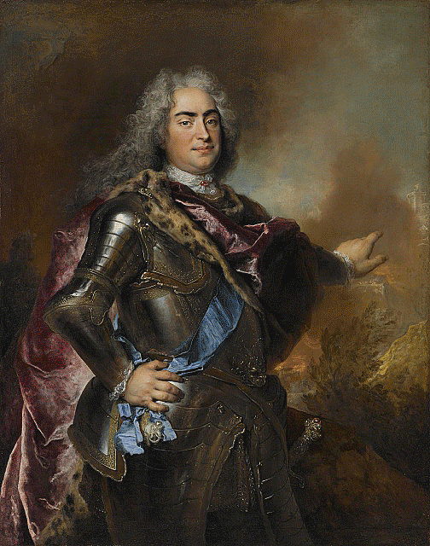
Nicolas de Largillierre, 1656–1746
Augustus the Strong, Elector of Saxony and King of Poland, 1714–15, Oil on Canvas, The Nelson-Atkins Museum of Art, Kansas City, Missouri, USA https://art.nelson-atkins.org/objects/16759/augustus-the-strong-elector-of-saxony-and-king-of-poland

Slide 3
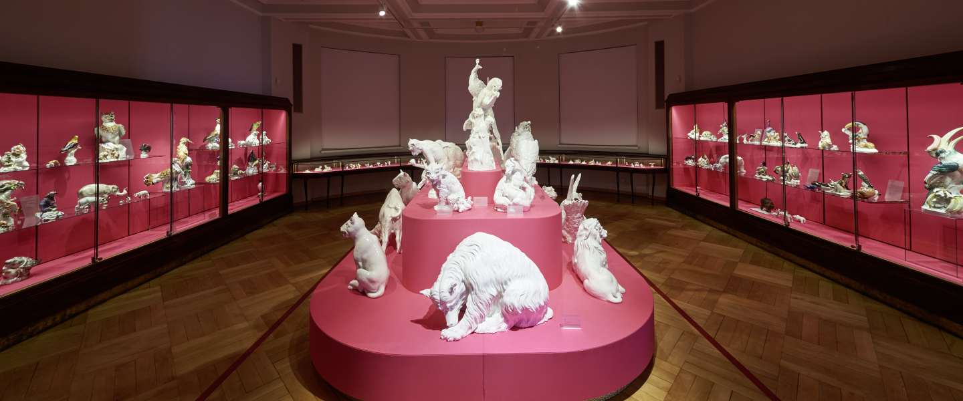
The Museum of the Meissen Porcelain Foundation displays works from the manufactory’s 300 years of history.
The collection tells the rich story of Europe’s oldest porcelain manufactory. https://www.erlebniswelt-meissen.com/en/experience/museum

Slide 4
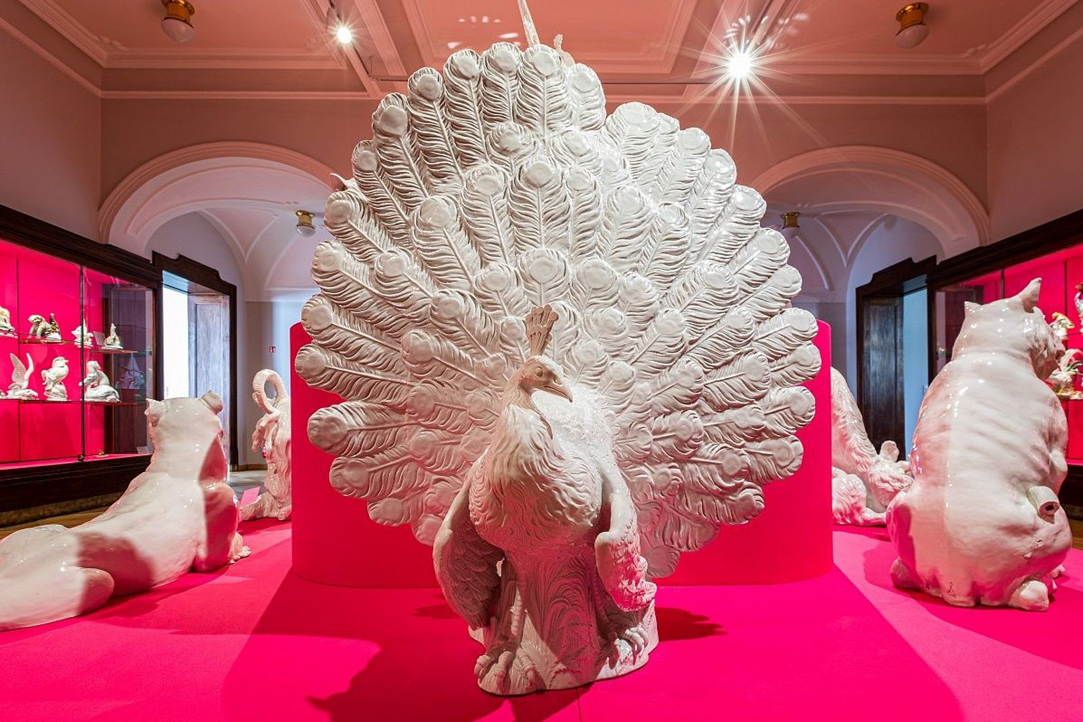
https://www.porzellan-museum.com/en/museum/museum-knockouts/

Slide 5
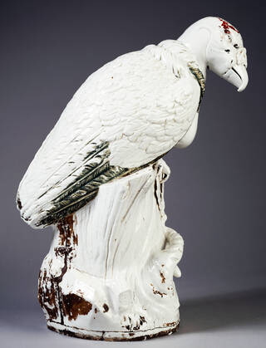
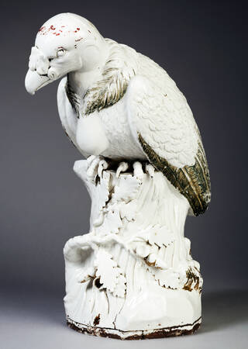
Meissen Porcelain Manufactory, active 1710 – present, Dresden, Germany
Modelled by Johann Joachim Kändler, 1706 – 1775
King Vulture, about 1731, white glazed hard-paste porcelain, 57.5x23 cm, Victoria and Albert Museum, London, UK https://www.vam.ac.uk/articles/meissens-king-vulture

Slide 6
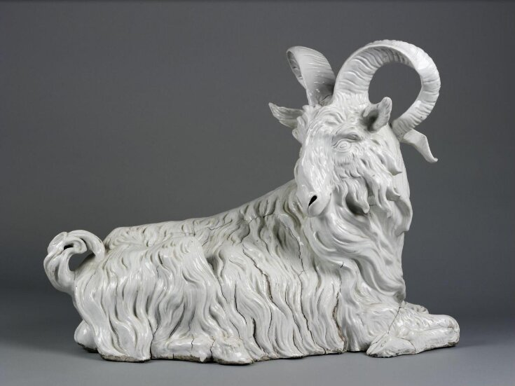
Meissen Porcelain Manufactory, active 1710 – present, Dresden, Germany
Modelled by Johann Joachim Kändler, 1706 – 1775
Goat figure, 1732, white glazed hard-paste porcelain, 66x55.9 cm, Victoria and Albert Museum, London, UK https://www.vam.ac.uk/articles/meissens-king-vulture

Slide 7
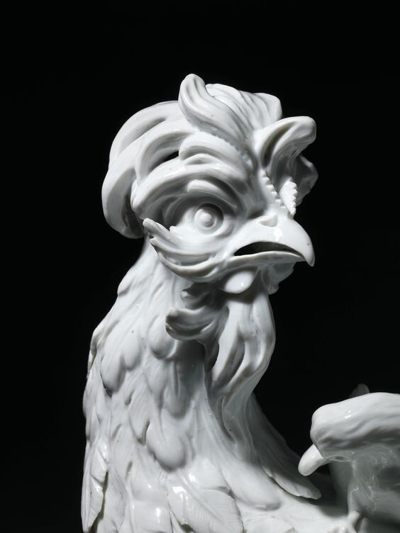
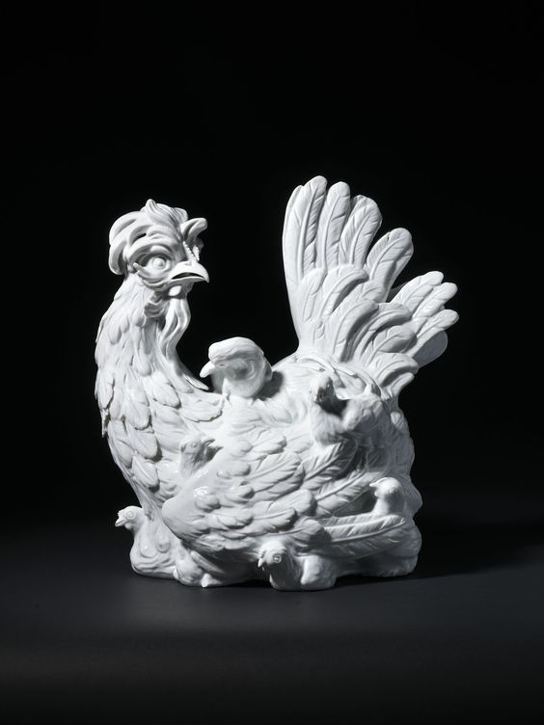
Meissen Porcelain Manufactory, active 1710 – present, Dresden, Germany
Modelled by Johann Joachim Kändler, 1706 – 1775
A Hen with her Chicks, 1732, white glazed hard-paste porcelain, Height: 34.5 cm, Private Collection http://www.alaintruong.com/archives/2019/07/06/37482303.html

Slide 8
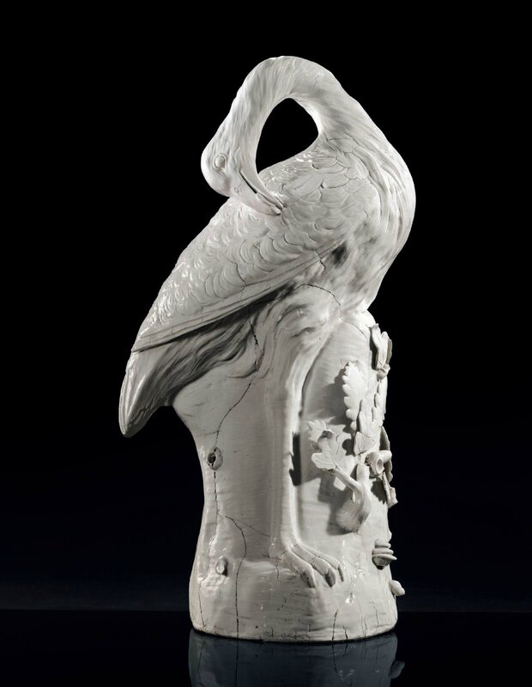
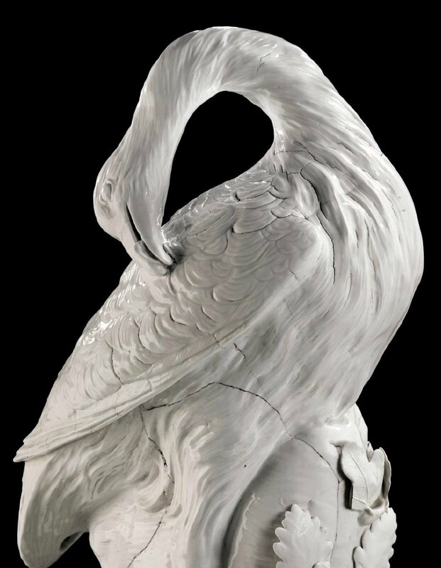
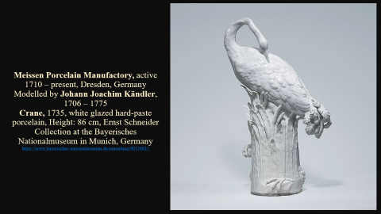
Meissen Porcelain Manufactory, active 1710 – present, Dresden, Germany
Modelled by Johann Joachim Kändler, 1706 – 1775
Great Bustard, 1732, white glazed hard-paste porcelain, Height: 83.8 cm, The Frick Colletion, New York, NY, USA https://www.christies.com/stories/archive

Slide 9
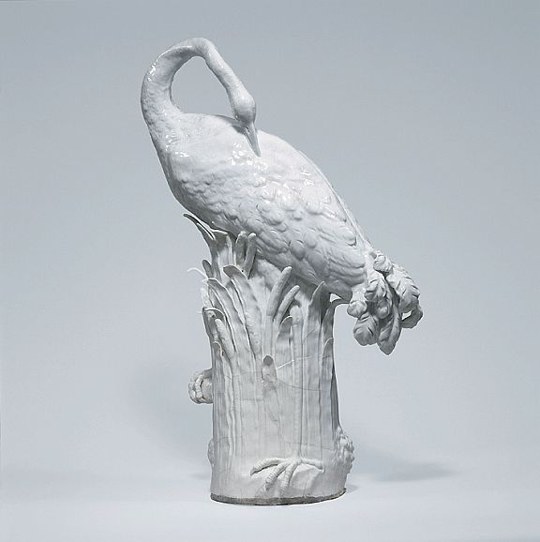
Meissen Porcelain Manufactory, active 1710 – present, Dresden, Germany
Modelled by Johann Joachim Kändler, 1706 – 1775
Crane, 1735, white glazed hard-paste porcelain, Height: 86 cm, Ernst Schneider Collection at the Bayerisches Nationalmuseum in Munich, Germany https://www.bayerisches-nationalmuseum.de/sammlung/00136615

Slide 10
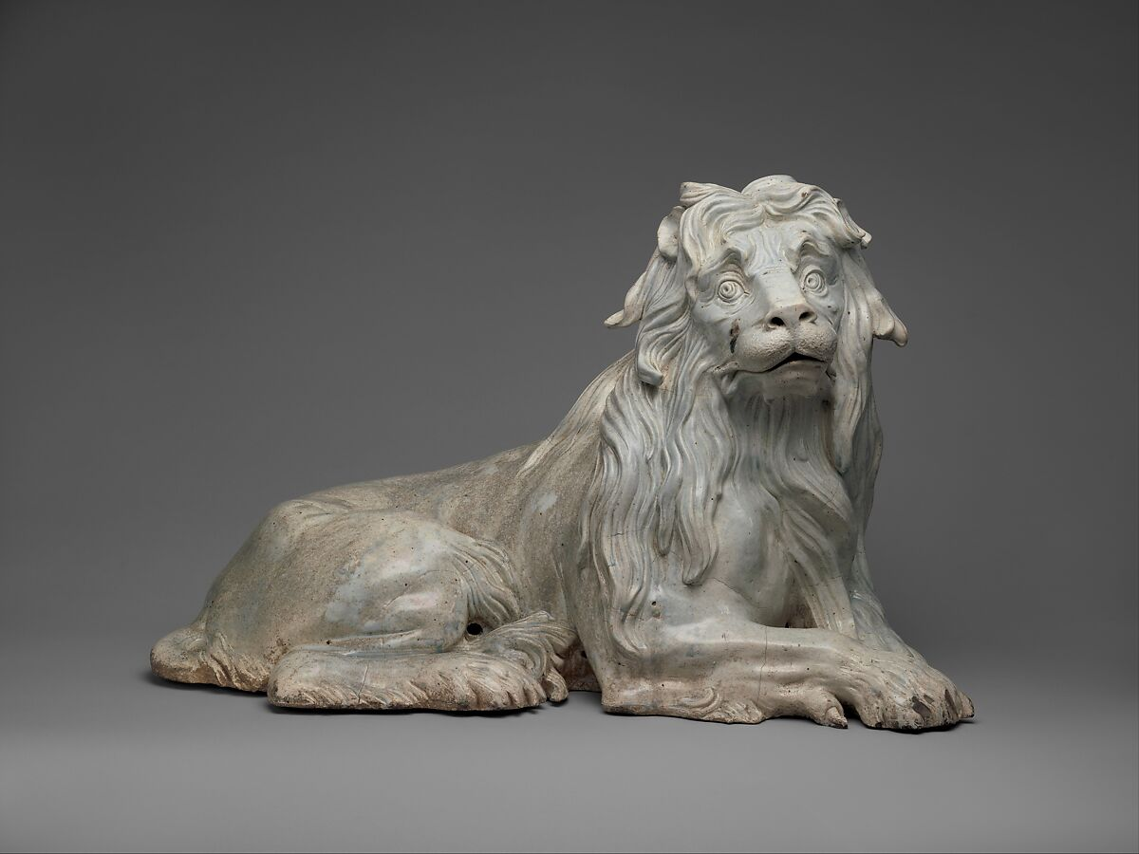
Meissen Porcelain Manufactory, active 1710 – present, Dresden, Germany
Modelled by Gottlieb Kirchner, 1706 – 1738
Lion, 1732, white glazed hard-paste porcelain, 53.3 x 83.2 x 34.3 cm, the MET, NY, USA https://www.metmuseum.org/art/collection/search/208816

Slide 11
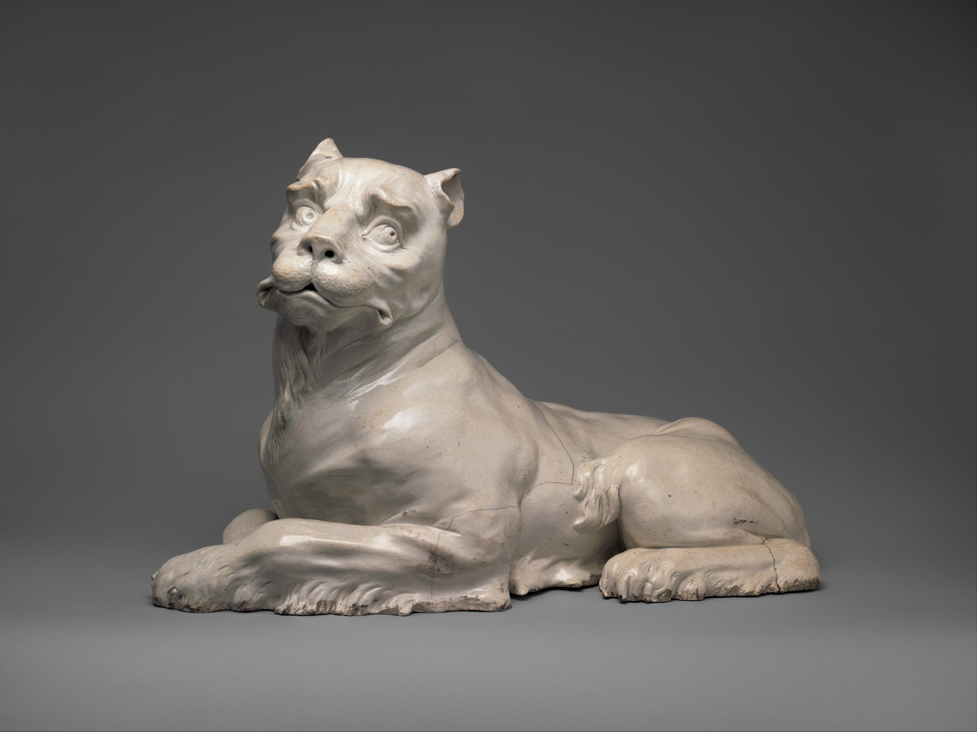
Meissen Porcelain Manufactory, active 1710 – present, Dresden, Germany
Modelled by Gottlieb Kirchner, 1706 – 1738
Lioness, 1732, white glazed hard-paste porcelain, 48.3 x 75.9 x 33 cm, the MET, NY, USA https://www.metmuseum.org/art/collection/search/207764

Slide 12
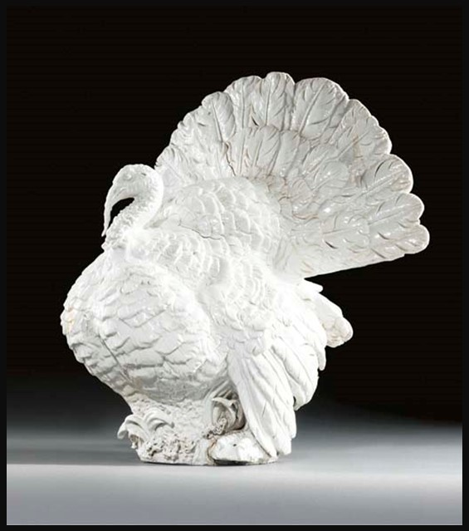
Meissen Porcelain Manufactory, active 1710 – present, Dresden, Germany
Modelled by Johann Joachim Kändler, 1706 – 1775
A Turkey, 1733, white glazed hard-paste porcelain, 53.5 × 51 × 20 cm, the Getty Museum, CA, USA https://www.christies.com/en/lot/lot-3933086

Slide 13
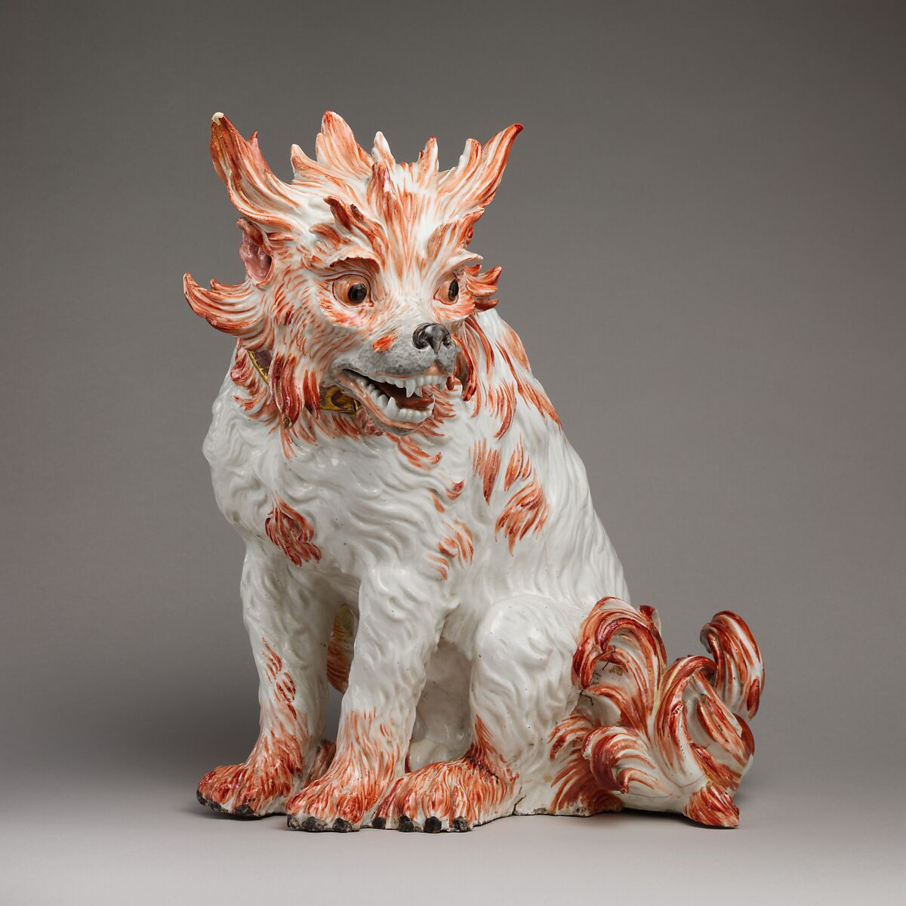
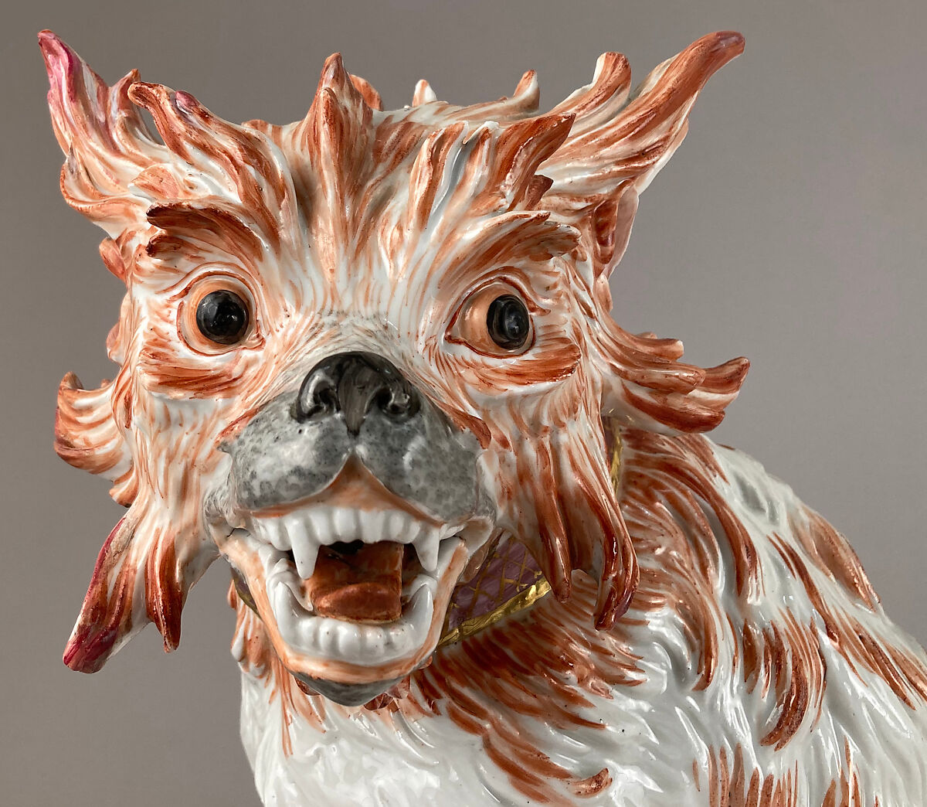
Meissen Porcelain Manufactory, active 1710 – present, Dresden, Germany
Modelled by Johann Joachim Kändler, 1706 – 1775
Bolognese Dog, 1733, white glazed hard-paste porcelain, 42.7 × 36.8 cm, the MET, New York, NY, USA https://www.metmuseum.org/art/collection/search/201771

Slide 14
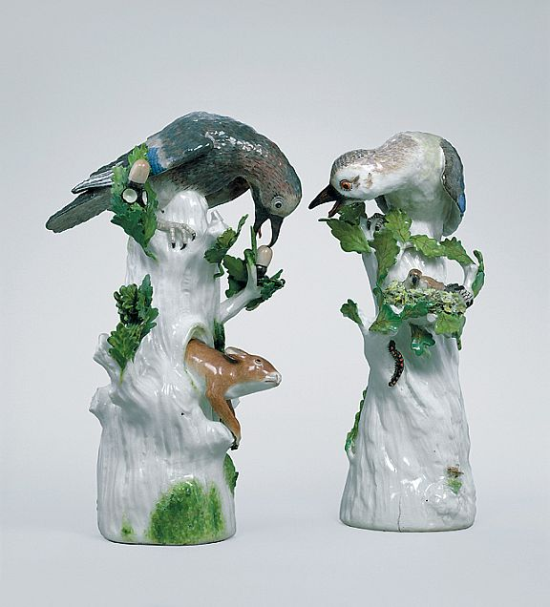
Meissen Porcelain Manufactory, active 1710 – present, Dresden, Germany
Modelled by Johann Joachim Kändler, 1706 – 1775
Jay with Nest, 1735-40, hard-paste porcelain painted in enamels and gold, Height: 39.2 cm,
Ernst Schneider Collection at the Bayerisches Nationalmuseum in Munich, Germany https://www.bayerisches-nationalmuseum.de/sammlung/00136782

Slide 15
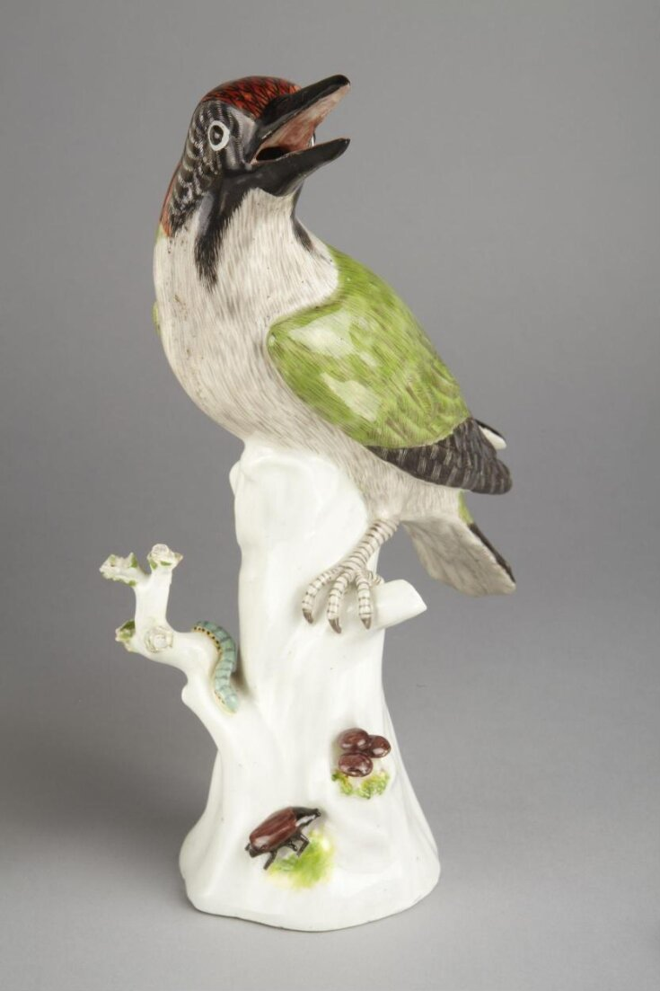
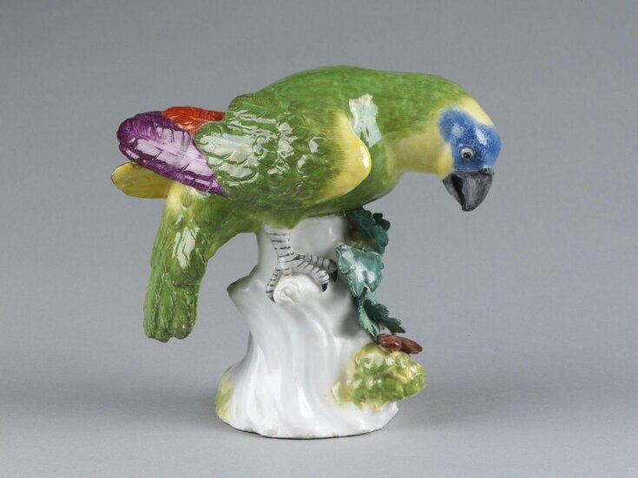
Meissen Porcelain Manufactory, active 1710 – present, Dresden, Germany
Modelled by Johann Joachim Kändler, 1706 – 1775
Figure of a Woodpecker, 1740-45, hard-paste porcelain painted in enamels, Height: 26.5 cm
Model of a Parrot, 1740, hard-paste porcelain painted in enamels, Height: 15.1 cm
Victoria and Albert Museum, London, UK https://collections.vam.ac.uk/item/O341820/figure-k%C3%A4ndler-johann-joachim/ and https://collections.vam.ac.uk/item/O307762/parrot-k%C3%A4ndler-johann-joachim/

Slide 16
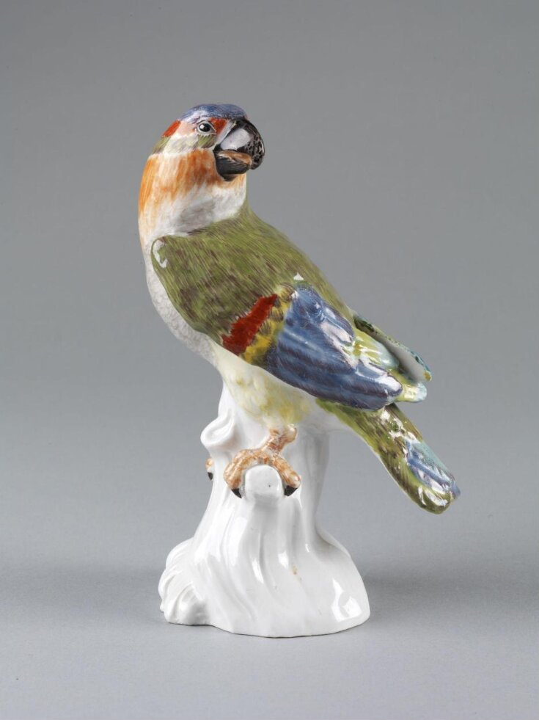
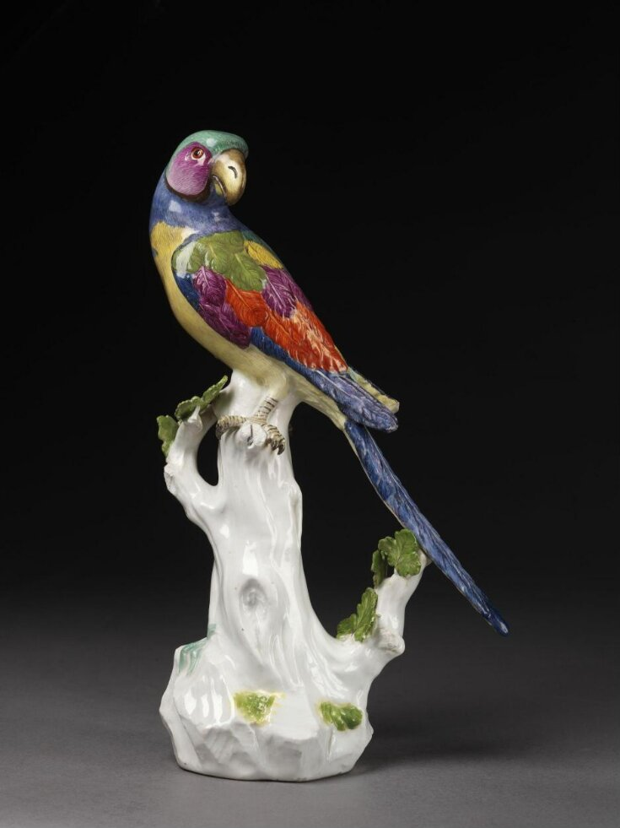
Meissen Porcelain Manufactory, active 1710 – present, Dresden, Germany
Modelled by Johann Joachim Kändler, 1706 – 1775
Model of a Parrot, 1742, hard-paste porcelain painted in enamels, Height: 19 cm
Model of a Parrot, 1742, hard-paste porcelain painted in enamels, Height: 32.1cm
Victoria and Albert Museum, London, UK https://collections.vam.ac.uk/item/O307765/parrot-k%C3%A4ndler-johann-joachim/ and https://collections.vam.ac.uk/item/O307767/parrot-k%C3%A4ndler-johann-joachim/

Slide 17
The End

