Slide 1
The Middle Ages
Western Europe
from the 4th to the 15th century

Slide 2
The Middle Ages
France
The Migration Period
4th century to 8th century

Slide 3
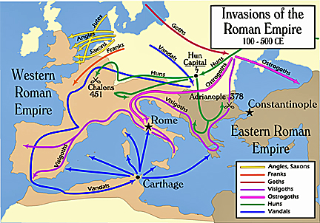
Migration Period, 5th cent.-800 AD
Ostrogoths
Visigoths
Franks
Anglo Saxons
Vandals https://en.wikipedia.org/wiki/Migration_Period

Slide 4
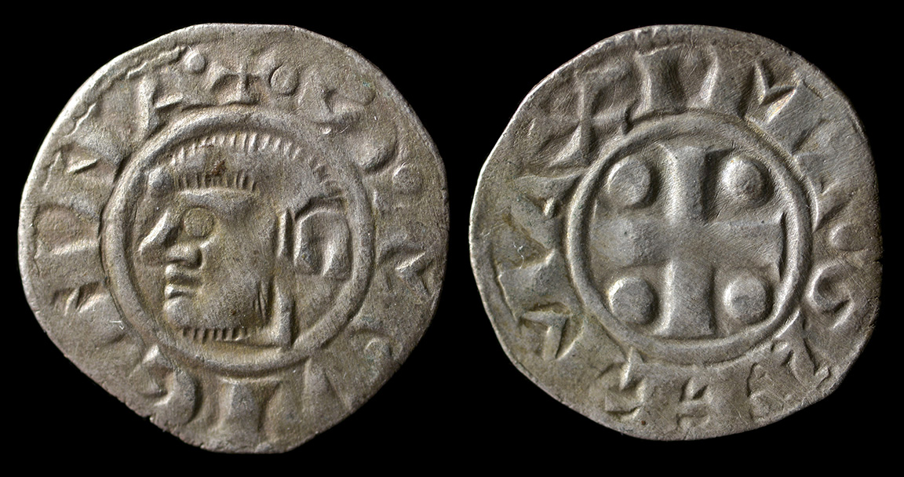
The Migration Period was a period in European history marked by large-scale migrations that saw the fall of the Western Roman Empire and subsequent settlement of its former territories by various tribes. The term refers to the important role played by the migration, invasion and settlement of various tribes, notably the Franks, Goths, Alemanni, Alans, Huns, the early Slavs, Pannonian Avars, Magyars, and Bulgars within or into the former Western Empire and Eastern Europe. The period is traditionally taken to have begun in AD 375 (possibly as early as 300) and ended in 568. Various factors contributed to this phenomenon of migration and invasion, and their role and significance are still widely discussed.

Slide 5
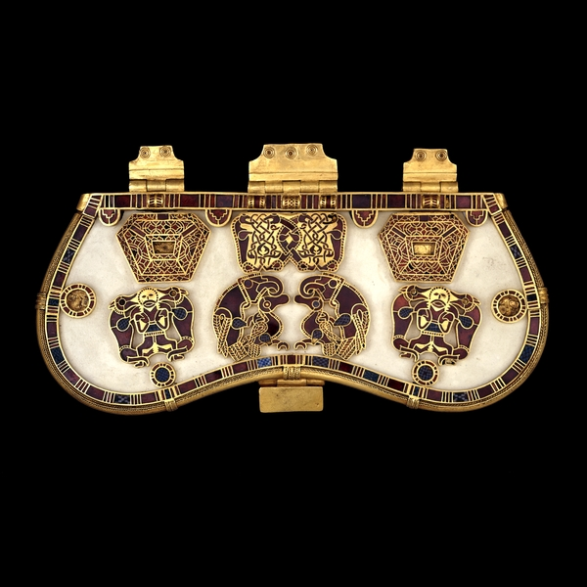
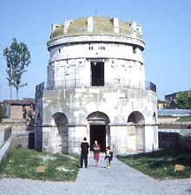
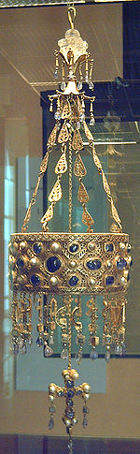
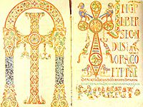
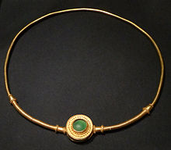
Migration Period
400-800 AD
Anglo Saxon
Sutton Hoo Ship Burial
Ostrogoths
Mausoleum of Theodoric in Ravenna
Vandals
Jewelry
Franks
Gelsian Scramentary
Visigoths
Votive Crown of Recceswinth

Slide 6
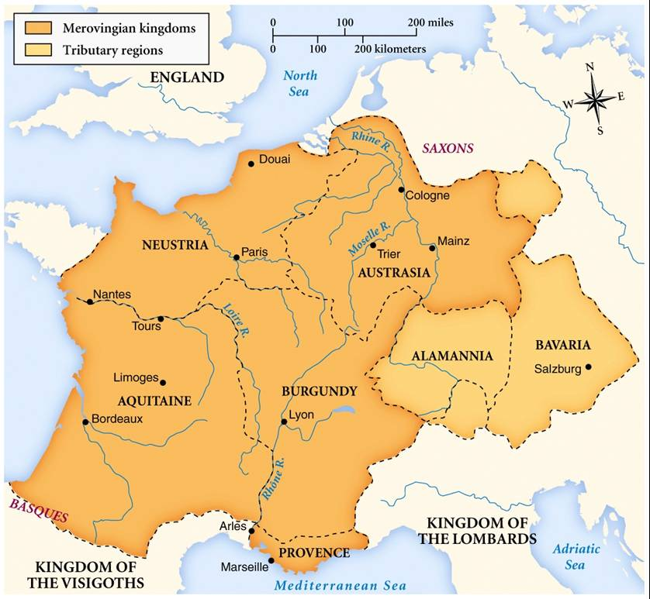
The Merovingian kingdoms at their height https://commons.wikimedia.org/wiki/File:Merovingian_dynasty.jpg

Slide 7
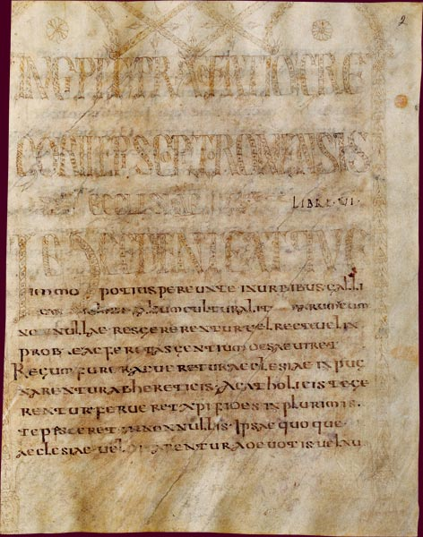
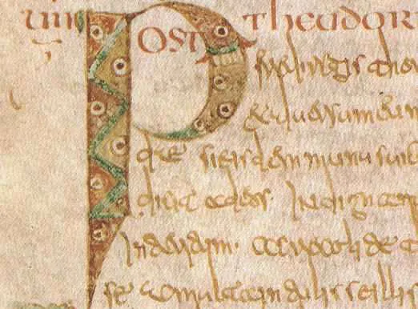
Gregory of Tours (c. 538 – 594 AD), History of the Franks, books 1 to 6, Frontispiece page., 7th century, Bibliothèque Nationale de France https://commons.wikimedia.org/wiki/File:Gr%C3%A9goire_de_Tours,_Histoire_des_Francs,_livres_1_%C3%A0_6,_page_de_frontispice.jpg https://www.medievalists.net/2009/04/wars-and-warriors-in-gregory-of-tours-histories-i-iv/

Slide 8
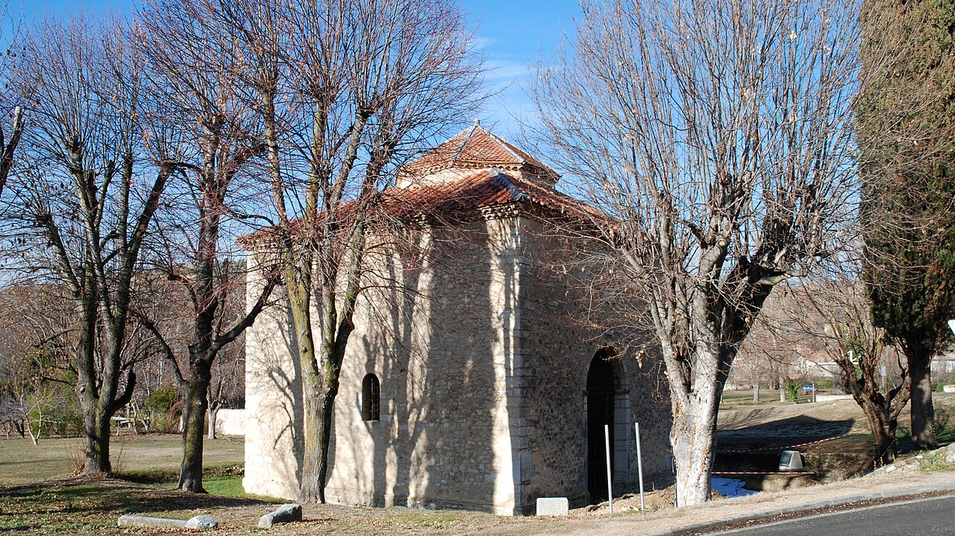
Baptistery of Riez, 5th century, 12th century dome, Alpes-de-Haute-Provence https://commons.wikimedia.org/wiki/File:Alpes-de-Haute-Provence_-_Baptist%C3%A8re_de_Riez_-_02.jpg

Slide 9
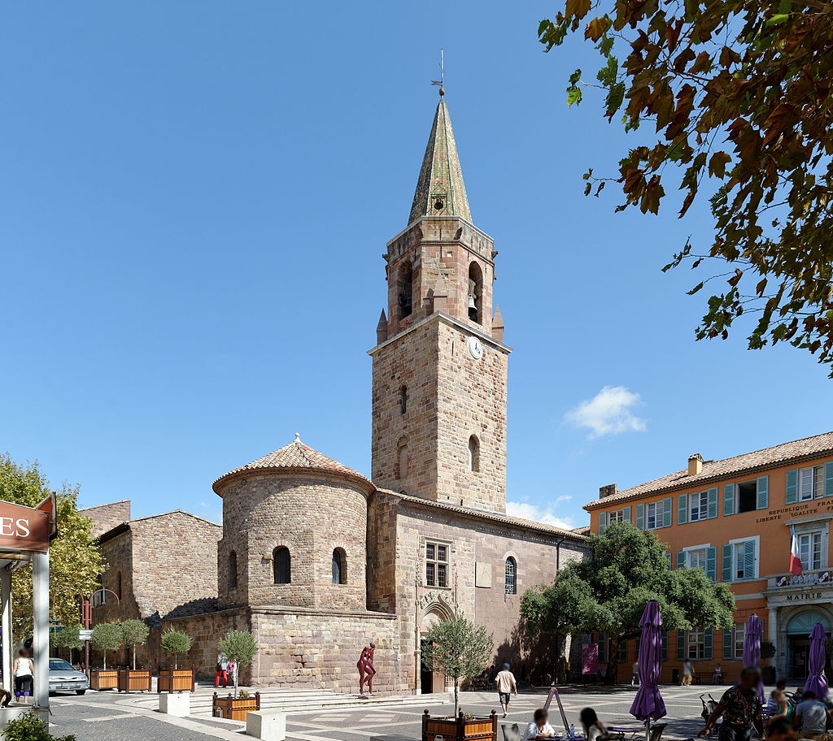
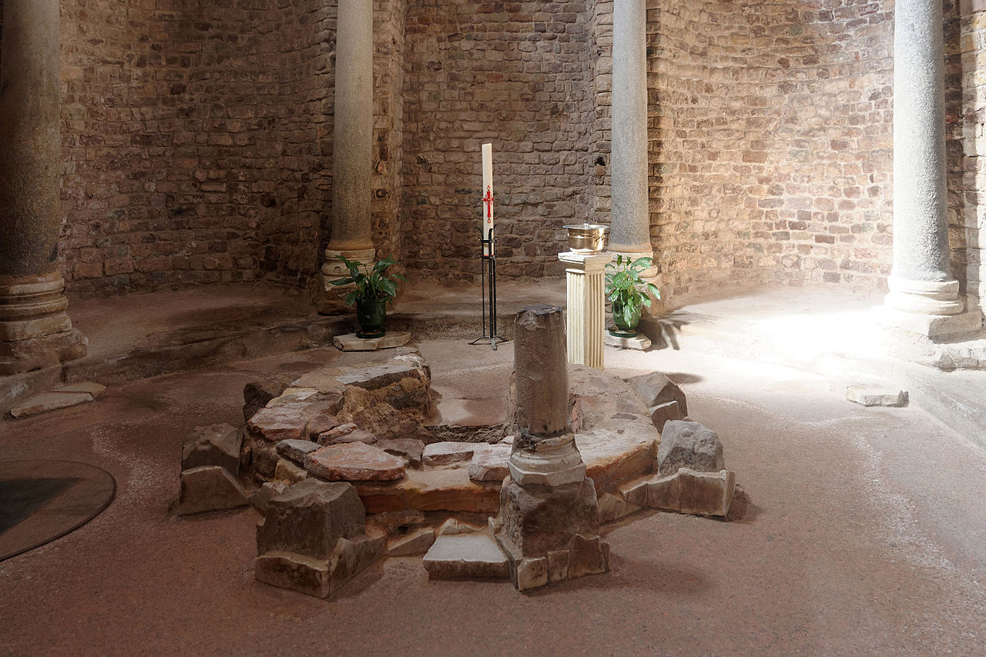
Cathedral of Saint Léonce, Fréjus, Var, France https://commons.wikimedia.org/wiki/File:Fr%C3%A9jus_Cath%C3%A9drale_Saint_L%C3%A9once_02.jpg

Slide 10
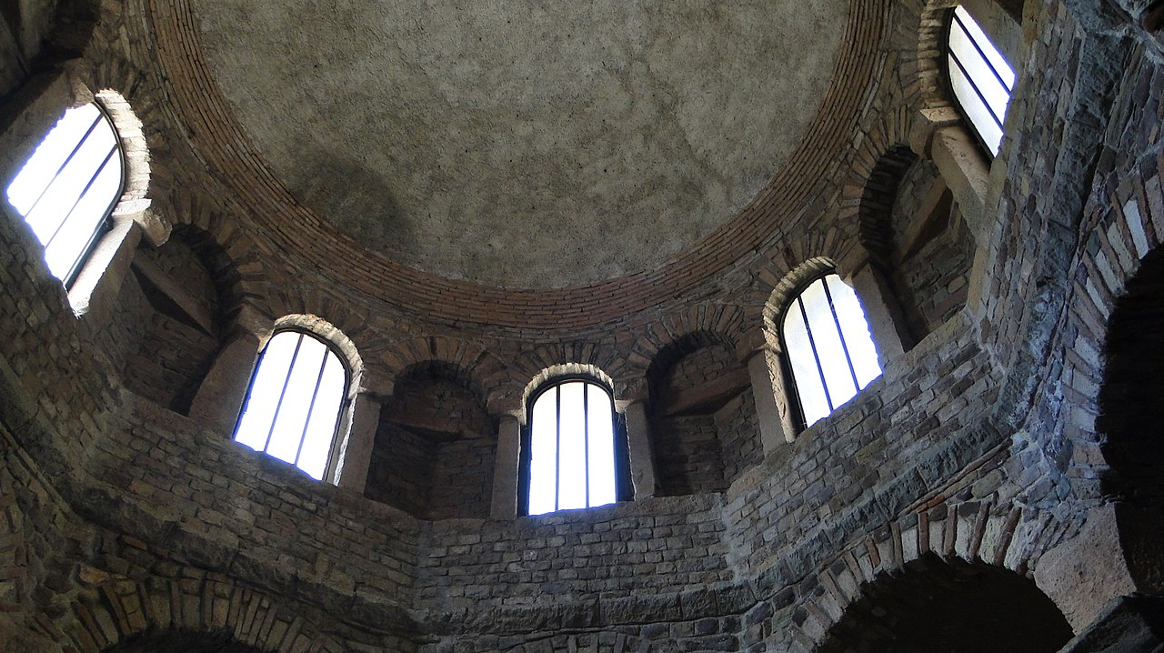
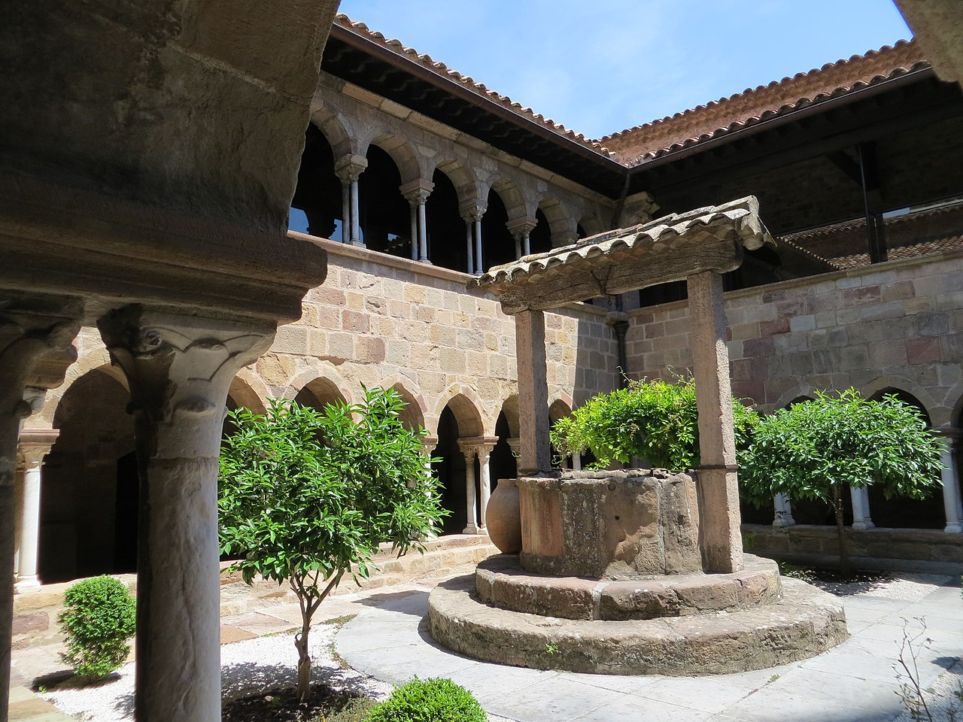
https://en.wikipedia.org/wiki/Fr%C3%A9jus_Cathedral#/media/File:Fr%C3%A9jusBattist.Cupola.jpg https://en.wikipedia.org/wiki/Fr%C3%A9jus_Cathedral#/media/File:12_PAC_-_Var_-_Fr%C3%A9jus_-_Cathedrale_Saint-Leonce_(2012-06-07_12-31-40).jpg

Slide 11
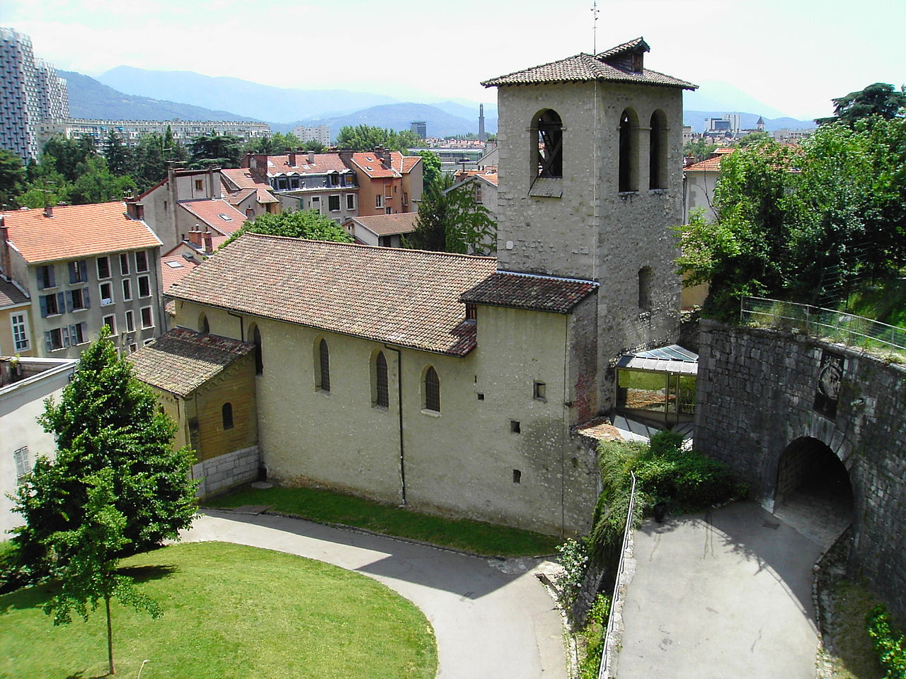
Grenoble Archaeological Museum, Saint-Laurent Church https://commons.wikimedia.org/wiki/File:Mus%C3%A9e_arch%C3%A9ologique2_-_Grenoble.JPG

Slide 12
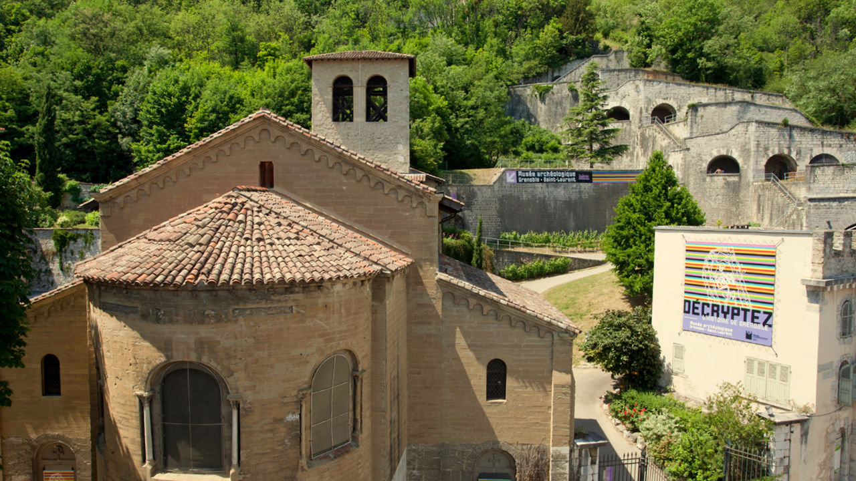
Saint-Laurent à Grenoble, 6th century, France https://commons.wikimedia.org/wiki/File:Le_mus%C3%A9e_arch%C3%A9ologique_de_Grenoble.jpg

Slide 13
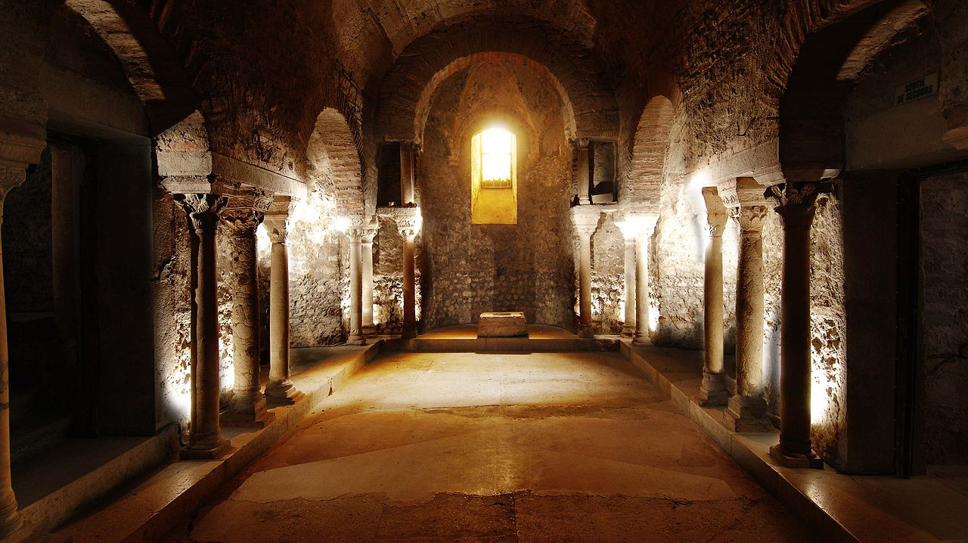
https://en.wikipedia.org/wiki/Grenoble_Archaeological_Museum#/media/File:126_Mus%C3%A9e_arch%C3%A9ologique_de_Grenoble.jpg

Slide 14
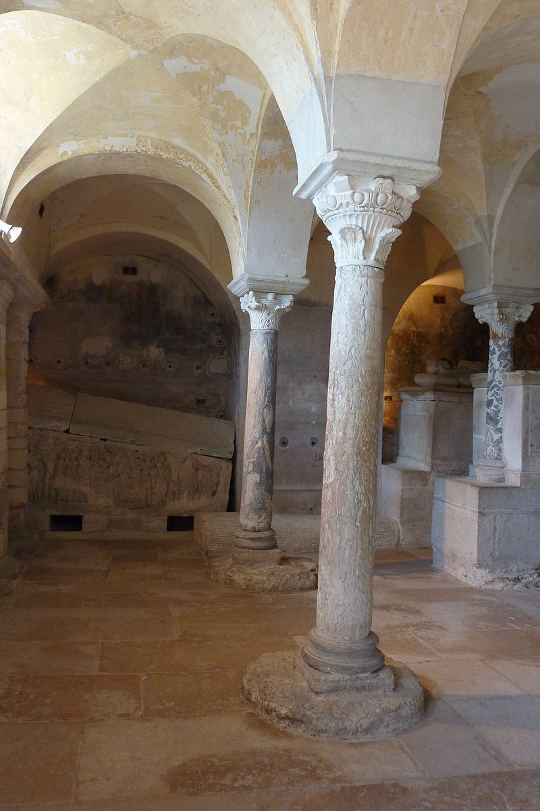
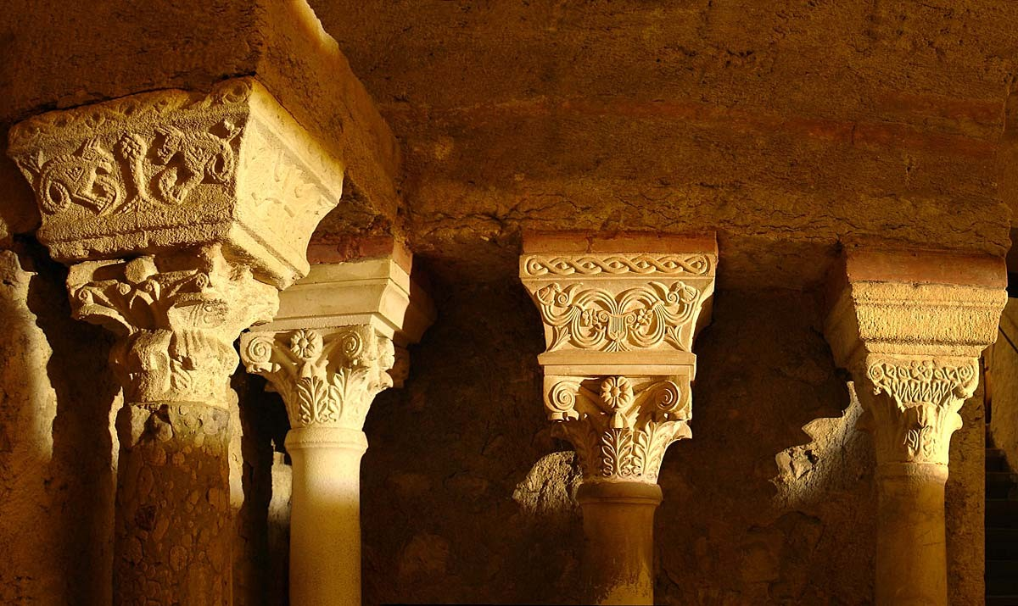
https://en.wikipedia.org/wiki/Merovingian_art_and_architecture https://www.grenoble-tourisme.com/en/catalog/detail/musee-archeologique-saint-laurent-grenoble-ferme-214472/

Slide 15
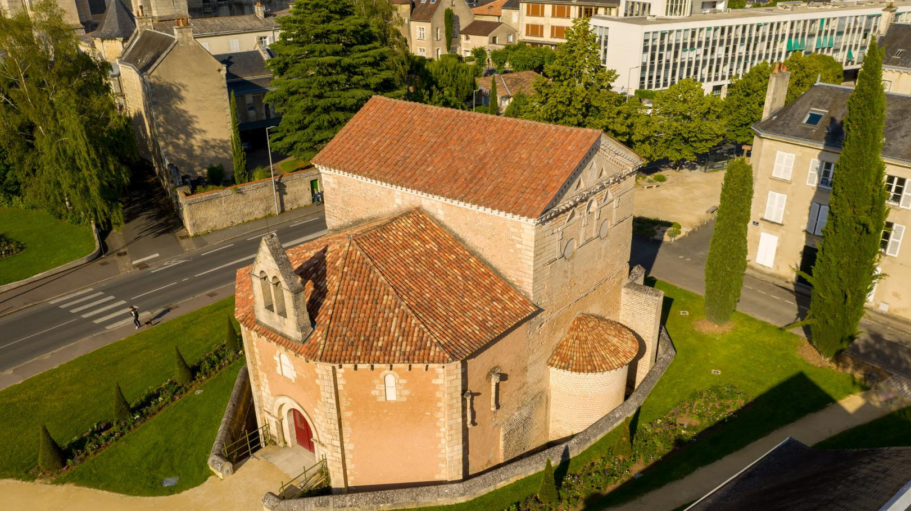
Baptistery of St. John in Poitiers, 6th century, France https://visitpoitiers.fr/en/activity/baptistere-saint-jean/

Slide 16
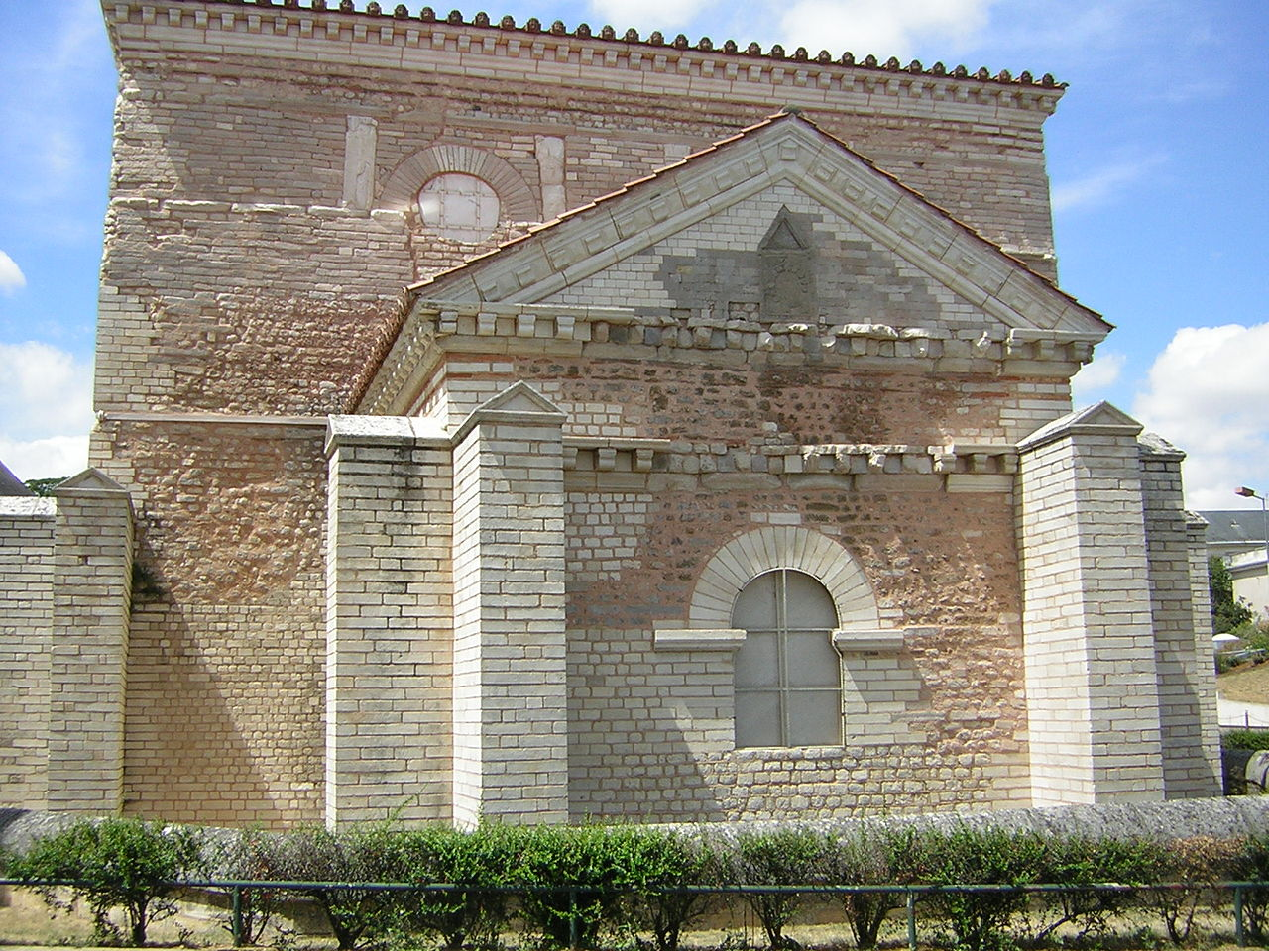
Baptistery of St. John in Poitiers, 6th century, France https://en.wikipedia.org/wiki/Baptist%C3%A8re_Saint-Jean#/media/File:312_Poitiers_baptisterio.JPG

Slide 17
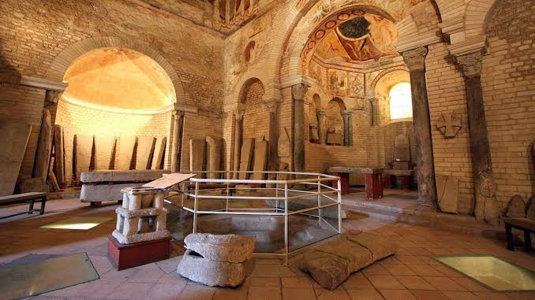
https://www.trip.com/travel-guide/attraction/bordeaux/baptistere-st-jean-23026609/

Slide 18
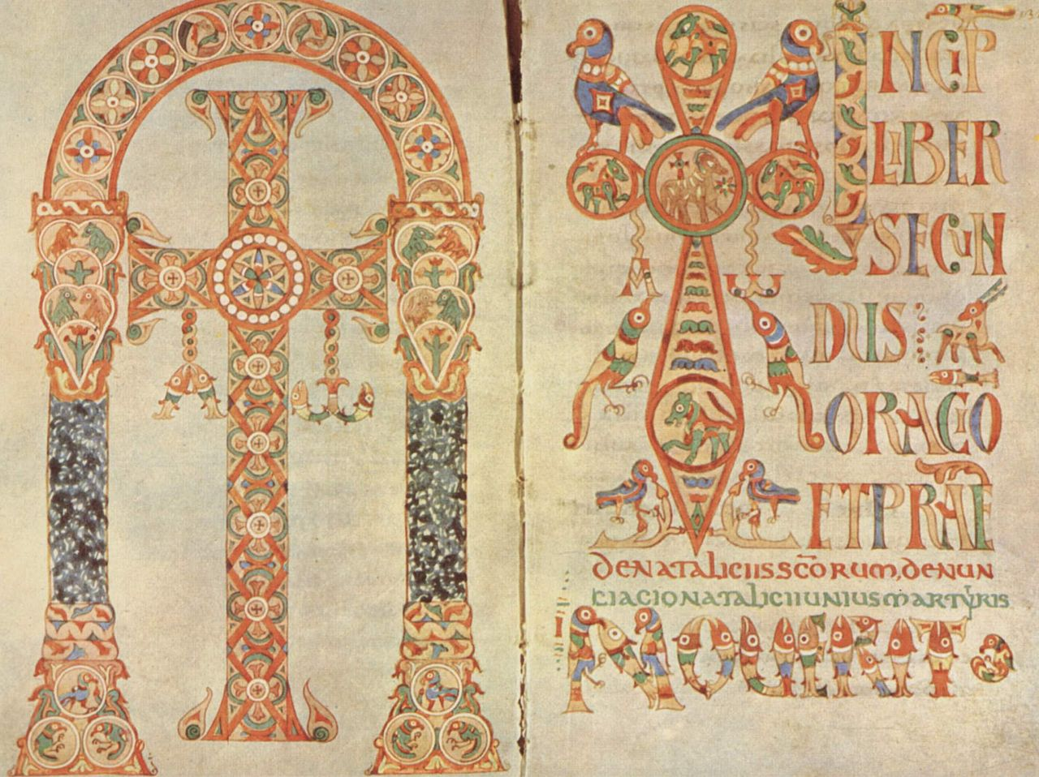
Gelasian Sacramentary, around 750, Illuminated Manuscript in Vellum, 26x33.4 cm, Vatican Library, Italy https://en.wikipedia.org/wiki/Gelasian_Sacramentary

Slide 19
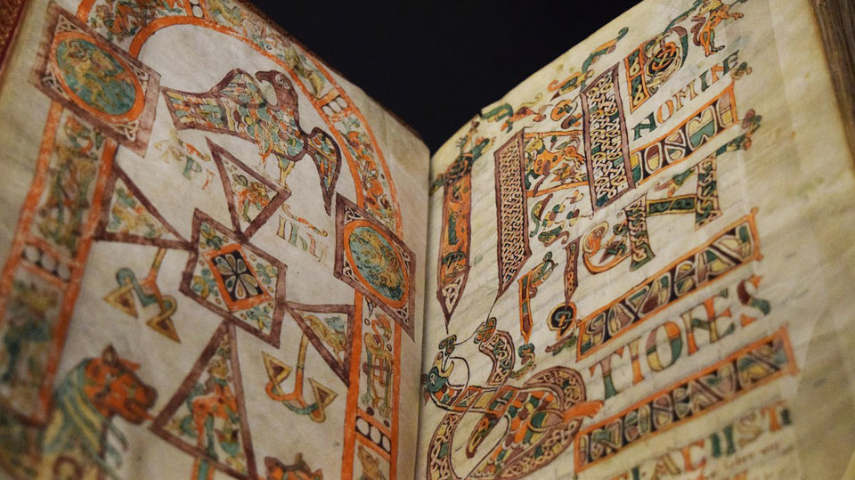
Augustinus Hipponensis, Quaestiones et locutiones in Heptateuchum, livres I-IV, 8th century. (around 750-770?), Cv-1r, Illuminated Manuscript, 305 x 220 mm, BnF, ms. Latin 12168, France https://archivesetmanuscrits.bnf.fr/ark:/12148/cc34697k and https://www.medieval.eu/the-merovingian-times/
/

Slide 20
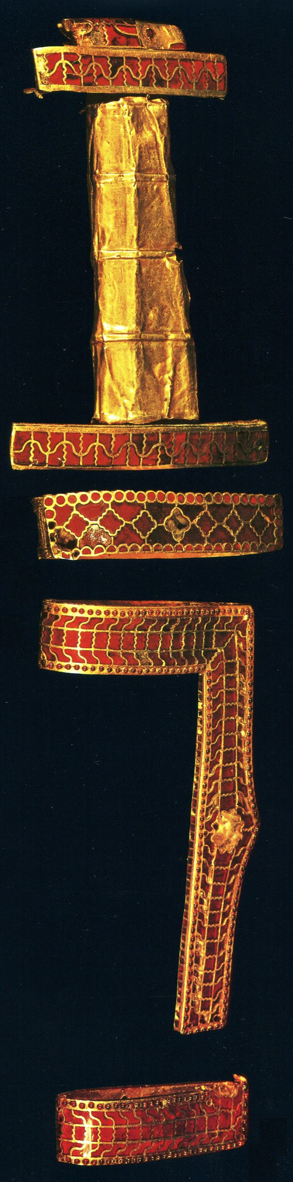
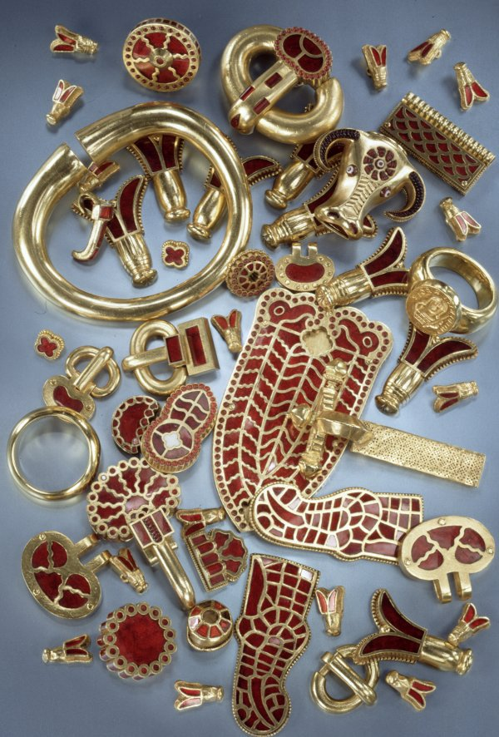
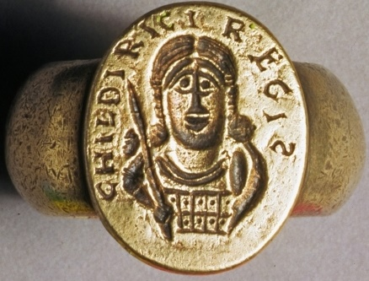
Among the greatest discoveries of lost objects was the 1653 accidental uncovering of Childeric I’s Tomb (ruled 473–480) in the church of Saint Brice in Tournai.
The grave objects included a golden bull's head and the famous golden insects (perhaps bees, cicadas, aphids, or flies) on which Napoleon modelled his coronation cloak. https://twitter.com/caitlinrgreen/status/826771331106689024 and https://gr.pinterest.com/pin/455848793529220985/ and http://www.thehistoryblog.com/wp-content/uploads/2015/07/Childeric-hilt-of-double-edged-sword-or-spatha-and-fittings-from-scramasax-scabbard.jpg

Slide 21
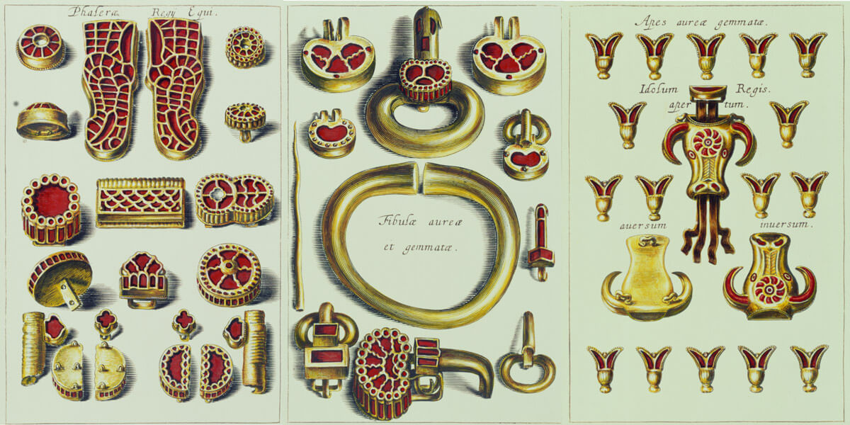
https://barbarzynskie-tsunami.muzeum.szczecin.pl/wystawa-barbarzynskie-tsunami/wielkie-sprzatanie.html#fancybox-14

Slide 22
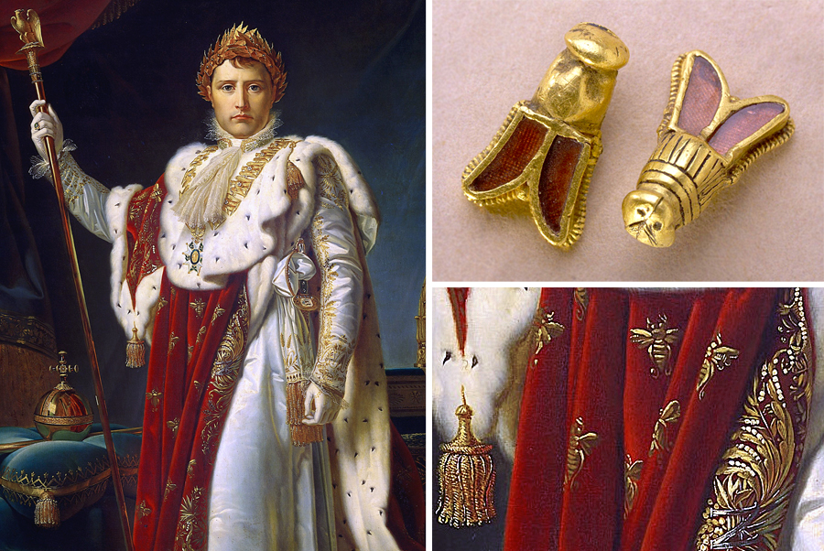
https://www.hhantiquejewelry.com/napoleon-bees-jewelry-tomb-childeric-i-symbols-empire/

Slide 23
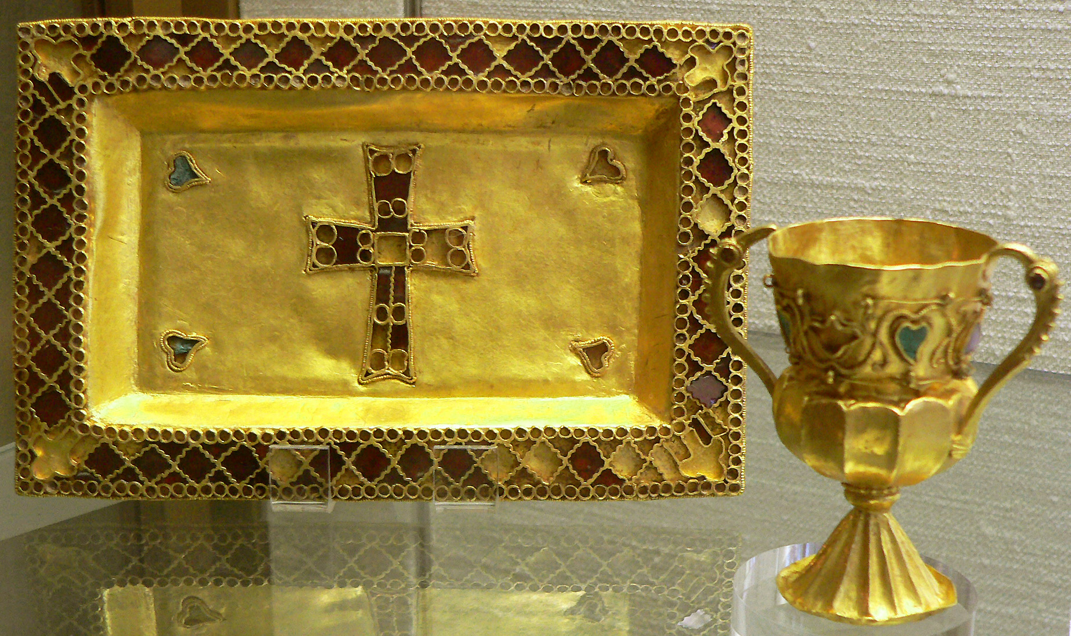
Trésor de Gourdon, 5th to 6th centuries, Chalice and Paten, Gold, turquoise et cloisonné garnets, Chalice H.: 7,5 cm, Paten: 7,5x19,5 cm; Cabinet des Médailles, Paris, France https://fr.wikipedia.org/wiki/Tr%C3%A9sor_de_Gourdon

Slide 24
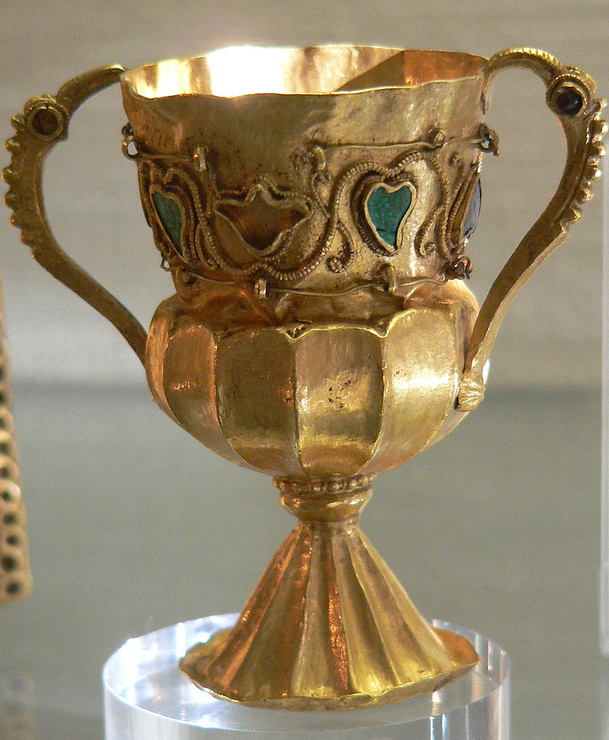
Trésor de Gourdon, Chalice, 5th to 6th centuries, Gold,turquoise et garnets, H.: 7,5 cm, Cabinet des Médailles, Paris, France https://commons.wikimedia.org/wiki/File:Tr%C3%A9sor_de_Gourdon_04.JPG https://fr.wikipedia.org/wiki/Tr%C3%A9sor_de_Gourdon

Slide 25
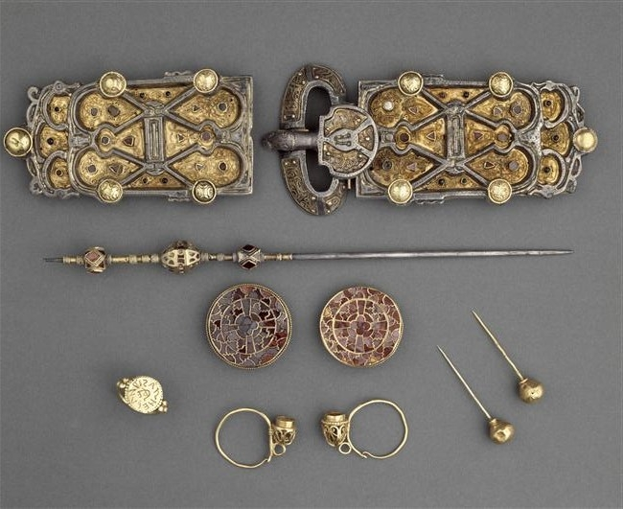
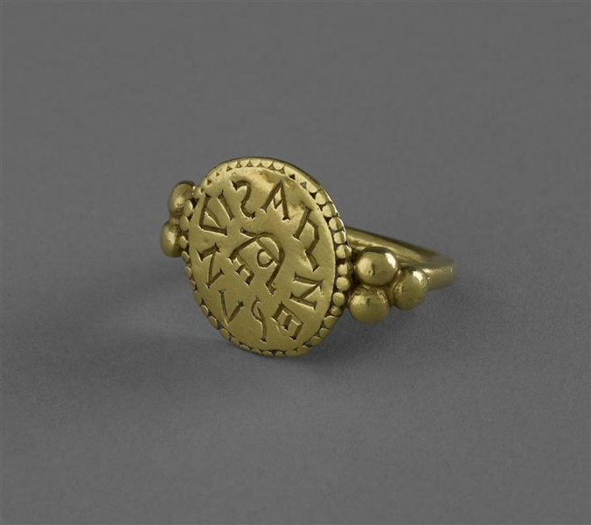
Metrial from the tomb of Queen Arnegunde buried between 580 and 590. Photo: © RMN-Grand Palais (National Archeology Museum) / Jean-Gilles Berizzi. https://archeologie.culture.gouv.fr/saint-denis/en/queen-arnegunde-510520-580590

Slide 26
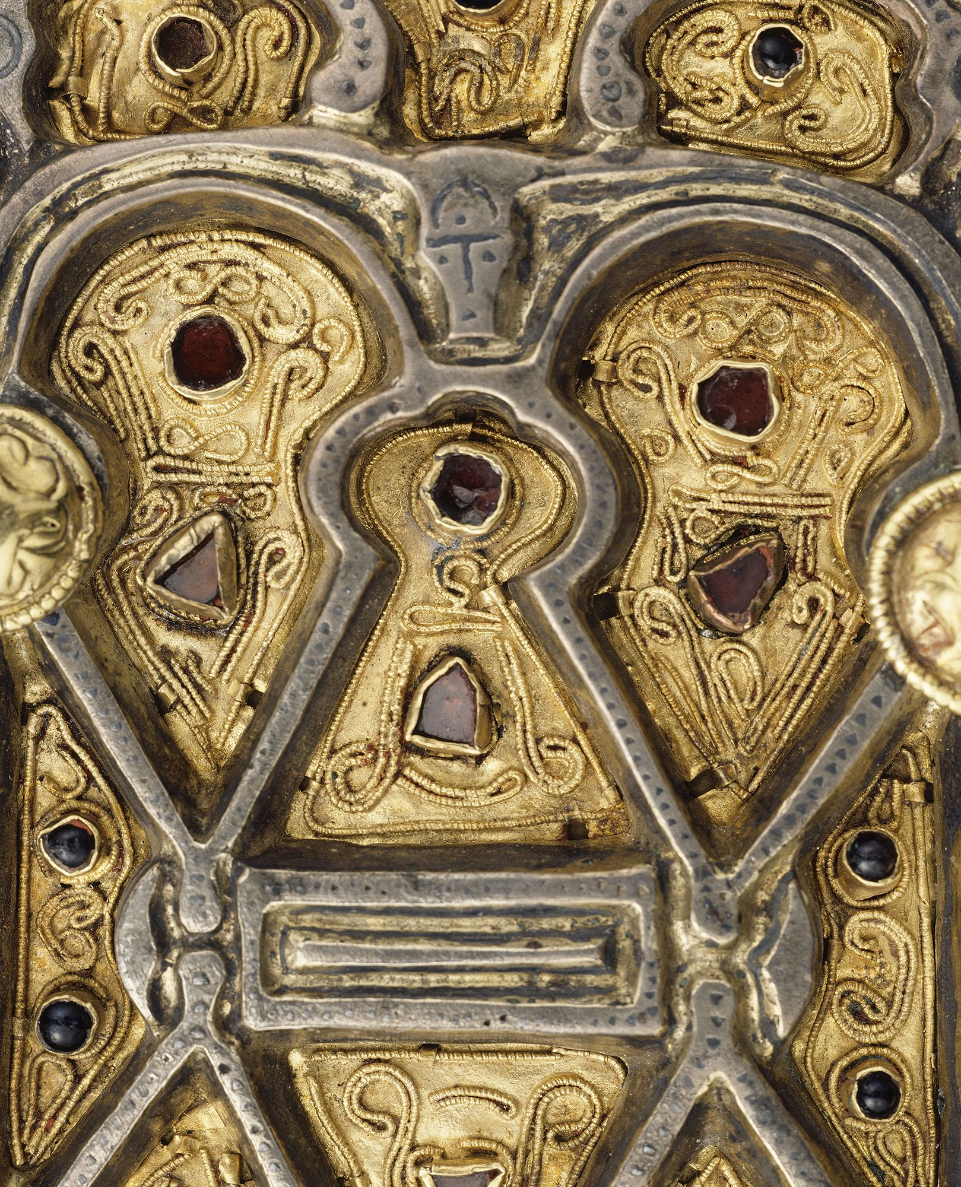
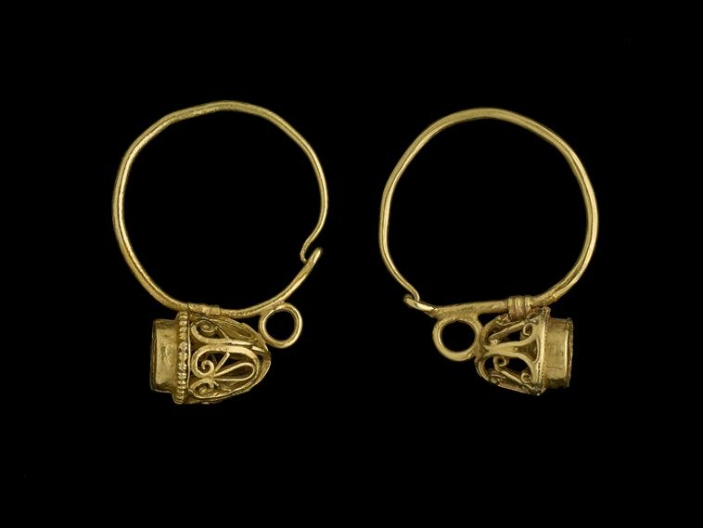
https://archeologie.culture.gouv.fr/saint-denis/en/queen-arnegunde-510520-580590 https://panoramadelart.com/parure-de-la-reine-aregonde

Slide 27
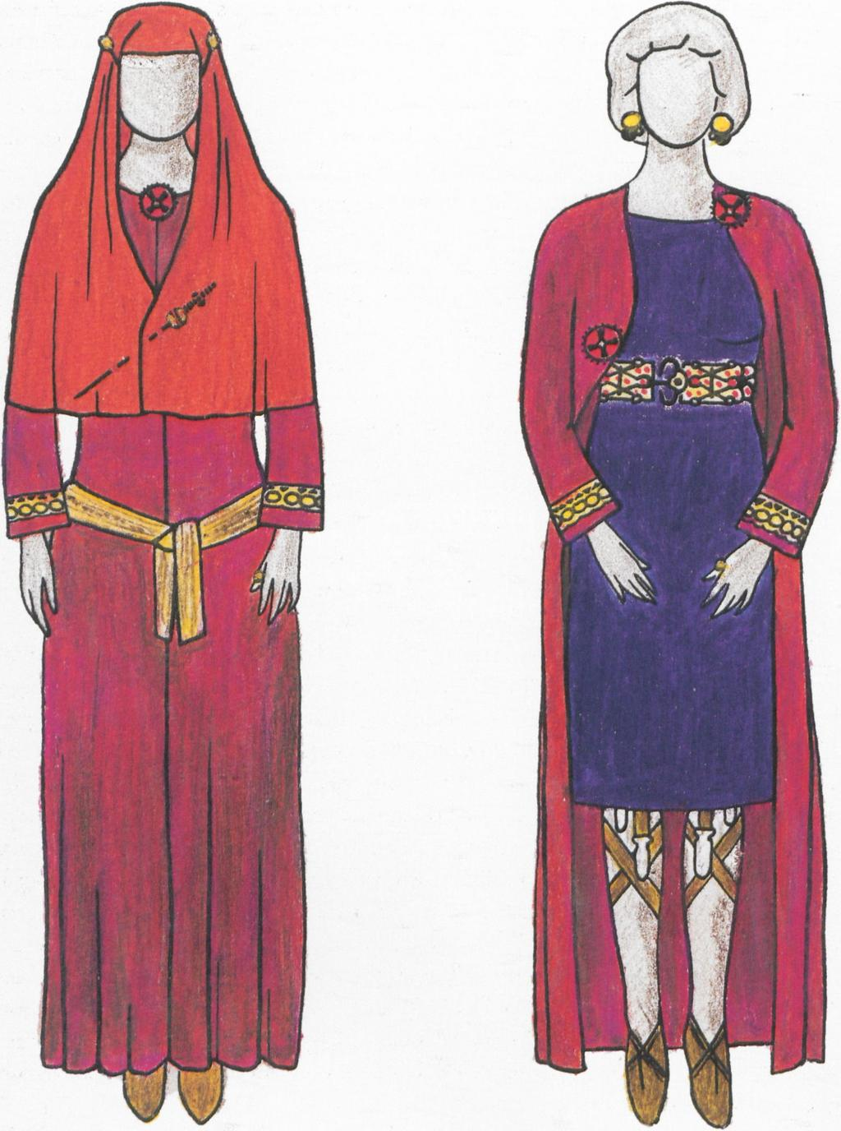
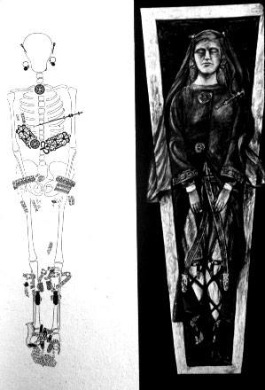
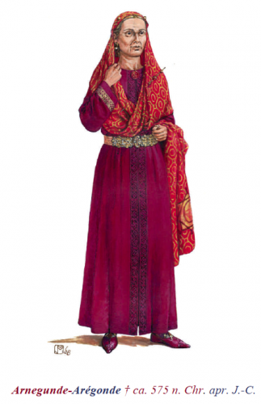
https://docplayer.org/55386822-Die-menschen-im-fruehmittelalter.html https://arula.hypotheses.org/557 https://m.facebook.com/471707109534948/photos/the-tomb-of-queen-arnegunde-aregundhttpbenedanteblogspotca201311the-tomb-of-quee/771866432852346/

Slide 28
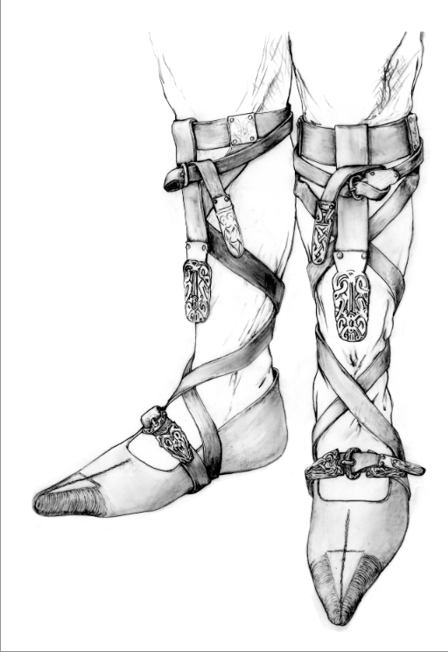
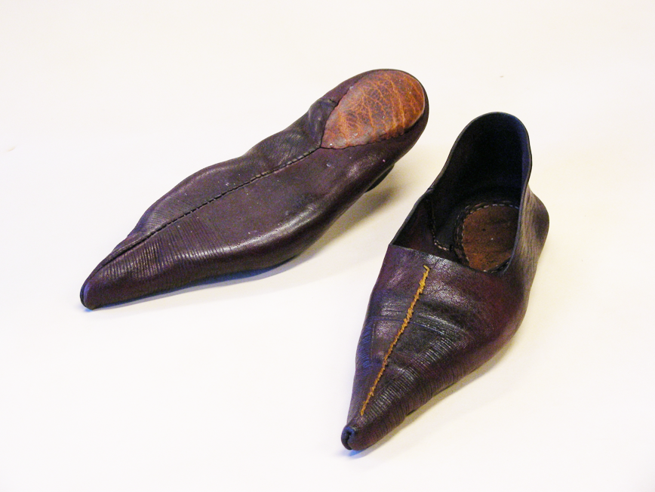
https://shoemuseum.ch/dossiers/2533-2/

Slide 29
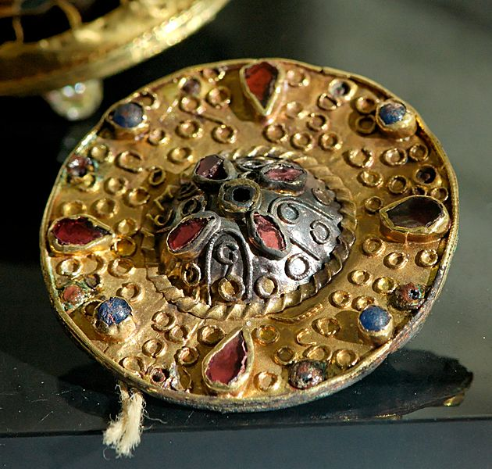
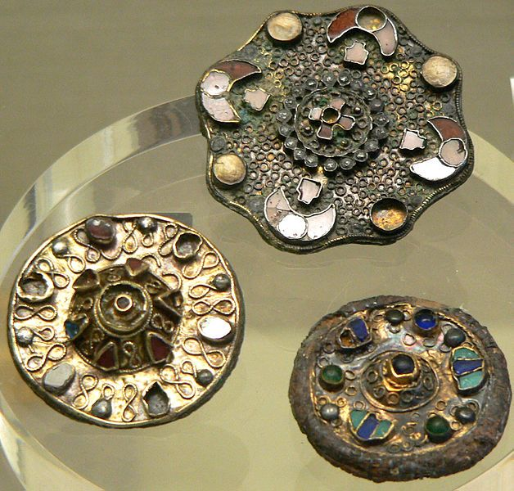
Merovingian Fibulae, Gold, garnets and glass paste and precious stones,
Cabinet of Medals, Paris, France https://fr.m.wikipedia.org/wiki/Fichier:Merovingian_fibula_CdM.jpg

Slide 30
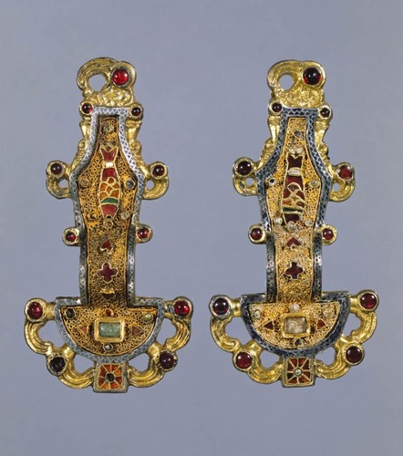
Looped fibulae,
Mid-sixth century
Silver gilt with semiprecious stones, inlays of garnets and other stones
Cabinet des Médailles, Paris https://quizlet.com/334524889/ap-art-history-unit-3-flash-cards/

