Slide 1
An Egyptian Hoard
of Byzantine Jewels

Slide 2
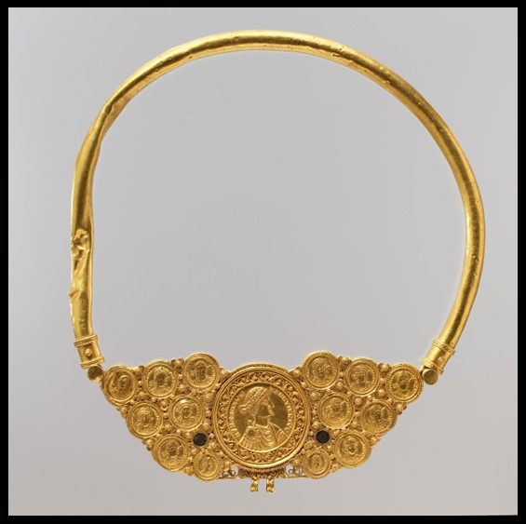
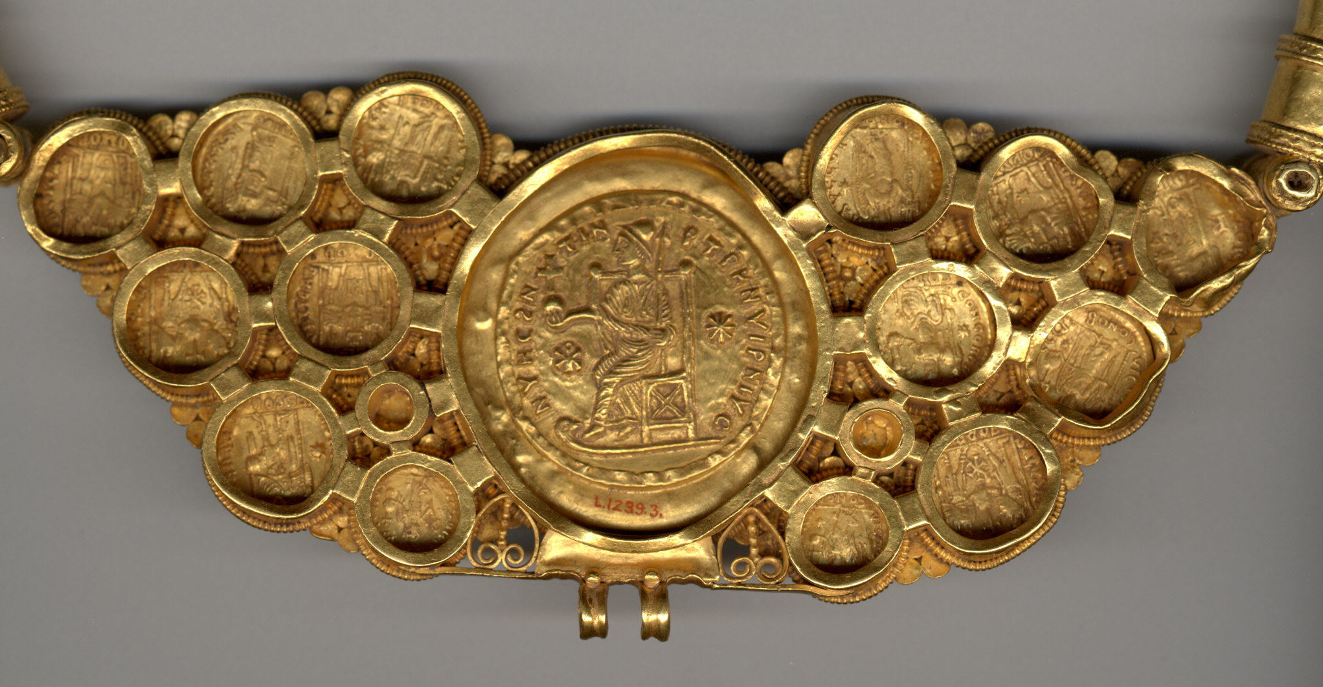
Pectoral with Coins and Pseudo-Medallion, ca. 539–50, Gold, niello, 23.9 x 21.9 x 1.6 cm, the MET, NY, USA https://www.metmuseum.org/art/collection/search/464070

Slide 3
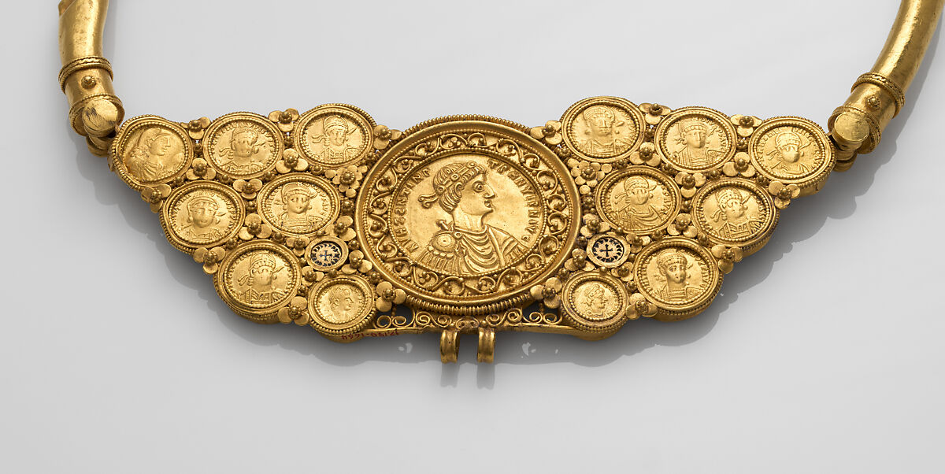

Slide 4
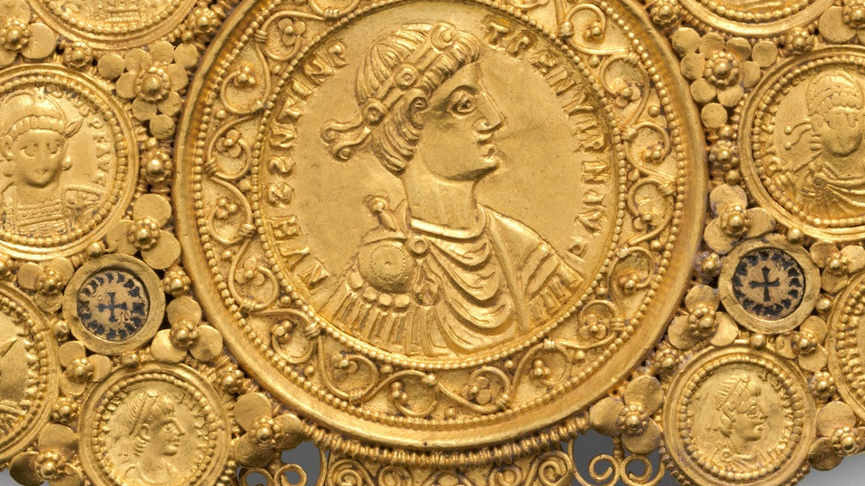
http://benedante.blogspot.com/2022/10/the-asyut-treasure.html

Slide 5
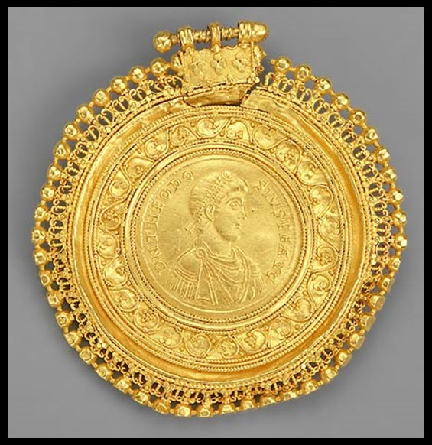
Medallion, consisting of a coin of Theodosius I (A.D. 379-395) set in an ornamental frame, 6th century, Gold, Diam: 0.5 cm, Freer Gallery of Art, Washington DC, USA https://archive.asia.si.edu/exhibitions/online/luxuryarts/1d.htm

Slide 6
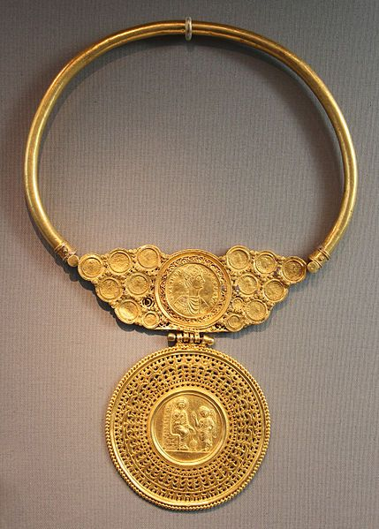
Gold Pectoral, early 7th century, Gold, H. including medallion: 35.2 cm, Altes Museum, Berlin, Germany https://commons.wikimedia.org/wiki/File:Officina_costantinopolitana,_tesoro_di_asyut_(egitto),_V-VI_sec_ca._02_collier.JPG

Slide 7
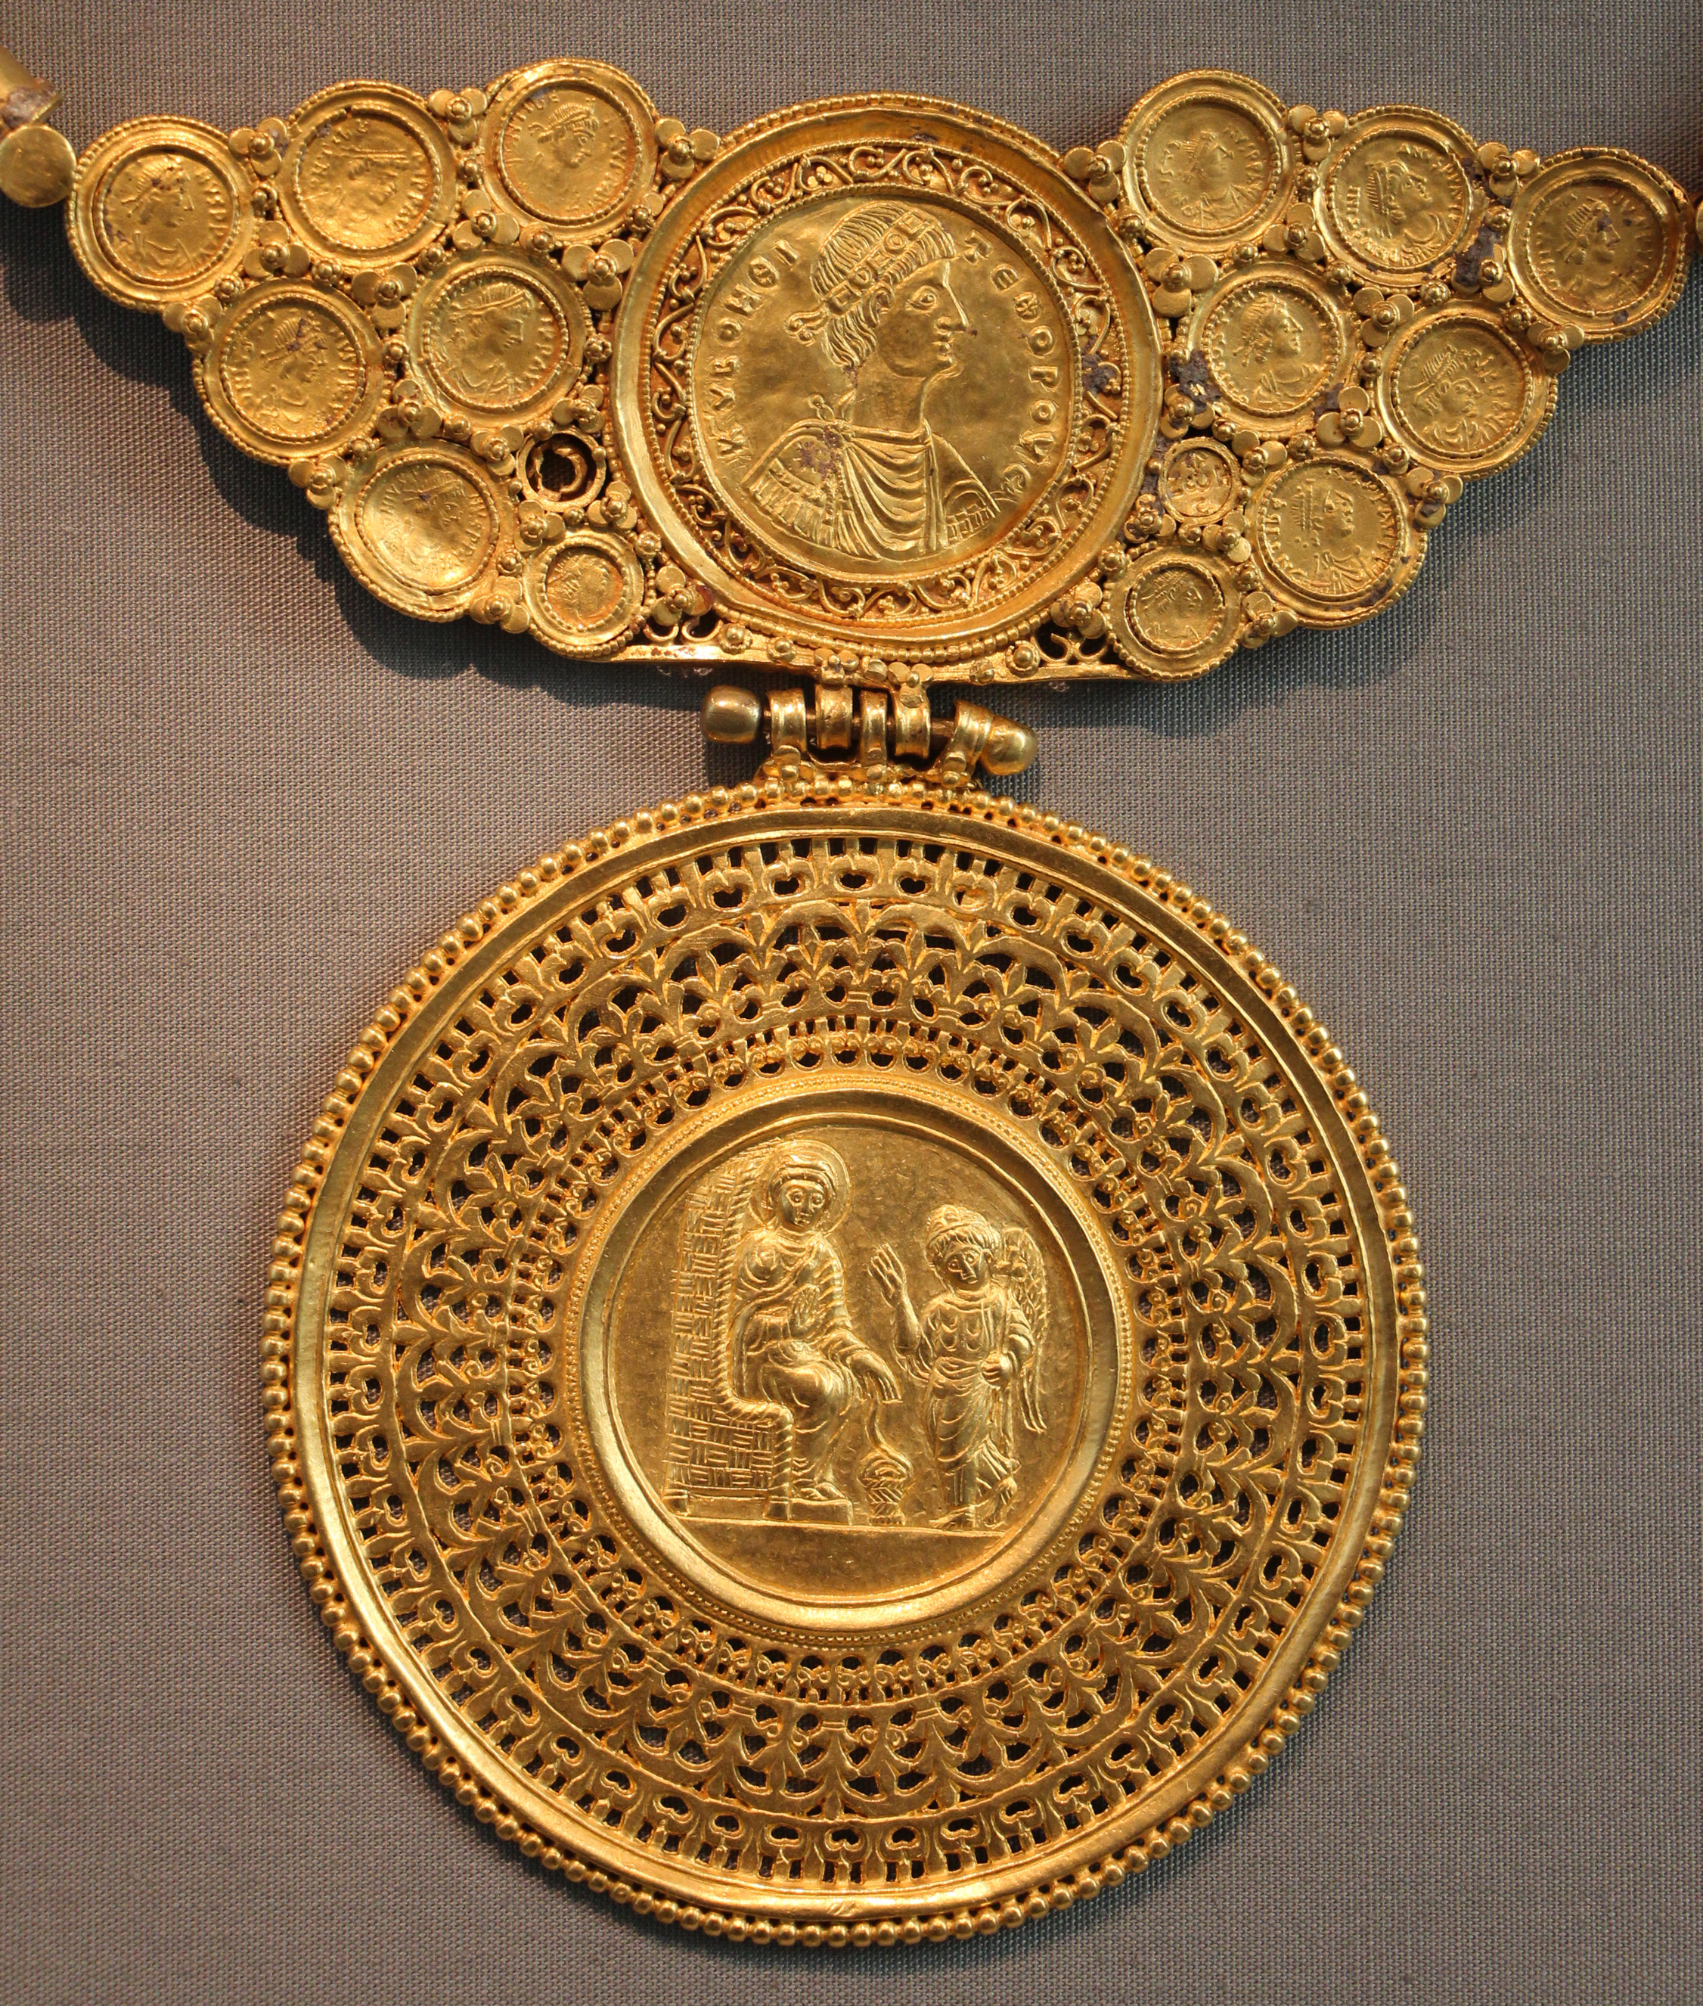

Slide 8
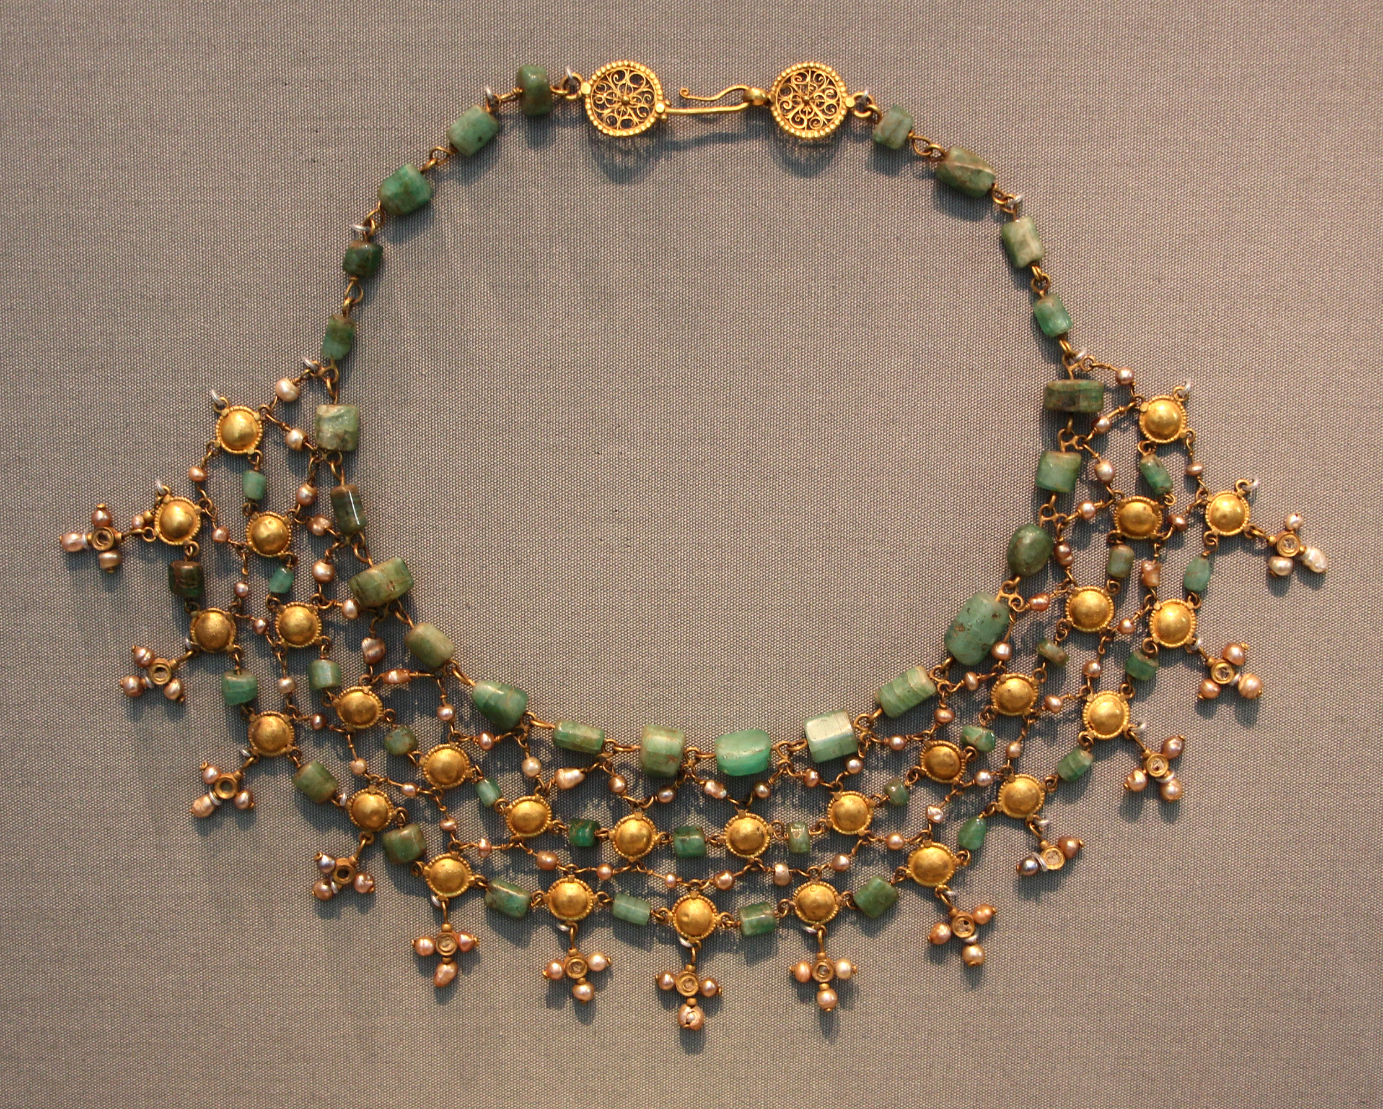
Necklace,
Gold, late 6th-7th century, Gold, emerald, sapphire, amethyst, pearls, mother-of-pearl, glass, sardonyx, Altes Museum, Berlin https://commons.wikimedia.org/wiki/File:Officina_costantinopolitana,_tesoro_di_asyut_(egitto),_V-VI_sec_ca._02_collier.JPG

Slide 9
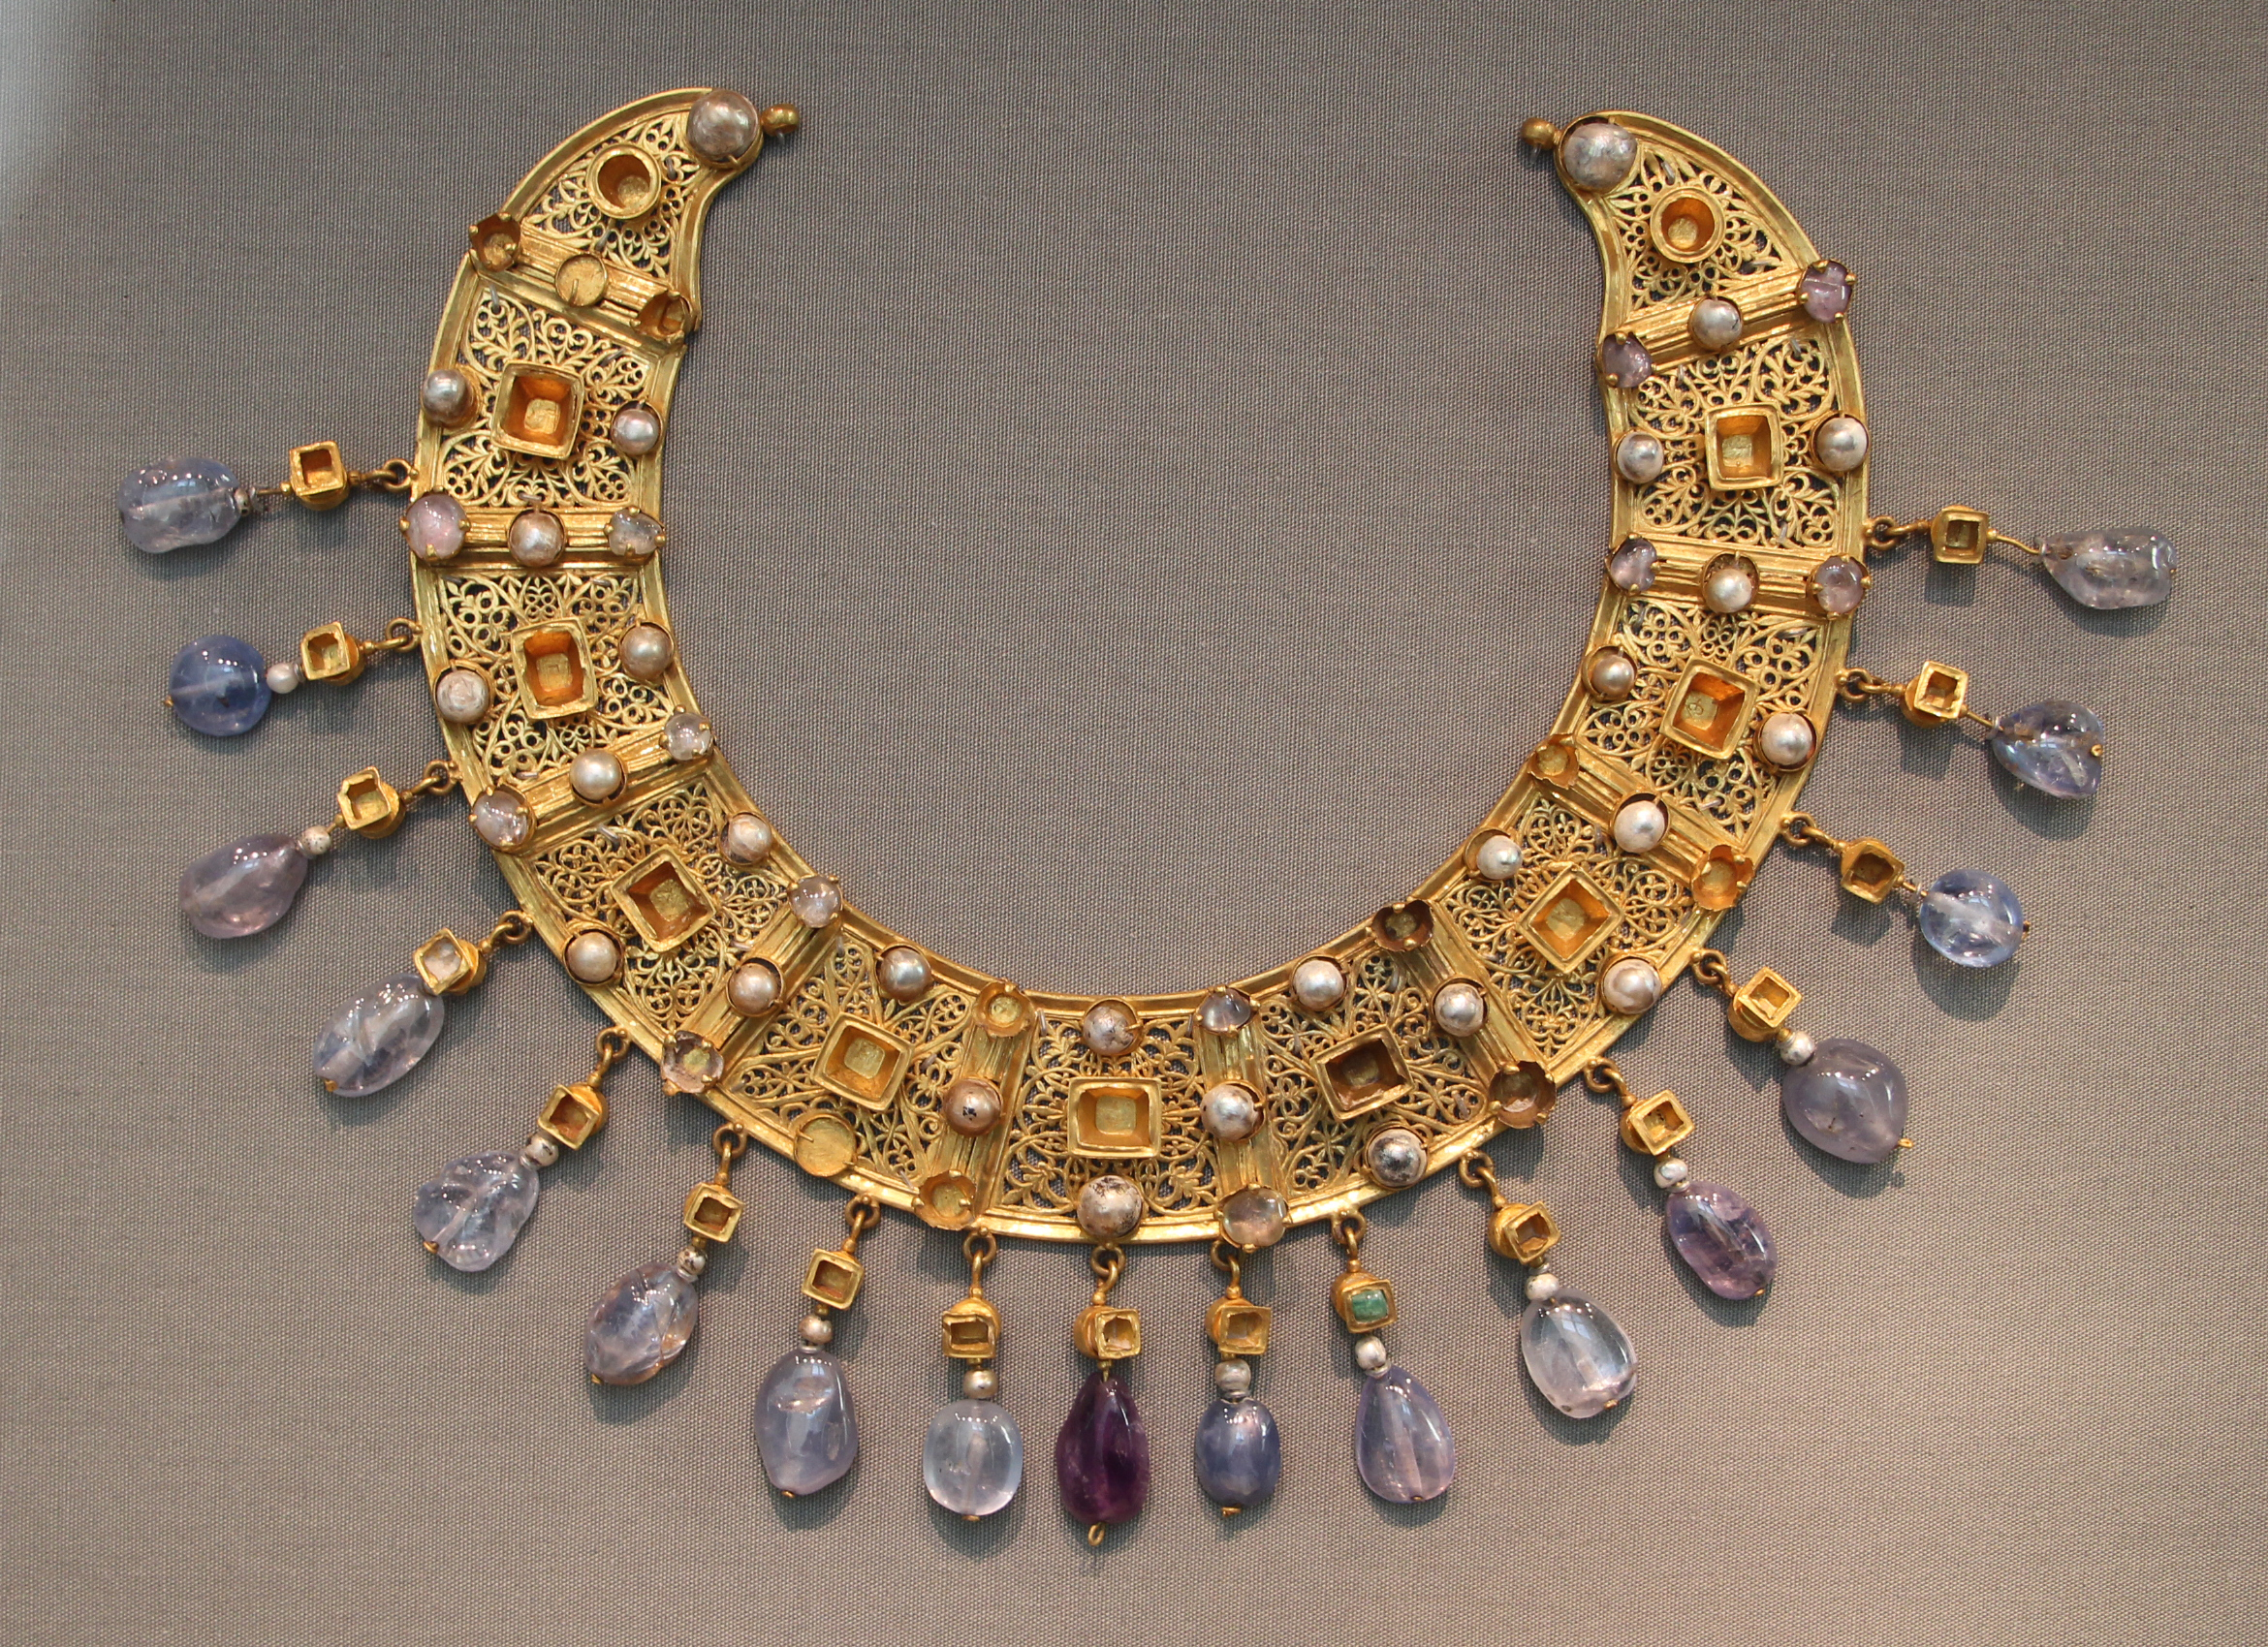
Byzantine collier, late 6th-7th century, Gold, emeralds, sapphires, amethysts and pearls, Diam: 23 cm, Altes Museum, Berlin, Berlin, Germany https://commons.wikimedia.org/wiki/File:Officina_costantinopolitana,_tesoro_di_asyut_(egitto),_V-VI_sec_ca._01_collier.JPG

Slide 10
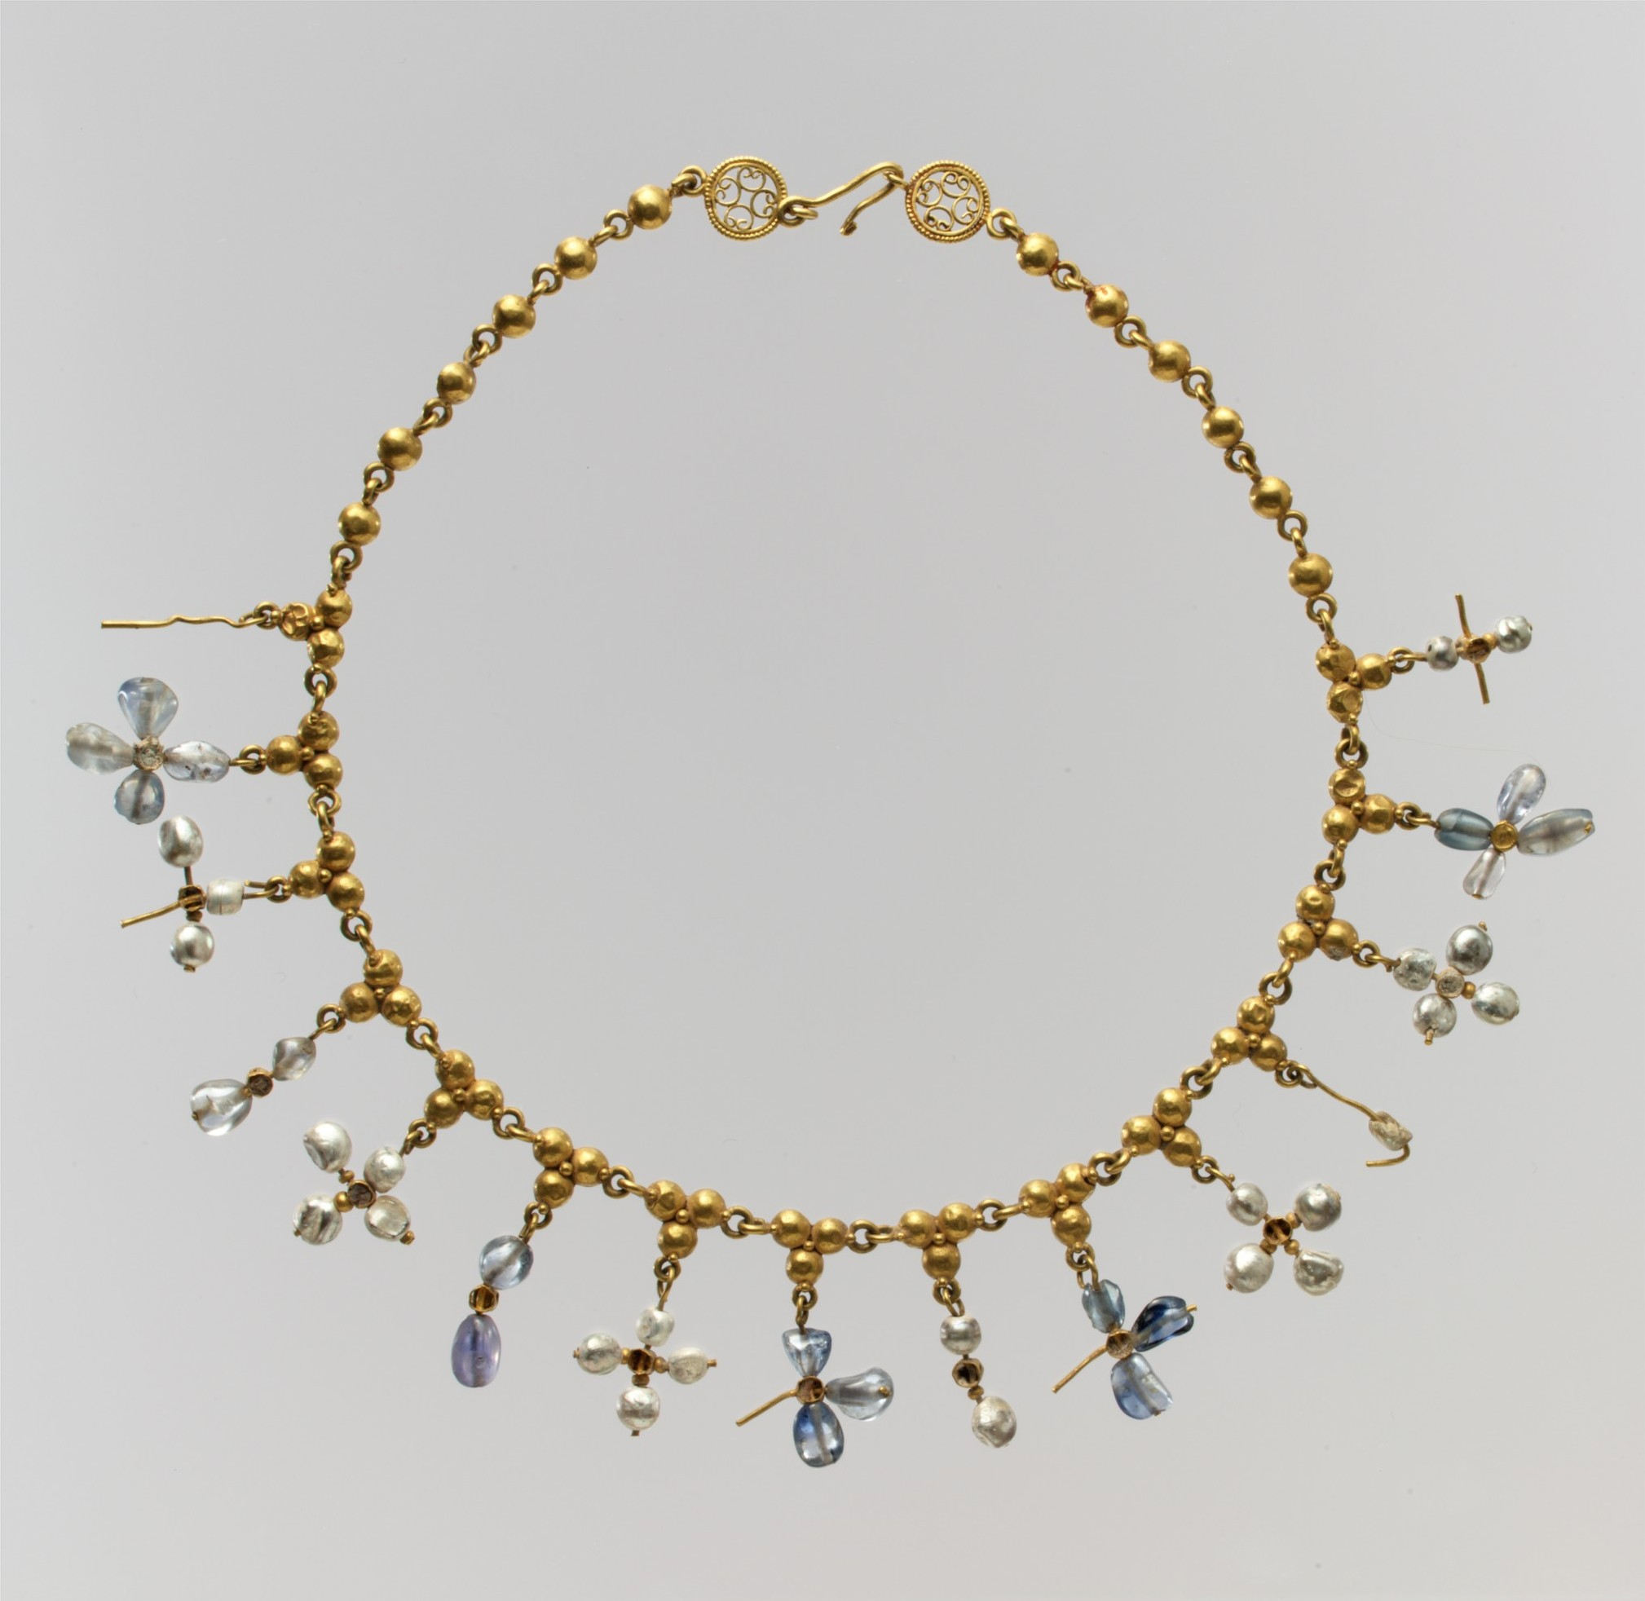
Necklace with Pendant Crosses, 6th–7th century, Gold, pearl sapphire, smokey quartz, quartz, Length: 45.2 cm, the MET, NY, USA https://www.metmuseum.org/art/collection/search/464073

Slide 11
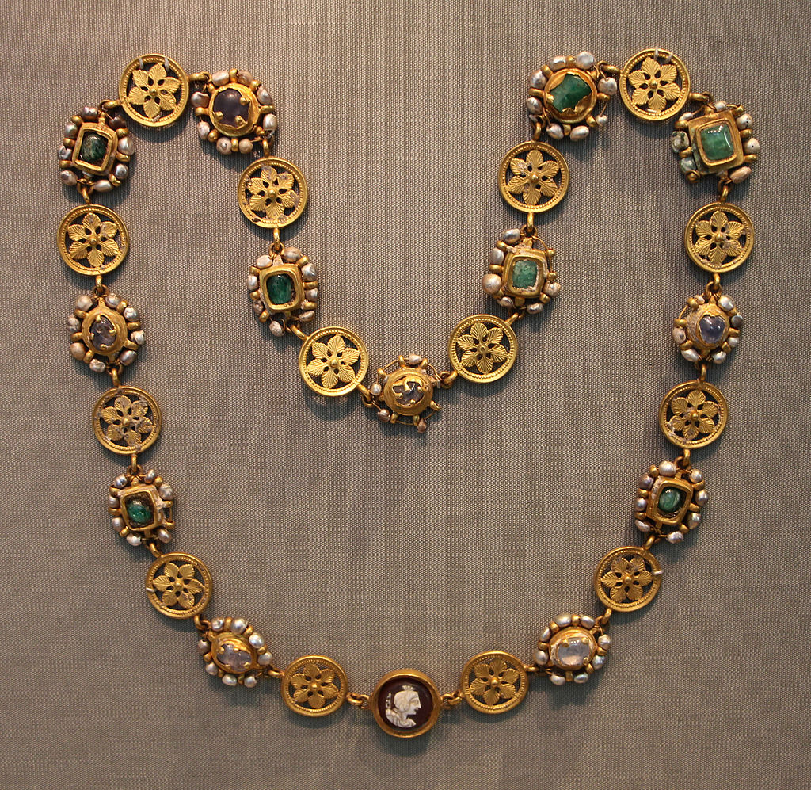
Necklace, early 7th century, Gold, pearls, emeralds, gems, cameo, Altes Museum, Berlin, Germany https://commons.wikimedia.org/wiki/Category:Asyut_Treasure#/media/File:Officina_costantinopolitana,_tesoro_di_asyut_(egitto),_V-VI_sec_ca._04_collana.JPG

Slide 12
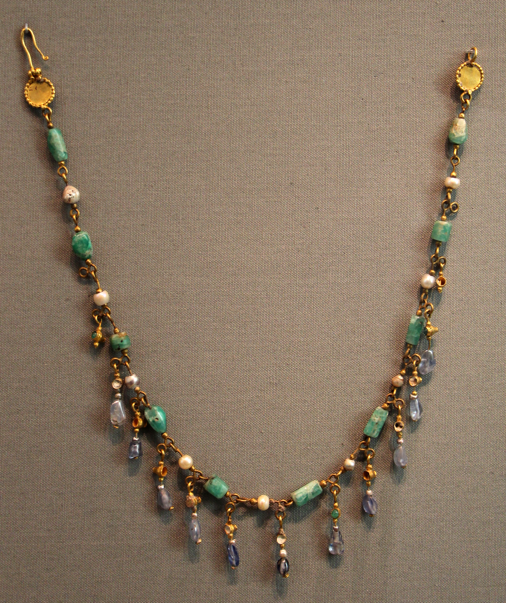
Necklace, early 7th century, Gold, pearls emeralds, sapphires, Altes Museum, Berlin, Germany https://upload.wikimedia.org/wikipedia/commons/4/44/Officina_costantinopolitana%2C_tesoro_di_asyut_%28egitto%29%2C_V-VI_sec_ca._12_collana.JPG

Slide 13
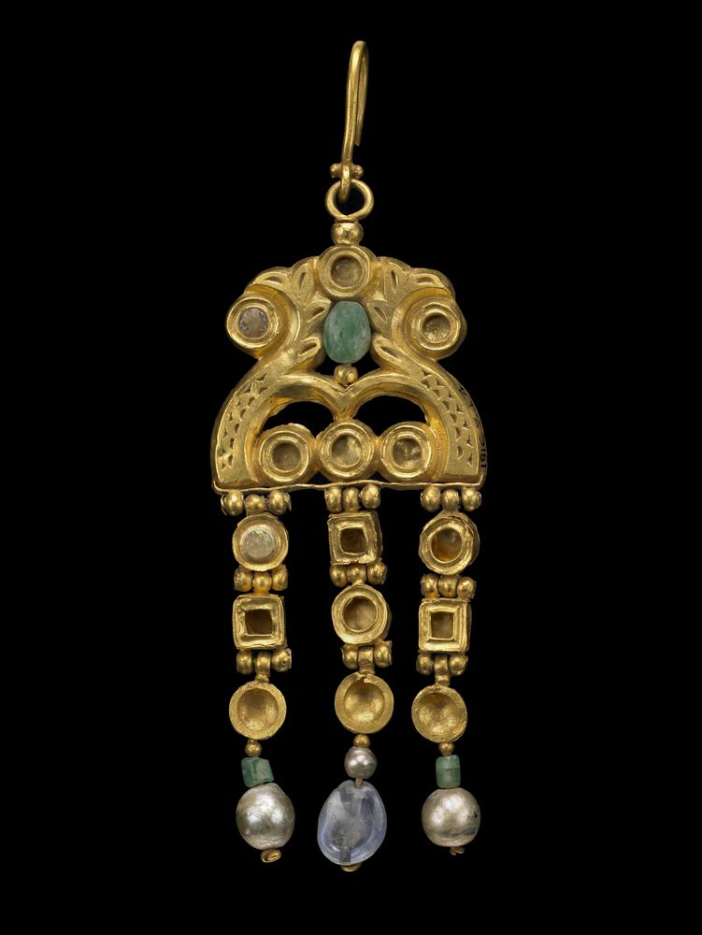
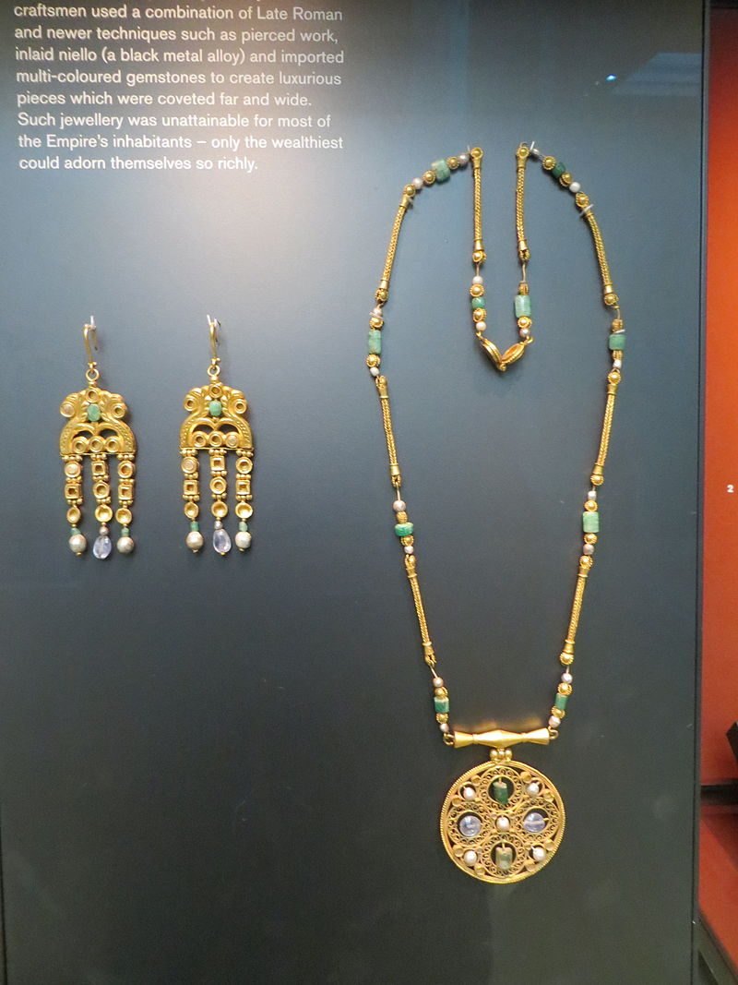
Necklace with Pendant, Earrings, c. 600, Gold, pearls, emeralds, sapphires, British Museum, London, UK https://www.britishmuseum.org/collection/object/H_1916-0704-4 and https://commons.wikimedia.org/wiki/Category:Asyut_Treasure#/media/File:Byzantine_Jewellery_(1).JPG

Slide 14
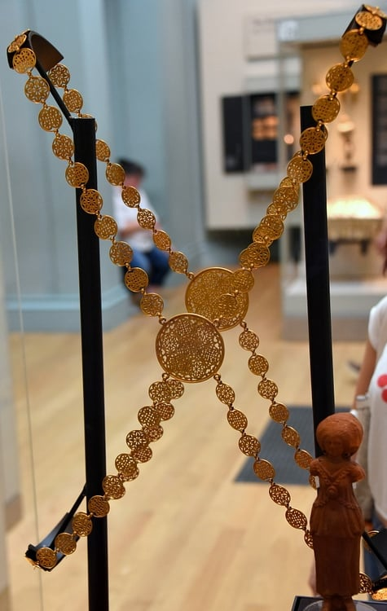
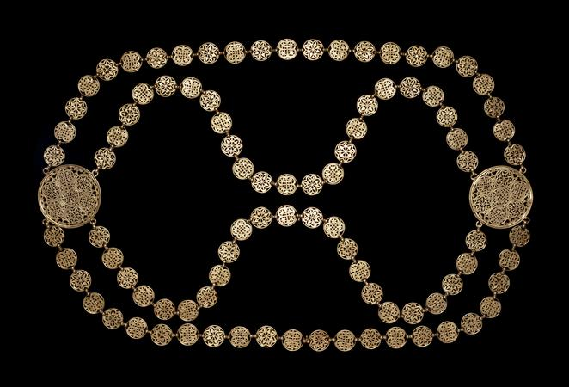
Breast Chain, early 7th century, Gold, Diam: 77.80 millimetres, British Museum, London, UK https://www.britishmuseum.org/collection/object/H_1916-0704-1 and https://www.worldhistory.org/image/5773/byzantine-gold-body-chain/

Slide 15
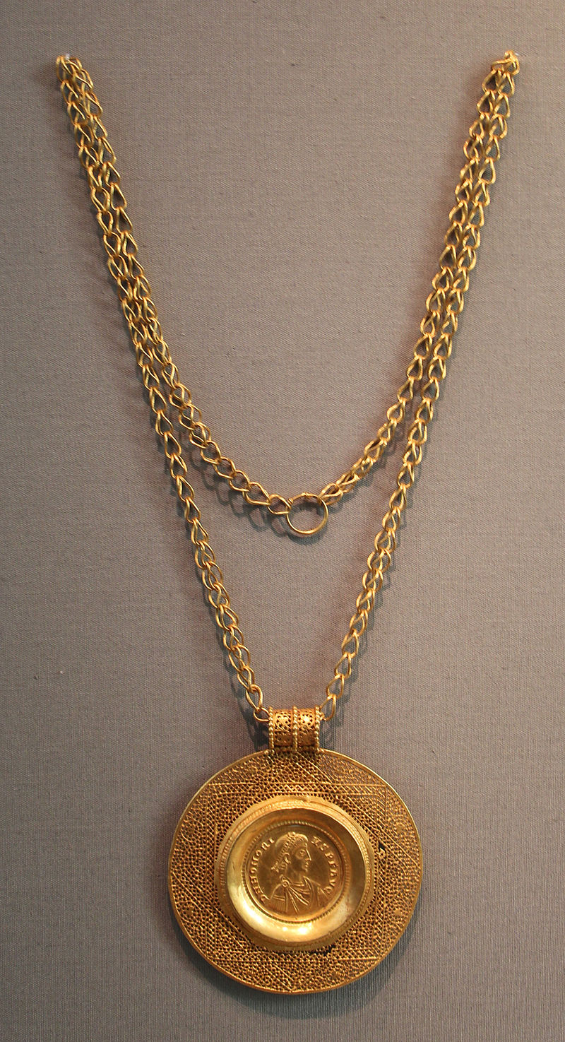
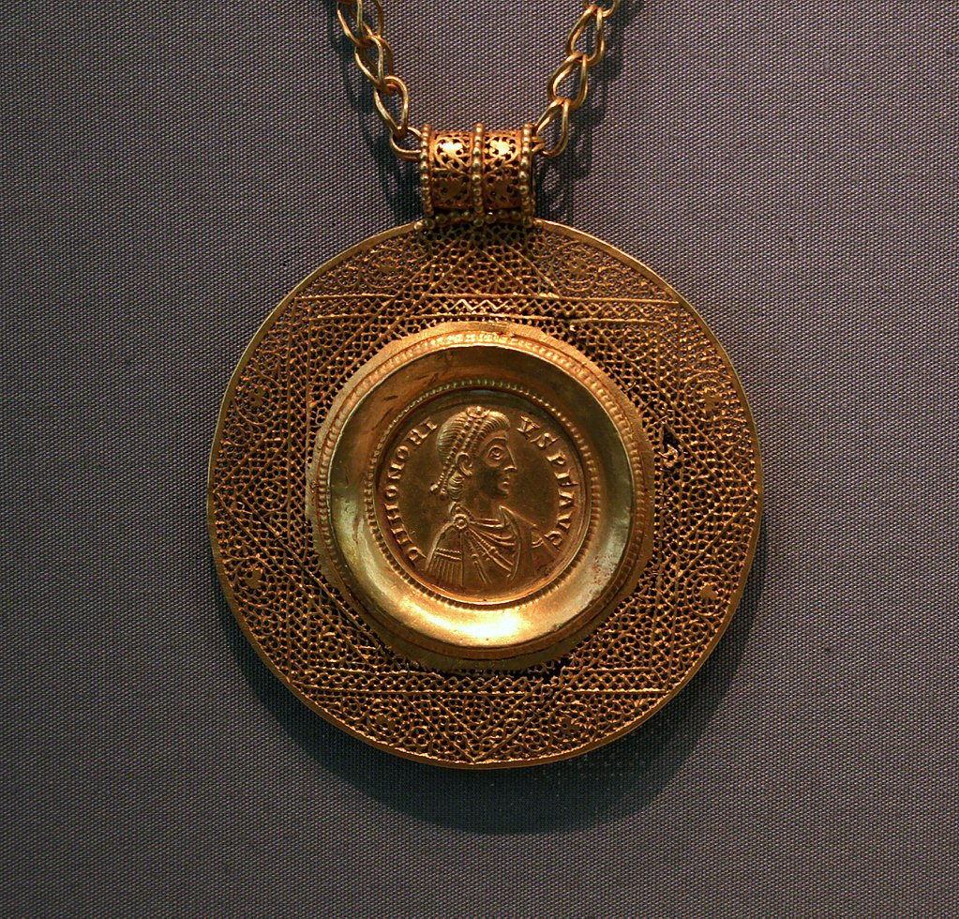
Chain with a Medallion of Emperor Honorius, early 5th century, Gold, Altes Museum, Berlin, Germamy https://commons.wikimedia.org/wiki/Category:Asyut_Treasure

Slide 16
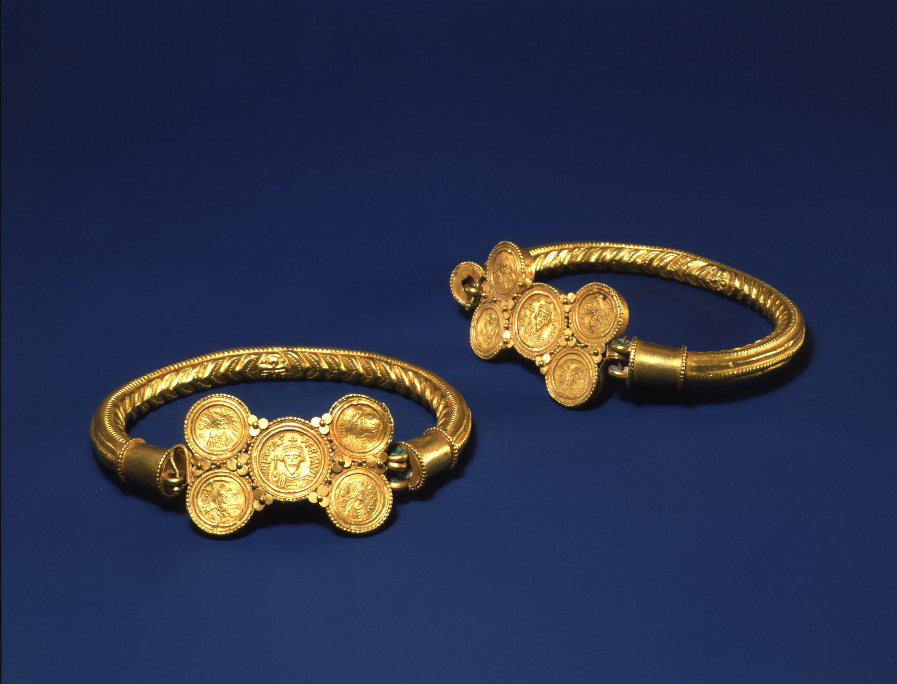
Armband with Coins of Phokas and Maurice Tiberius, first half of the 7th century, 11 x 11 cm, Dumbarton Oaks, Washington DC, USA http://museum.doaks.org/objects-1/info/27448

Slide 17
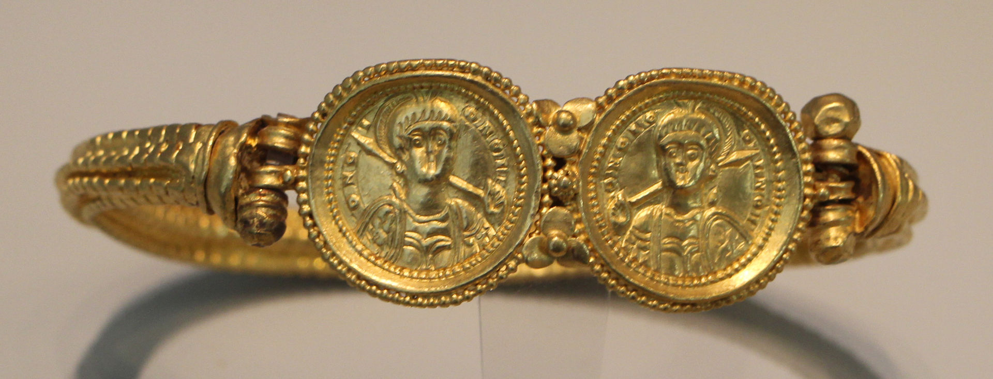
Armband with Coins, first half of the 7th century, Gold, Altes Museum, Berlin, Germany https://commons.wikimedia.org/wiki/Category:Byzantine_jewellery_in_Germany#/media/File:Officina_costantinopolitana,_tesoro_di_asyut_(egitto),_V-VI_sec_ca._05_bracciale_con_solidi_d'oro.JPG

Slide 18
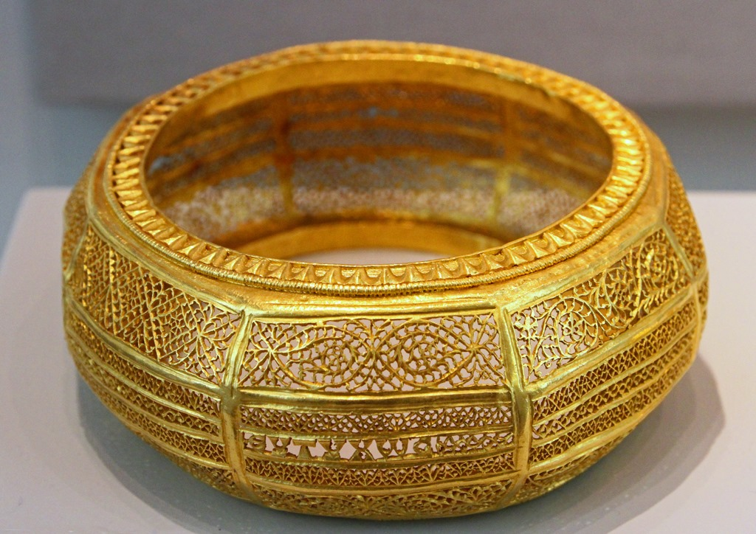
Βracelet, early 7th century, Gold, Altes Museum, Berlin, Germany https://www.facebook.com/Tresuresofancientegypt/posts/asyut-bracelet-part-of-a-large-golden-byzantine-treasure-found-in-1909-near-asyu/1961216380703901/

Slide 19
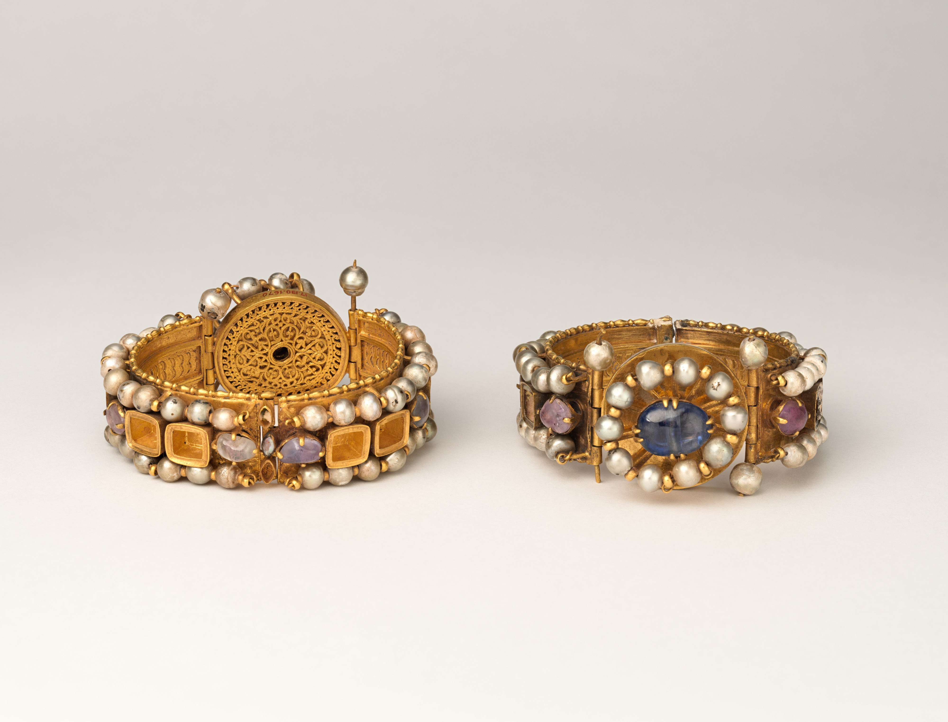
Pair of Bracelets, early 7th century, Gold, pearls spphires, and emerald plasma, Diam: 8.3 cm, the MET, NY, USA https://www.metmuseum.org/art/collection/search/464077

Slide 20
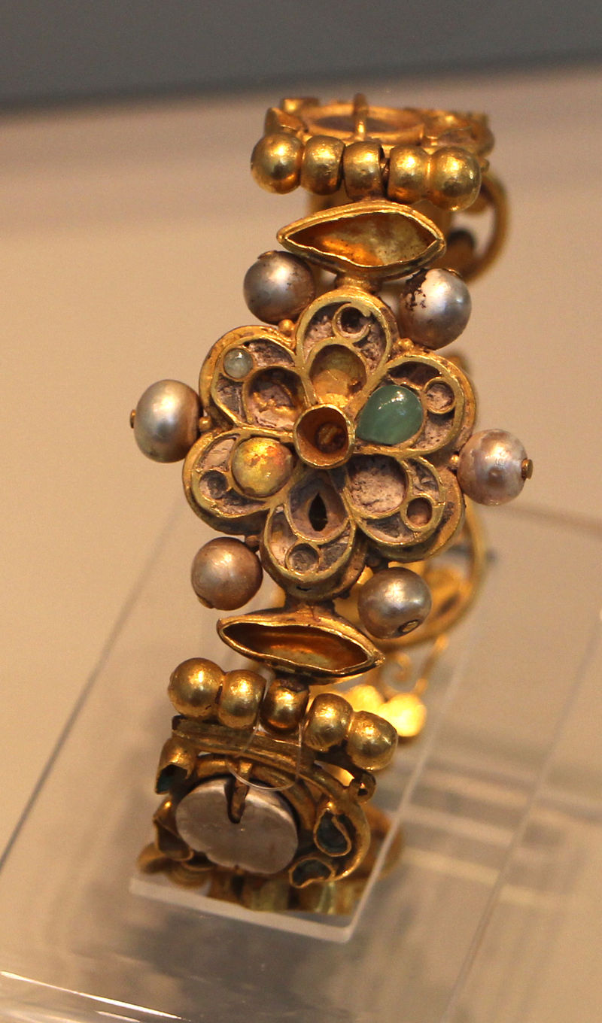
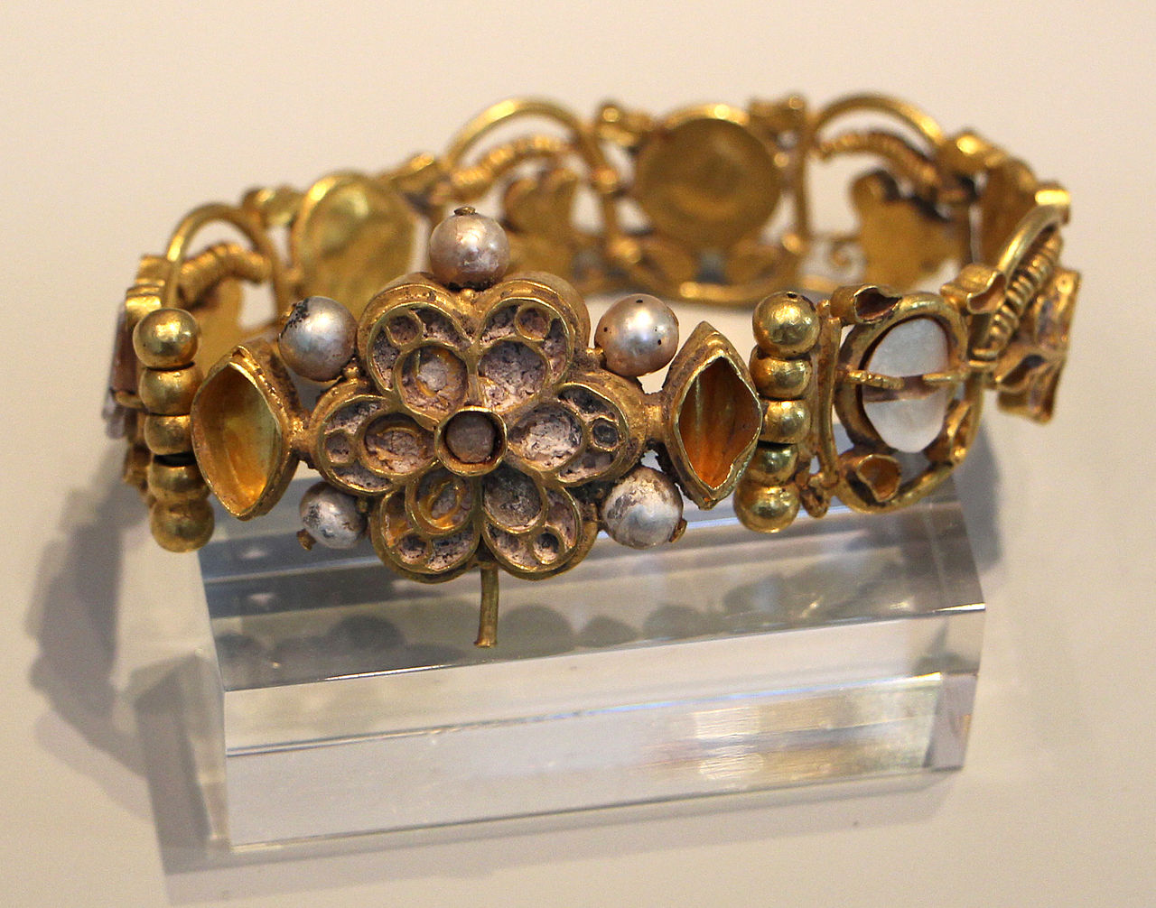
Pair of Bracelets, early 7th century, Gold, pearls, emeralds, mother of pearl, glass paste, Diam: 7 cm, Altes Museum, Berlin, Germany https://commons.wikimedia.org/wiki/Category:Asyut_Treasure

Slide 21
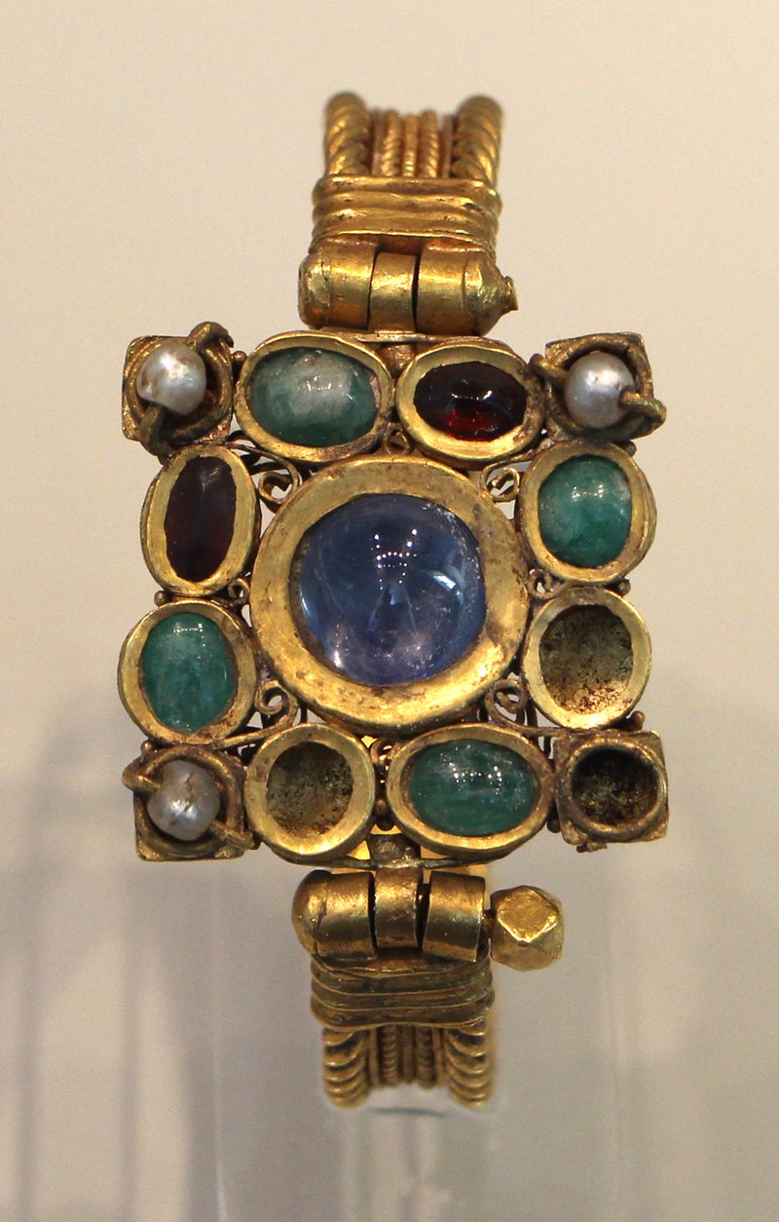
Bracelet, raeky 7th century, Gold, emerald, sapphire, amethyst, pearls, mother-of-pearl, glass, sardonyx, Altes Muserm, Berlin, Germany https://commons.wikimedia.org/wiki/Category:Asyut_Treasure#/media/File:Officina_costantinopolitana,_tesoro_di_asyut_(egitto),_V-VI_sec_ca._07_bracciale.JPG

