Slide 1
Roman Emperor
Gaius Galerius Valerius Maximianus
305-311 AD

Slide 2
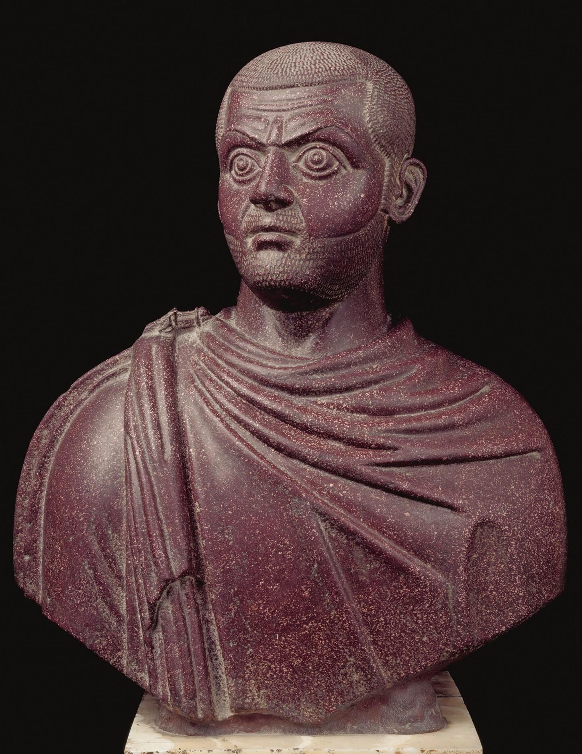
Portrait of Emperor Galerius, 284-305 AD, Porphyry, H. 59 cm, Cairo Museum, Egypt https://i.pinimg.com/originals/ec/c2/4e/ecc24eafae986f9fb90b88ceb39d9a84.jpg

Slide 3
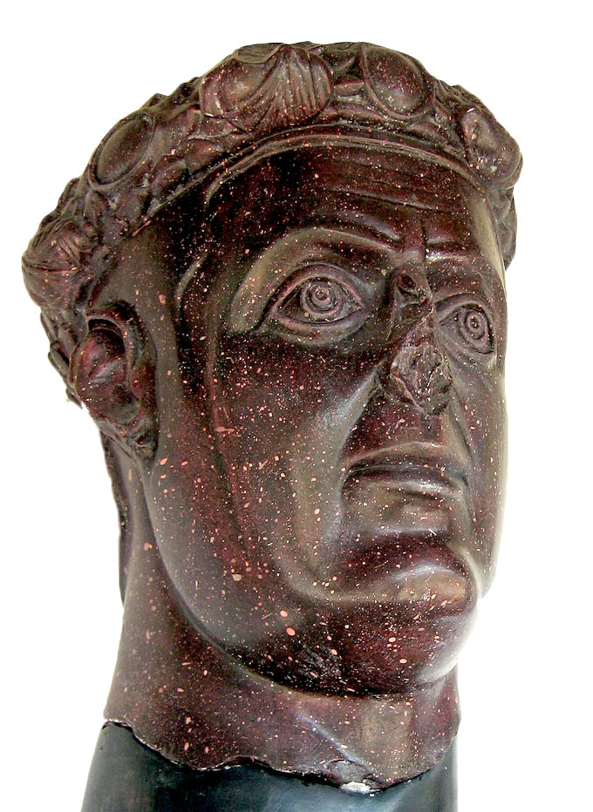
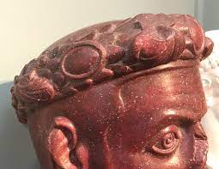
Emperor Galerius' portrait head in porphyry, from his palace in Felix Romuliana/Gamzigrad, early 4th century AD, Porphyry, H. 35 cm, National Museum, Zajèčar, Serbia https://commons.wikimedia.org/wiki/File:Romuliana_Galerius_head.jpg

Slide 4
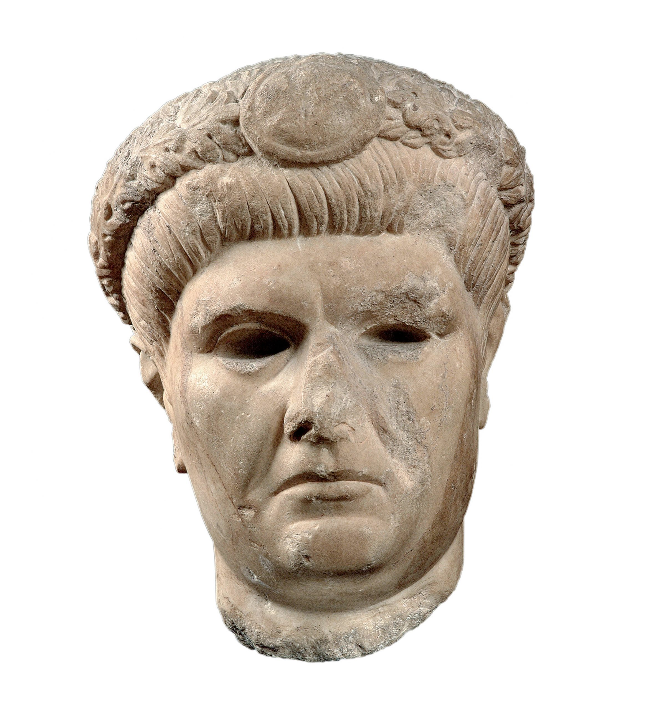
Portrait of the Emperor Galerius from an over life-sized statue, 310 AD, 27x17,9 cm, Canellopoulos Museum, Athens, Greece https://camu.gr/en/item/portraito-tou-aftokratora-galeriou/

Slide 5
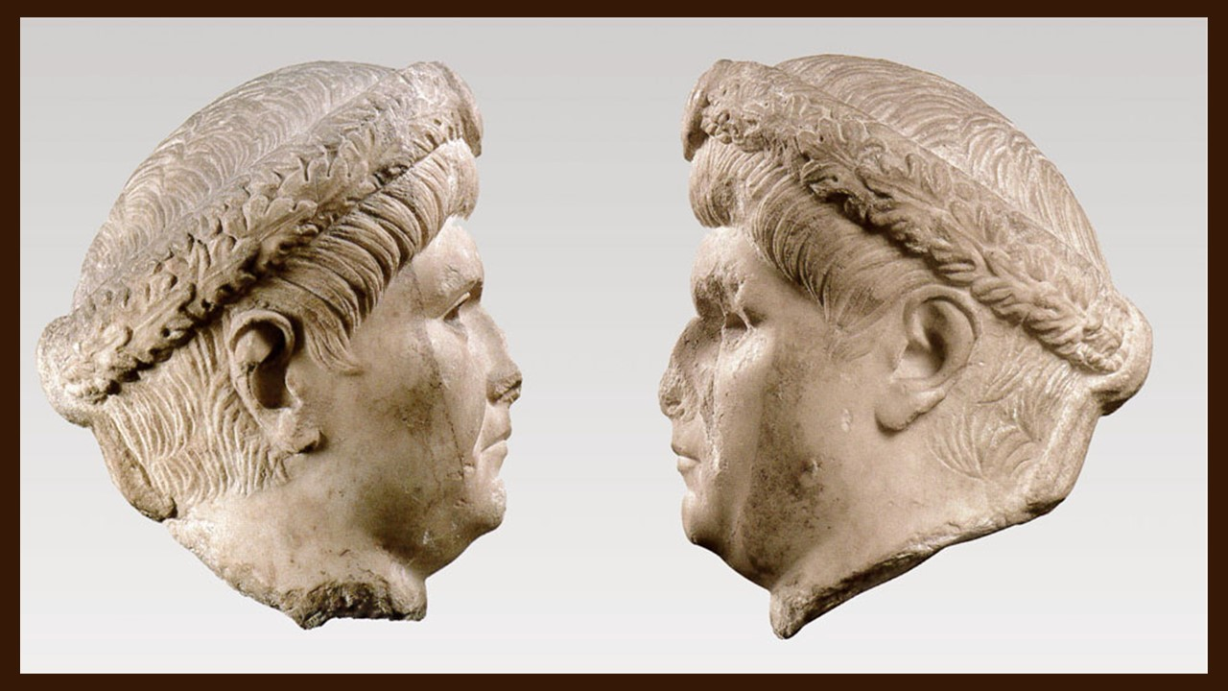

Slide 6
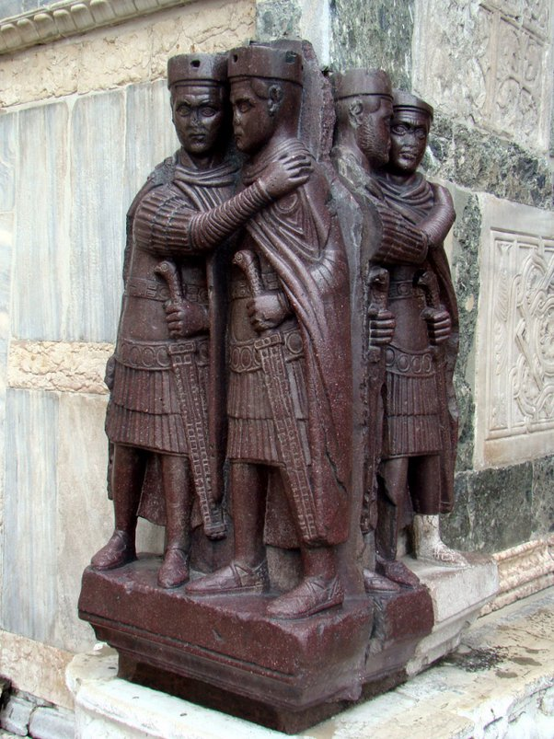
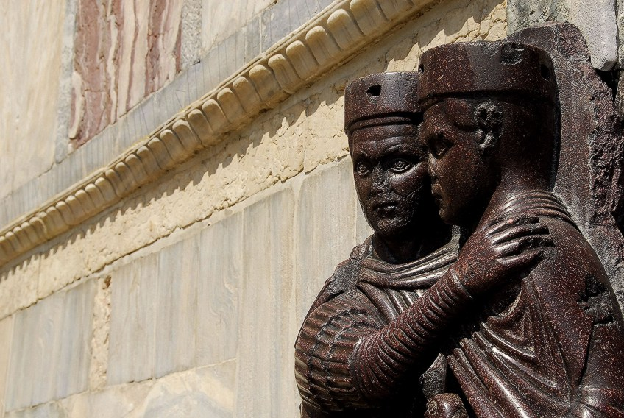
The Four Tetrarchs, 300 AD, Porphyry, H.130 cm, Piazza San Marco, Venice, Italy https://www.quora.com/Who-was-the-Tetrarch-in-ancient-Rome and https://artincontext.org/famous-roman-statues/

Slide 7
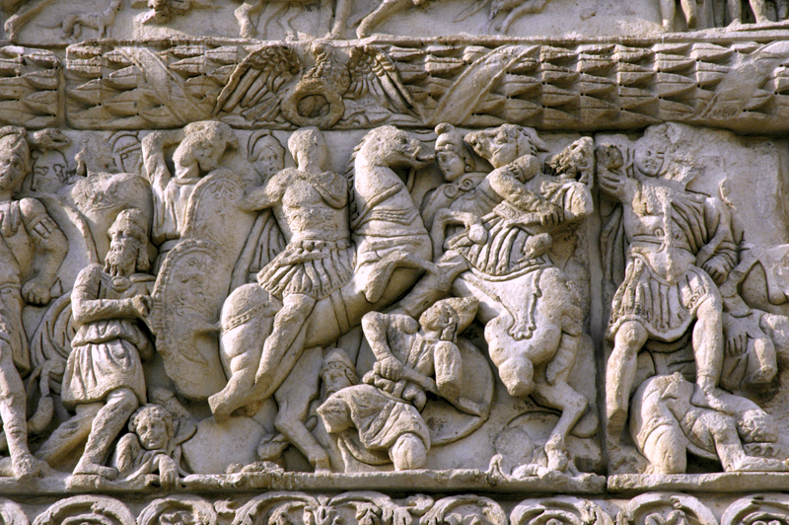
The Arch of Galerius, Detail of Galerius attacking Narseh, Thessaloniki, Greece https://en.wikipedia.org/wiki/Galerius#/media/File:Arch-of-Galerius-1.jpg

Slide 8
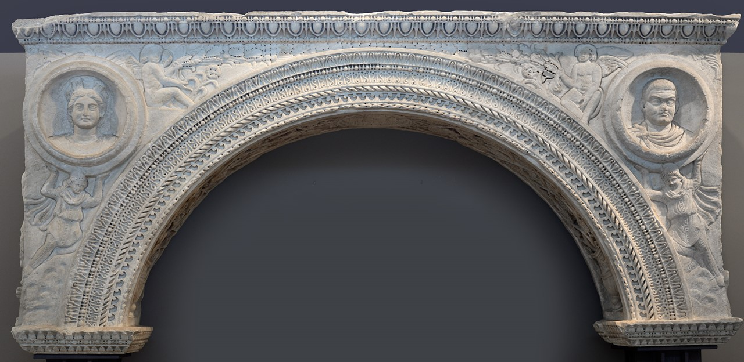
Arch with relief presentation from a Temple in the Palatial Complex of Galerius, early 4th century AD, Archaeological Museum of Thessaloniki https://www.amth.gr/en/exhibitions/permanent-exhibitions/thessaloniki-metropolis-macedonia

Slide 9
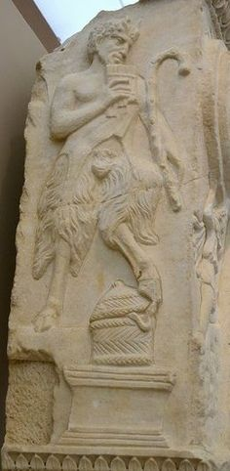
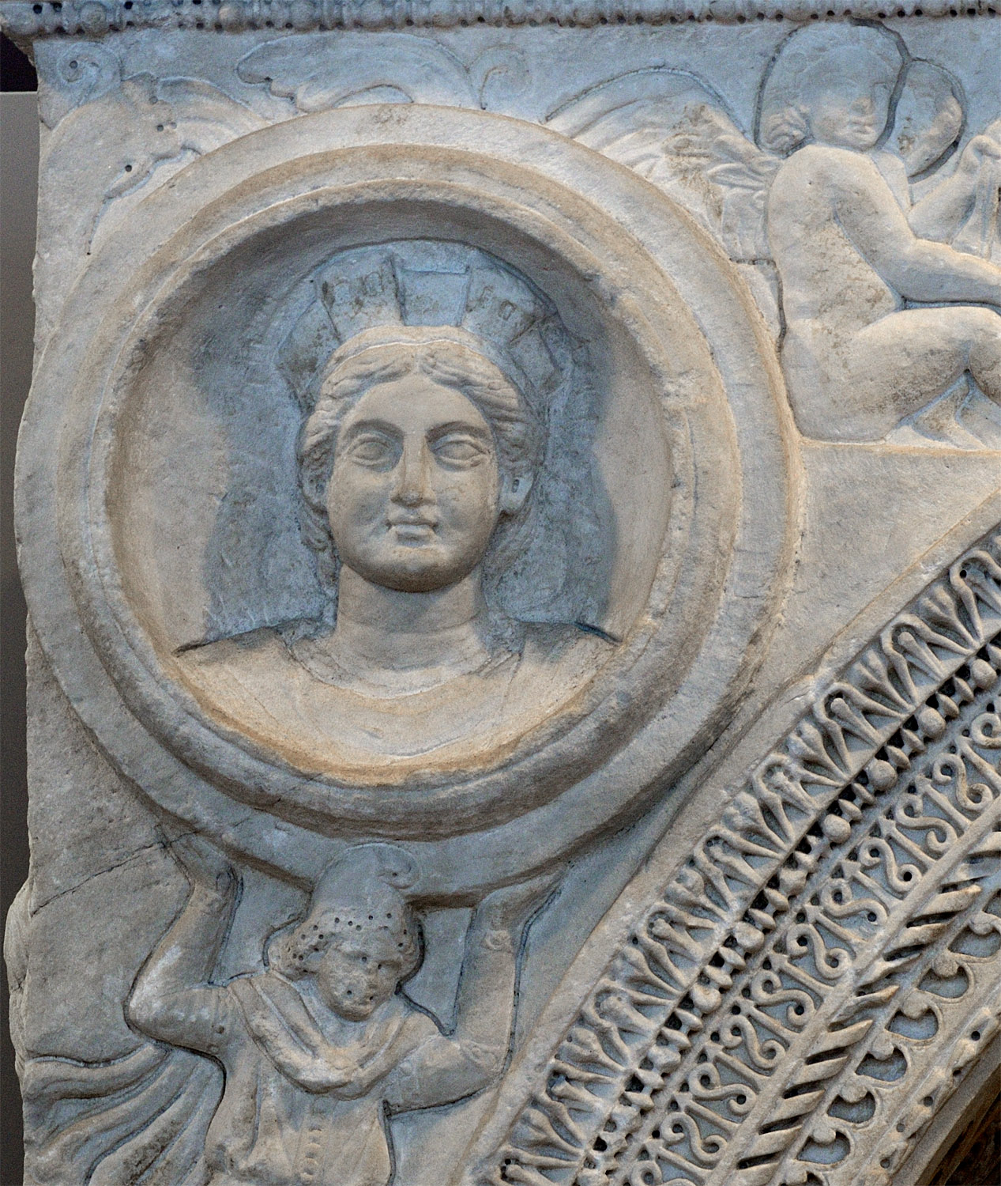
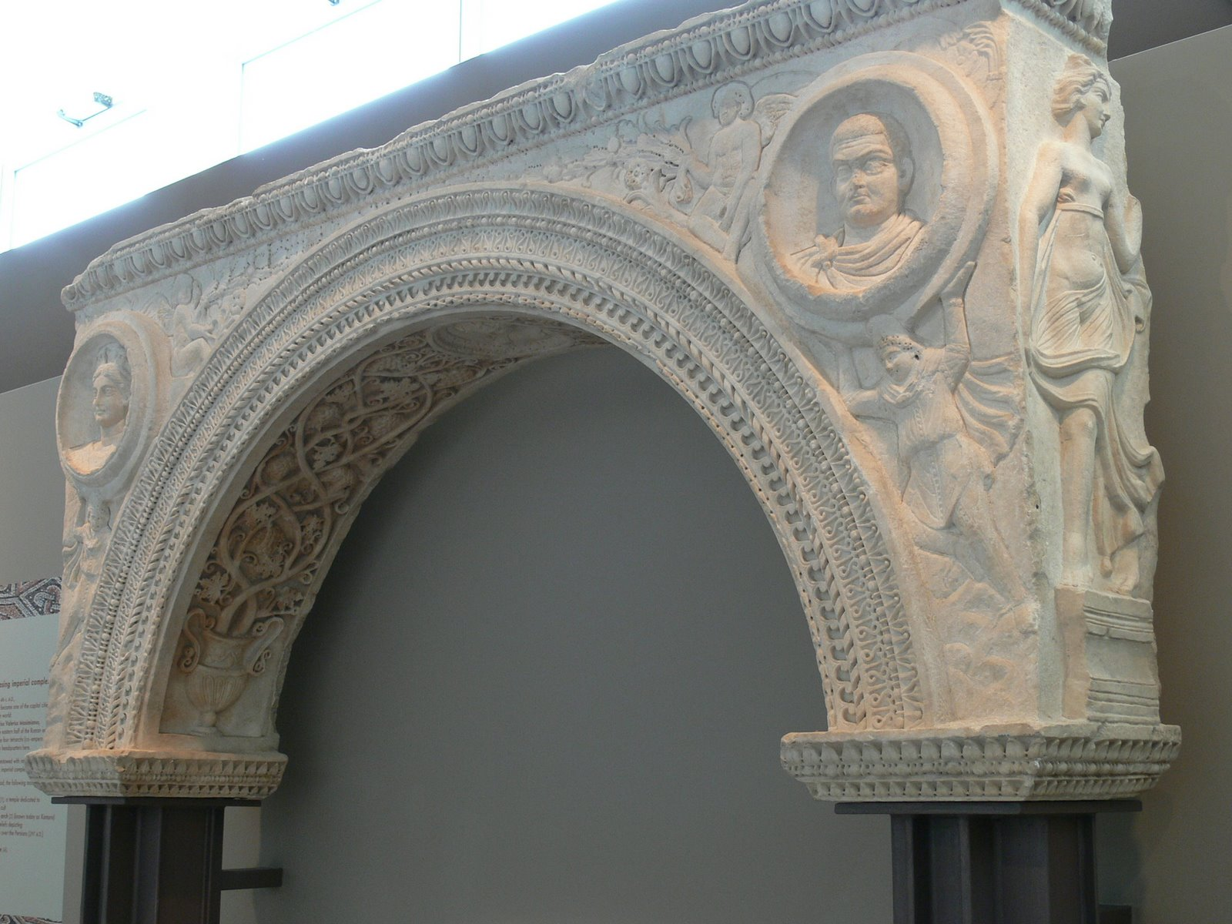
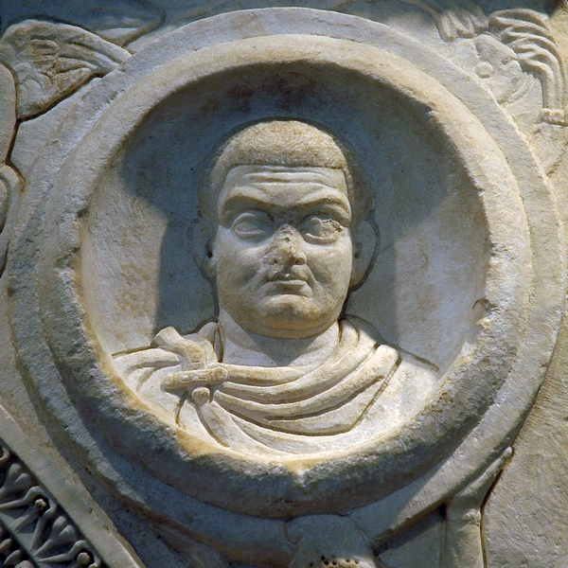
The small Arch of Galerius, a work of high artistic quality, is the product of a local workshop in Thessaloniki. “The rich relief decorations occupy three sides of the arch. The main side depicts two men from the East, possibly Persians, raising two circular medallions with their hands. The right medallion depicts Gaius Galerius Valerius Maximianus, while the left one initially depicted his wife, Galeria Valeria.” https://www.amth.gr/en/exhibitions/highlights

Slide 10
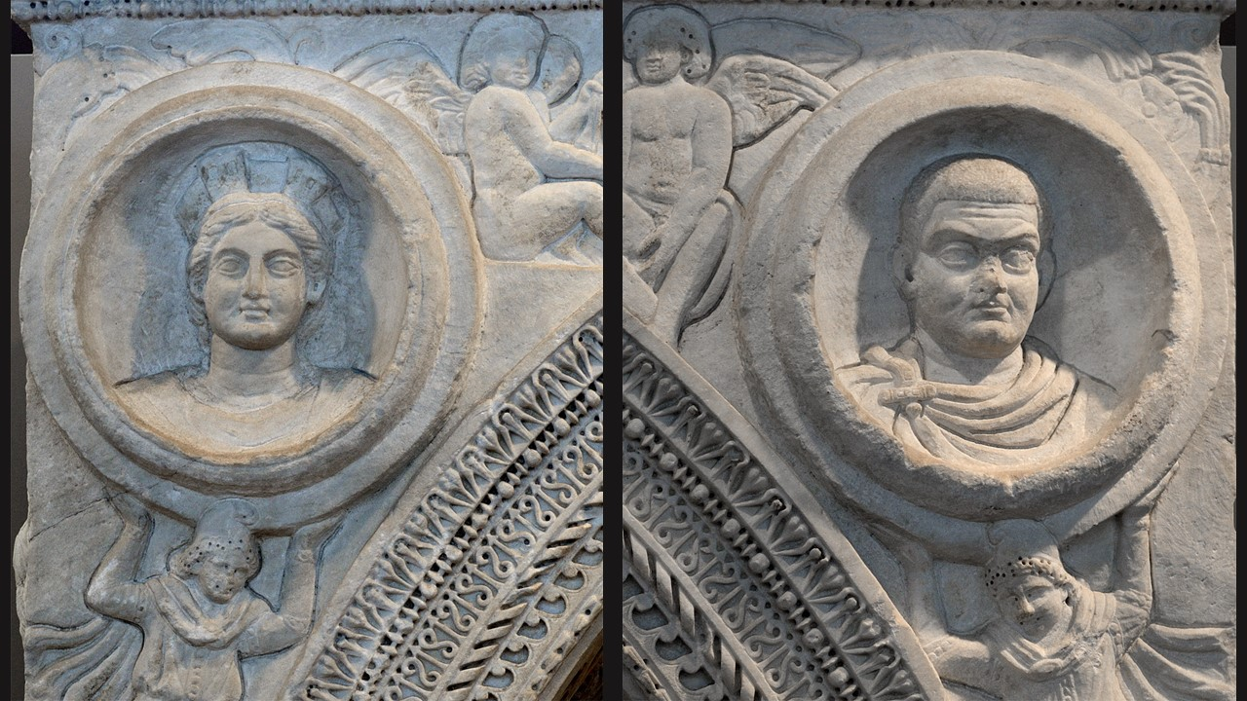

Slide 11
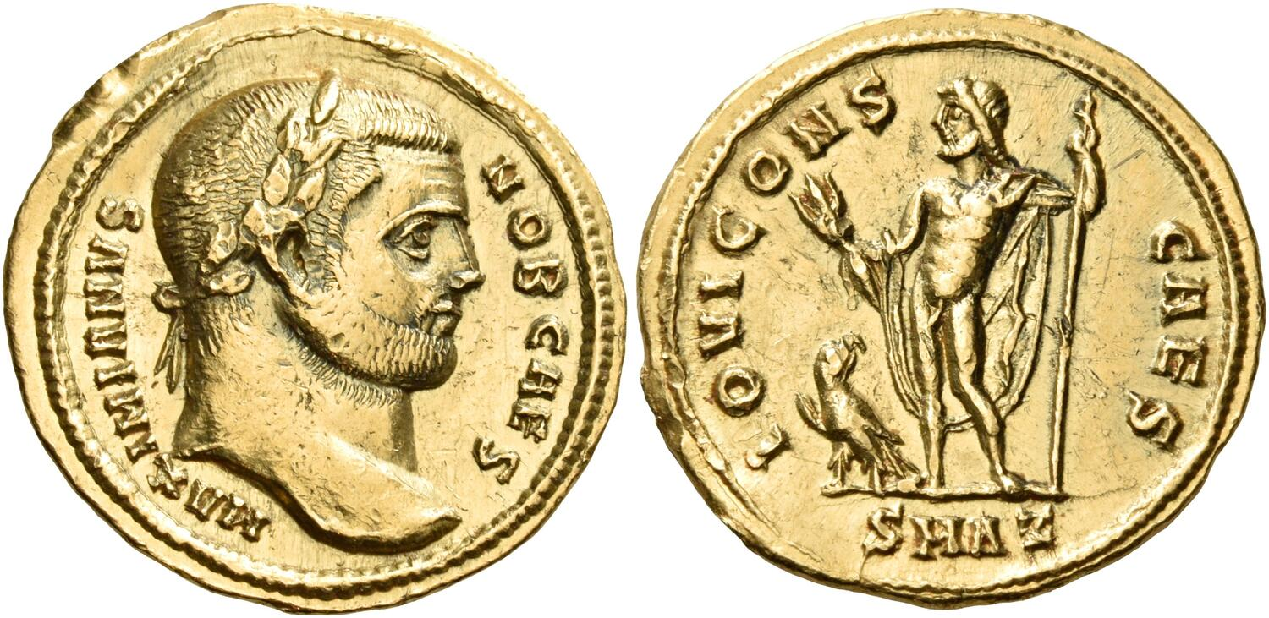
Galerius, as Caesar, 293-305, Aureus, Gold, H. 6 mm, Private Collection https://www.numisbids.com/n.php?p=lot&sid=3922&lot=383

