Slide 1
Henri Matisse, 1869 – 1954
Dance…

Slide 2
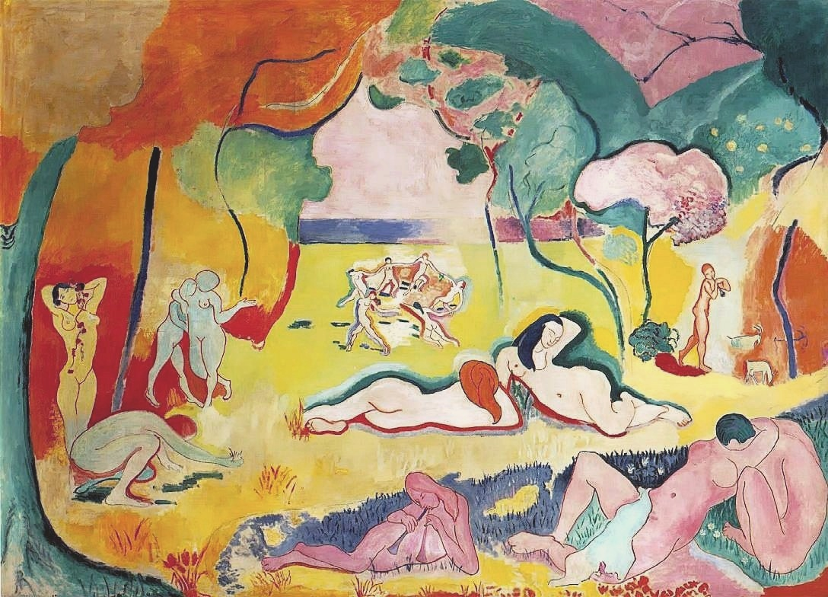
Le bonheur de vivre (Joy of Life), 1905, oil on canvas, 176.5 x 240.7 cm, Barnes Foundatio, Philadelphia, USA https://en.wikipedia.org/wiki/Le_bonheur_de_vivre#/media/File:Bonheur_Matisse.jpg

Slide 3
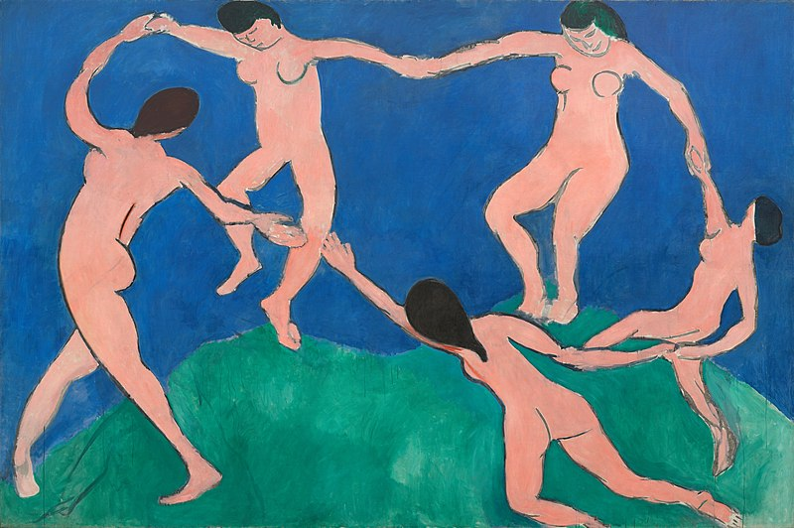
Dance I, 1909, oil on canvas, 259.7 x 390.1 cm, MOM, NY, USA https://www.moma.org/collection/works/79124

Slide 4
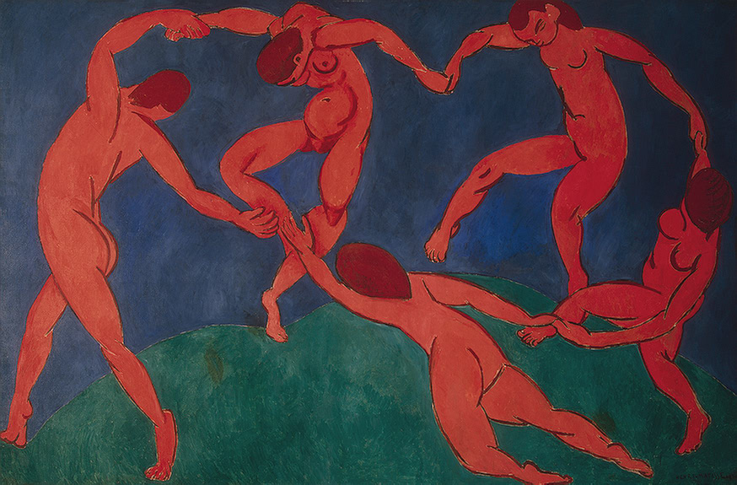
Dance II, 1910, oil on canvas, 260 x 391 cm, State Hermitage Museum, Saint Petersburg, Russia https://en.wikipedia.org/wiki/File:Matissedance.jpg

Slide 5
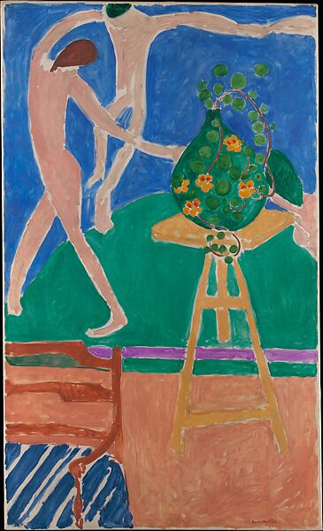
Nasturtiums with the Painting ‘Dance’, 1912, oil on canvas, 75 ½ × 45 ⅜″ (191.8 × 115.3 cm), the MET, NY, USA https://www.metmuseum.org/art/collection/search/483301

Slide 6
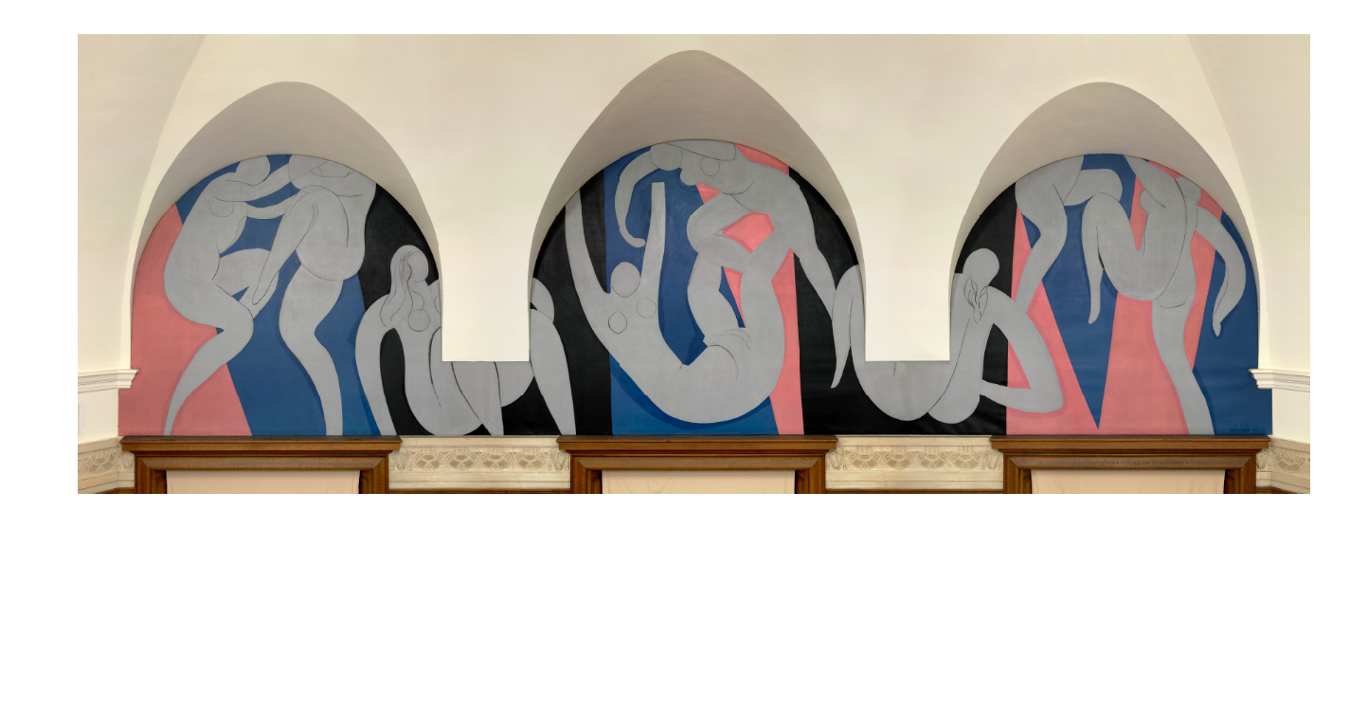
The Dance, Summer 1932 - April 1933, Oil on canvas; three panels, Overall (left): 339.7 x 441.3 cm, Overall (center): 355.9 x 503.2 cm, Overall (right): 338.8 x 439.4 cm, the Barnes, Philadelphia, PA, USA https://collection.barnesfoundation.org/objects/6967/The-Dance/

Slide 7
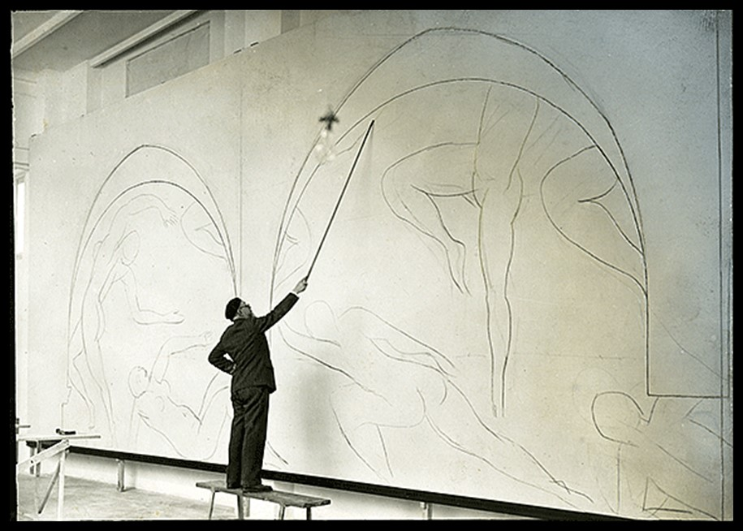
Unidentified Photographer
Henri Matisse using a bamboo stick to sketch The Dance in his studio in Nice, 1931, Photograph Collection, Barnes Foundation Archives, Philadelphia https://www.ias.edu/ideas/2016/bois-matisse-barnes

Slide 8
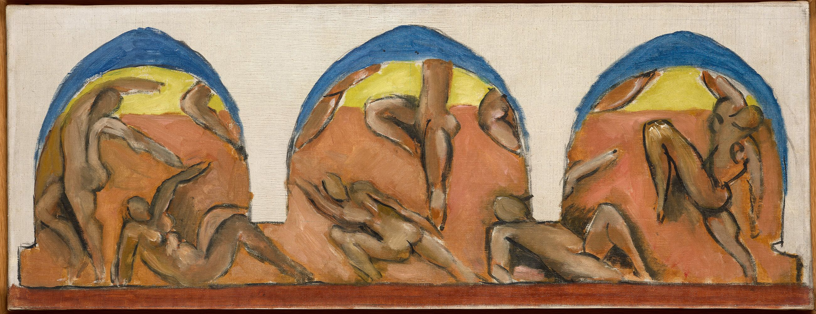
Study for Barnes Mural, Ocher Harmony, 1930–31, oil on canvas, 22x88 cm, Musée Matisse Nice, France https://philamuseum.org/calendar/exhibition/matisse-1930s

Slide 9
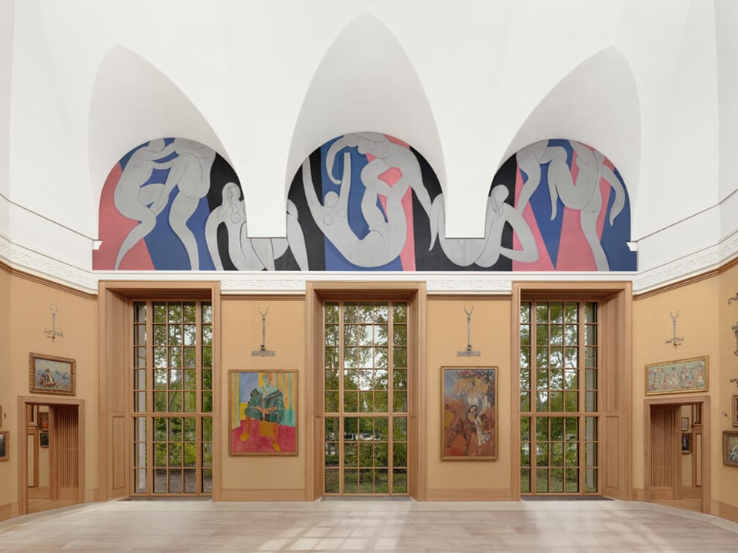
The Dance (view of the Main Room, South Wall), Summer 1932 - April 1933, Oil on canvas; three panels, Overall (left): 339.7 x 441.3 cm, Overall (center): 355.9 x 503.2 cm, Overall (right): 338.8 x 439.4 cm, the Barnes, Philadelphia, PA, USA https://collection.barnesfoundation.org/objects/6967/The-Dance/ensemble

Slide 10
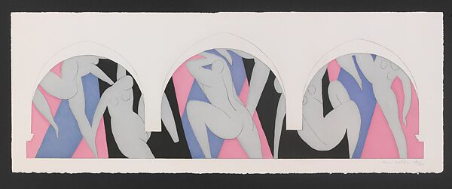
Dance: After the Paris version of the Barnes Mural, 1935, Etching and color aquatint on paper, 30.2 x 80.3 cm, the MET, NY, USA https://www.metmuseum.org/art/collection/search/492859

Slide 11
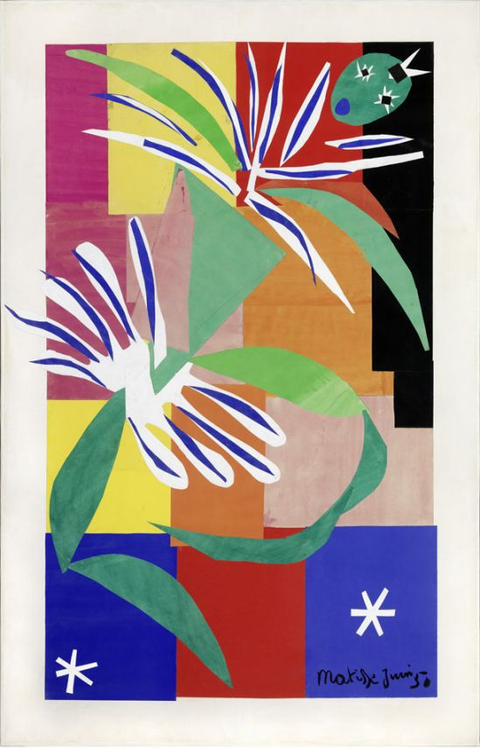
Creole Dancer, 1950, Cutout, 205 × 120 cm, Musée Matisse, Nice, France https://tresors.nice.fr/oeuvre/danseuse-creole-nice

Slide 12
The End

