Slide 1
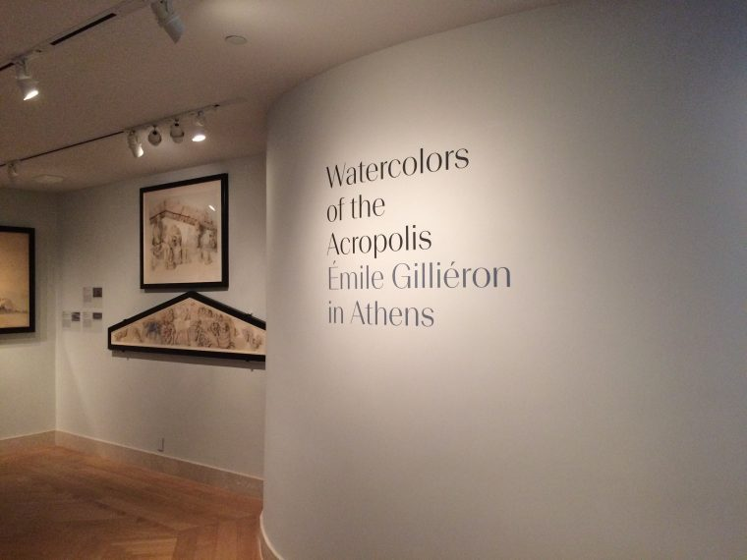

Slide 2
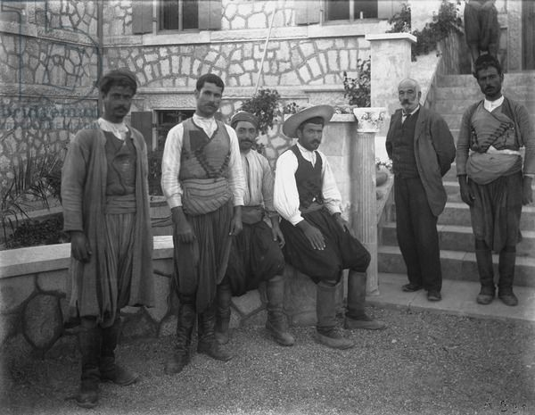
Émile Gilliéron among Evans’s local workers at Knossos, Crete

Slide 3
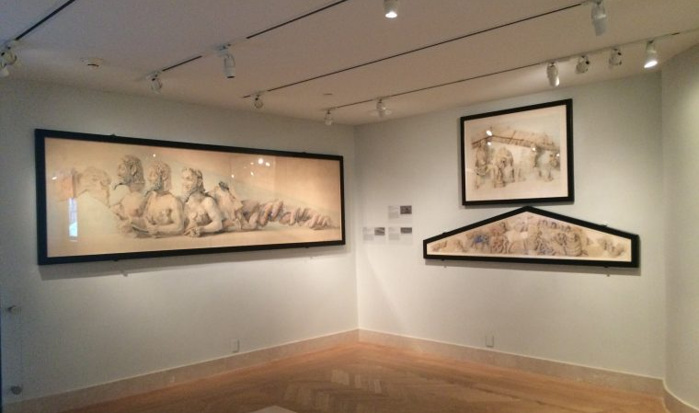
Watercolors of the Acropolis: Emile Gillieron in Athens is on view at the Metropolitan Museum of Art in New York
Photo by Eleni Sakellis

Slide 4
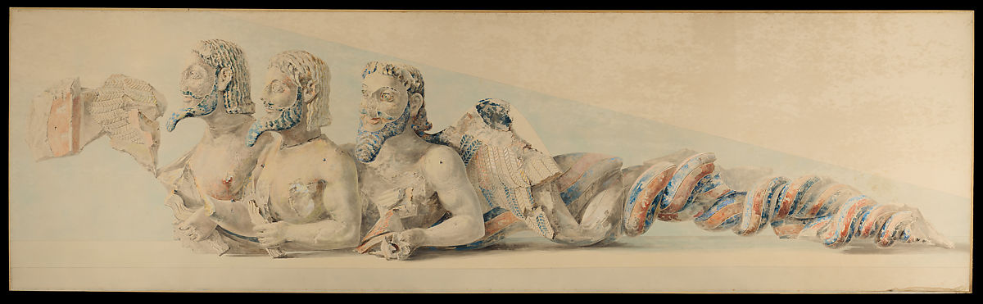
Émile Gilliéron, 1850–1924
Winged three-bodied Deamon, commonly known as “Bluebeard”, 1919, watercolor, graphite, and crayon on paper, 101.3 x 337.8 cm, the MET, NY
After the sixth-century BC Hekatompedon pedimental sculpture found on the Acropolis of Athens

Slide 5
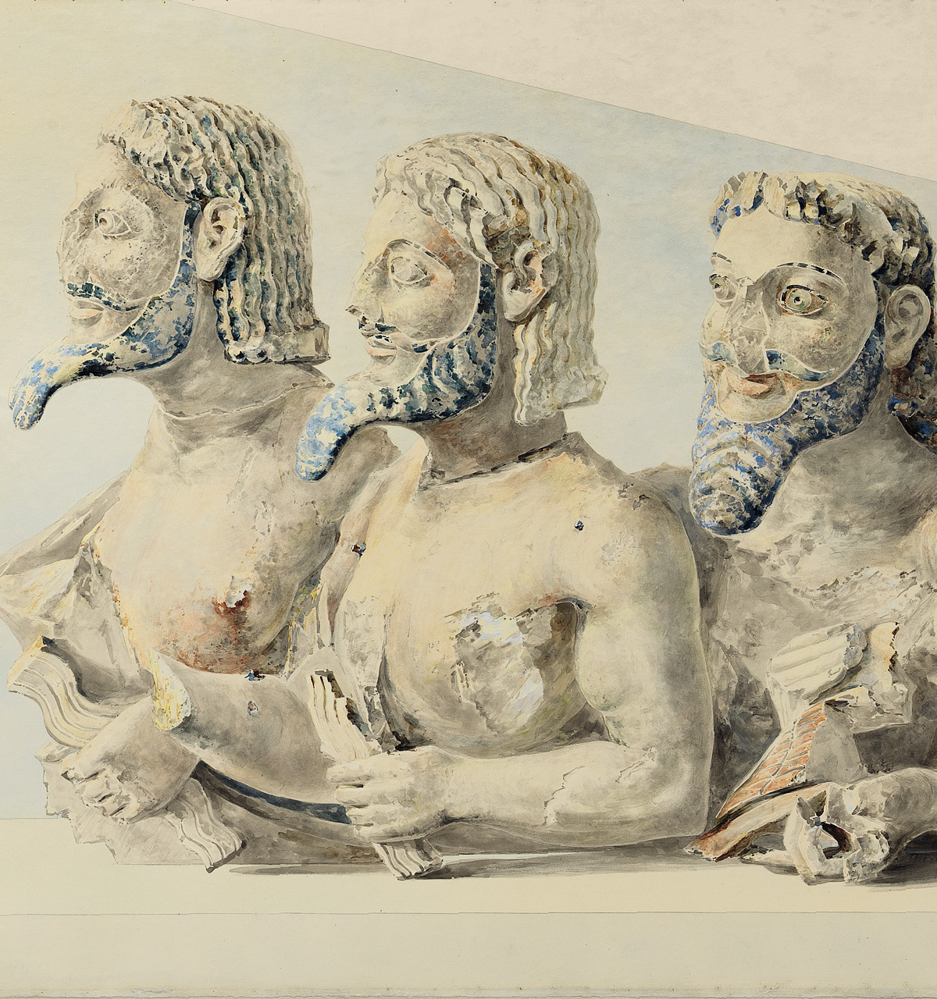
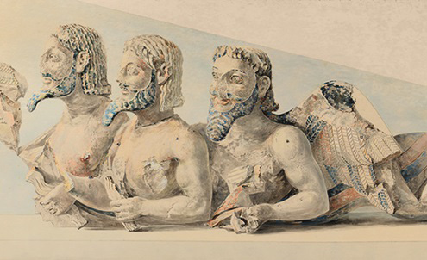
Detail of the Winged three-bodied Deamon, commonly known as “Bluebeard”

Slide 6
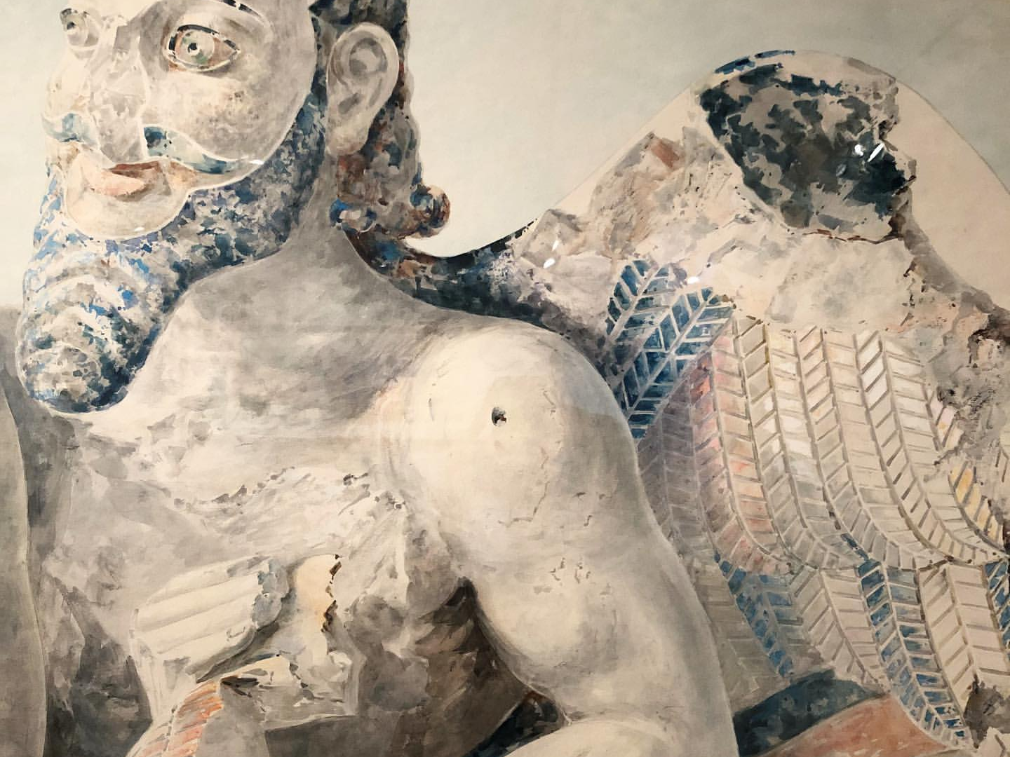

Slide 7
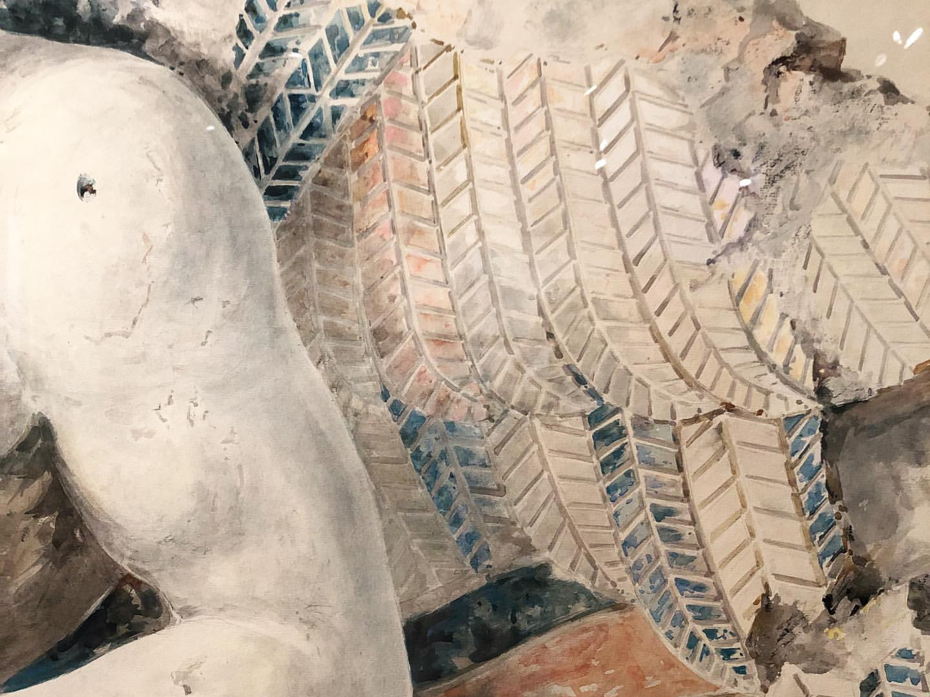

Slide 8
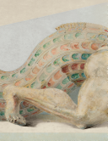
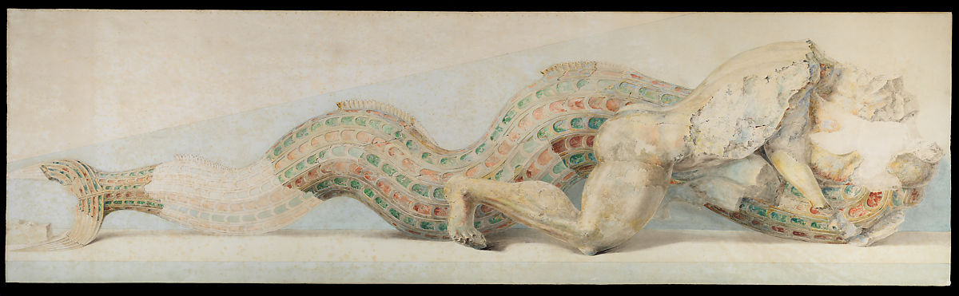
Émile Gilliéron, 1850–1924
Herakles and Triton, 1919, watercolor, graphite, and crayon on paper, 97.2 x 338.1 cm, the MET, NY
After the sixth-century BC Hekatompedon pedimental sculpture found on the Acropolis of Athens

Slide 9
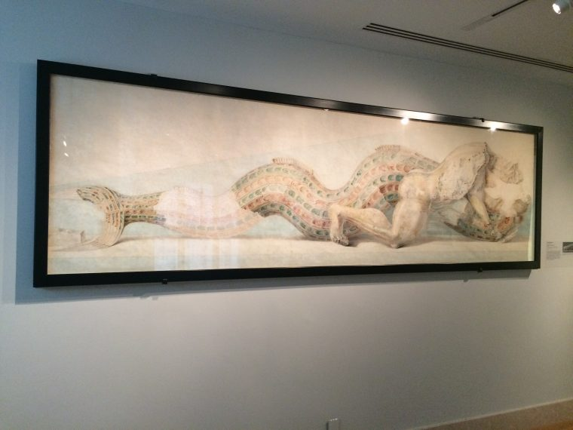
Herakles and Triton, 1919, watercolor, graphite, and crayon on paper, the MET, NY
Photo by Eleni Sakellis

Slide 10
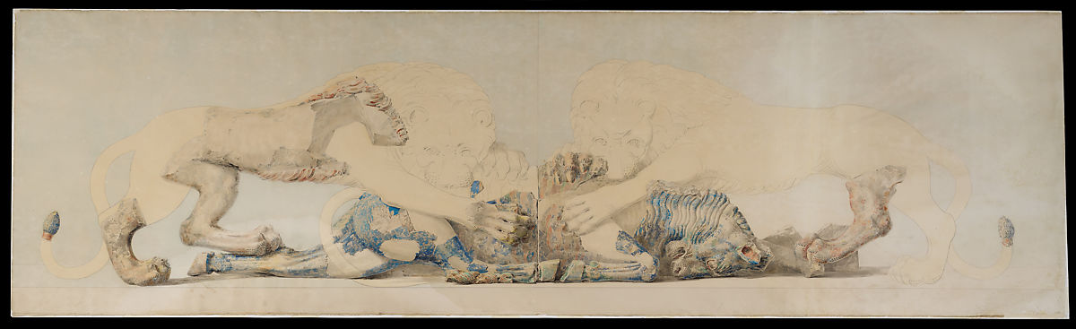
Émile Gilliéron, 1850–1924
Two Lions Savaging a Bull, 1919, watercolor, graphite, and crayon on paper, 97.5 x 337.8 cm, the MET, NY
After the sixth-century BC Hekatompedon pedimental sculpture found on the Acropolis of Athens

Slide 11
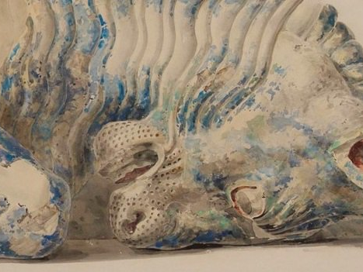

Slide 12
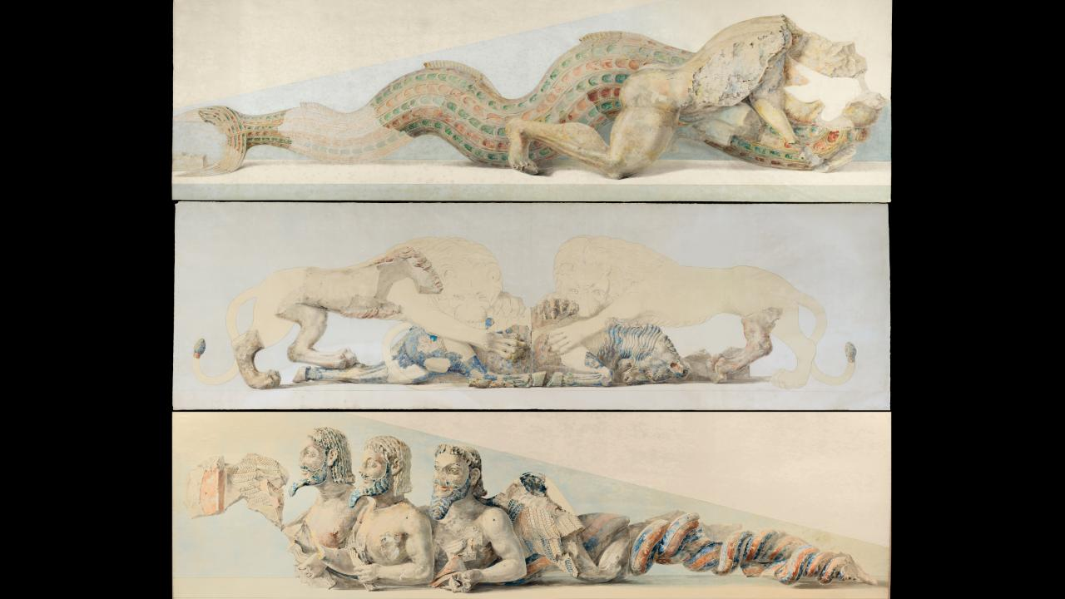
The three watercolours Émile Gilliéron painted of the Hekatompedon pedimental sculptures

Slide 13
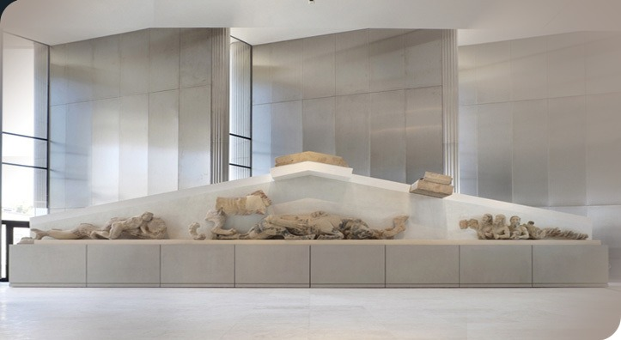
The earliest Temple on the Acropolis, known as Hekatompedon was a Doric peripteral temple with an impressive pedimental sculptural decoration.
The Hekatompedon Pediment, 570 BC, poros stone, the Acropolis Museum, Athens

Slide 14
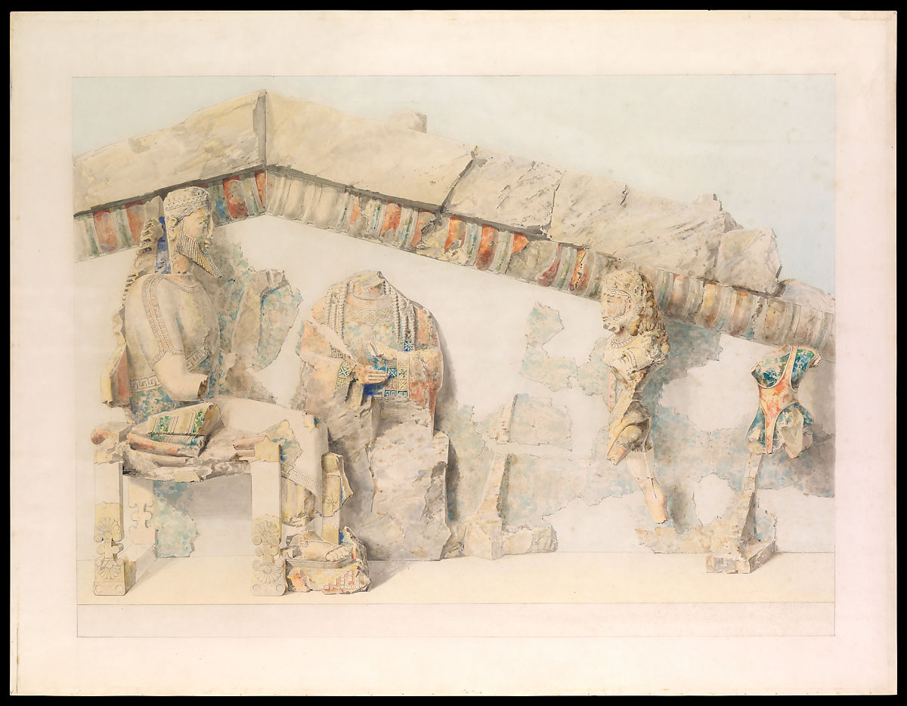
Émile Gilliéron, 1850–1924
Introduction of Herakles into Olympos, 1919, watercolour, 84.5 x 110.5 cm, the MET,
NY

Slide 15
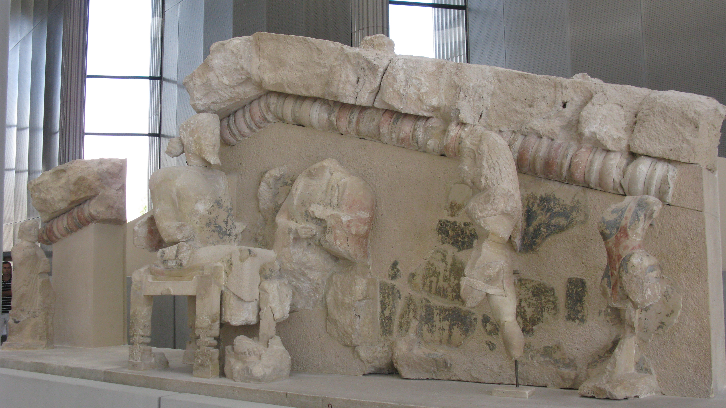
Introduction of Herakles into Olympos, 570 BC, poros stone, the Acropolis Museum, Athens

Slide 16
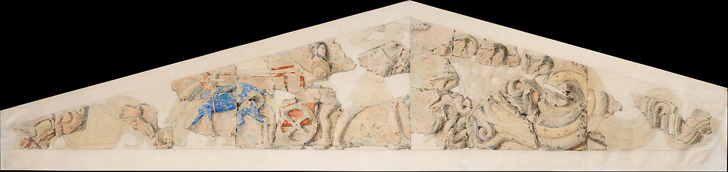
Émile Gilliéron, 1850–1924
Herakles and the Hydra, 1919, watercolour,
41.9 x 214.6 cm, the MET, NY

Slide 17
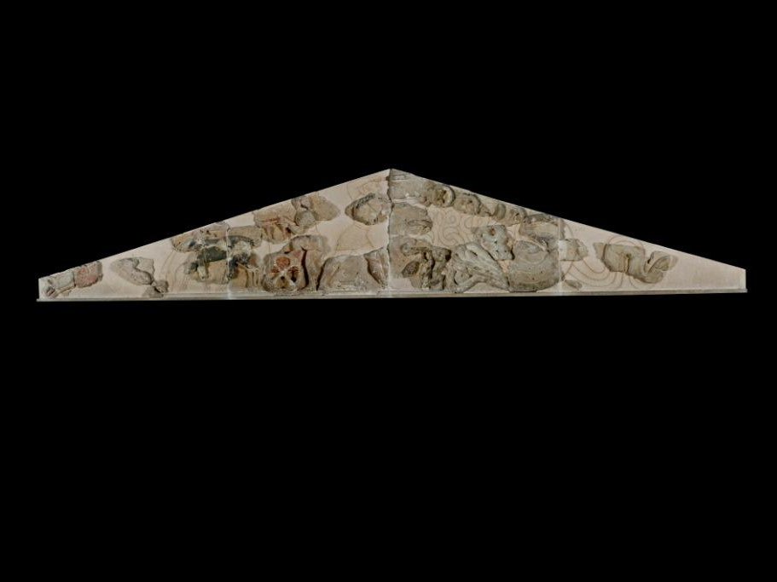
The Hydra Pediment, 570 BC, poros stone, the Acropolis Museum, Athena

