Slide 1

The Art of the Old Kingdom
1st-6th Dynasties
c. 3100-2100 BC

Slide 2
Lesson Info and PowerPoint: https://www.teachercurator.com/
https://www.facebook.com/teachercurator/

Slide 3
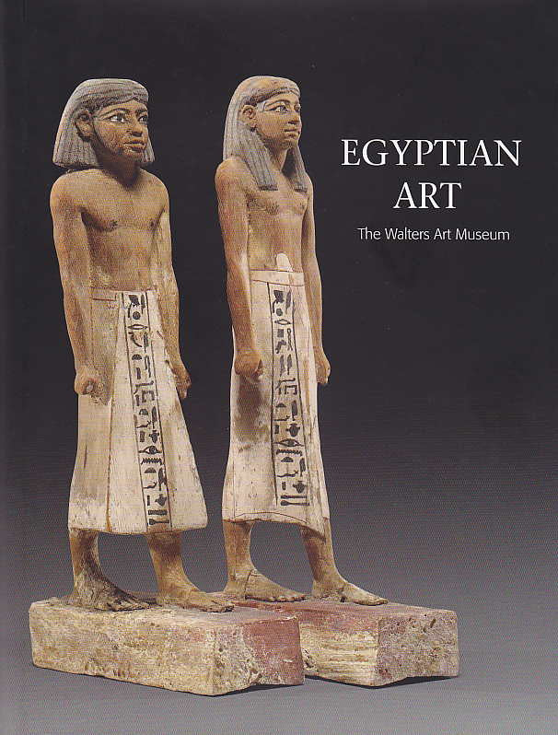
Lesson Info and PowerPoint: https://www.teachercurator.com/ https://www.facebook.com/teachercurator/

Slide 4
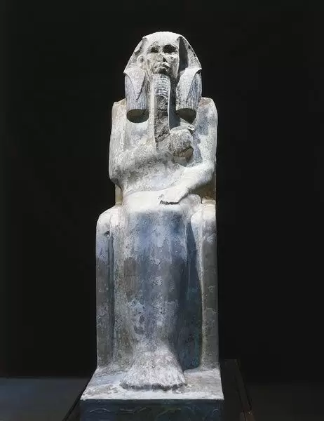
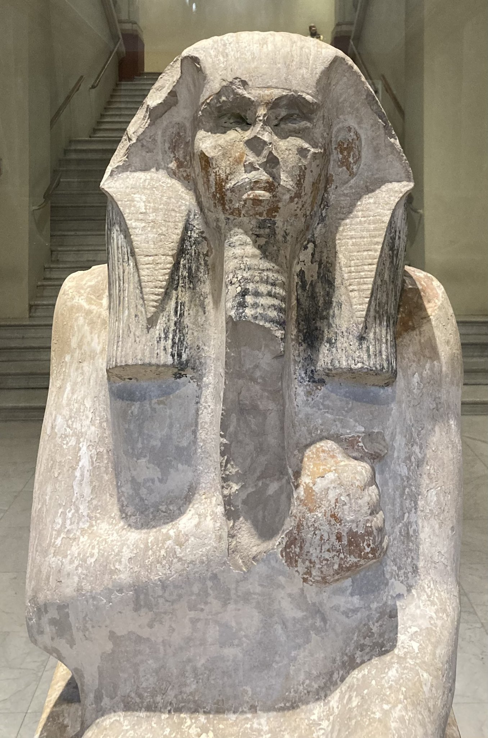
Ka statue of Djoser from his Serdab c. 2630–2611 BC,
3rd Dynasty, Limestone, Height: 144 cm, The Egyptian Museum, Cairo, Egypt https://www.prints-online.com/statue-djoser-egyptian-art-14181496.html https://twitter.com/alisonfisk/status/1500446990185947141?lang=ar-x-fm

Slide 5
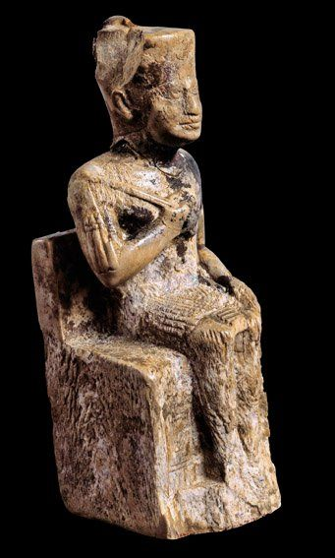
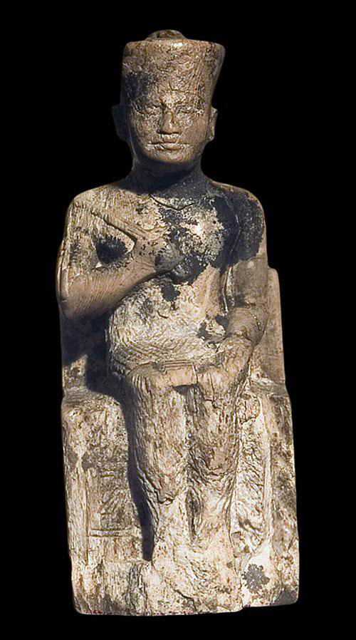
Seated Statue of Khufu from Abydos, c. 2551–2528 BC, 4th Dynasty, Ivory, 7.5x2.9x2.6 cm, The Egyptian Museum, Cairo, Egypt https://abydos.org/blog/2019/5/17/happy-museum-day-king-khufu https://stitchingcorner.com/?p=2274

Slide 6
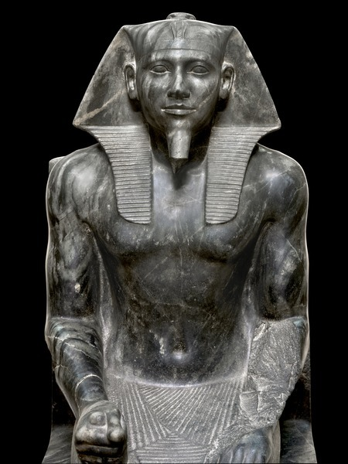
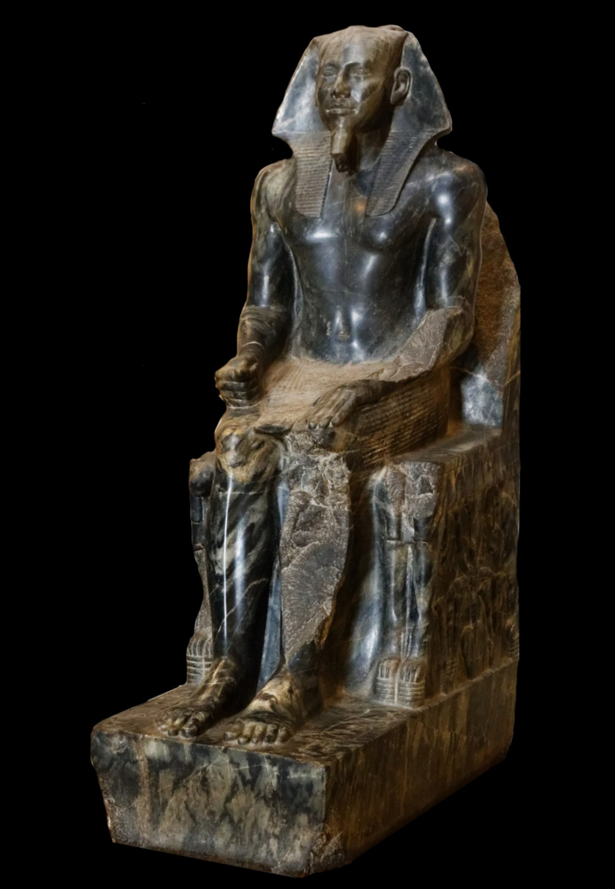
Khaphre Enthroned from Giza, c. 2520–2494 BC, 4th Dynasty, Diorite, Height: 168 cm, The Egyptian Museum, Cairo, Egypt https://www.hmoob.in/wiki/Khafre https://cavegirl66.tumblr.com/post/633512143198797824/khafre-enthroned

Slide 7
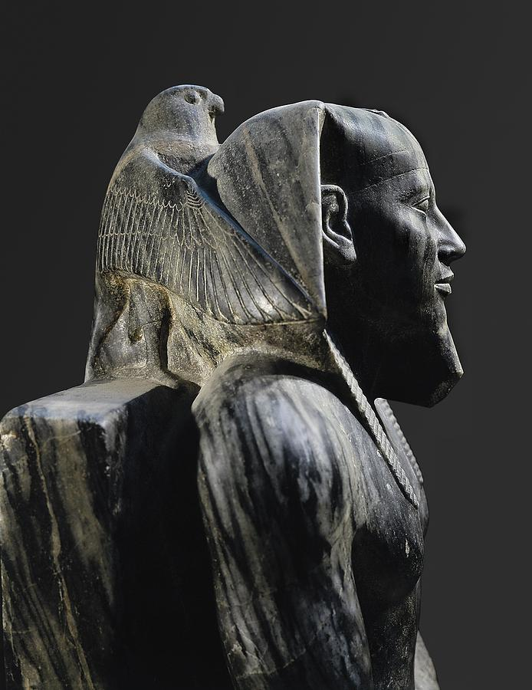
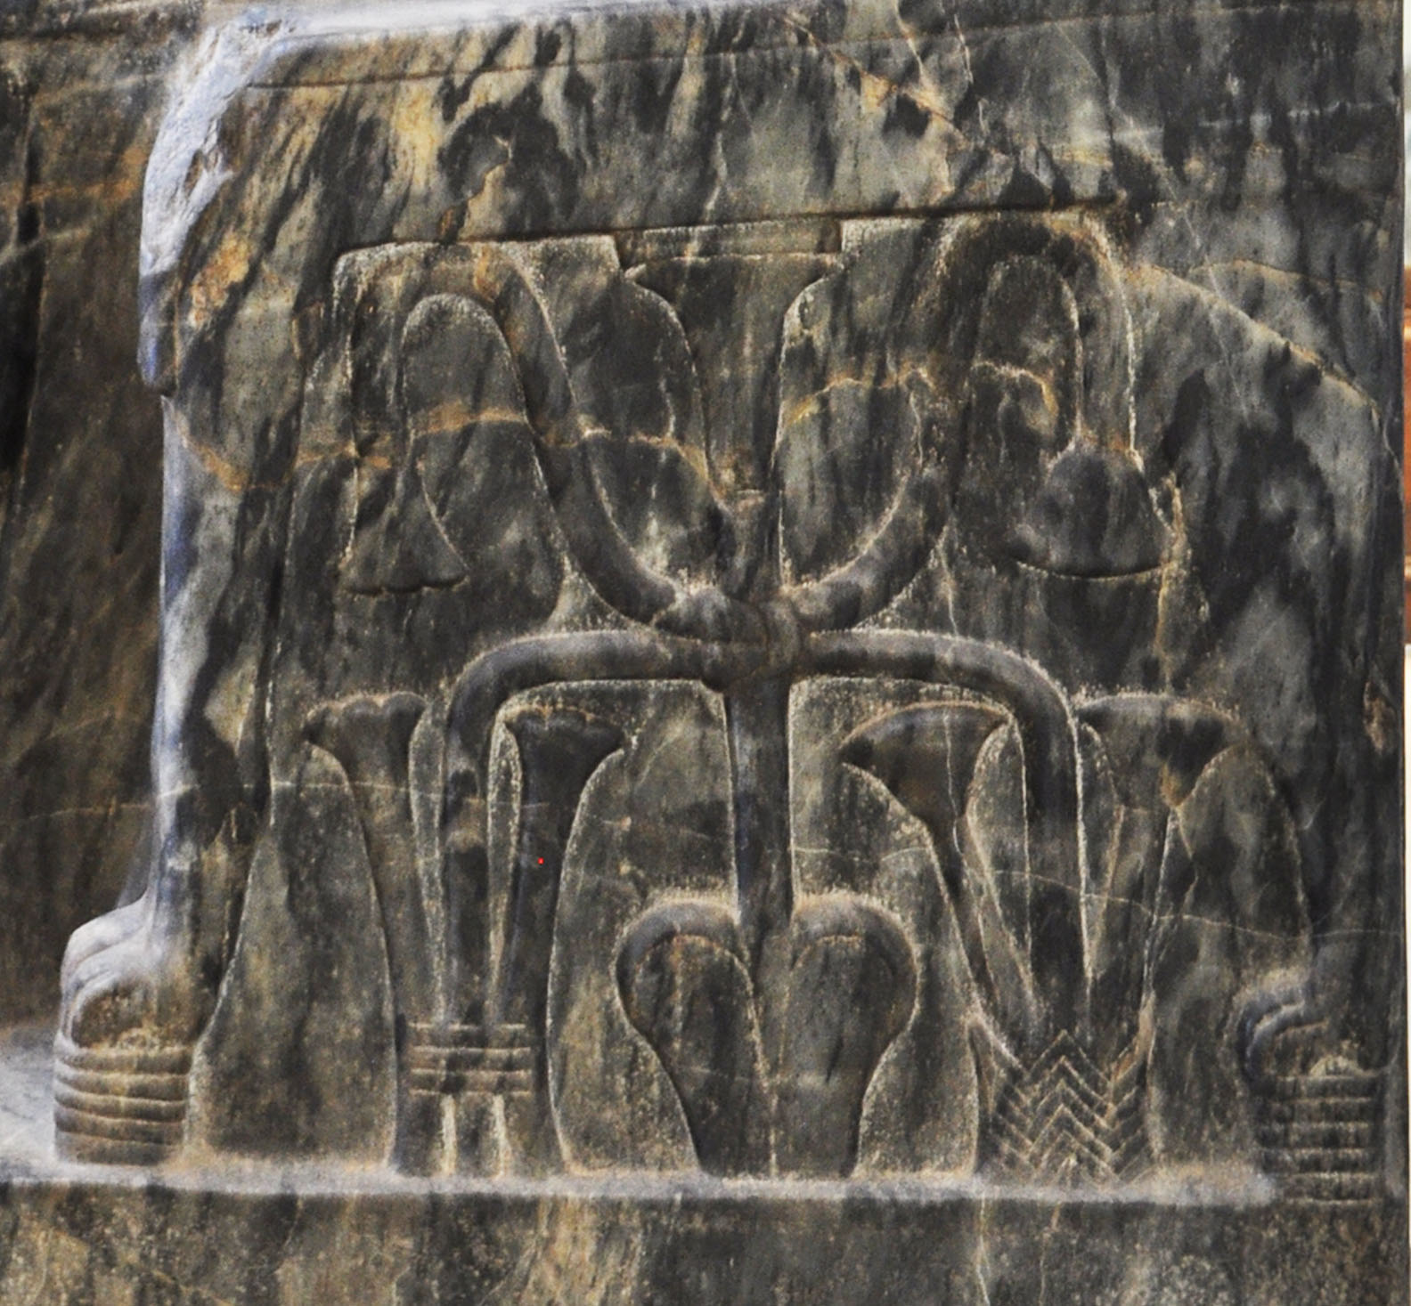
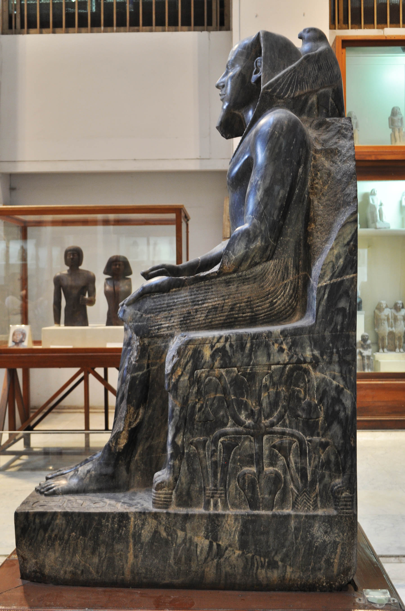
https://fineartamerica.com/featured/1-statue-of-khafre-enthroned-2520-bc-everett.html https://egymonuments.gov.eg/collections/khafra-statue-2/

Slide 8
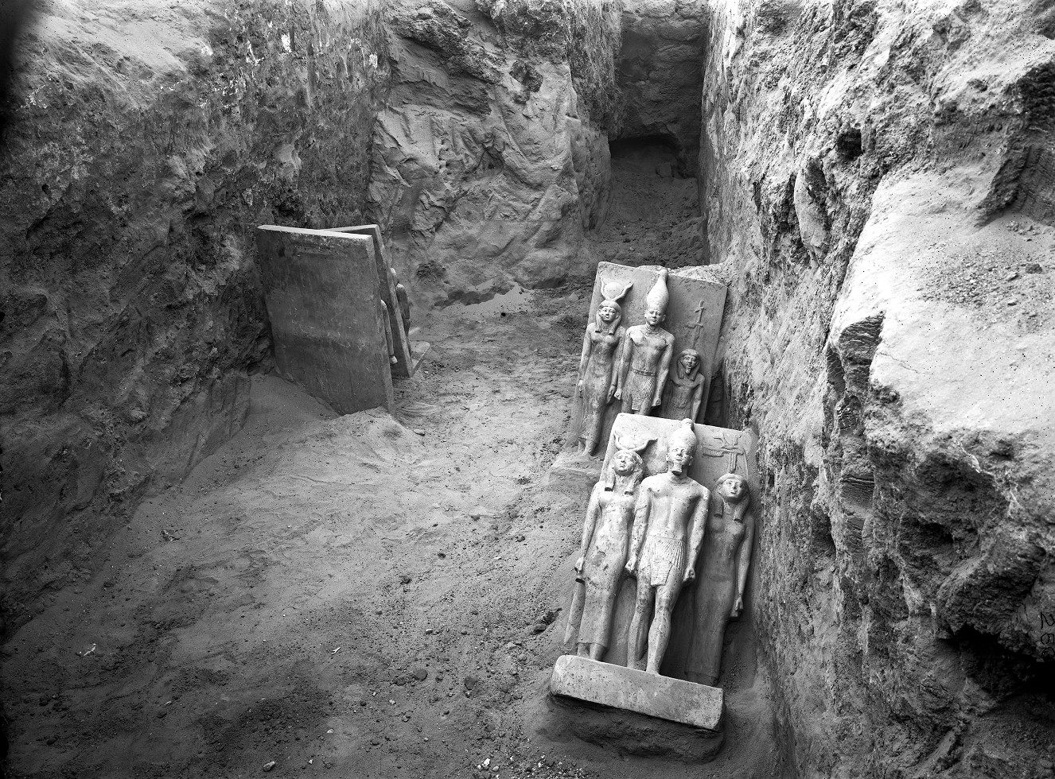
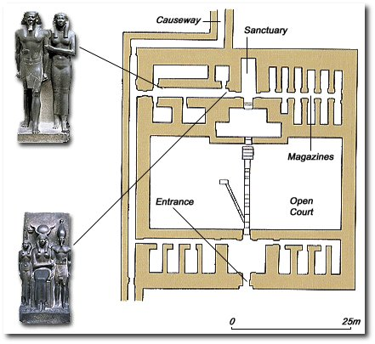
Four greywacke triads, Menkaure valley temple, S magazines, corridor III 4, photo: 1908 (The Giza Archives) https://www.khanacademy.org/humanities/ap-art-history/ancient-mediterranean-ap/ancient-egypt-ap/a/king-menkaure-mycerinus-and-queen https://www.ancient-egypt.co.uk/boston/menkaura/pages/boston_03_2006%20323.htm

Slide 9
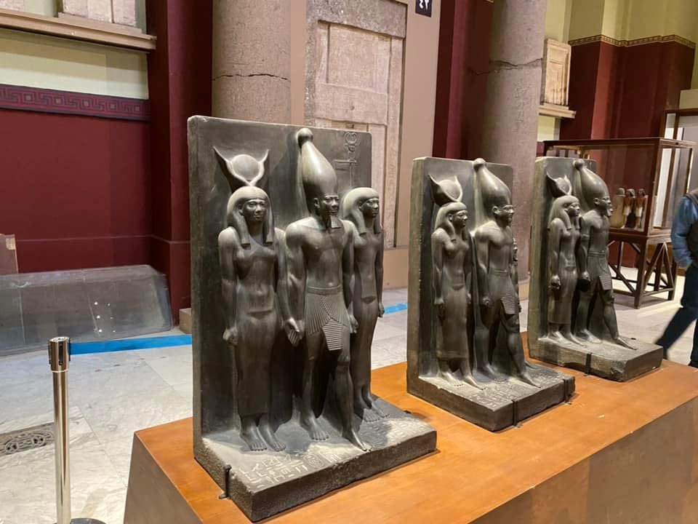
https://www.reddit.com/r/OutoftheTombs/comments/st6bov/for_the_first_time_the_cairo_triads_of_menkaure/

Slide 10
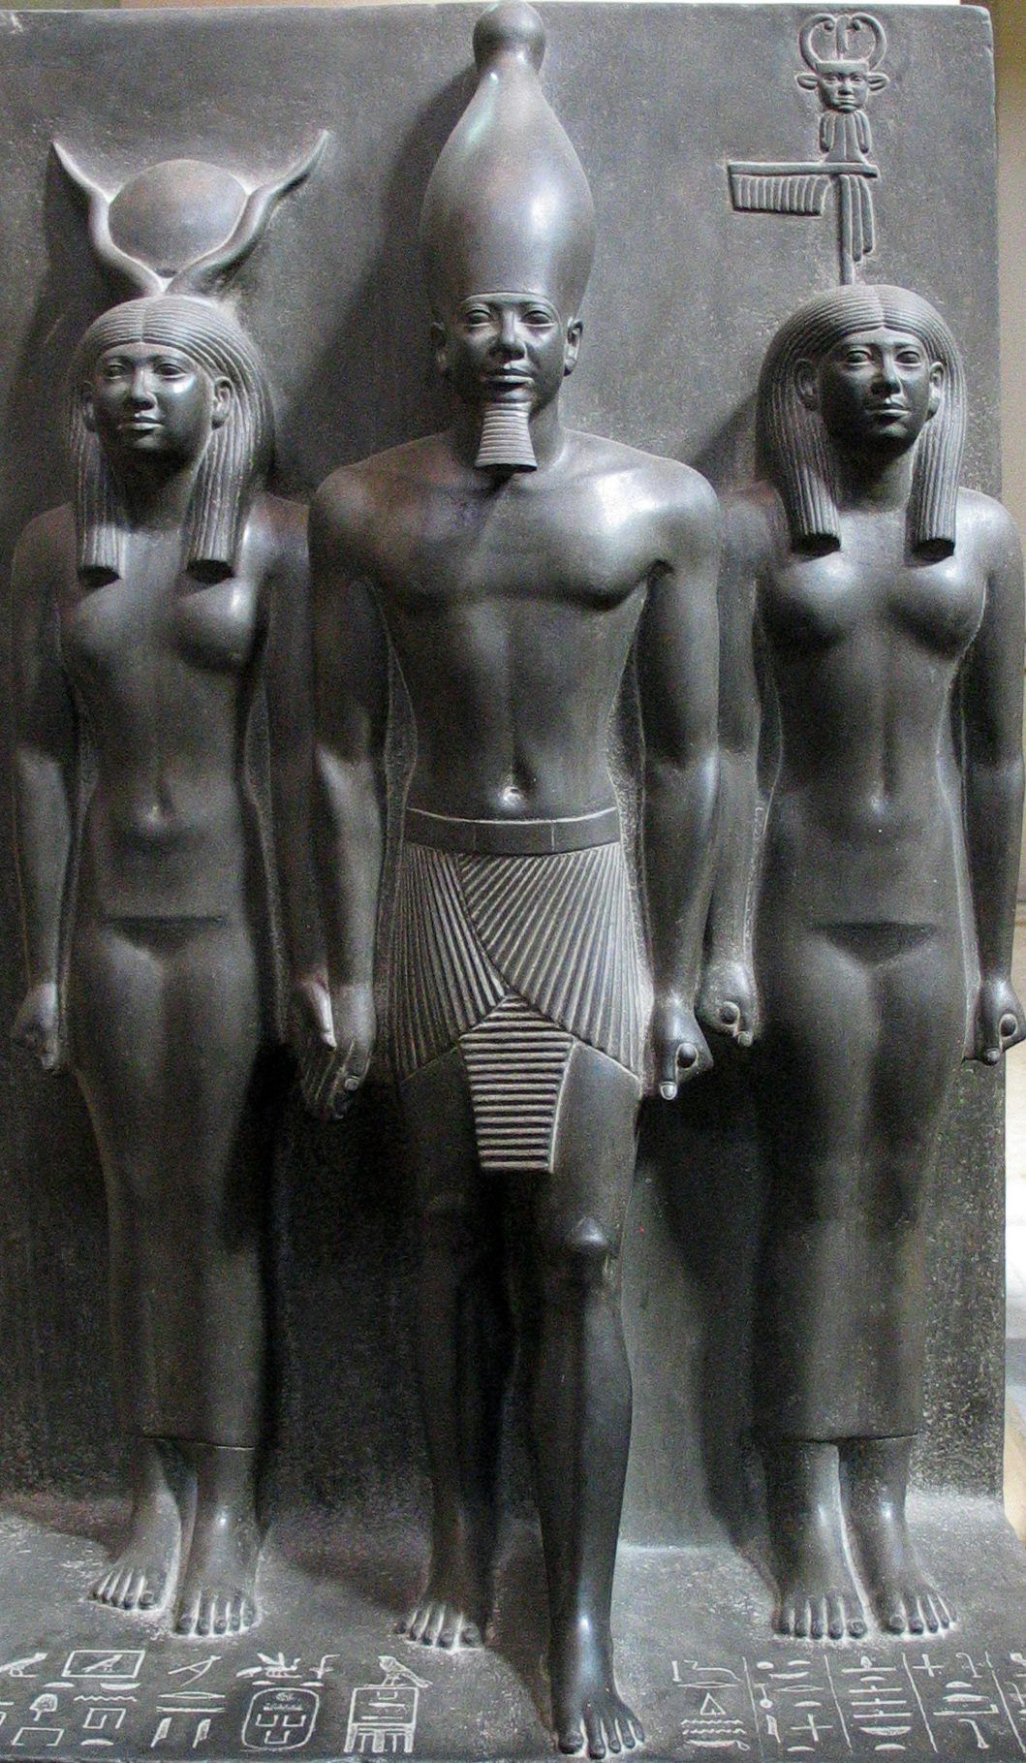
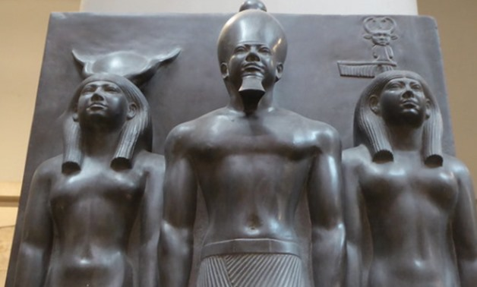
Pharaoh Mencaure with goddess Hathor and personification of Cynopolis, c. 2490–2472 BC, 4th Dynasty, Greywacke/Schist, Height: 96 cm, The Egyptian Museum, Cairo, Egypt https://www.reddit.com/r/ArtefactPorn/comments/itoms8/a_sculpted_triad_showing_king_menkaure_between/ https://www.egypttoday.com/Article/4/84828/Egypt-s-Min-of-Tourism-Antiquities-organizes-a-guided-video

Slide 11
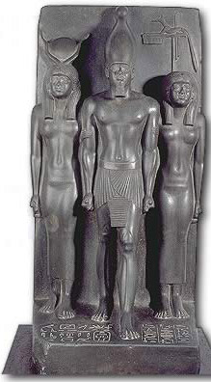
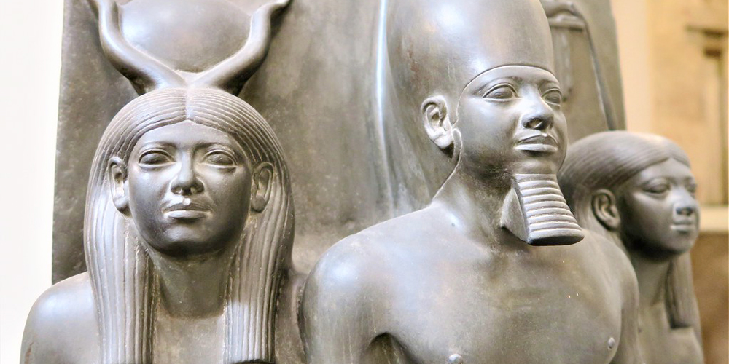
Pharaoh Mencaure with goddess Hathor and personification of 17th nome of Upper Egypt, c. 2490–2472 BC, 4th Dynasty, Greywacke/Schist, Height: 92.5 cm, The Egyptian Museum, Cairo, Egypt http://www.touregypt.net/egyptmuseum/egyptian_museumq6.htm https://www.tripsinegypt.com/king-menkaure/

Slide 12
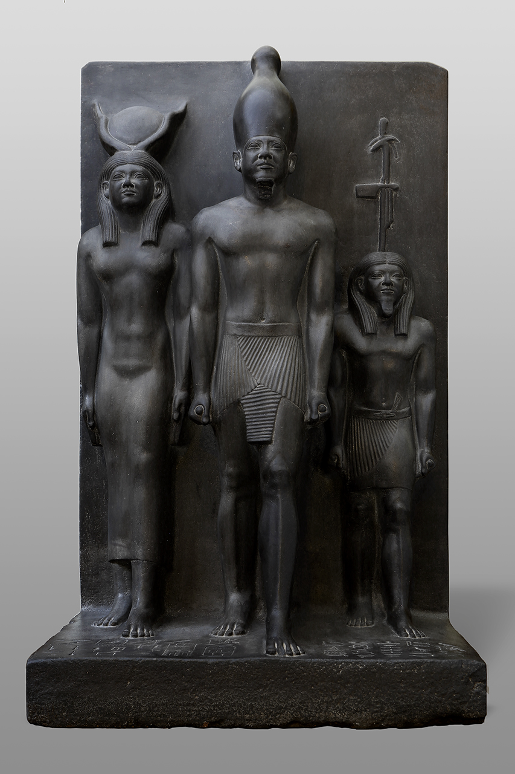
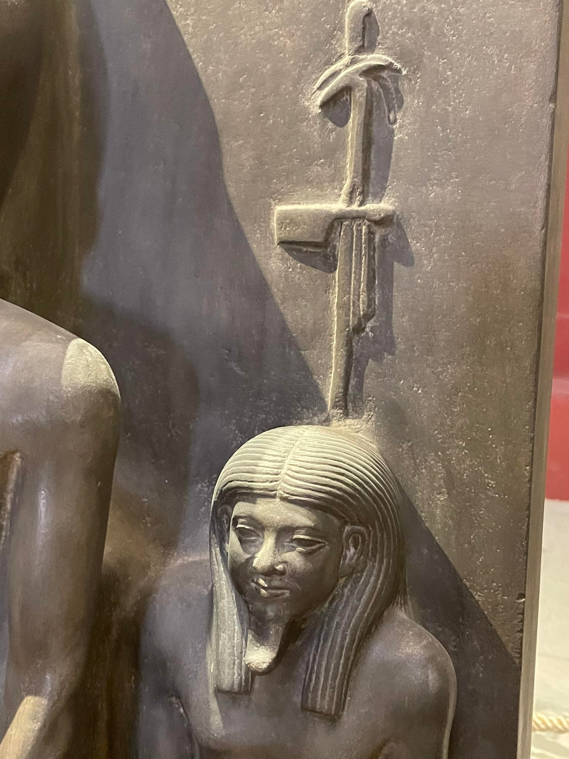
Menkaure between Hathor and the Theban God, c. 2490–2472 BC, 4th Dynasty, Greywacke/Schist, Height: between 92.5 cm and 95.5 cm, The Egyptian Museum, Cairo, Egypt https://www.egyptianmuseumcairo.com/egyptian-museum-cairo/artefacts/menkaure-triad/ https://www.reddit.com/r/OutoftheTombs/comments/vc41fm/king_menkaure_hathor_and_the_goddess_of_the_nome/

Slide 13
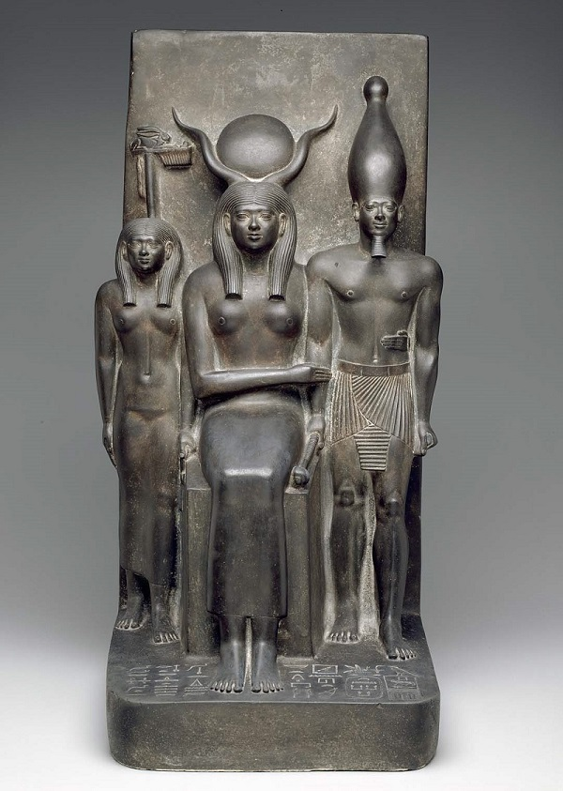
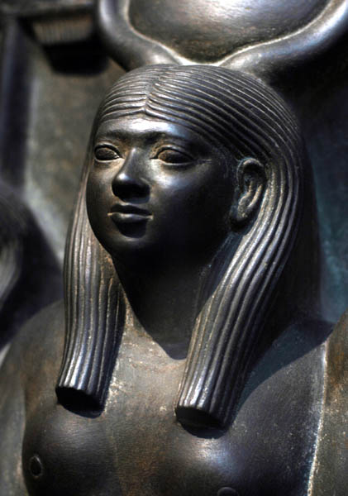
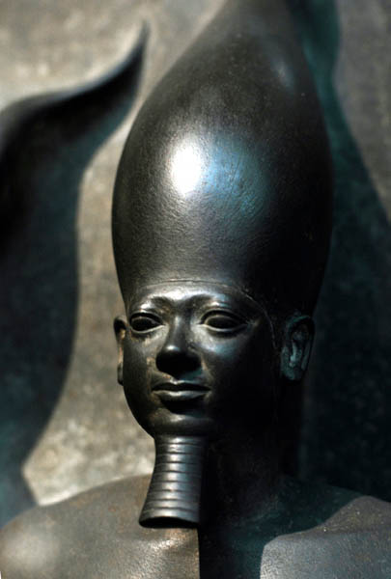
Pharaoh Mencaure with goddess Hathor and the personification of Hare nome, c. 2490–2472 BC, 4th Dynasty, Greywacke/Schist, 43.5 x 84.5 x 49 cm, MFA, Boston, USA https://collections.mfa.org/objects/138424/king-menkaura-the-goddess-hathor-and-the-deified-hare-nome;jsessionid=CAA49801CC06EC1E9DD92532113529C7?ctx=27a25e08-eb79-4b4a-b06d-f0498b01b7fa&idx=5

Slide 14
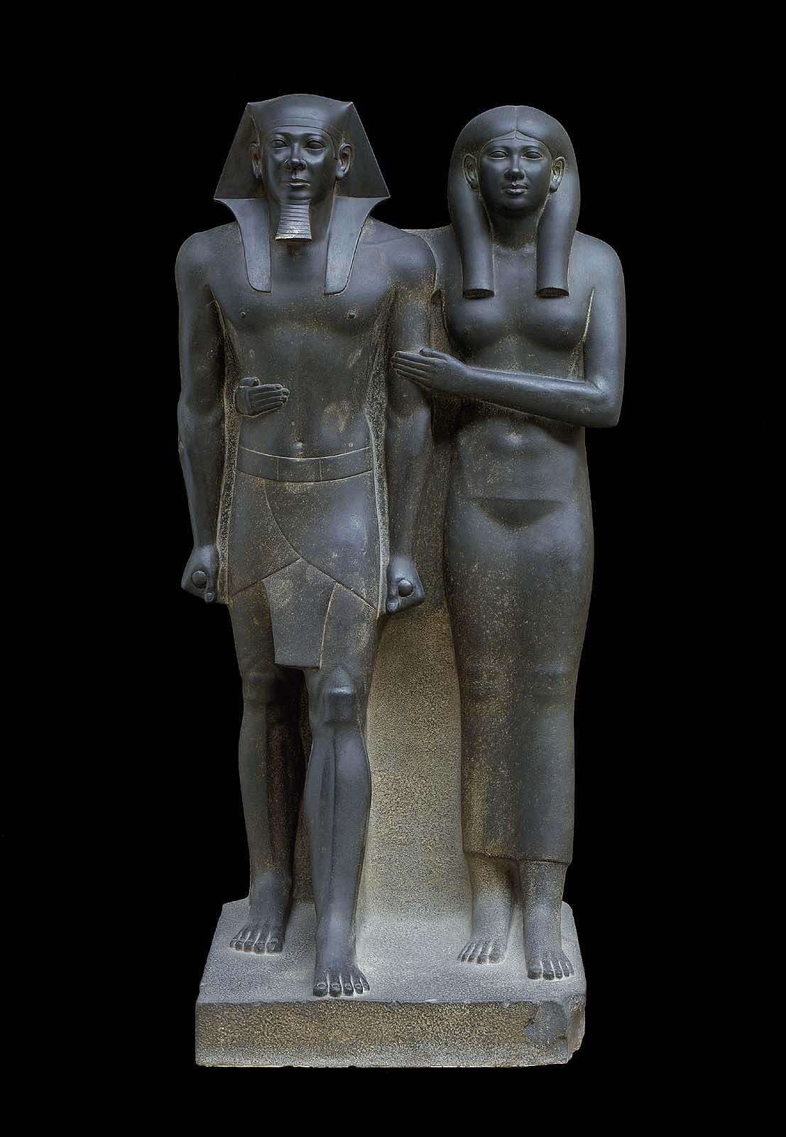
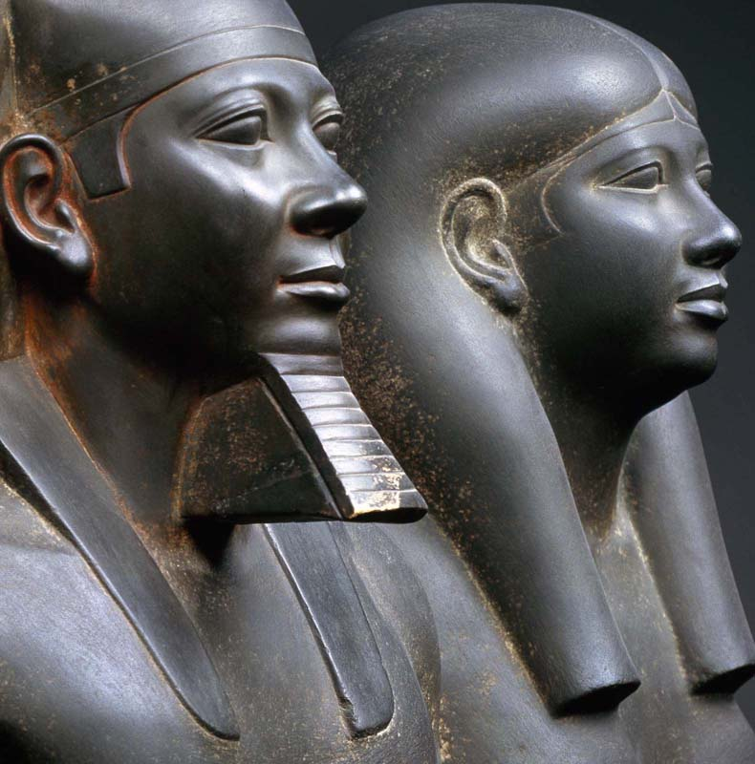
Menkaure and Queen Khamerernebty, c. 2490–2472 BC, 4th Dynasty, Greywacke/Schist, 142.2 x 57.1 x 55.2 cm, MFA, Boston, USA https://collections.mfa.org/objects/230 https://www.exploringart.co/ancient-gyptian-art-king-menkaure-queen/

Slide 15
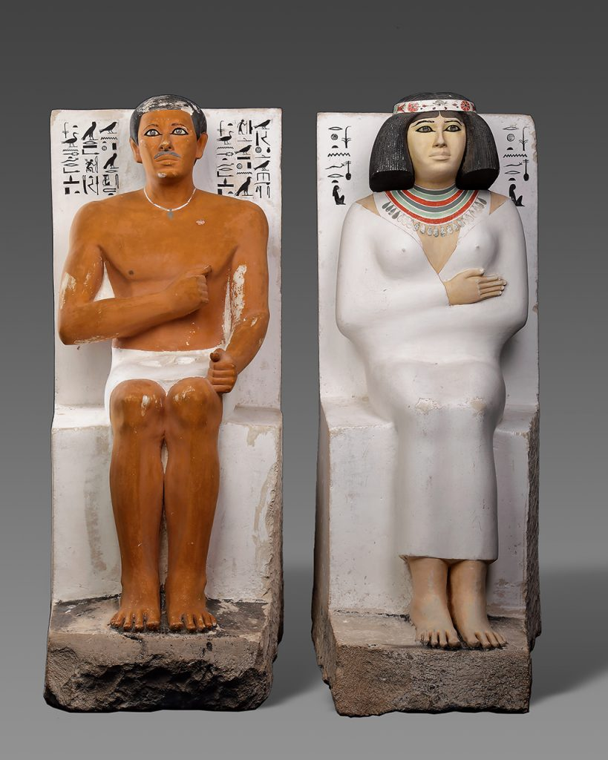
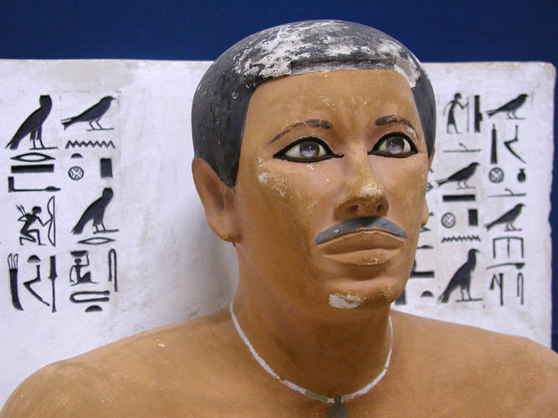
Prince Rahotep and his wife Nofret, son of Snofru, from his Mastaba in Meidum, c. 2590, 4th Dynasty, Painted limestone - eyes inlaid with rock-crystal, calcite and outlined with copper, Height of Rahotep: 121 cm, Height of Nofret 122 cm, The Egyptian Museum, Cairo, Egypt https://www.egyptianmuseumcairo.com/egyptian-museum-cairo/artefacts/rahotep-and-nofret/ https://en.wikipedia.org/wiki/Prince_Rahotep#/media/File:Rahotep_statue.jpg

Slide 16
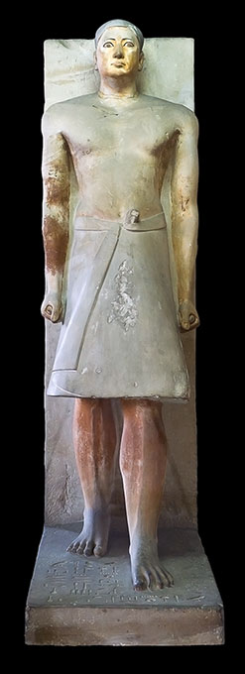
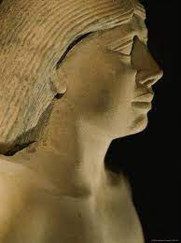
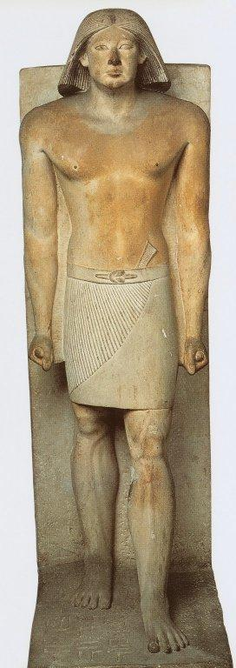
Statues of Ranofer c. 2450 BC, 5th Dynasty, Painted Limestone, The Egyptian Museum, Cairo, Egypt https://didoofcarthage.tumblr.com/post/189532484339/statue-of-ranefer https://www.chegg.com/flashcards/03-egypt-ffbd6419-dc36-4513-820e-5ee16e3024a8/deck https://m.facebook.com/w.of.Egypt/posts/prince-ranofer4th-dynastypainted-limestonesaqqara-mastaba-of-ranofer-no40a-marie/1096757413746328/

Slide 17
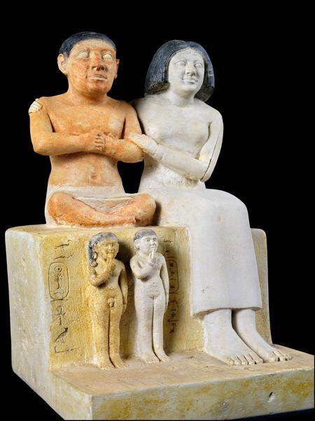
The Dwarf Seneb And His Family, c. 2240 BC, 6th Dynasty, Painted Limestone, Height: 22 cm, The Egyptian Museum, Cairo, Egypt https://www.facebook.com/Egypt.Museum/photos/a.489172547785308/1408428969192990/

Slide 18
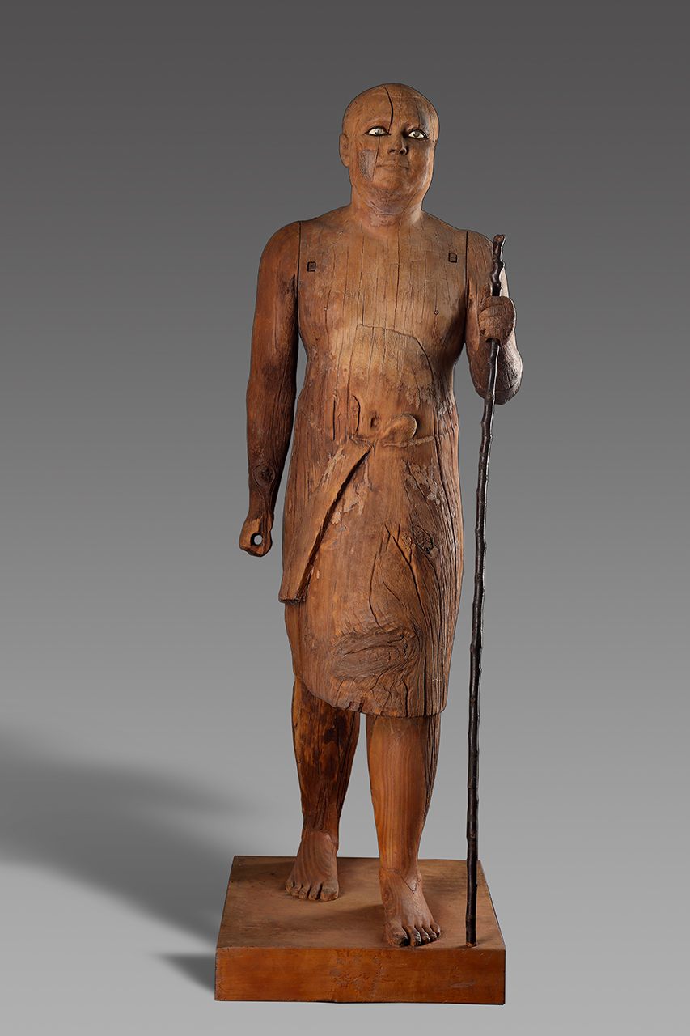
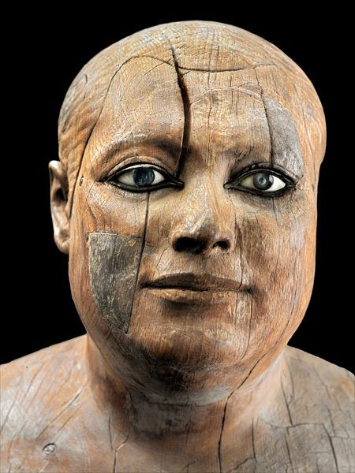
Statue of Ka Aper from Saqqara, c.2450-2350 BC, 5th Dynasty,
Wood, Eyes: Eyes: Rock crystal, calcite, copper, black stone, Height: 112 cm, The Egyptian Museum, Cairo, Egypt https://www.egyptianmuseumcairo.com/egyptian-museum-cairo/artefacts/statue-of-ka-aper/ https://www.reddit.com/r/interestingasfuck/comments/ecuv6e/wooden_statue_of_sheikh_elbeled_an_egyptian/

Slide 19
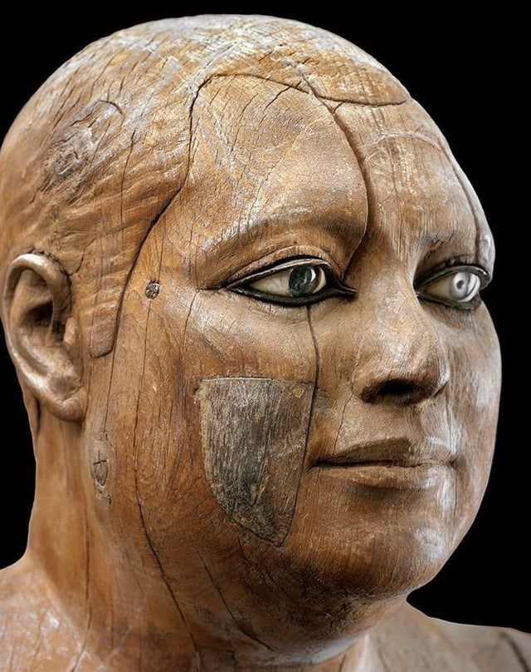
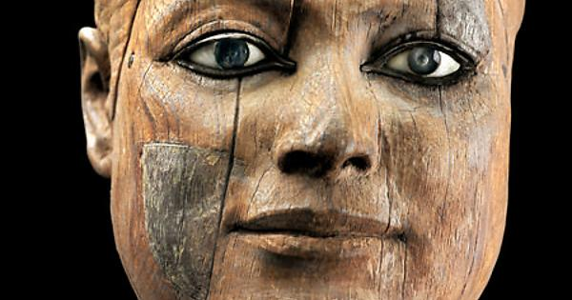
https://www.reddit.com/r/OutoftheTombs/comments/vi7q9q/the_4500_years_old_wooden_statue_of_kaaper_the/ https://imgur.com/gallery/tlX0dFX

Slide 20
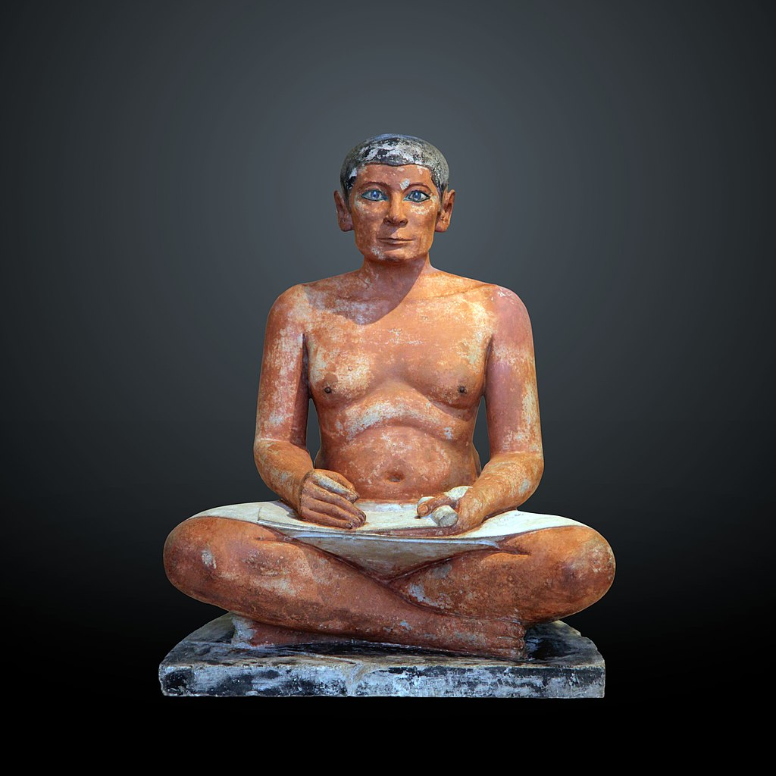
The Seated Scribe, c. 2550, 4th Dynasty, Painted Limestone, Eyes: rock crystal, magnesite, copper-arsenic alloy, Nipples: wood, Height: 53.7 cm, Louvre, Paris, France https://en.wikipedia.org/wiki/The_Seated_Scribe

Slide 21
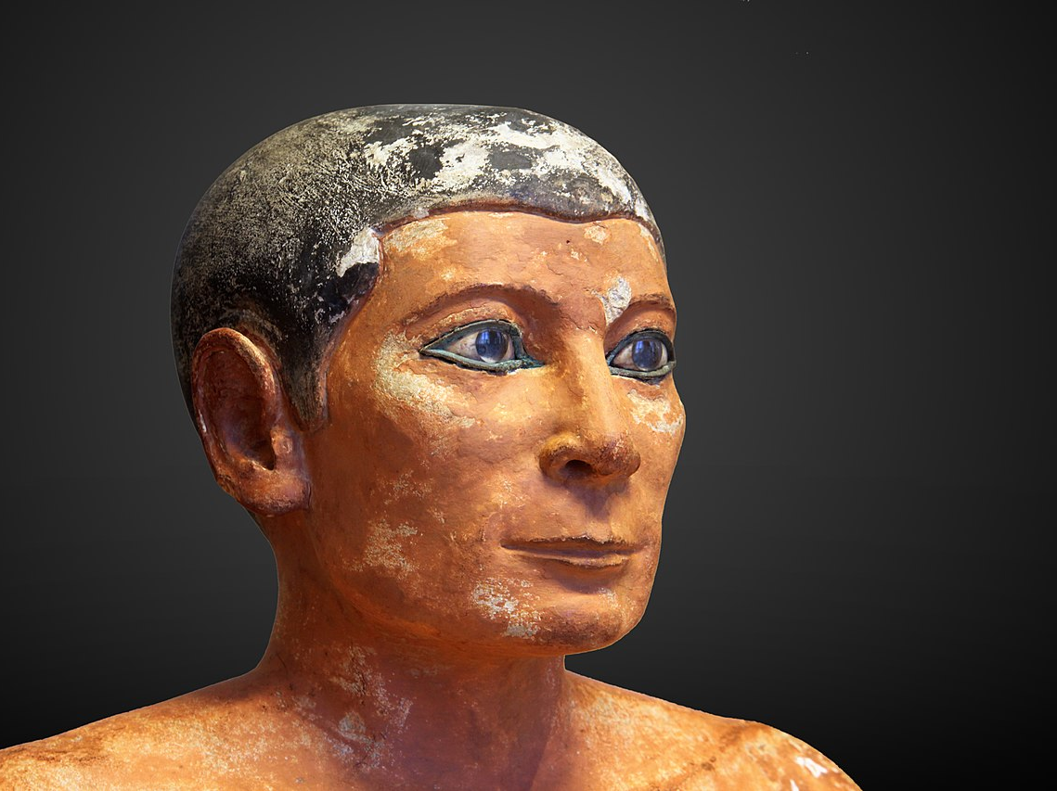
https://en.wikipedia.org/wiki/The_Seated_Scribe#/media/File:Seated_scribe-E_3023-IMG_9797-gradient.jpg

Slide 22
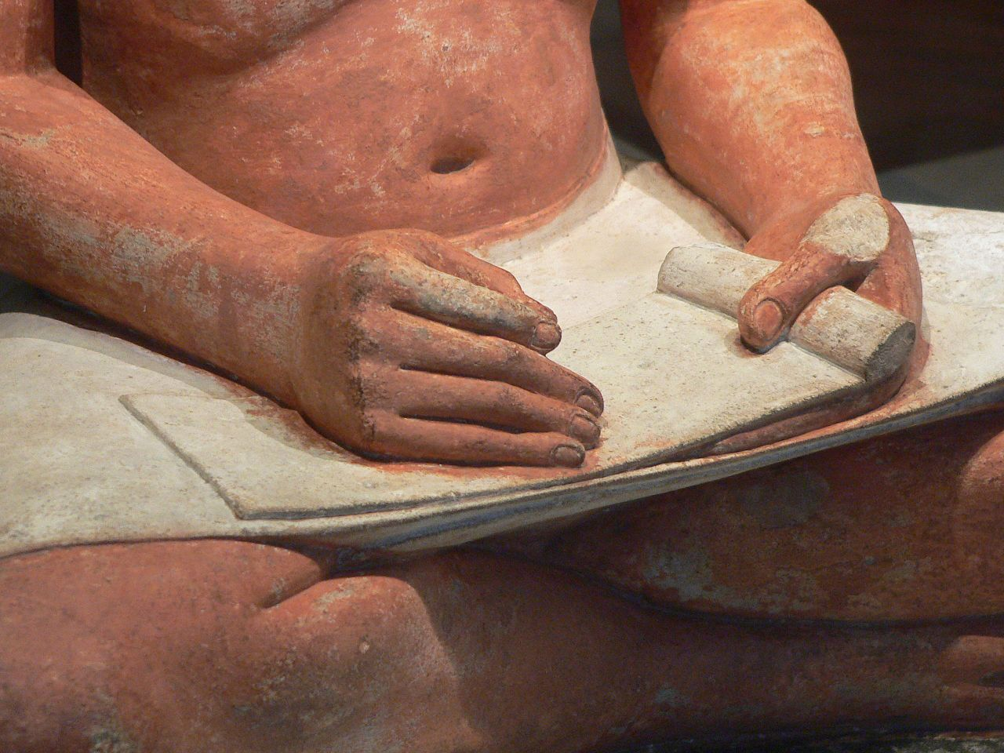
https://en.wikipedia.org/wiki/The_Seated_Scribe#/media/File:Louvre-antiquites-egyptiennes-p1020382.jpg

Slide 23
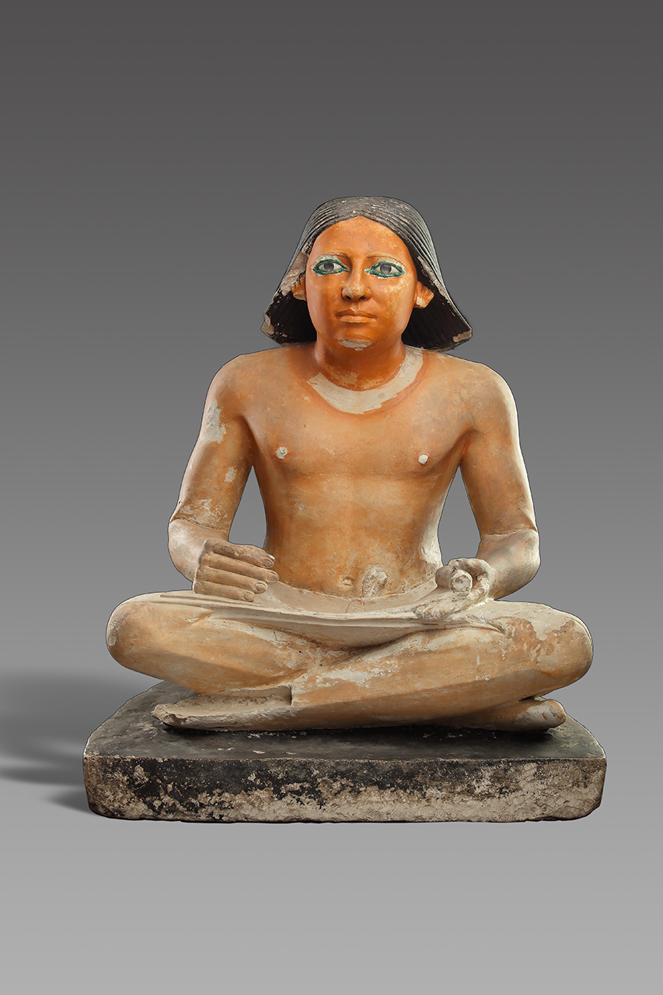
Seated Scribe, c. 2470 BC, 5th Dynasty, Painted Limestone, Eyes: Rock Crystal, Calcite, Copper, Height: 51 cm, The Egyptian Museum, Cairo, Egypt https://www.egyptianmuseumcairo.com/egyptian-museum-cairo/artefacts/scribe-statue-cg-36/

Slide 24
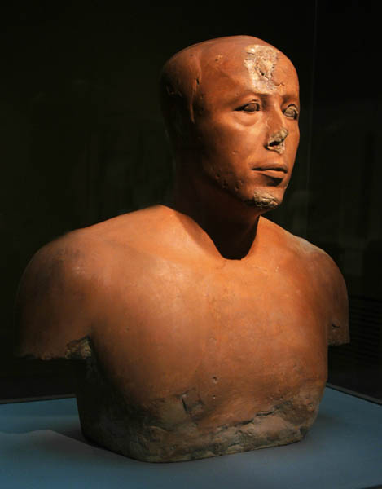
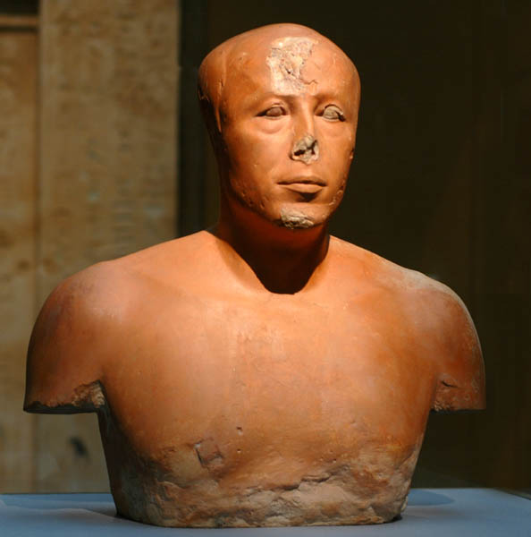
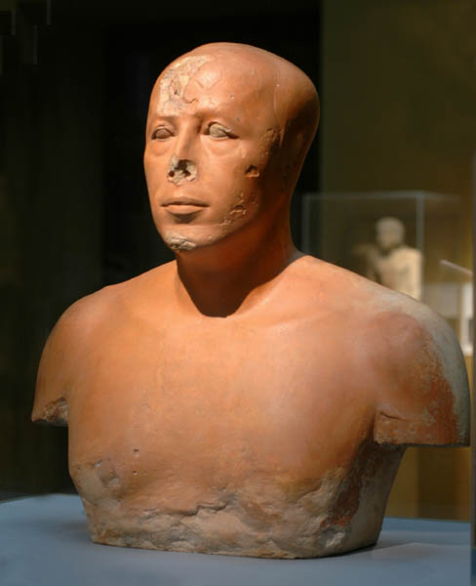
Bust of Prince Ankhhaf, 2558-2532 BC, 4th Dynasty, Painted limestone, Height: 50.5 cm, MFA, Boston, USA https://collections.mfa.org/objects/45982/bust-of-prince-ankhhaf;jsessionid=5B3E102540D8C15EFC30AB8370516E75

Slide 25
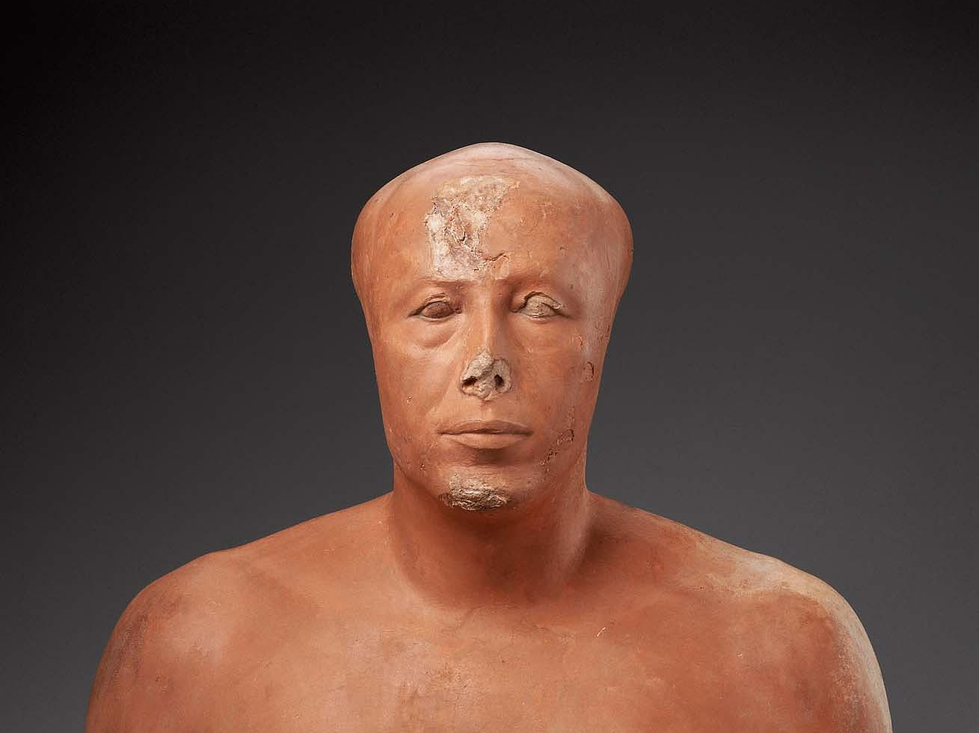
https://collections.mfa.org/objects/45982/bust-of-prince-ankhhaf;jsessionid=31F01D6427B635A46F0DE644AFD493D7?ctx=e91ee663-9973-45bb-95cd-56624b8c6b66&idx=0

Slide 26
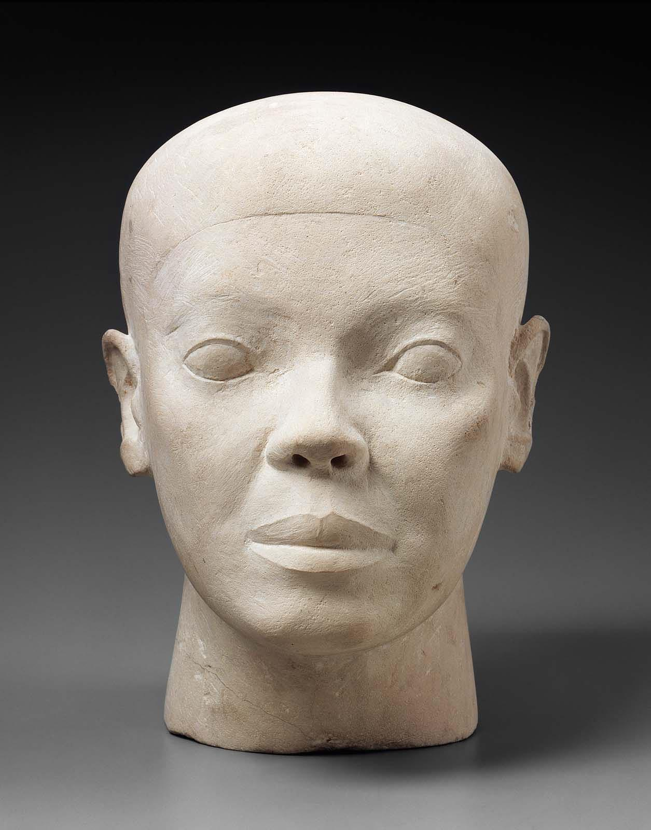
Reserve Head, c. 2600-2490 BC, 4th Dynasty, Limestone, Height: 30 cm, MFA, Boston, USA https://collections.mfa.org/objects/141966

Slide 27
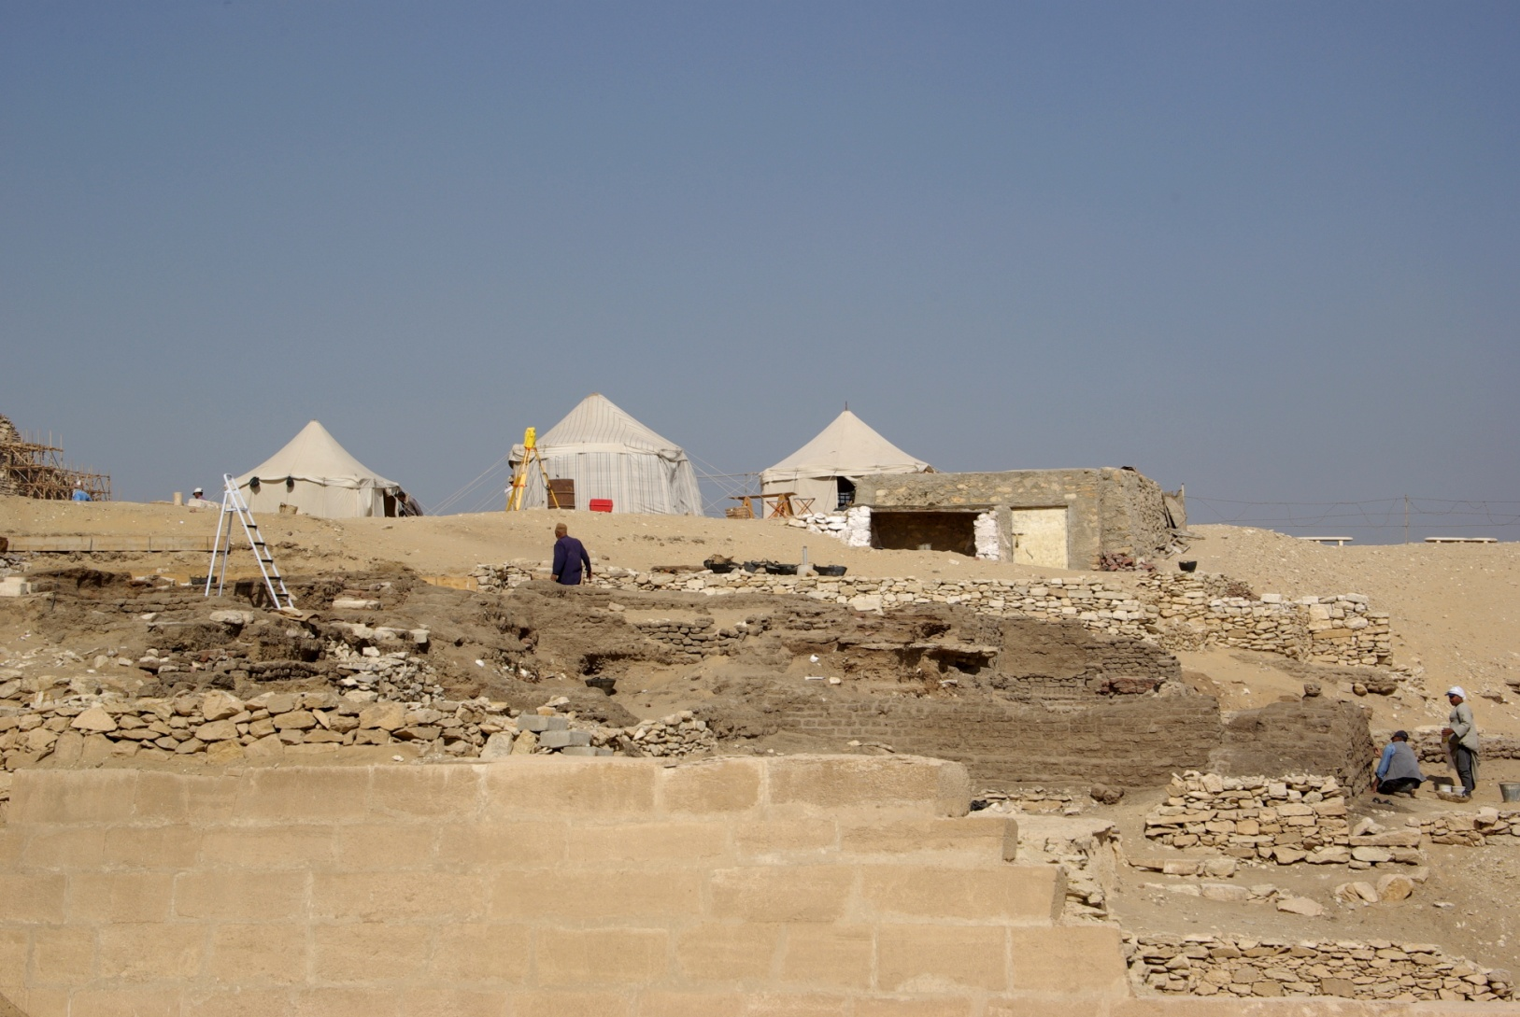
Mastaba of HesyRa, c. 2600 BC, 3rd Dynasty https://en.wikipedia.org/wiki/Mastaba_of_Hesy-Re
The Mastaba of Hesyrais an ancient Egyptian tomb complex in the great necropolis of Saqqara in Egypt. It is the final resting place of the high official HesyRa, who served in office during the Third Dynasty under King Djoser. His large mastaba is renowned for its well-preserved wall paintings and relief panels made from imported Lebanese cedar, which are today considered masterpieces of
Old Kingdom wood carving.
The mastaba itself is the earliest example of a painted tomb from the Old Kingdom and the only known example from the Third
Dynasty.

Slide 28
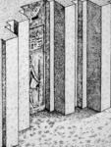
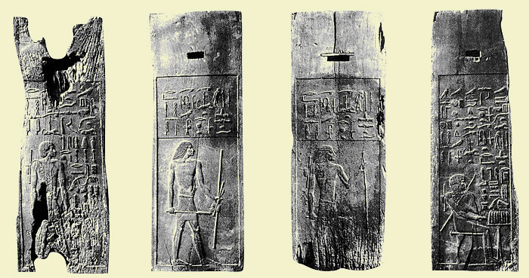
Relief Wooden Panels of HesyRa, c. 2600 BC, 3rd Dynasty, Wood, The Egyptian Museum, Cairo, Egypt https://www.egyptologica.be/section_egyptologie_egyptologica/article_egyptologie.php?ID=32

Slide 29
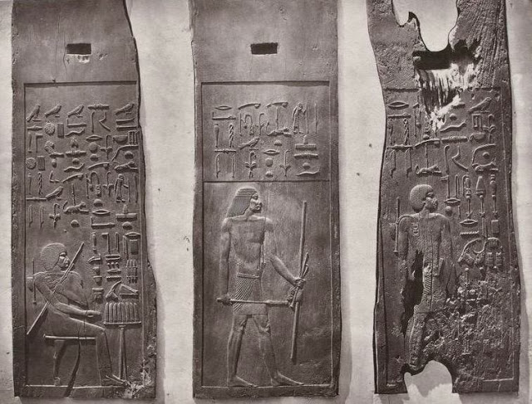
Relief Wooden Panels of HesyRa, c. 2600 BC, 3rd Dynasty, Wood, The Egyptian Museum, Cairo, Egypt https://lampmagician.files.wordpress.com/2021/02/18049668_1951397191745754_1439023079_o.jpg

Slide 30
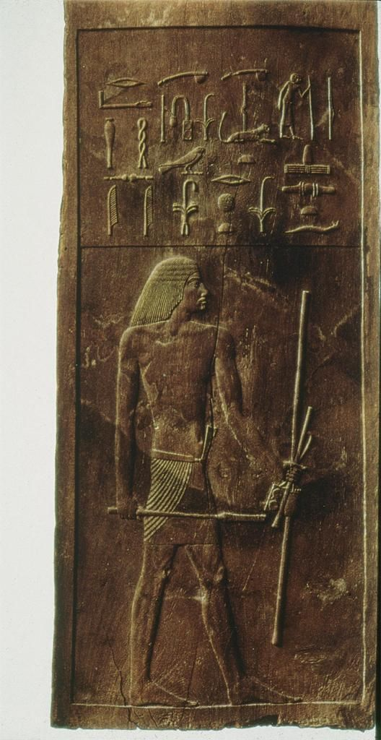
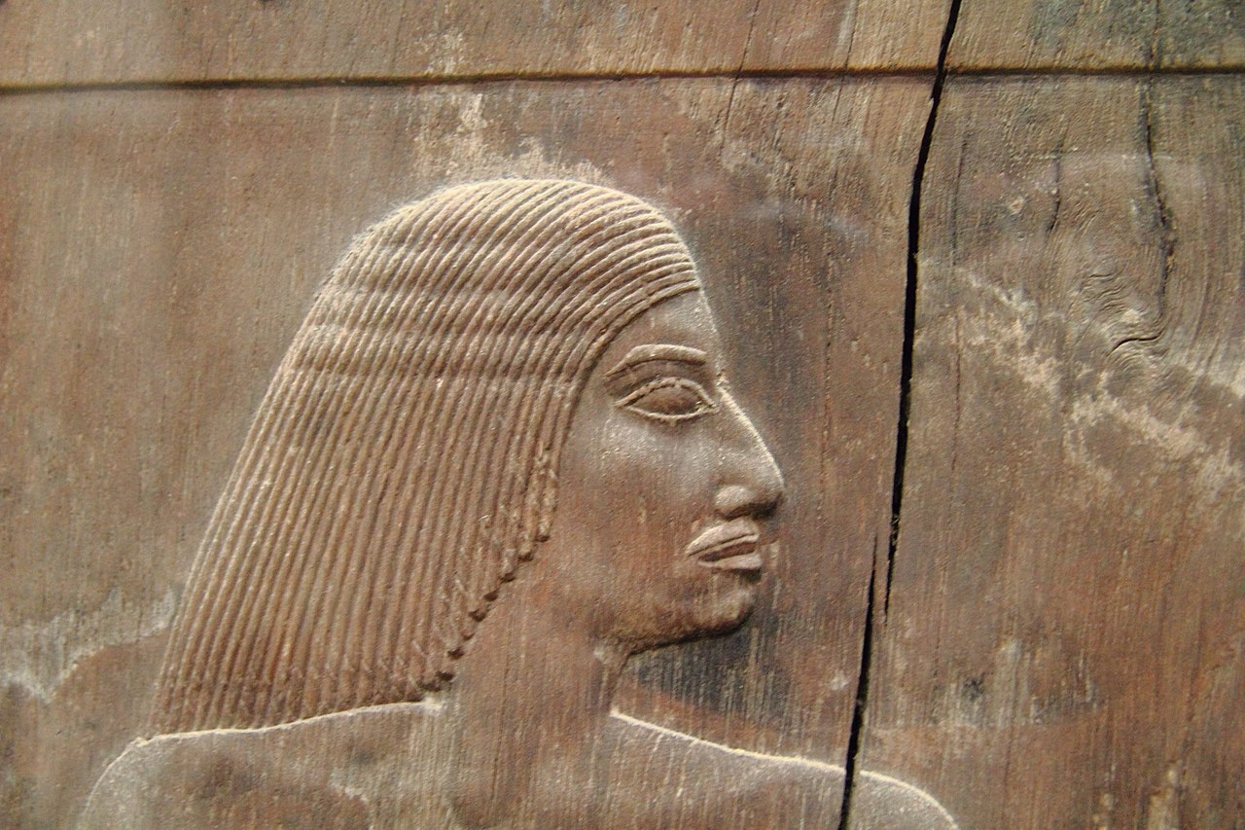
Wood Panel of HesyRa, c. 2600 BC, 3rd Dynasty, Wood, The Egyptian Museum, Cairo, Egypt https://gr.pinterest.com/pin/307370743288276454/ https://commons.wikimedia.org/wiki/File:%C3%84gyptisches_Museum_Kairo_2016-03-29_Hesire_01.jpg

Slide 31
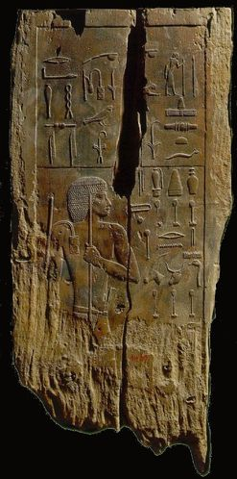

Wood Panel of HesyRa, c. 2600 BC, 3rd Dynasty, Wood, The Egyptian Museum, Cairo, Egypt http://ancienempire.over-blog.com/article-le-mastaba-de-hezyre-82290651.html https://commons.wikimedia.org/wiki/File:%C3%84gyptisches_Museum_Kairo_2016-03-29_Hesire_01.jpg https://quizlet.com/193272528/egypt-schmeegypt-flash-cards/

Slide 32


Wood Panel of HesyRa, c. 2600 BC, 3rd Dynasty, Wood, The Egyptian Museum, Cairo, Egypt https://commons.wikimedia.org/wiki/File:%C3%84gyptisches_Museum_Kairo_2016-03-29_Hesire_01.jpg

Slide 33


https://commons.wikimedia.org/wiki/File:%C3%84gyptisches_Museum_Kairo_2016-03-29_Hesire_01.jpg

Slide 34

Painted Limestone False Door of Iteti Ankhiris with Statue at back of Niche, ca. 2345–2181 BC, 6th Dynasty, from Saqqara, Painted Limestone, Height: 315 cm, width: 210 cm, The Egyptian Museum, Cairo, Egypt https://www.egyptianmuseumcairo.com/egyptian-museum-cairo/artefacts/false-door-with-statue-at-back-from-tomb-of-iteti/

Slide 35

The Mastaba of Ti, ca. 2450 – 2350, 5th Dynasty, Saqqara, Egypt https://sailingstonetravel.com/saqqara-the-ultimate-guide/

Slide 36


Hippopotamus Hunt, relief in the mastaba of Ti, ca. 2450 – 2350, 5th Dynasty, Saqqara, Egypt https://sites.google.com/site/katehymanmiad/art-history/prehistory-and-the-first-civilizations https://commons.wikimedia.org/wiki/File:Electric_catfish_in_Mastaba_of_Ti_bas-relief_colour.jpg

Slide 37

https://www.flickr.com/photos/manna4u/44522545732

Slide 38


The Mastaba of Mereruka, 6th Dynasty, Saqqara, Egypt https://en.wikipedia.org/wiki/Mereruka https://www.ancient-origins.net/ancient-places-africa/false-doors-gateways-egyptian-underworld-003214

Slide 39

https://www.flickr.com/photos/manna4u/43615373304

Slide 40


The Meidum Geese painting, c. 2620 BC, 3rd Dynasty, from Meidum, Egypt https://egyptiangeographic.com/en/news/show/351 and https://www.nbcnews.com/science/science-news/egypts-famous-meidum-geese-painting-may-be-fake-n333491

Slide 41

https://www.flickr.com/photos/ckirie/44534255914

Slide 42


Tomb of Queen Hatephere, c. 256 BC, 4th Dynasty, Giza, Egypt http://www.touregypt.net/featurestories/hetepheres.htm

Slide 43

Queen Hatephere’s Firniture, c. 256 BC, 4th Dynasty, The Egyptian Museum, Cairo, Egypt https://br.pinterest.com/pin/592504894705713294/

Slide 44





http://www.touregypt.net/featurestories/hetepheres.htm https://gr.pinterest.com/pin/109986415885012231/

Slide 45


Silver bracelets with butterfly design of Queen Hetephere’s, c. 2575-2550, 4th Dynasty, The Egyptian Museum, Cairo, Egypt https://www.reddit.com/r/ArtefactPorn/comments/thkpfs/silver_bracelets_with_butterfly_design_of_queen/ https://gr.pinterest.com/pin/Aei5XE-woUGvPyn-PqESNzXHDihdrJRcqVLBWDZoiM5bzBCKSoeobgc/

Slide 46
The End

