Slide 1
John Singer Sargent, 1856-1925
Spanish Dancers

Slide 2
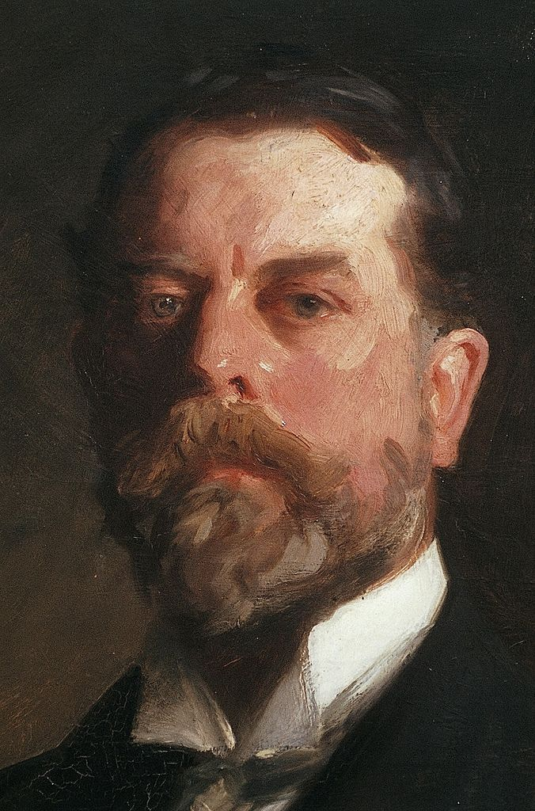
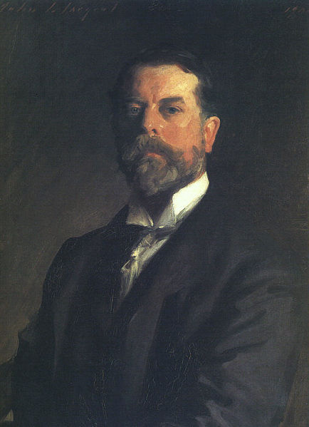
Self-Portrait (and detail), 1906, Oil on canvas, 70x53 cm, the MET, NY, USA https://gr.pinterest.com/pin/384213411941243543/ https://commons.wikimedia.org/wiki/File:Sargent,_John_SInger_(1856-1925)_-_Self-Portrait_1907_b.jpg

Slide 3
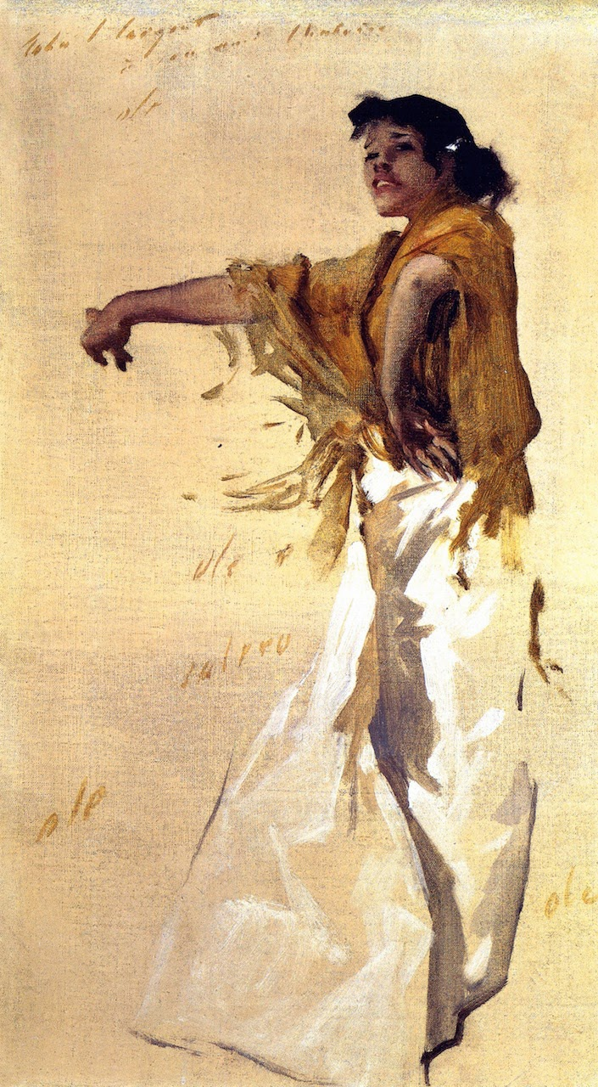
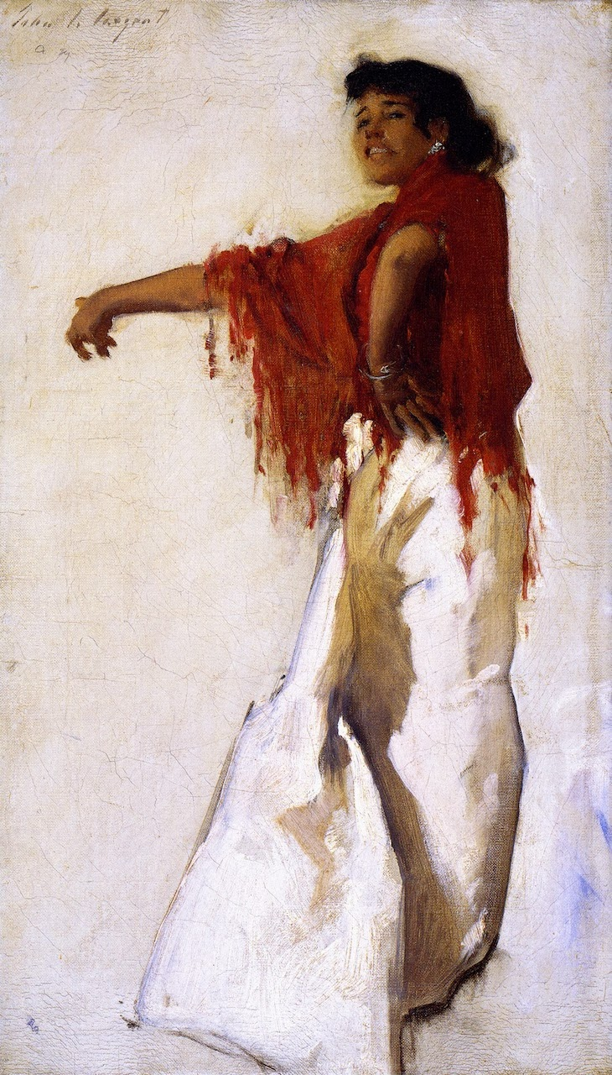
Spanish Gypsy Dancer, 1879, Oil on canvas 46.4 x 28.6 cm Private Collection
Spanish Gypsy Dancer, 1879, Oil on canvas 46.4 x 28.6 cm, Adelson Galleries, Boston MA, USA
Both:https://instareyog.blogspot.com/2014/03/john-singer-sargent-part-3.html

Slide 4
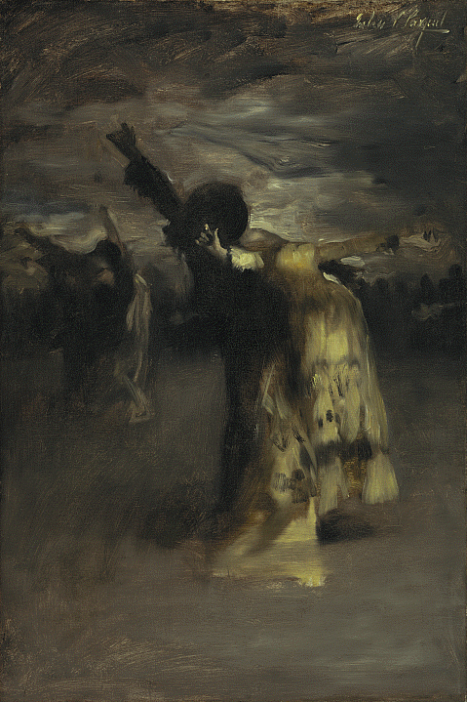
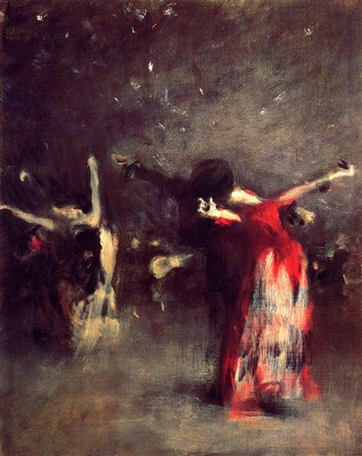
Study for Spanish Dance,
1879-1880, Oil on canvas,
72.39 x 48.26 cm, Nelson-Atkins Museum of Art
MS, USA https://art.nelson-atkins.org/objects/5539/study-for-spanish-dance
Study for The Spanish Dance, c.1879, Oil, canvas, 48.26 x 38.74 cm, Private Collection https://www.wikiart.org/en/john-singer-sargent/study-for-the-spanish-dance

Slide 5
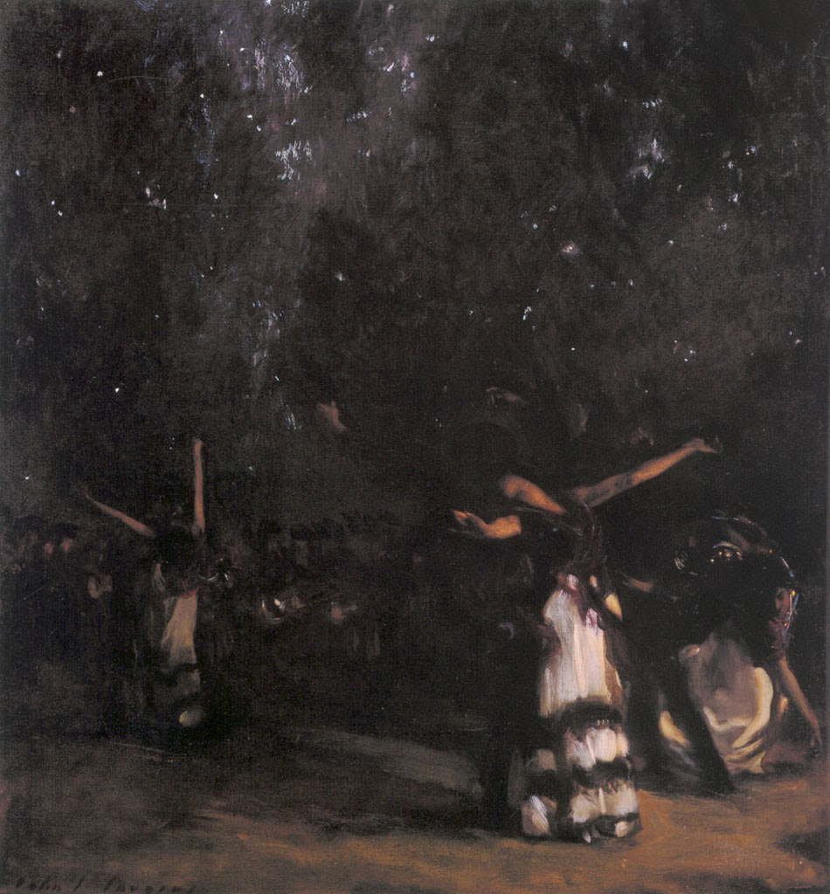
Spanish Dance, 1879-80, Oil on canvas, 89.5 x 84.5 cm, The Hispanic Society of America, NY, USA https://instareyog.blogspot.com/2014/03/john-singer-sargent-part-3.html

Slide 6
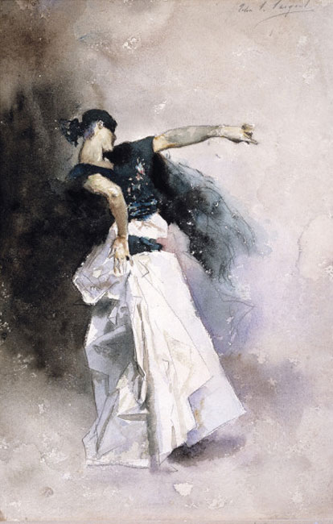
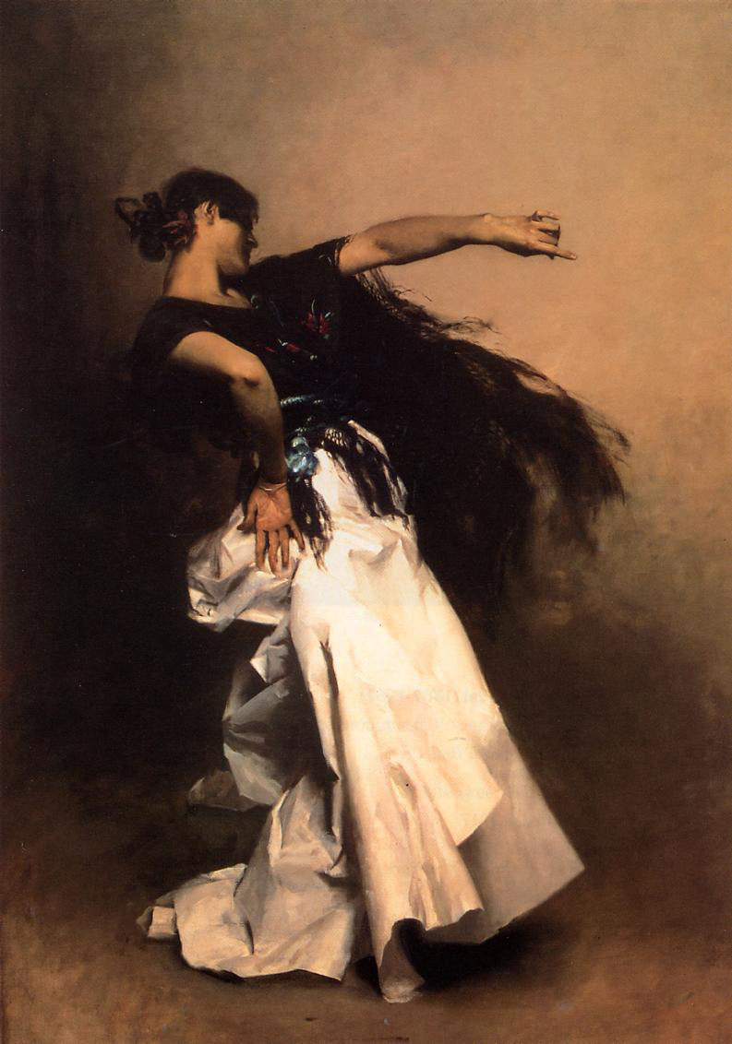
Study for Spanish Dancer, c. 1880–1881, Watercolor over graphite on paper, 30.16 × 20 cm, 52.07 × 41.28 × 4.13 cm, Dallas Museum of Art, TX, USA https://www.jssgallery.org/Paintings/Sketches/Study_for_El_Jaleo/10286.html
Spanish Dancer, c. 1879-82, Oil on canvas,
222.75x1511.3 cm, Private collection https://upload.wikimedia.org/wikipedia/commons/7/7b/Sargent_John_Singer_Spanish_Dancer.jpg

Slide 7
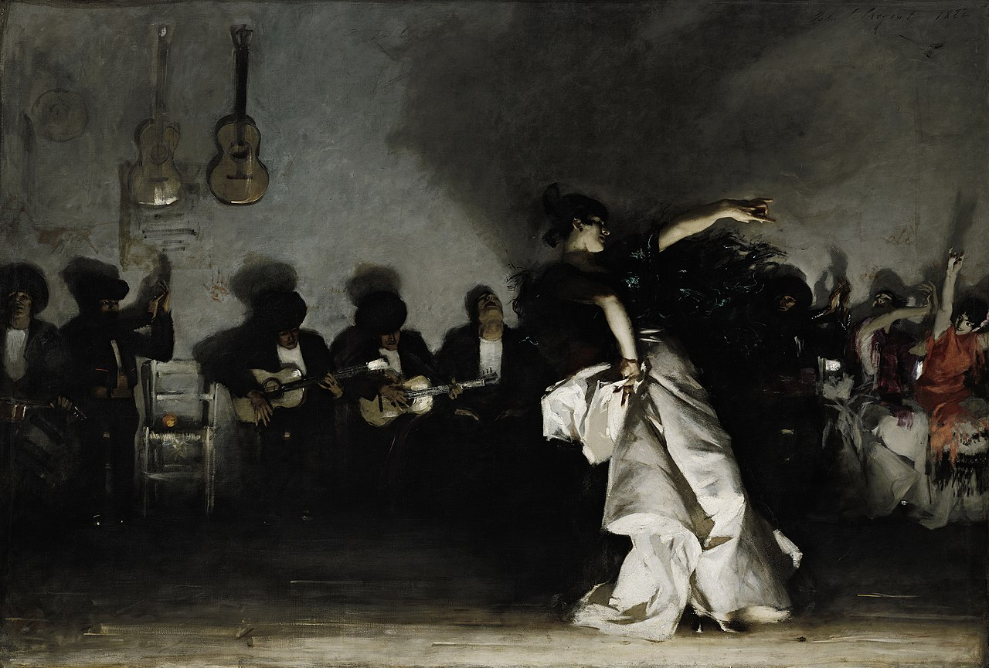
El Jaleo, 1882, Oil on canvas, 237×352 cm, Isabella Stewart Gardner Museum, Boston, USA https://en.wikipedia.org/wiki/El_Jaleo

Slide 8
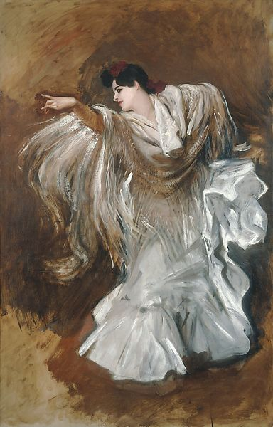
La Carmencita Dancing, 1890, Oil on canvas, 137.16 x 88.9 cm, Private Collection https://www.metmuseum.org/art/collection/search/21358

Slide 9
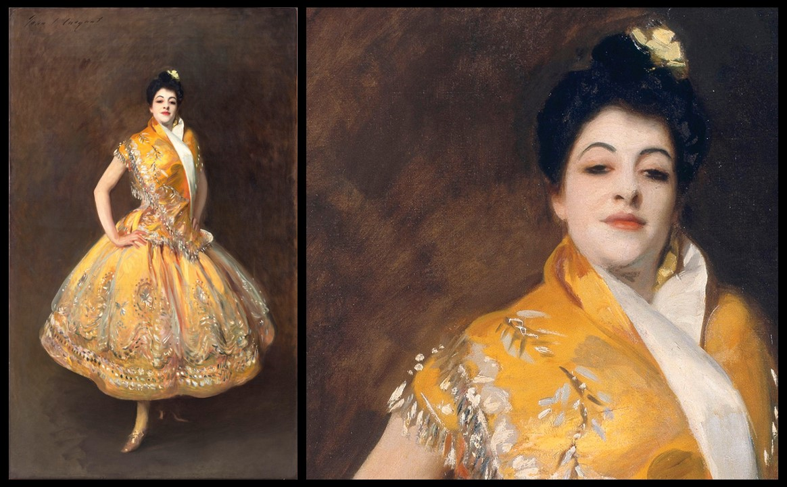
La Carmencita (and detail), c. 1890, Oil on Canvas, 229,0 x 140,0 cm, Musée d’Orsay, Paris, France https://www.musee-orsay.fr/en/artworks/la-carmencita-9161 and https://www.facebook.com/artic/photos/pcb.10156398108568150/10156398121923150/?type=3&eid=ARAJqnf0ffscPXNE5DuZvOr1KSTg38J0yvdUPccBTitulGvhVU0Wpt-1YLwxNsNS_whsdRXHa7EE0-w9

Slide 10
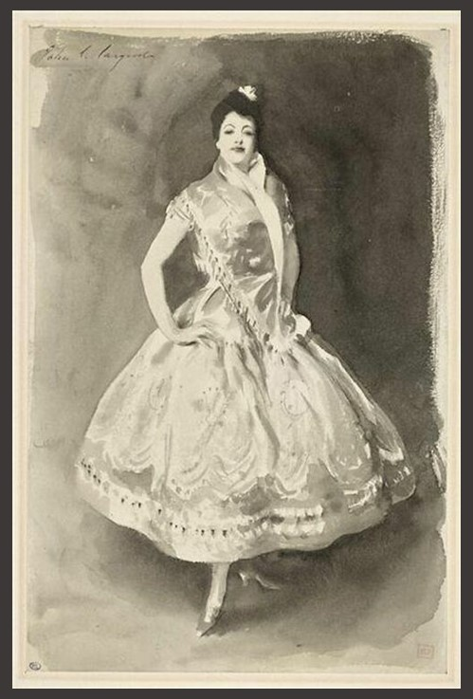
La Carmencita, c. 1890-1910, Brush on Paper, 0.346 x 0.226 m, Louvre Museum, Paris, France, Musée d’Orsay, Paris, France https://collections.louvre.fr/en/ark:/53355/cl020500419

Slide 11
The End

