Slide 1

The Art Of Ancient Egypt
Introduction
The Palette of Narmer

Slide 2
Lesson Info and PowerPoint: https://www.teachercurator.com/
https://www.facebook.com/teachercurator/

Slide 3
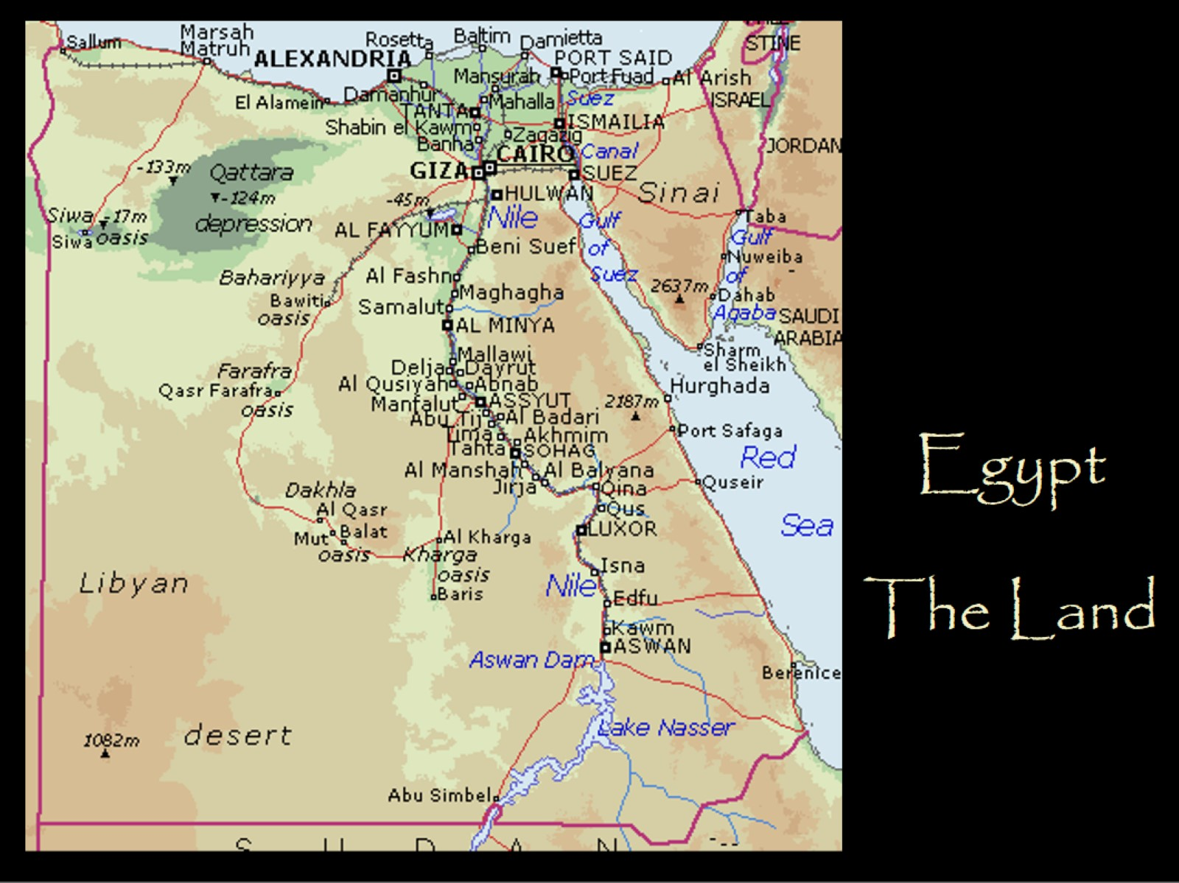
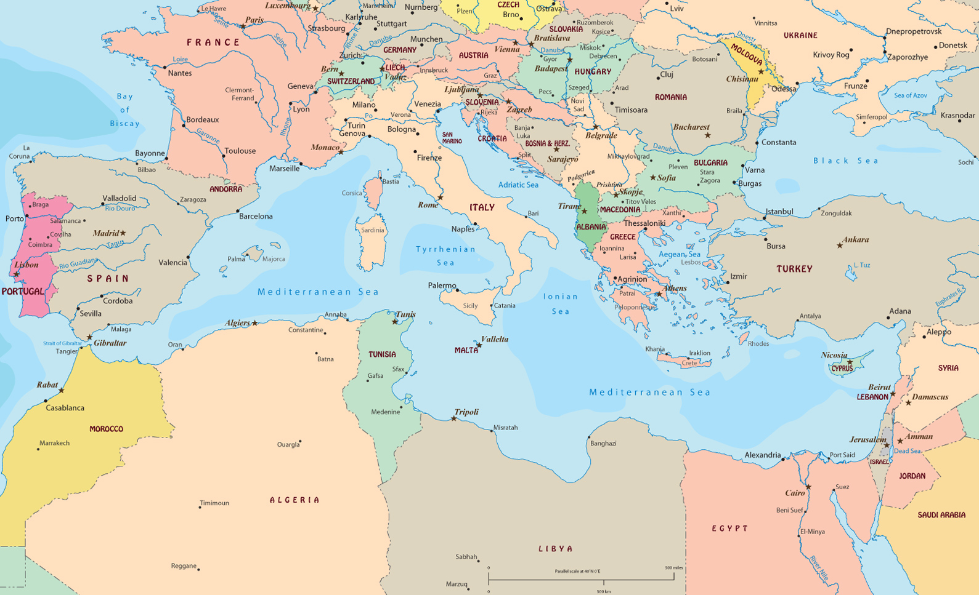
Egypt
The Land

Slide 4
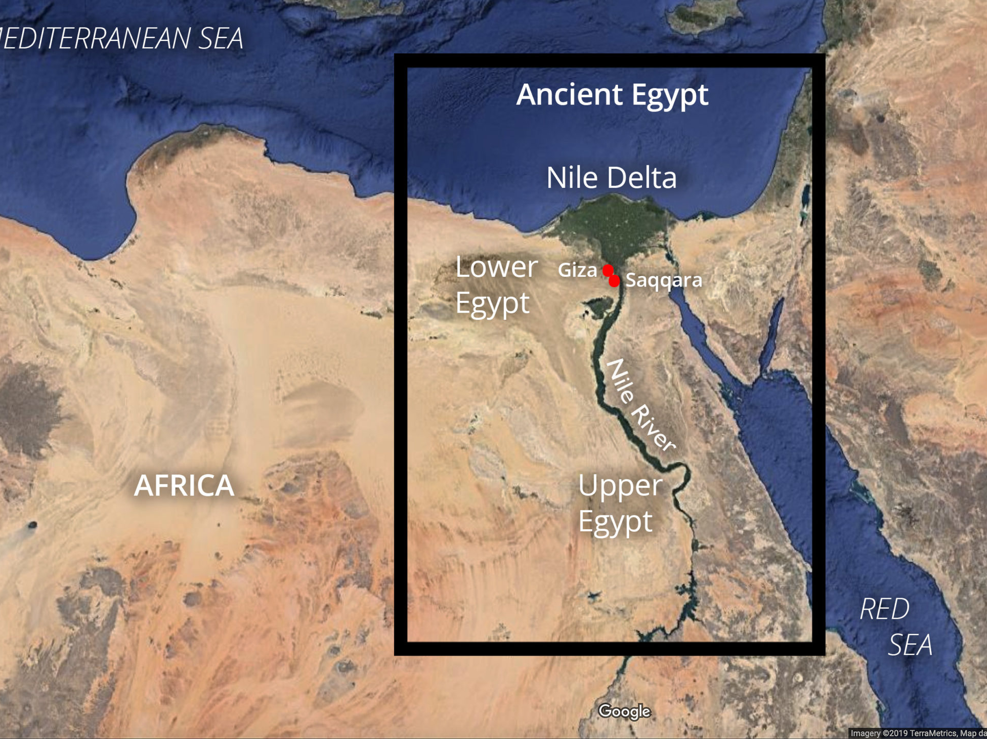
“Egypt is a land of duality and cycles, both in topography and culture. The geography is almost entirely rugged, barren desert, except for an explosion of green that straddles either side of the Nile as it flows the length of the country.” https://www.khanacademy.org/humanities/ap-art-history/ancient-mediterranean-ap/ancient-egypt-ap/a/ancient-egypt-an-introduction

Slide 5
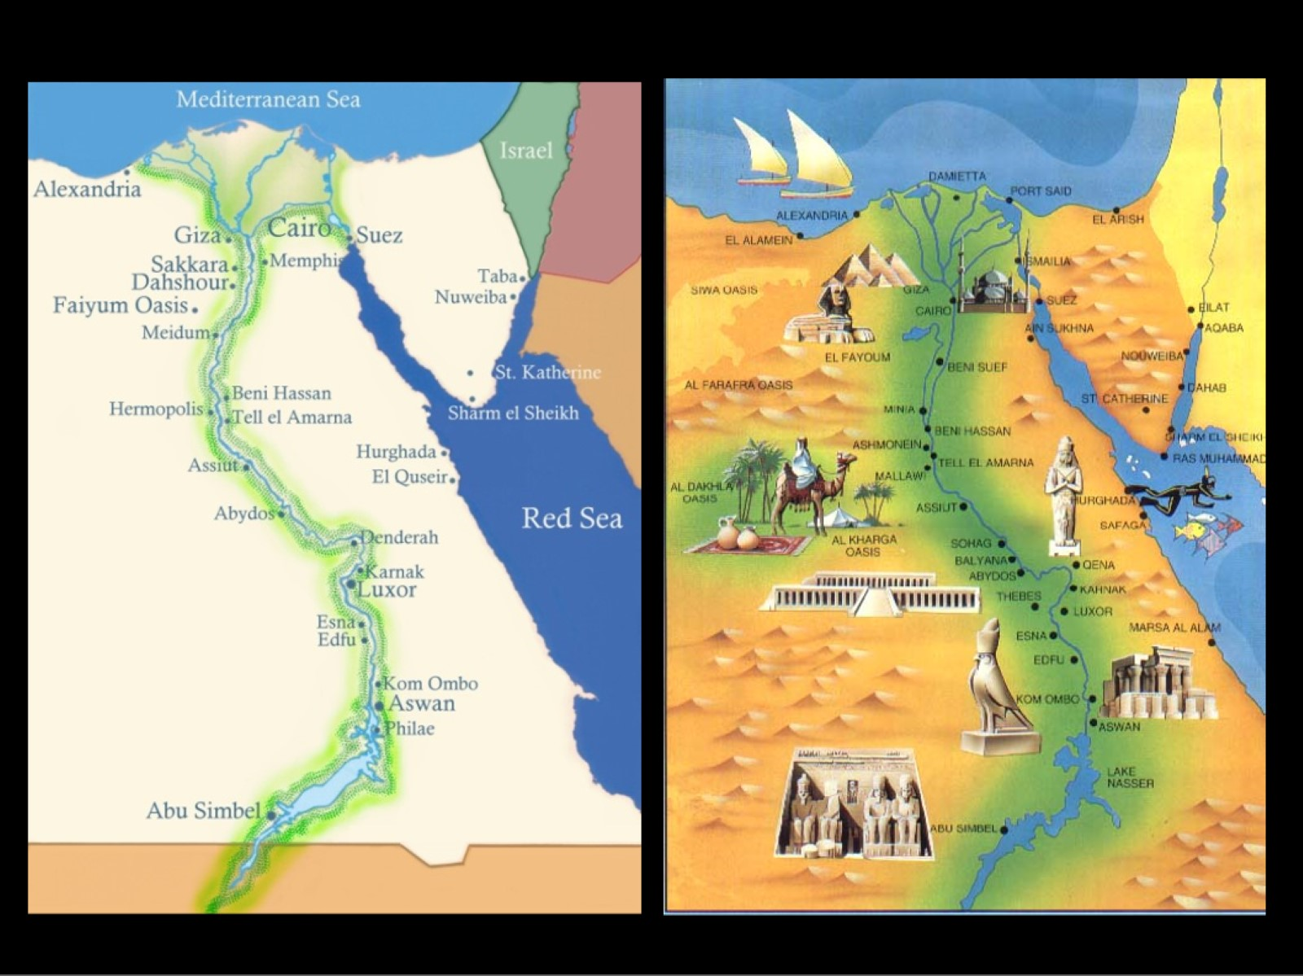
The river emerges from far to the south, deep in Africa, and empties into the Mediterranean sea in the north after spreading from a single channel into a fan-shaped system, known as a delta, in its northernmost section. The river valley is flanked by imposing cliffs of limestone and sandstone. https://gr.pinterest.com/pin/529032287450065960/

Slide 6
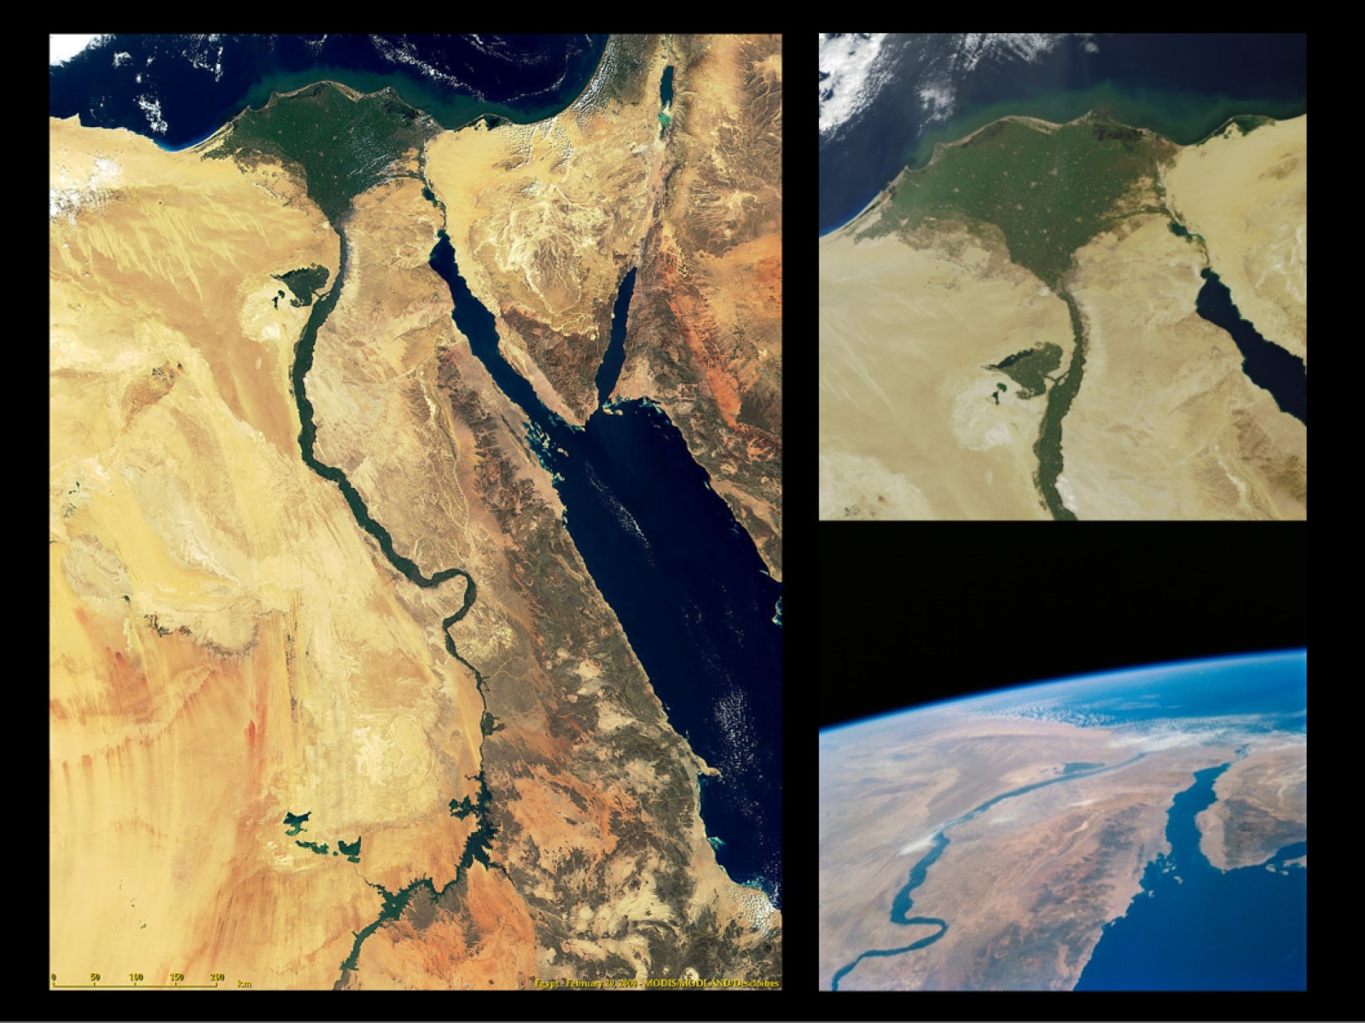
One of the reasons for the overall stability of Egyptian culture was that it was largely isolated by virtue of its geography. With high cliffs and expansive deserts bordering the east and west, the sea at the north, and a series of huge rapids in the Nile to the south (known as cataracts), the stretch of the river valley that gave rise to dynastic Egypt was quite closed off from the outside. https://www.esa.int/ESA_Multimedia/Images/2005/04/The_Nile_Delta_and_the_Sinai_Peninsula

Slide 7
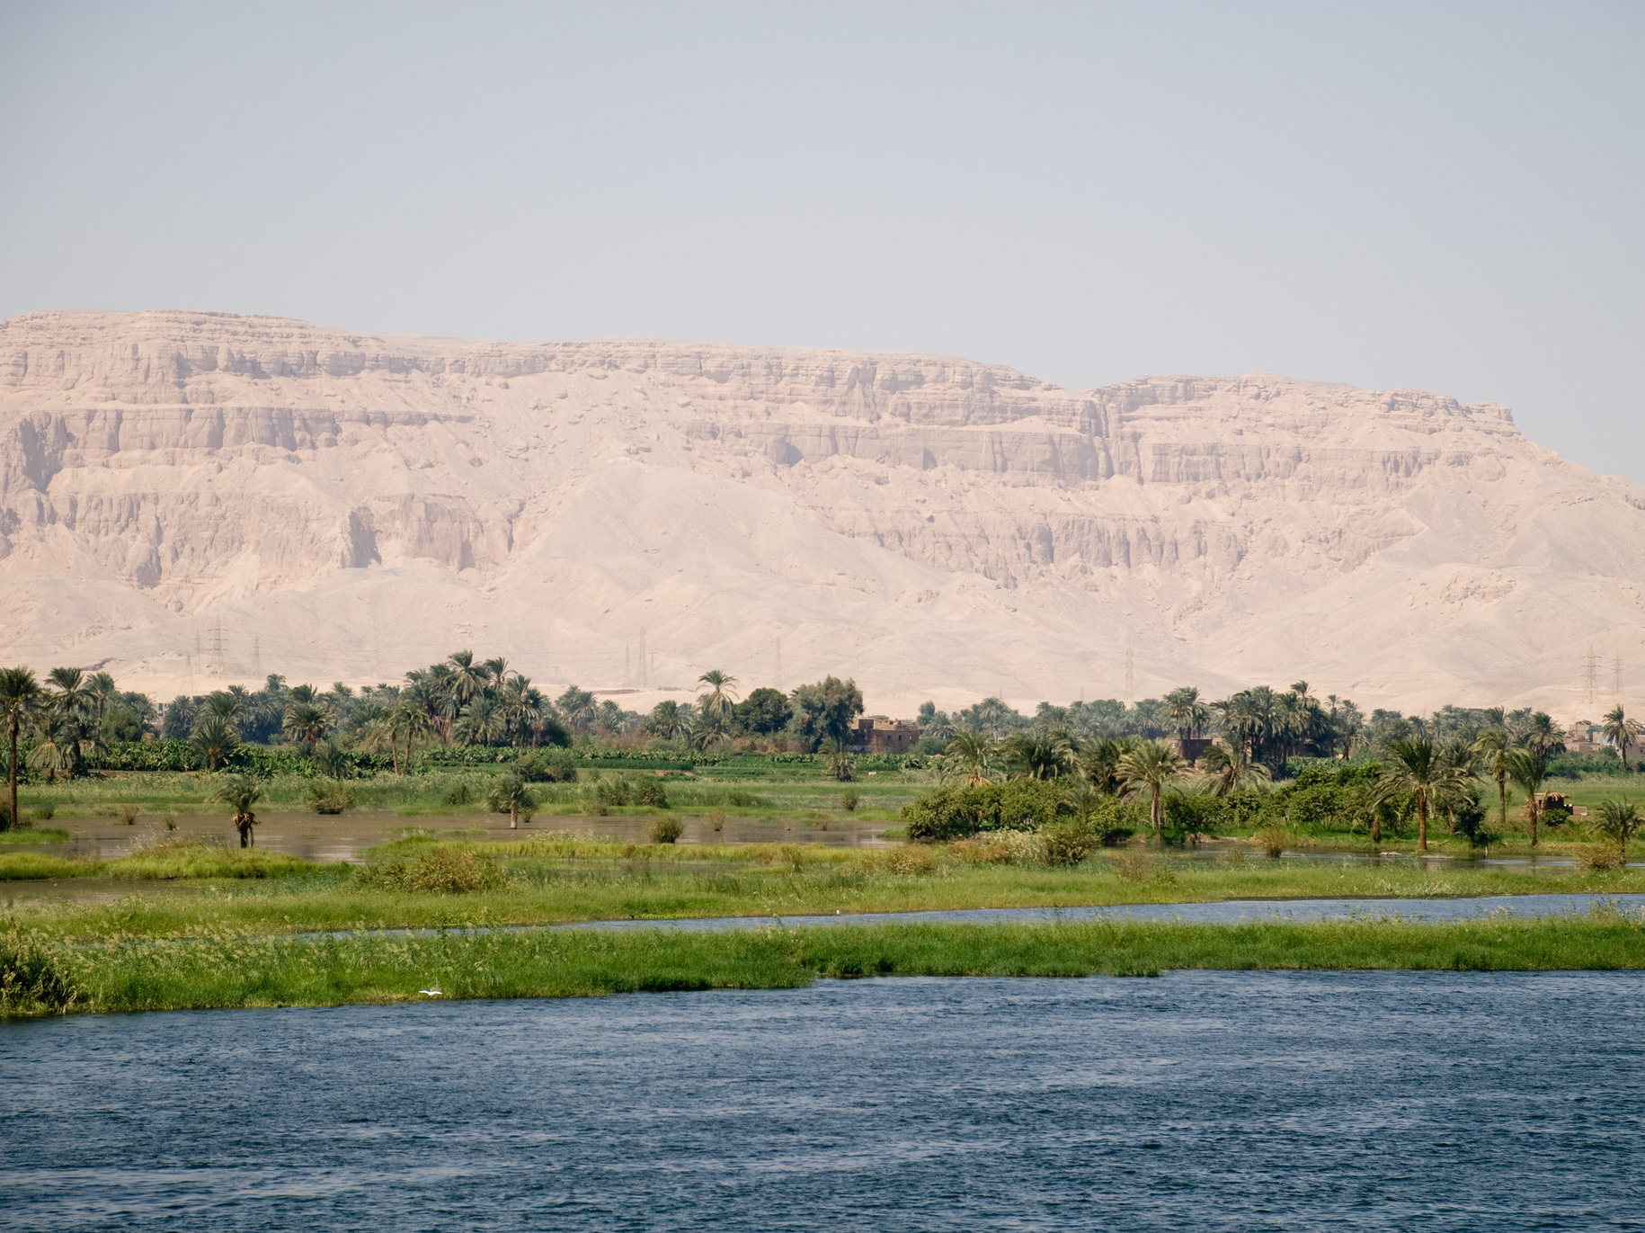
Egypt was undoubtedly the “gift of the Nile,” as the Greek historian Herodotus famously wrote. The influence of this river on Egyptian culture and development cannot be overstated without its presence, the civilization would have been entirely different. The Nile provided a constant source of life by giving water and creating the lush fertile land between the river and the barren desert. https://www.khanacademy.org/humanities/ap-art-history/ancient-mediterranean-ap/ancient-egypt-ap/a/ancient-egypt-an-introduction

Slide 8

Each year, fed by melting snow in the far-off headlands deep in Africa, the Nile overflowed its banks in an annual flood that covered the ground with rich, black silt and produced incredibly fertile fields. The Egyptians referred to this area as Kemet, the “Black Lands,” and contrasted this dense, dark soil against the Deshret, the “Red Lands” of the sterile desert. https://stock.adobe.com/search?k=%22nile+delta%22

Slide 9
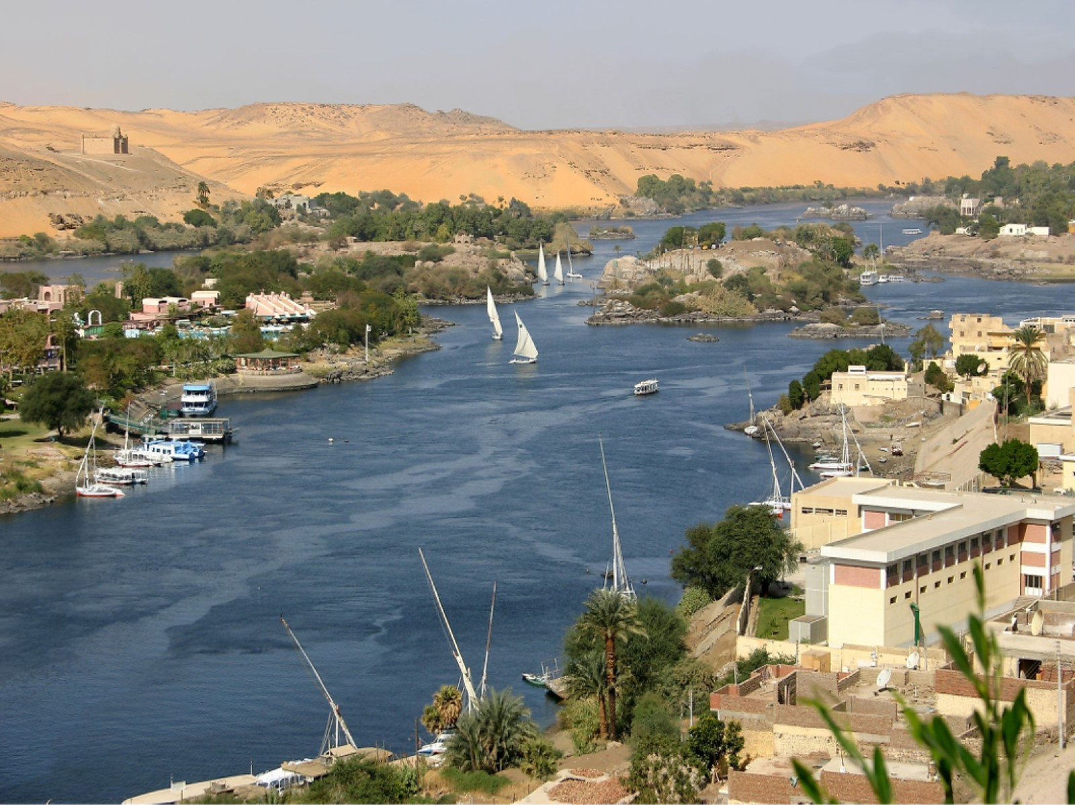
The Egyptians referred to the cultivated area as Kemet, the “Black Lands,” and contrasted this dense, dark soil against the Deshret, the “Red Lands” of the sterile desert. https://www.worldatlas.com/rivers/nile-river.html

Slide 10
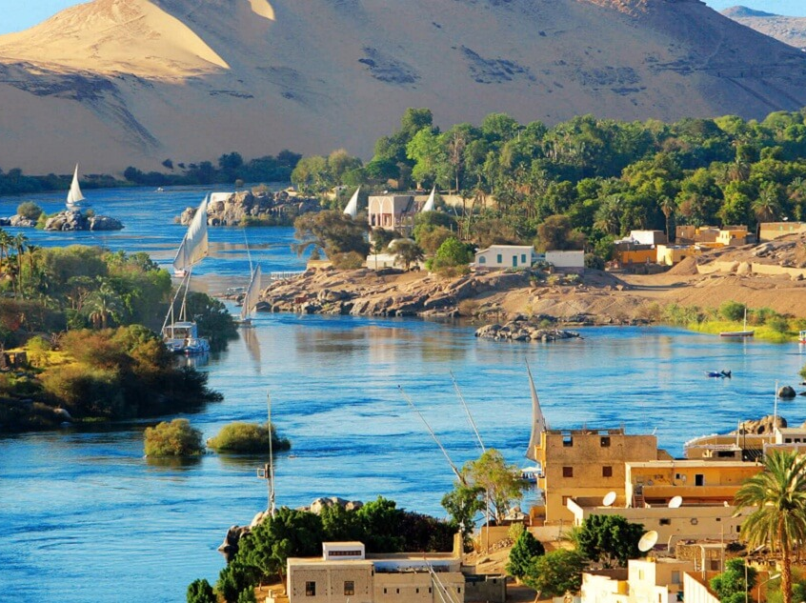
https://www.luxorandaswan.com/Egypt/wiki/The-Nile-River-History

Slide 11
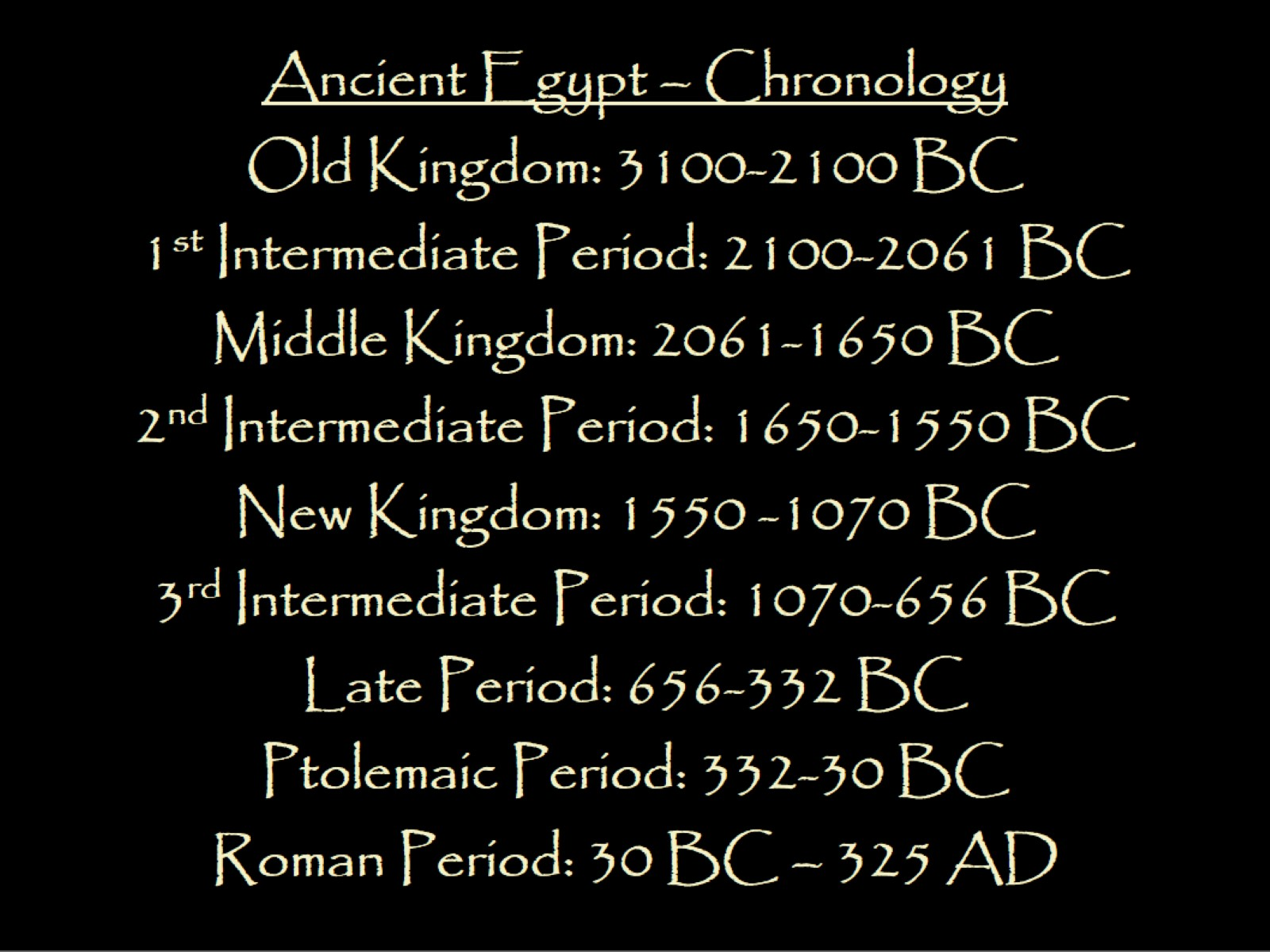

Slide 12
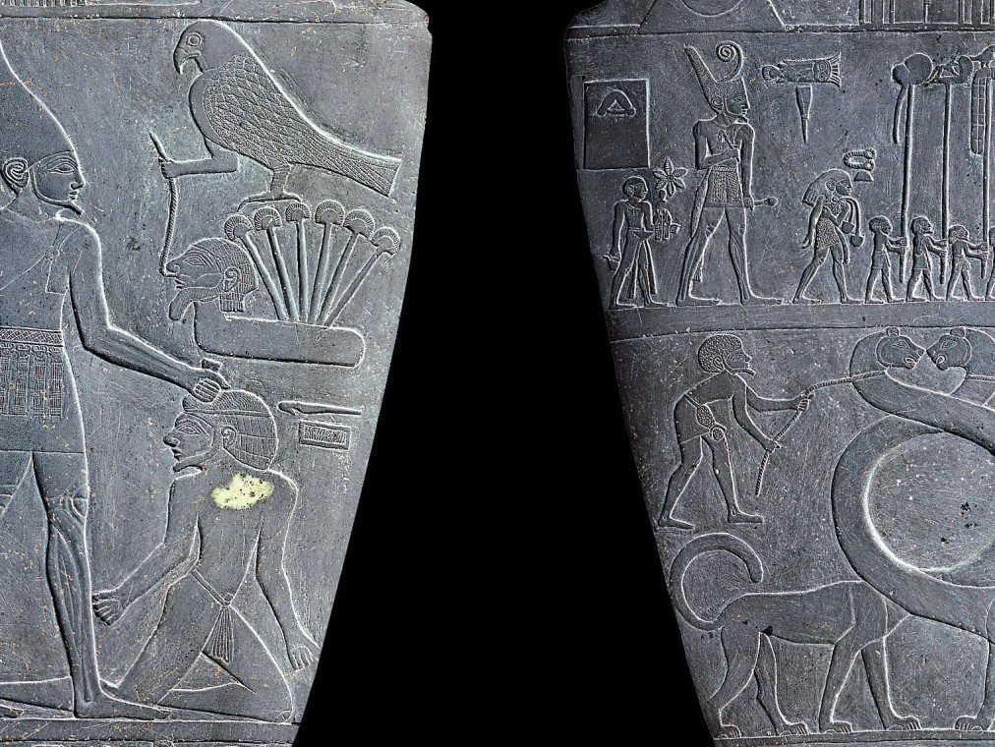
The Palette of Narmer… where it all started!

Slide 13
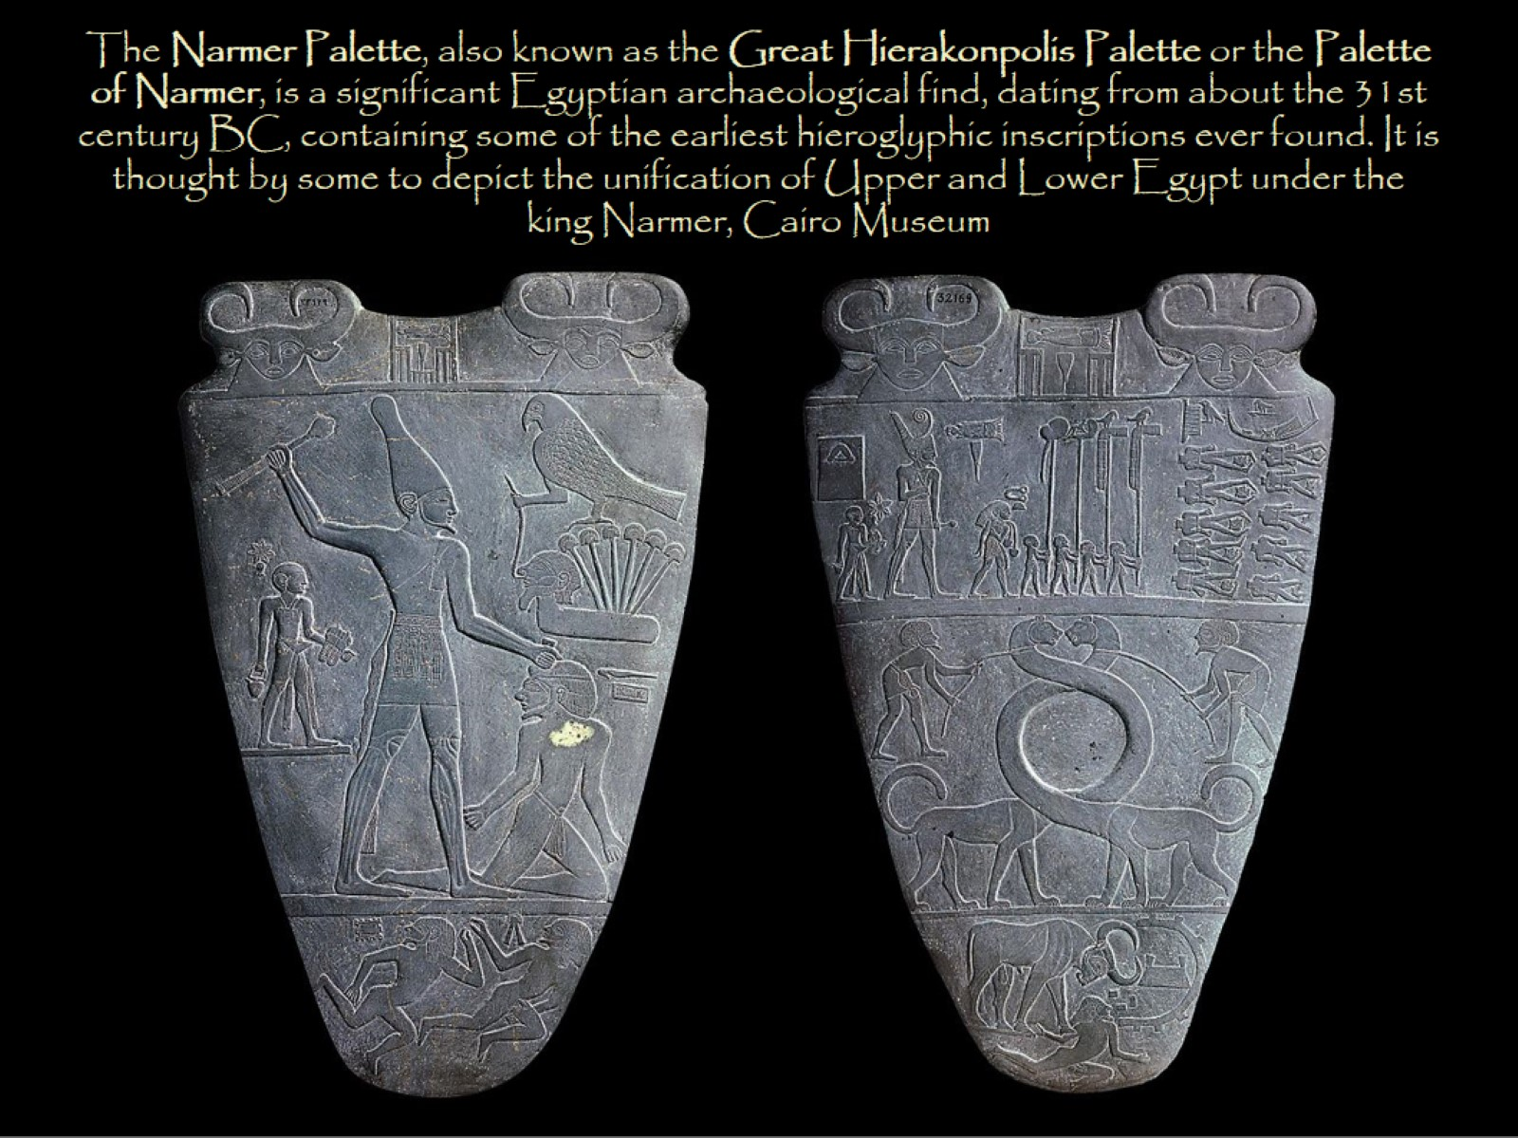
The Narmer Palette, also known as the Great Hierakonpolis Palette or the Palette of Narmer, is a significant Egyptian archaeological find, dating from about the 31st century BC, containing some of the earliest hieroglyphic inscriptions ever found. It is thought by some to depict the unification of Upper and Lower Egypt under the king Narmer, Cairo Museum

Slide 14
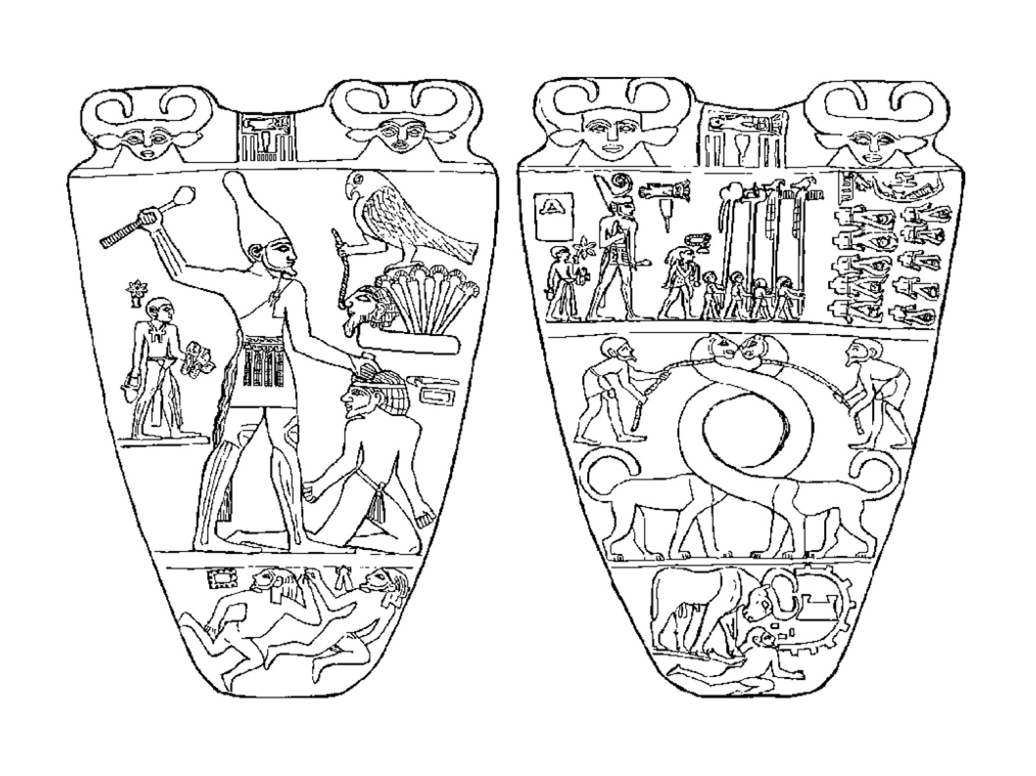

Slide 15
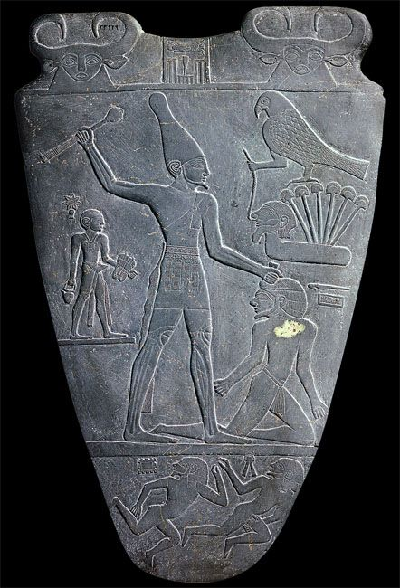
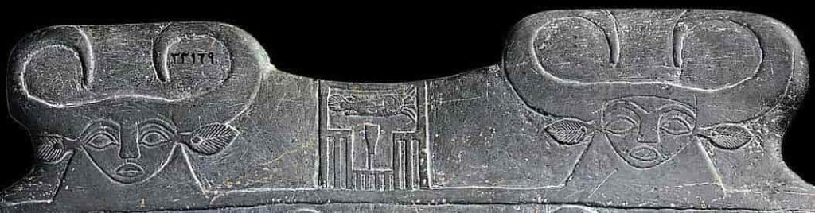

Slide 16
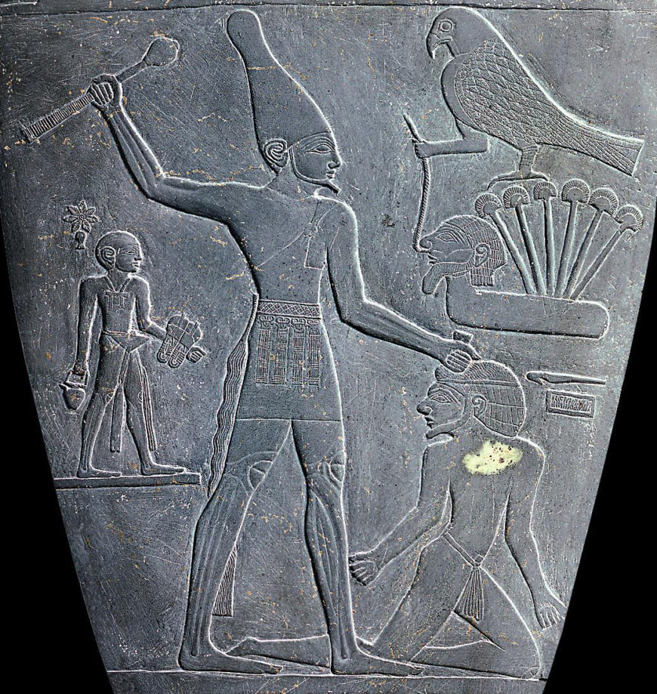

Slide 17
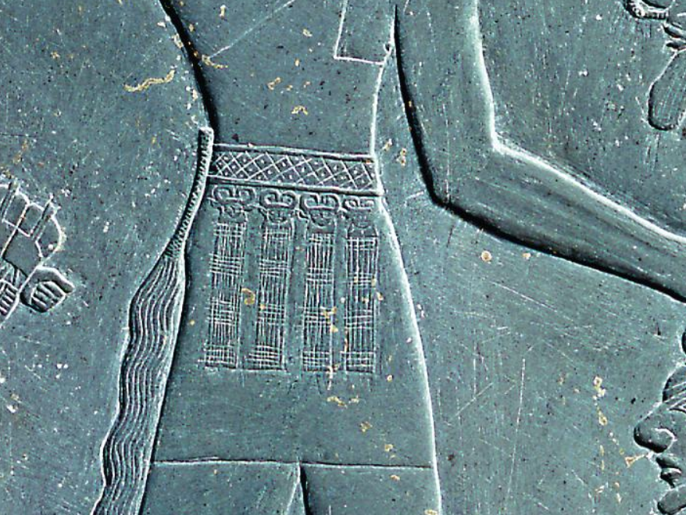

Slide 18
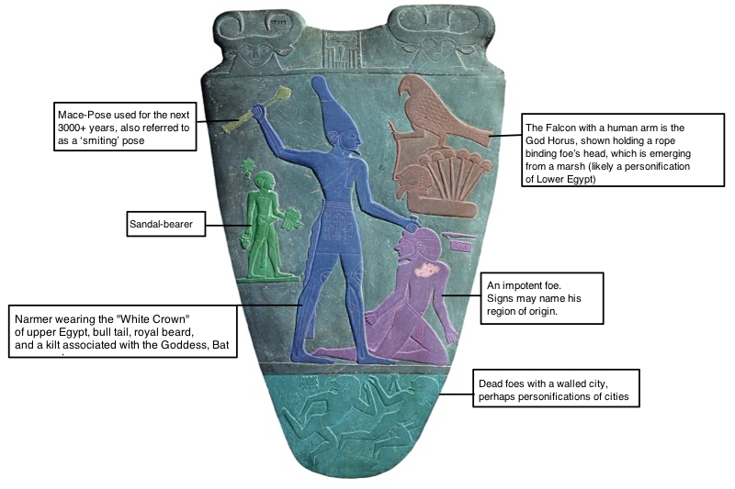

Slide 19
The Narmer Palette, also known as the Great Hierakonpolis Palette or the Palette of Narmer, is a significant Egyptian archaeological find, dating from about the 31st century BC, containing some of the earliest hieroglyphic inscriptions ever found. It is thought by some to depict the unification of Upper and Lower Egypt under the king Narmer, Cairo Museum

Slide 20
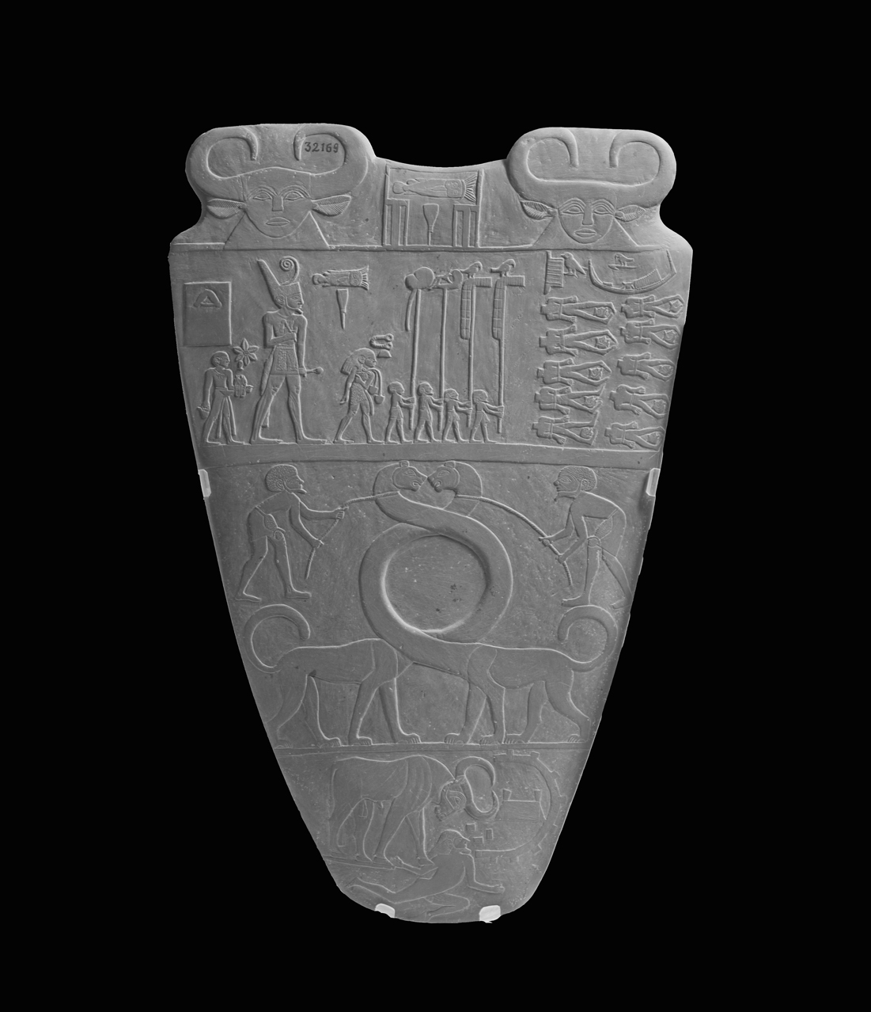
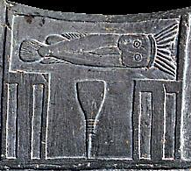

Slide 21
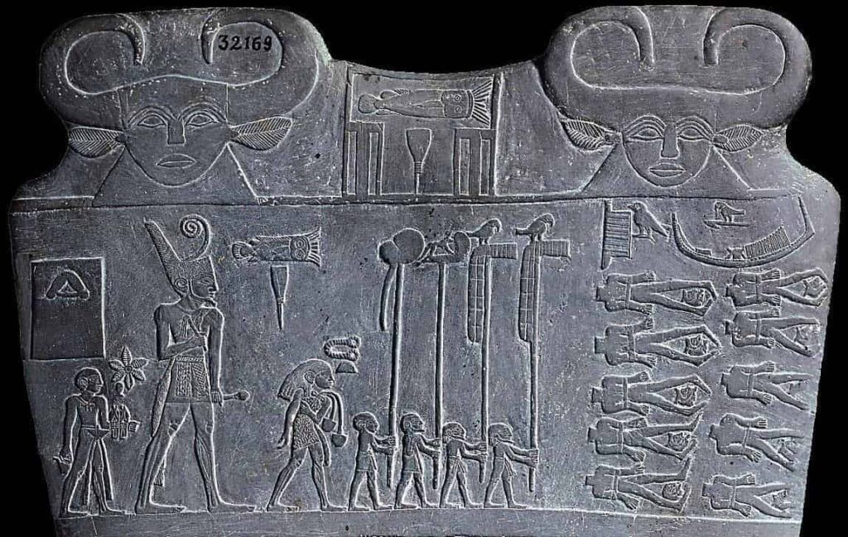

Slide 22
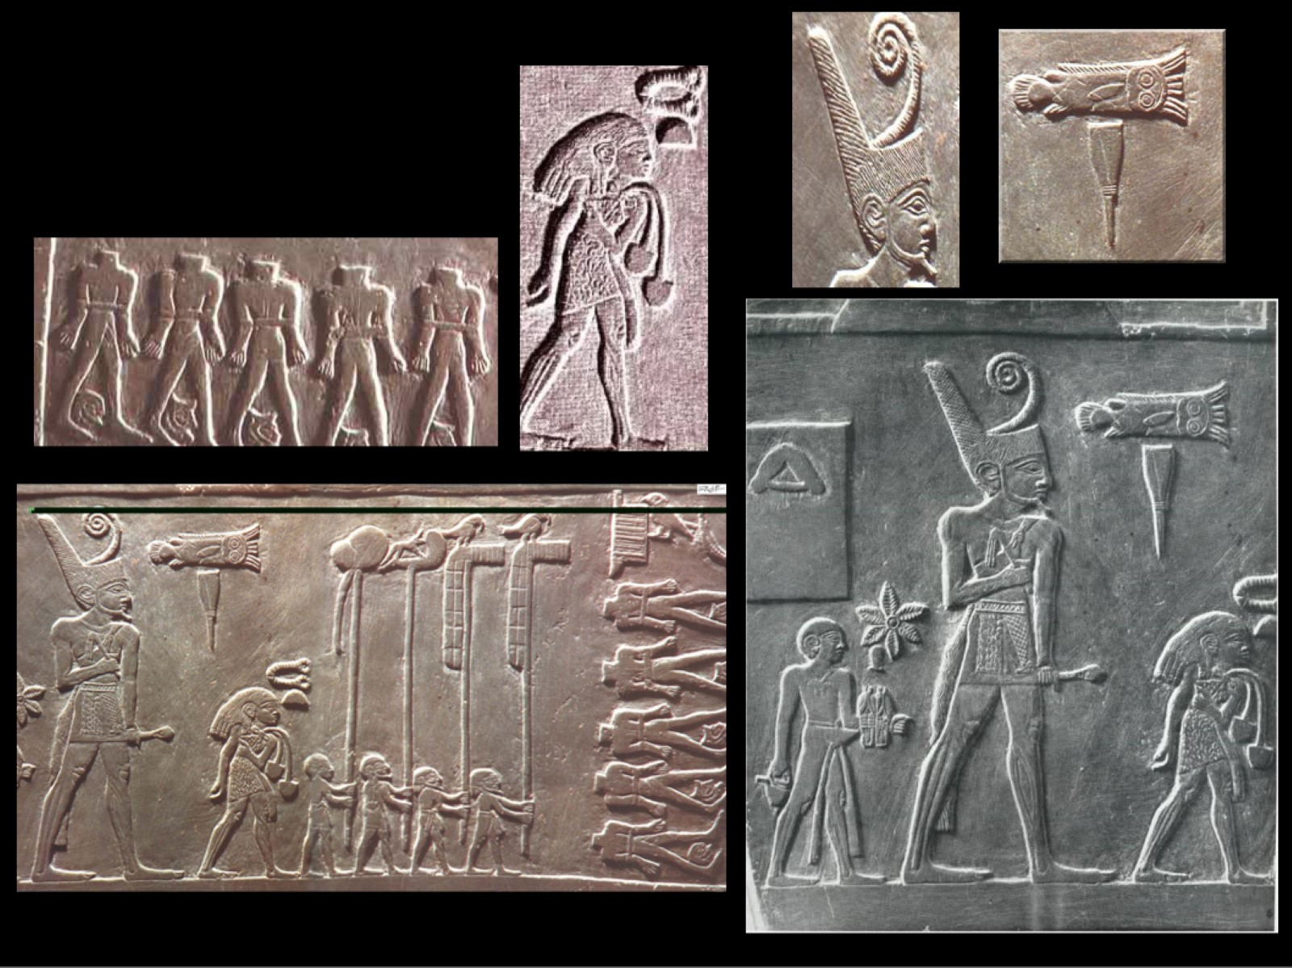

Slide 23
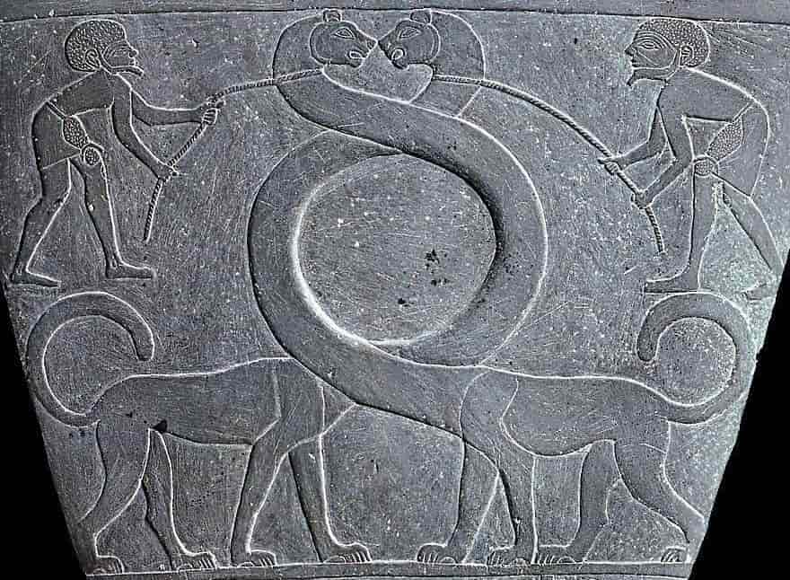

Slide 24
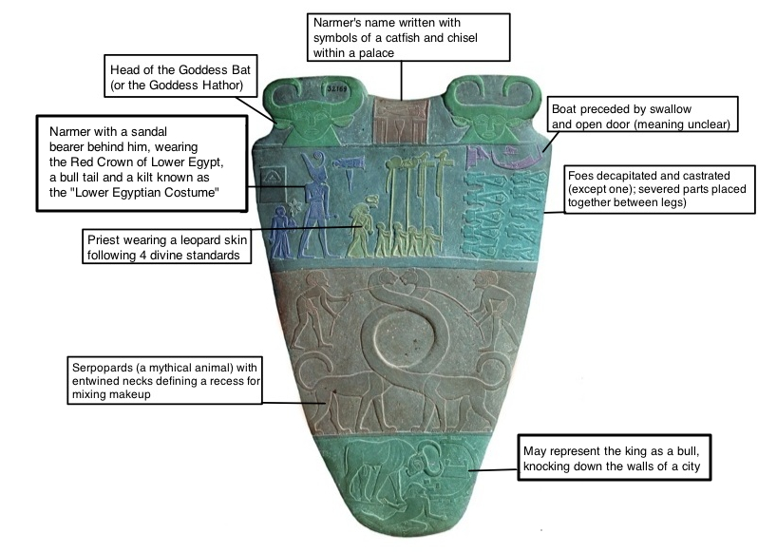

Slide 25
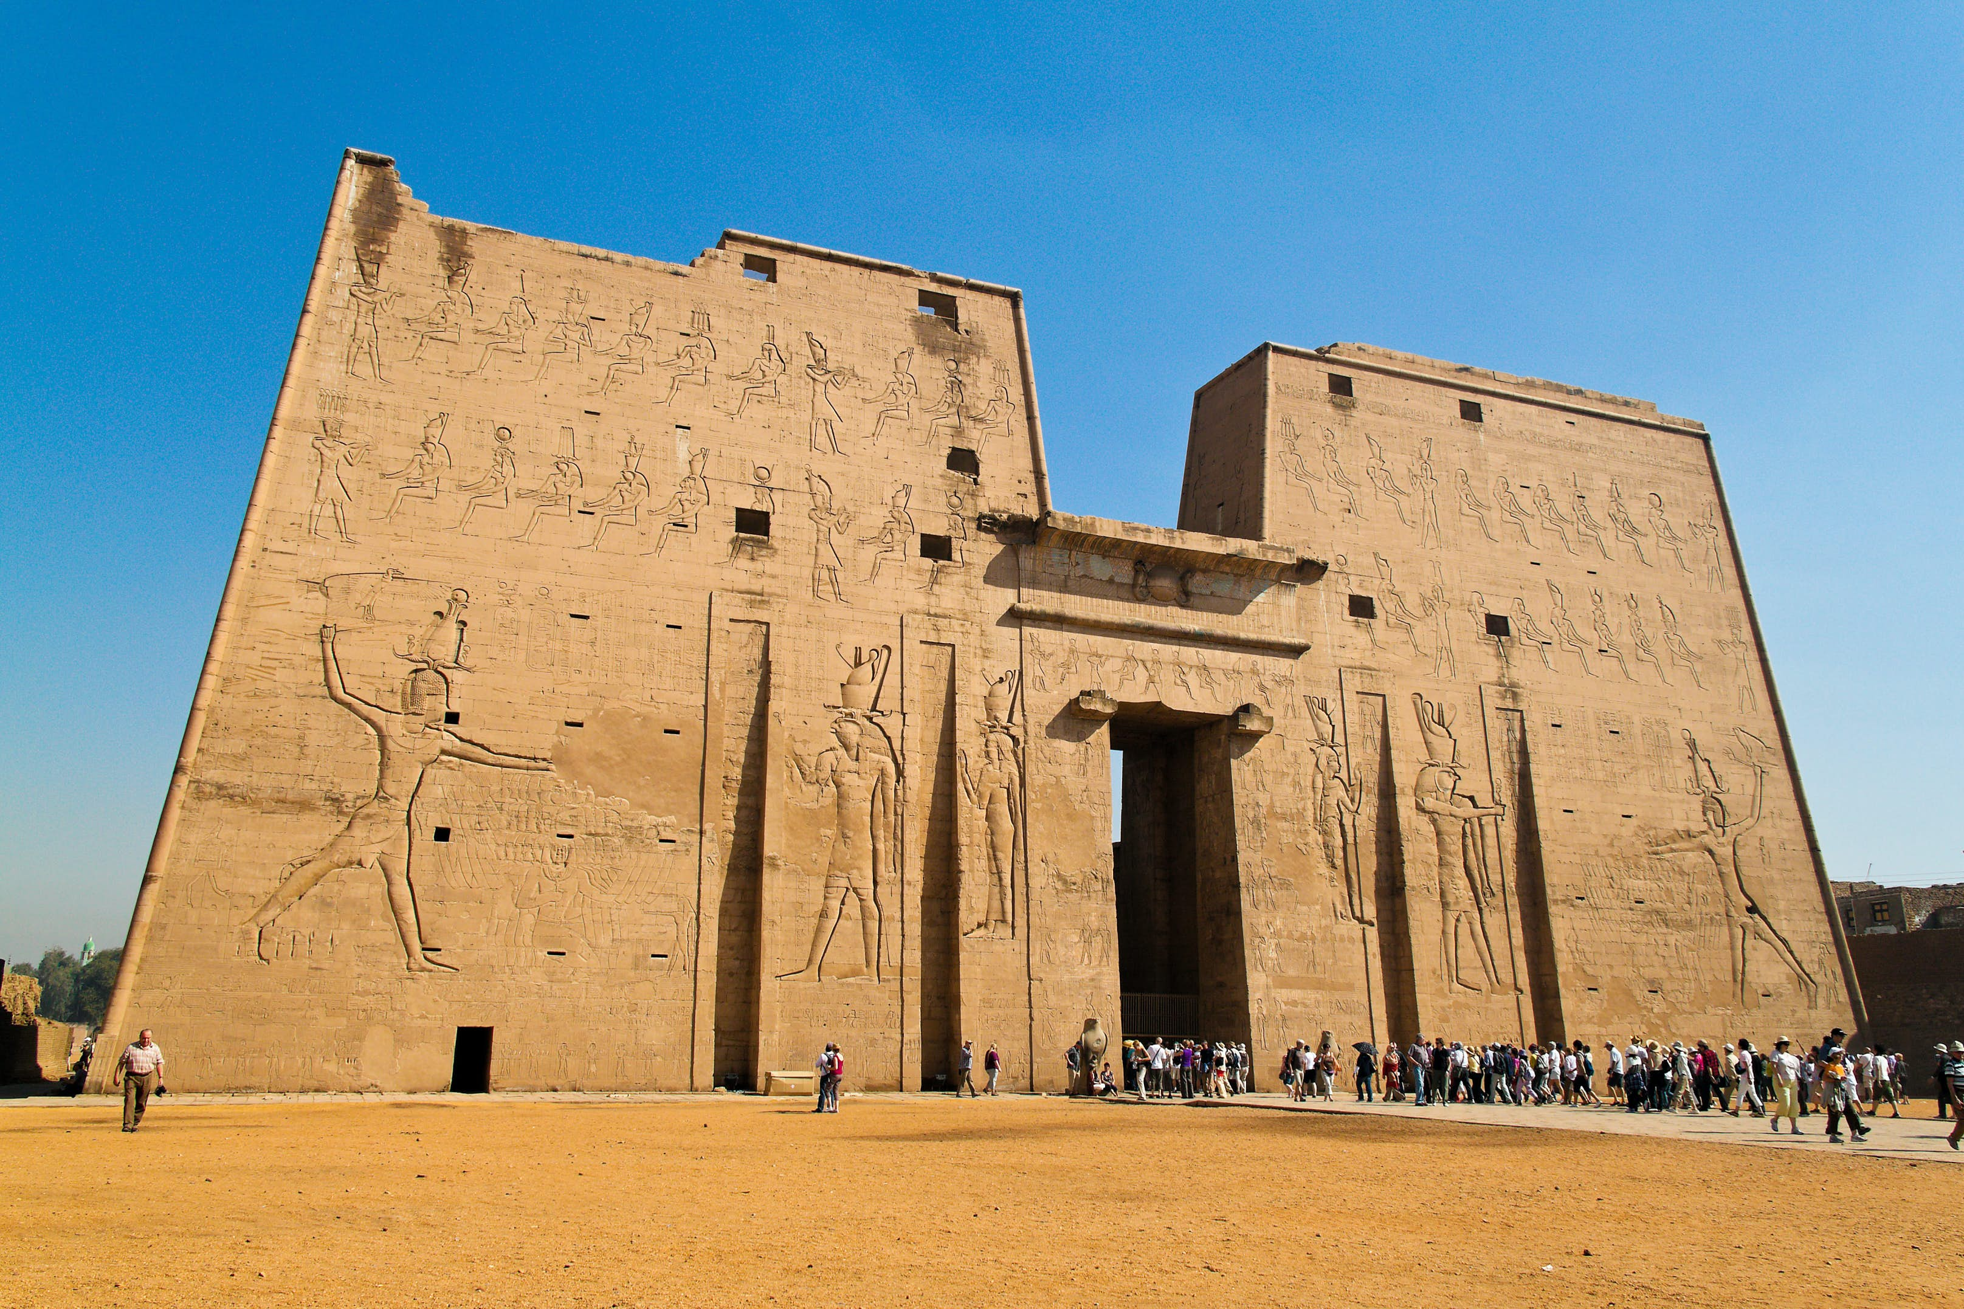
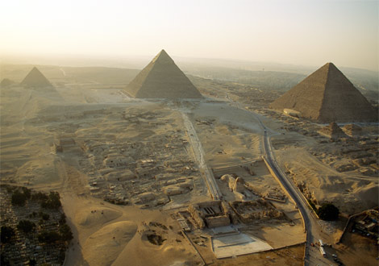
Longevity – Stability - Consistency
Ancient Egyptian civilization lasted for more than 3,000 years and showed a stunning level of continuity.
While today we consider the Greco-Roman period to be in the distant past, it should be noted that Cleopatra VII’s (69-30 BC) reign is closer to our own time than it was to that of the construction of the Great Pyramid of Cheops in Giza (c. 2580 BC) . It took humans nearly 4,000 years to build something—anything—taller than the Great Pyramid. https://www.lonelyplanet.com/egypt/edfu/attractions/temple-of-horus/a/poi-sig/1073702/1298044 and https://el.m.wikipedia.org/wiki/%CE%91%CF%81%CF%87%CE%B5%CE%AF%CE%BF:Great-Pyramids-of-Giza-Aerial-View-Cairo-Egypt.jpg

Slide 26
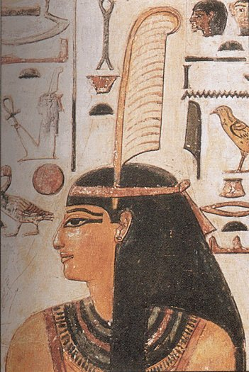
The consistent cycles the Egyptians saw in their natural world, such as the daily rising and setting of the sun and the Nile’s annual inundation, persuaded them that there should be a perfect cosmic order/balance. This divine order was known as ma’at—embodying truth, righteousness, justice, and cosmic law—and was eventually personified as a goddess. From early in Egypt’s history, a primary role of the pharaoh was to be the champion of ma’at and preserve that cosmic order to help protect Egypt from the problems that surrounded them. https://en.wikipedia.org/wiki/Maat

Slide 27
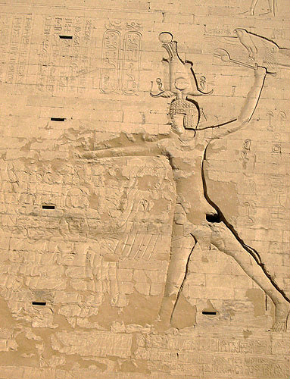
Egypt’s stability is in stark contrast to the Ancient Near East of the same period, which endured an overlapping series of cultures and upheavals with amazing regularity. The earliest royal monuments, such as the Narmer Palette carved around 3100 BC, display identical royal costumes and poses as those seen on later rulers, (https://commons.wikimedia.org/wiki/Category:Pharaoh_slaying_his_enemies#/media/File:Edfu_Tempel_11.jpg ) even Ptolemaic kings and
Roman emperors on their temples more than three millennia later.

Slide 28
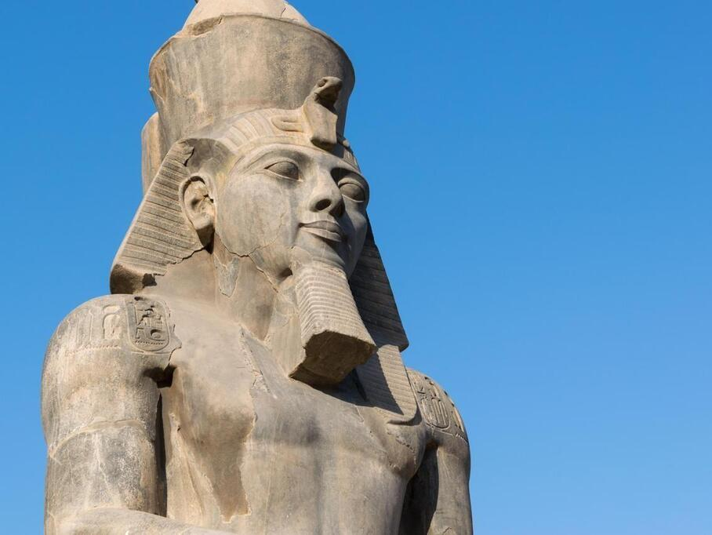
The Pharaoh
Rulers in Egypt were complex intermediaries that straddled the terrestrial and divine realms. They were, obviously, living humans, but upon accession to the throne, they also embodied the eternal office of kingship itself. The Ka, or spirit, of kingship was often depicted as a separate entity standing behind the human ruler. This divine aspect of the office of kingship was what gave authority to the individual person who was the king. The living king was associated with the god Horus, the powerful, virile falcon-headed god who was believed to bestow the throne to the first human king. https://larochesuryon.maville.com/actu/actudet_-egypte.-le-visage-du-pharaon-ramses-ii-reconstitue-pour-la-premiere-fois-3-300-ans-apres-sa-mort-_54135-5414720_actu.Htm

Slide 29
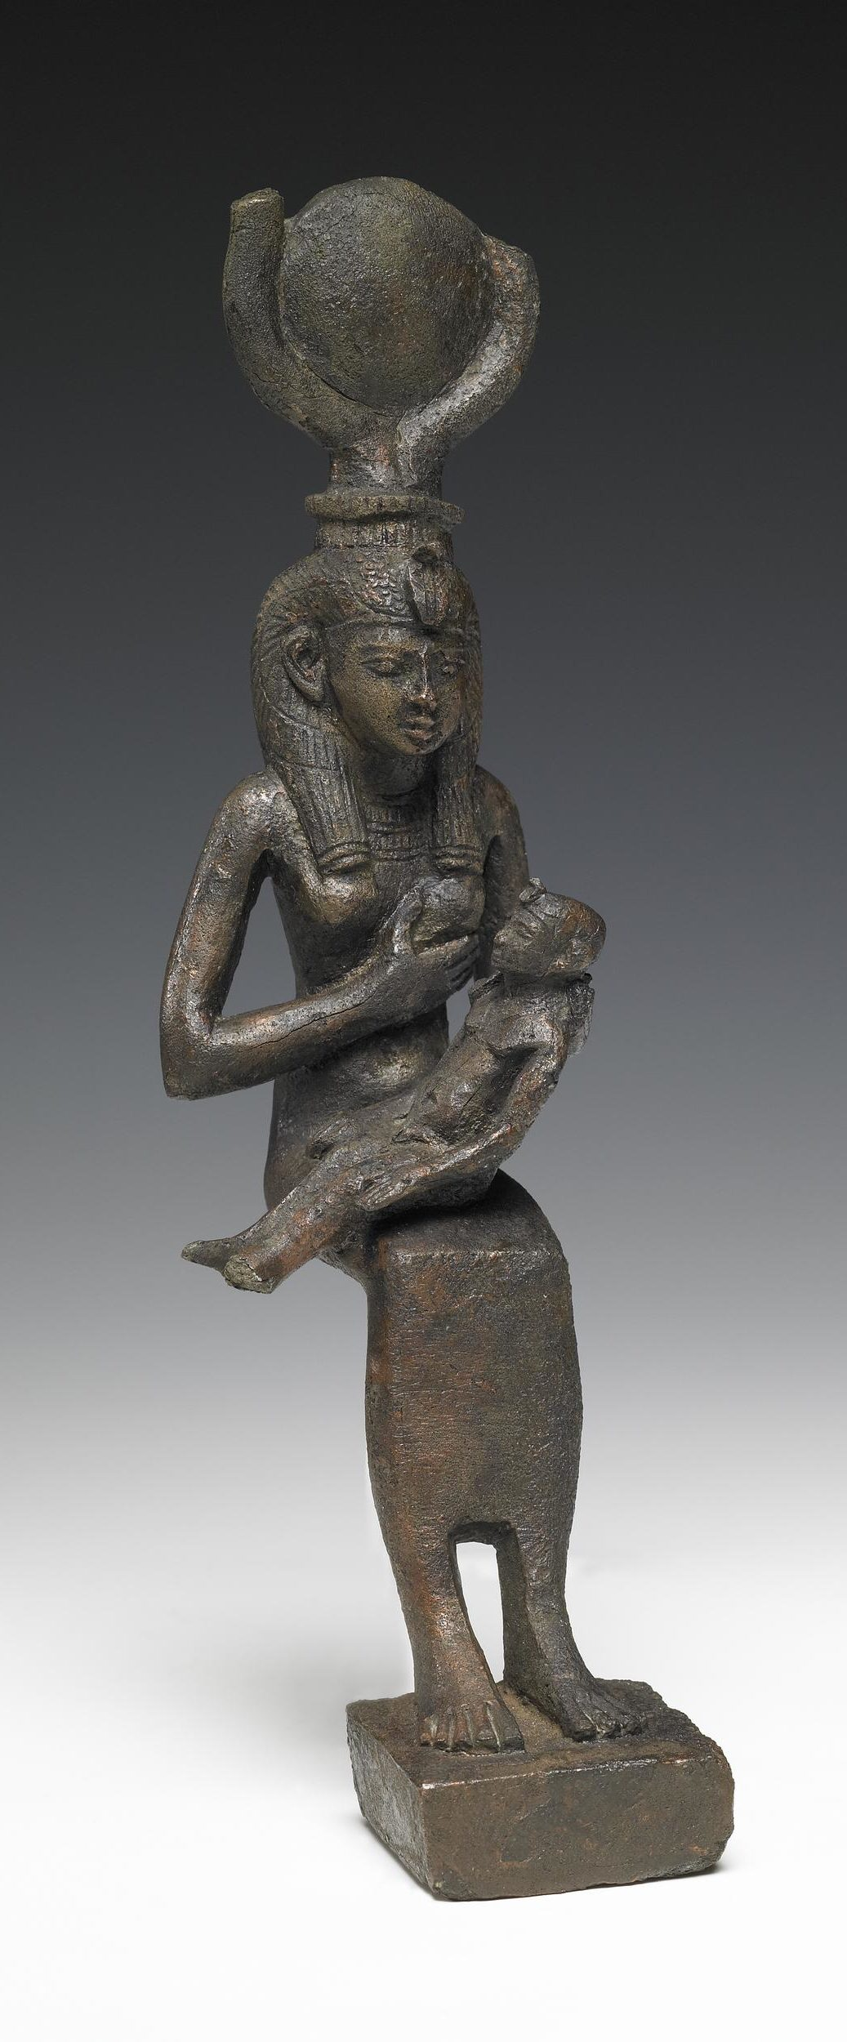
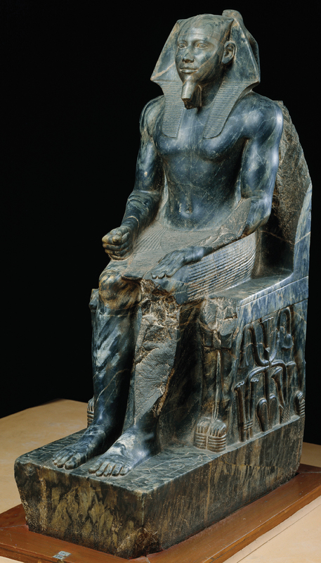
Bronze figure of Isis nursing Horus, c. 4th century–3rd century BC, Bronze, 23.6 cm high, British Museum, London, UK https://www.khanacademy.org/humanities/ap-art-history/ancient-mediterranean-ap/ancient-egypt-ap/a/ancient-egypt-an-introduction
Khafre Enthroned, 4th dynasty (Old Kingdom), ca. 2540 BC, Green Diorite, 167.5 cm tall, Egyptian Museum, Cairo, Egypt http://classicalchopped2.artinterp.org/omeka/exhibits/show/ancient-portraits/item/9

Slide 30
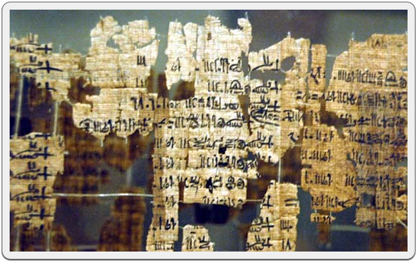
Turin King-List
The Turin King-List, also known as the Turin Royal Canon, is a unique papyrus, written in hieratic, currently in the Egyptian Museum at Turin. Written during the long reign of Ramesses II (Reign: 1279–1213 BC – 19th Dynasty), the Turin King-List is one of our most important sources of knowledge about the chronology of Egypt between the 1st and 17th Dynasty. http://www.ancient-egypt.org/from-a-to-z/t/turin-king-list.html

Slide 31
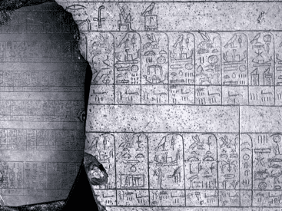
The Palermo Stone is one of the 7 fragments of a Stele known as the Royal Annals of the Old Kingdom. The Stele contains a List of ancient Egyptian Kings dating from the 1st Dynasty up to the 5th Dynasty https://www.ticketsource.co.uk/whats-on/online/online/ancient-egyptian-royal-annals-new-investigation-and-discoveries-on-the-palermo-stone/e-rmbaek

Slide 32
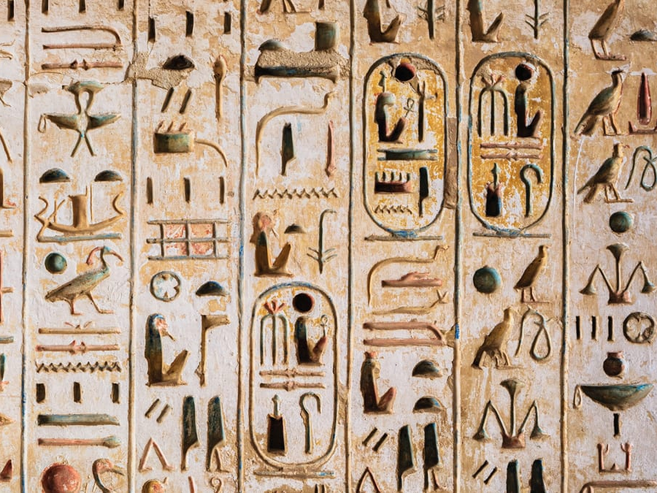
Photo credits for the Palette of Narmer: https://en.wikipedia.org/wiki/Narmer_Palette https://smarthistory.org/palette-of-king-narmer/ https://www.khanacademy.org/humanities/ap-art-history/ancient-mediterranean-ap/ancient-egypt-ap/a/ancient-egypt-an-introduction https://www.wikiwand.com/en/Narmer_Palette
PowerPoint Text quoted from: https://www.khanacademy.org/humanities/ap-art-history/ancient-mediterranean-ap/ancient-egypt-ap/a/ancient-egypt-an-introduction

