Slide 1
Edward Hopper, 1882–1967
The Early Years

Slide 2
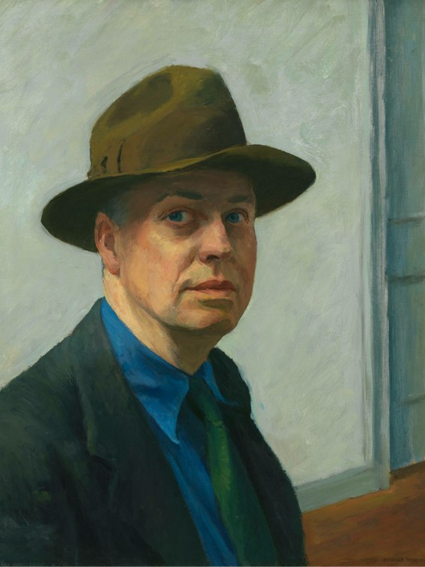
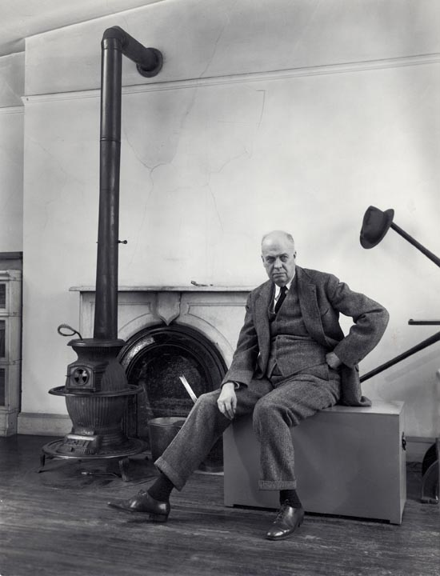
Self-Portrait, 1925–1930, Oil on canvas, 64.5 × 51.8 cm, Whitney Museum of American Art, NY, USA https://whitney.org/collection/works/6068
Edward Hopper in his Studio by Berenice Abbott Abbott, c. 1947 - printed c.1972, Silver gelatin photograph, 34 x 26.1 cm, Private Collection https://oldprintshop.com/product/98360

Slide 3
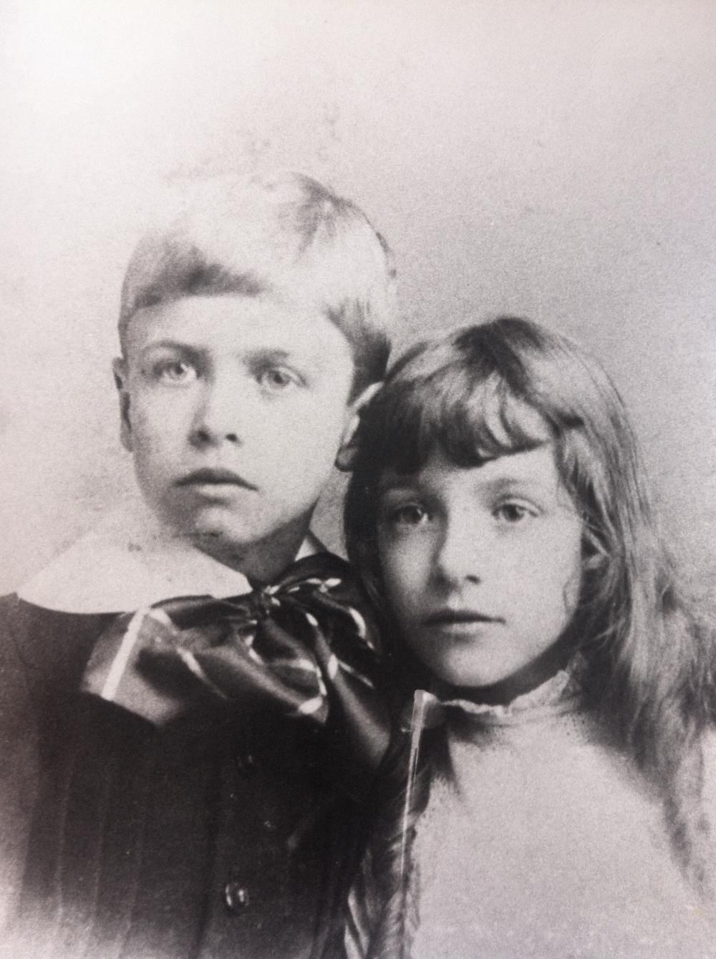
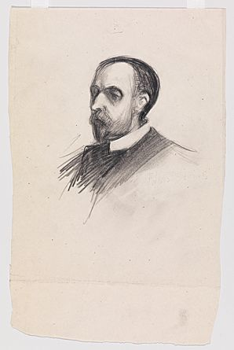
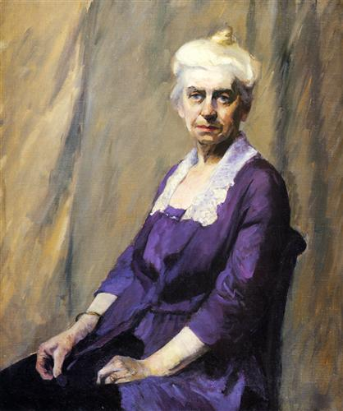
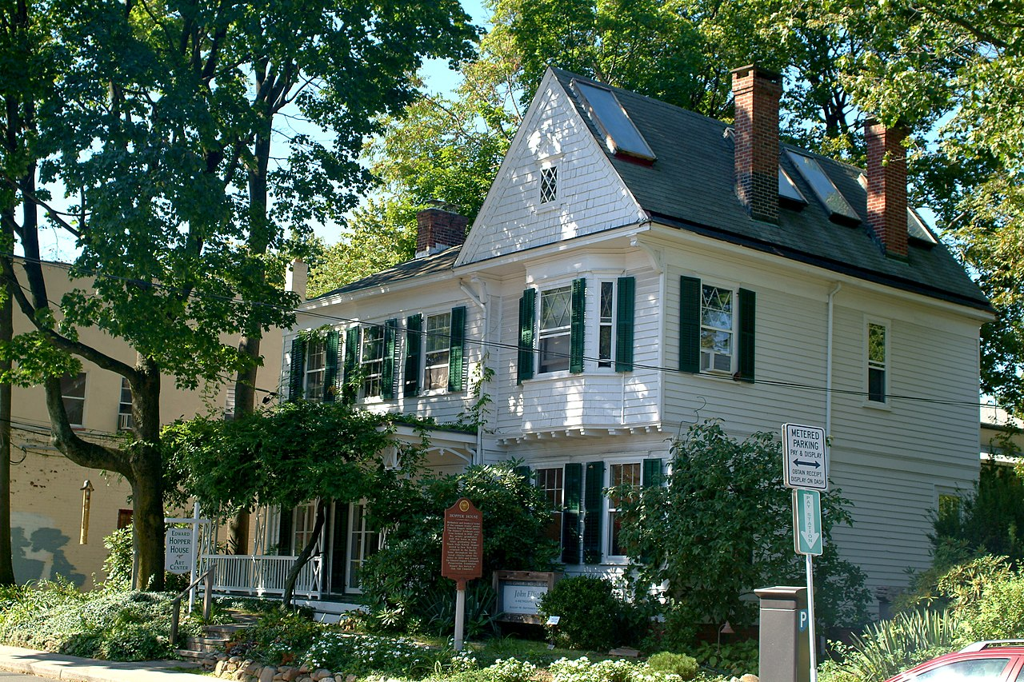
Edward Hopper and his sister Marion, ca. 1890,
Courtesy of the Arthayer
R. Sanborn Hopper
Collection Trust https://artistshomes.org/site/edward-hopper- house-museum-study-center#pretty
Photo[gallery]/12/
Portrait of Artist’s
Father Garret Henry
Hopper, 1903, Graphite pencil on paper,
23.82x 15.53, Whitney
Museum of American Art, NY, USA https://www.incollect.com/articles/edward-hopper-and-nyack
Elizabeth Griffiths Smith Hopper, The Artist's Mother), c. 1915–1916, Oil on canvas, 95.6 × 81.3 cm, Whitney Museum of American Art, NY, USA https://whitney.org/collection/works/6075
Edward Hopper Birthplace and Boyhood Home, also known as the Edward Hopper House Art Center, Nyack in Rockland County, NY, USA https://en.wikipedia.org/wiki/Edward_Hopper_Birthplace_and_Boyhood_Home

Slide 4
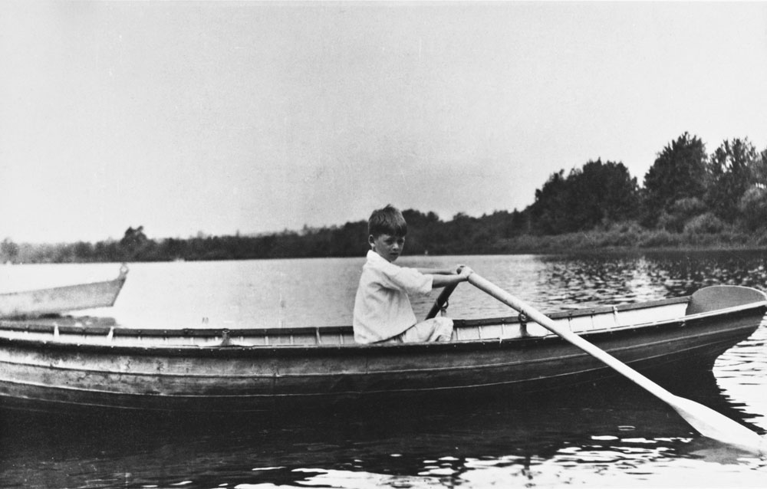
Edward Hopper, late 1880s, Courtesy of The Arthayer R. Sanborn Hopper https://www.incollect.com/articles/edward-hopper-and-nyack
Collection Trust

Slide 5
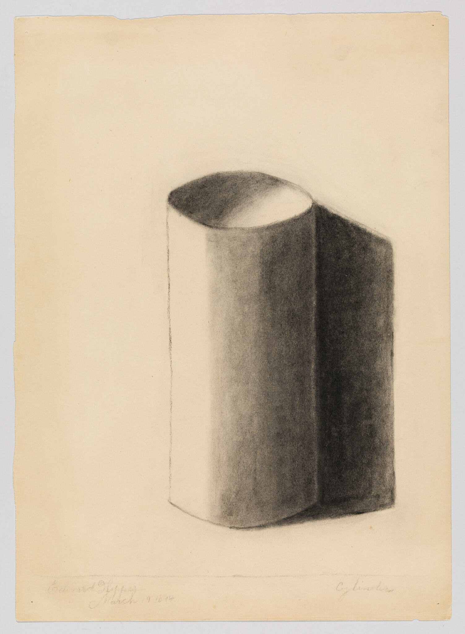
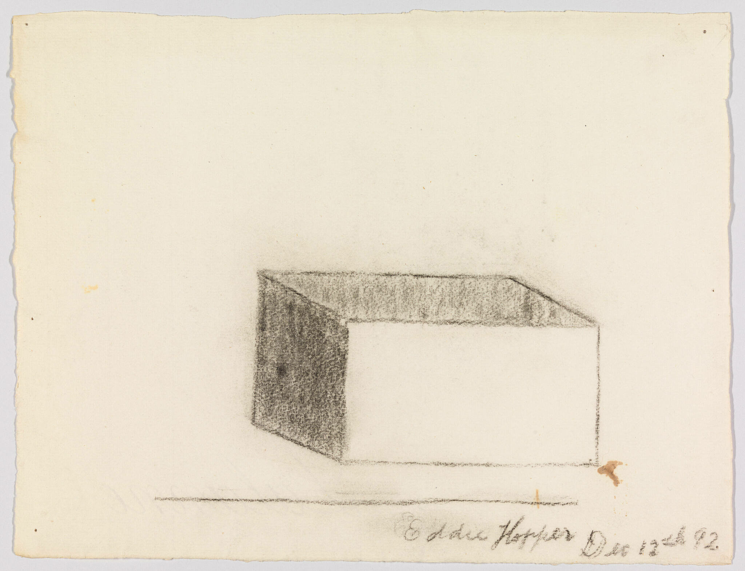
Study of a Cube, 1892, Charcoal on paper, 24.3 × 31.4 cm, Whitney Museum of American Art, NY, USA https://whitney.org/collection/works/31630
Cylinder,1894, Charcoal on paper, 37.9 × 27.3 cm, Whitney Museum of American Art, NY, USA https://whitney.org/collection/works/9408

Slide 6
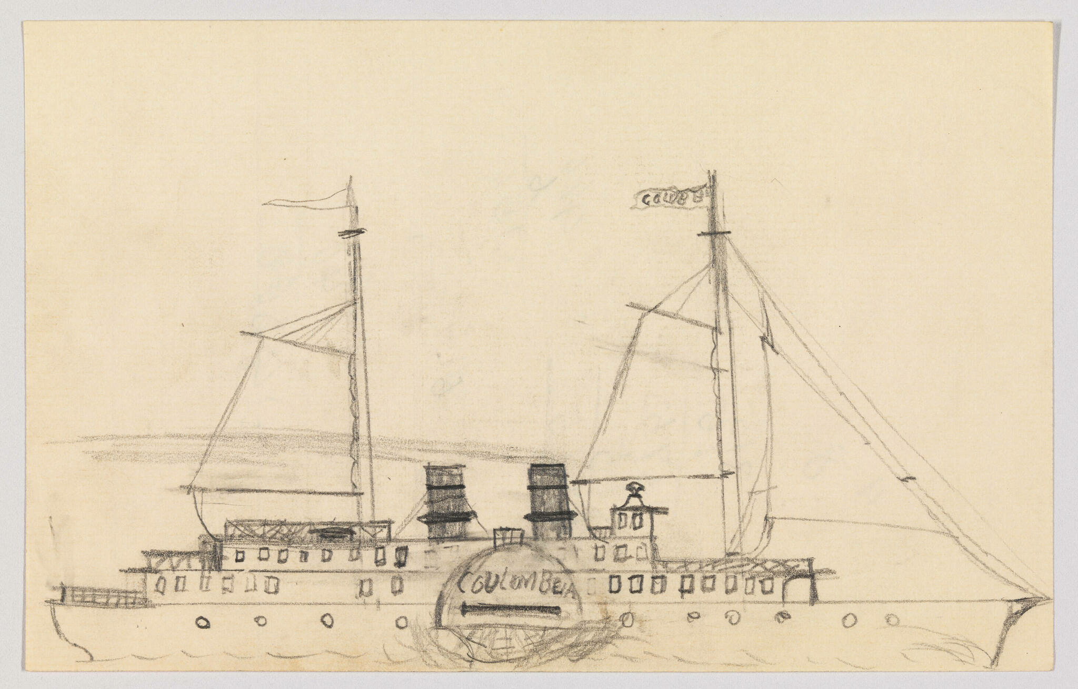
Study of the Steamboat Columbia, 1892–1895, Graphite pencil on paper, 10.8 × 17.1 cm, Whitney Museum of American Art, NY, USA https://whitney.org/collection/works/22186

Slide 7
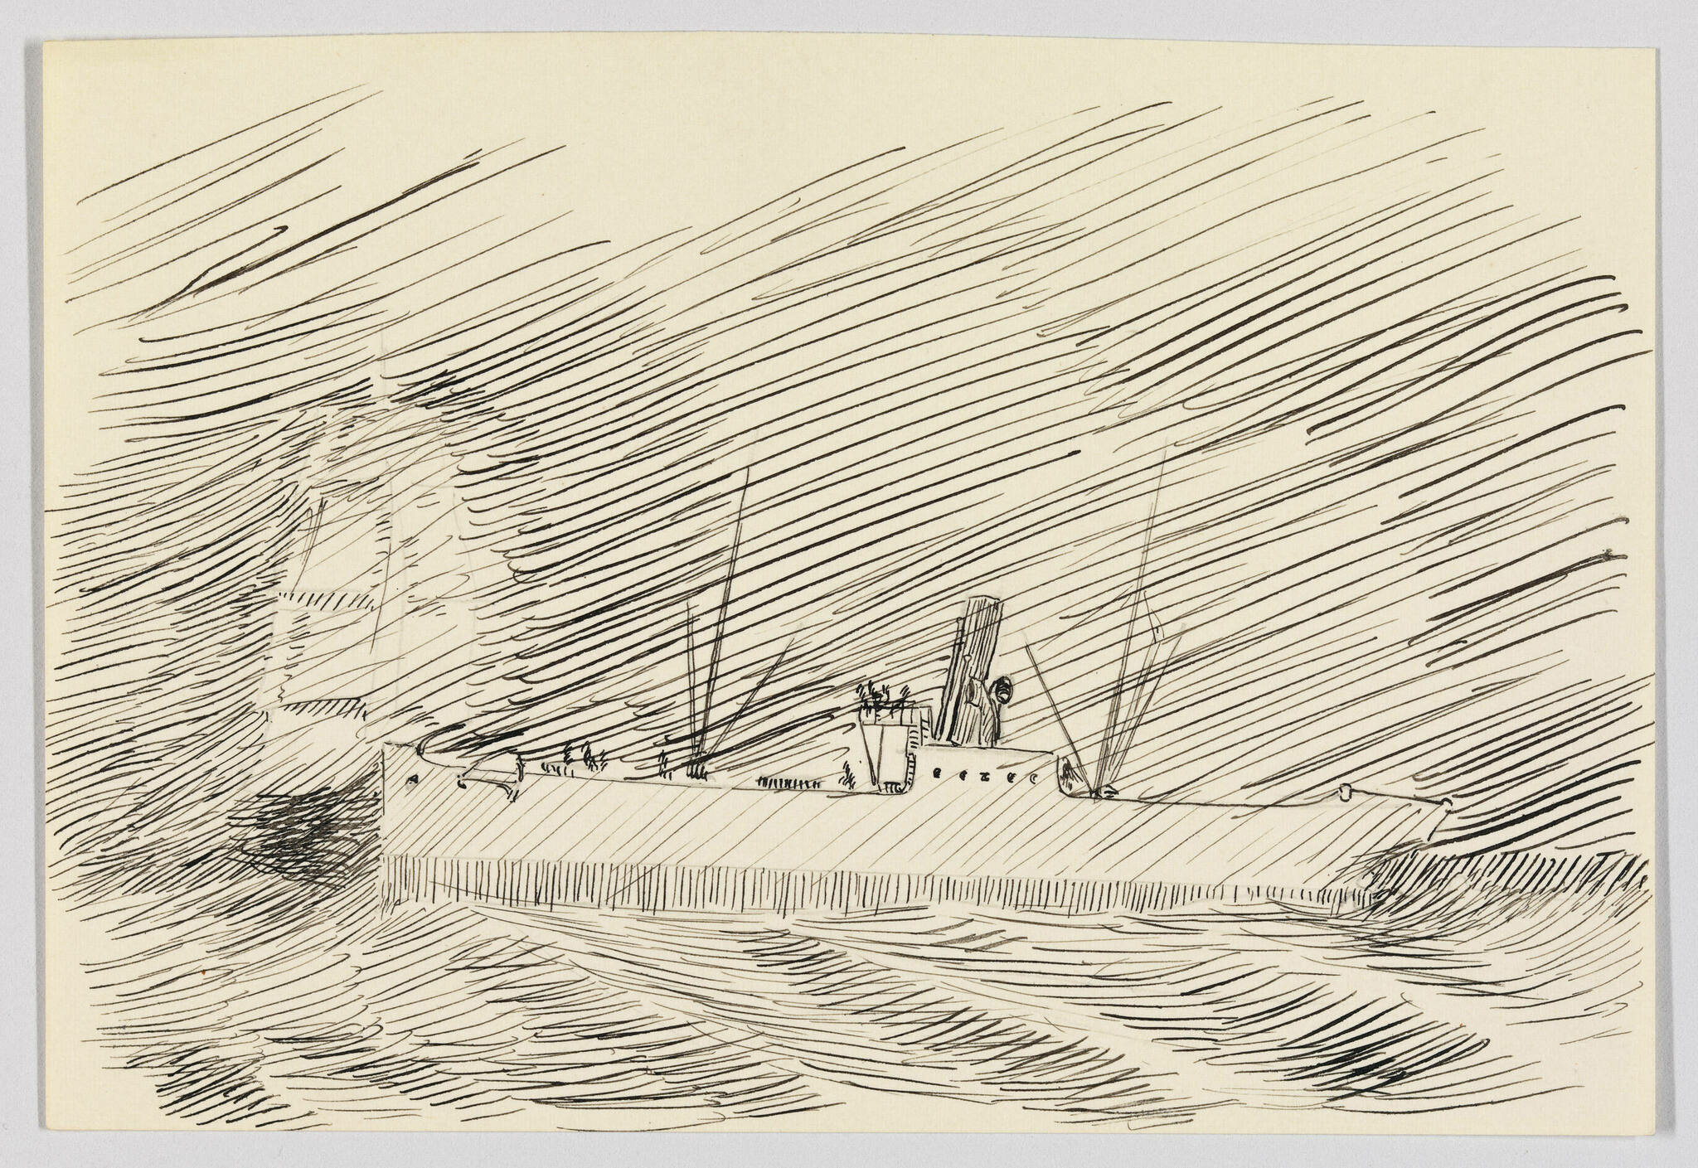
Study of a Large Ship and Sailboat in Stormy Sea, 1895–1899, Pen and ink and graphite pencil on paper (recto); Graphite pencil on paper (verso), 10.3 × 15.1 cm, Whitney Museum of American Art, NY, USA https://whitney.org/collection/works/21479

Slide 8
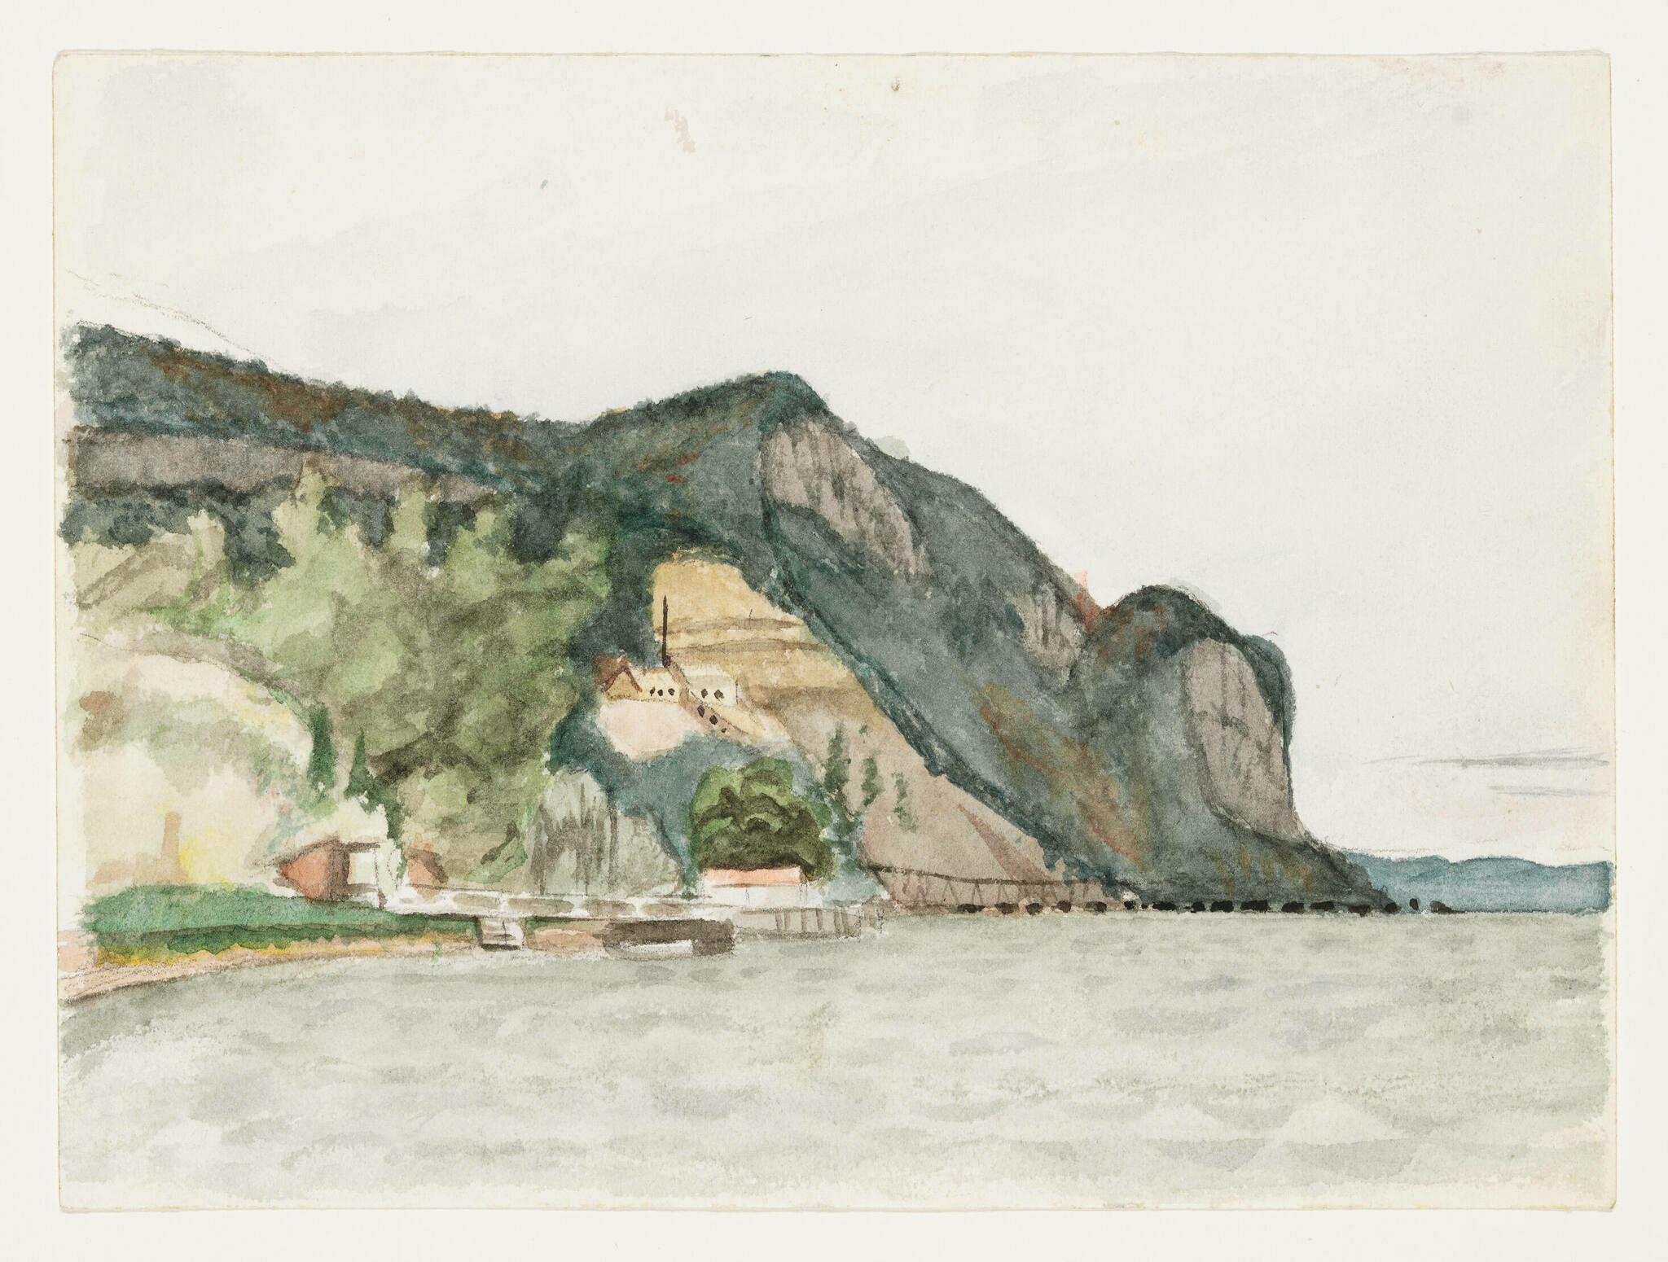
Hook Mountain, Nyack, c. 1899, Watercolor and graphite pencil on paper, 12.9 × 17.5 cm, Whitney Museum of American Art, NY, USA https://whitney.org/collection/works/9260

Slide 9
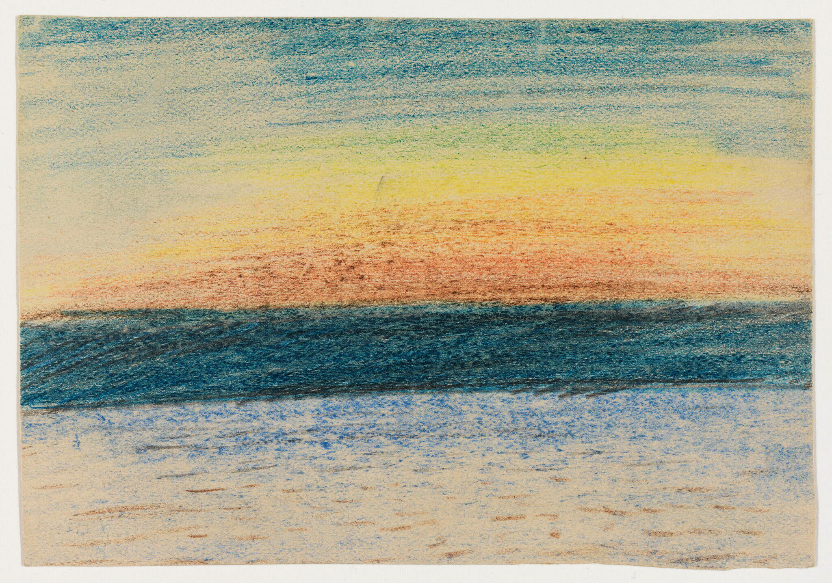
Study of Sunset, 1895-1899, Wax crayon and graphite pencil on paper, 8.3 × 11.9 cm, Whitney Museum of American Art, NY, USA https://whitney.org/collection/works/21386

Slide 10
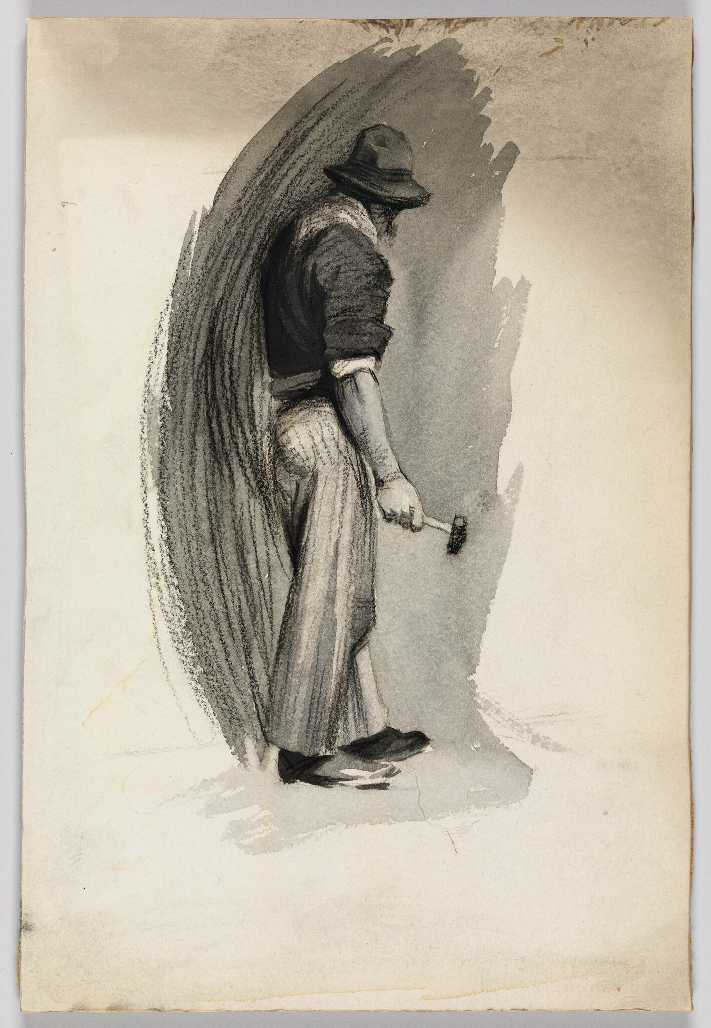
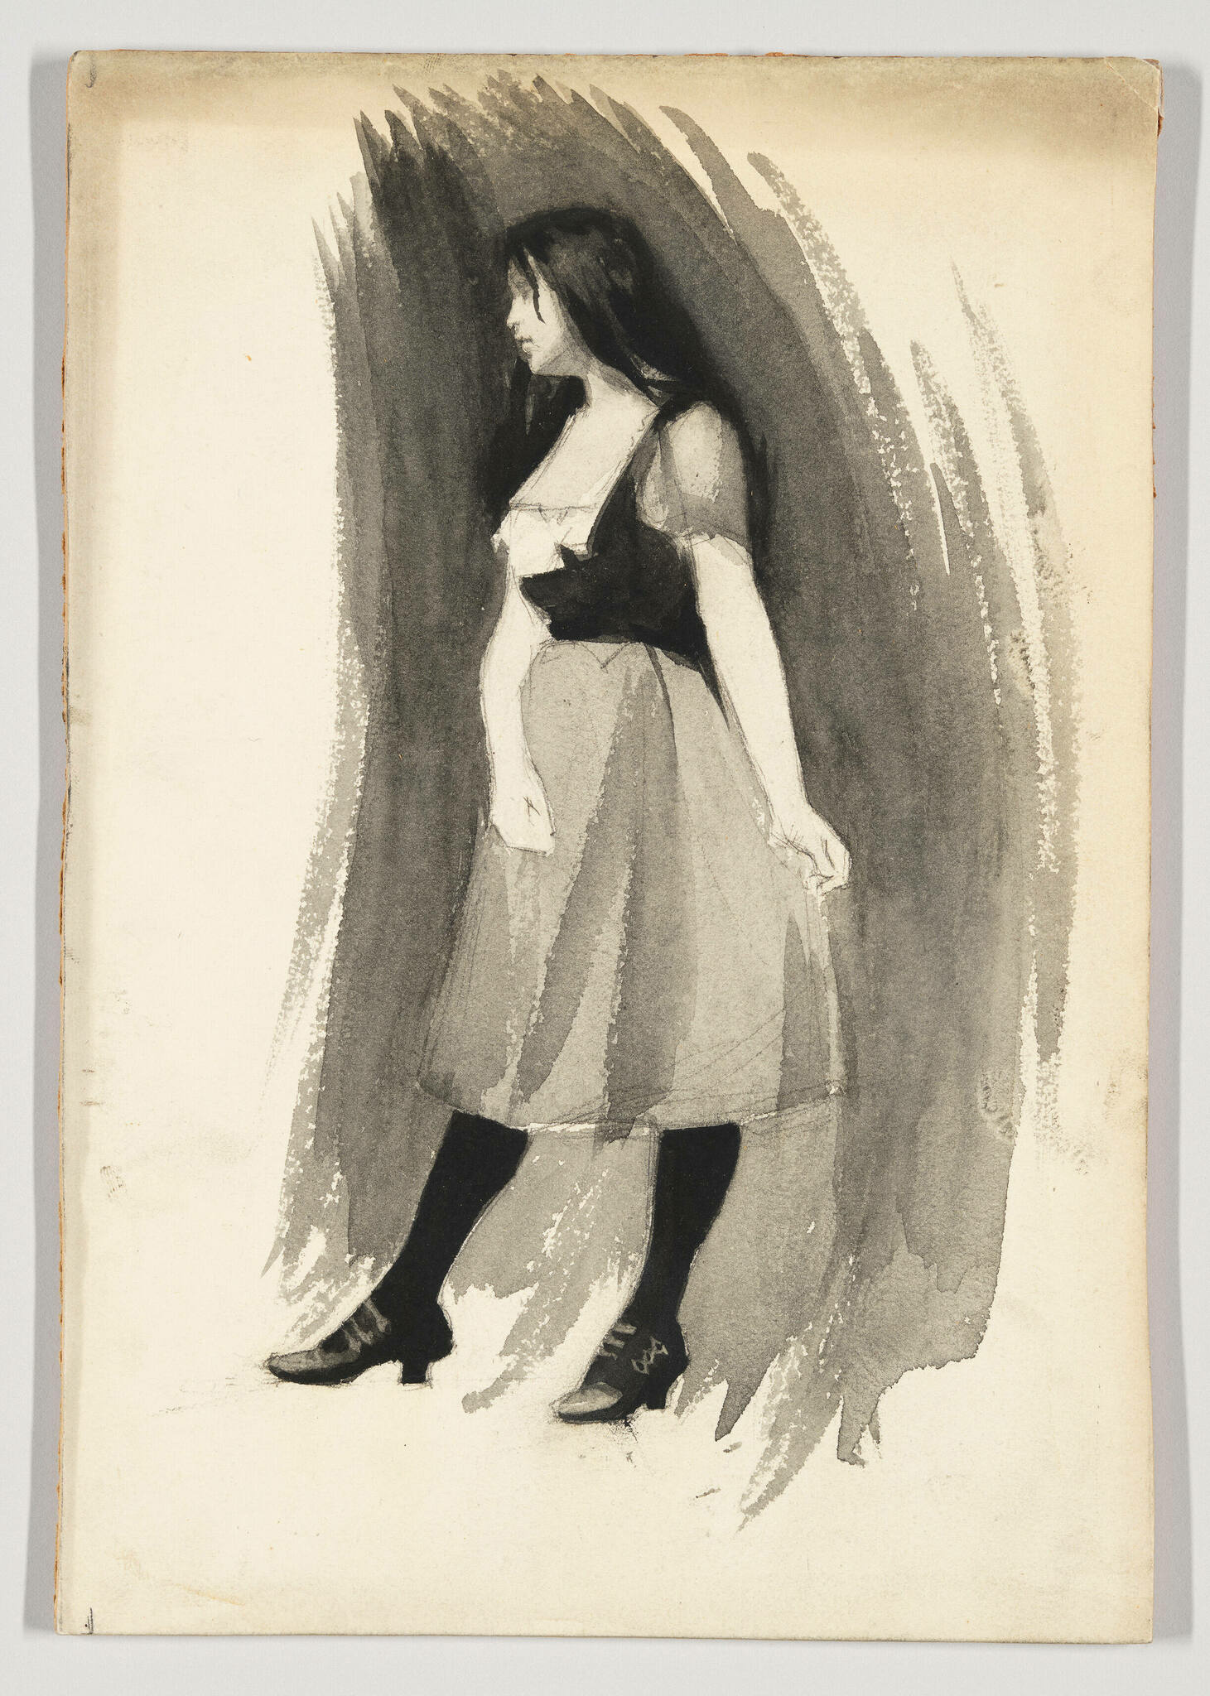
Study of a Man with Hammer, 1899–1906, Opaque watercolor and fabricated chalk on board, 27.9 × 18.7 cm, Whitney Museum of American Art, Ny, USA https://whitney.org/collection/works/6965
Study of Woman in Skirt and Stockings, 1899–1906, Opaque watercolor and fabricated chalk on board, 27.9 × 19.2 cm, Whitney Museum of American Art, Ny, USA https://whitney.org/collection/works/6966

Slide 11
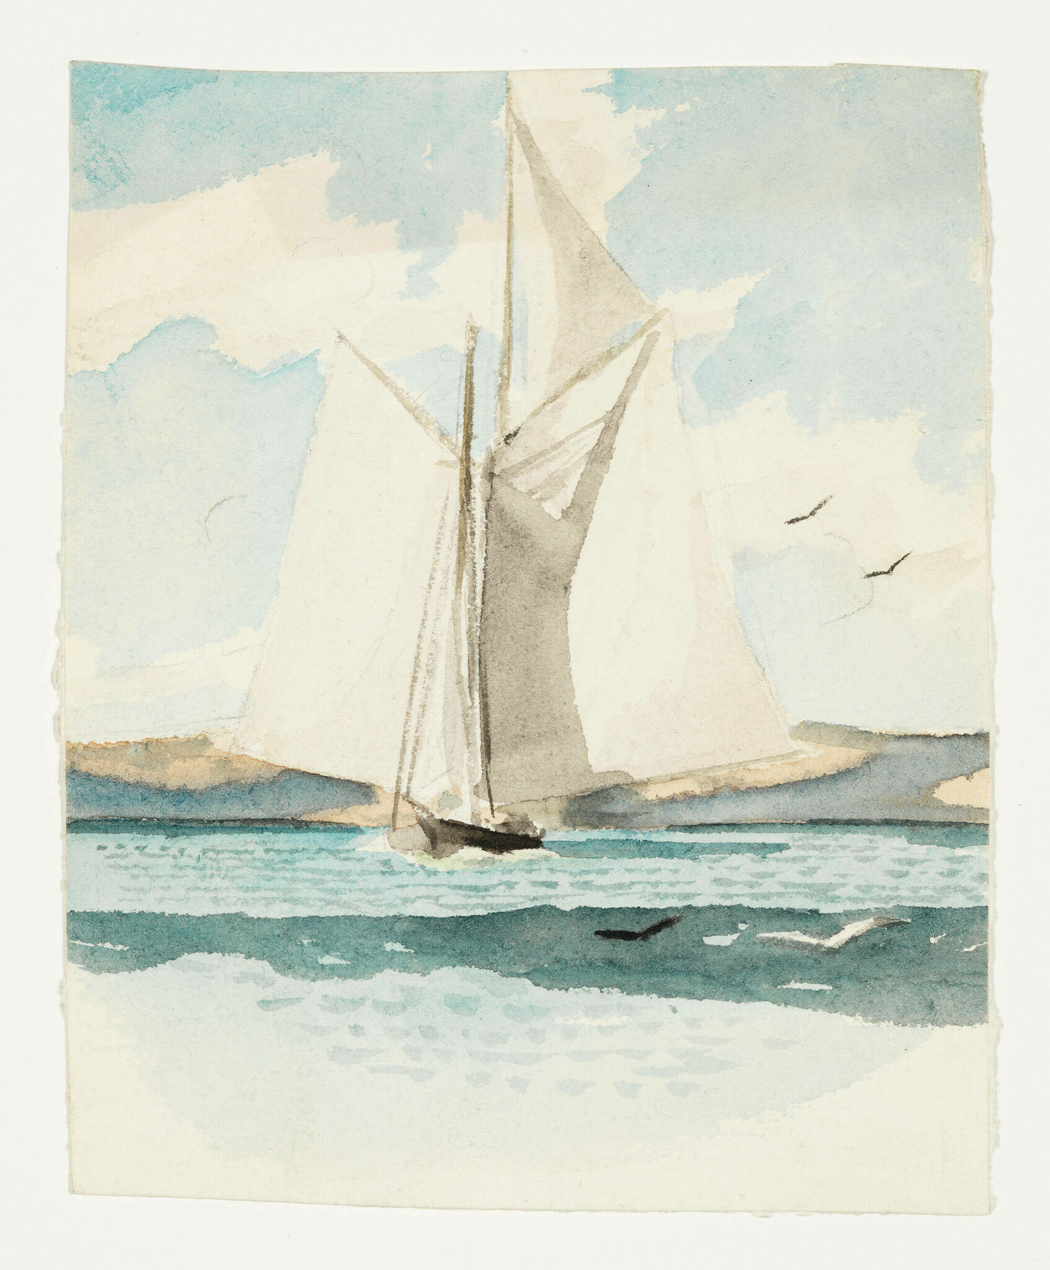
Sailboat, c. 1900, Watercolor and graphite pencil on paper, 13.8 × 11.1 cm, Whitney Museum of American Art, NY, USA https://whitney.org/collection/works/9841

Slide 12
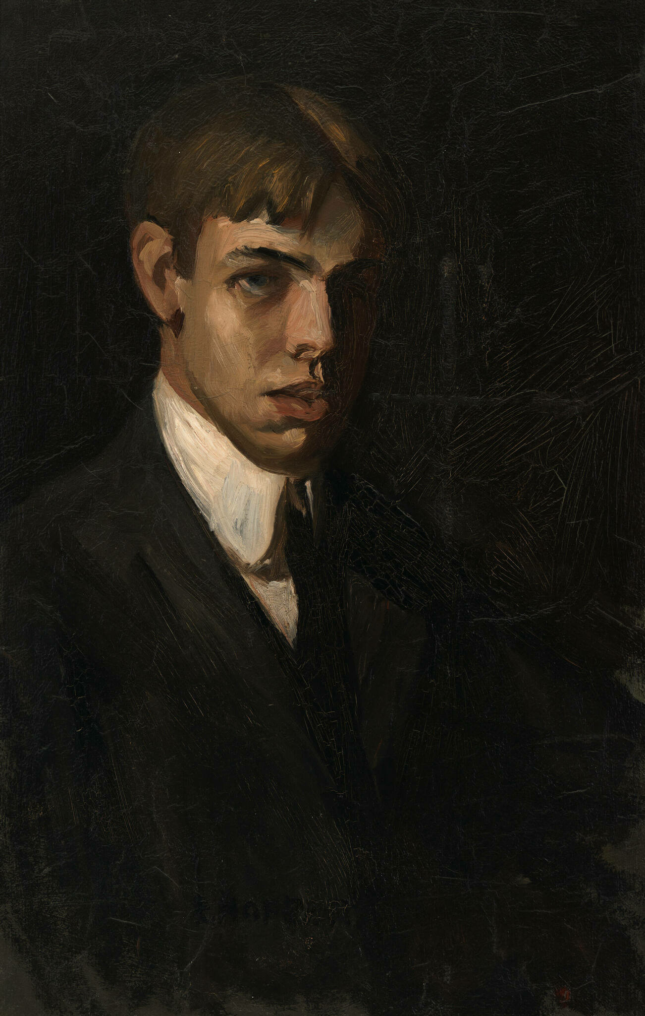
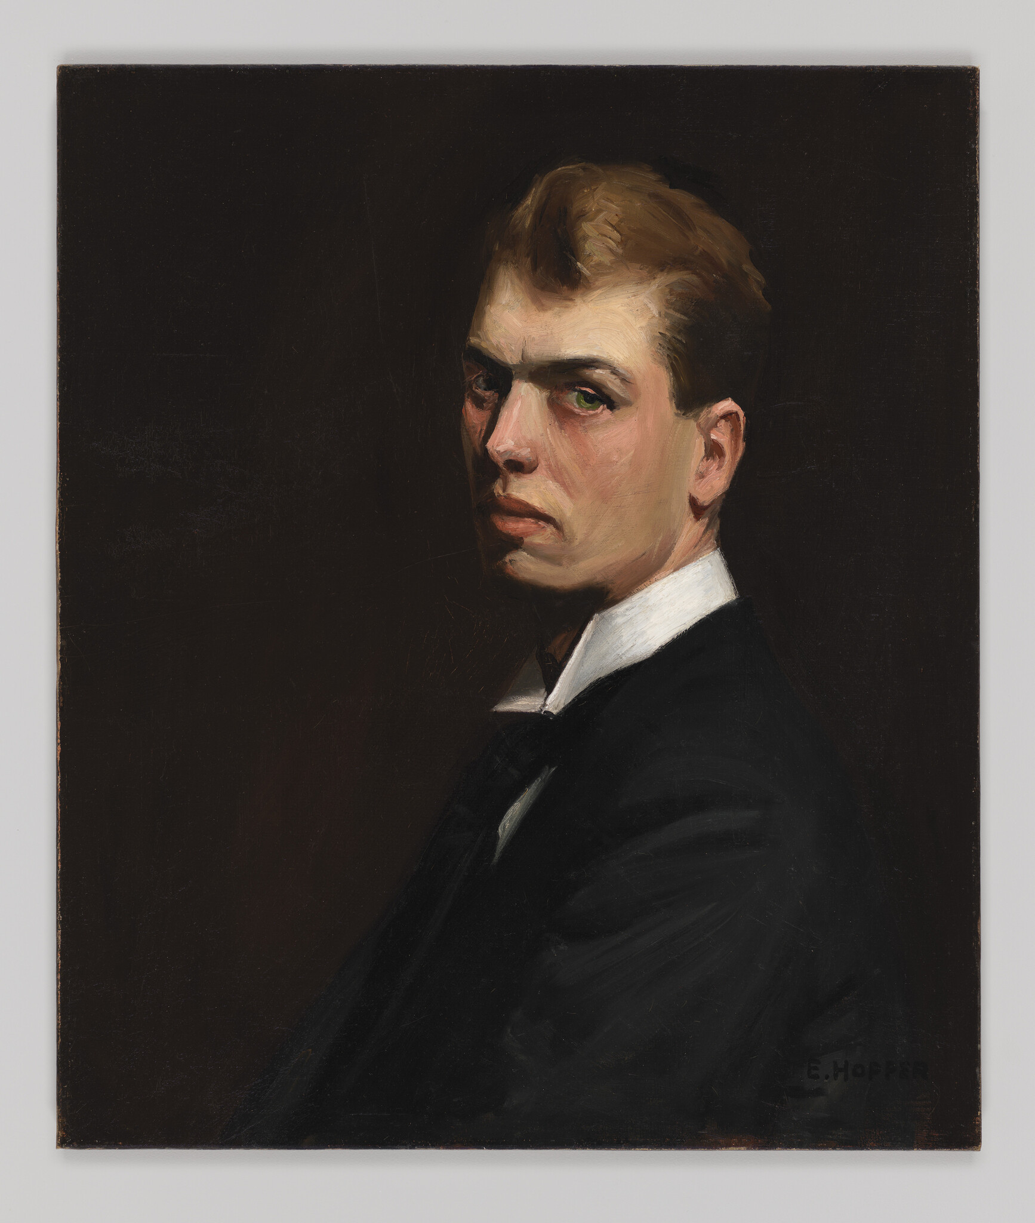
Two Self-Portraits, 1903–1906, Oil on canvas, 71.4 × 46.4 cm (left), 65.9 × 56.2 cm (right), Whitney Museum of American Art, NY, USA https://whitney.org/collection/works/6009 https://whitney.org/collection/works/6008

Slide 13
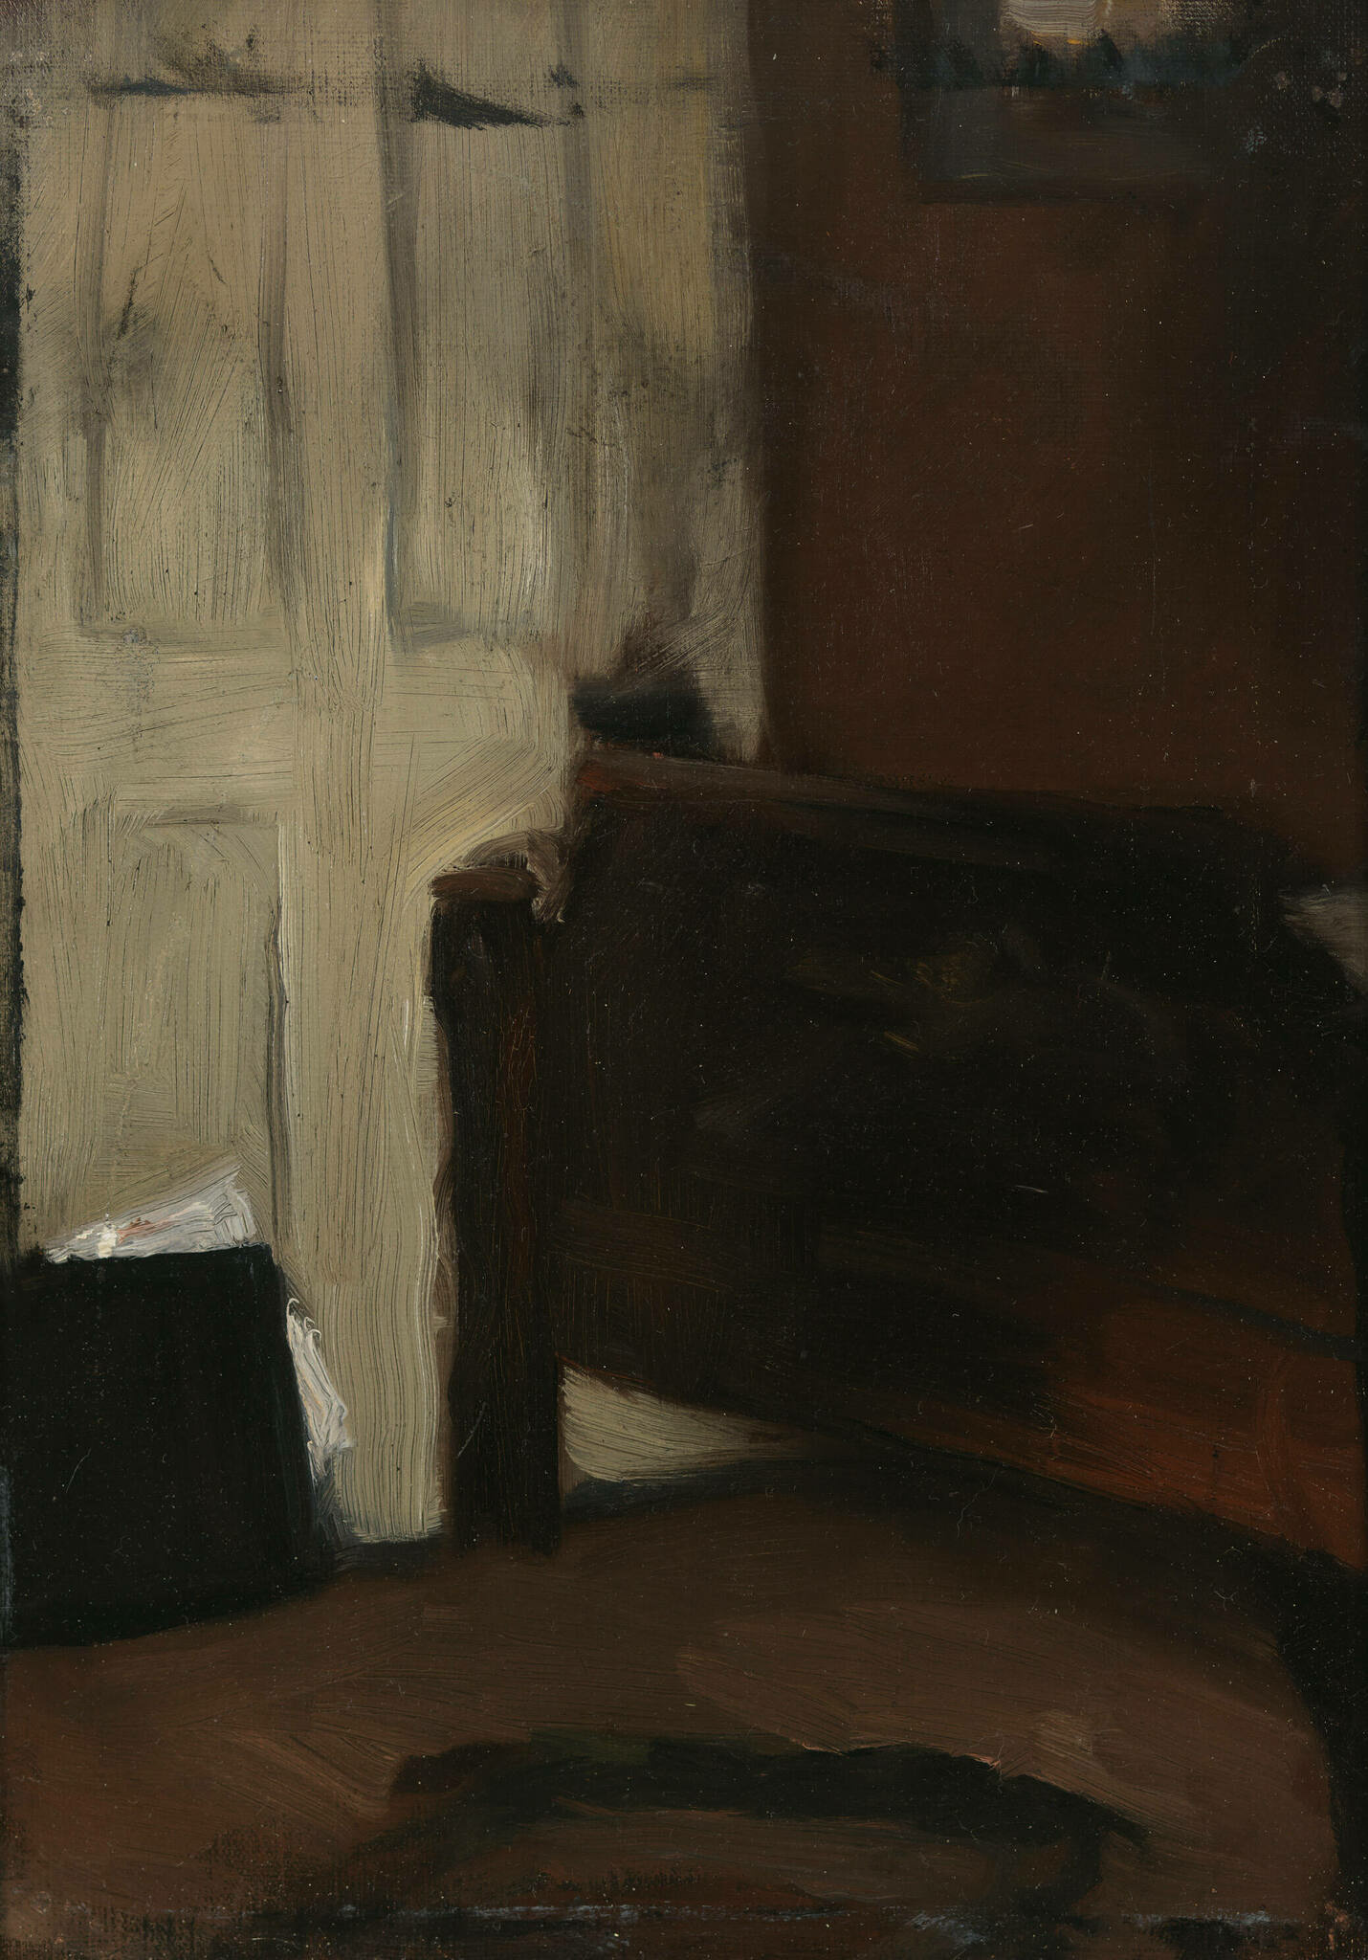
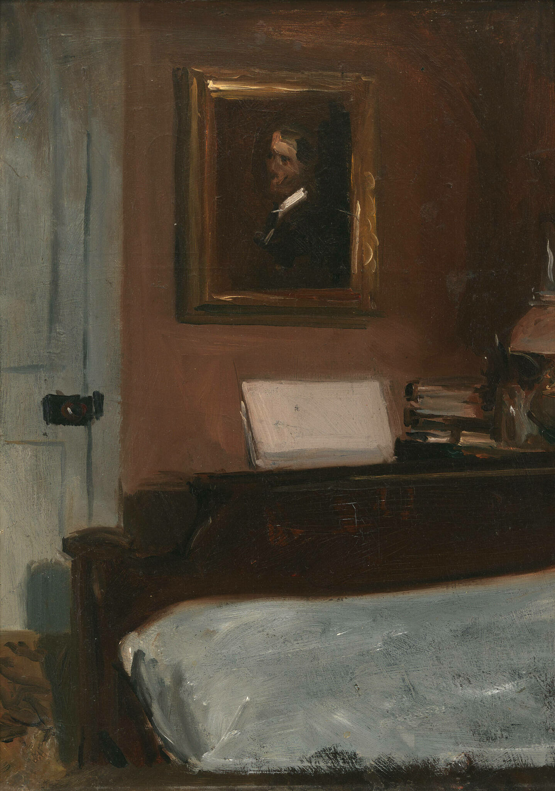
Two paintings of the Artist's Bedroom in Nyack, 1905-1906, Oil on linen (left), Oil on composition board (right), 35.6 × 25.4 cm (left), 38.1 × 27.9 cm (right), Whitney Museum of American Art, NY, USA https://whitney.org/collection/works/6065 and https://whitney.org/collection/works/6064

Slide 14
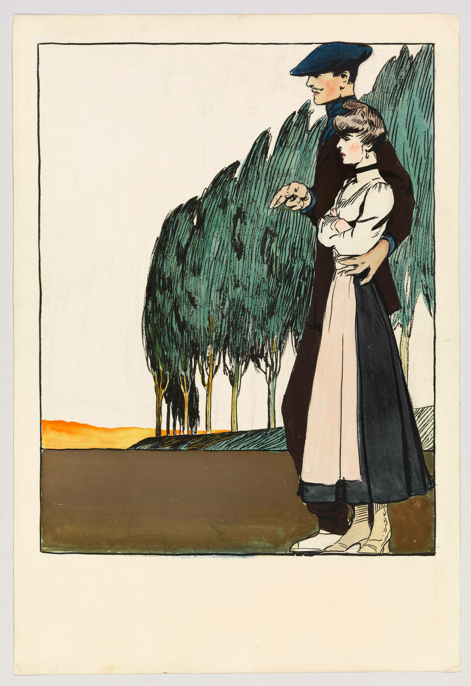
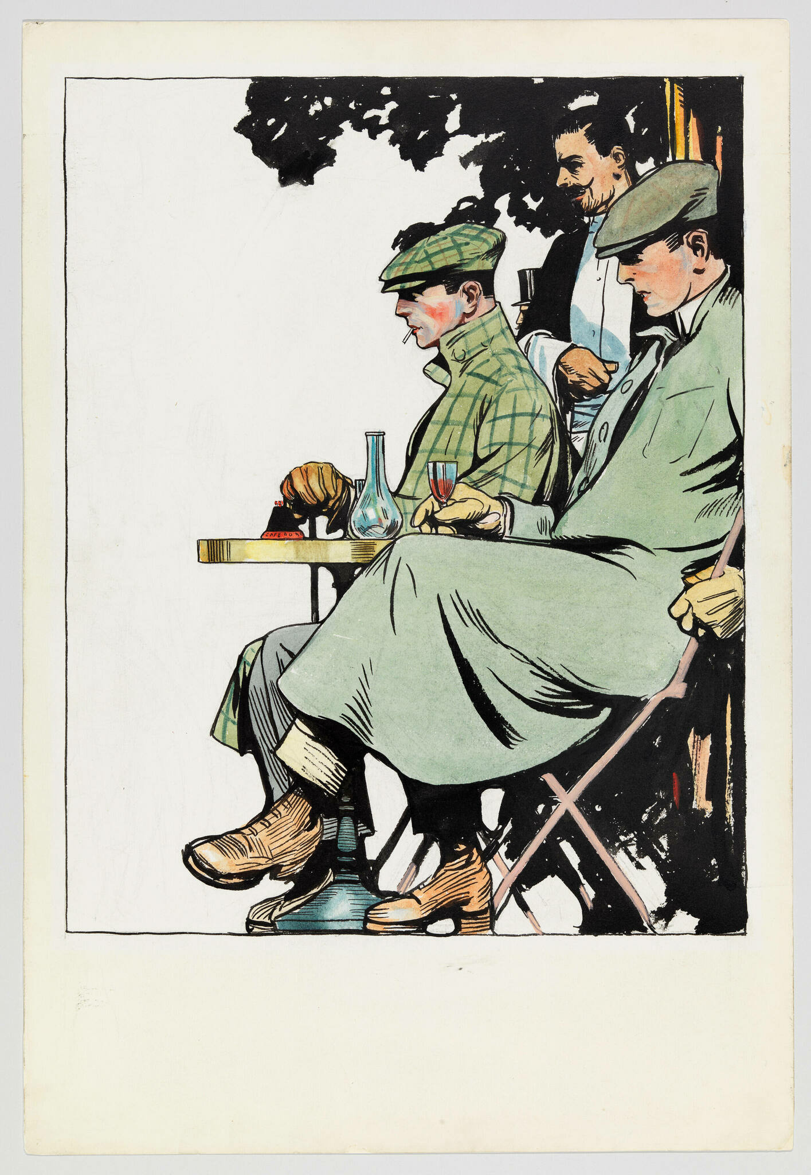
Couple Near Poplars, 1906, Watercolor, brush and ink, and graphite pencil on paper, 55.2 × 37.5 cm, Whitney Museum of American Art, NY, USA https://whitney.org/collection/works/6928
Men Seated at Café Table, 1906, Transparent and opaque watercolor, pen and ink, brush and ink, and graphite pencil on paper, 55.2 × 37.6 cm, Whitney Museum of American Art, NY, USA https://whitney.org/collection/works/6921

Slide 15
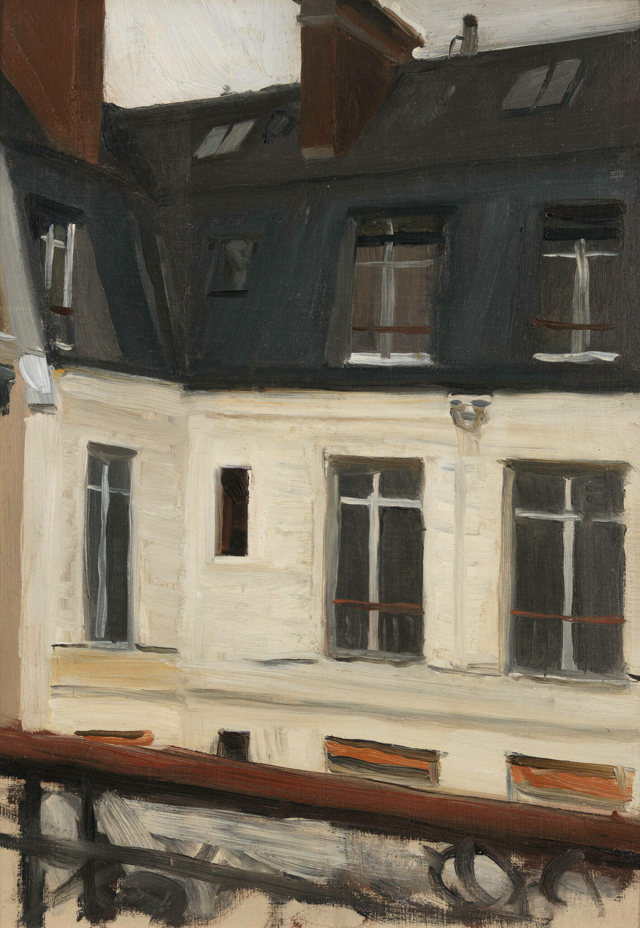
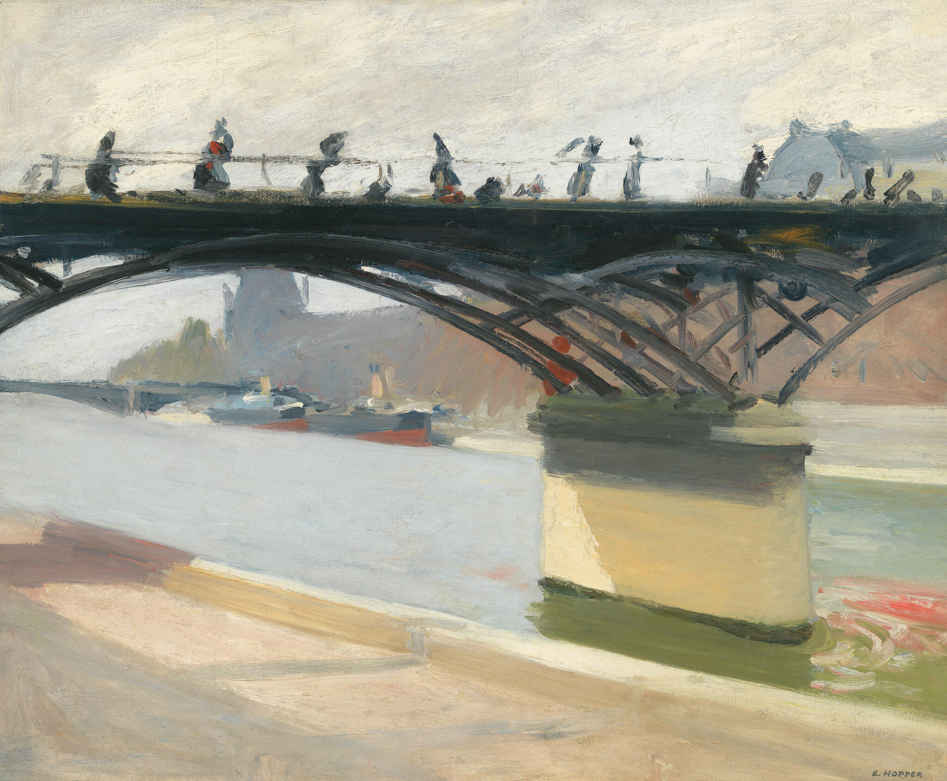
Le Pont des Arts
Le Pont des Arts
1907
Le Pont des Arts
1907
Le Pont des Arts, 1907, Oil on canvas, 60.2 × 73.2 cm, Whitney Museum of American Art, NY, USA https://whitney.org/collection/works/5894
View Across Interior Courtyard at 48 rue de Lille, Paris, 1906, Oil on wood, 33 × 23.5 cm, Whitney Museum of American Art, NY, USA https://whitney.org/collection/works/6060

Slide 16
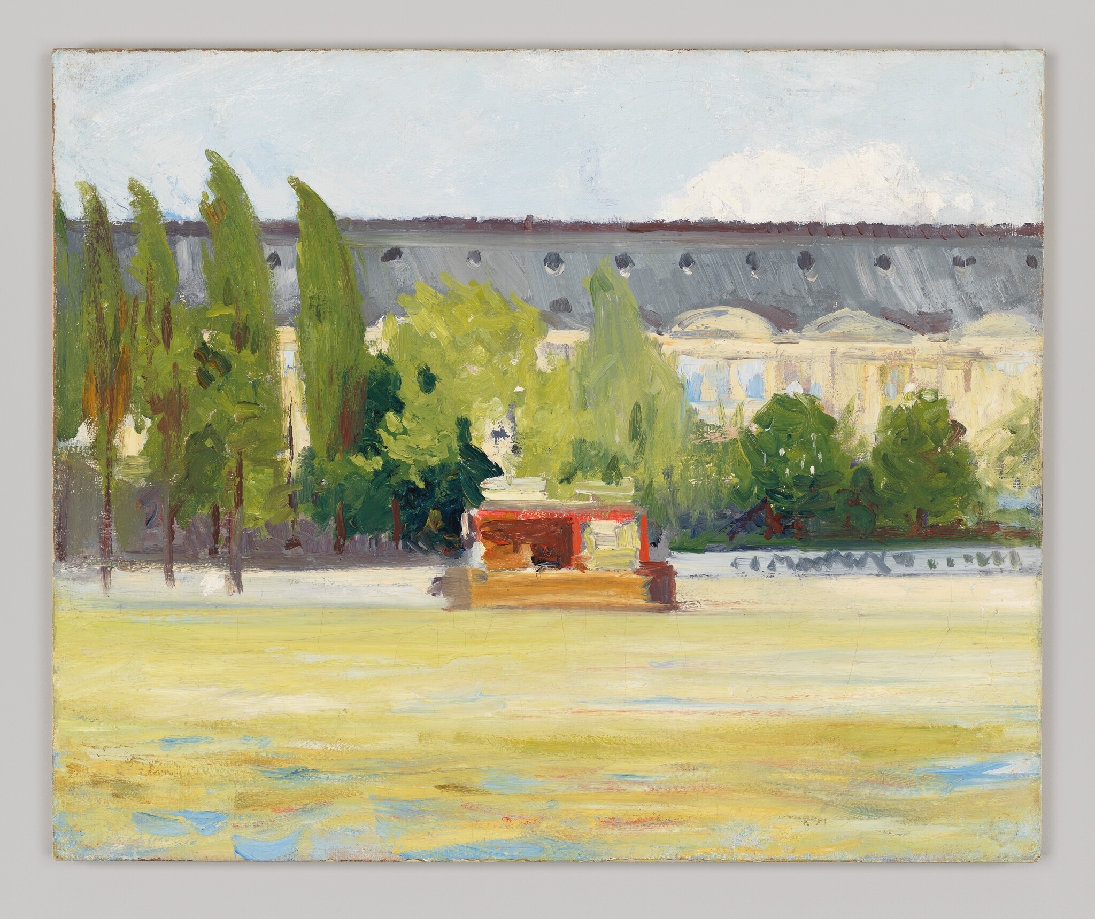
Louvre and Boat Landing, 1907, Oil on canvas, 60 × 73 cm, Whitney Museum of American Art, NY, USA https://whitney.org/collection/works/6094

Slide 17
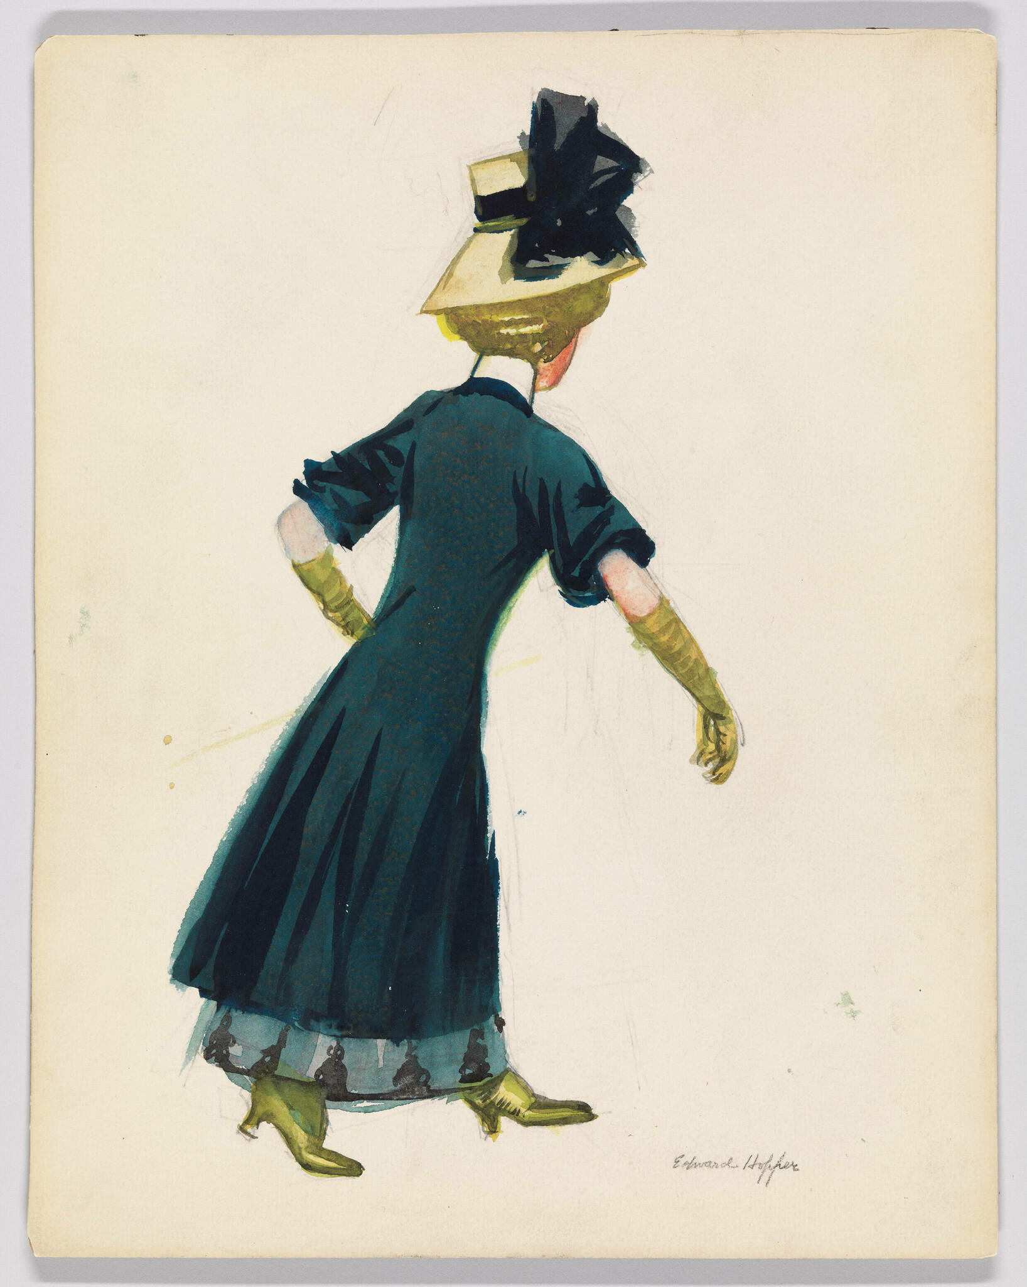
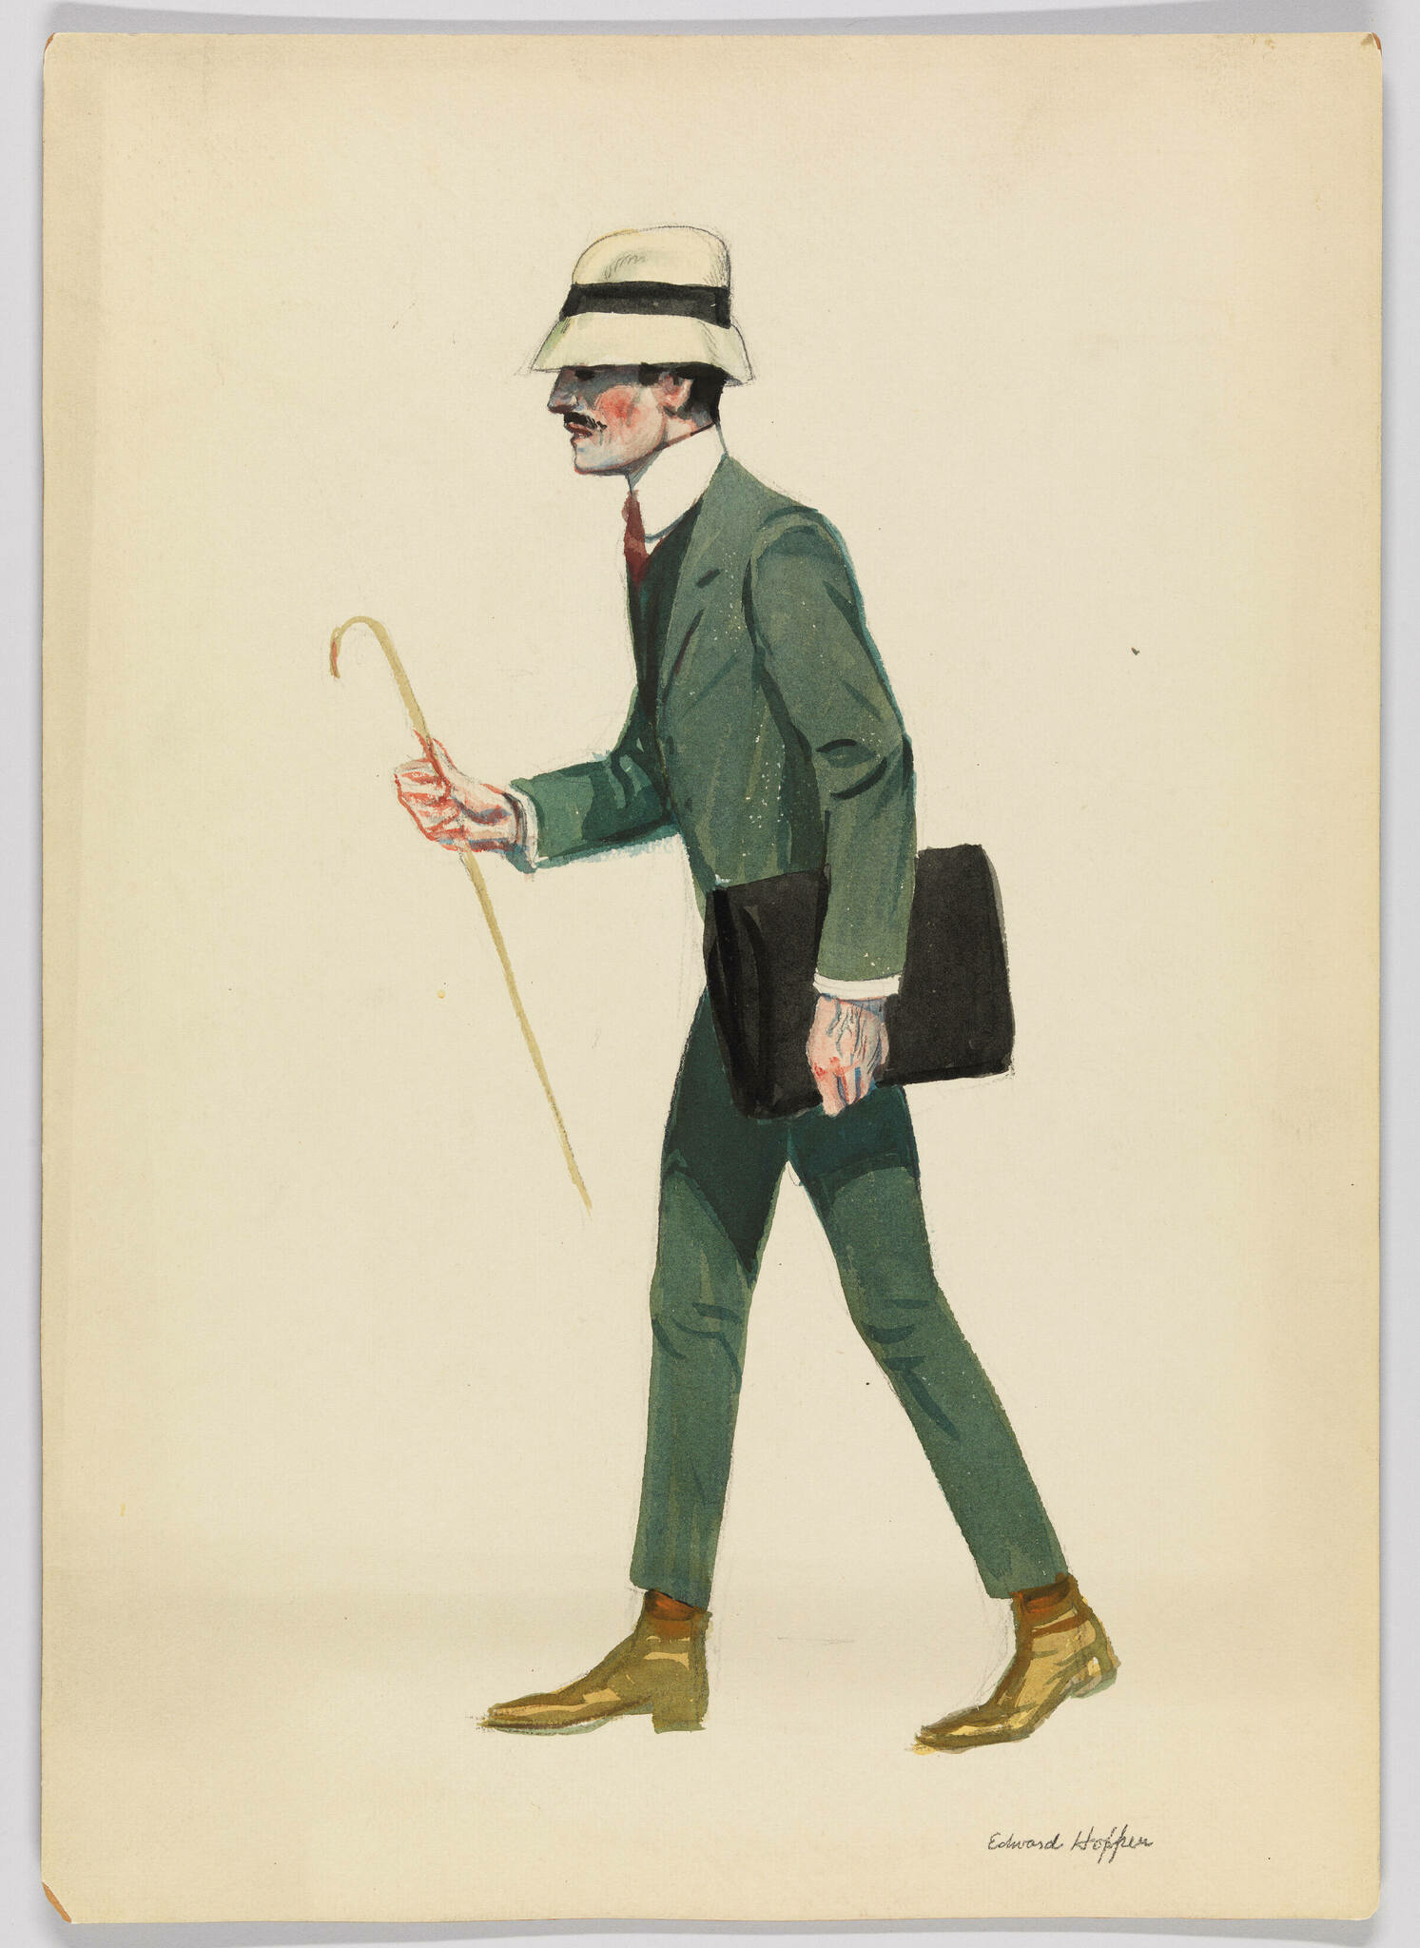
Parisian Woman Walking, 1906–1907, Watercolor and graphite pencil on board, 30.2 × 23.8 cm, Whitney Museum of American Art, NY, USA https://whitney.org/collection/works/6898
Walking Man with Cane and Briefcase, 1906–1907, Watercolor and graphite pencil on board, 37.9 × 27 cm, Whitney Museum of American Art, NY, USA https://whitney.org/collection/works/6903

Slide 18
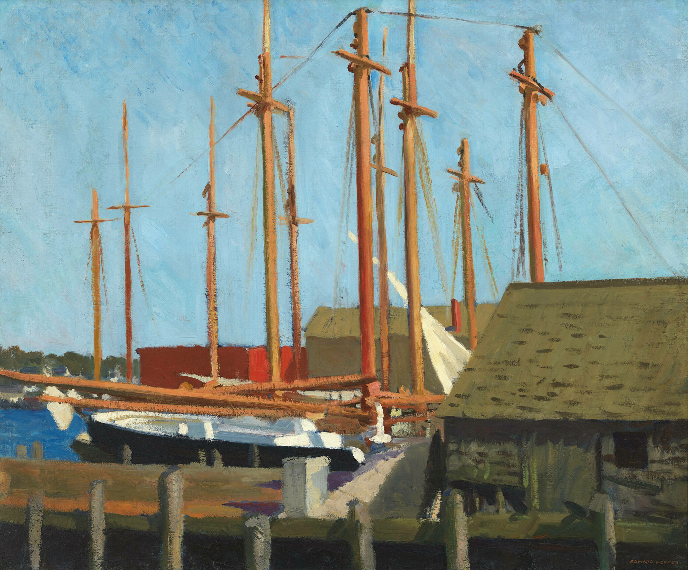
Tall Masts,
1912, Oil on canvas, 61.6 × 74.3 cm,
Whitney Museum of American Art, NY, USA https://whitney.org/collection/works/5828

Slide 19
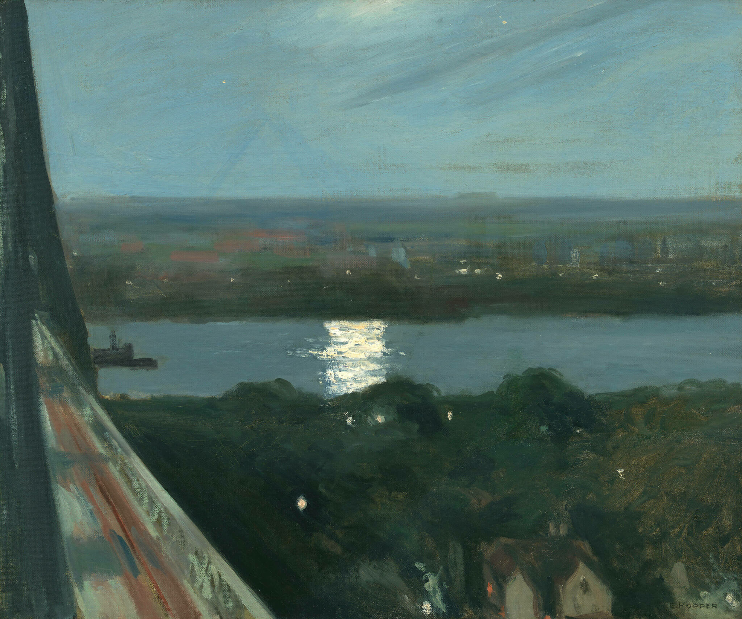
Blackwell's Island, 1911, Oil on canvas, 61.9 × 74.5 cm, Whitney Museum of American Art, NY, USA https://whitney.org/collection/works/5899

Slide 20
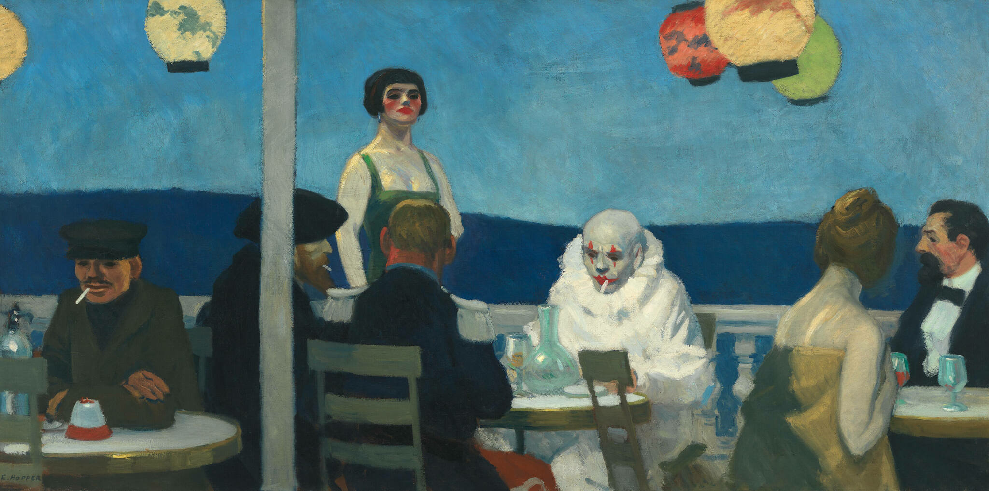
Soir Bleu, 1914, Oil on canvas, 91.8 × 182.7 cm, Whitney Museum of American Art, NY, USA https://whitney.org/collection/works/6081

Slide 21
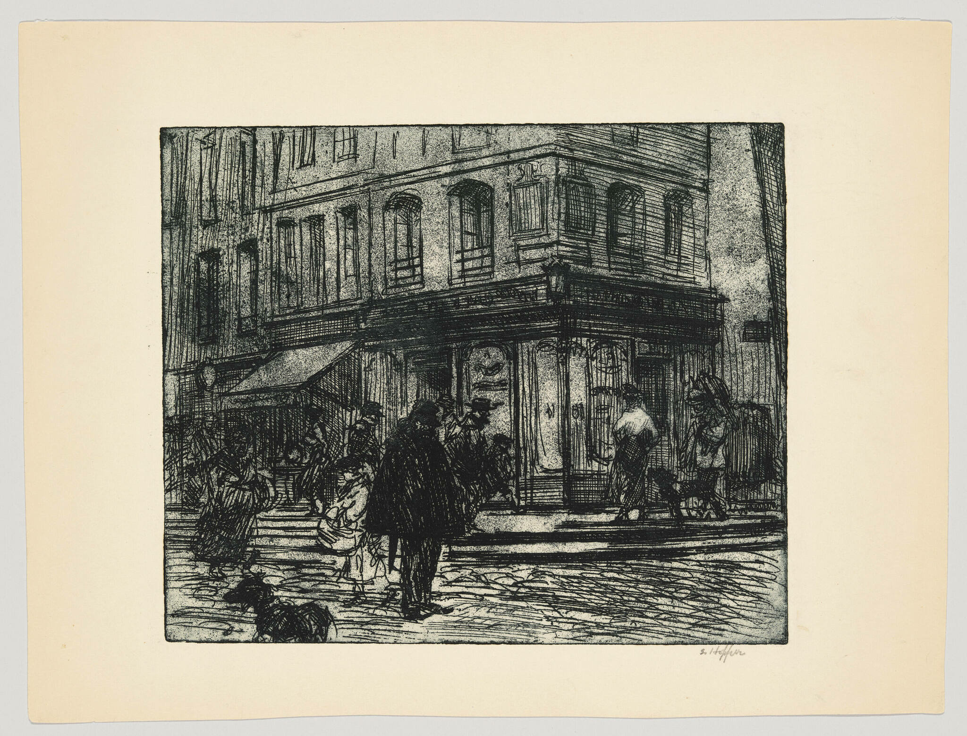
Street in Paris, 1915–1918, Etching and aquatint, Sheet (Irregular): 27 × 35.2 cm, Plate: 20 × 24.1 cm, Whitney Museum of American Art, NY, USA https://whitney.org/collection/works/7035

Slide 22
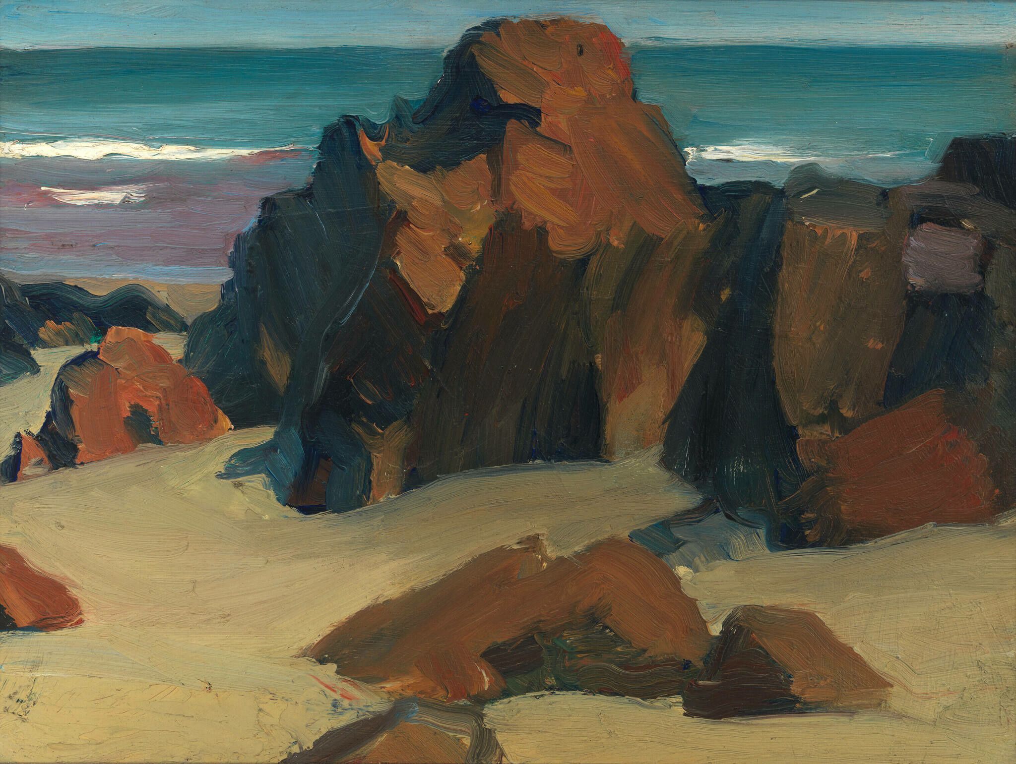
Rocks and Sand, 1916, Oil on paperboard, 24.4 × 33 cm, Whitney Museum of American Art, NY, USA https://whitney.org/collection/works/5864

Slide 23
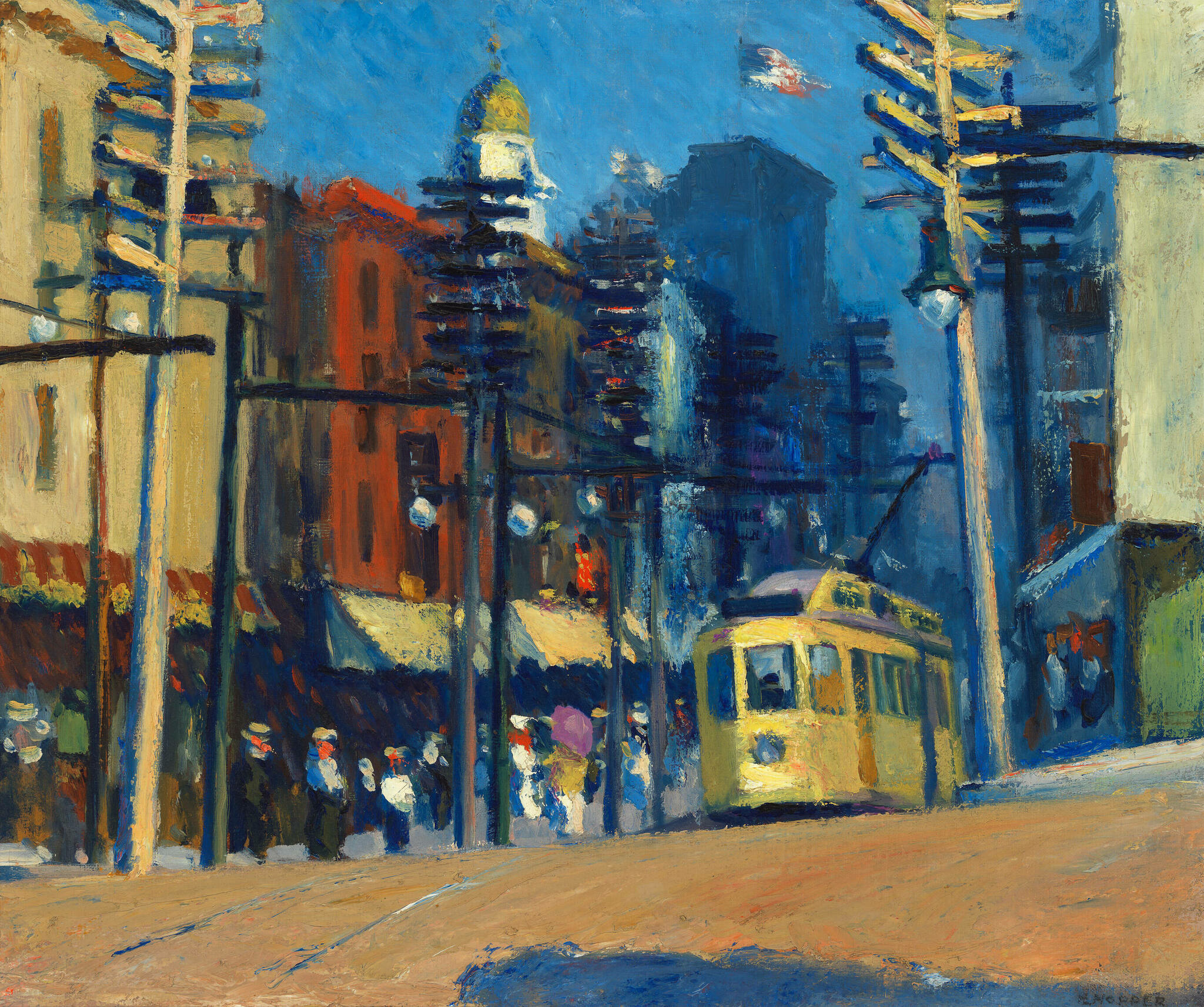
Yonkers, 1916, Oil on canvas, 61.8 × 74.1 cm, Whitney Museum of American Art, NY, USA https://whitney.org/collection/works/6086

Slide 24
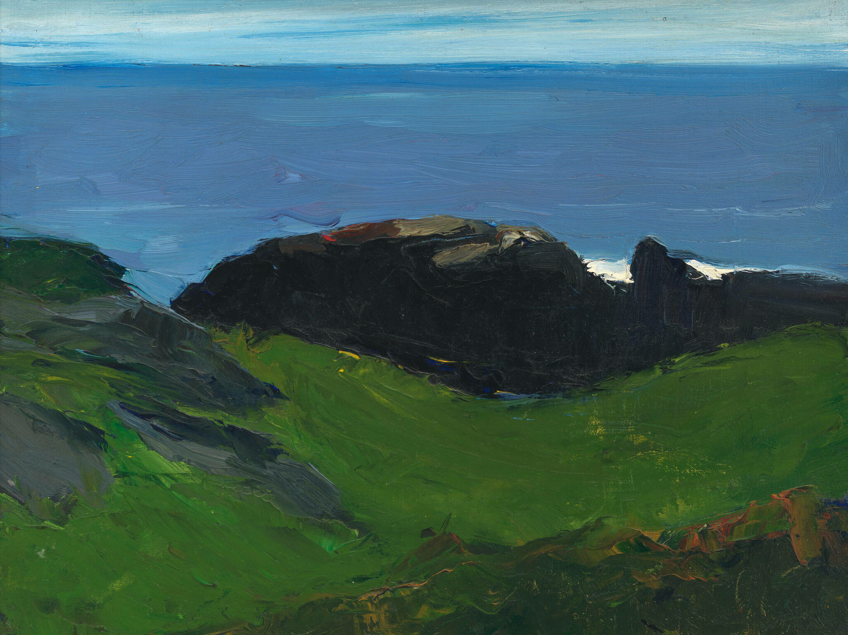
Sea and Shore, 1916–1919, Oil on canvas board, 24.3 × 32.7 cm, Whitney Museum of American Art, NY, USA https://whitney.org/collection/works/6120

Slide 25
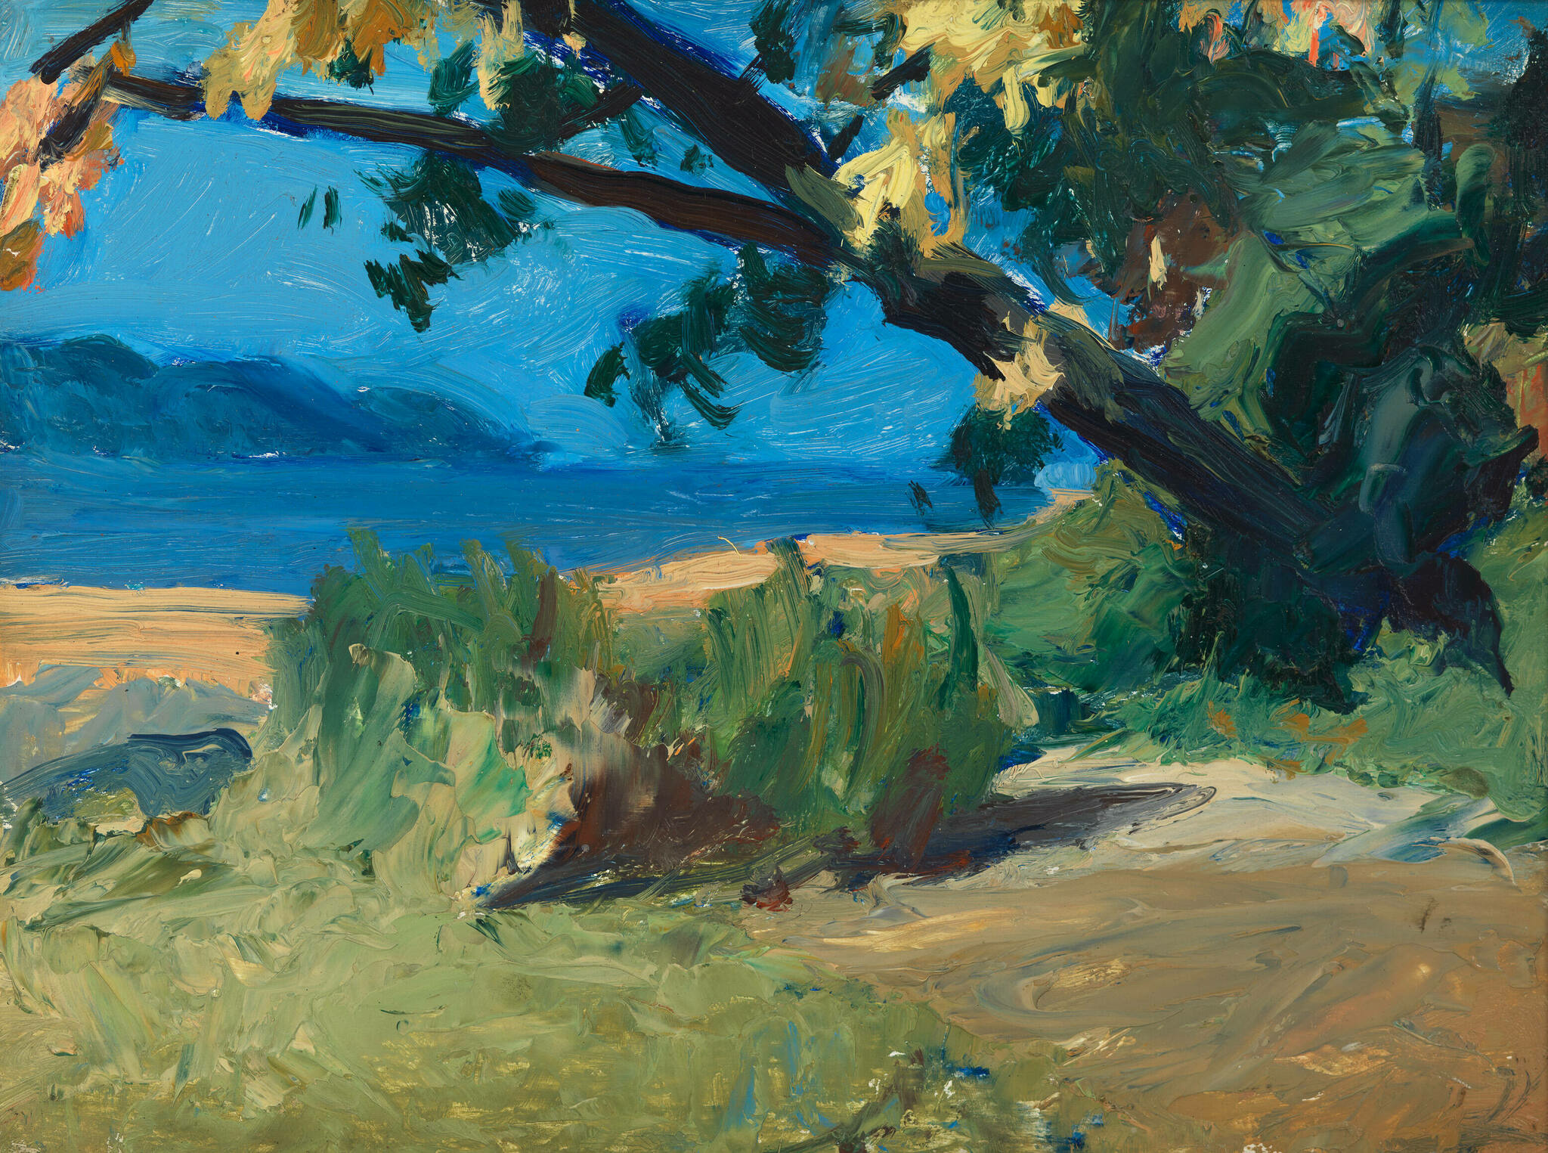
Trees and Beach, 1916–1919, Oil on wood, 24.1 × 33 cm, Whitney Museum of American Art, NY, USA https://whitney.org/collection/works/6109

Slide 26
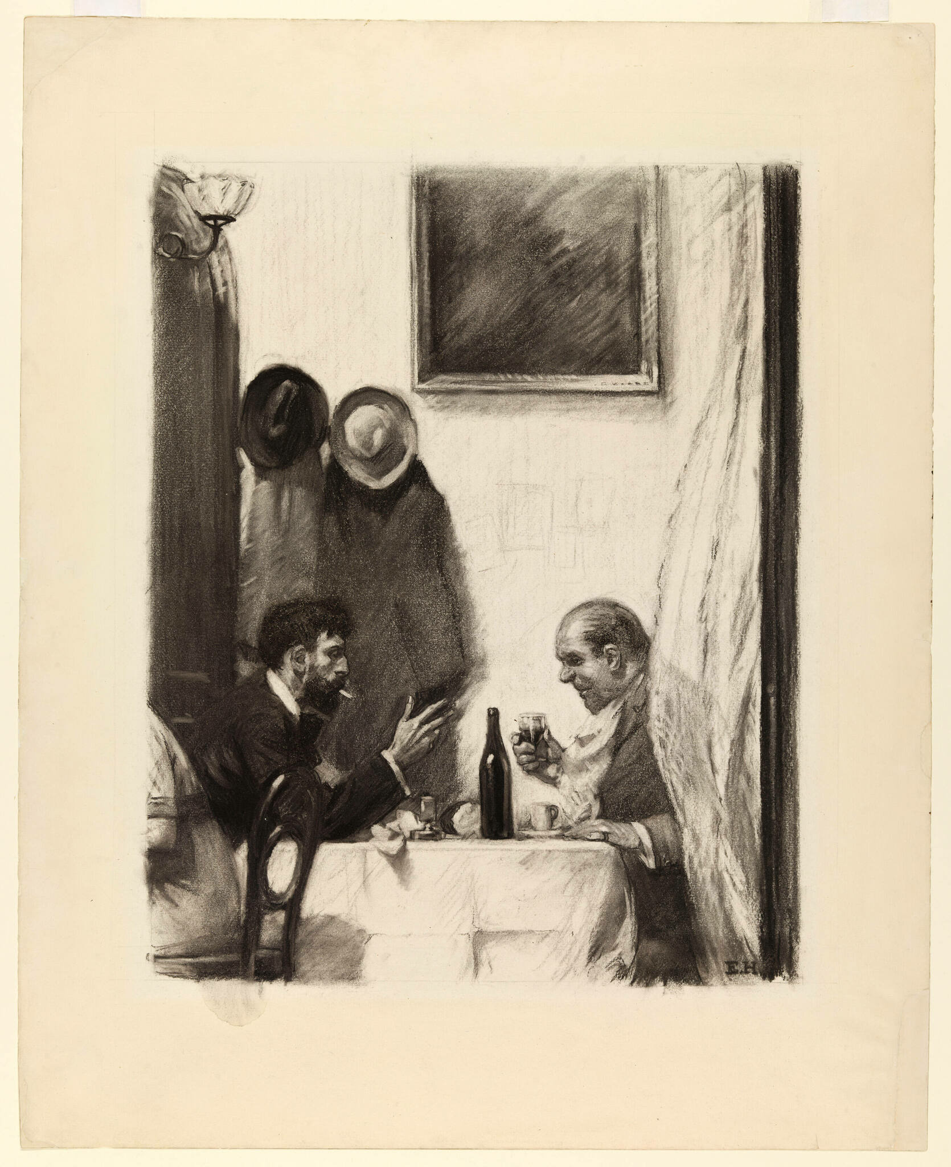
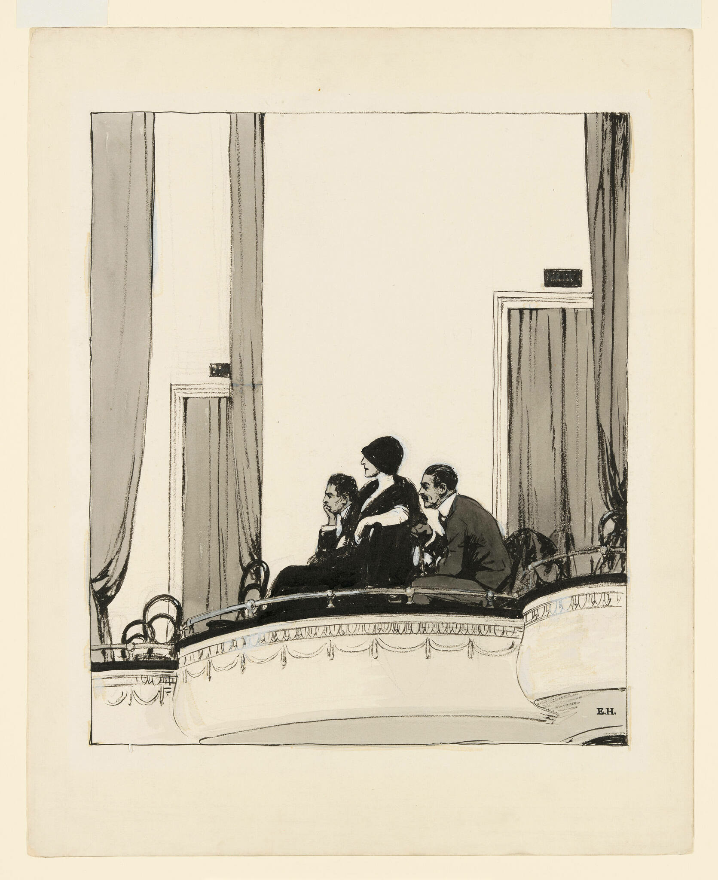
In a Restaurant, c. 1916–1925, Charcoal on paper, 67.8 × 54.9 cm, Whitney Museum of American Art, BY, USA https://whitney.org/collection/works/8949
At the Theater, c. 1916–1922, Brush and ink and wash, opaque watercolor and fabricated chalk on paper, 47 × 37.8 cm, Whitney Museum of American Art, NY, USA https://whitney.org/collection/works/7641

Slide 27
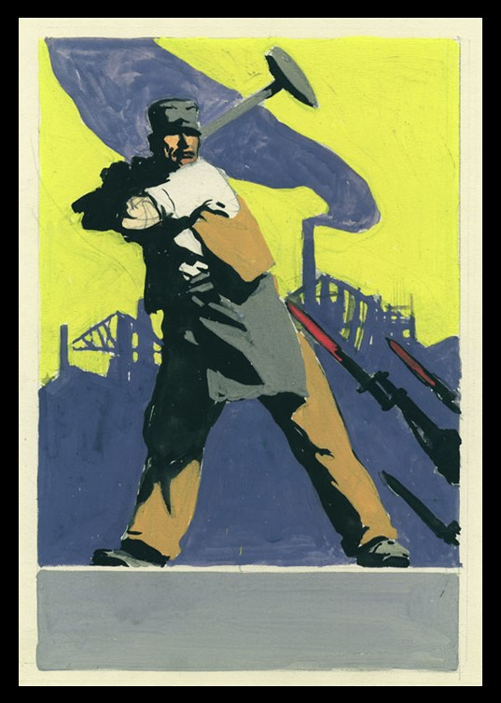
Study for Smash the Hun, 1918, created for WWI propaganda poster sponsored by the Unites States Shipping Board Emergency Fleet Corporation in 1918. The four-colour poster won Hopper the first prize among fourteen hundred contestants. Smash the Hun appeared on the cover of the Morse Dry Dock Dial for February 1919. https://rockwellcenter.org/wp-content/uploads/2011/06/Study-for-Smash-1918.jpg

Slide 28
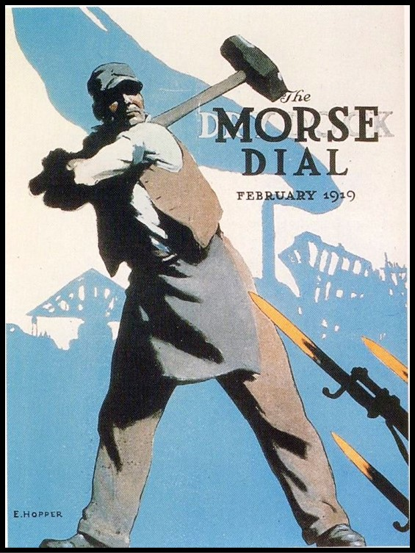
Smash the Hun, 1918, WWI poster by Edward Hopper for the in-house magazine of the Morse Dry Dock and Repair Company in Brooklyn, where Hopper worked as an illustrator (Issue of Feb 1919) https://rockwellcenter.org/wp-content/uploads/2011/06/Hopper-Smash-the-Hun1.jpg

Slide 29
Eward Hopper, 1882–1967
The End

