Slide 1
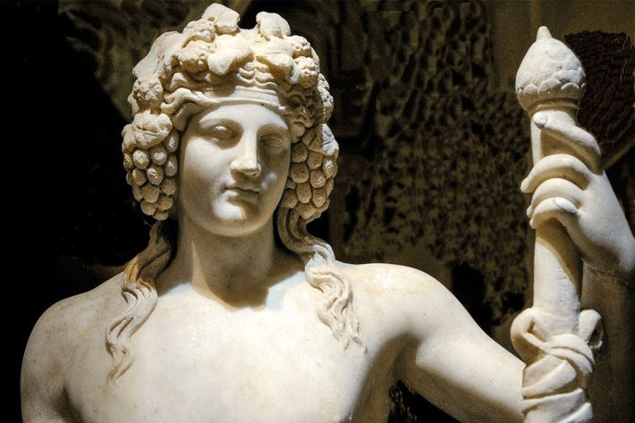
Dionysus riding a Panther or a Tiger tps://www.nationalgeographic.co.uk/history-and-civilisation/2022/05/dionysus-greek-god-of-wine-and-revelry-was-more-than-just-a-party-god

Slide 2
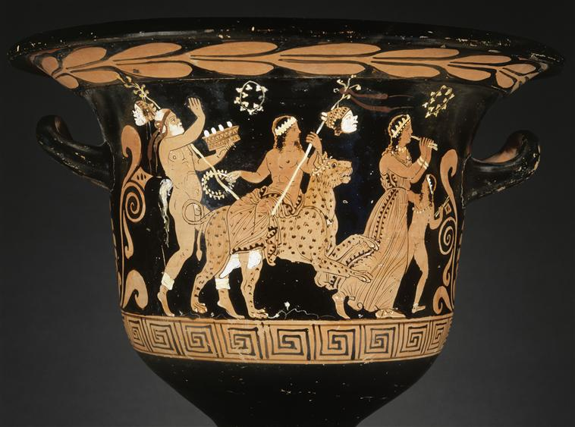
Red Figure Bell-Krater with Dionysian procession, Dionysos riding a panther, Papposilene, maenad (Side A), Woman, goose and Eros (Side B), around 370 BC, H. 0.395m, D. 0.43m, Louvre Museum, Paris, France https://www.photo.rmn.fr/archive/95-022026-2C6NU0NINB6W.html

Slide 3
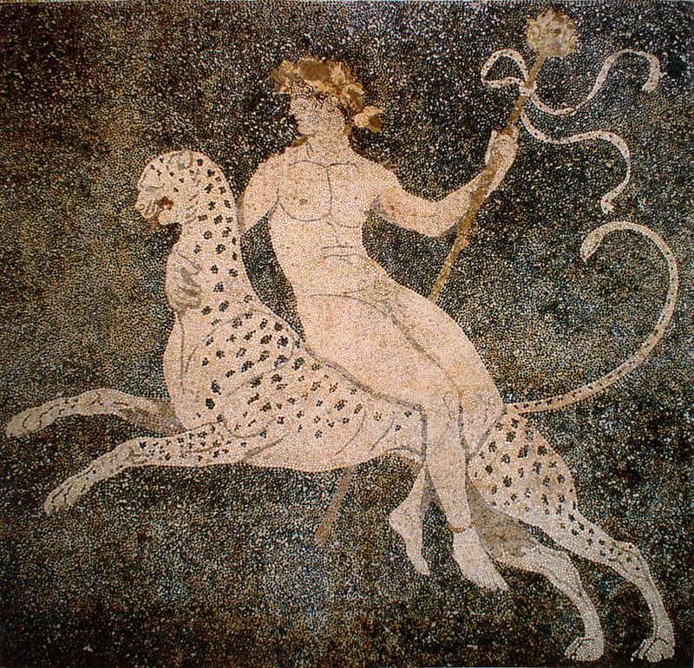
Dionysus riding a Panther, 325-300 BC, Pepple Floor Mosaic, 2.72 x 2.69 m, Pella Archaeological Museum, Greece https://commons.wikimedia.org/wiki/File:Dionysos_mosaic_from_Pella.jpg

Slide 4
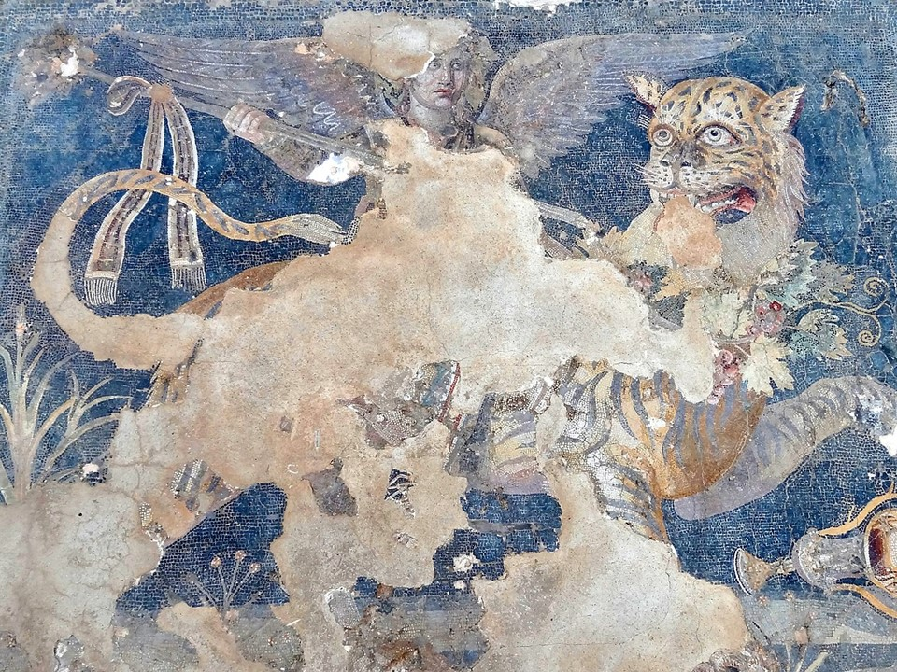
House of Dionysos, Epiphany of Dionysos, 2nd century BC, Floor Mosaic, glass, faience, terracotta, and natural stonesDelos Island, Greece https://en.wikipedia.org/wiki/Mosaics_of_Delos#/media/File:Delos_Museum_Mosaik_Dionysos_05.jpg

Slide 5
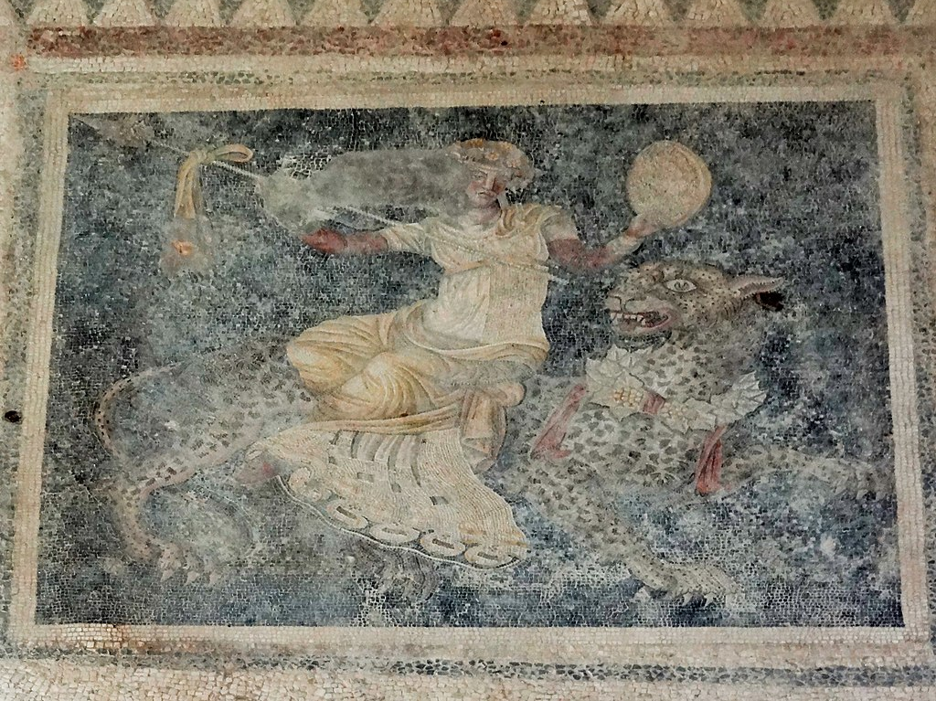
House of Masks, Dionysus riding a Panther, 120-80 BC, Floor Mosaic, glass, faience, terracotta, and natural stones, Delos Island, Greece https://romeartlover.tripod.com/Delo2.html

Slide 6
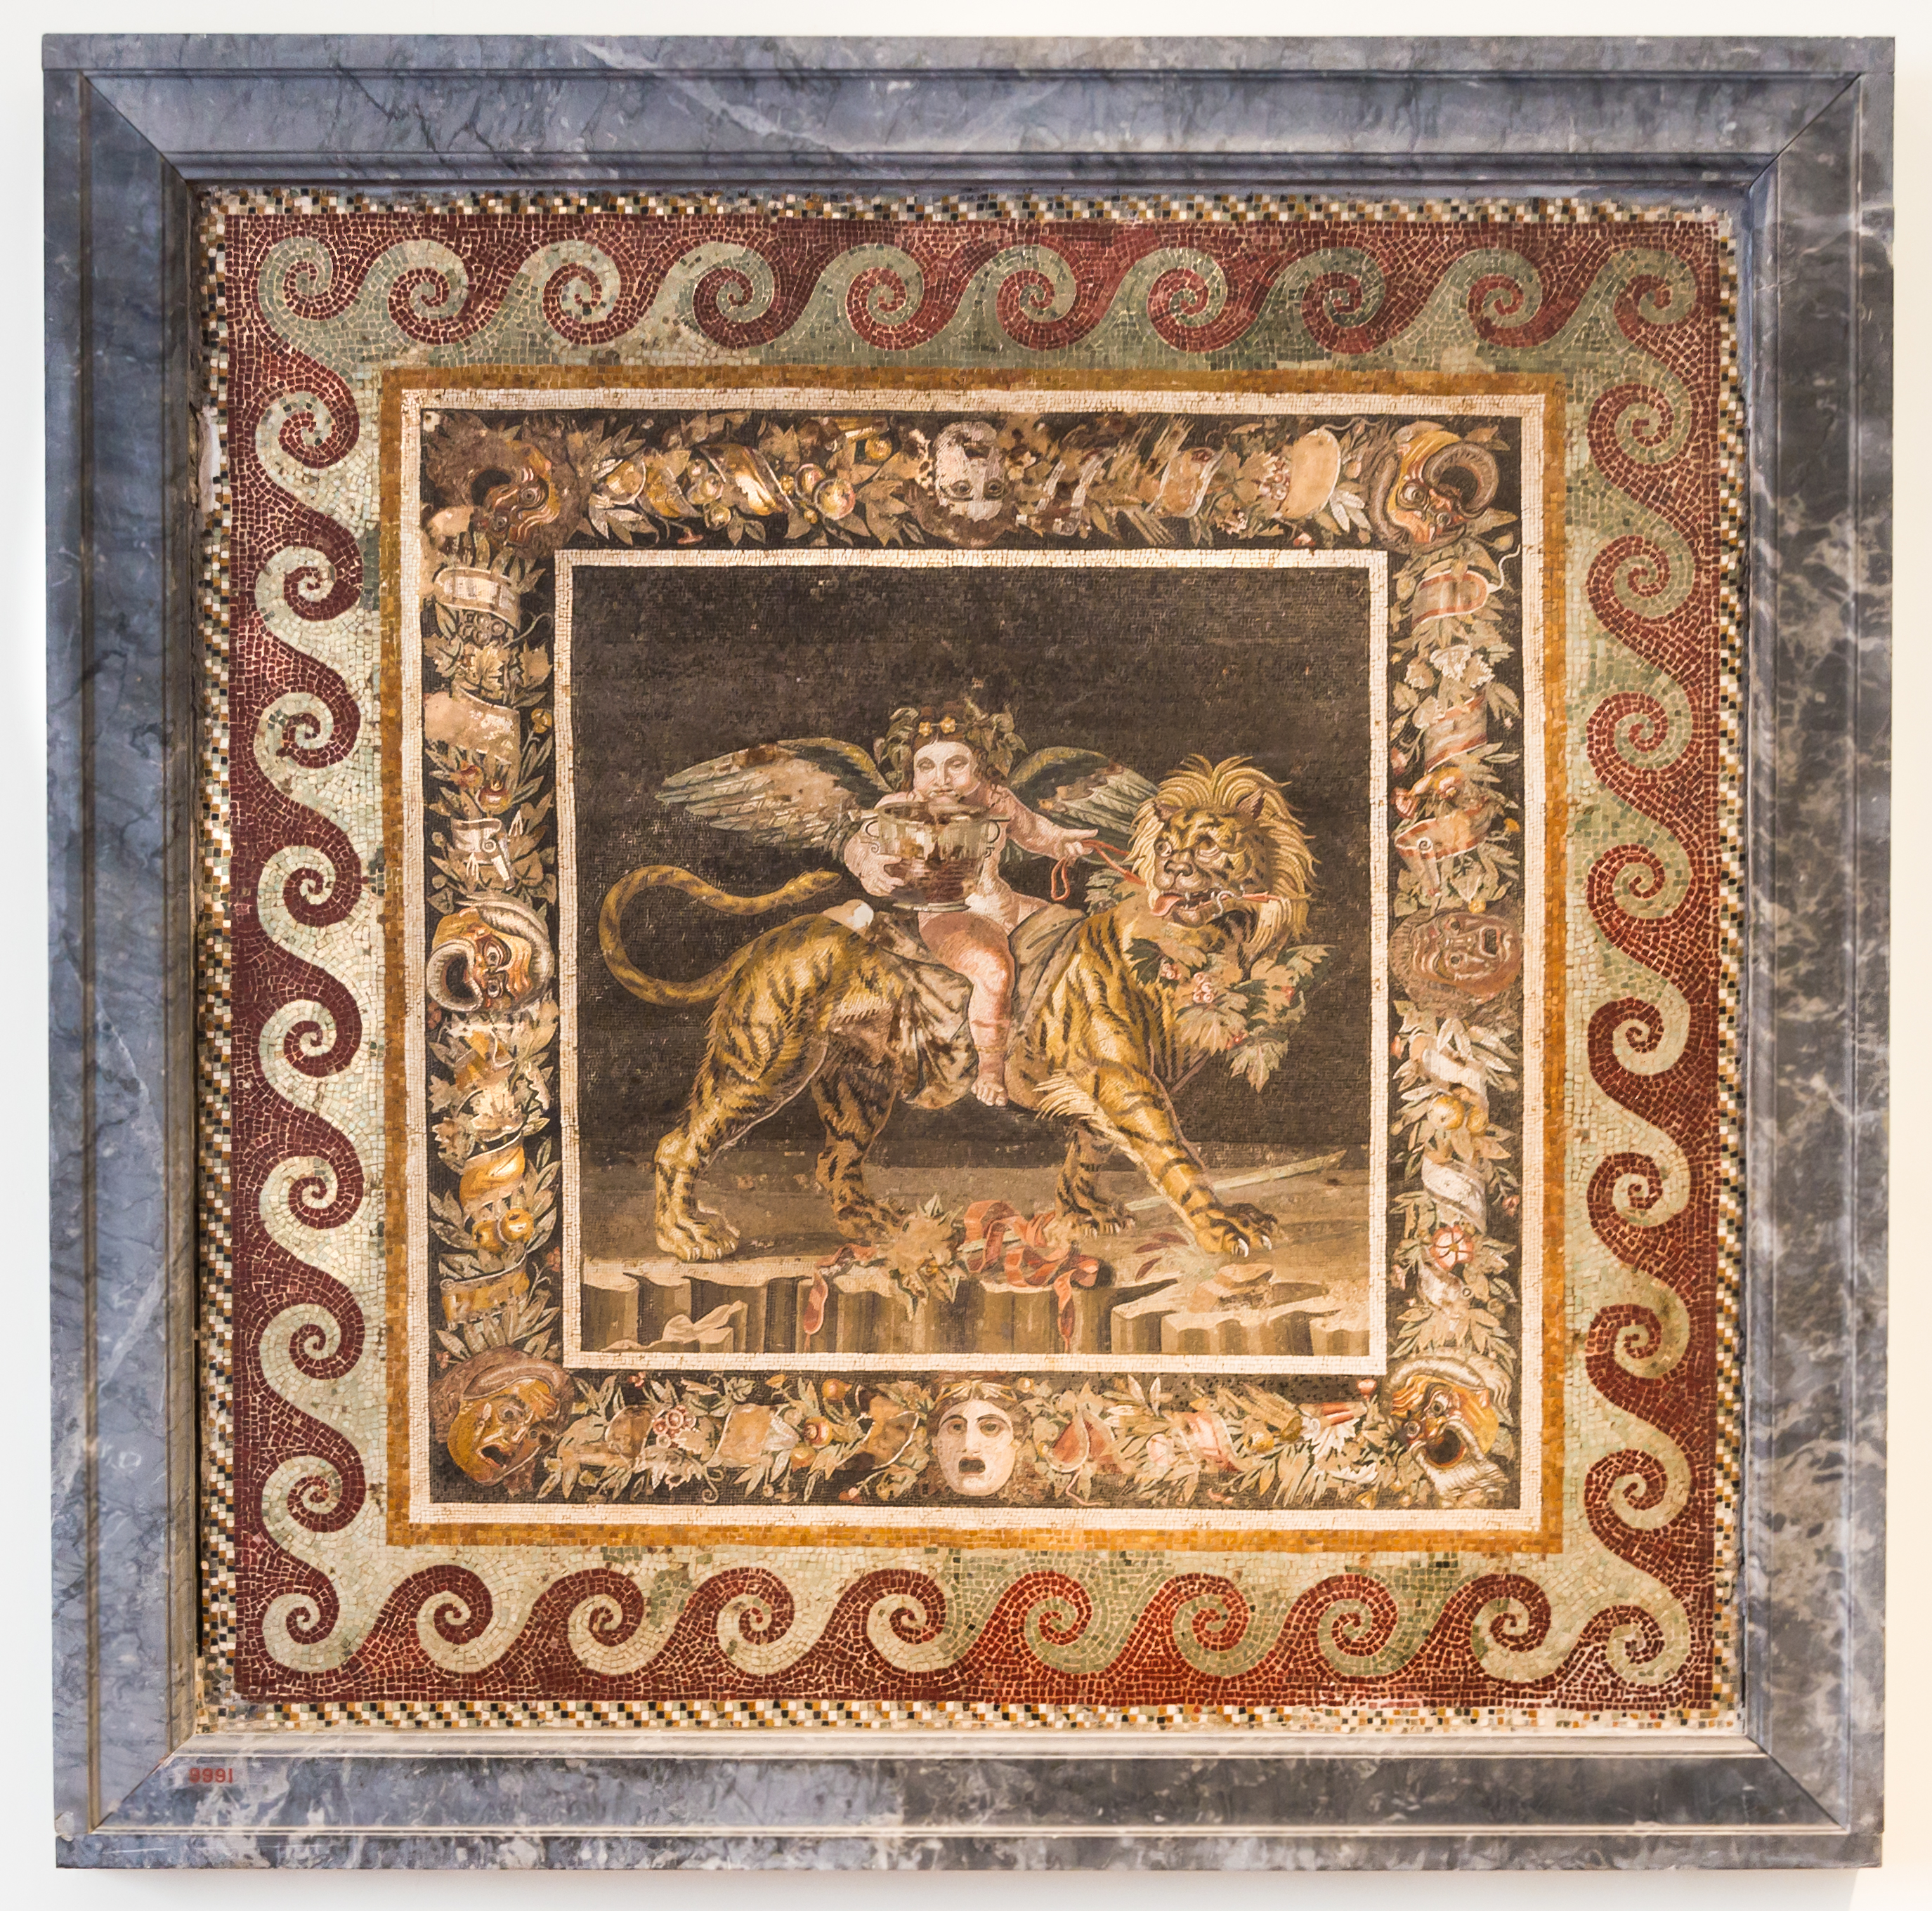
House of the Faun, Young Dionysus riding a Tiger, 1st century AD, Floor Mosaic, 165x165 cm, from Pompeii, Naples National Archaeological Museum, Italy https://www.nationalgeographic.co.uk/history-and-civilisation/2022/05/dionysus-greek-god-of-wine-and-revelry-was-more-than-just-a-party-god

Slide 7
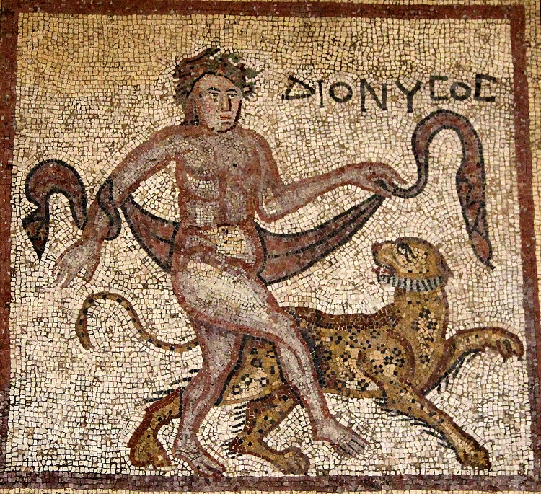
Dionysus with a Panther,4th cent. AD, Floor Mosaic panel, 1.4x1.36 m, British Museum, London, UK https://www.worldhistory.org/image/3367/dionysos-with-panther/

Slide 8
The End tps://www.nationalgeographic.co.uk/history-and-civilisation/2022/05/dionysus-greek-god-of-wine-and-revelry-was-more-than-just-a-party-god

