Slide 1
Frederic Edwin Church, 1826–1900
Athens, April 1869

Slide 2
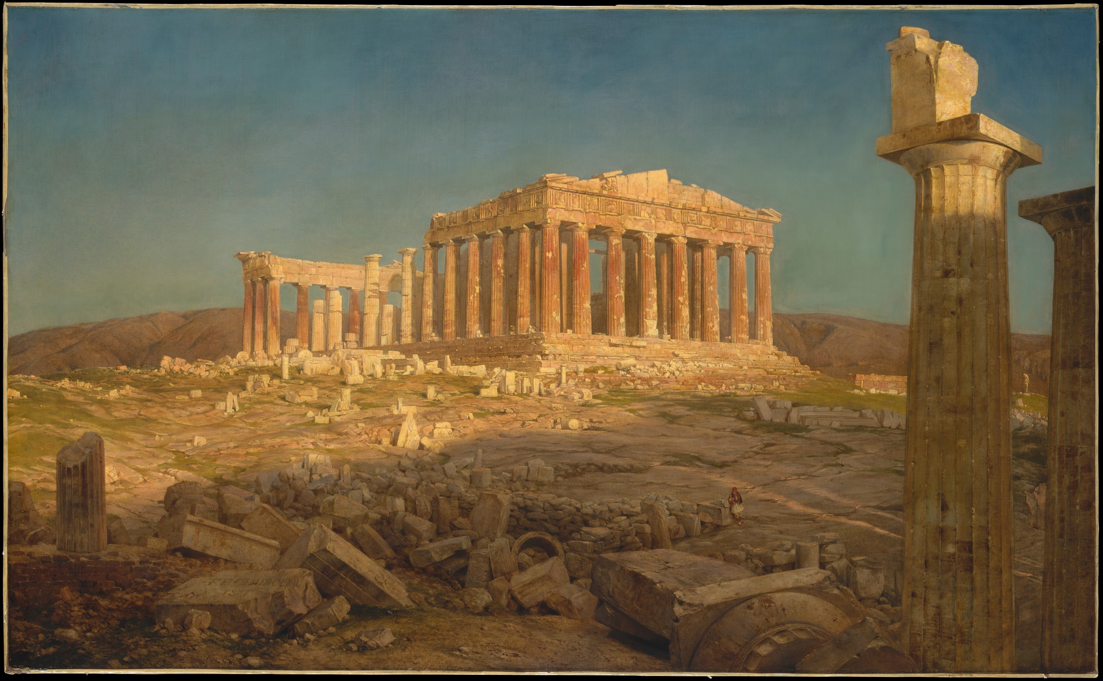
The Parthenon, 1871, Oil on Canvas,
113 x 184.5 cm, The MET, NY, USA https://www.metmuseum.org/art/collection/search/10482

Slide 3
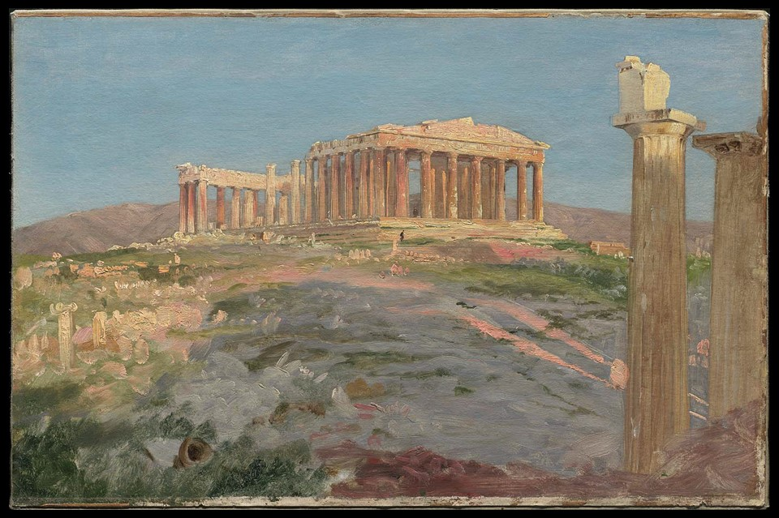
Study for "The Parthenon", 1869-70, Oil on Paper mounted on Canvas, 33 x 50.8 cm, MFA, Boston, USA https://upload.wikimedia.org/wikipedia/commons/6/69/Frederic_Edwin_Church_-_Study_for_%22The_Parthenon%22_-_2008.48_-_Museum_of_Fine_Arts.jpg

Slide 4
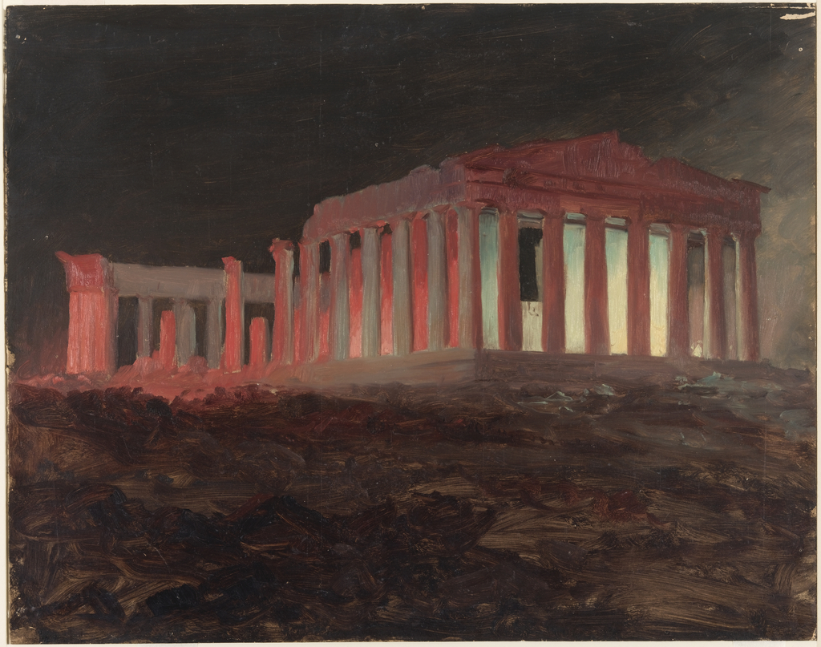
Parthenon, Athens, from the Northwest (Illuminated Night View), April 1869, Brush and Oil, black Chalk on thin cream Paperboard, 32.9 × 41.4 cm, Cooper Hewitt, NY, USA https://collection.cooperhewitt.org/objects/18200507/

Slide 5
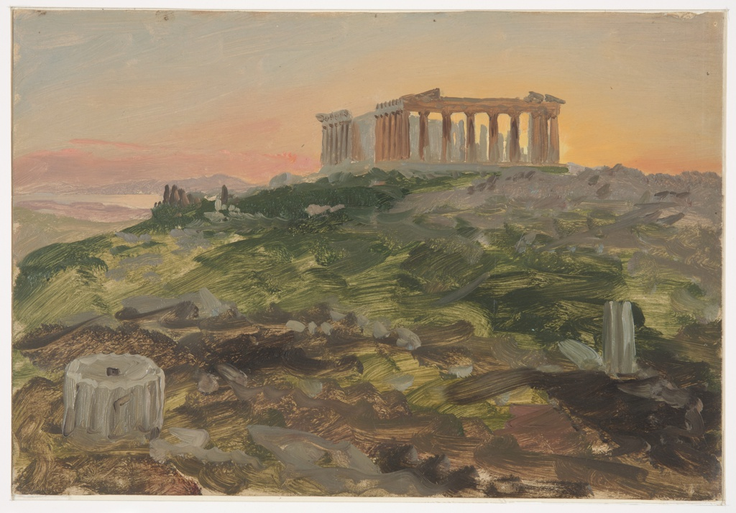
Parthenon, Athens, from the Southeast (Illuminated Night View), April 1869, Brush and Oil, Graphite traces on Paperboard, 22.5 x 32.8 cm, Cooper Hewitt, NY, USA https://collection.cooperhewitt.org/objects/18198973/

Slide 6
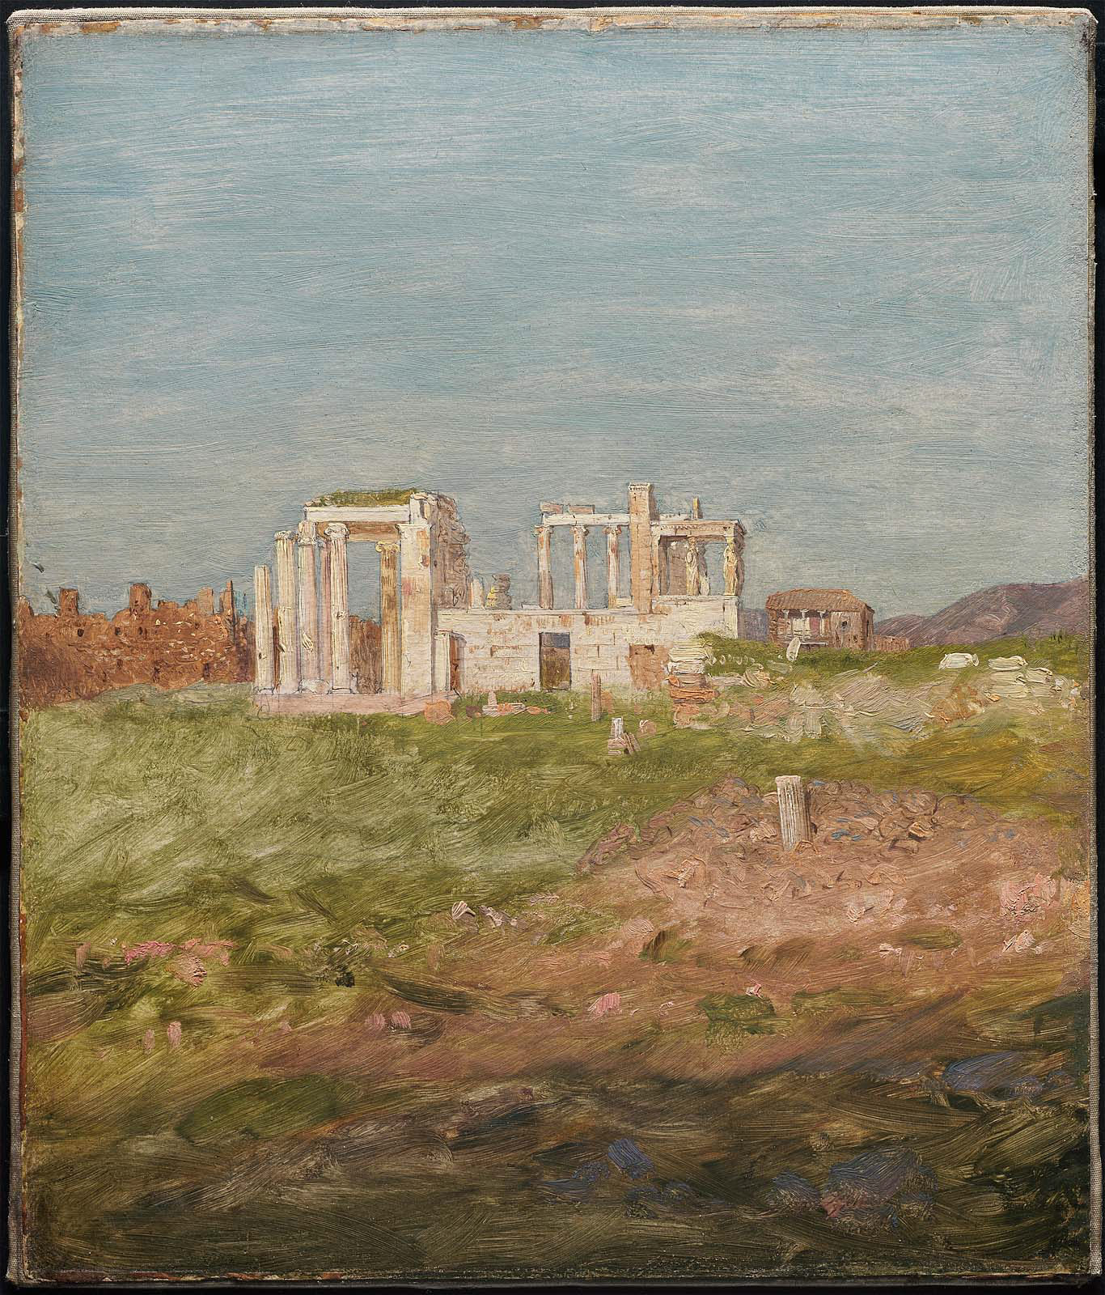
Erechtheum, 1869-70, Oil on paper mounted on canvas, 33 x 27.9 cm, MFA, Boston, USA https://commons.wikimedia.org/wiki/File:Frederic_Edwin_Church_-_Erechtheum_-_2008.47_-_Museum_of_Fine_Arts.jpg

Slide 7
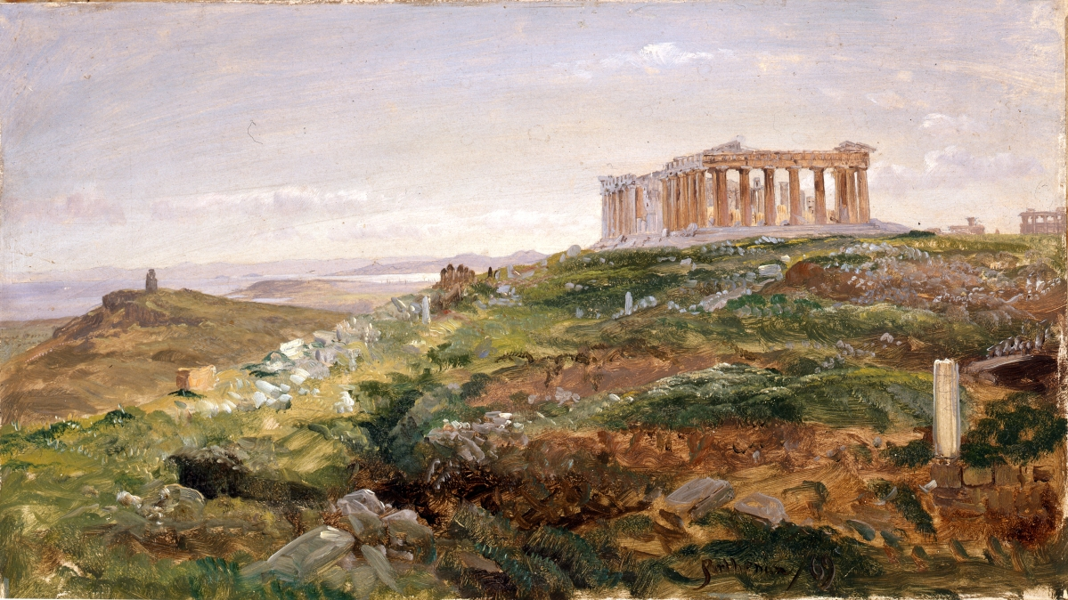
The Parthenon and the Acropolis, Athens, 1869, Oil on Paper mounted on Canvas, Olana State Historic Site, Hudson, New York State Office of Parks, Recreation and Historic Preservation, USA https://www.antiquesandthearts.com/frederic-church-a-painters-pilgrimage-wadsworth-atheneum-museum-of-art/

Slide 8
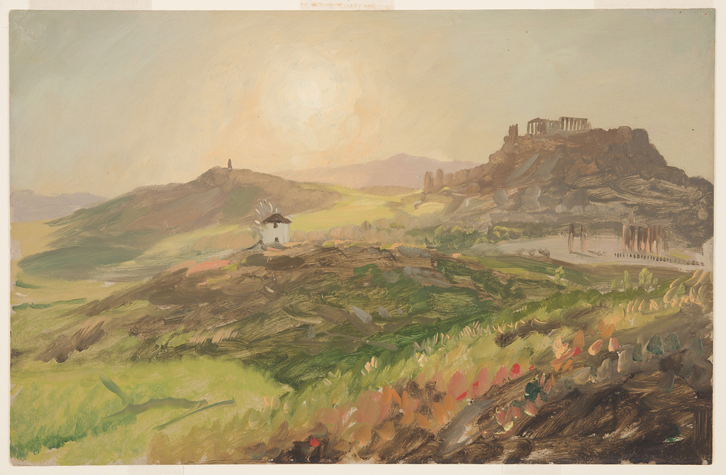
View of the Acropolis, Athens, 1869, Brush and Oil, Graphite on Cardboard; 32.9 × 50.8 cm, Cooper Hewitt, NY, USA https://collection.cooperhewitt.org/objects/18197461/

Slide 9
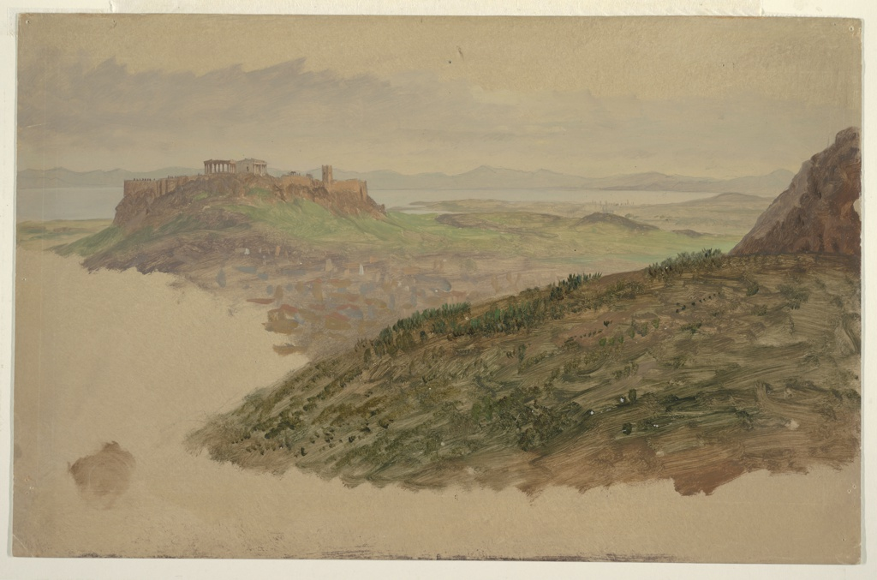
View of the Acropolis from Mount Lycabettus, Athens, April1869, Brush and Oil, Graphite on Cardboard, 33 x 51.1 cm, Cooper Hewitt, NY, USA https://collection.cooperhewitt.org/objects/18197455/

Slide 10
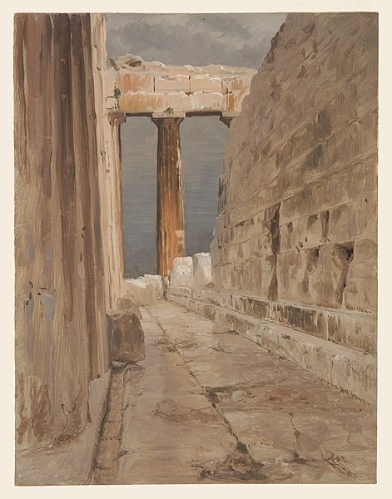
North Peristyle of the Parthenon, Athens, 1869, Brush and Oil, Graphite on thin Board, 32.9 × 25.4 cm, Cooper Hewitt, NY, USA https://commons.wikimedia.org/wiki/File:Drawing,_North_Peristyle_of_the_Parthenon,_Athens,_1869_%28CH_18199563%29.jpg

Slide 11
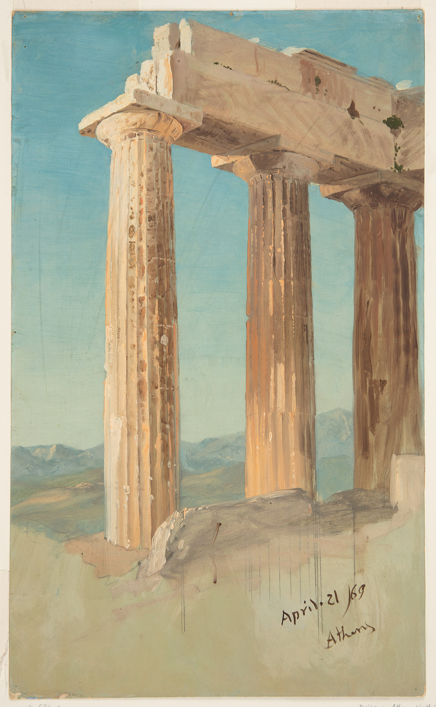
Columns of the Parthenon, April 21,1869, Brush and Oil, Graphite on green Cardboard, 50.5 × 30.6 cm, Cooper Hewitt, NY, USA https://www.si.edu/object/columns-parthenon-athens%3Achndm_1917-4-573-a

Slide 12
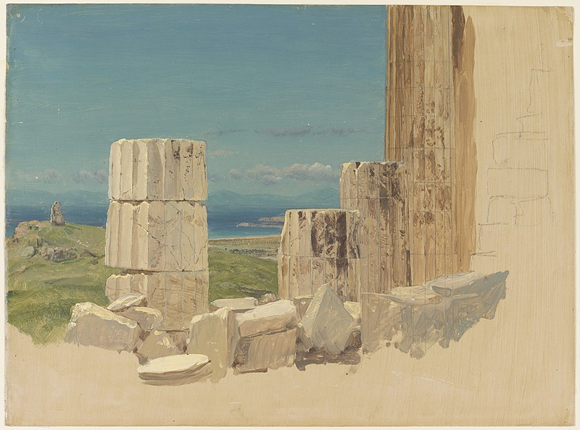
Broken Columns, View from the Parthenon, Athens, April 1869, Brush and Oil, Graphite on thin Paperboard, 28.2 × 38.2 cm, Cooper Hewitt, NY, USA https://commons.wikimedia.org/wiki/File:Drawing,_Broken_Columns,_View_from_the_Parthenon,_Athens,_April_1869_%28CH_18199569-2%29.jpg

Slide 13
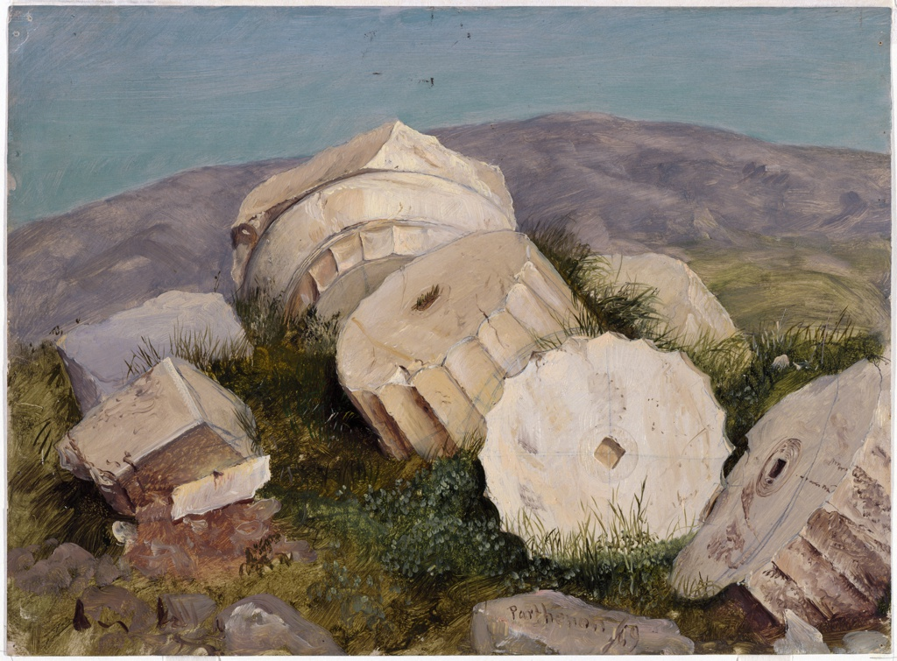
Broken Column of the Parthenon, Athens, Brush and Oil, Graphite on Paperboard; 27.9 x 38.7 cm, Cooper Hewitt, NY, USA https://collection.cooperhewitt.org/objects/18199575/

Slide 14
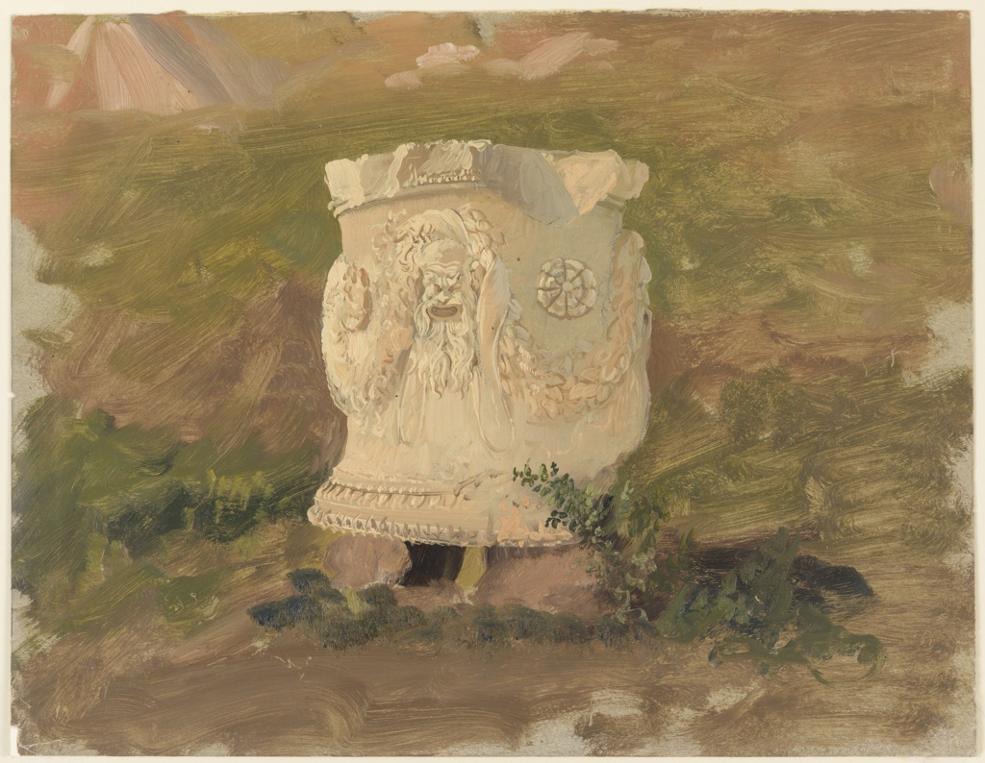
Base of a Capital, Dionysius Theatre, Athens, April 1869, Brush and Oil, Graphite on Paperboard, 48.4 × 32.9 cm, Cooper Hewitt, NY, USA https://collection.cooperhewitt.org/objects/18199657/

