Slide 1
Edward Hopper, 1882–1967
Cape Cod

Slide 2
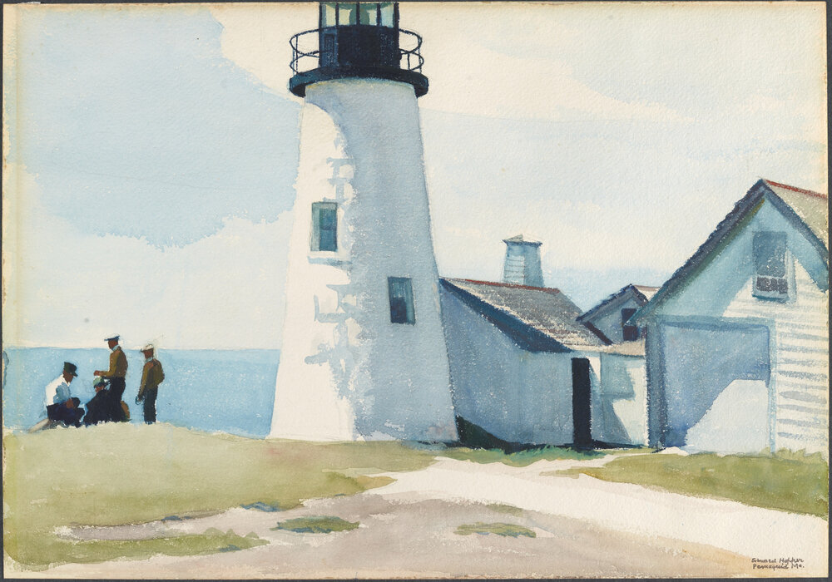
Pemaquid Light, 1929, watercolor and graphite on paper, 35.56 x 50.8 cm, Portland Museum of Art, ME, USA https://collections.portlandmuseum.org/objects-1/info?query=Portfolios%20%3D%20%221%22&sort=0&page=46

Slide 3
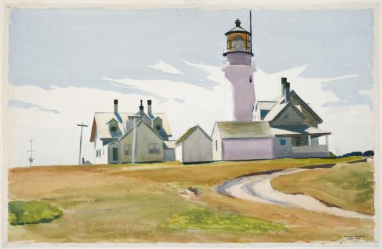
Highland Light, 1930. Watercolor over graphite on rough white wove paper. Harvard Art Museums/Fogg Museum https://harvardartmuseums.org/calendar/art-talk-live-on-cape-cod-with-edward-hopper

Slide 4
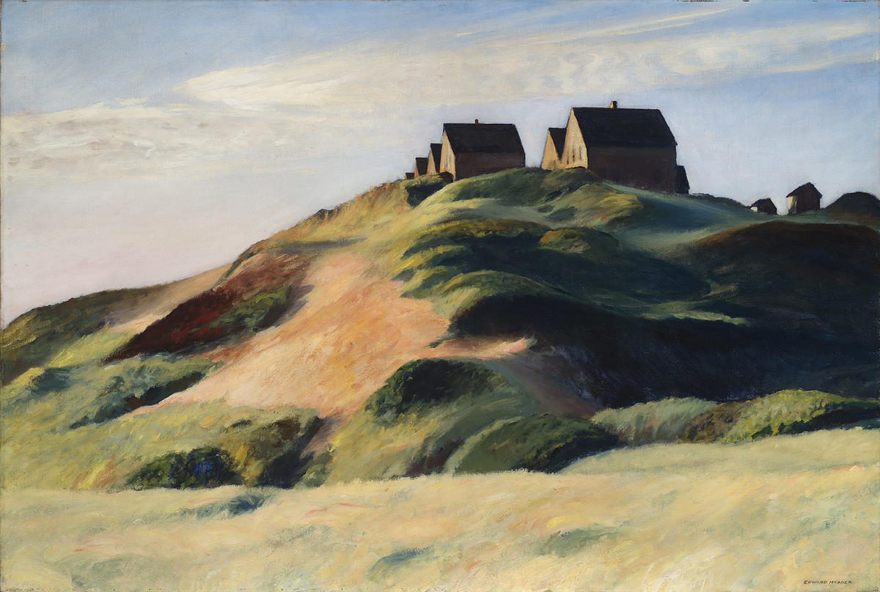
Corn Hill, 1930,oil on canvas, 72.4 x 108cm, McNay Art Museum, San Antonio, TX, USA https://collection.mcnayart.org/objects/2475/corn-hill-truro-cape-cod

Slide 5
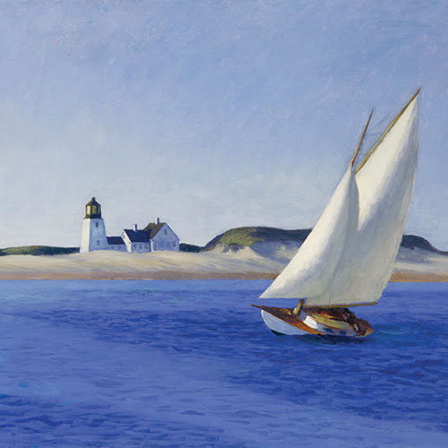
The Long Leg, c. 1930, oil on canvas, The Huntington Library, Art Museum, and Botanical Gardens, CA, USA https://www.huntington.org/long-leg

Slide 6
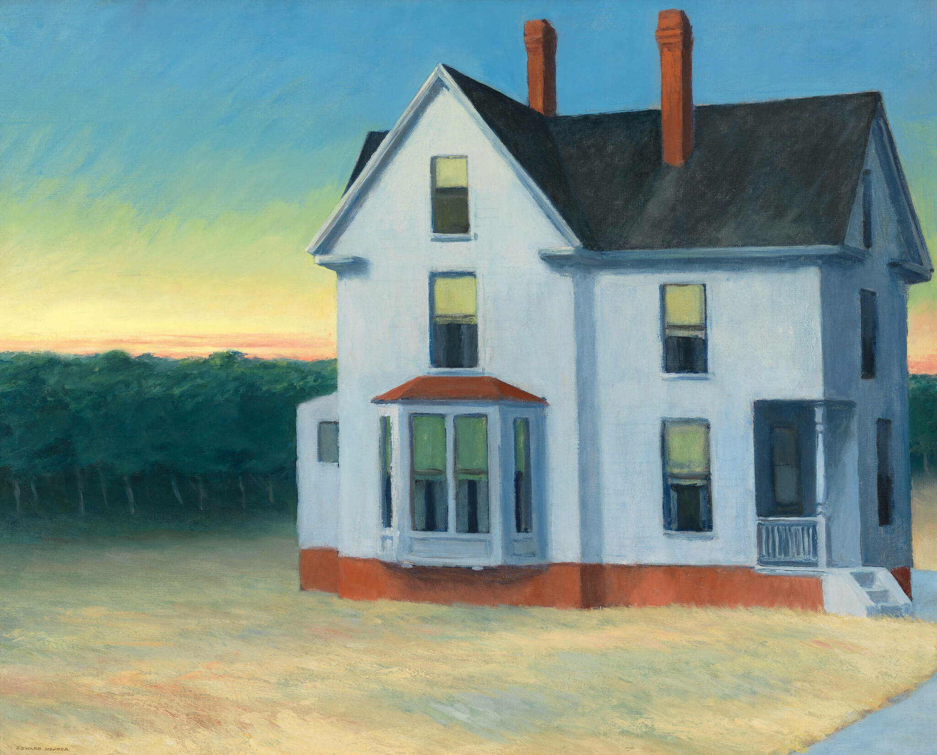
Cape Cod Sunset, 1934, oil on canvas, 74 × 92.1 cm, Whitney Museum of American Art, NY, USA https://whitney.org/collection/works/5907

Slide 7
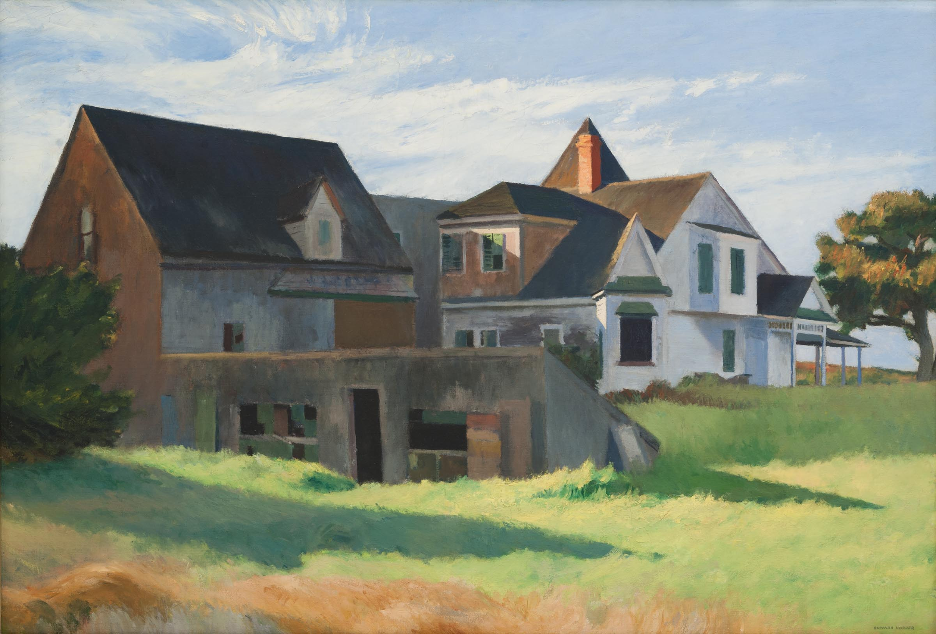
Cape Cod Afternoon, 1936, oil on canvas, 86.36 × 127.00 cm, Carnegie Museum of Art, Pittsburgh, PA, USA https://collection.cmoa.org/objects/069c2afd-1423-46eb-b1bc-fc0735e91836

Slide 8
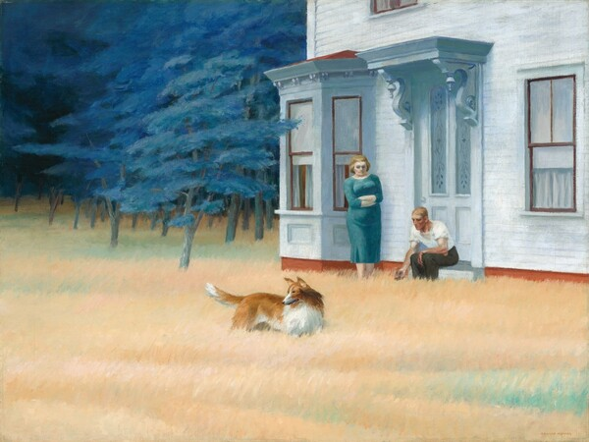
Cape Cod Evening, 1939, oil on canvas, 76.2 x 101.6 cm, NGA, Washington, DC, USA https://www.nga.gov/collection/art-object-page.61252.html

Slide 9
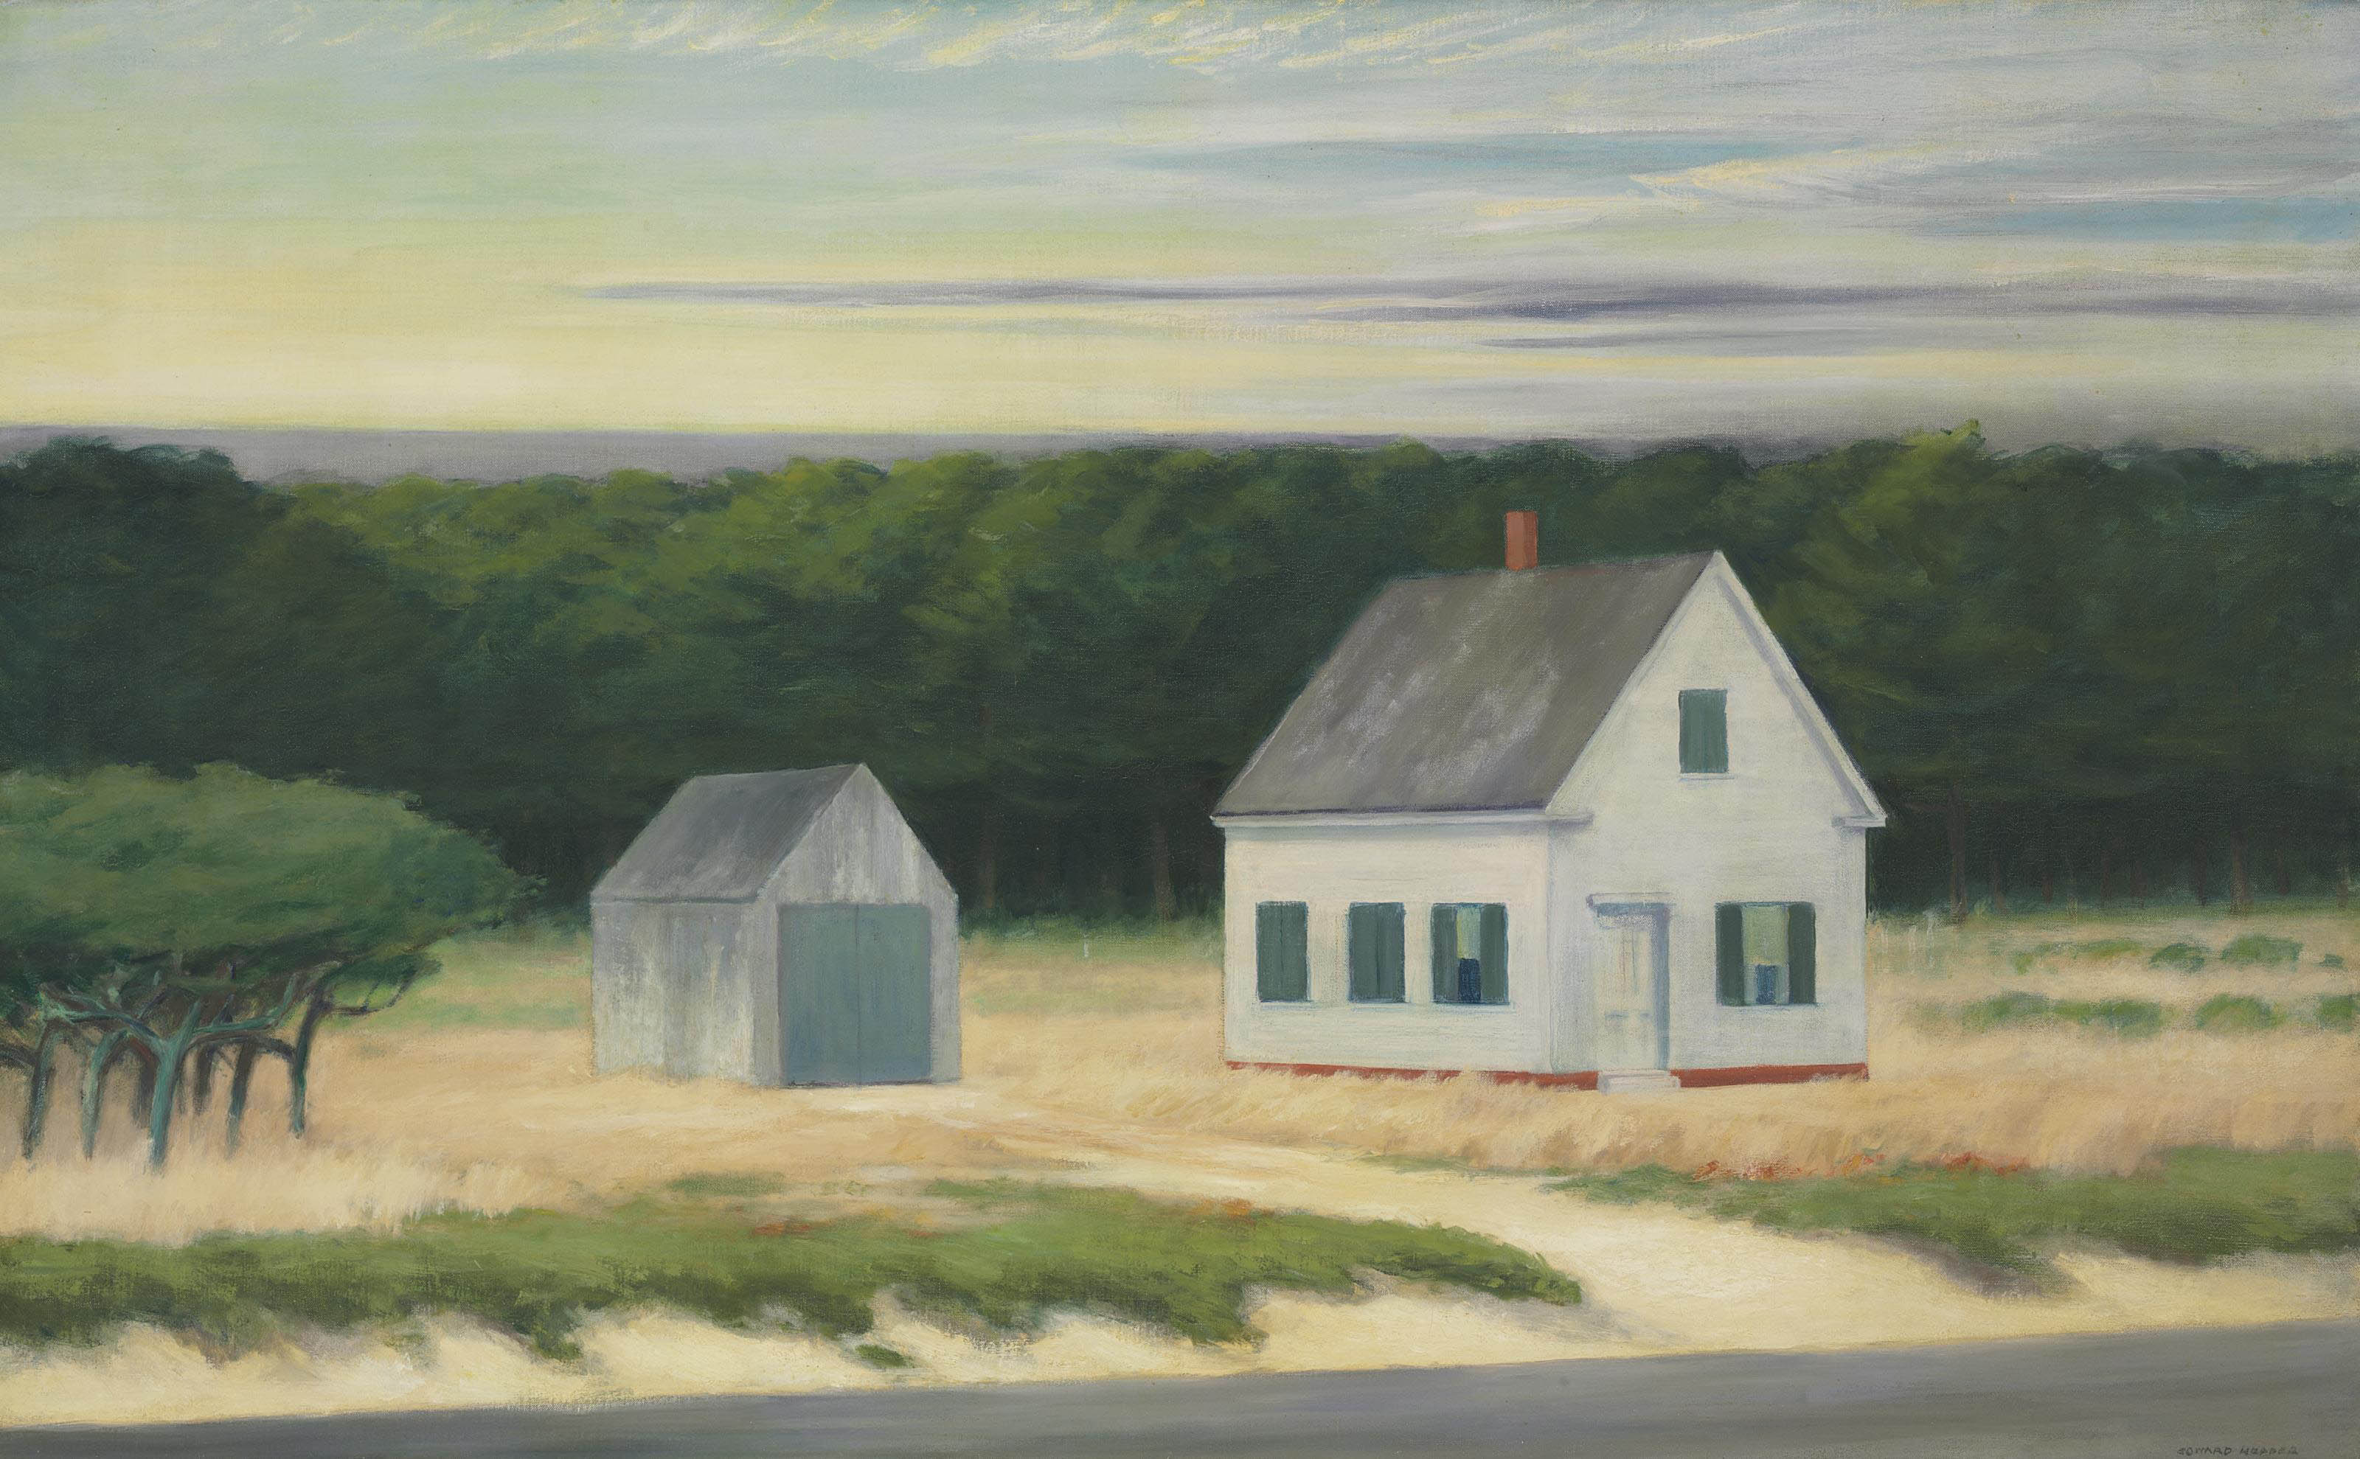
October on Cape Cod, 1946, oil on canvas, 66.7 x 107.3 cm, Private Collection https://www.christies.com/en/lot/lot-5631572

Slide 10
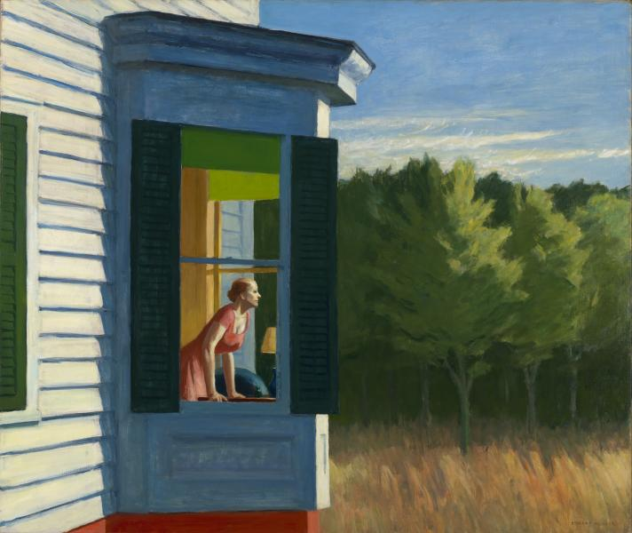
Cape Cod Morning, 1950, oil on canvas, 86.7 x 102.3 cm, Smithsonian American Art Museum, Washington, DC, USA https://americanart.si.edu/artwork/cape-cod-morning-10760

Slide 11
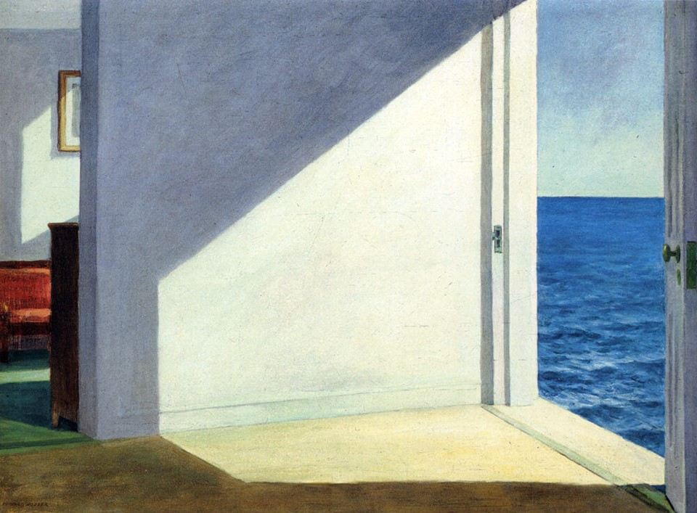
Rooms by the Sea, 1951, Oil on canvas, 74.3 × 101.6 cm, Yale University Art Gallery, New Haven, Connecticut, USA https://www.edwardhopper.net/rooms-by-the-sea.jsp

Slide 12
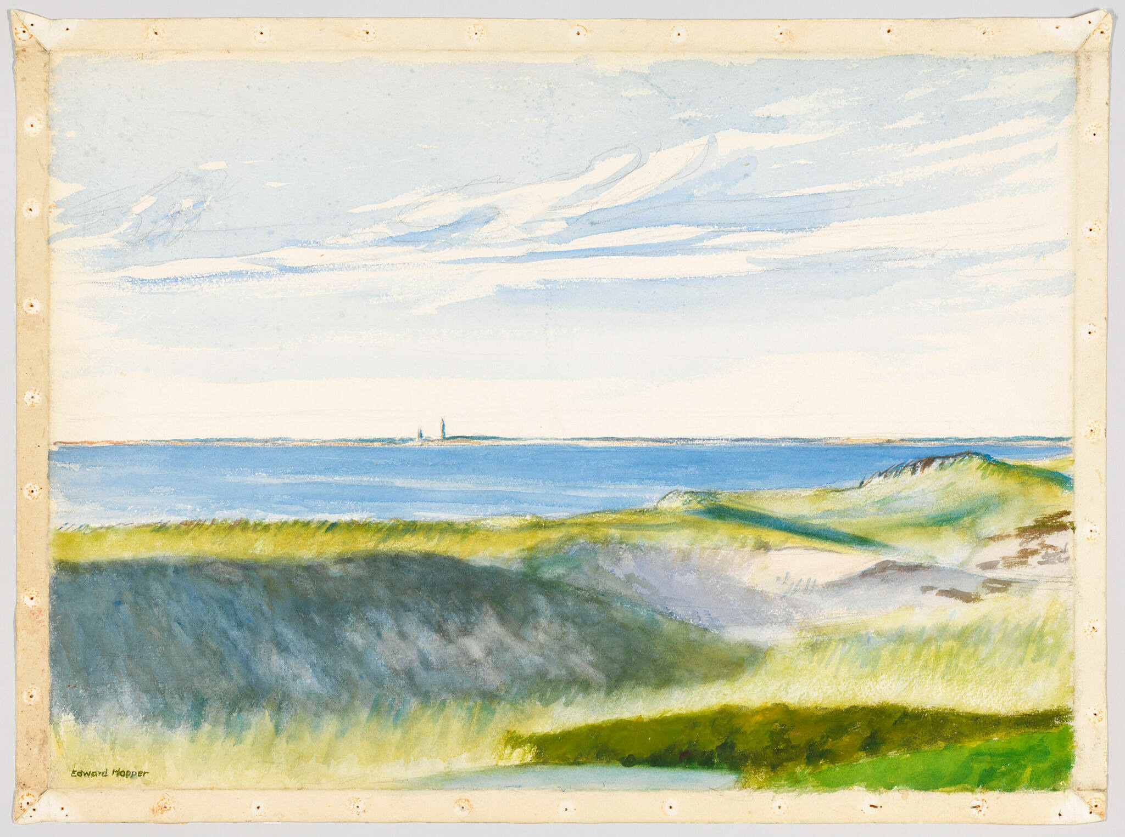
Cape Cod Bay, 1965, Watercolor and graphite pencil on paper, 55.6 × 75.4 cm, Whitney Museum of American Art, NY, USA https://whitney.org/collection/works/6829

Slide 13
The End

