Slide 1
The
Summer
of 1874
Édouard Manet
1832-1883

Slide 2
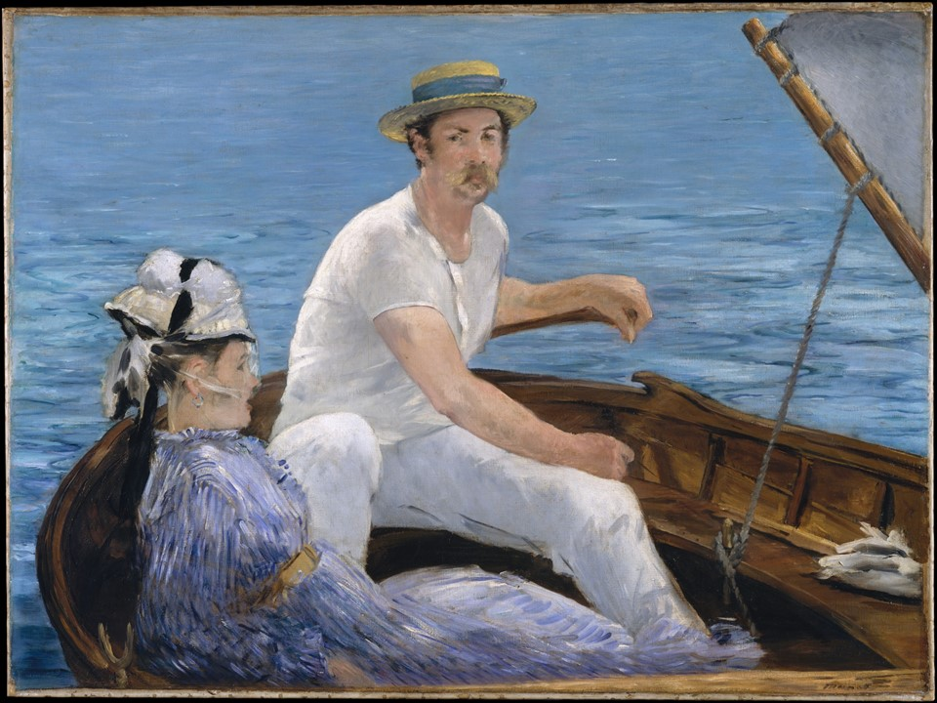
Boating, 1874, oil on canvas, 97.2 x 130.2 cm, the MET, NY, USA https://www.metmuseum.org/art/collection/search/436947

Slide 3
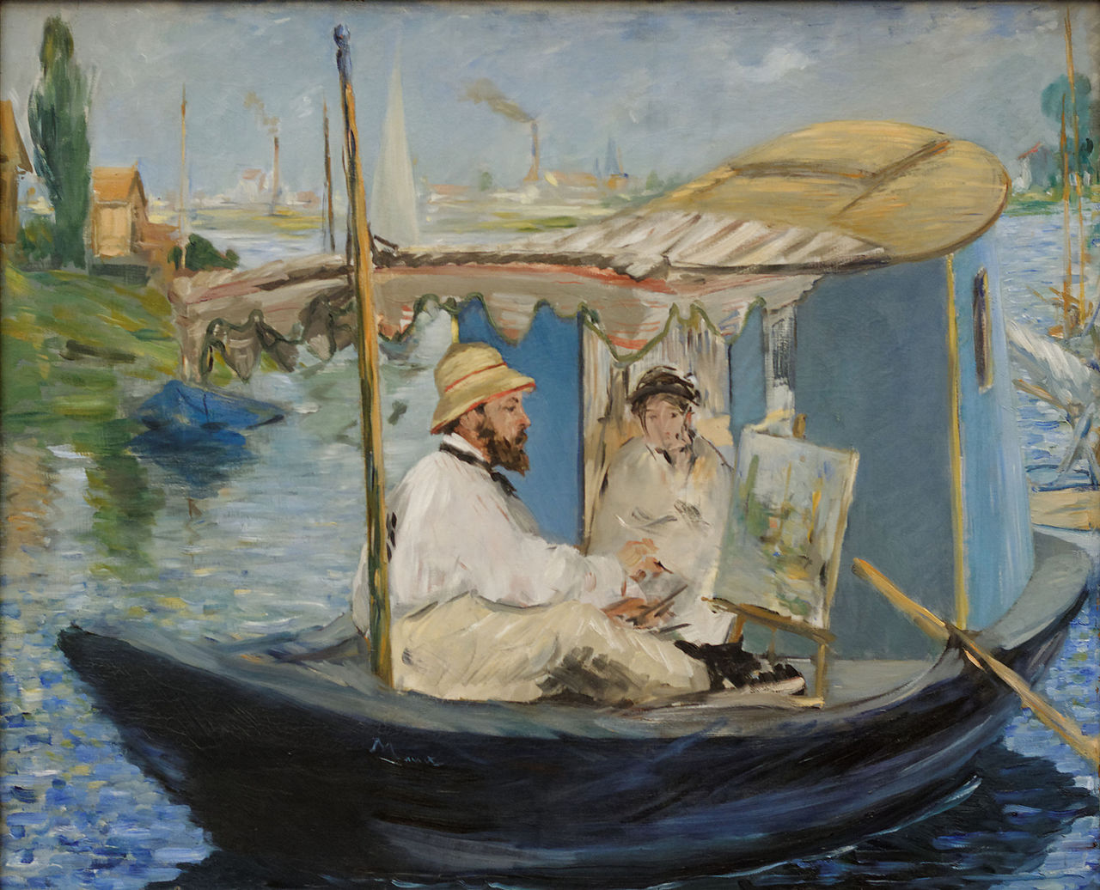
Monet in his Studio Boat, 1874,
Oil on Canvas, 82.5 x 100.5 cm, Neue Pinakothek, Munich, Germany https://en.wikipedia.org/wiki/Claude_Monet_Painting_in_his_Studio#/media/File:Monet_Painting_on_His_Studio_Boat_Edouard_Manet_1874.jpg

Slide 4
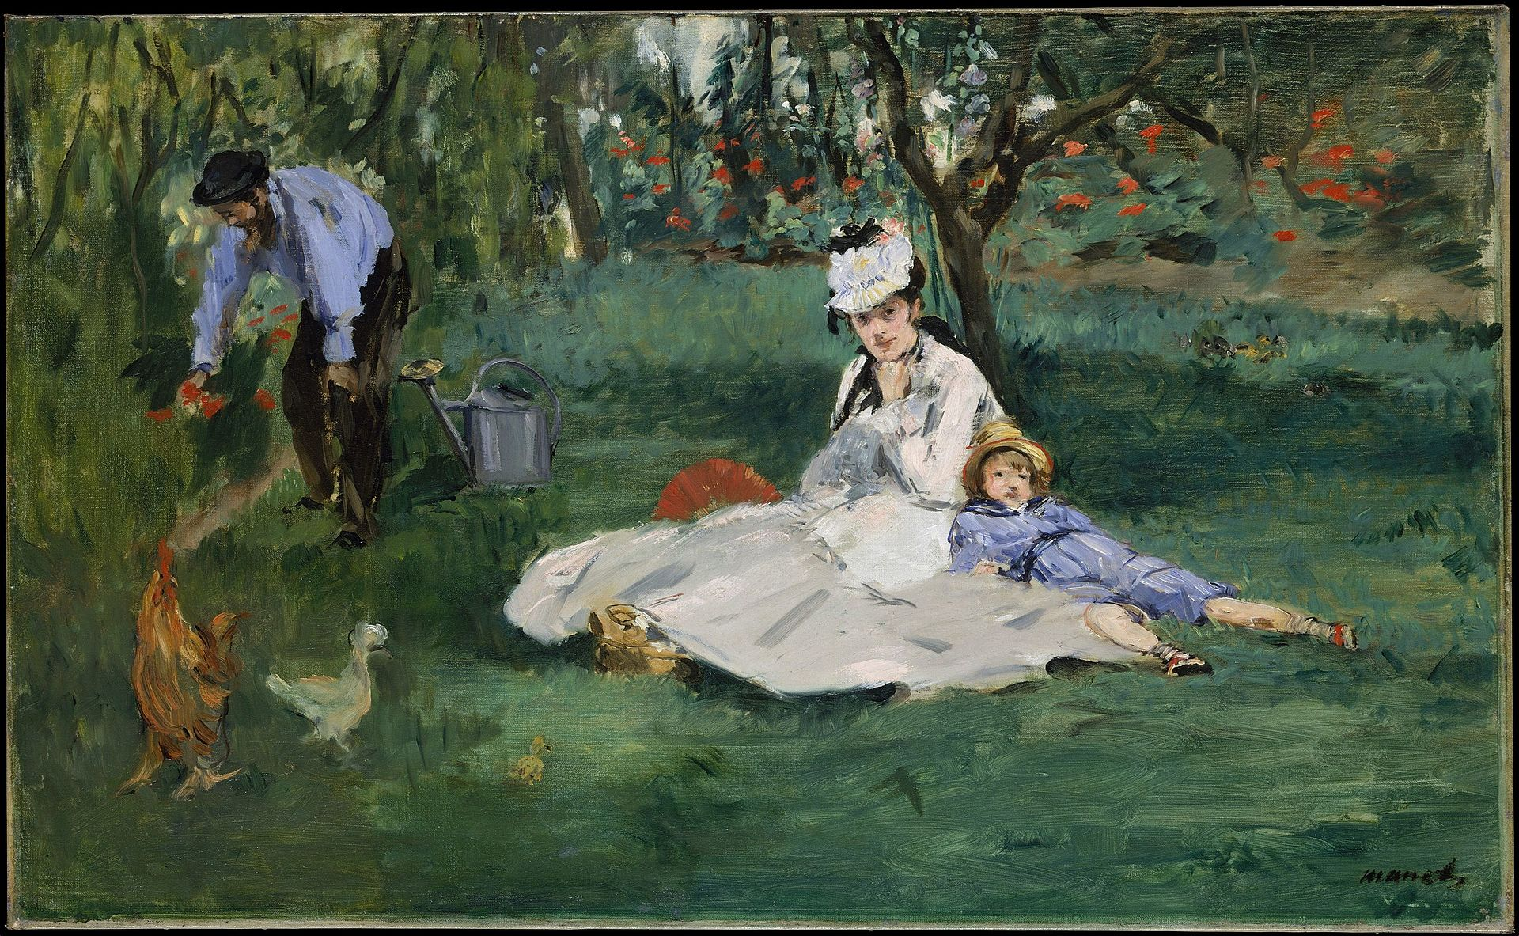
The Monet Family in their Garden, 1874, Oil on Canvas, 61x99.7 cm, the MET, NY, USA https://commons.wikimedia.org/wiki/File:%C3%89douard_Manet_--The_Monet_Family_in_Their_Garden_at_Argenteuil.jpg

Slide 5
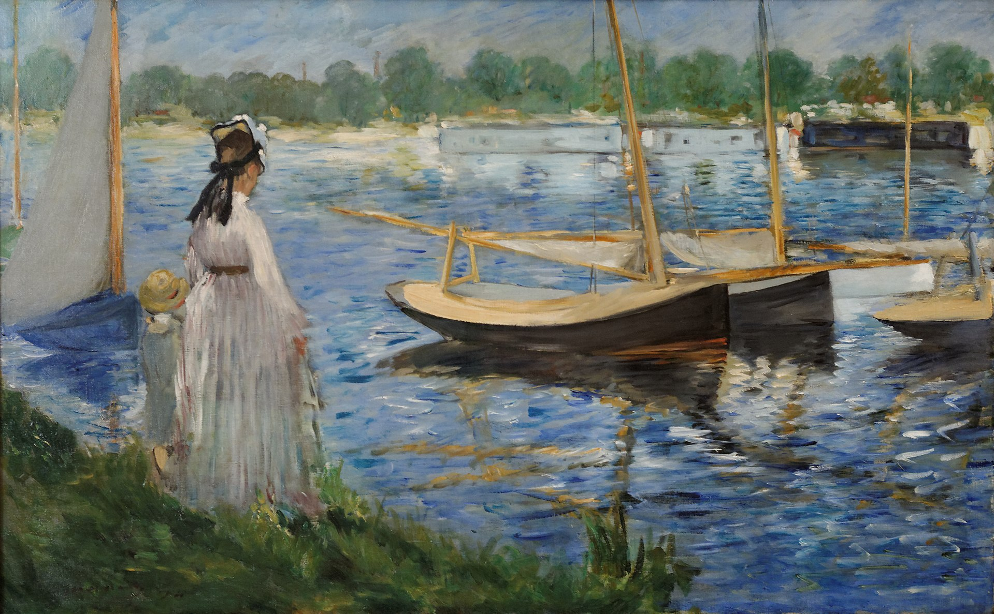
Banks of the Seine at Argenteuil, 1874, Oil on Canvas, 62.3x103 cm, Courtauld Gallery, London, UK https://commons.wikimedia.org/wiki/File:Banks_of_the_Seine_at_Argenteuil_Edouard_Manet_1874.jpg

Slide 6
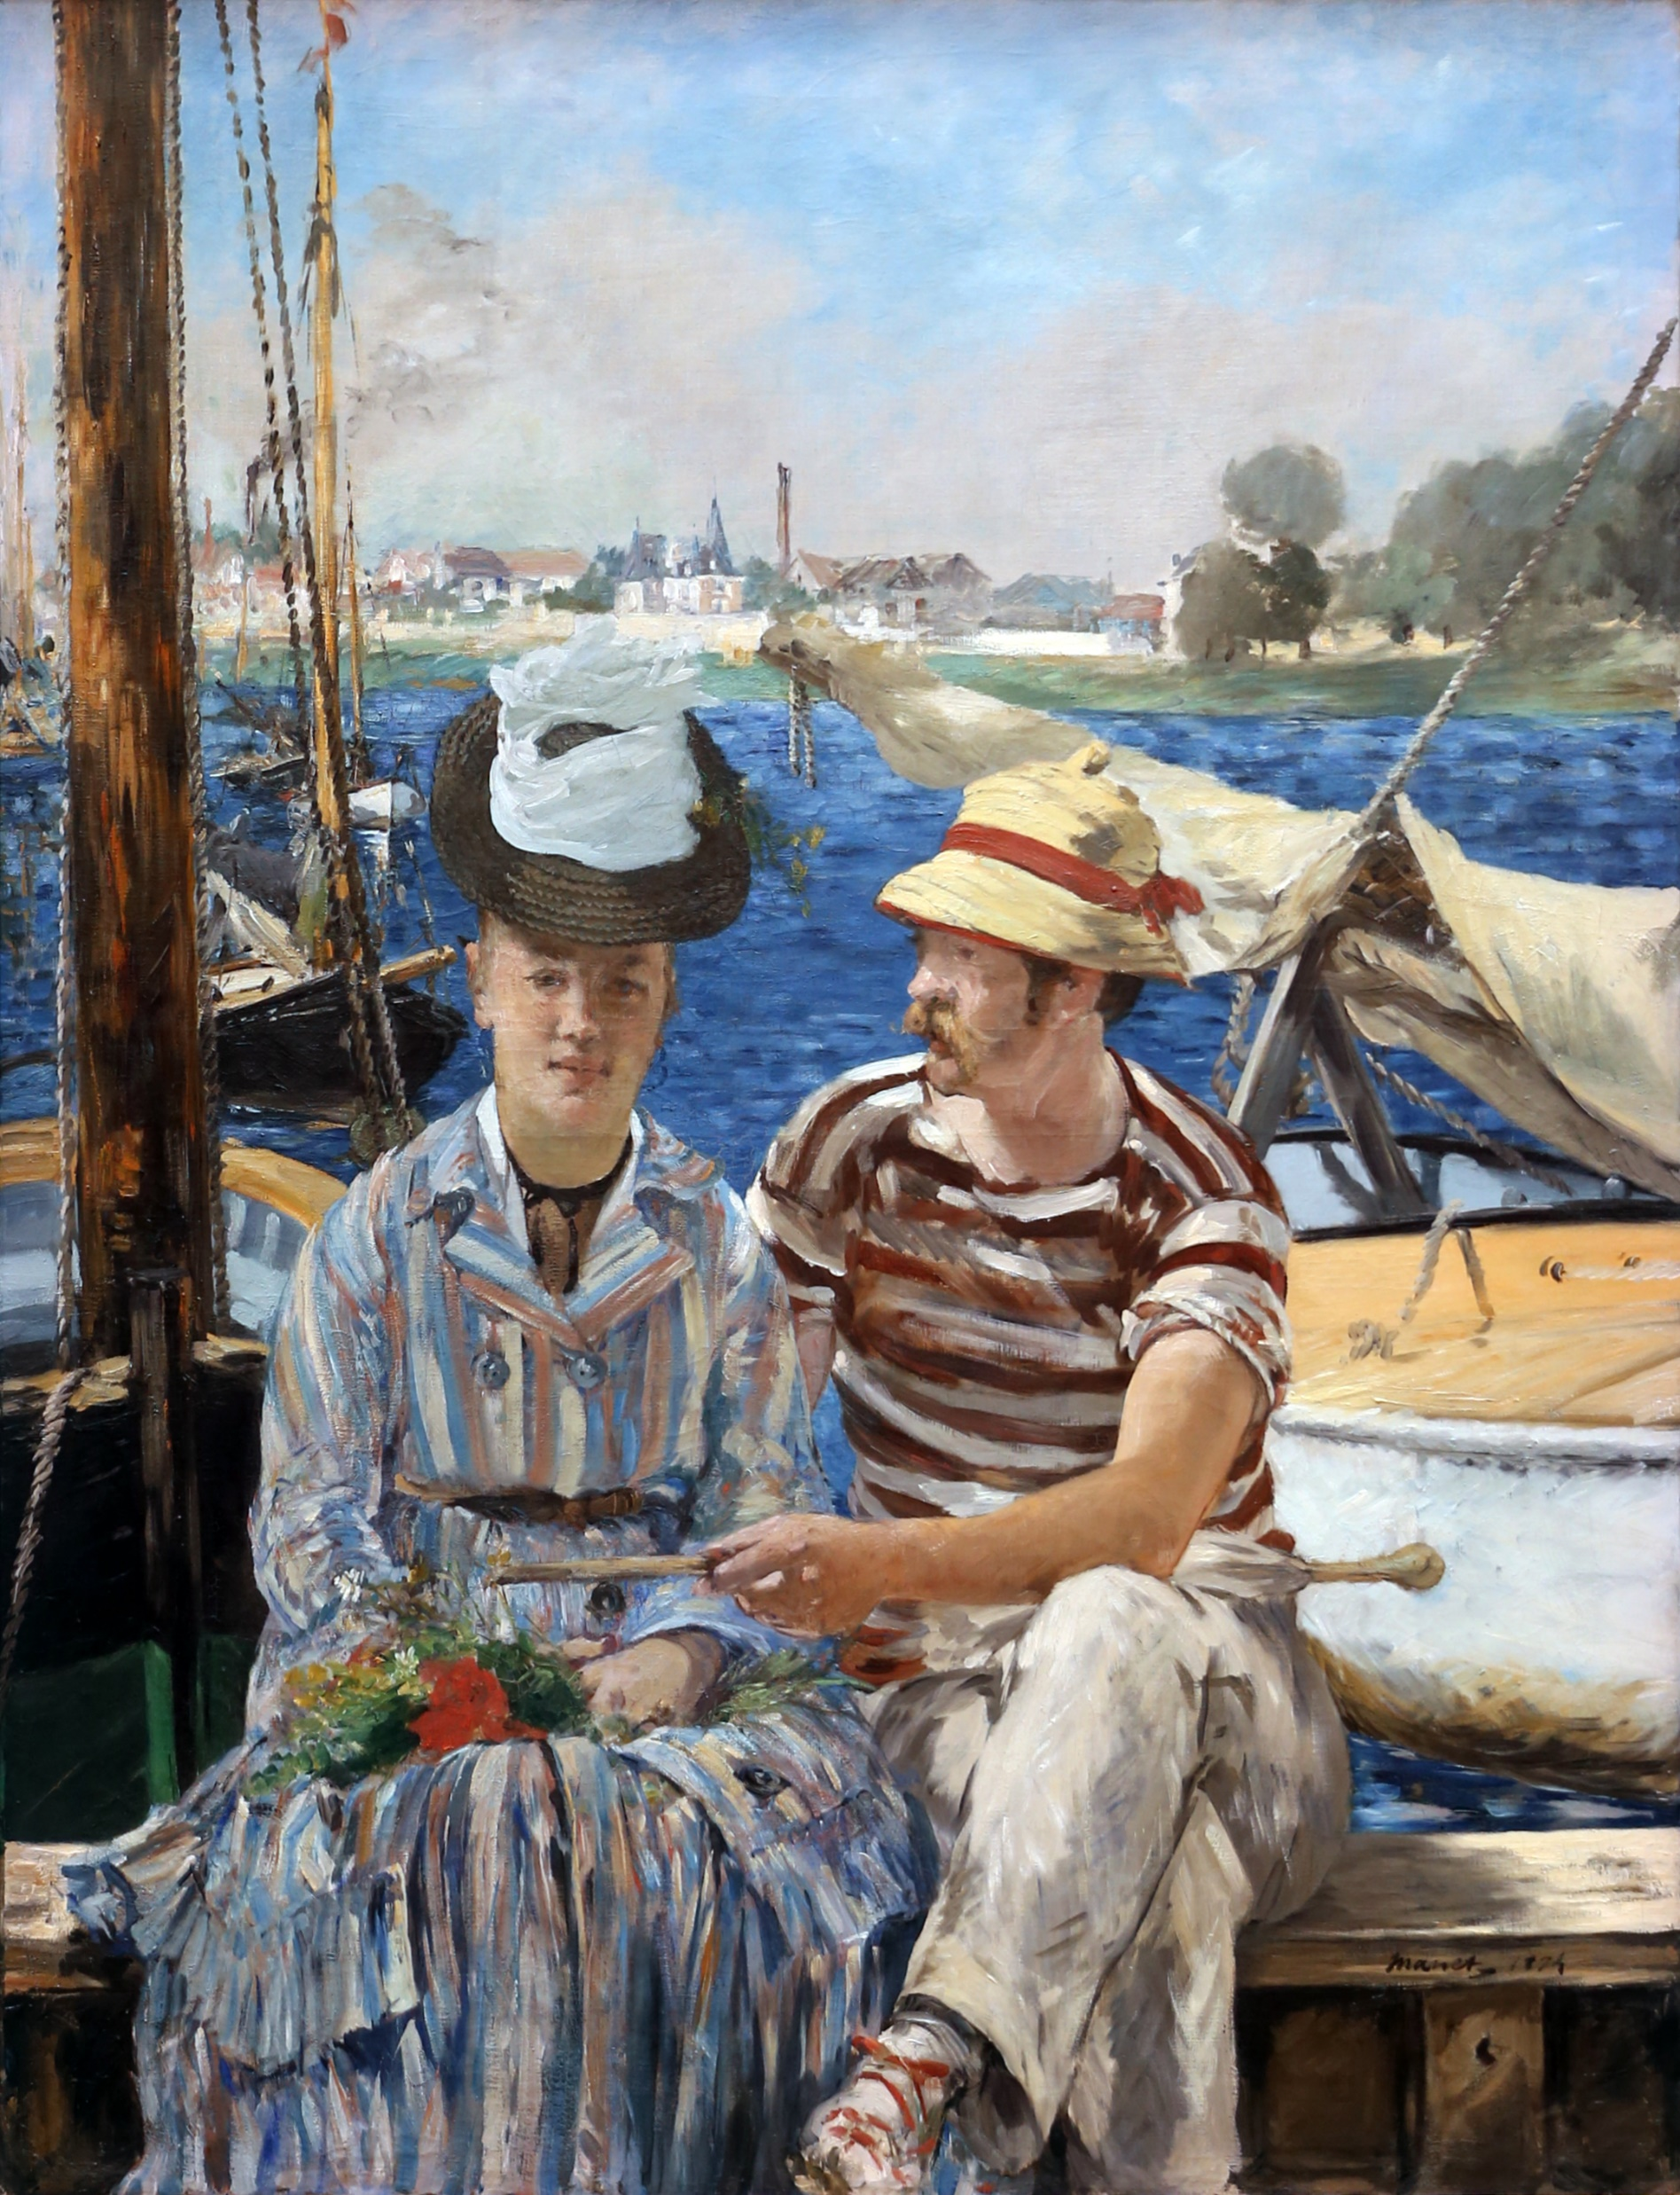
Argenteuil, 1874, Oil on Canvas, 149x115 cm, Musée des Beaux-Arts, Tournai, France https://upload.wikimedia.org/wikipedia/commons/8/8d/Edouard_Manet_003.jpg

Slide 7
The End

