Slide 1
Émile Gallé, 1846–1904
The World of the Sea

Slide 2
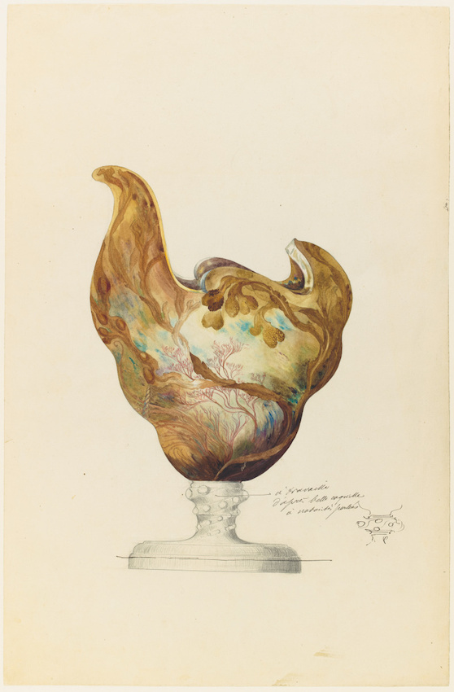
Model of vase in the shape of a nautilus and decorated with seaweed, Date: 1863, Pencil, H. 49.4 cm. Musée d’Orsay, Paris, France https://www.musee-orsay.fr/fr/oeuvres/modele-de-vase-en-forme-de-nautile-et-decor-dalgues-101982

Slide 3
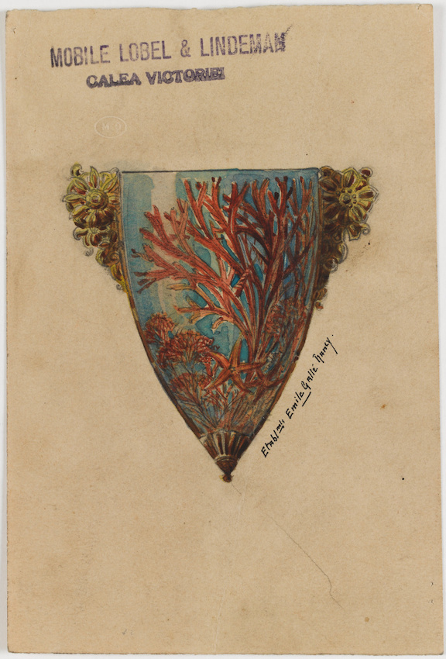
Wall vase decorated with coral, shell and starfish, Date: 1863, Pencil, H. 15.3 cm, Musée d’Orsay, Paris, France https://www.musee-orsay.fr/fr/oeuvres/vase-dapplique-decor-de-corail-coquillage-et-etoile-de-mer-160089

Slide 4
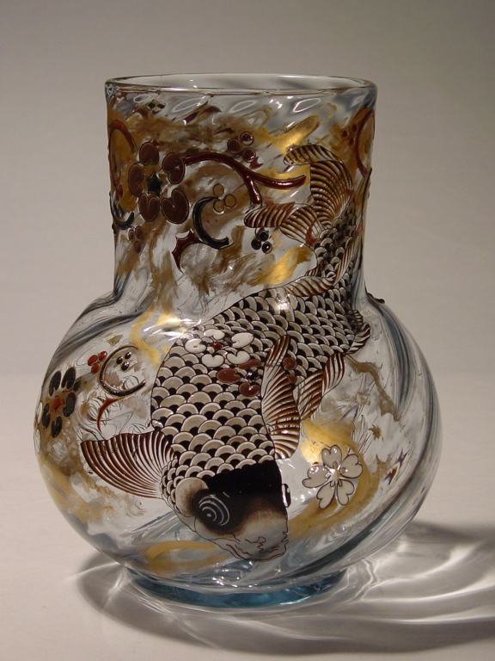
La Carpe, 1878, Enamel Glass, Glass and Crystal Museum, Vosges du Nord, France https://webmuseo.com/ws/musee-verre/app/collection/record/67

Slide 5
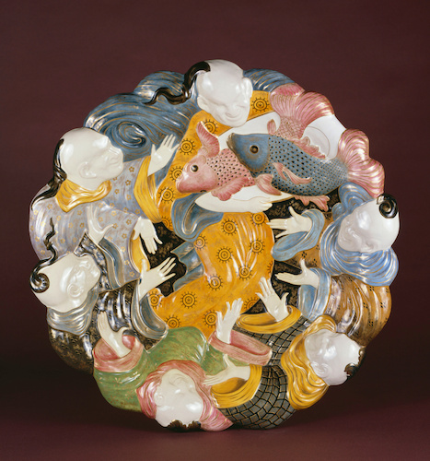
Ornament dish, c. 1878, Earthenware, polychrome small fire decoration on ivory tin enamel, gold highlights, DM. 58.0 cm, Musée d’Orsay, Paris, France https://www.musee-orsay.fr/fr/oeuvres/plat-dornement-1403

Slide 6
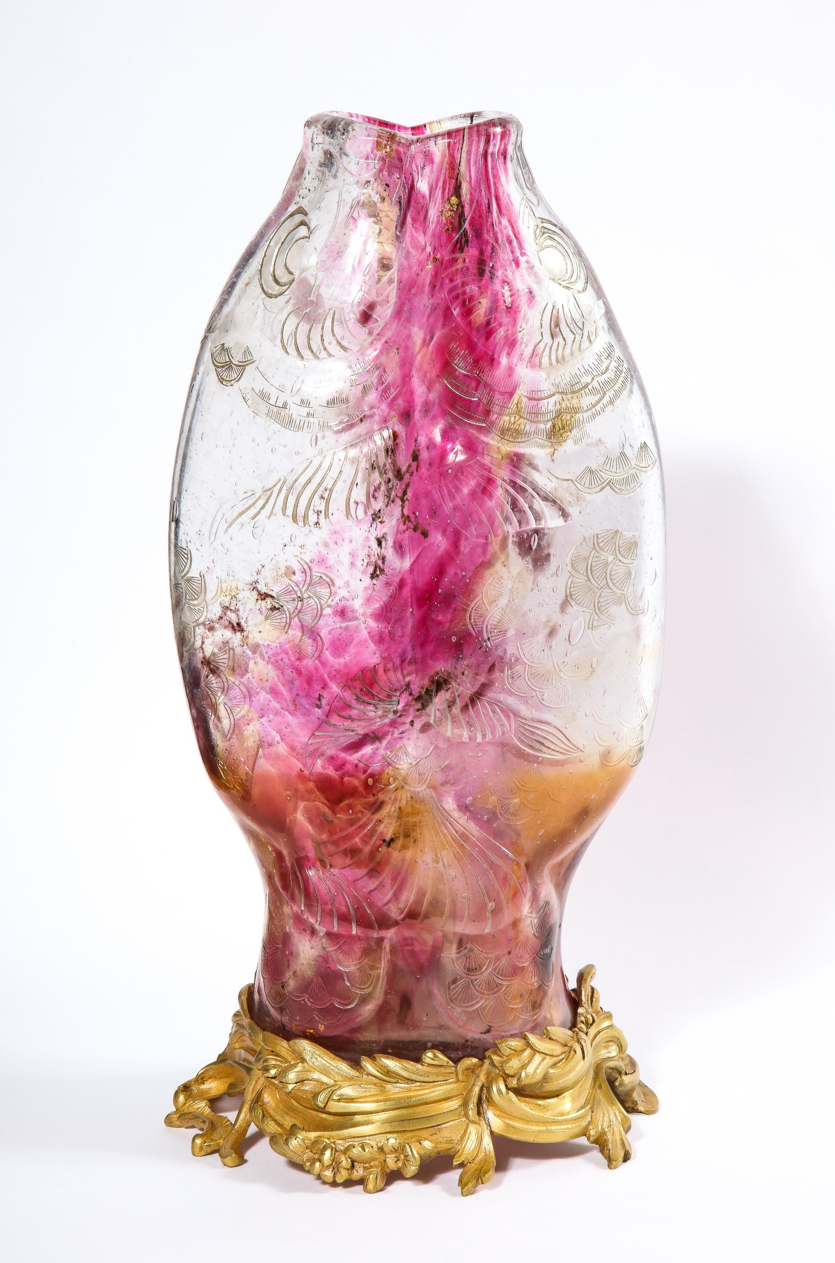
Ormolu-Mounted Double Carp Fish Pink-Glass Vase, c. 1879, enamel Glass, H. 40.64 cm, Private Collection https://www.1stdibs.com/furniture/decorative-objects/vases-vessels/vases/emile-galle-rare-important-ormolu-mounted-double-carp-fish-pink-glass-vase/id-f_27704782/

Slide 7
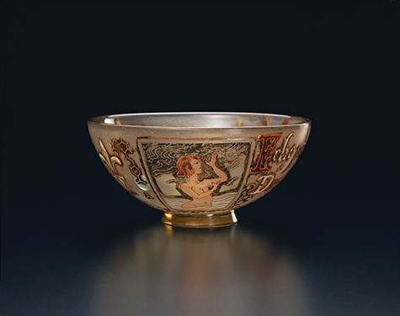
Bowl with Water Nymph Design, 1884-1889, Glass, H. 5.7 cm, Pola Museum, Ashigarashimo-gun, Kanagawa Prefecture, Japan https://www.polamuseum.or.jp/en/collection/006-0816/

Slide 8
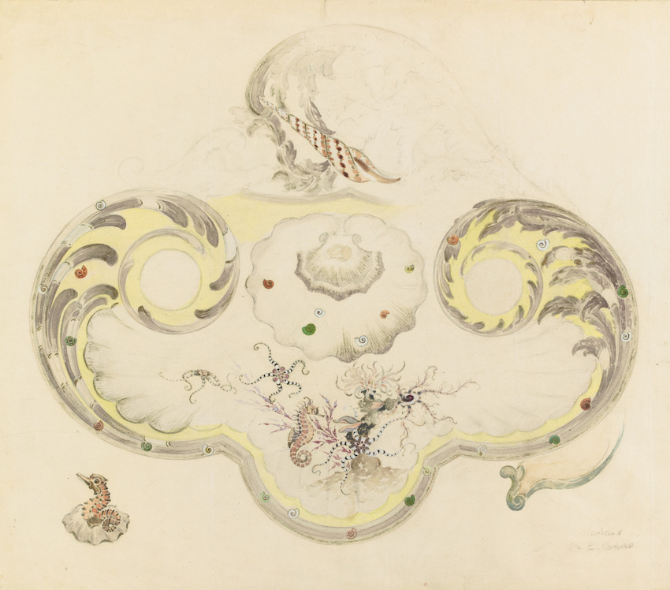
Model of faience desk in the shape of rockery, decorated with aquatic fauna and flora, c. 1889, pencil and watercolor, H. 36.1 cm, Musée d’Orsay, Paris, France https://www.musee-orsay.fr/fr/oeuvres/modele-decritoire-en-faience-de-forme-rocaille-decor-de-faune-et-de-flore-aquatiques-coquillages-hippocampe-ophiures-escargots-anemones-et-algues-detail-dun-reservoir-figurant-en-ronde-bosse-un-hippocampe-et-une-101988

Slide 9
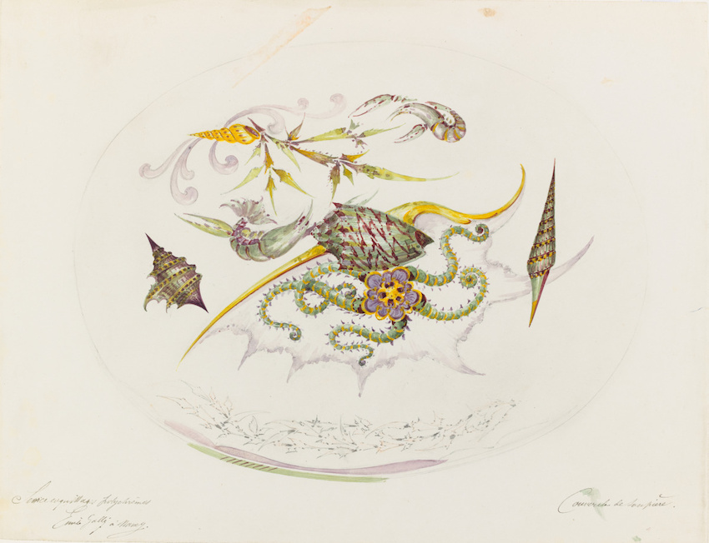
Decorative model of a tureen lid from the Polychrome Shells service: shells, lobsters, brittle stars and seaweed, c. 1889, pencil, watercolor and ink, H. 27.0 cm, Musée d’Orsay, Paris, France https://www.musee-orsay.fr/fr/oeuvres/modele-de-decor-dun-couvercle-de-soupiere-du-service-coquillages-polychromes-coquillages-homards-ophiure-et-algues-102288

Slide 10
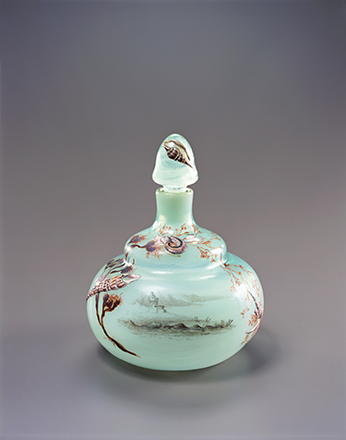
Stoppered Bottle with Seashell and Water-weed Design, 1889, Glass, H. 14.0 cm, Pola Museum, Ashigarashimo-gun, Kanagawa Prefecture, Japan https://www.polamuseum.or.jp/en/collection/006-0855/

Slide 11
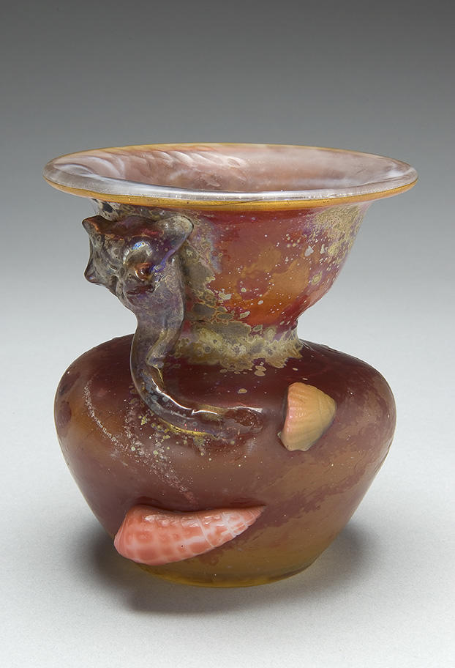
Marine Vase, c. 1895, Internally decorated, applied, wheel-carved, and iridized glass with martelé technique, H. 13.3 cm, McNay Art Museum, Sn Antonio, TX, USA https://collection.mcnayart.org/objects/19447/marine-vase

Slide 12
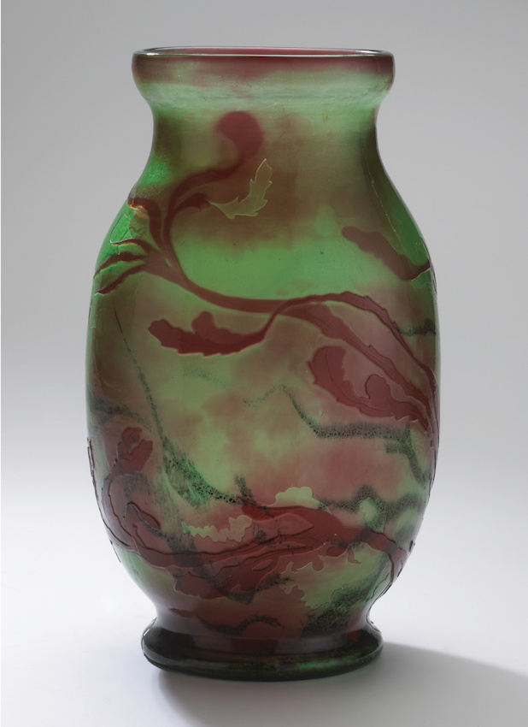
Vase Decorated With Seaweed, between 1899 and 1900, two-layer glass, metal oxide inclusions, wheel-etched and acid-etched decoration,
H. 25.0 cm, Musée d’Orsay, Paris, France https://www.musee-orsay.fr/fr/oeuvres/vase-decor-dalgues-143513

Slide 13
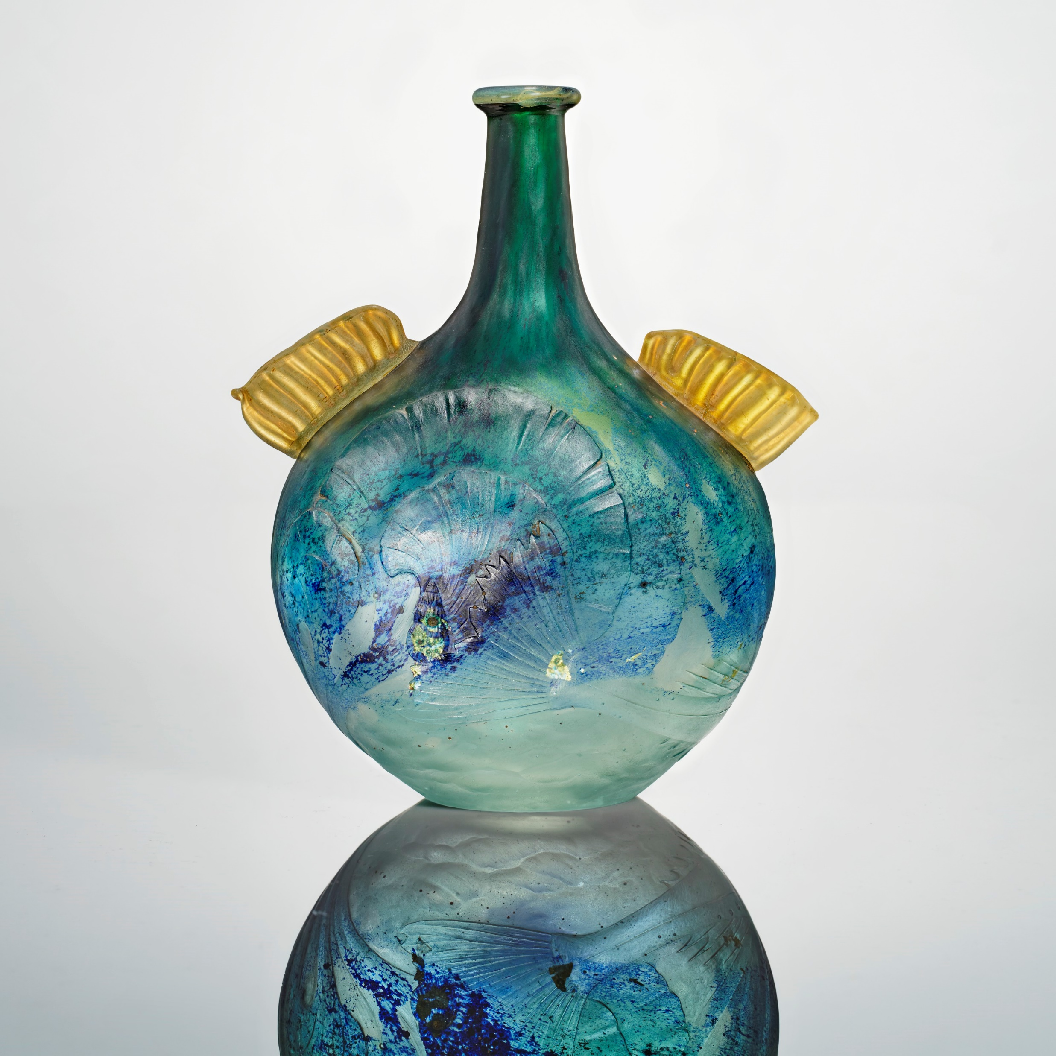
Poisson et Crabe' Vase, circa 1900, triple layer crystal with internal iridescence with deeply wheel engraved marine decorations and two applied yellow fins, 21 x 17.2 x 7 cm, Private Collection https://www.christies.com/en/lot/lot-6354263

Slide 14
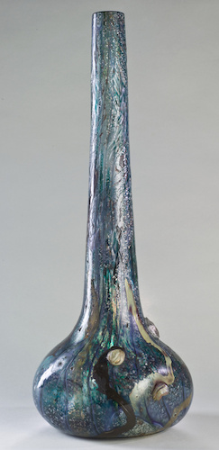
La Mer, c. 1900, Glass Marquetry, H. 71,2 cm, Musée d’Orsay, Paris, France https://www.musee-orsay.fr/fr/oeuvres/la-mer-152889

Slide 15
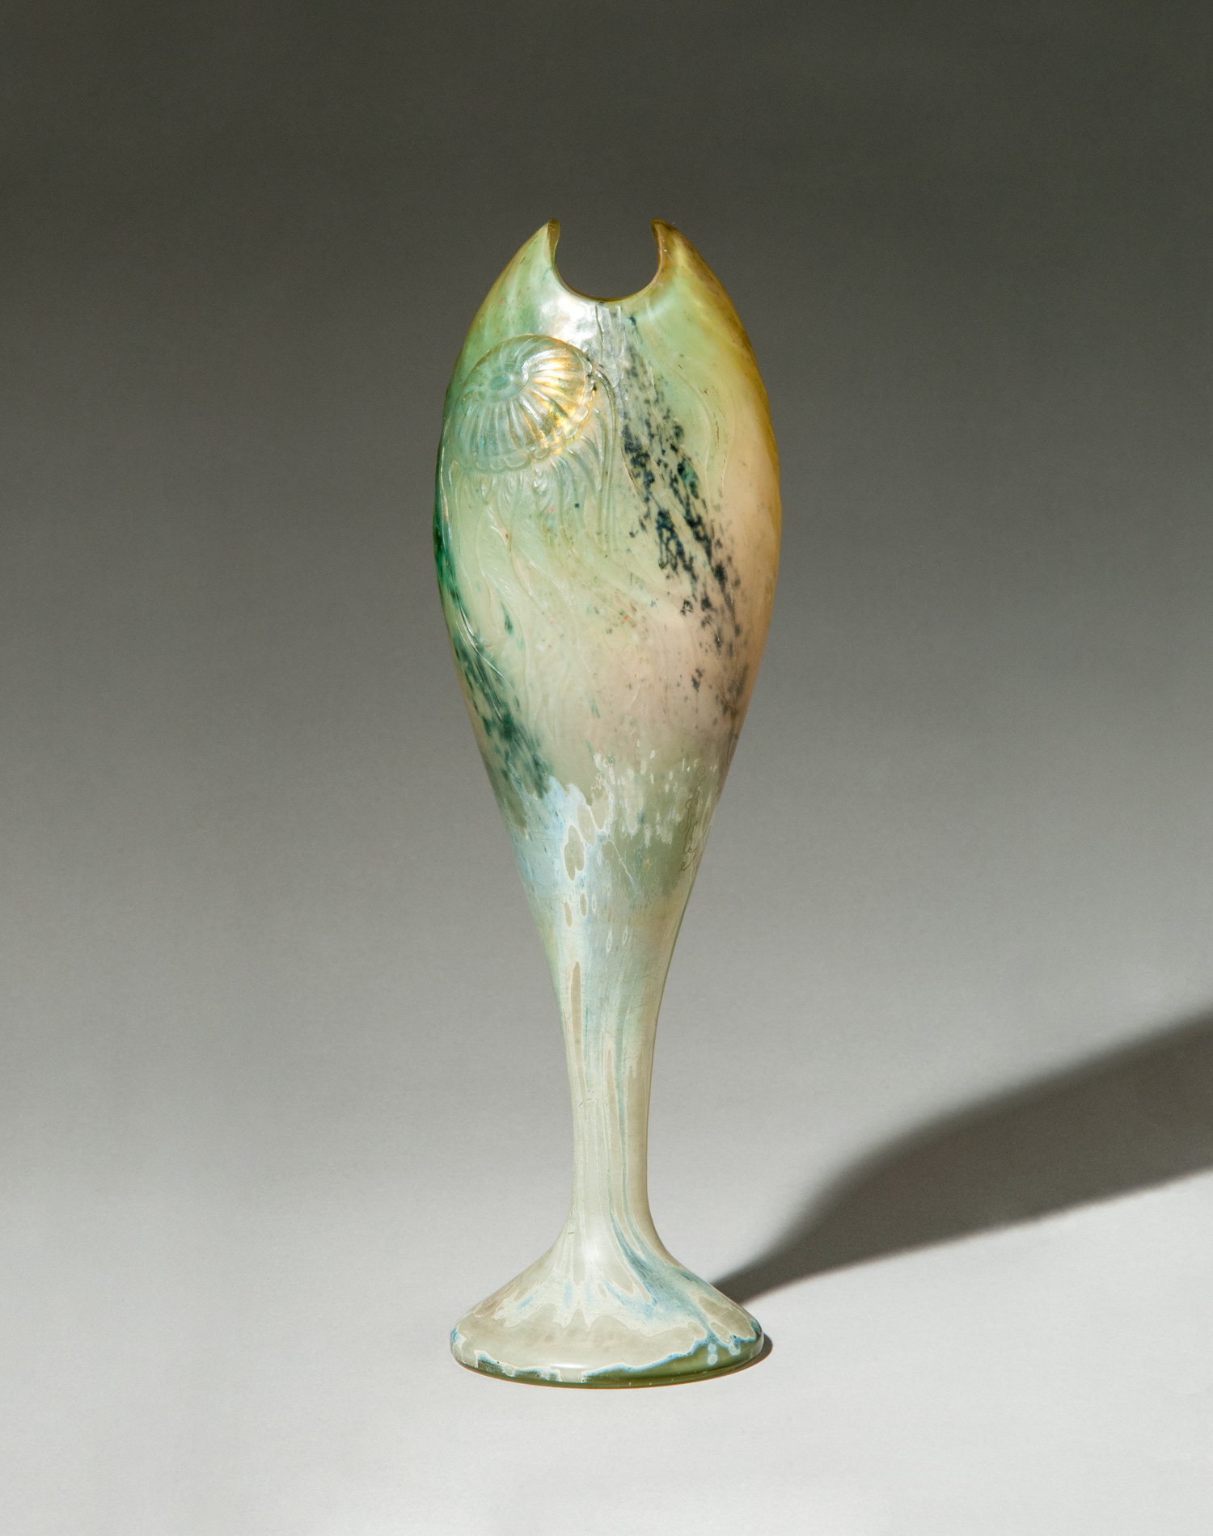
“Meduse” Vase, c. 1900, Double glazed footed vase modelled as a fish, internally decorated with powder inclusions, partially iridescent, ornamented with an acid-etched and wheel-carved jellyfish on a hammered background echoing the surface of the water, H. 30 cm, Robert Zehil Gallery, Monaco http://robertzehilgallery.com/galerie/art-nouveau/antiques-emile-galle-meduse-vase-glass-1900/

Slide 16
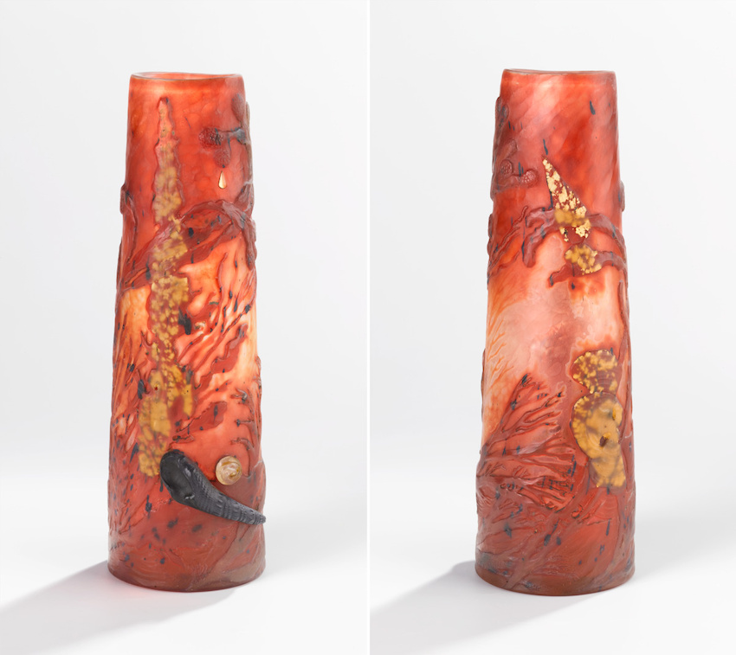
Roller vase with marine decor, c. 1902, multi-layered blown glass, metallic inclusions, H. 28.2 cm, Musée d’Orsay, Paris, France https://www.musee-orsay.fr/fr/oeuvres/vase-rouleau-decor-marin-203570

Slide 17
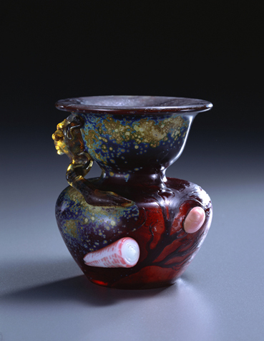
Vase with Seashell Design, 1903, Glass, H. 12.8, Pola Museum, Ashigarashimo-gun, Kanagawa Prefecture, Japan https://www.polamuseum.or.jp/en/collection/006-0342/

Slide 18
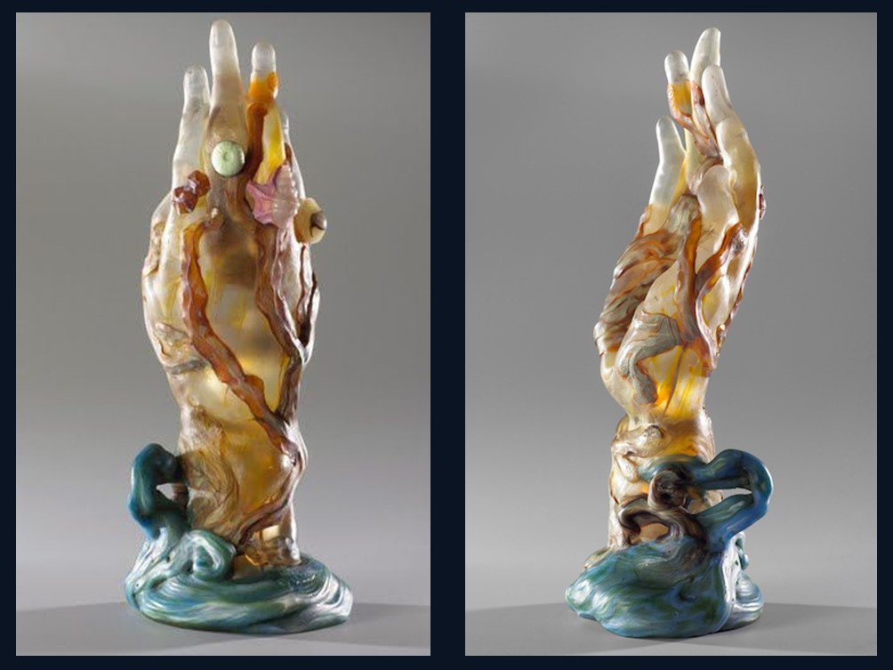
Hand With Seaweed and Shells, 1904, Glass modelled under heat with inclusions of metallic oxides, veins, applications in low and high relief and wheel engraving, 33.4 x 13.4 cm, Musée d'Orsay https://www.musee-orsay.fr/en/exhibitions/hand-seaweed-and-shells-emile-galles-artistic-testament-196300 and https://gr.pinterest.com/pin/51791464437097192/

Slide 19
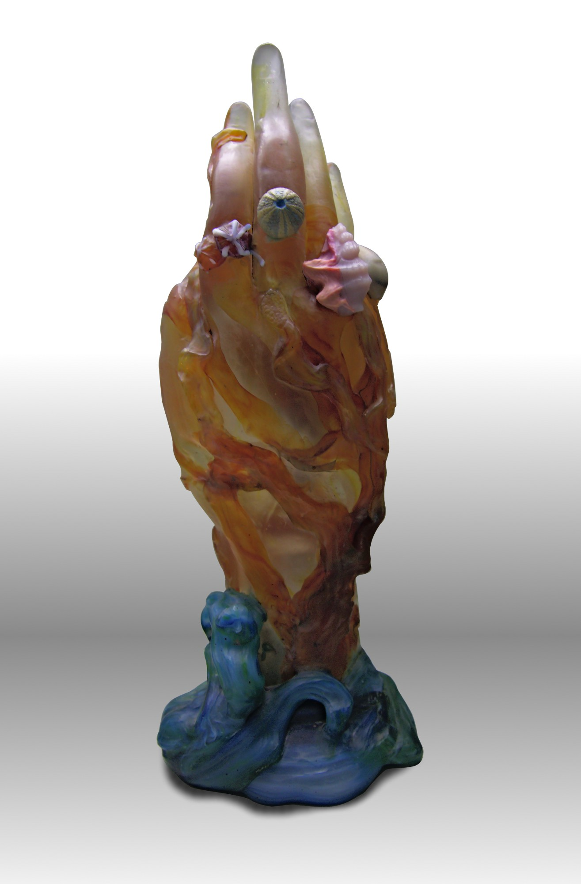
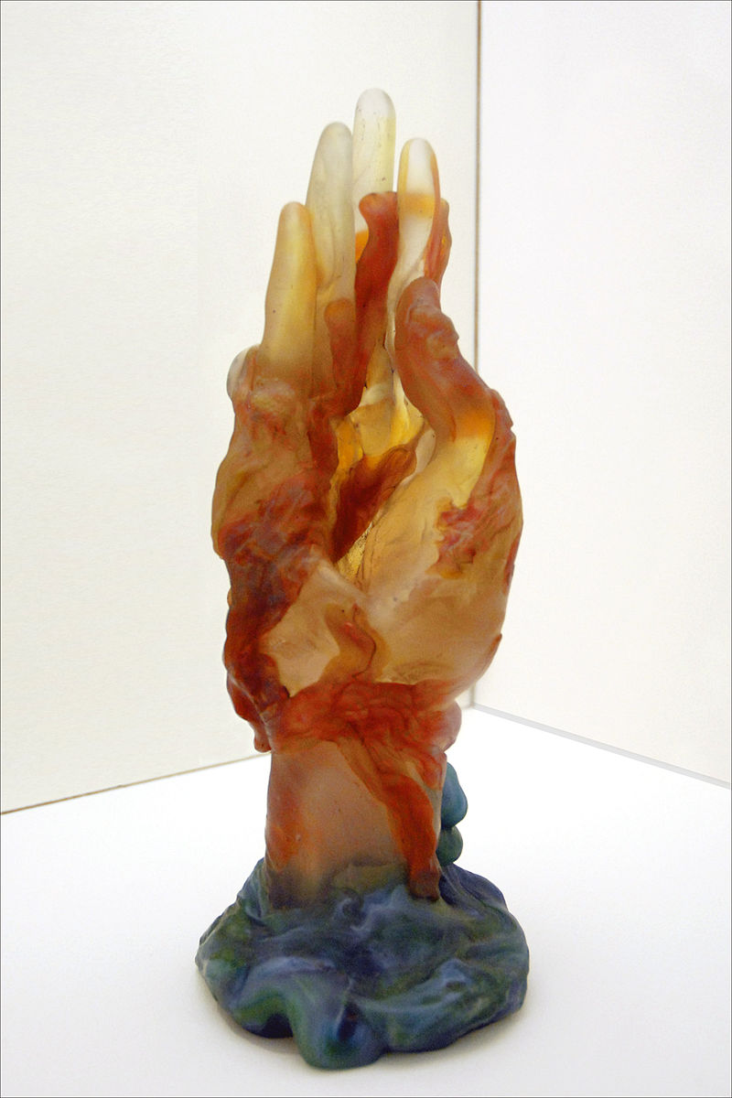
The Hand with Seaweed and Seashells , 1904, partially blown and hot-modeled crystal, metal oxide inclusions, marbling, applications, wheel engraving, Nancy School Museum, Nancy, France https://upload.wikimedia.org/wikipedia/commons/5/5d/%C3%89mile_Gall%C3%A9%2C_main_aux_algues_et_coquillages_%281904%29.jpg and https://fr.wikipedia.org/wiki/La_Main_aux_algues_et_aux_coquillages#/media/Fichier:La_main_aux_algues_et_aux_coquillages_(Emile_Gall%C3%A9)_(4935426077).jpg

Slide 20
The End…

