Slide 1
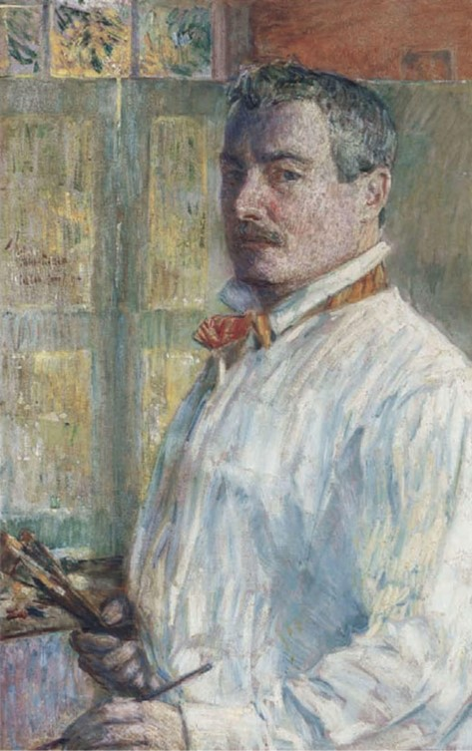
15 Paintings by
Child Hassam depicting the Isles of Shoals
Childe Hassam, 1859–1935
Self-Portrait, 1914, Oil on Canvas, 83.4 x 52.7 cm, American Academy of Arts and Letters, NY, USA https://www.pubhist.com/w15056

Slide 2
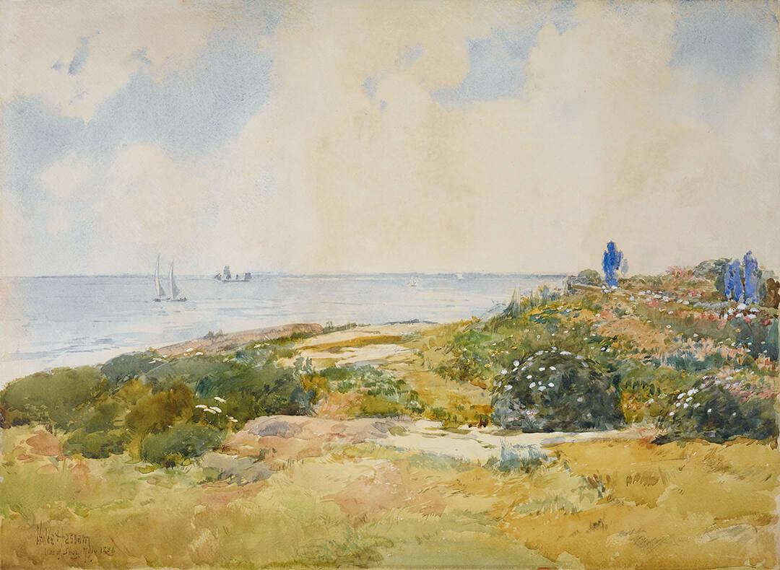
Isles of Shoals, 1886, Watercolor and Gouache on Paper, 52.7 x 73 cm, Crystal Bridges Museum of American Art, Bentonville, AR, USA https://collection.crystalbridges.org/objects/56/isles-of-shoals

Slide 3
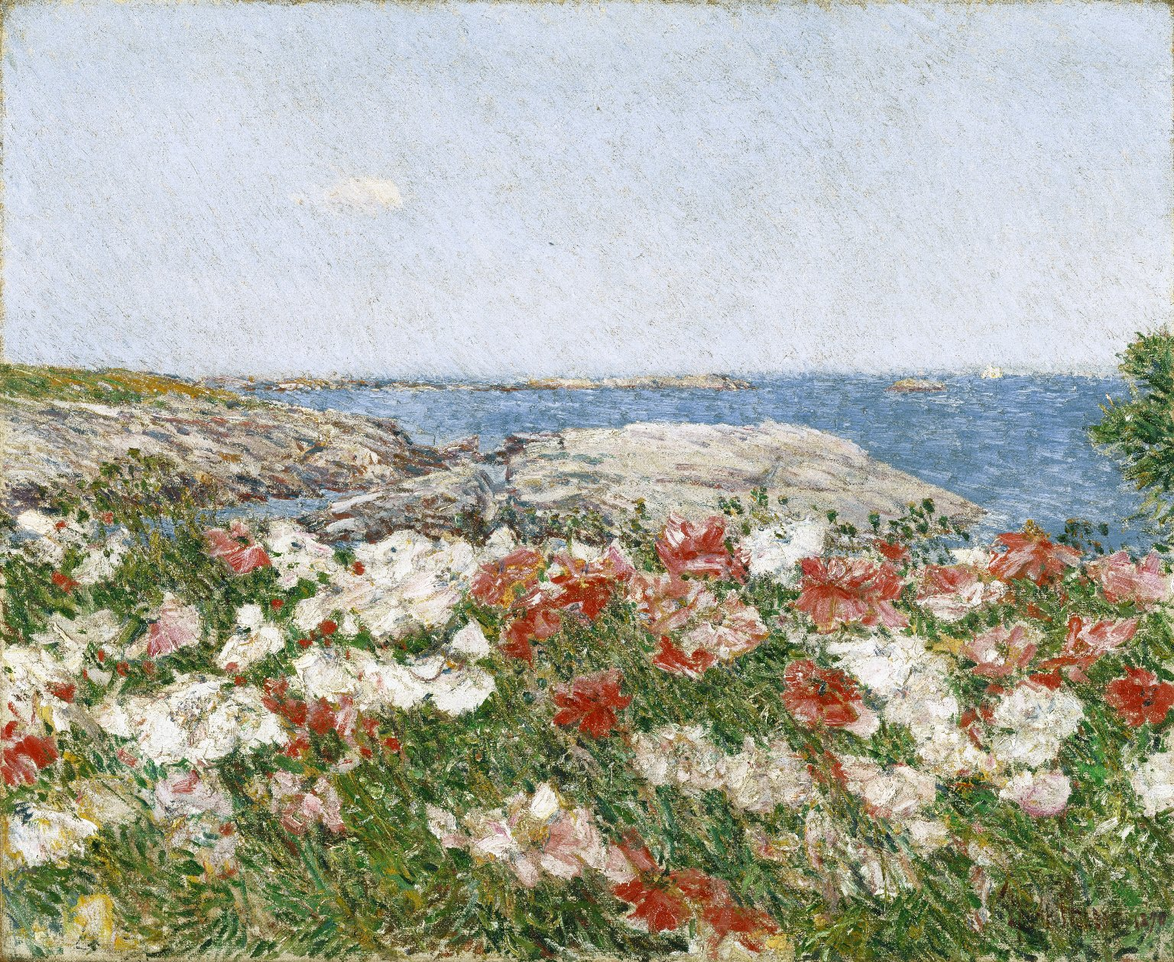
Poppies on the Isles of Shoals, 1890. Oil on Canvas, 45.7 x 55.7 cm, Brooklyn Museum, NY, USA https://commons.wikimedia.org/wiki/File:Poppies_on_the_Isles_of_Shoals,_Childe_Hassam.jpg

Slide 4
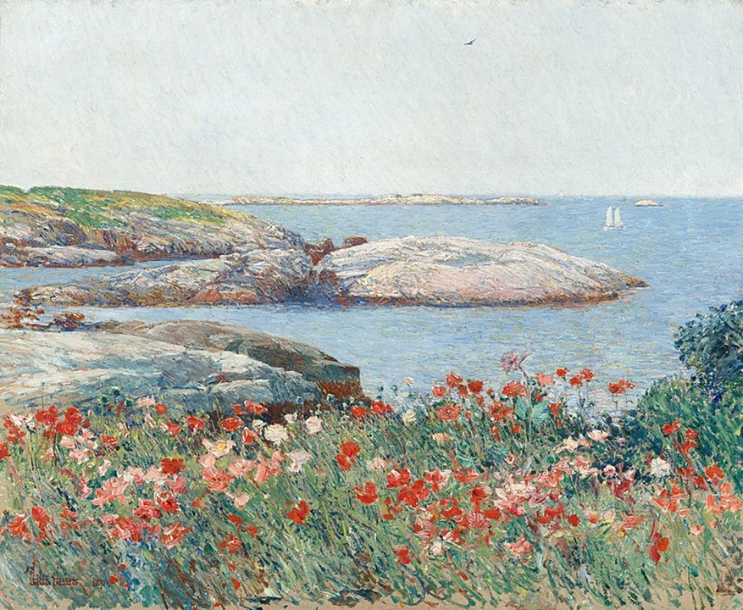
Poppies on the Isles of Shoals, 1891, 50.2x61 cm, National Gallery of Art, Washington DC, USA https://commons.wikimedia.org/wiki/File:Childe_Hassam,_Poppies,_Isles_of_Shoals,_1891.jpg

Slide 5
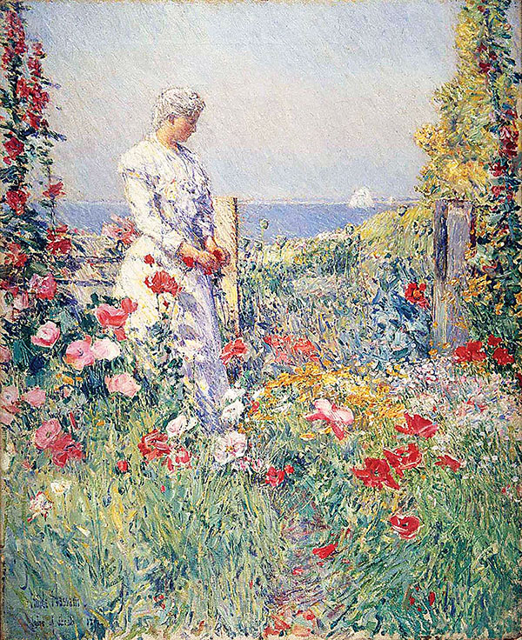
In the Garden, 1892 Smithsonian American Art Museum, Washington DC, USA https://www.historynet.com/childe-hassams-island-escape/

Slide 6
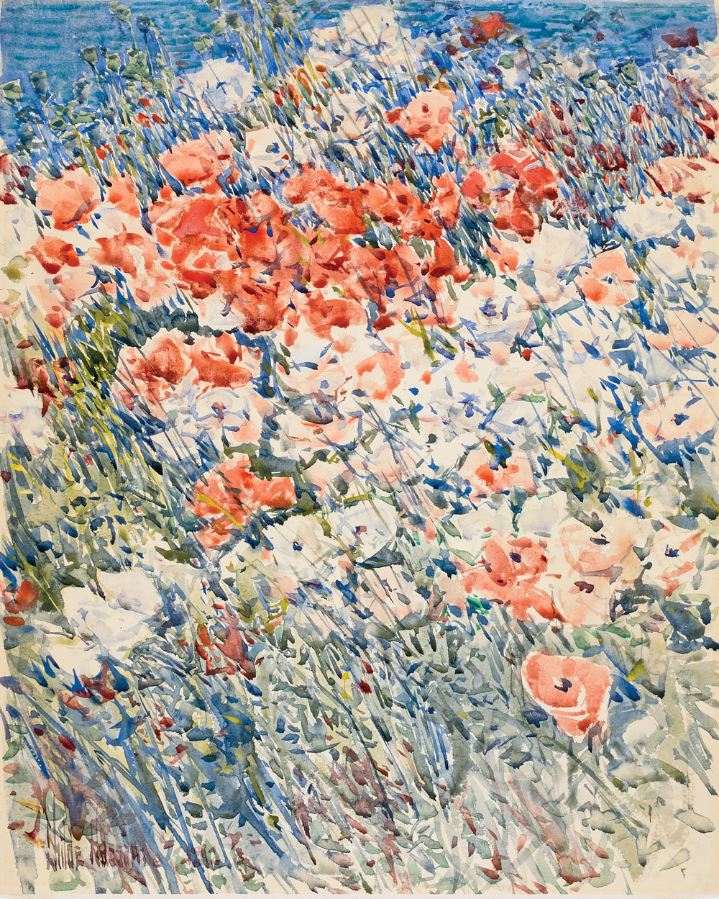
The Island Garden, 1892
Watercolor on Paper, 44.4 x 35.5 cm, Smithsonian American Art Museum, Washington DC, USA https://www.incollect.com/articles/american-impressionist-childe-hassam-and-the-isles-of-shoals

Slide 7
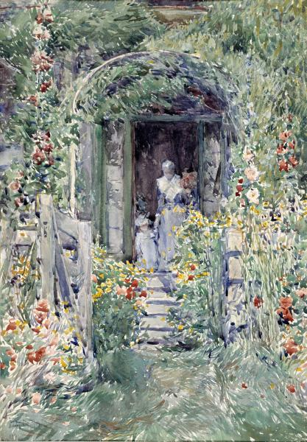
The Garden in Its Glory, 1892, Watercolor on Paper, 50.6 x 35.2 cm, Smithsonian American Art Museum, Washington DC, USA https://americanart.si.edu/artwork/garden-its-glory-10075

Slide 8
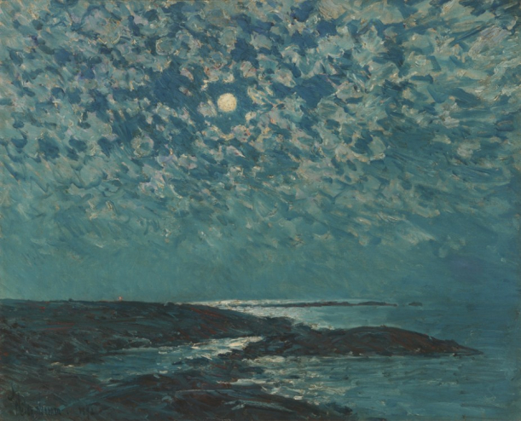
Moonlight, 1892, Oil on Canvas, 45.72x57.15 cm, Private collection https://ncartmuseum.org/exhibition/american-impressionist-childe-hassam-and-the-isles-of-shoals/#uael-gallery-11

Slide 9
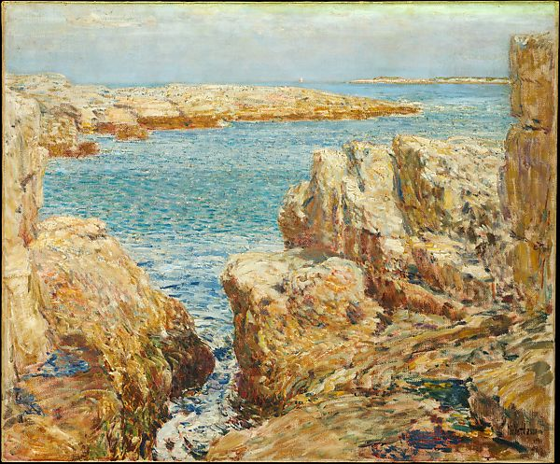
Coast Scene, Isles of Shoals, 1901, Oil on Canvas, 63.2 x 76.5 cm, the MET, NY, USA https://www.metmuseum.org/art/collection/search/11032

Slide 10
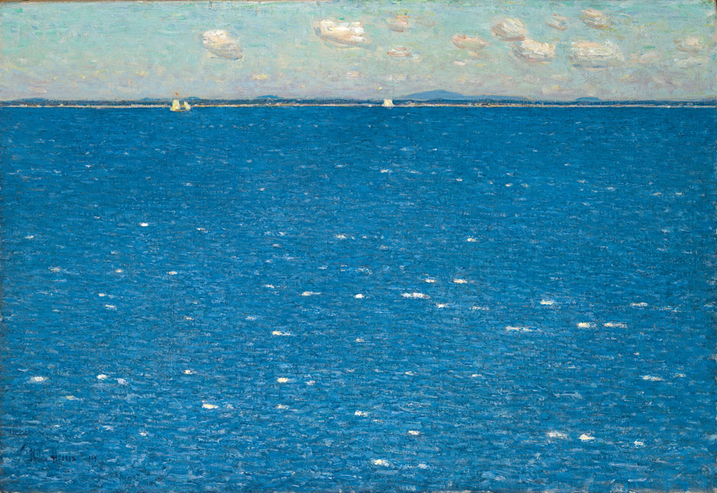
West Wind, Isles of Shoals, 1904, Oil on Canvas, 38.1x55.9 cm, Yale University Art Gallery, USA https://www.incollect.com/articles/american-impressionist-childe-hassam-and-the-isles-of-shoals

Slide 11
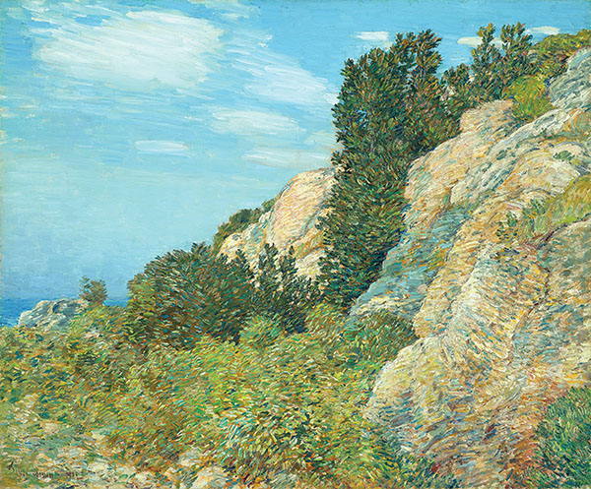
The Laurel in the Ledges, Appledore, 1905, Oil on Canvas, 63.5x76.2 cm, North Carolina Museum of Art, Raleigh, NC, USA https://www.historynet.com/childe-hassams-island-escape/

Slide 12
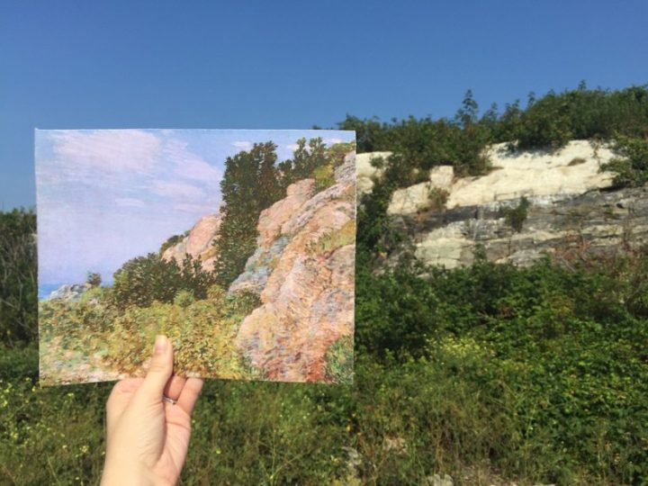
Comparison of Childe Hassam’s “The Laurel in the Ledges, Appledore” with the view of Appledore Island today (photo courtesy the North Carolina Museum of Art) https://hyperallergic.com/333153/finding-the-realism-in-impressionist-childe-hassams-work/

Slide 13
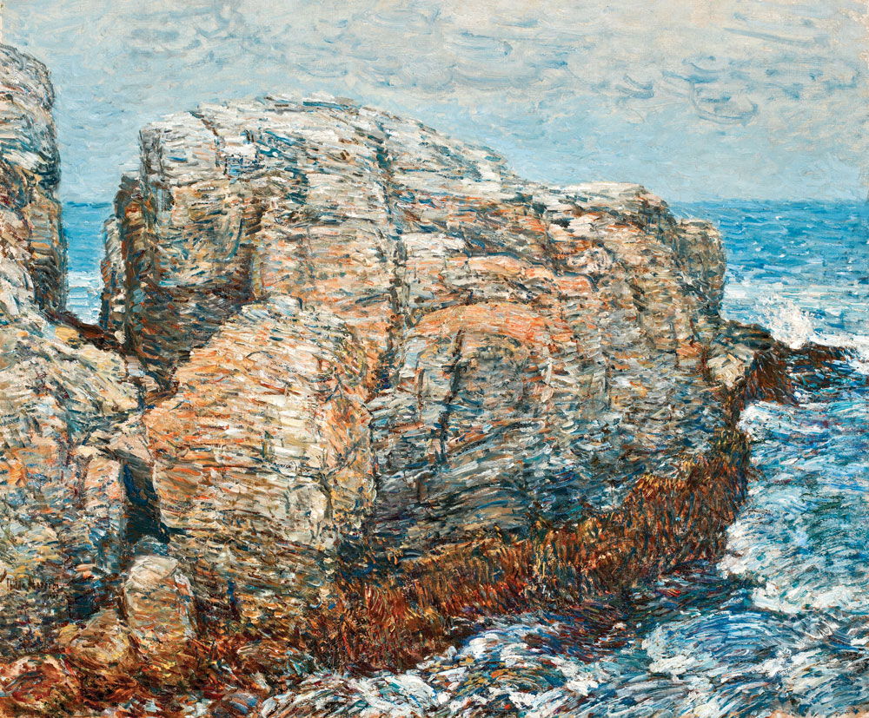
Sylph’s Rock, Appledore, 1907, Oil on Canvas, 63.5x76.2 cm, Worcester Art Museum, Worcester, Mass, USA https://www.incollect.com/articles/american-impressionist-childe-hassam-and-the-isles-of-shoals

Slide 14
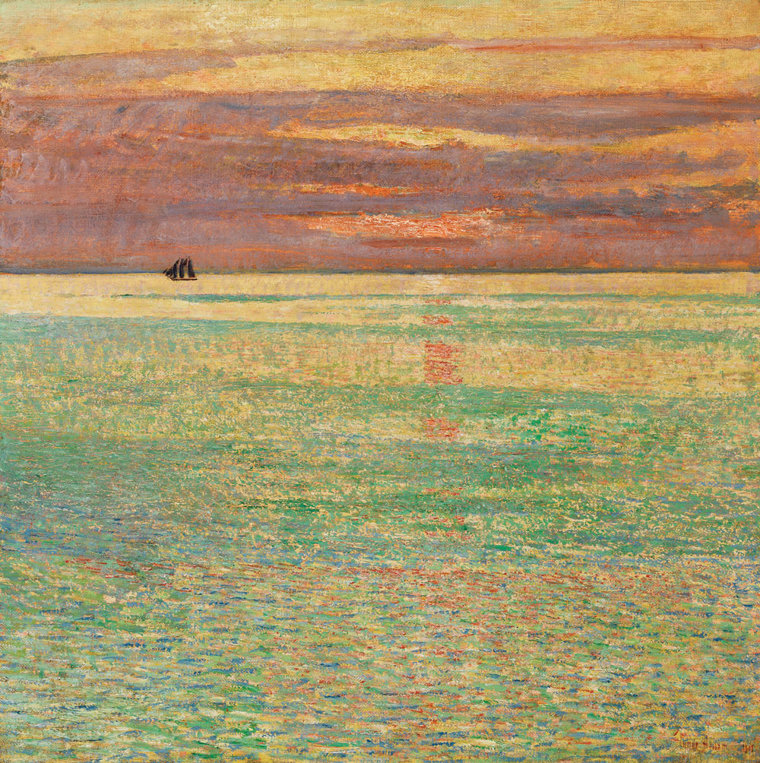
Sunset at Sea, 1911
Oil on canvas,
87.22x87.63 cm, Private collection https://www.incollect.com/articles/american-impressionist-childe-hassam-and-the-isles-of-shoals

Slide 15
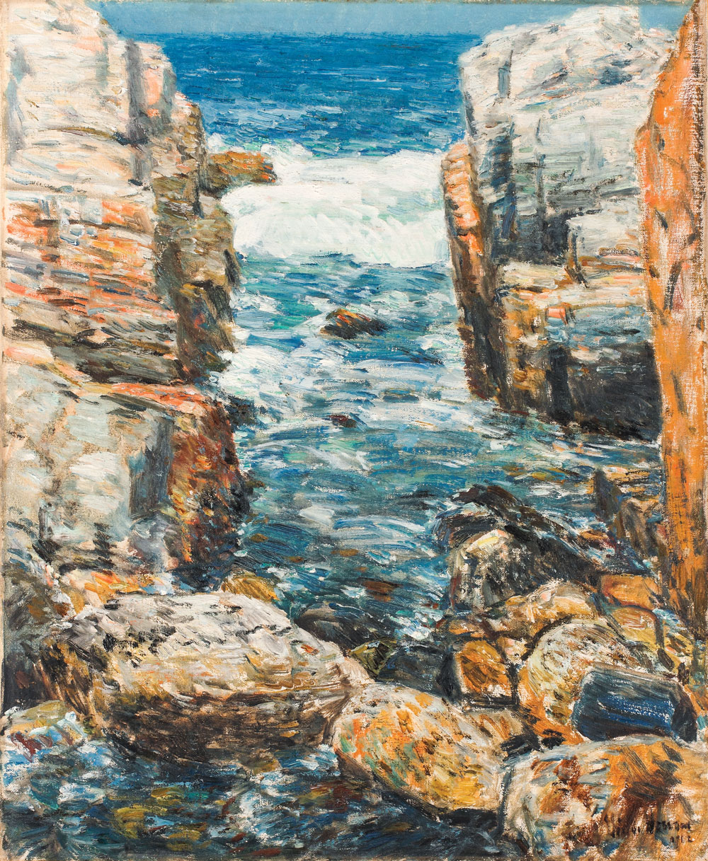
South Gorge, Appledore, Isles of Shoals, 1912
Oil on Canvas, 59.7 x 49.5 cm, Newark Museum, NJ, USA https://www.incollect.com/articles/american-impressionist-childe-hassam-and-the-isles-of-shoals

Slide 16
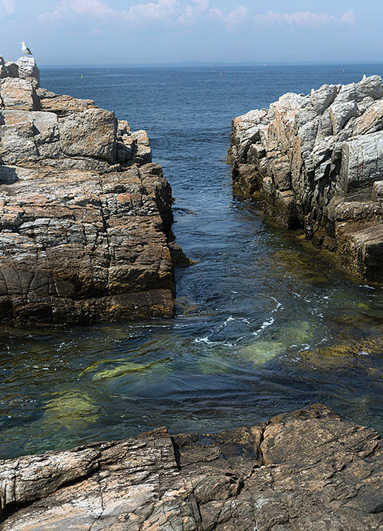
The South Gorge, Appledore, Isles of Shoals (© 2015 Photo by Kathy Tarantola/PEM) https://www.historynet.com/childe-hassams-island-escape/

Slide 17
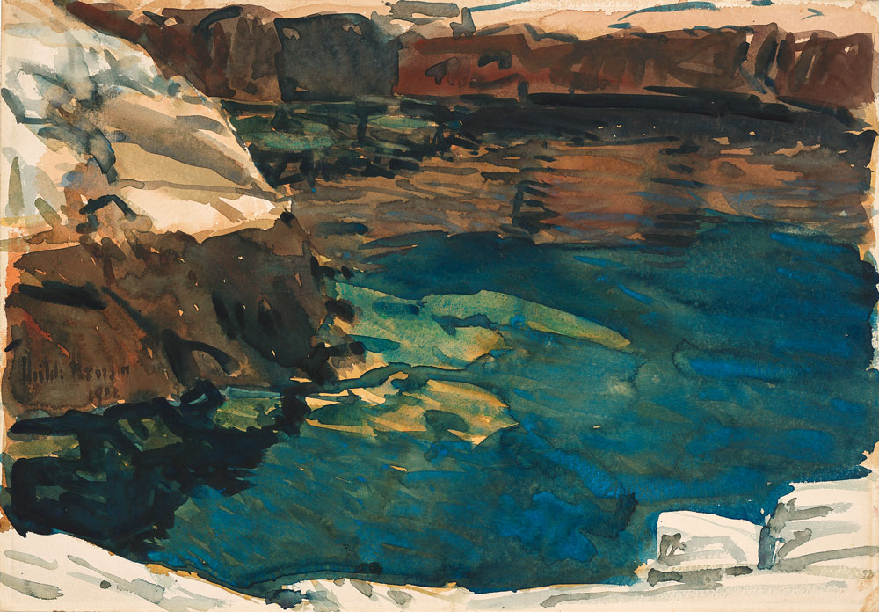
The Cove, 1912, Watercolor on Paper, 35.56x50.8 cm, Wichita Art Museum, Wichita, KS, USA https://www.incollect.com/articles/american-impressionist-childe-hassam-and-the-isles-of-shoals

Slide 18
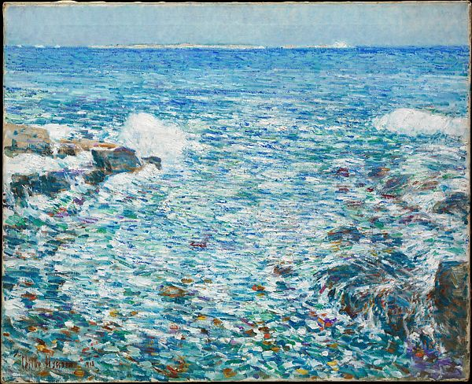
Isles of Shoals, 1913, Oil on Canvas, 89.5 x 71.8 cm, the MET, NY, USA https://www.metmuseum.org/art/collection/search/15583

