Slide 1
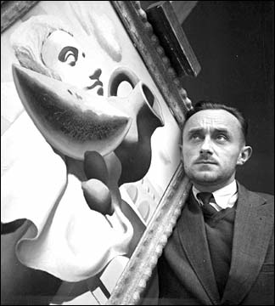
Adolphe Jean-Marie Mouron, known as A.M. Cassandre,
1901-1968 https://gr.pinterest.com/pin/483574078741763813/

Slide 2
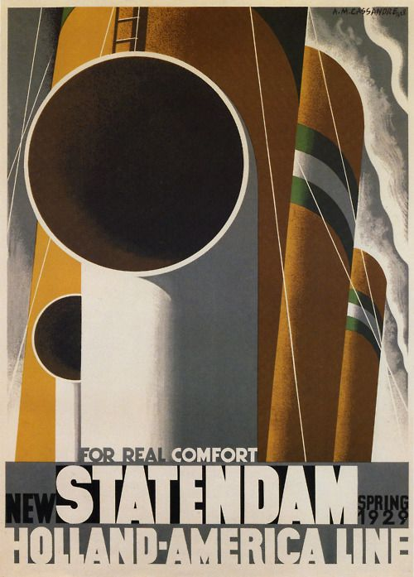
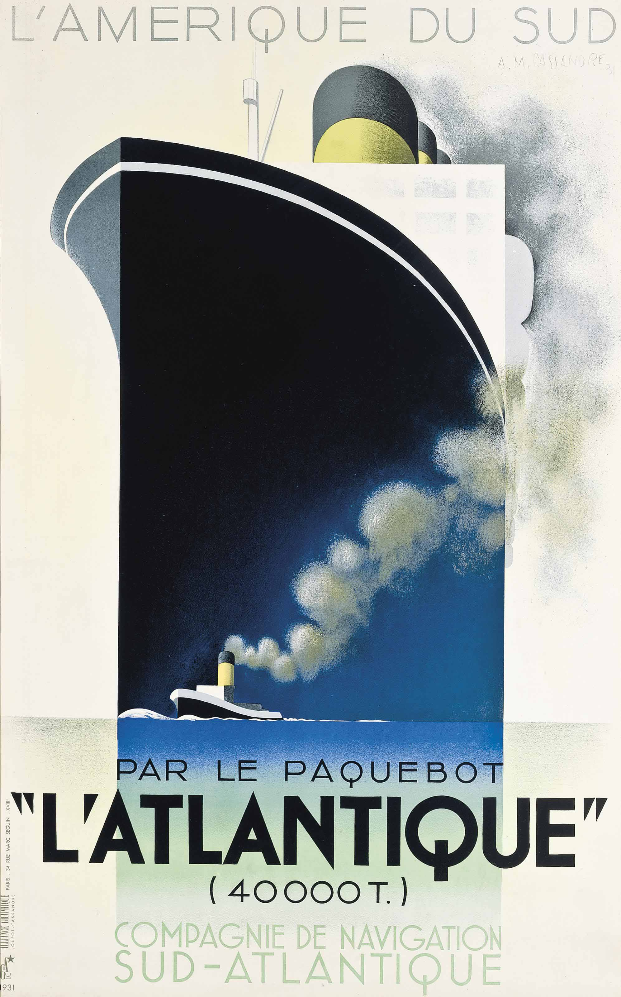
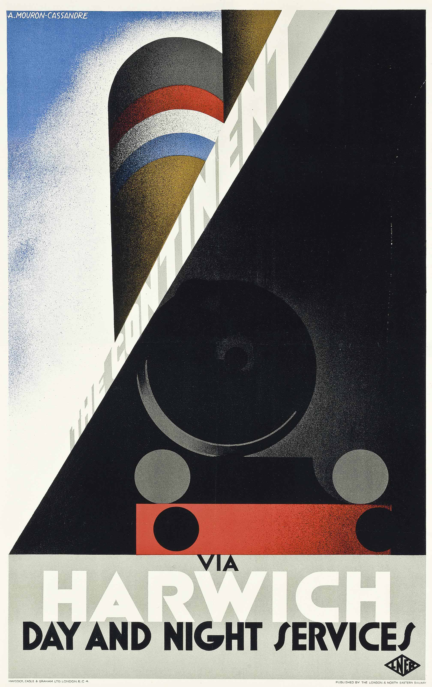
Statendam, 1928, lithograph in colours, 82.55 x 60.96 cm, Private Collection https://www.swanngalleries.com/news/vintage-posters/2021/11/upcoming-highlights-rare-important-travel-posters-november-23-2021/
L’Atlantique, 1931, lithograph in colours, 99 x 62 cm, Private Collection https://www.amazon.com/LAtlantique-Vintage-Poster-artist-Cassandre/dp/B017ZF79CY
The Ccontinent via Harwich, 1928, lithograph in colours, 101 x 62 cm, Private Collection https://auctions.posterauctions.com/lots/view/1-5INZNJ/the-continent-via-harwich-1928

Slide 3
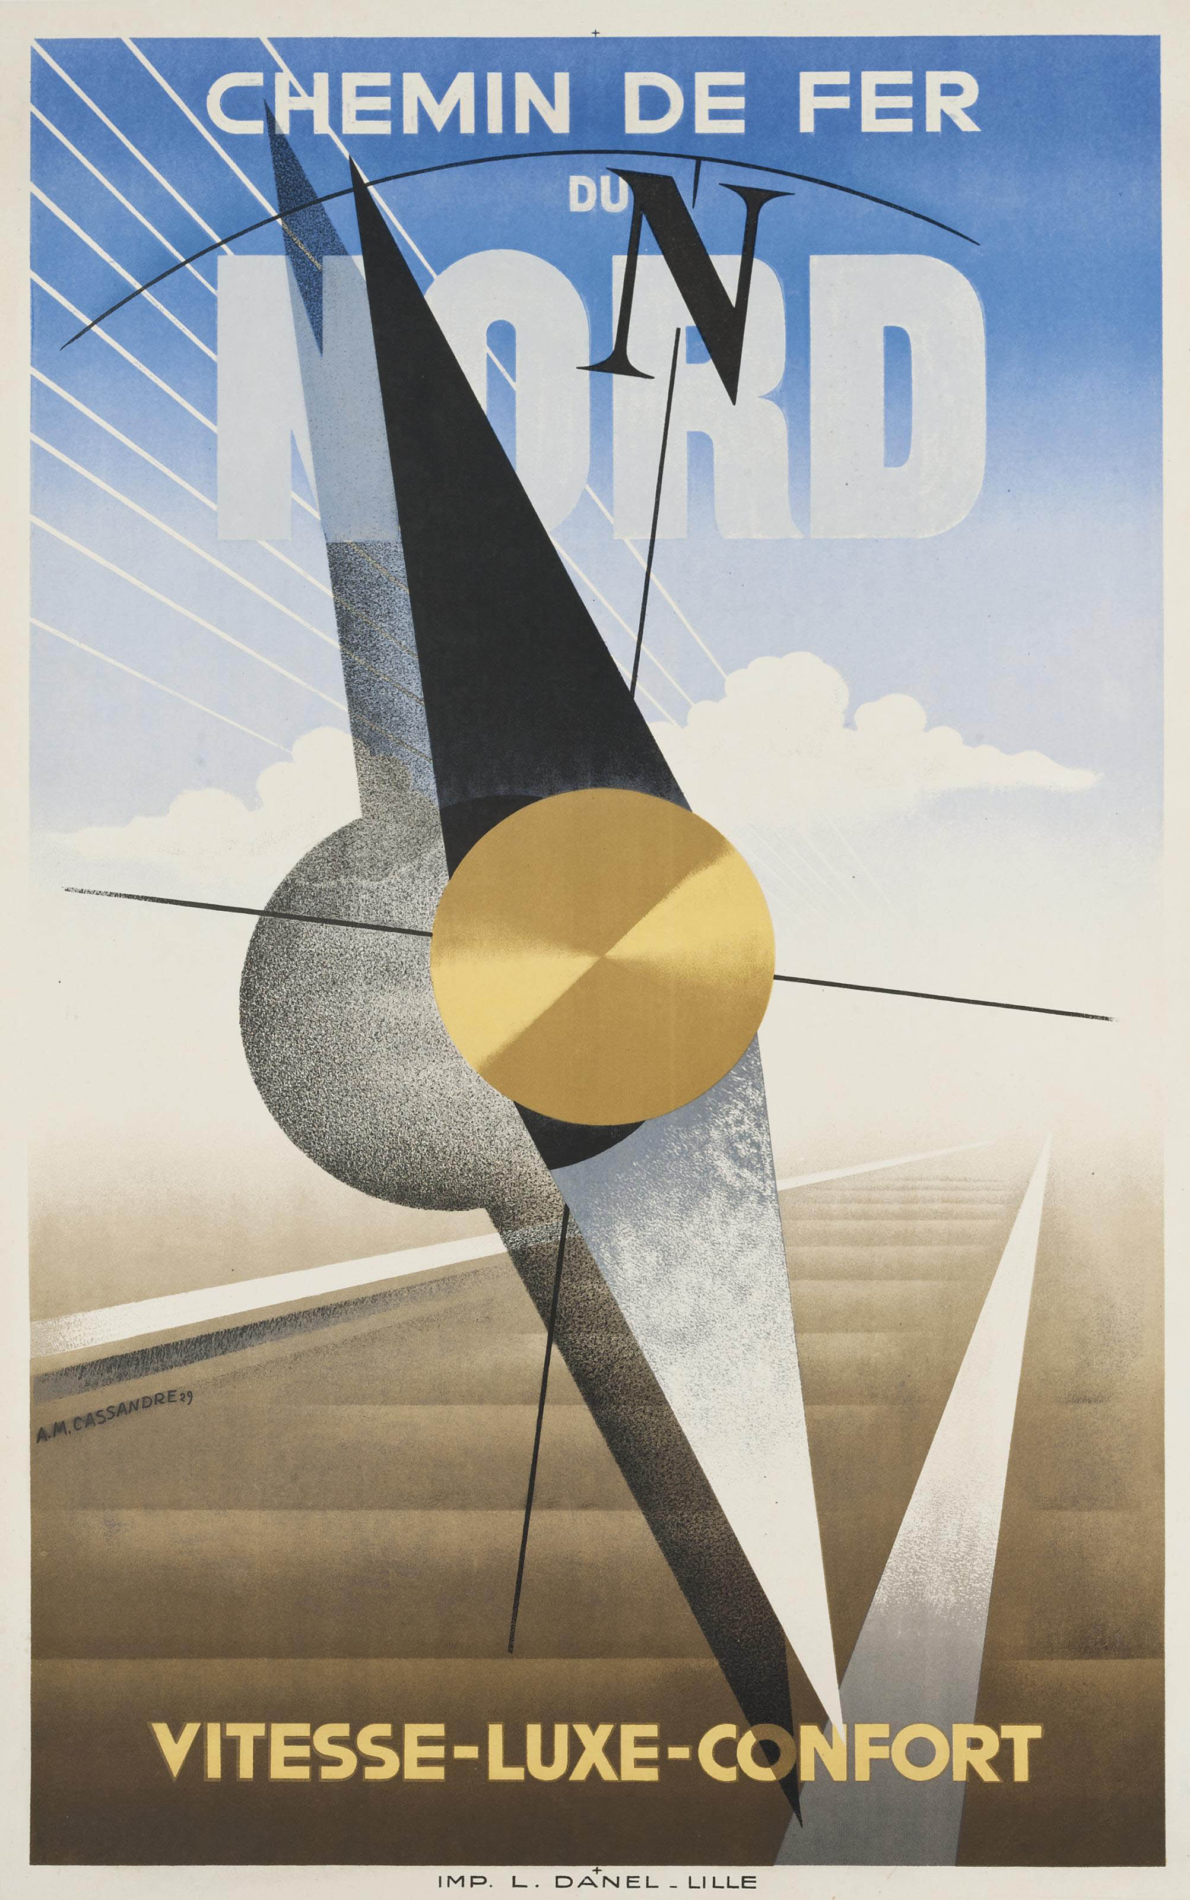
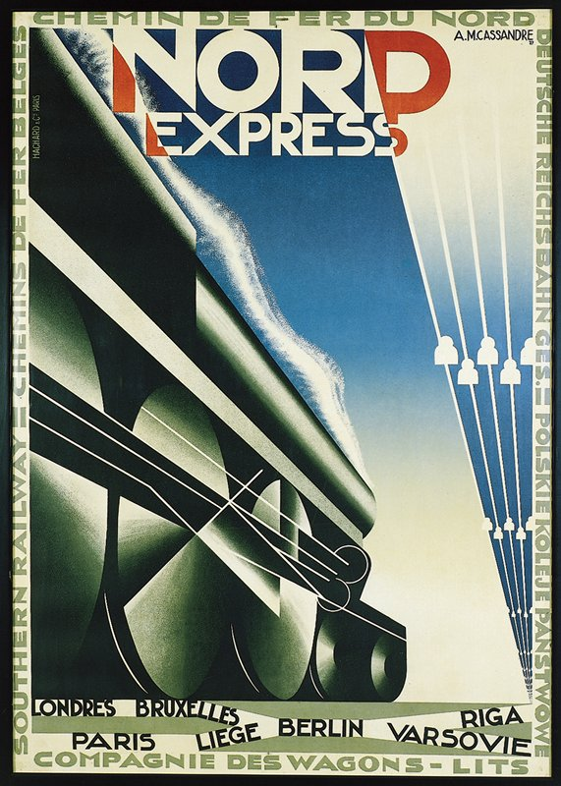
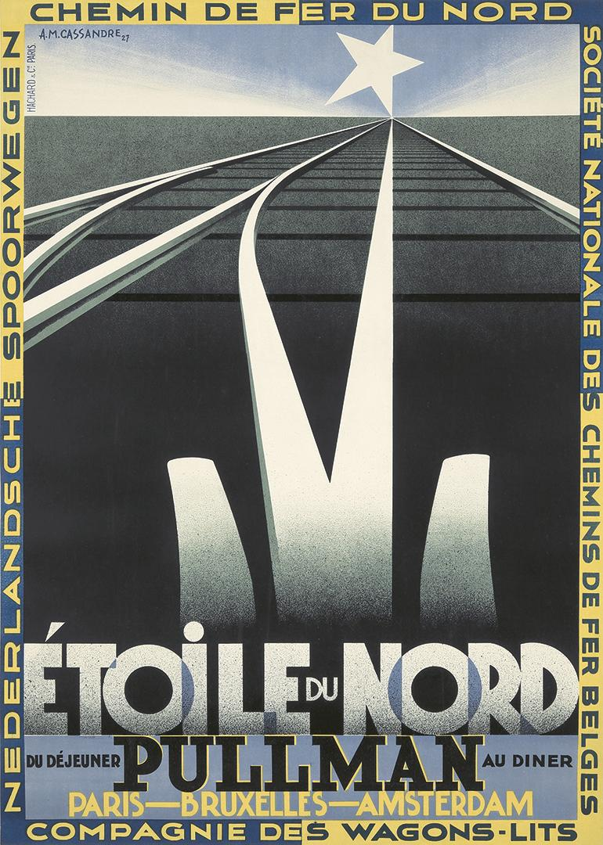
Chemin de Fer du Nord, 1929, lithograph in colours, 99 x 62 cm, Private Collection https://catalogue.swanngalleries.com/Lots/auction-lot/ADOLPHE-MOURON-CASSANDRE-(1901-1968)-CHEMIN-DE-FER-DU-NORD-1?saleno=2161&lotNo=37&refNo=607457
Nord Express, 1927, lithograph in colours, 105.09 x 74.93 cm, Minneapolis Institute of Art, USA https://collections.artsmia.org/art/7158/nord-express-adolphe-mouron-cassandre
Etoile du Nord, 1927, lithograph in colours, 75.5 x 106 cm, Private Collection https://auctions.posterauctions.com/lots/view/1-HG2O2/etoile-du-nord-1927

Slide 4
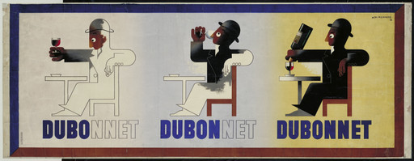
Dubo Dubon Dubonnet, 1932, lithograph in colours, 44.5 x 115.6 cm, MOMA, NY, USA

Slide 5
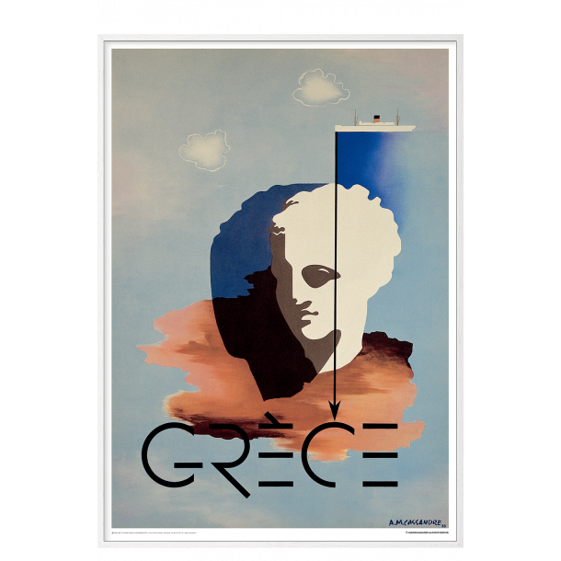
Grèce, 1933, lithograph in colours, 88 x 125 cm, Private Collection https://permild-rosengreen.com/shop/159-posters/4985-cassandre-1933---grece/

Slide 6
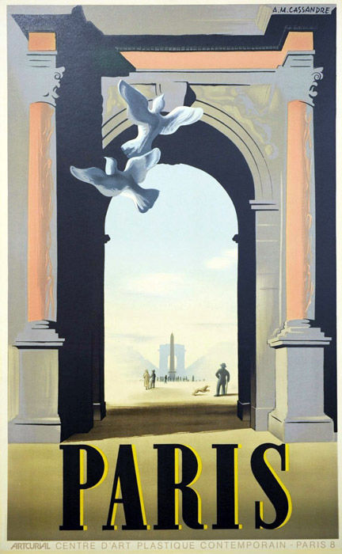
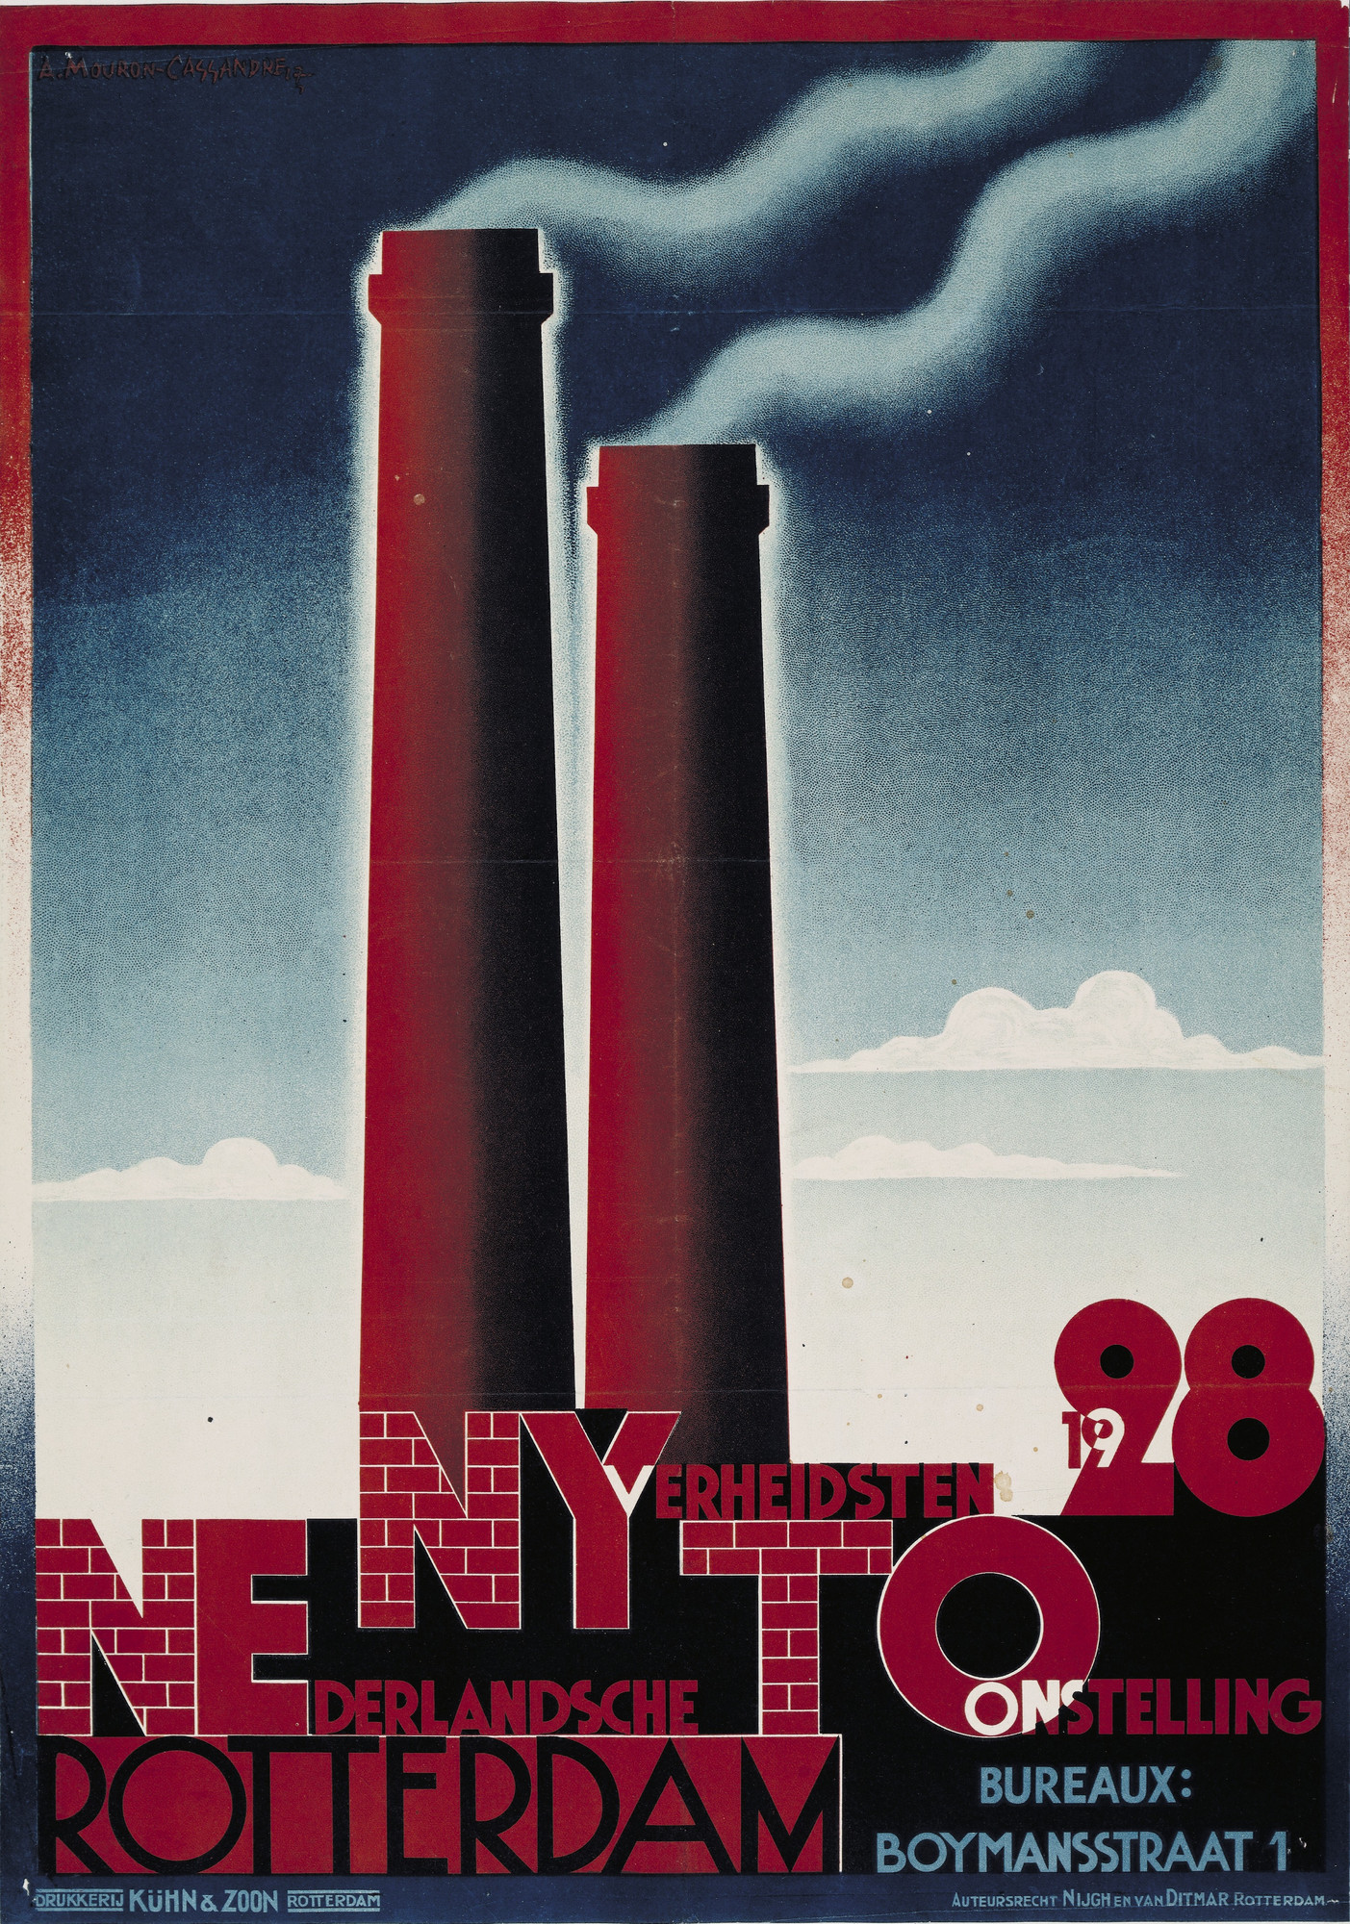
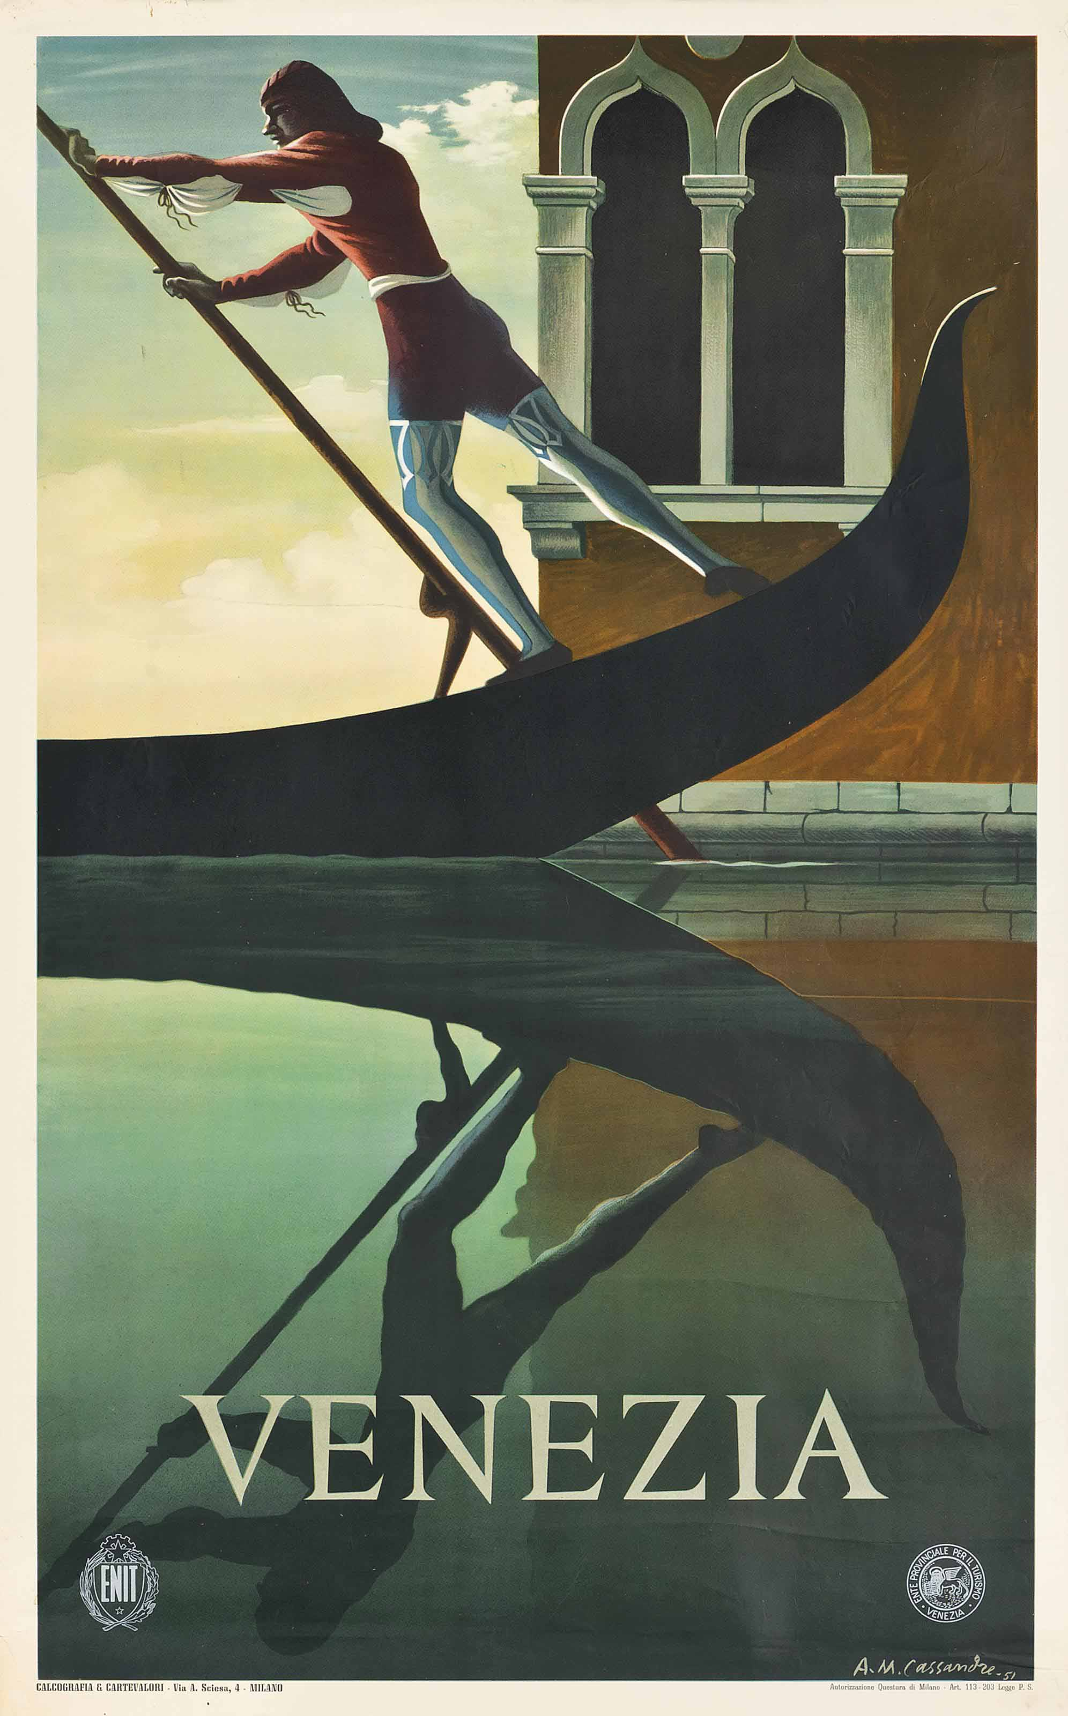
Paris, 1935, lithograph in colours, 75 x 125 cm, Private Collection https://www.catawiki.com/en/l/23358303-a-m-cassandre-paris-1935-1984
Rotterdam, 1928, lithograph in colours, 105 x 75 cm, MOMA, NY, USA https://www.moma.org/collection/works/7152
Venezia, 1951, lithograph in colours, 100 x 62 cm, Private Collection http://www.artnet.com/artists/am-cassandre/venezia-w3nL_8TDYIczTJFetY9xcw2

