Slide 1
Villa Pisanella in Boscoreale

Slide 2
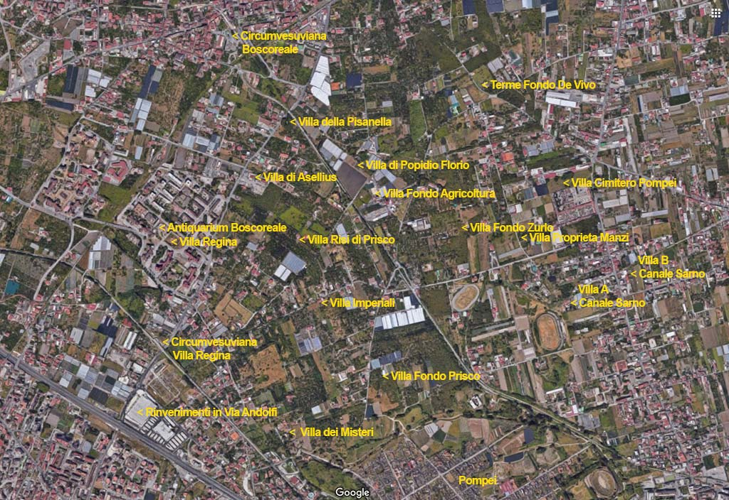
Boscoreale, location plan of Villa Pisanella and other villas based on the plan displayed in Bocoreale Antiquarium. The locations are an indication only. Most of the villas are buried and not visitable.
Photo courtesy of Google Earth. https://www.pompeiiinpictures.com/pompeiiinpictures/VF/Villa_013%20Boscoreale%20Villa%20della%20Pisanella%20p1.htm

Slide 3
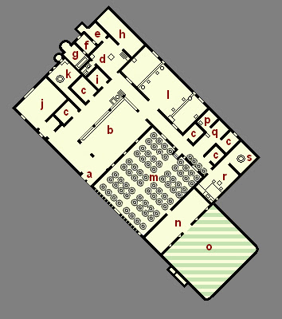
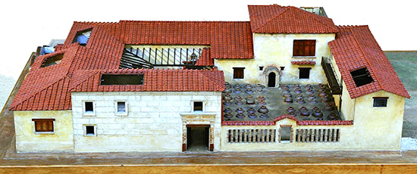
Plan and Model of the reconstruction of the Villa “alla Pisanella” before the volcanic eruption of 79 AD https://sites.google.com/site/ad79eruption/boscoreale/villa-pisanella and https://www.romanoimpero.com/2021/04/villa-della-pisanella.html

Slide 4
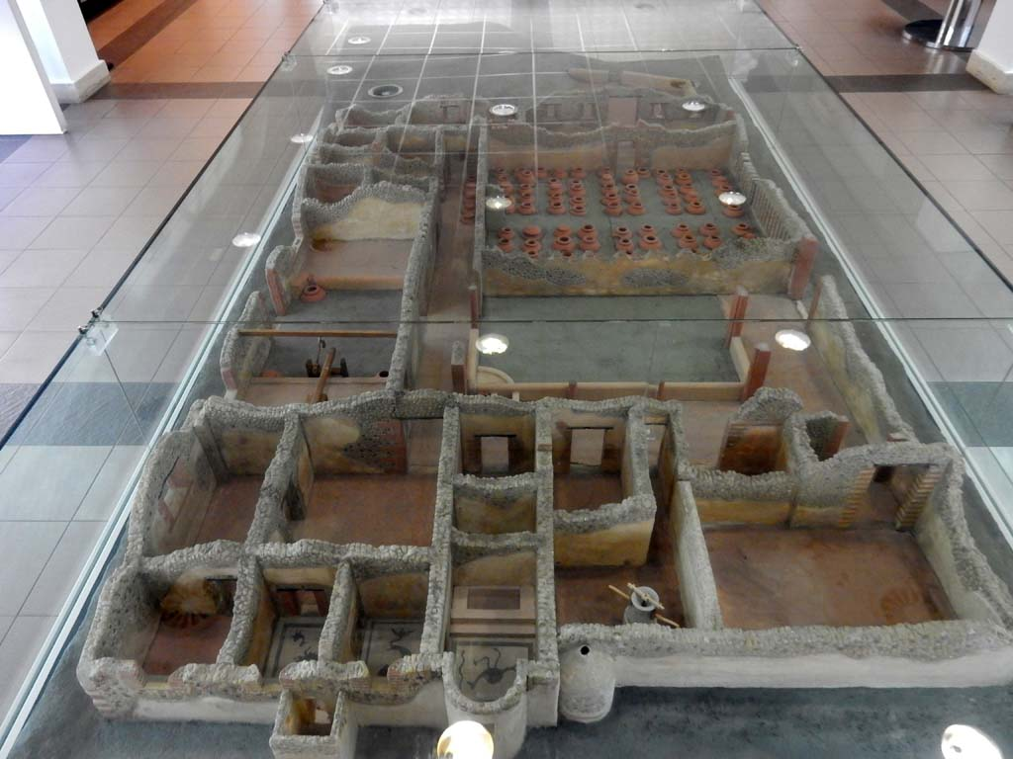
Model of Villa Pisanella, Boscoreale Boscoreale Antiquarium, Photo courtesy of Buzz Ferebee https://www.pompeiiinpictures.com/pompeiiinpictures/VF/Villa_013%20Boscoreale%20Villa%20della%20Pisanella%20p1.htm

Slide 5
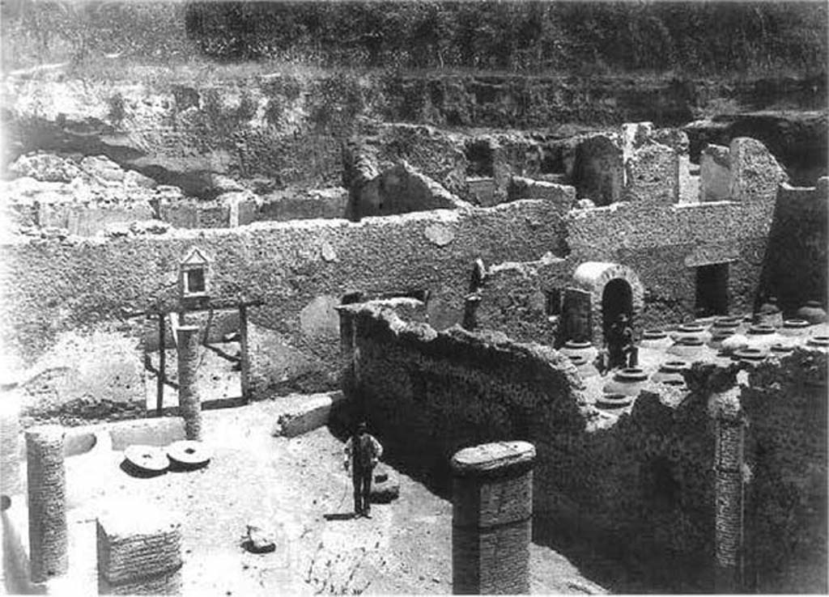
Villa Pisanella (old photo during excavations),1903, looking North across the courtyard/peristyle and Cella Vinaria https://www.pompeiiinpictures.com/pompeiiinpictures/VF/Villa_013%20Boscoreale%20Villa%20della%20Pisanella%20p1.htm

Slide 6
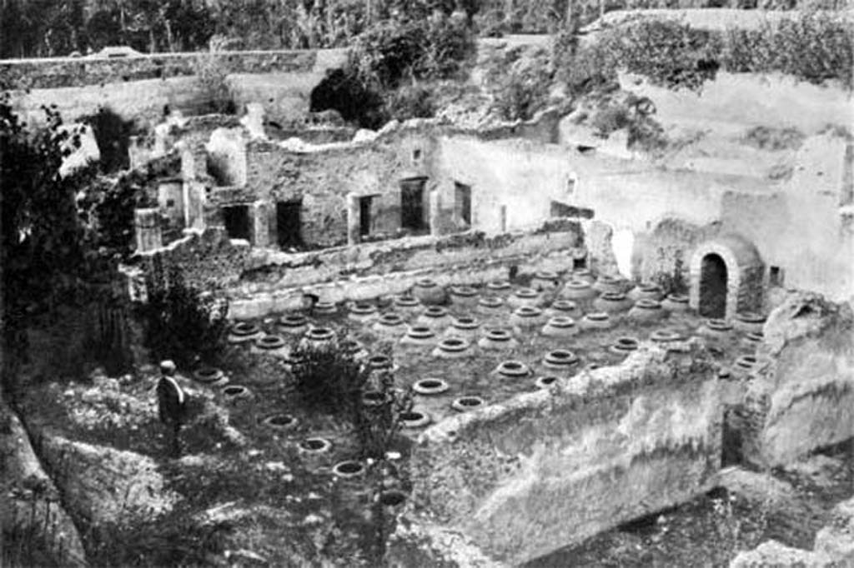
Villa Pisanella (old photo during excavations) 1903, looking Nort/West across the Cella Vinaria https://www.pompeiiinpictures.com/pompeiiinpictures/VF/Villa_013%20Boscoreale%20Villa%20della%20Pisanella%20p1.htm

Slide 7
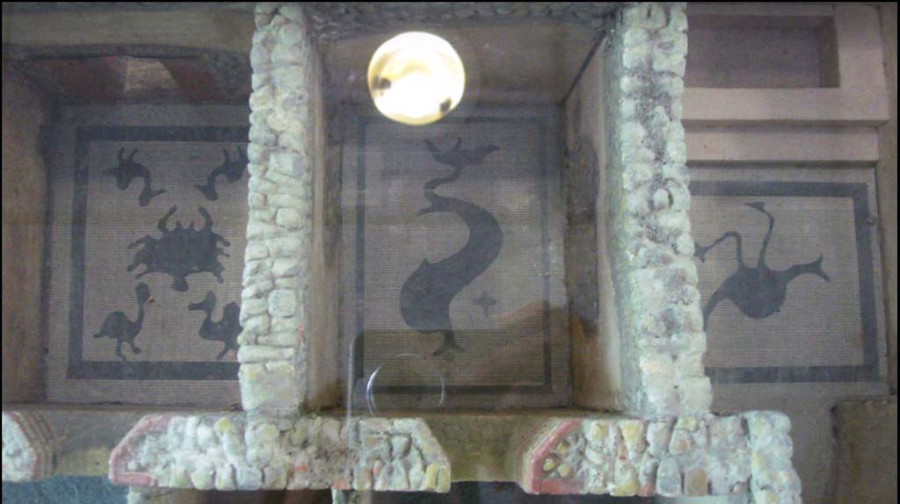
Model of Villa Pisanela’s private Bath, Apodyterium E, Tepidarium F, Calidarium G. Model in Boscoreale Villa Pisanella, Boscoreale. May 2018. Mosaic floors in Apodyterium (Rm M - Mosaic of 4 Duks and a Crub), Tepidarium (Rm N – Mosaic of a “monstrous” Dolphin) , Calidarium (Rm O – Mosaic of Stork and Snake), Boscoreale, Italy https://www.pompeiiinpictures.com/pompeiiinpictures/VF/Villa_013%20Boscoreale%20Villa%20della%20Pisanella%20p1.htm

Slide 8
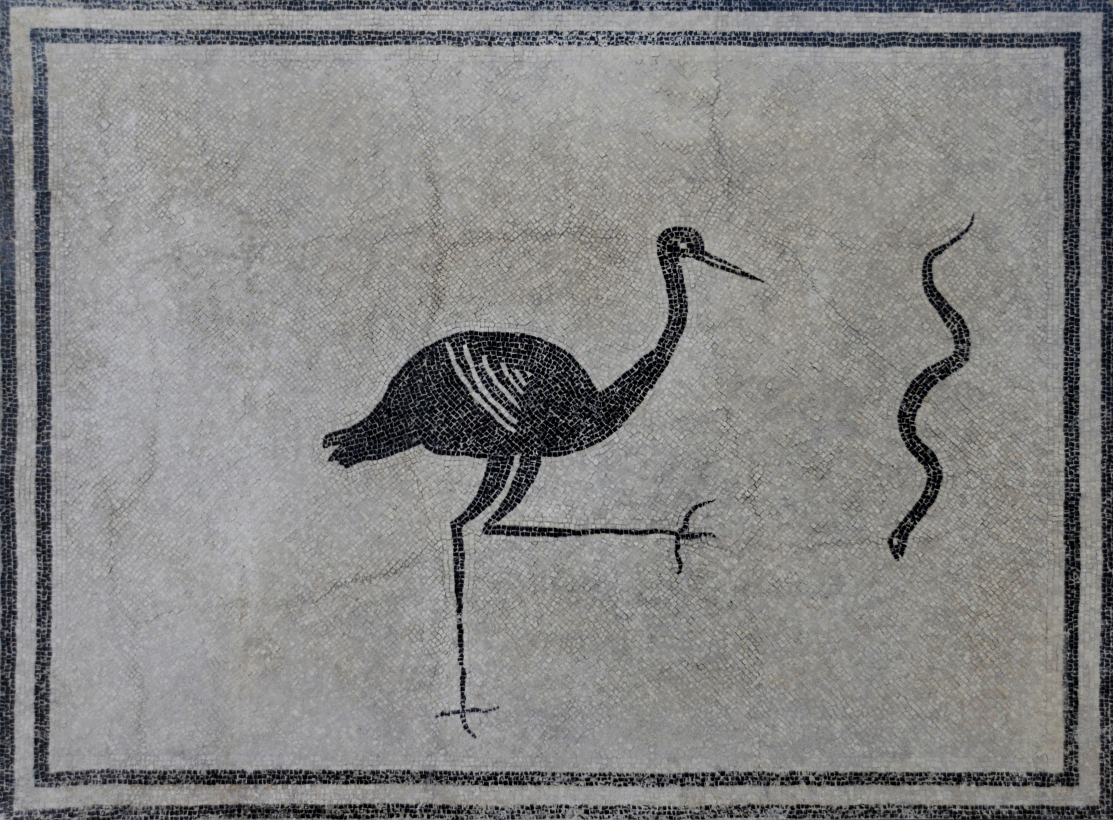
Stork advancing towards a Snake, third quarter of 1st century AD, Black-and-White Mosaic floor from the Caldarium of Villa Pisanella at Boscoreale, Boscoreale Antiquarium, Italy https://commons.wikimedia.org/wiki/File:Black-and-white_mosaic_floor_depicting_a_stork_advancing_towards_a_snake,_from_the_caldarium_of_Villa_della_Pisanella_at_Boscoreale,_third_quarter_of_1st_century_AD,_Antiquarium_of_Boscoreale,_Italy.jpg

Slide 9
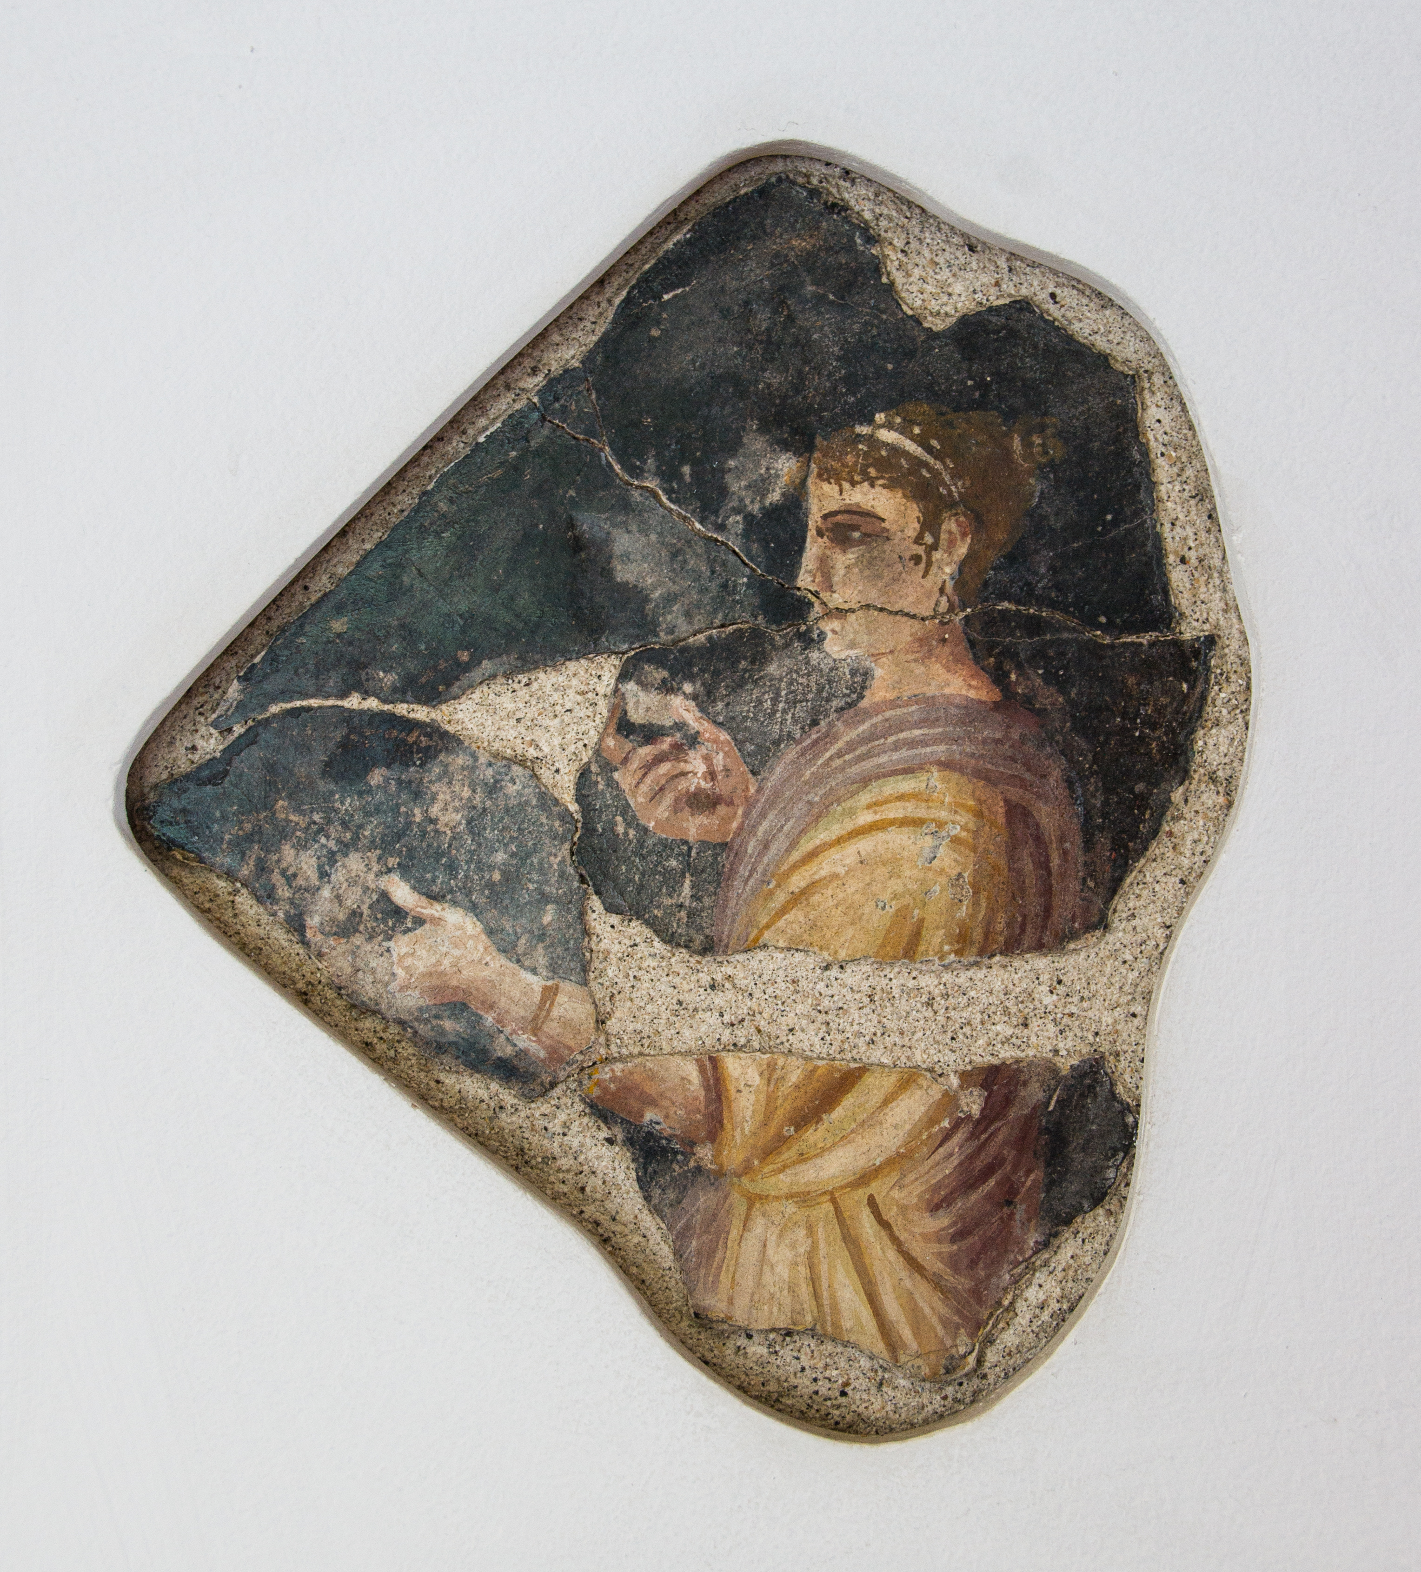
Villa Pisanella, 40-20 BC, Fragment of a Fresco wall decoration from the upper floor of the Villa, featuring a Woman on a black background presenting fruits, Boscoreale, Italy https://commons.wikimedia.org/wiki/File:Women_villa_della_Pisanella_Pompeii_Museum_Boscoreale.jpg

Slide 10
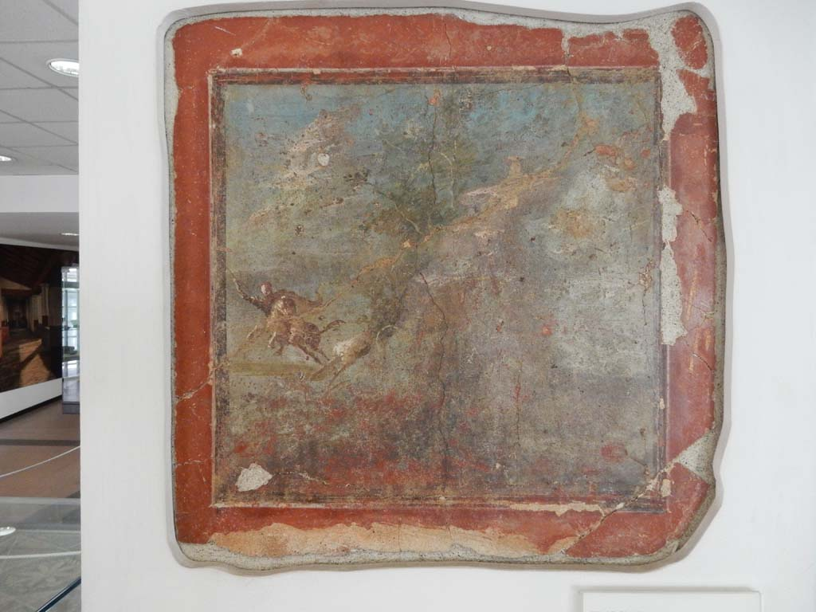
Villa della Pisanella,Fresco with Hunt Scene, 1st century AD, Room J, triclinium with red walls, Boscoreale Antiquarium, Italy https://www.pompeiiinpictures.com/pompeiiinpictures/VF/Villa_013%20Boscoreale%20Villa%20della%20Pisanella%20p1.htm

Slide 11
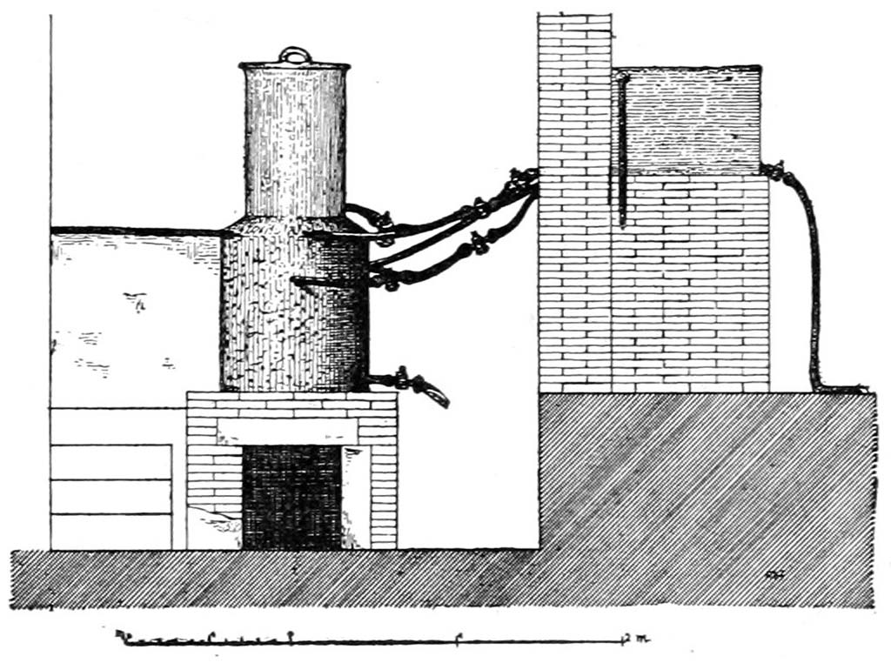
Villa Pisanella hot water tank reservoir for supplying the Villa’s bath facilities https://www.pompeiiinpictures.com/pompeiiinpictures/VF/Villa_013%20Boscoreale%20Villa%20della%20Pisanella%20p3.htm

Slide 12
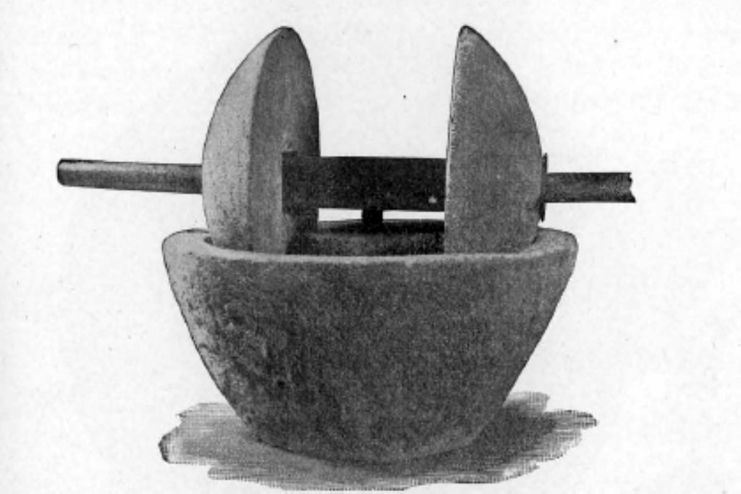
Villa Pisanella Olive Crusher https://www.pompeiiinpictures.com/pompeiiinpictures/VF/Villa_013%20Boscoreale%20Villa%20della%20Pisanella%20p3.htm

Slide 13
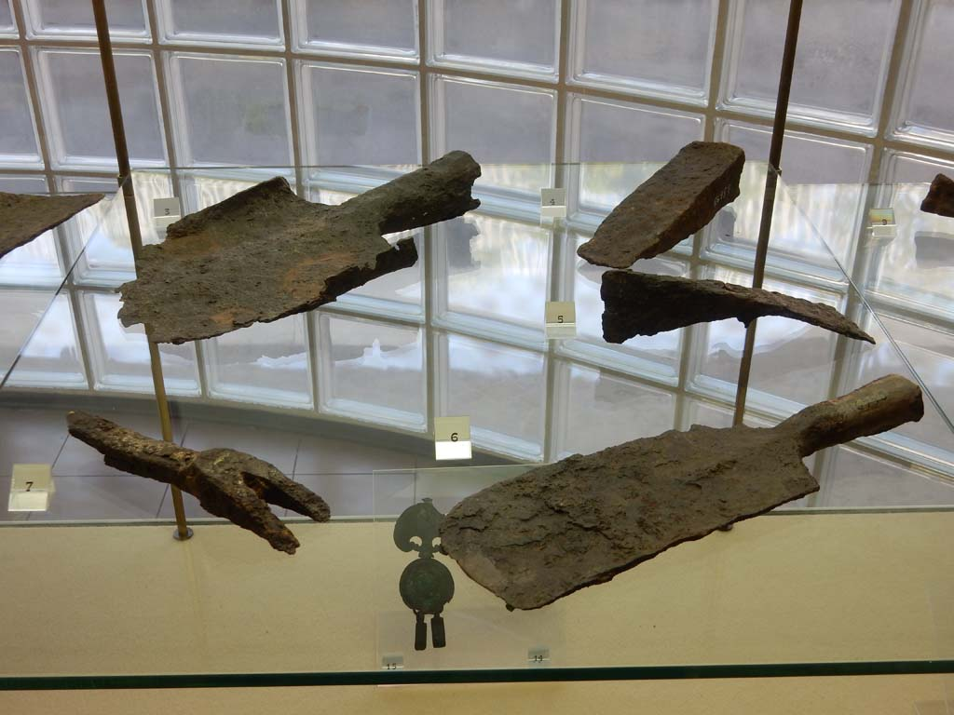
Villa Pisanella Iron Tools, Boscoreale Antiquarium, Italy https://www.pompeiiinpictures.com/pompeiiinpictures/VF/Villa_013%20Boscoreale%20Villa%20della%20Pisanella%20p3.htm

Slide 14
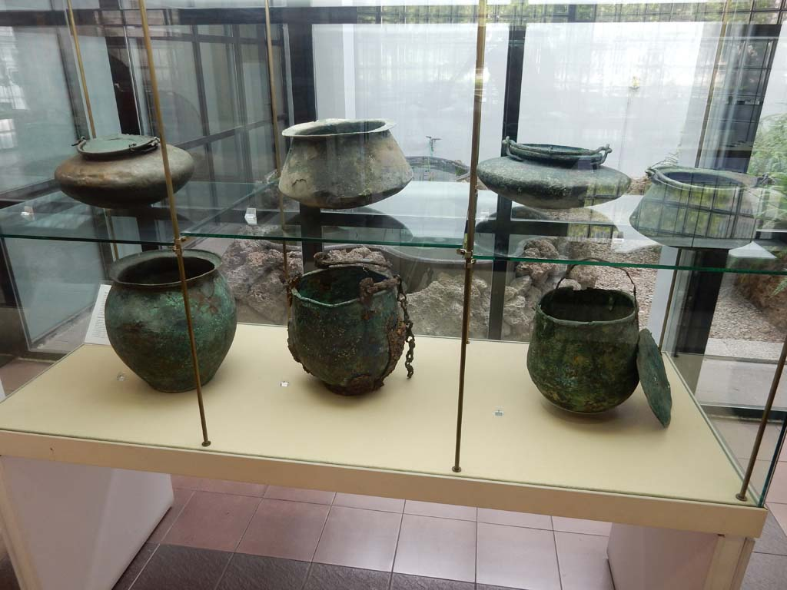
Villa Pisanella Kitchen Utensils, Boscoreale Antiquarium, Italy https://www.pompeiiinpictures.com/pompeiiinpictures/VF/Villa_013%20Boscoreale%20Villa%20della%20Pisanella%20p3.htm

Slide 15
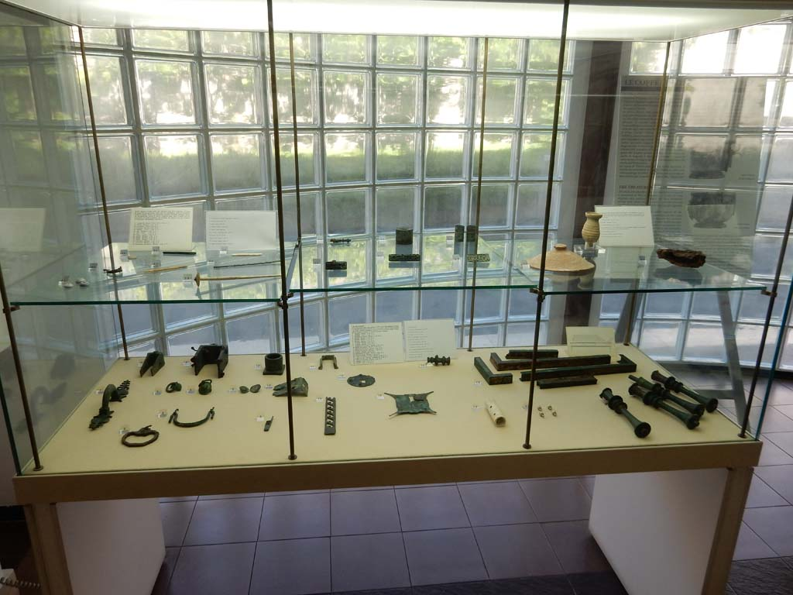
Villa Pisanella household items like door handles, bronze bed ornaments, etc, Boscoreale Antiquarium, Italy https://www.pompeiiinpictures.com/pompeiiinpictures/VF/Villa_013%20Boscoreale%20Villa%20della%20Pisanella%20p3.htm

Slide 16
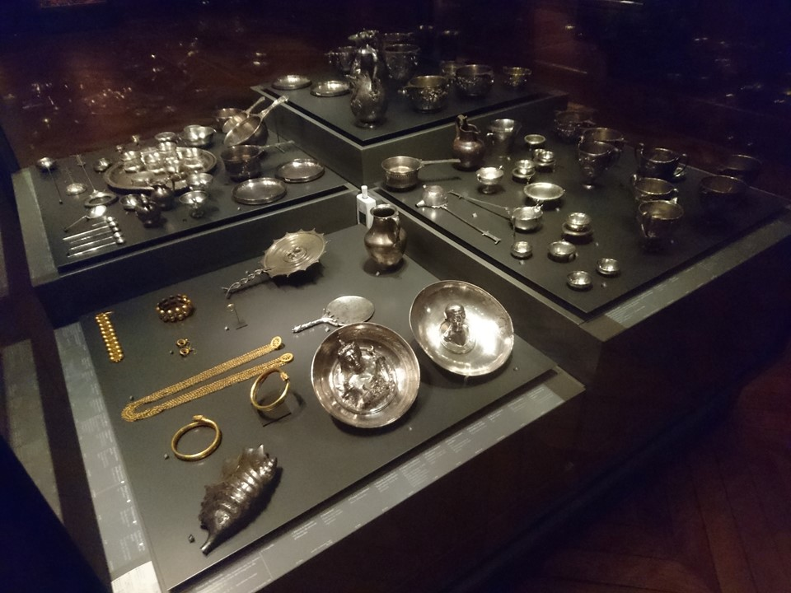
Boscoreale Treasure, 50 BC-50 AD, silver, Louvre Museum, Paris, France https://commons.wikimedia.org/wiki/File:Tr%C3%A9sor_de_Boscoreale_%E2%80%93_Mus%C3%A9e_du_Louvre_%E2%80%93_Q178624_%E2%80%93_a.jpg

Slide 17
The End

