Slide 1
Donatello, ca. 1386-1466
Ten Masterpieces

Slide 2
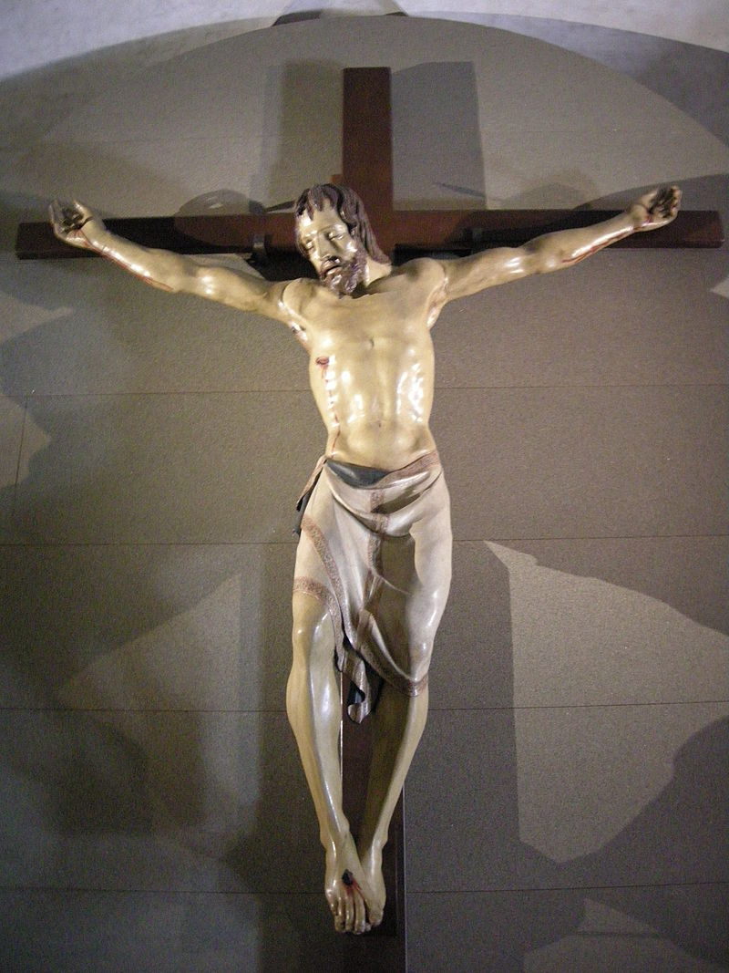
Santa Croce Crucifix, c.1406-1408, Polychrome Wood, Height: 165 cm, Cappella Bardi di Vernio, Santa Croce, Florence, Italy https://en.wikipedia.org/wiki/Santa_Croce_Crucifix_(sculpture)

Slide 3
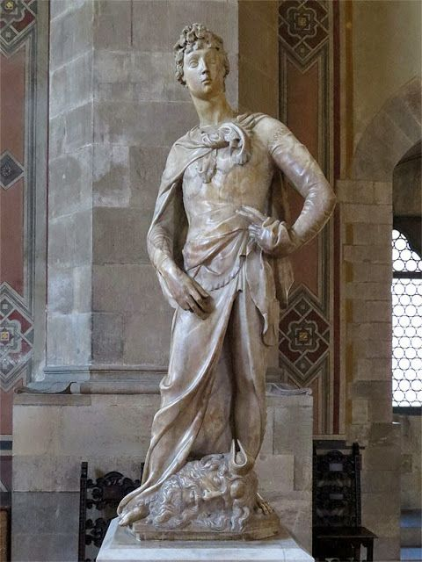
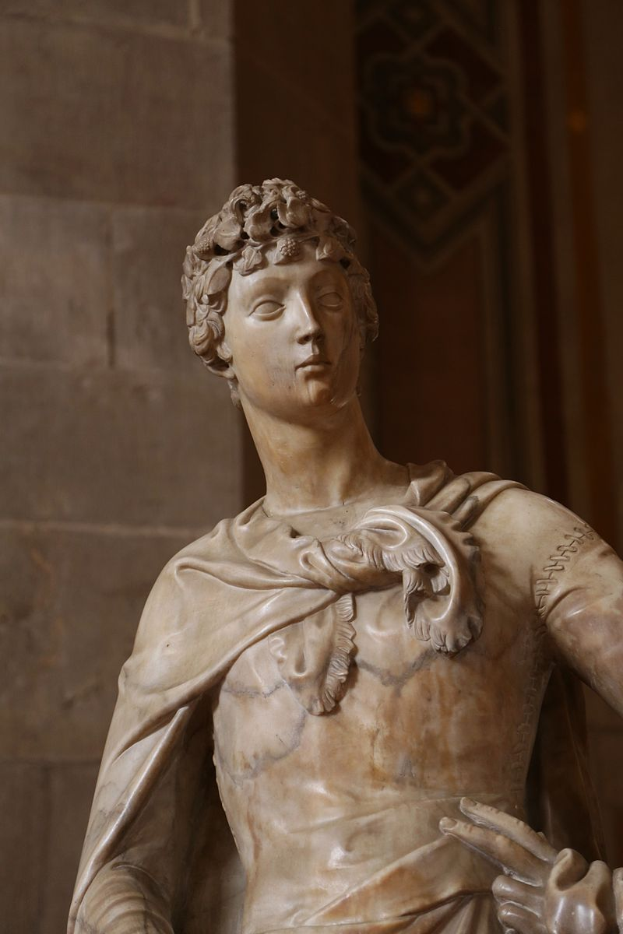
David, 1409, Marble, Height:
191 cm, Museo Nazionale del Bargello, Florence, Italy https://dailyphotostream.blogspot.com/2015/04/the-marble-david.html https://commons.wikimedia.org/wiki/Category:Marble_David_by_Donatello?uselang=it#/media/File:David,_Donatello,_ca._1408,_Bargello_Florenz-06.jpg

Slide 4
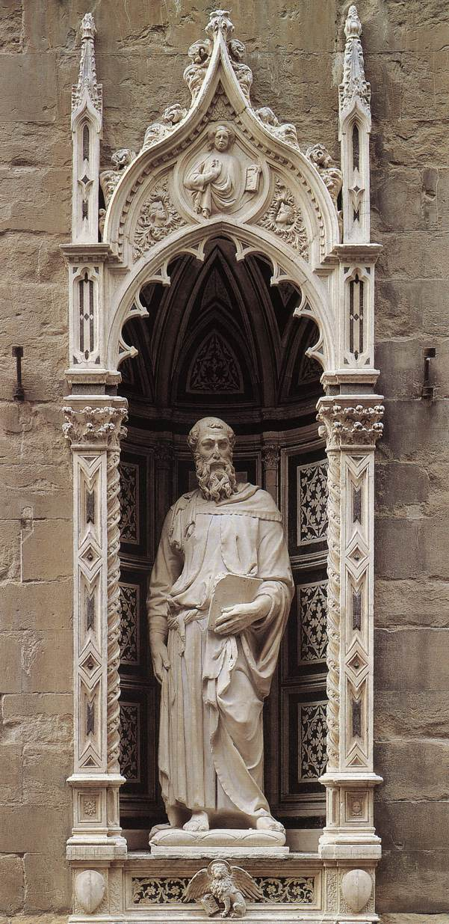
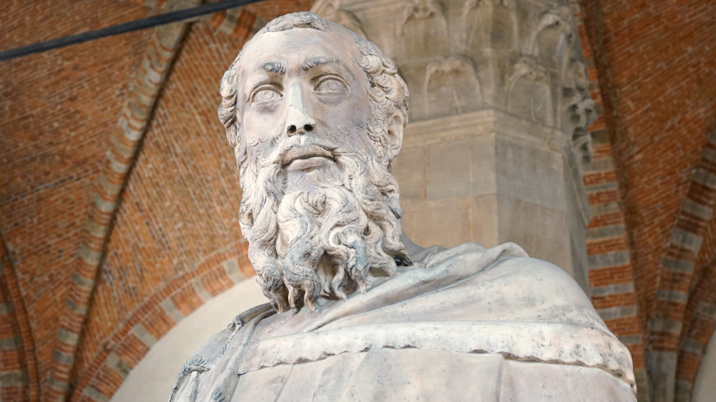
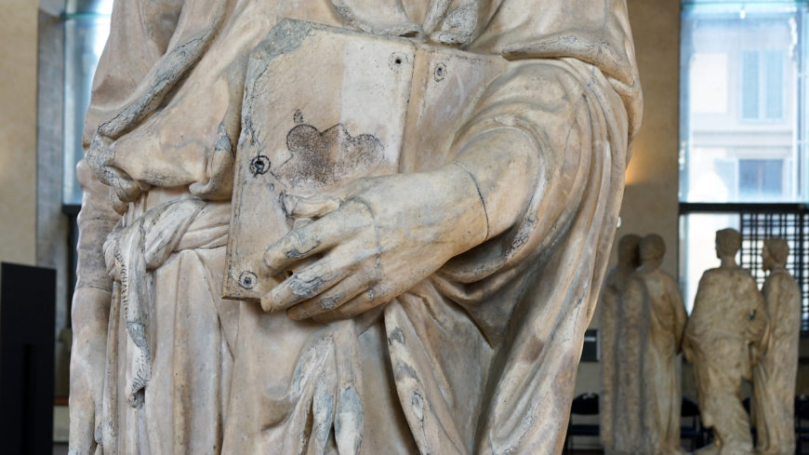
Saint Mark, 1411, Marble, height 236 cm, Orsanmichele, Florence, Italy https://commons.wikimedia.org/wiki/File:Stmark.jpg https://smarthistory.org/donatello-st-mark/

Slide 5
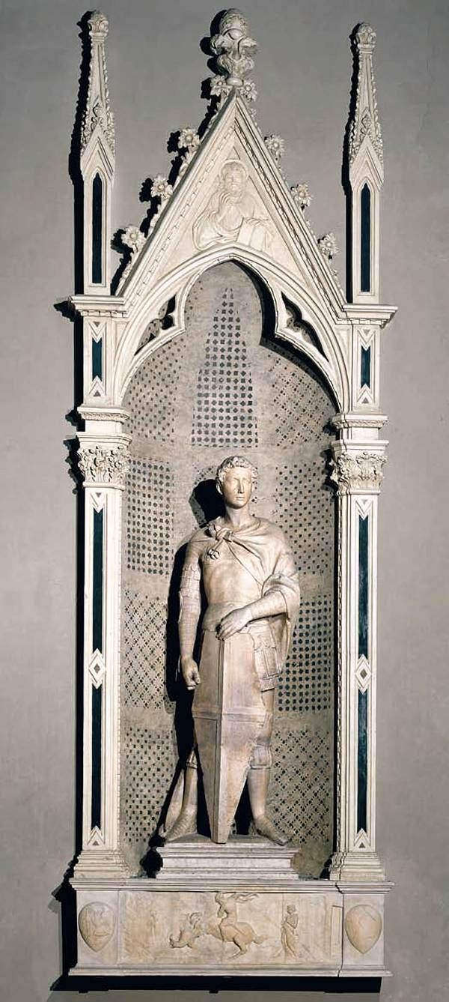
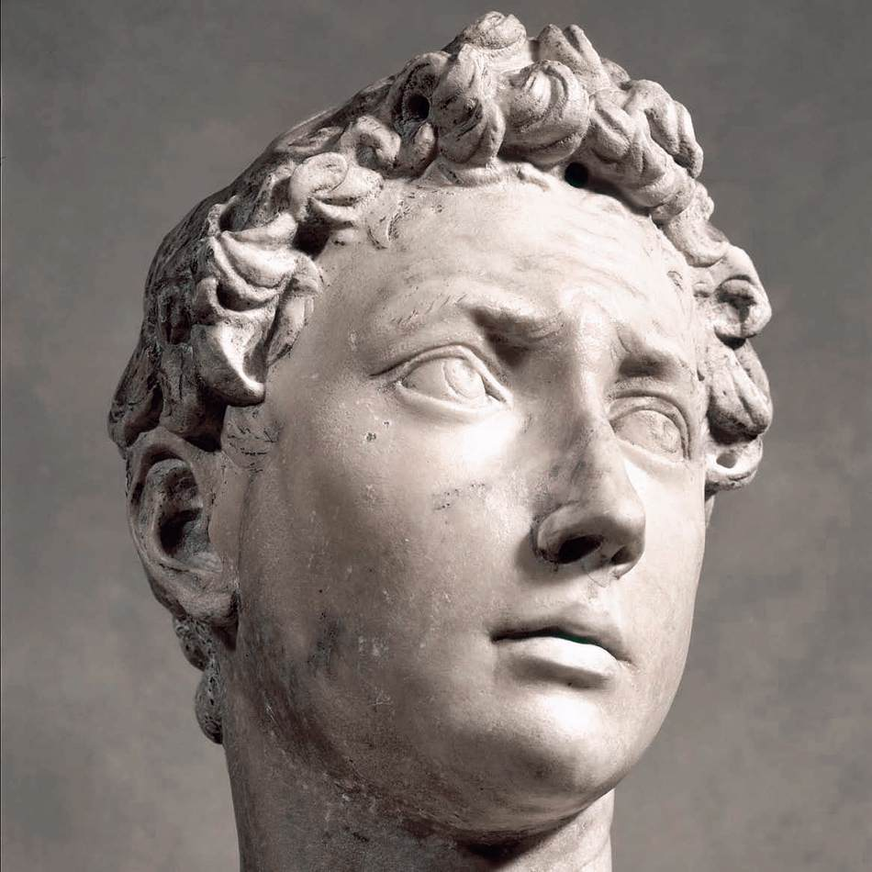
Saint George, c. 1416, Marble, height 214 cm, Museo Nazionale del Bargello, Florence, Italy https://www.wga.hu/frames-e.html?/ https://www.wga.hu/frames-e.html?/html/d/donatell/1_early/orsanmic/1georg_1.html

Slide 6
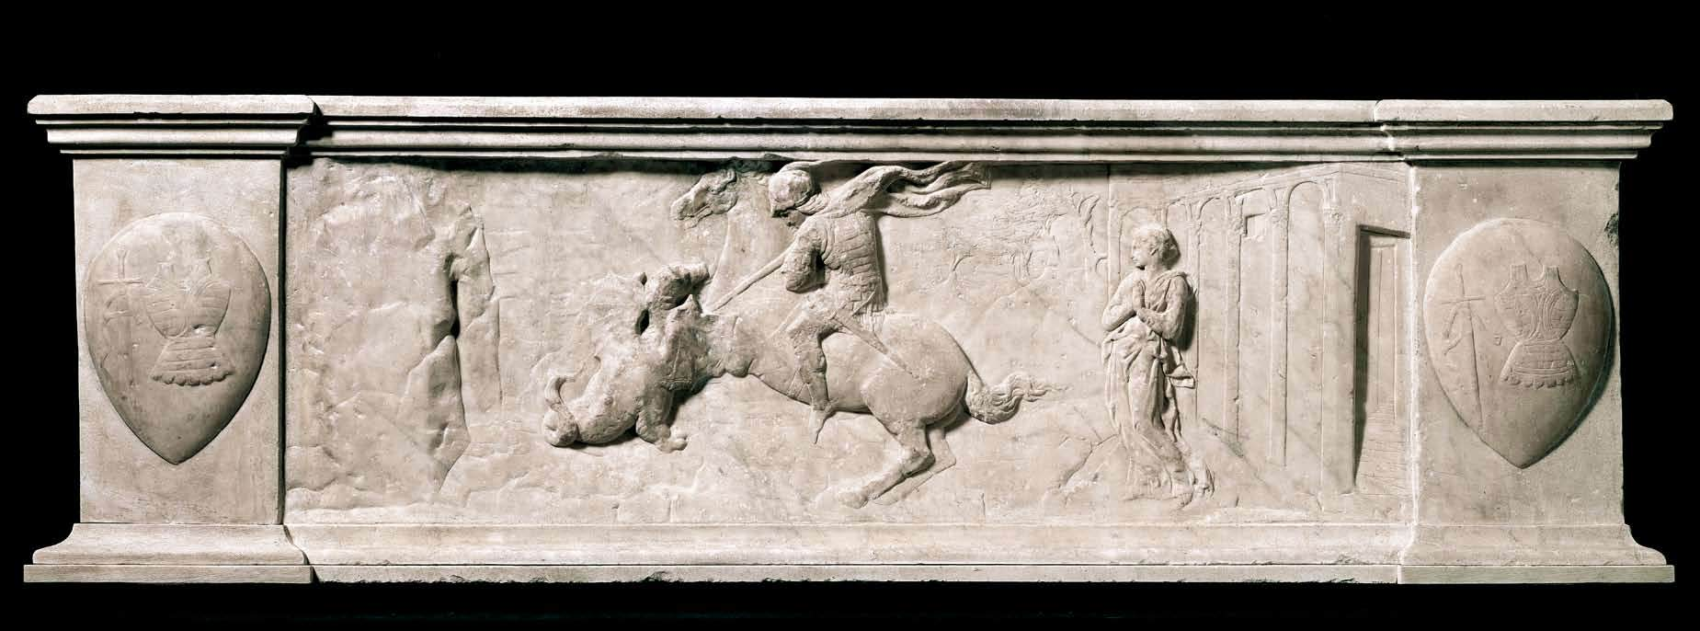
https://www.wga.hu/frames-e.html?/html/d/donatell/1_early/orsanmic/1georg_1.html

Slide 7
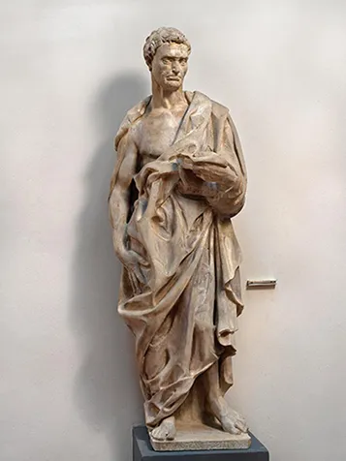
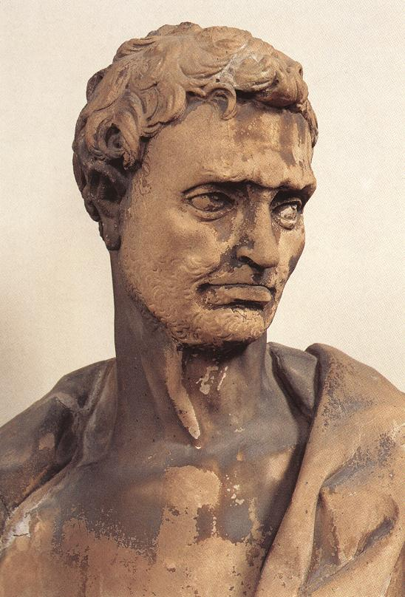
Prophet Jeremiah, 1423-26, Marble, height: 191 cm, Museo dell'Opera del Duomo, Florence Italy https://www.thehistoryofart.org/donatello/prophet-jeremiah/ http://www.lib-art.com/artgallery/9146-prophet-jeremiah-donatello.html

Slide 8
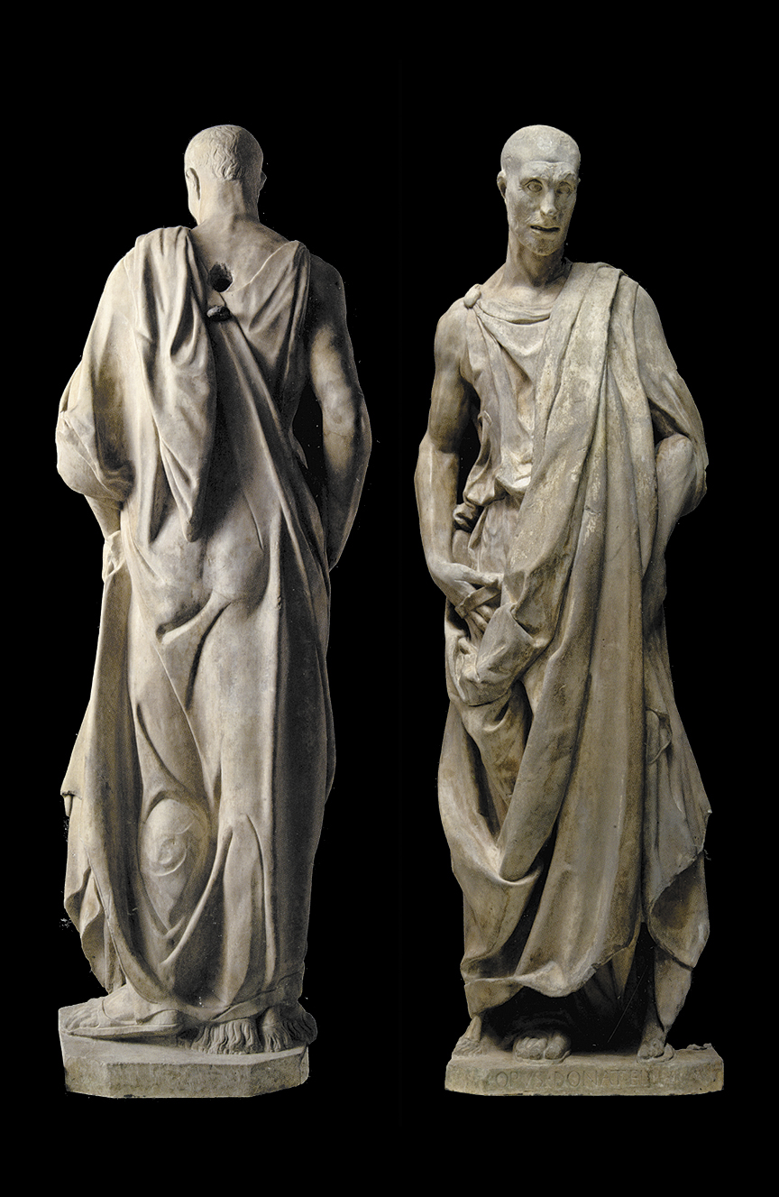
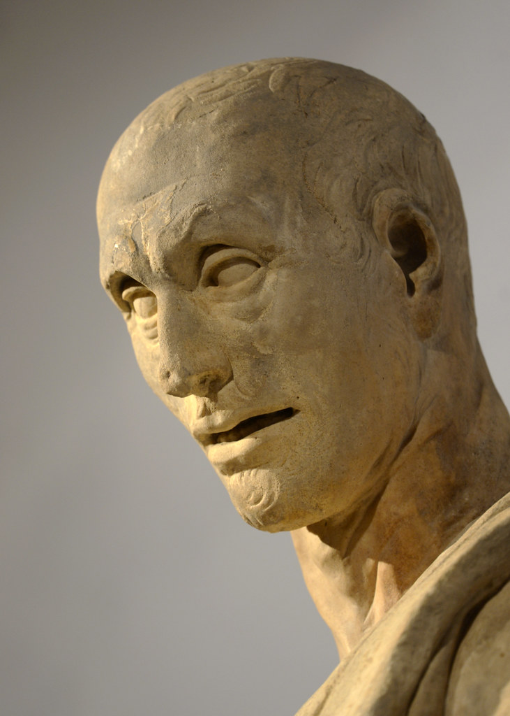
Prophet Habakkuk, 1427-36m, marble, height: 196 cm, Museo dell'Opera del Duomo, Florence, Italy https://www.nybooks.com/articles/2015/04/23/magic-donatello/ https://www.flickr.com/photos/nicnac/39737906700

Slide 9
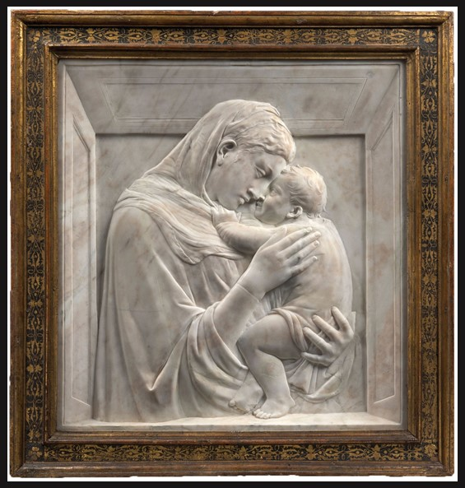
Madonna and Child (the Pazzi Madonna), 1420-25, Marble, 74,5 x 73 x 6,5 cm, Staatlichen Museen zu Berlin https://www.theartnewspaper.com/2021/11/30/first-major-donatello-exhibition-in-nearly-40-years-to-open-in-florence

Slide 10
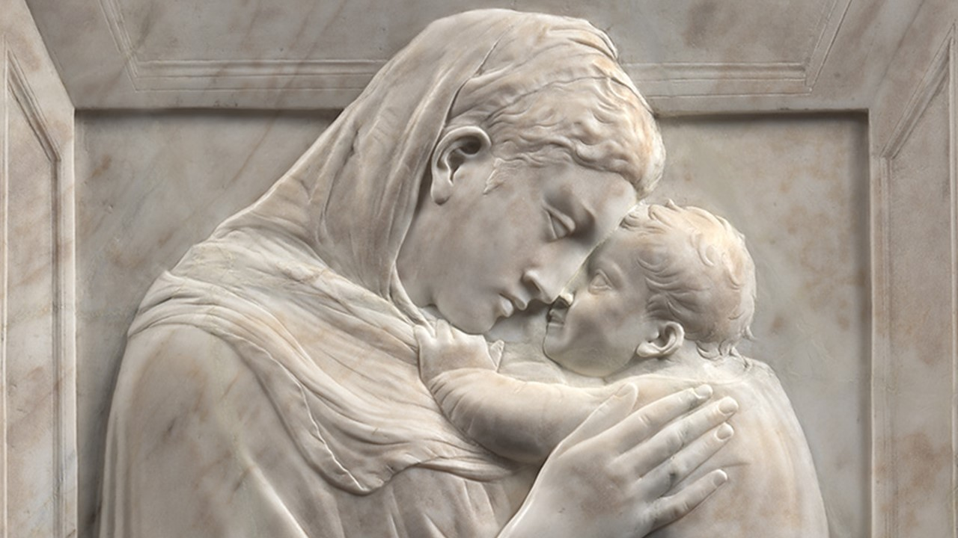
https://www.palazzostrozzi.org/en/upcoming-exhibitions/

Slide 11
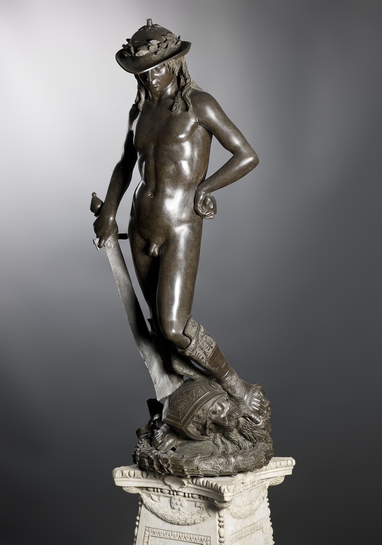
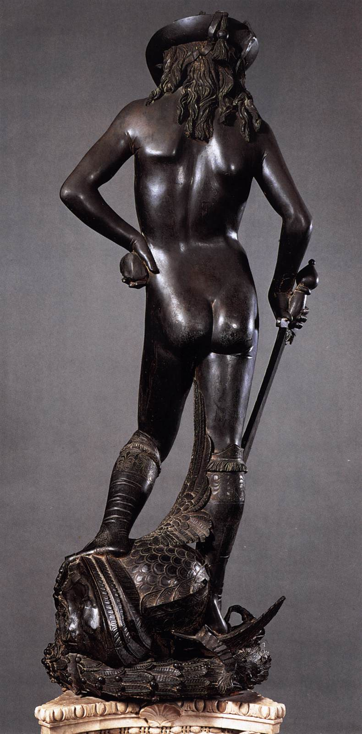
David, c. 1430, Bronze, Height: 158 cm, Museo Nazionale del Bargello, Florence, Italy https://www.finestresullarte.info/arte-base/la-scultura-rinascimentale-origini-sviluppo-artisti

Slide 12
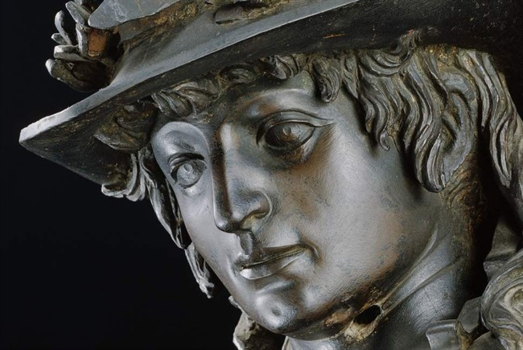
https://m.visittuscany.com/en/attractions/donatellos-david/

Slide 13
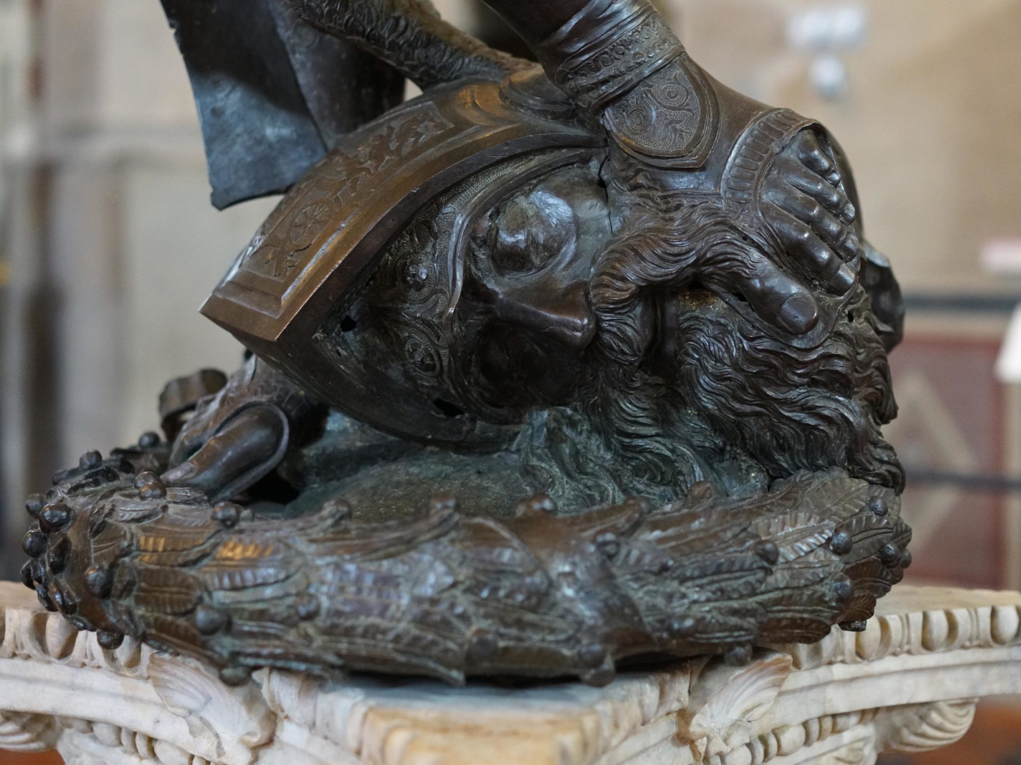
https://smarthistory.org/donatello-david/

Slide 14
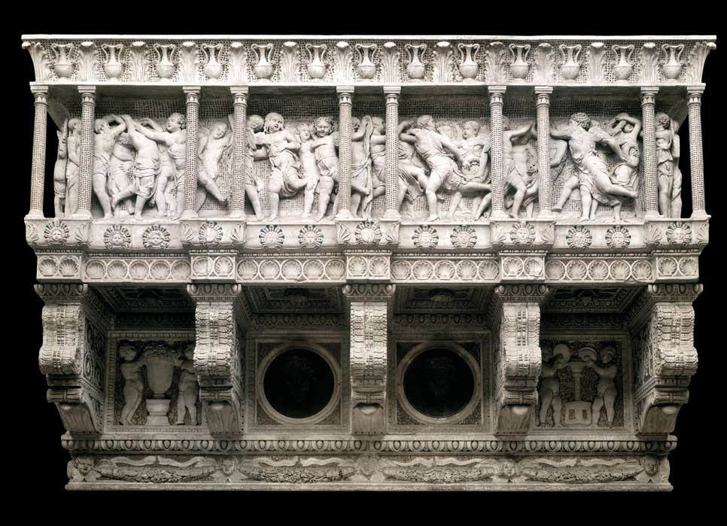
Cantoria, 1431-39, Marble, 348 x 570 cm, Museo dell'Opera del Duomo, Florence, Italy https://www.wga.hu/frames-e.html?/html/d/donatell/1_early/orsanmic/1georg_1.html

Slide 15
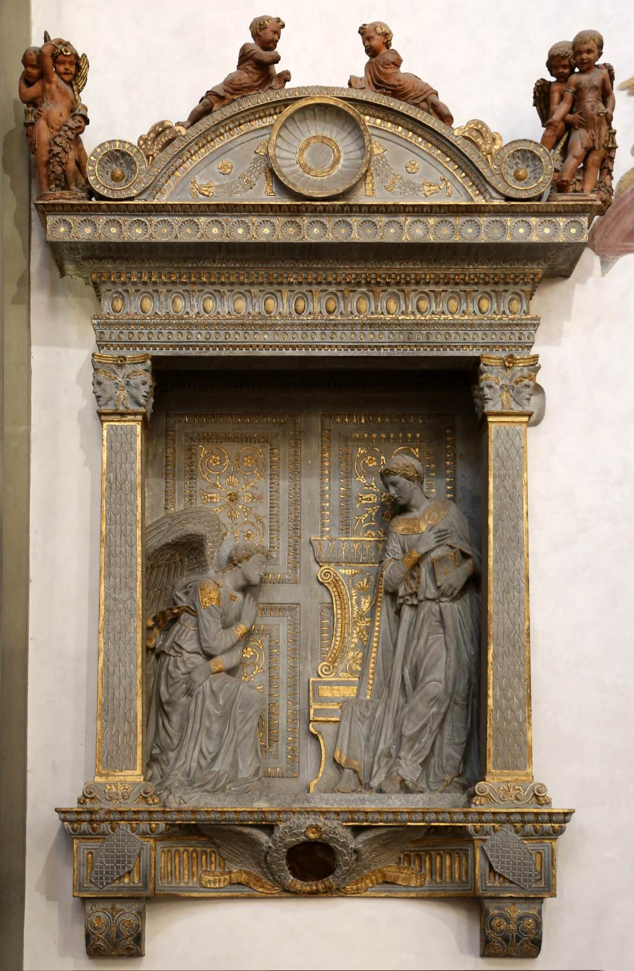
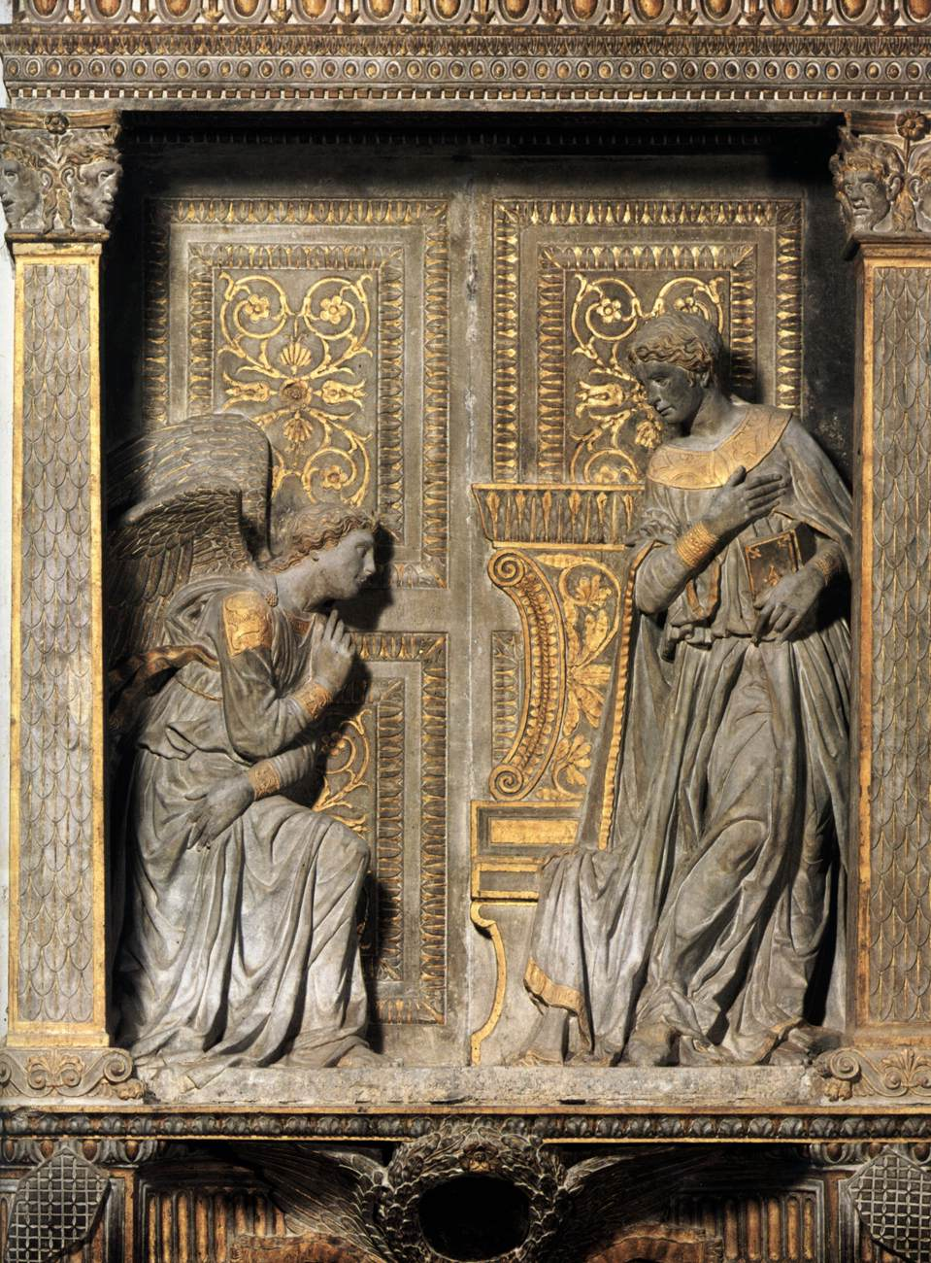
Annunciation, c. 1435, Gilded pietra serena, 218 x 168 cm, Santa Croce, Florence, Italy https://www.wga.hu/frames-e.html?/html/d/donatell/1_early/orsanmic/1georg_1.html

Slide 16
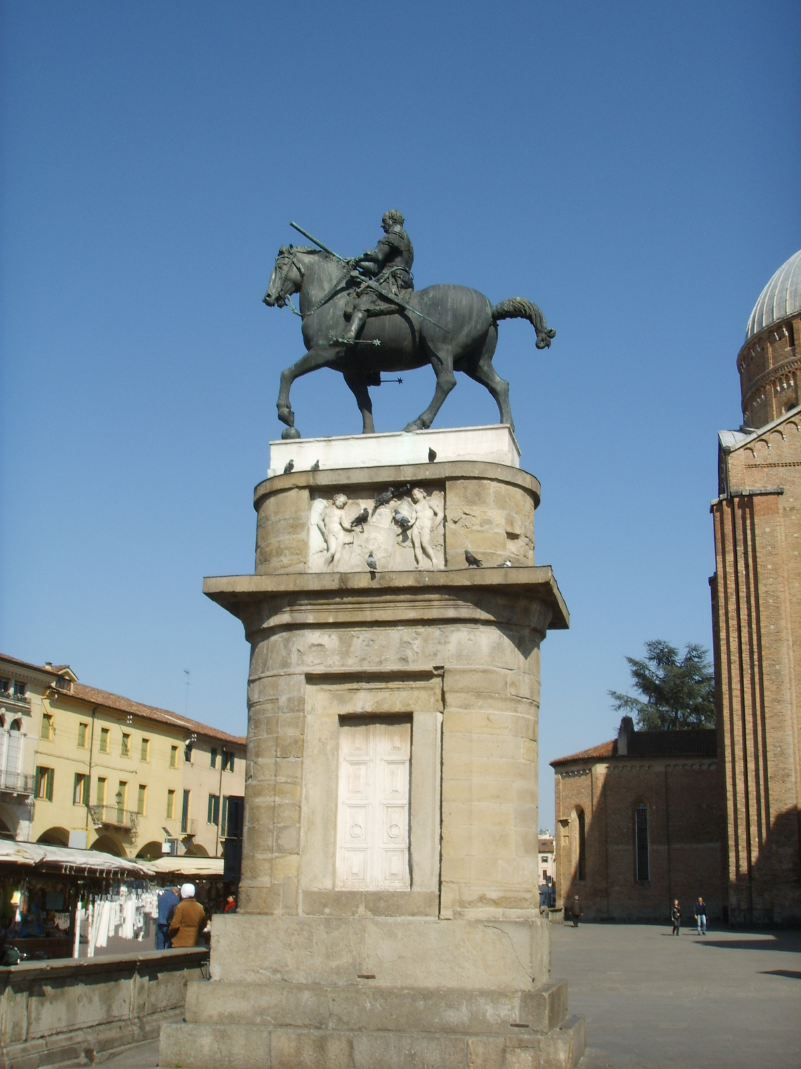
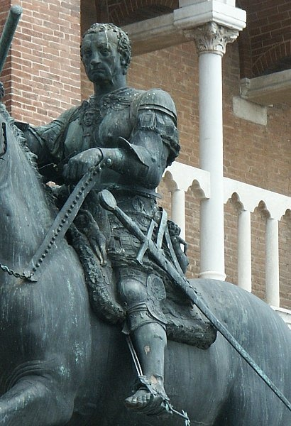
Equestrian Statue of Gattamelata, 1453, Bronze, 340 x 390 cm, Piazza del Santo, Padua, Italy https://commons.wikimedia.org/wiki/File:Donatello,_Monumento_equestre_al_Gattamelata_00.JPG https://www.artble.com/artists/donatello/sculpture/equestrian_statue_of_gattamelata

Slide 17
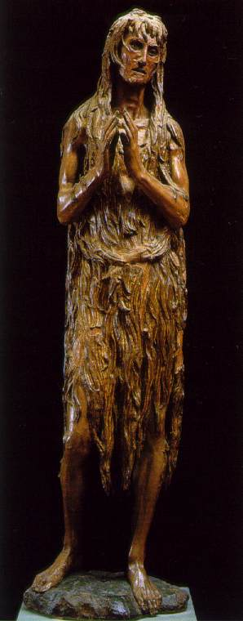
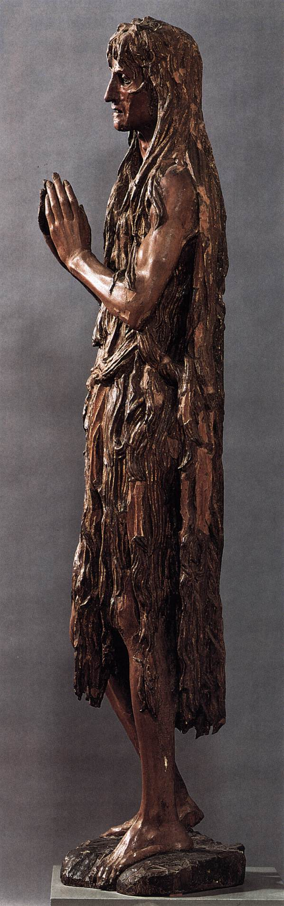
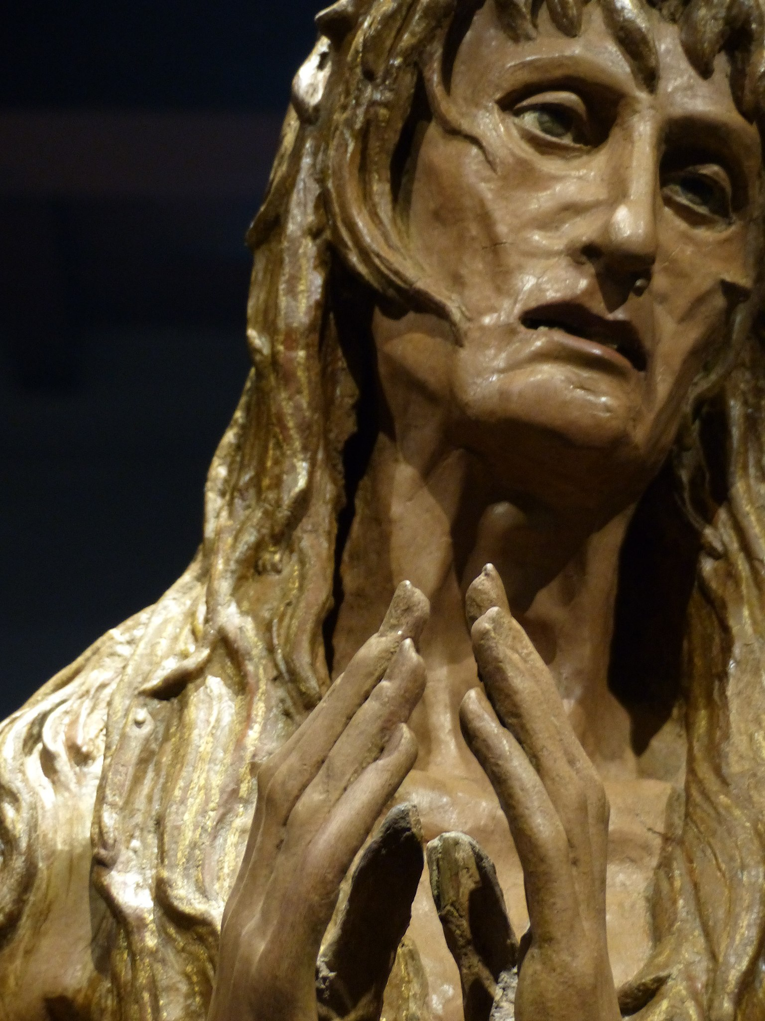
St Mary Magdalen, c. 1457, Wood, Height: 188 cm, Museo dell'Opera del Duomo, Florence, Italy https://dwightlongenecker.com/mary-magdalene-and-me-too/ https://www.wga.hu/frames-e.html?/html/d/donatell/1_early/orsanmic/1georg_1.html https://commons.wikimedia.org/wiki/File:Maria_Magdalena,_Donatello,_Florencia,_Italia,_2019_04.jpg

Slide 18
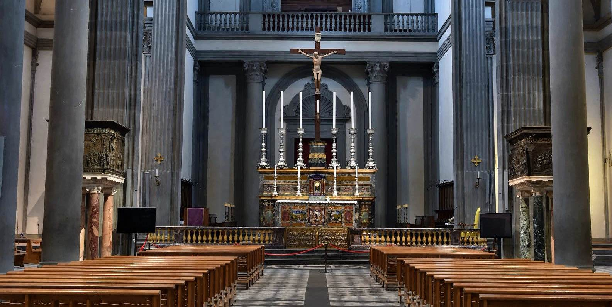
View of the nave of San Lorenzo and both of Donatello’s Pulpits, 1465, San Lorenzo, Florence, Italy https://www.wga.hu/frames-e.html?/html/d/donatell/1_early/orsanmic/1georg_1.html

Slide 19
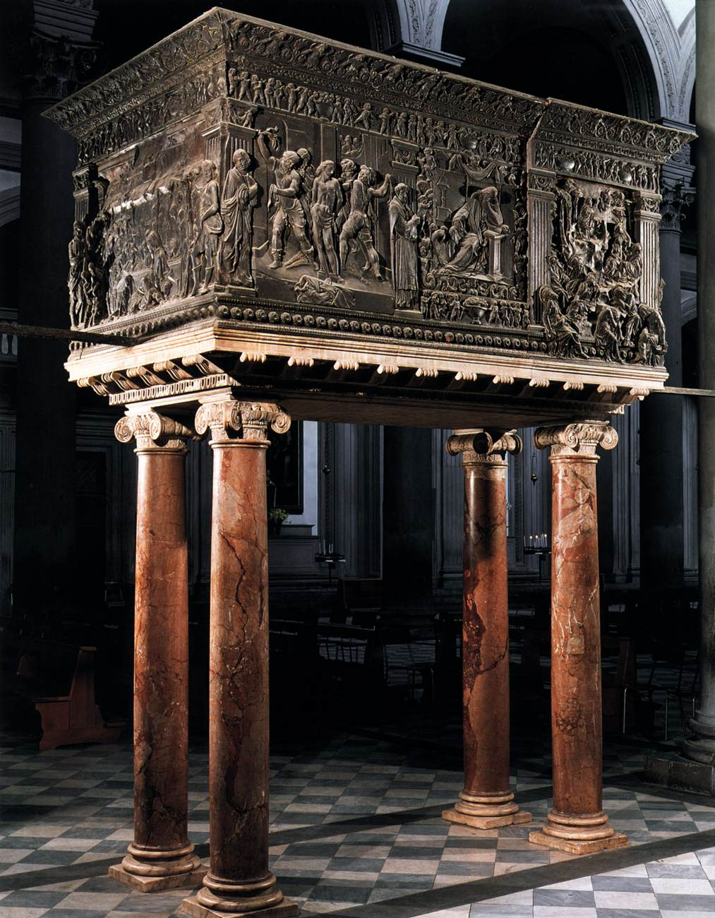
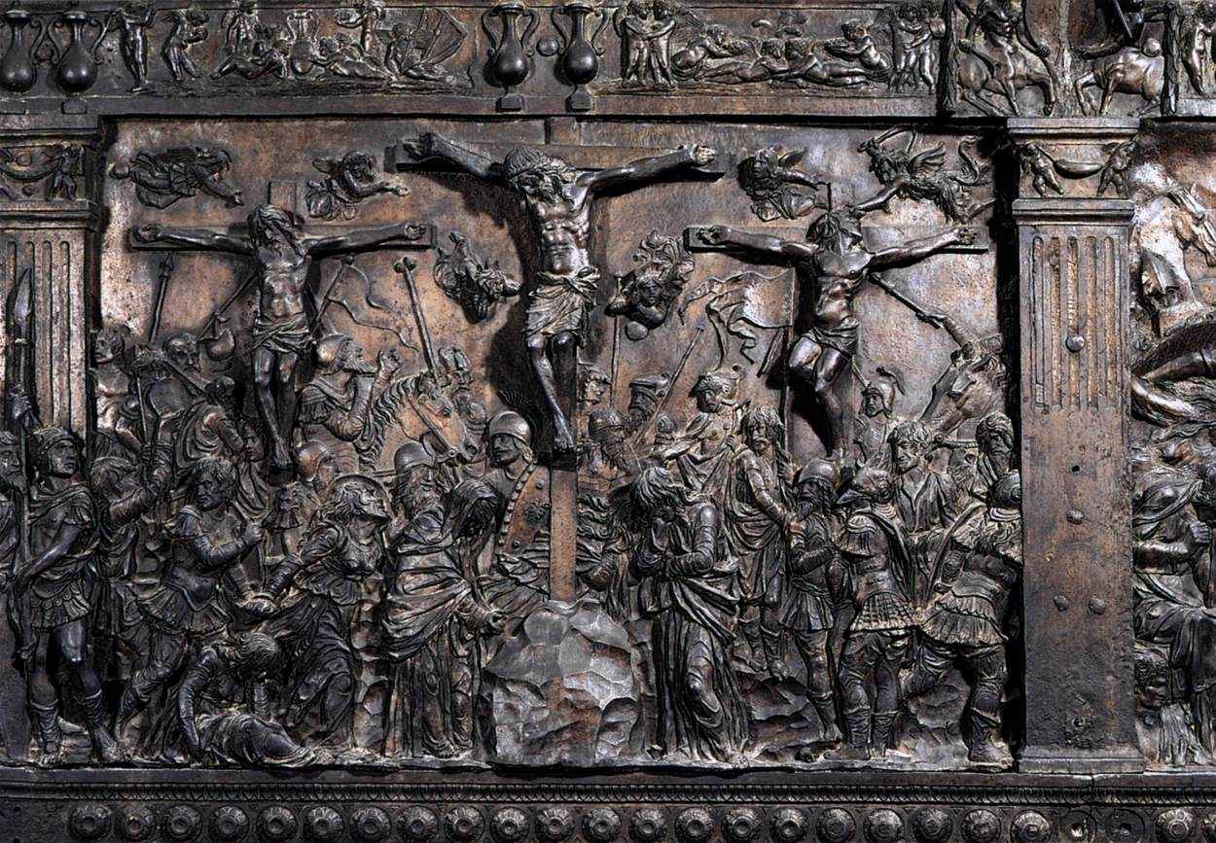
The Passion Pulpit and Crucifixion scene, 1460-65, Marble and Bronze, 137 x 280 cm,
San Lorenzo, Florence, Italy https://www.wga.hu/frames-e.html?/html/d/donatell/1_early/orsanmic/1georg_1.html

Slide 20
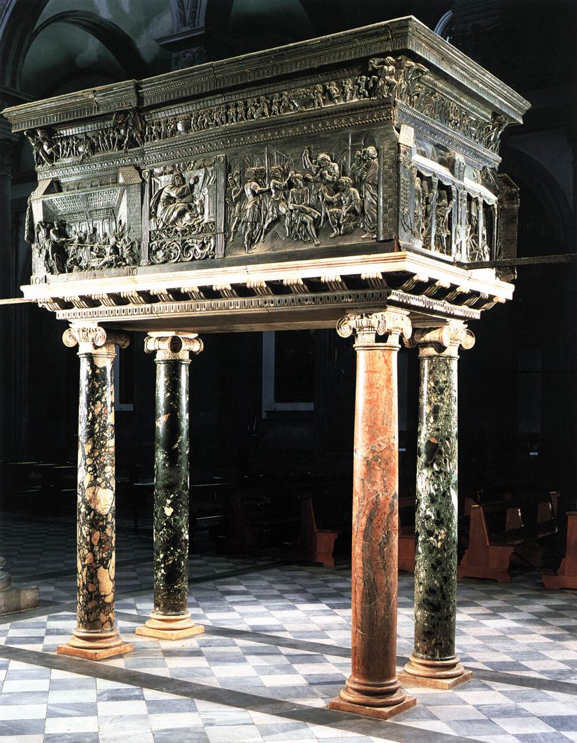
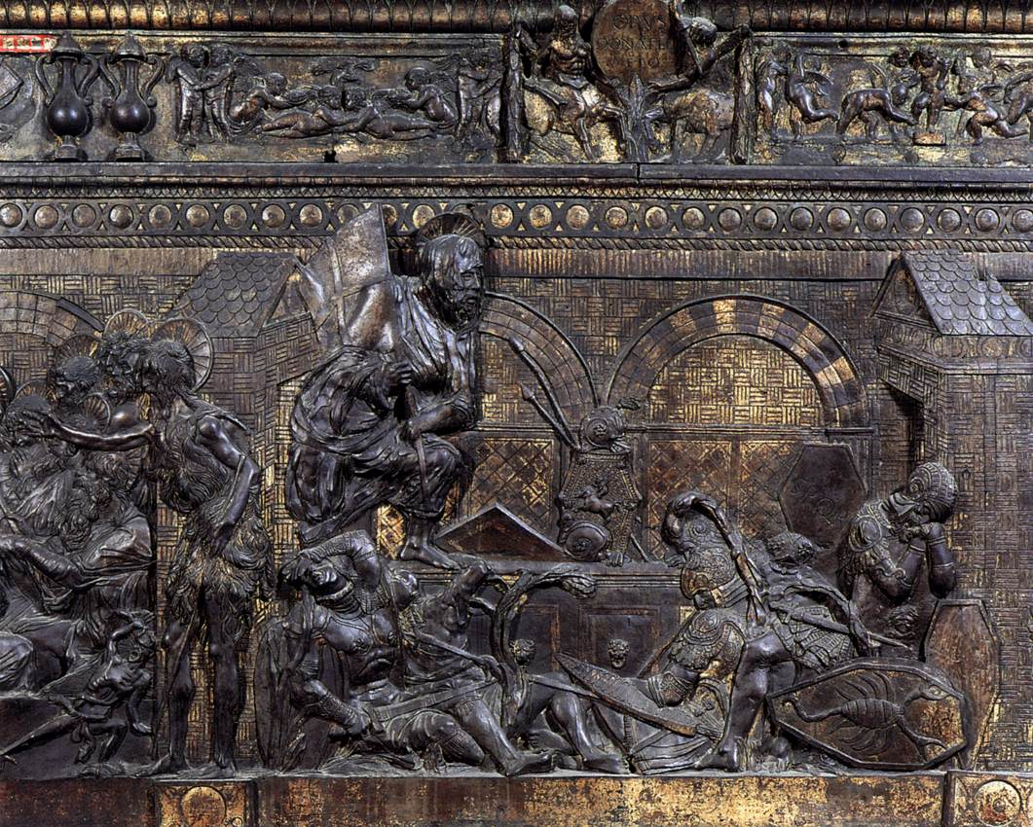
The Resurrection Pulpit and Resurrection Scene, 1465, Marble and Bronze, 123 x 292 cm, San Lorenzo, Florence, Italy https://www.wga.hu/frames-e.html?/html/d/donatell/1_early/orsanmic/1georg_1.html

Slide 21
The End

