Slide 1
Giuseppe Arcimboldo
1527-1593
The Four Seasons

Slide 2
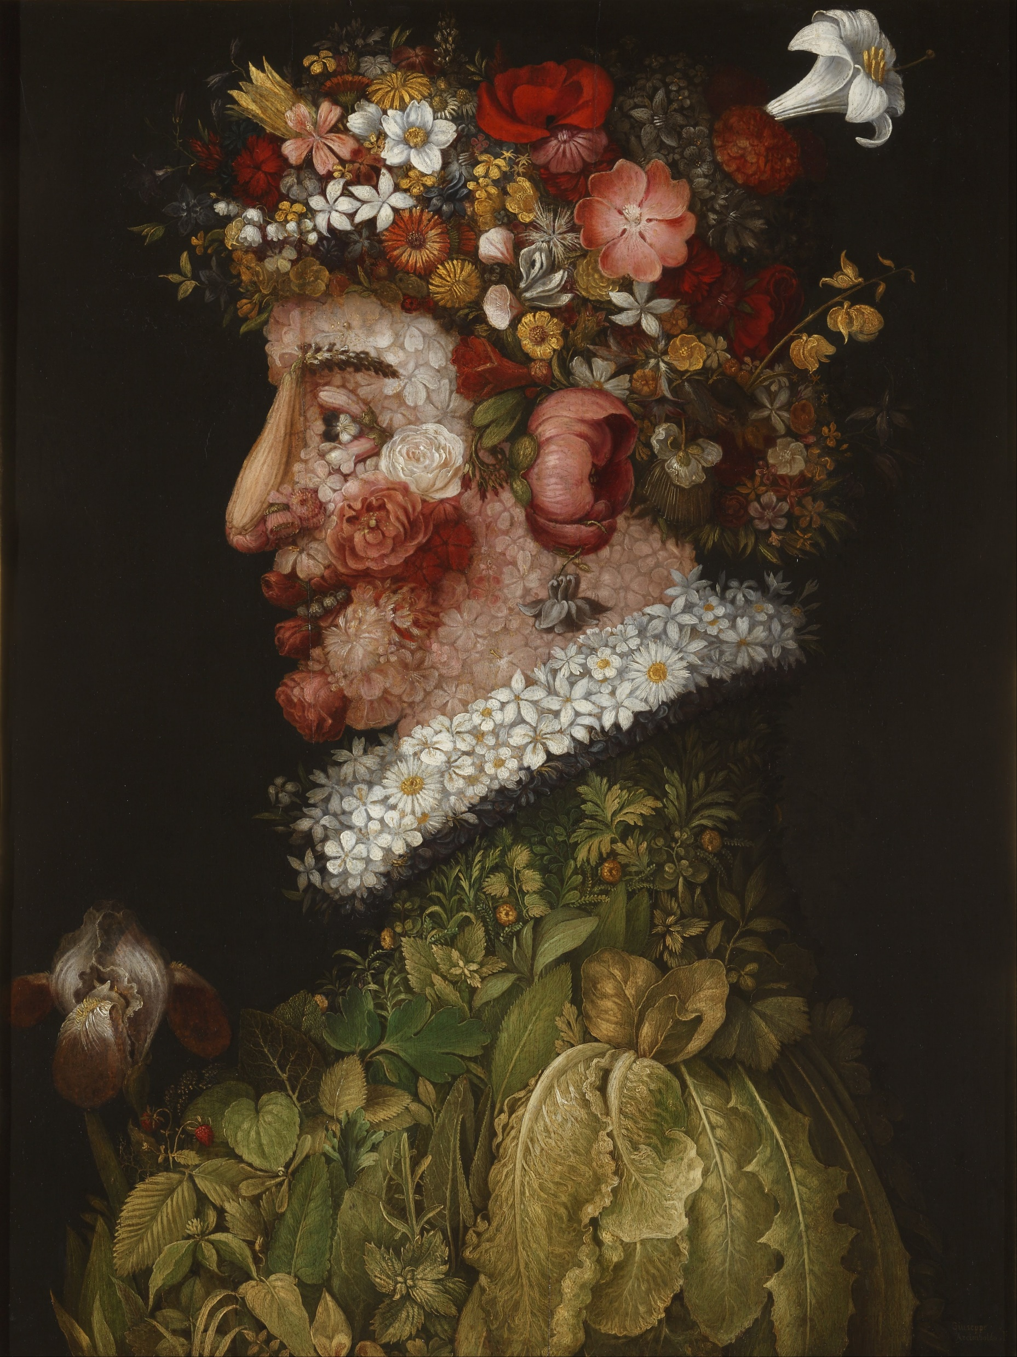
The Four Seasons – Spring, 1563, oil on canvas, 76x63.5 cm, Real Academia de Bellas Artes de San Fernando, Madrid, Spain https://commons.wikimedia.org/wiki/File:Giuseppe_Arcimboldo_-_La_Primavera_-_Google_Art_Project.jpg

Slide 3
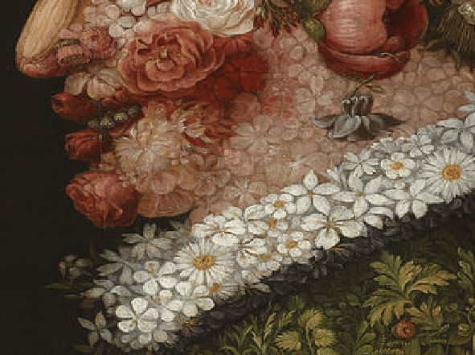
https://www.researchgate.net/figure/Figura-16-Giuseppe-Arcimboldo-La-Primavera-1563-Real-Academia-de-Bellas-Artes-de-San_fig16_318795156

Slide 4
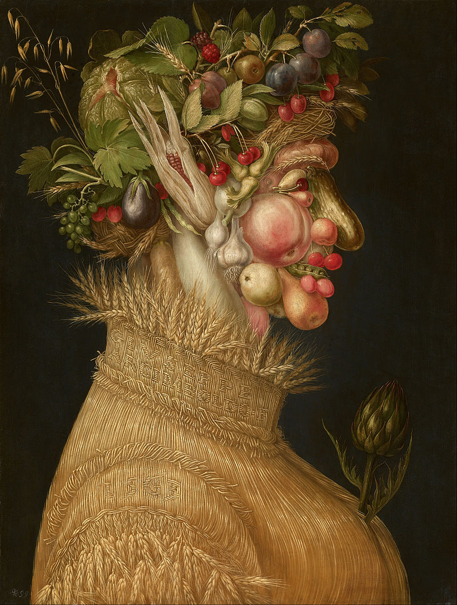
The Four Seasons – Summer, 1563, oil on panel, 670x508 mm, Kunsthistorisches Museum, Vienna, Austria https://commons.wikimedia.org/wiki/File:Giuseppe_Arcimboldo_-_Summer_-_Google_Art_Project.jpg

Slide 5
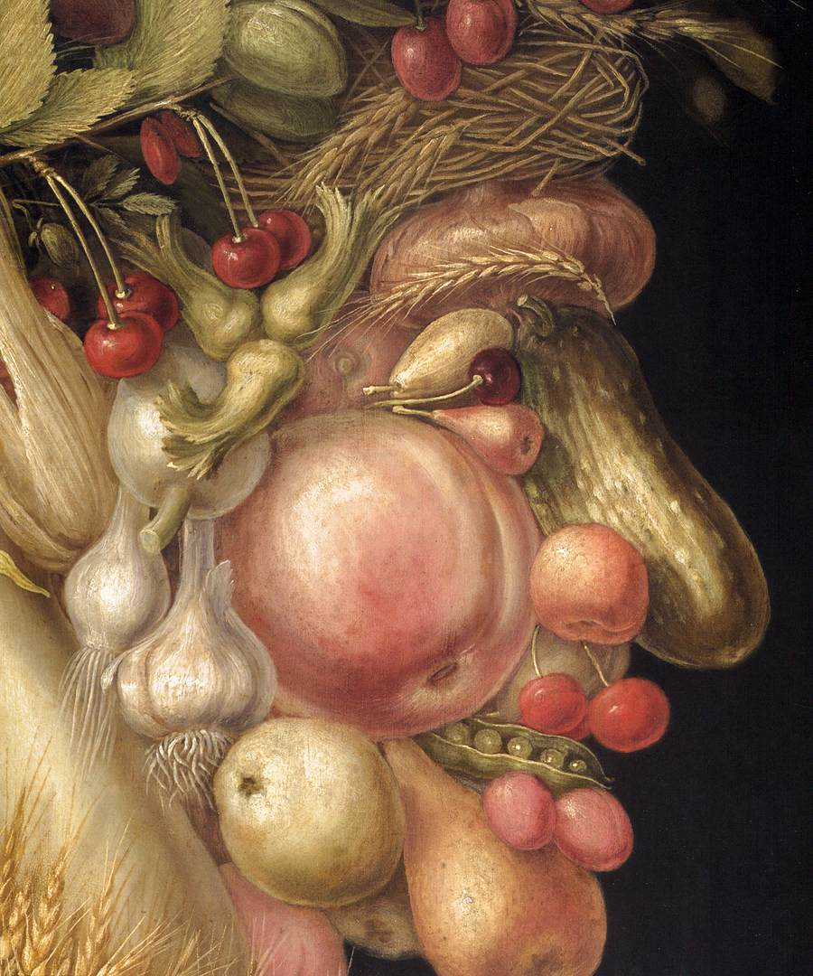
https://dyscover24x7.files.wordpress.com/2017/02/1seaso21.jpg

Slide 6
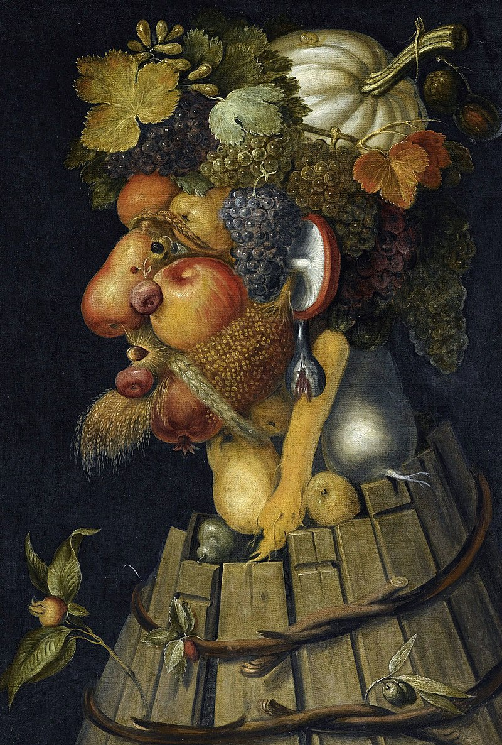
The Four Seasons – Autumn, 1573, oil on canvas, 76x64 cm, Louvre Museum, Paris, France https://commons.wikimedia.org/wiki/File:Arcimboldo_Oto%C3%B1o.jpg

Slide 7
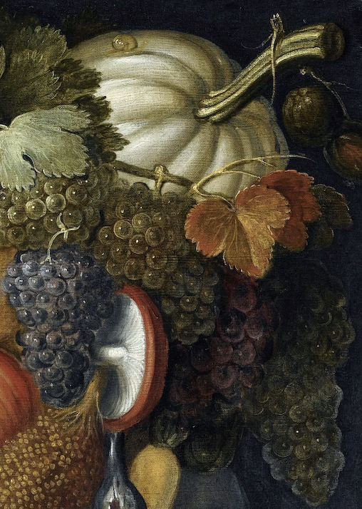
https://news.artnet.com/art-world/giuseppe-arcimboldo-autumn-three-things-2039018

Slide 8
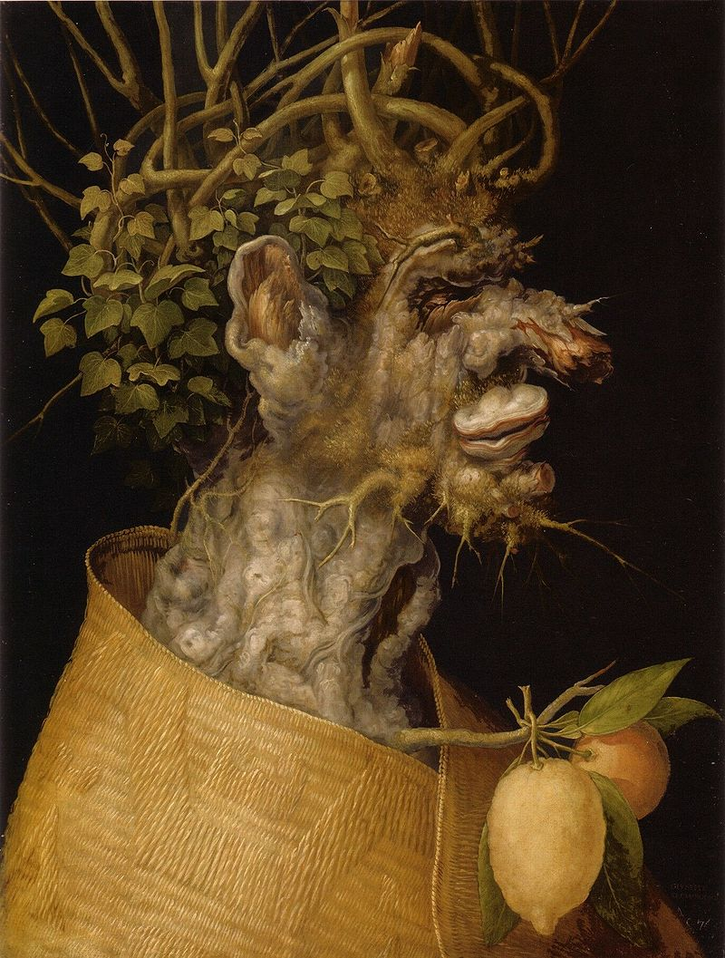
The Four Seasons – Winter, 1563, oil on linden wood, 66,6x50,5 cm, Kunsthistorisches Museum, Vienna, Austria https://commons.wikimedia.org/wiki/File:Arcimboldo_Winter_1563.jpg

Slide 9
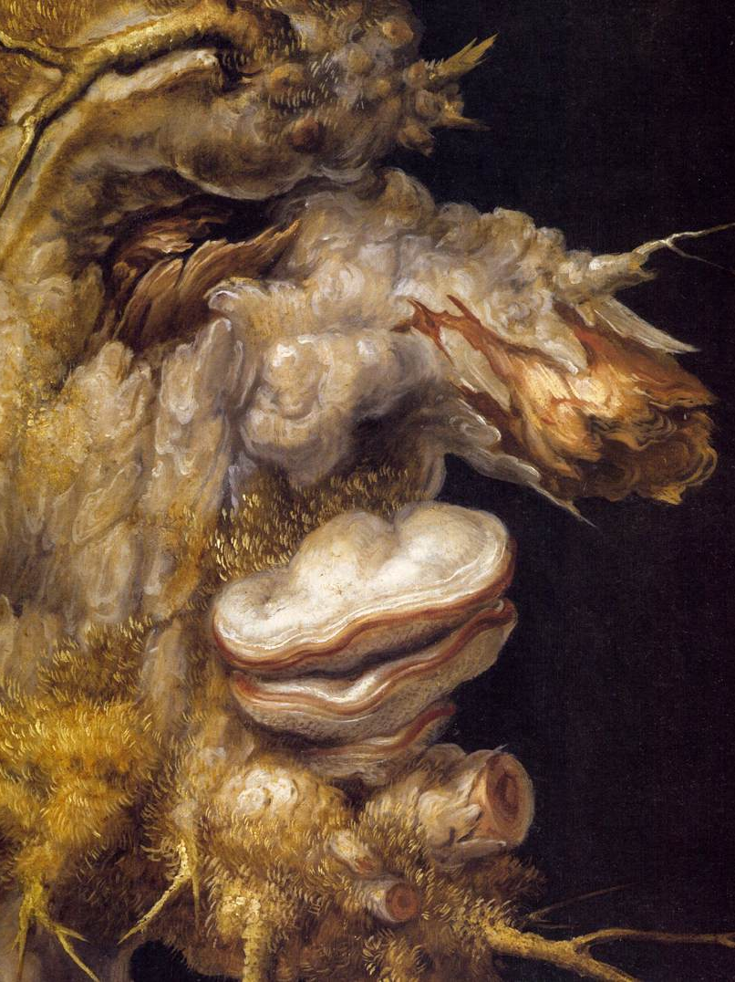
https://commons.wikimedia.org/wiki/File:Giuseppe_Arcimboldo_-_Winter_(detail)_-_WGA0809.jpg

Slide 10
The
End

