Slide 1
Vincent van Gogh,
1853 – 1890
Paintings of Irises

Slide 2
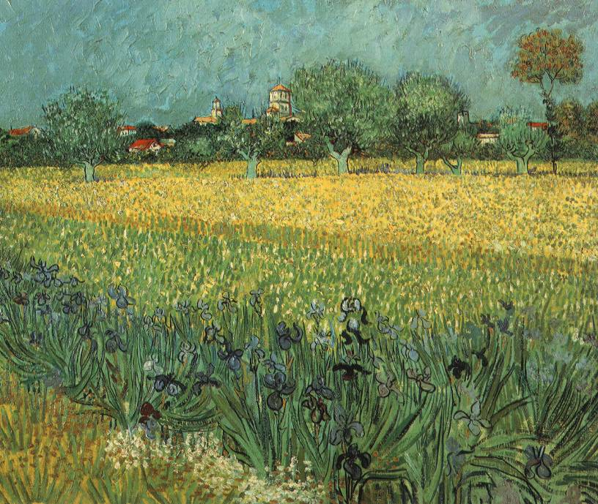
Field with Irises near Arles, 1888, Oil on Canvas, 54 cm x 65 cm, Van Gogh Museum, Amsterdam, Netherlands https://upload.wikimedia.org/wikipedia/commons/9/9f/VanGogh-View_of_Arles_with_Irises.jpg

Slide 3
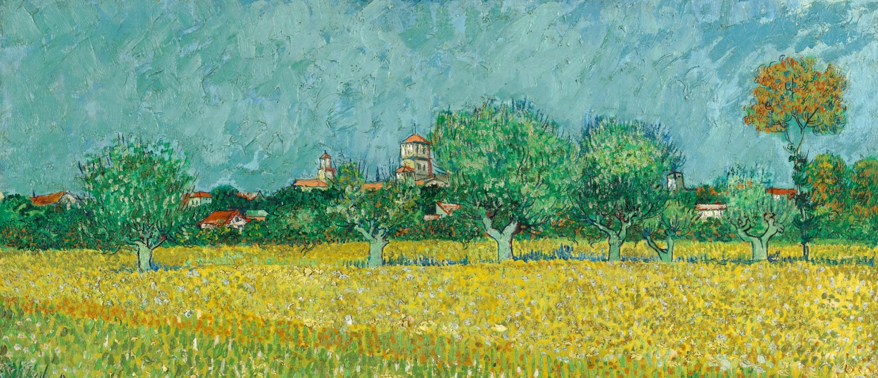
Field with Irises near Arles (detail), 1888, Oil on Canvas, 54 cm x 65 cm, Van Gogh Museum, Amsterdam, Netherlands https://www.vangoghmuseum.nl/en/collection/s0037V1962

Slide 4
Field with Irises near Arles (detail), 1888, Oil on Canvas, 54 cm x 65 cm, Van Gogh Museum, Amsterdam, Netherlands https://www.vangoghmuseum.nl/en/collection/s0037V1962

Slide 5
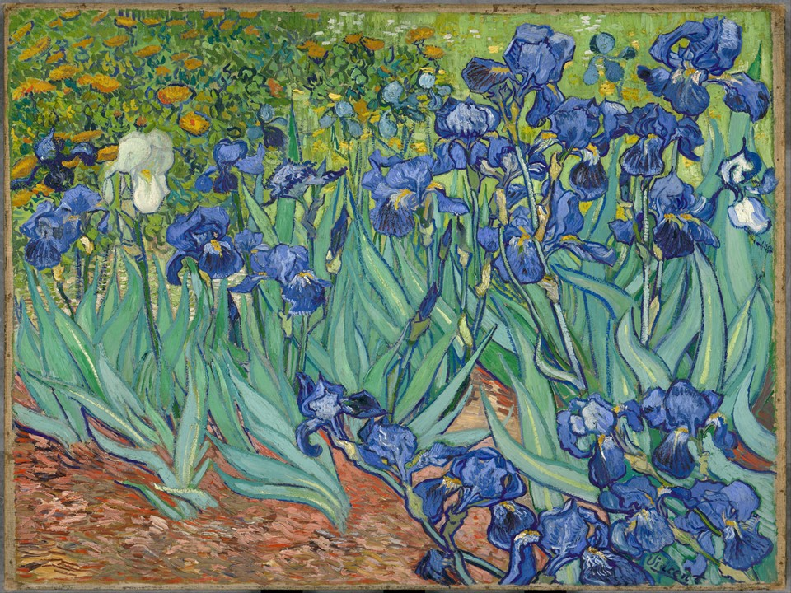
Irises, 1889, Oil on Canvas, 74.3 × 94.3 cm, The J. Paul Getty Museum, CA, USA https://www.getty.edu/art/collection/objects/826/vincent-van-gogh-irises-dutch-1889/

Slide 6
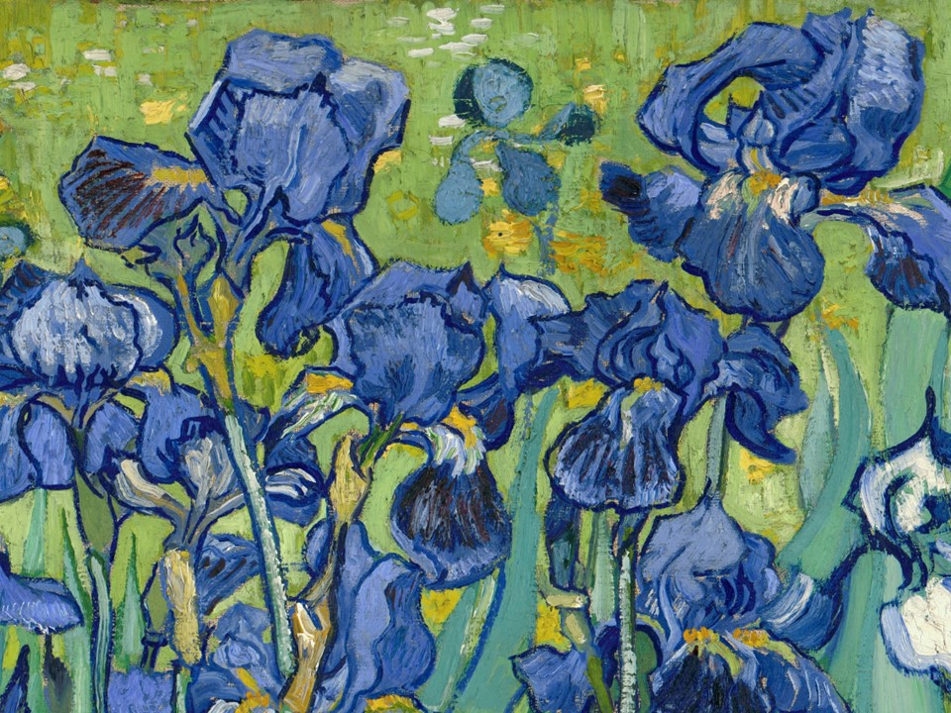
Irises (detail), 1889, Oil on Canvas, 74.3 × 94.3 cm, The J. Paul Getty Museum, CA, USA https://blogs.getty.edu/iris/five-ways-of-seeing-van-goghs-irises/

Slide 7
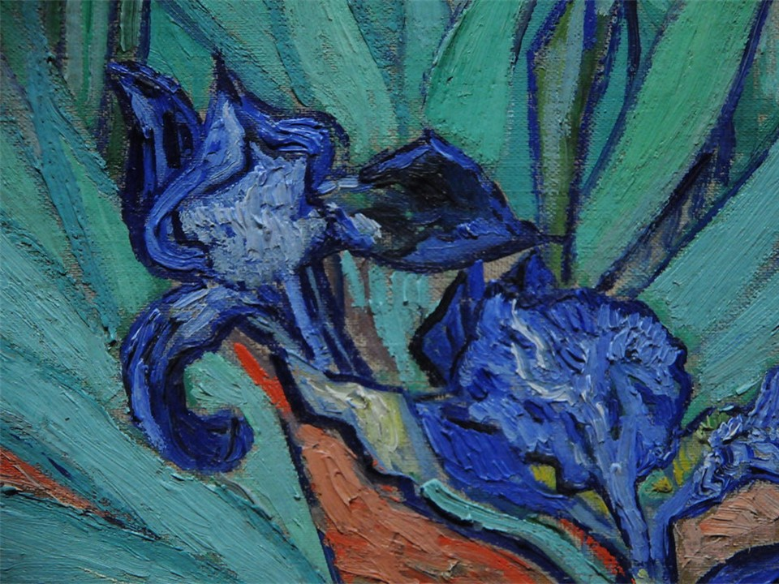
Vincent van Gogh, Dutch Artist, 1853 – 1890
Irises (detail), 1889, Oil on Canvas, 74.3 × 94.3 cm, The J. Paul Getty Museum, CA, USA https://www.flickr.com/photos/artexplorer/5554991992

Slide 8
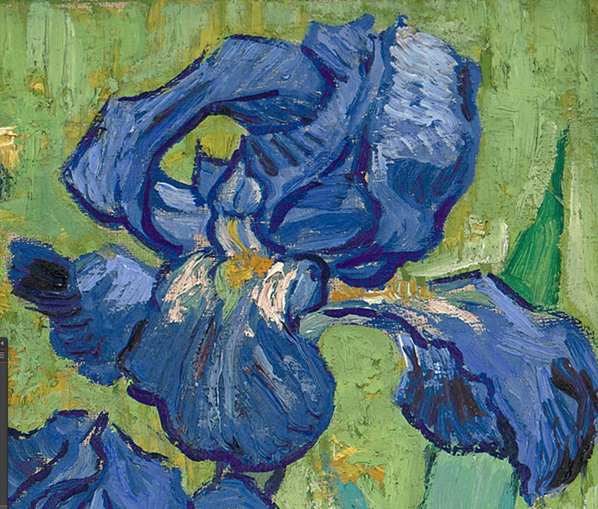
Irises (detail), 1889,
Oil on Canvas, 74.3 × 94.3 cm, The J. Paul Getty Museum, CA, USA https://creativepro.com/free-high-resolution-art-the-getty-museum/

Slide 9
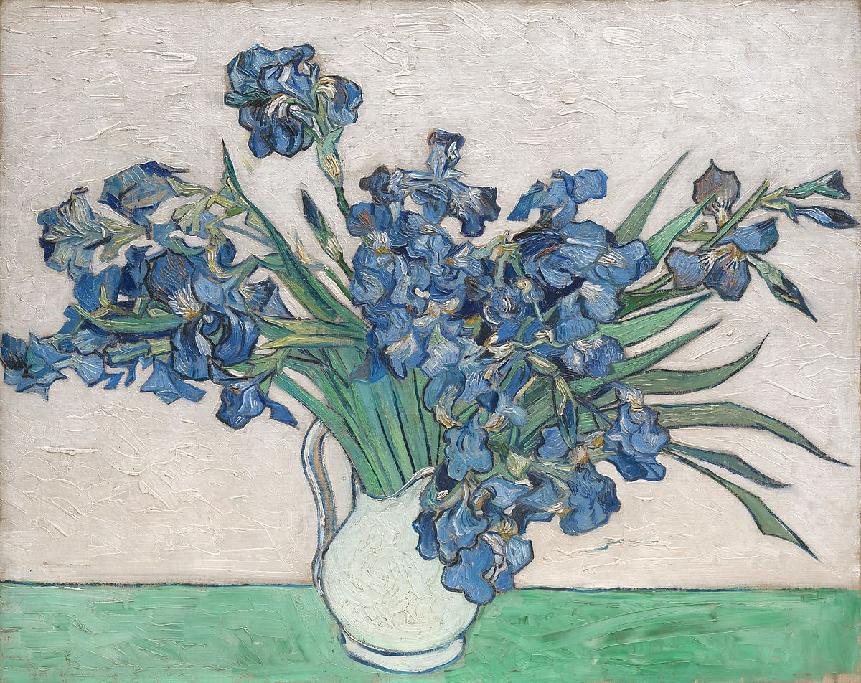
Irises, 1890, Oil on Canvas, 73.7 × 92.1 cm, Metropolitan the MET, NY, USA https://www.metmuseum.org/art/collection/search/436528

Slide 10
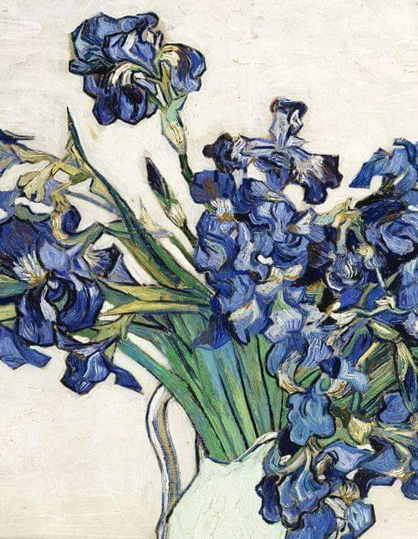
Irises (detail), 1890, Oil on Canvas, 73.7 × 92.1 cm, Metropolitan the MET, NY, USA https://madeleineengland.tumblr.com/post/645942294012379136/vincent-van-gogh-irises-1890

Slide 11
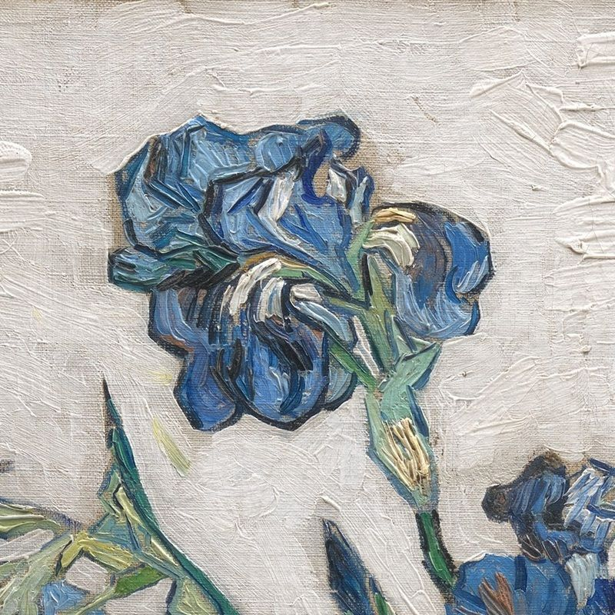
Irises (detail), 1890, Oil on Canvas, 73.7 × 92.1 cm, Metropolitan the MET, NY, USA https://www.lonequixote.com/blog/irises-detail2

Slide 12
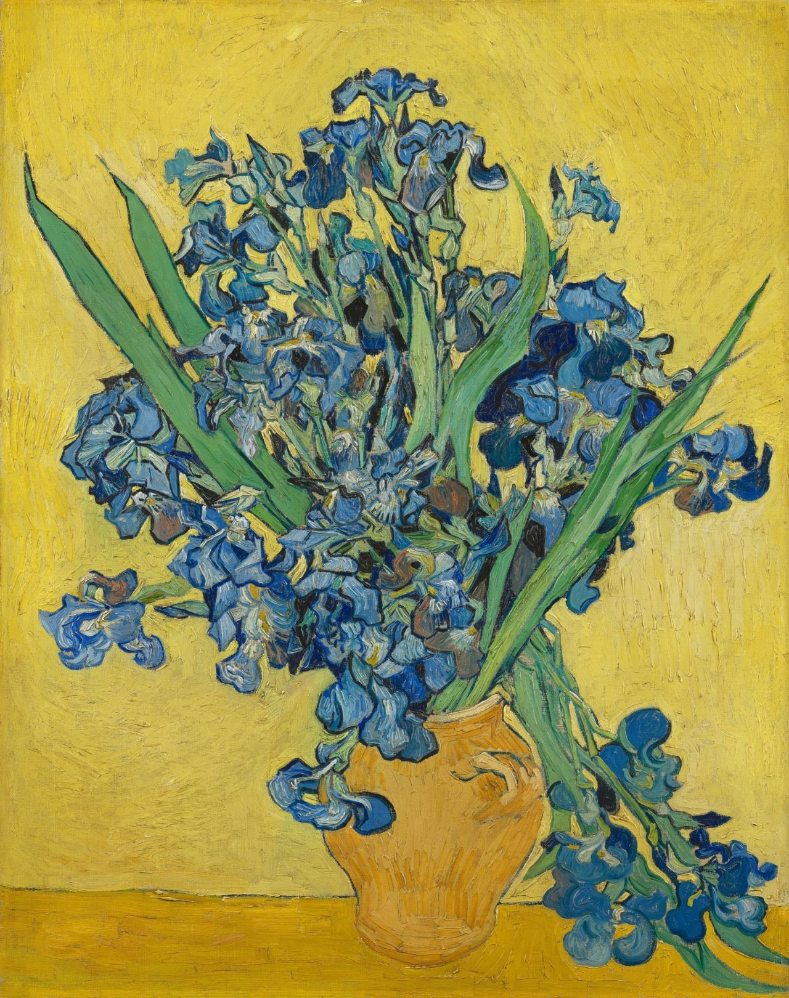
Irises, 1890, Oil on Canvas, 92.7 cm x 73.9 cm, Van Gogh Museum, Amsterdam, The Netherlands https://www.vangoghmuseum.nl/en/collection/s0050V1962

Slide 13
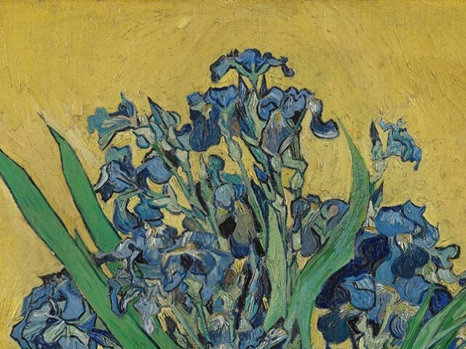
Irises (detail), 1890, Oil on Canvas, 92.7 cm x 73.9 cm, Van Gogh Museum, Amsterdam, Netherlands https://www.sothebys.com/en/museums/museum-of-fine-arts-houston/exhibitions/vincent-van-gogh-his-life-in-art

Slide 14
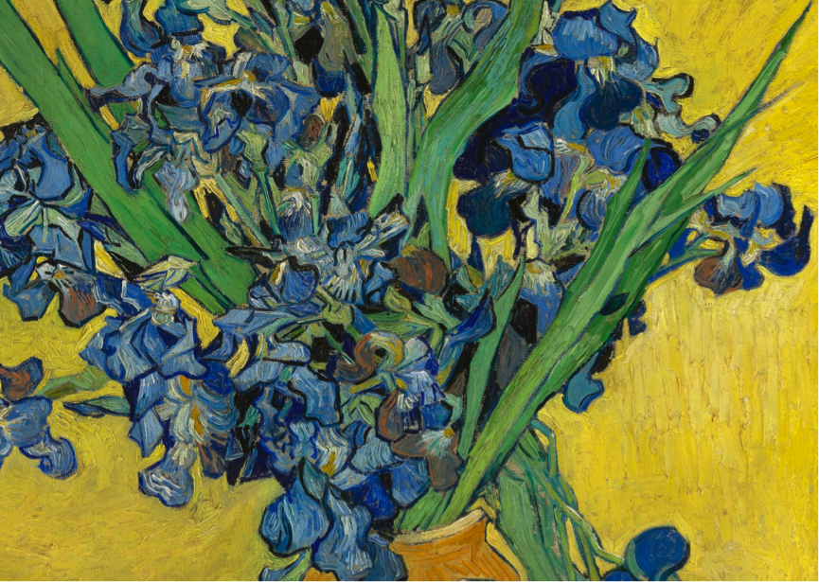
Irises (detail), 1890, Oil on Canvas, 92.7 cm x 73.9 cm, Van Gogh Museum, Amsterdam, Netherlands https://artdependence.com/articles/symbolism-in-art-irises-van-gogh-1889/

Slide 15
The End!

