Slide 1
Henri de Toulouse-Lautrec, 1864 – 1901
In the Garden of
Père Forest…

Slide 2
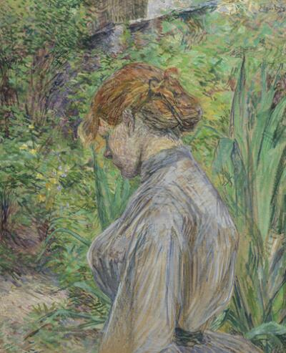
Red-Headed Woman in the Garden of M. Forest, 1987, oil on cardboard, 71.4 x 58.1 cm, The Norton Simon Foundation, CA, USA https://www.nortonsimon.org/art/detail/F.1973.37.P/

Slide 3
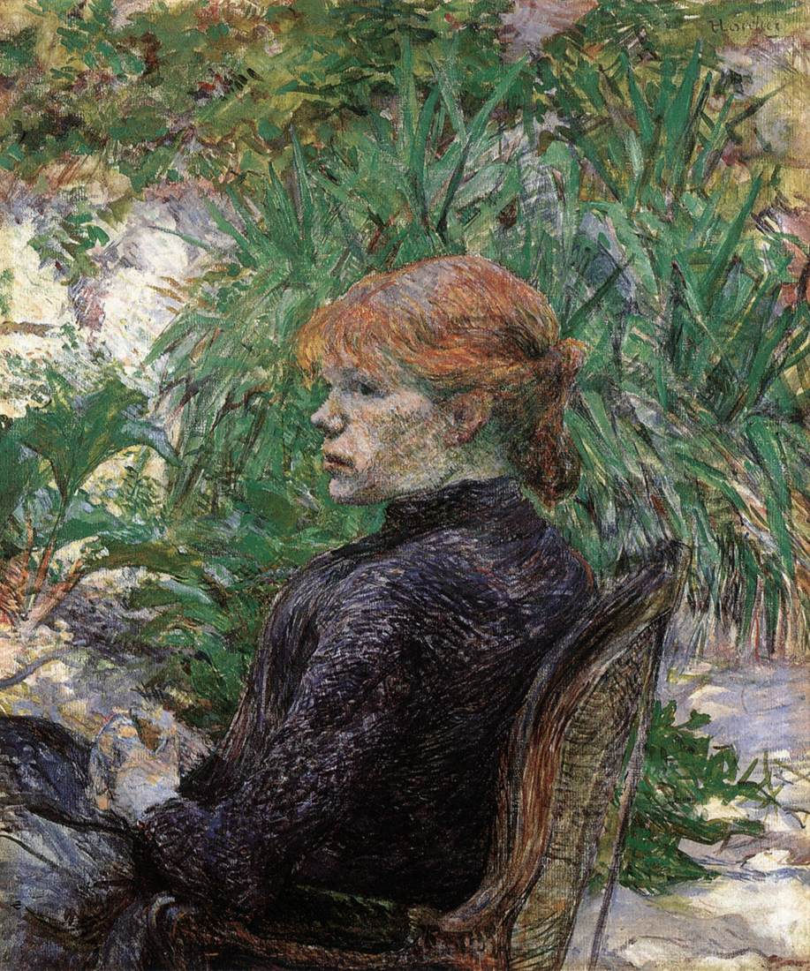
Redheaded Woman sitting in the Garden of Mr. Forest, 1889, oil on canvas, 65.0 x 54.0 cm, Private Collection https://fineartbiblio.com/artworks/henri-de-toulouse-lautrec/5782/red-haired-girl-in-monsieur-forest-s-garden-carmen-gaudin

Slide 4
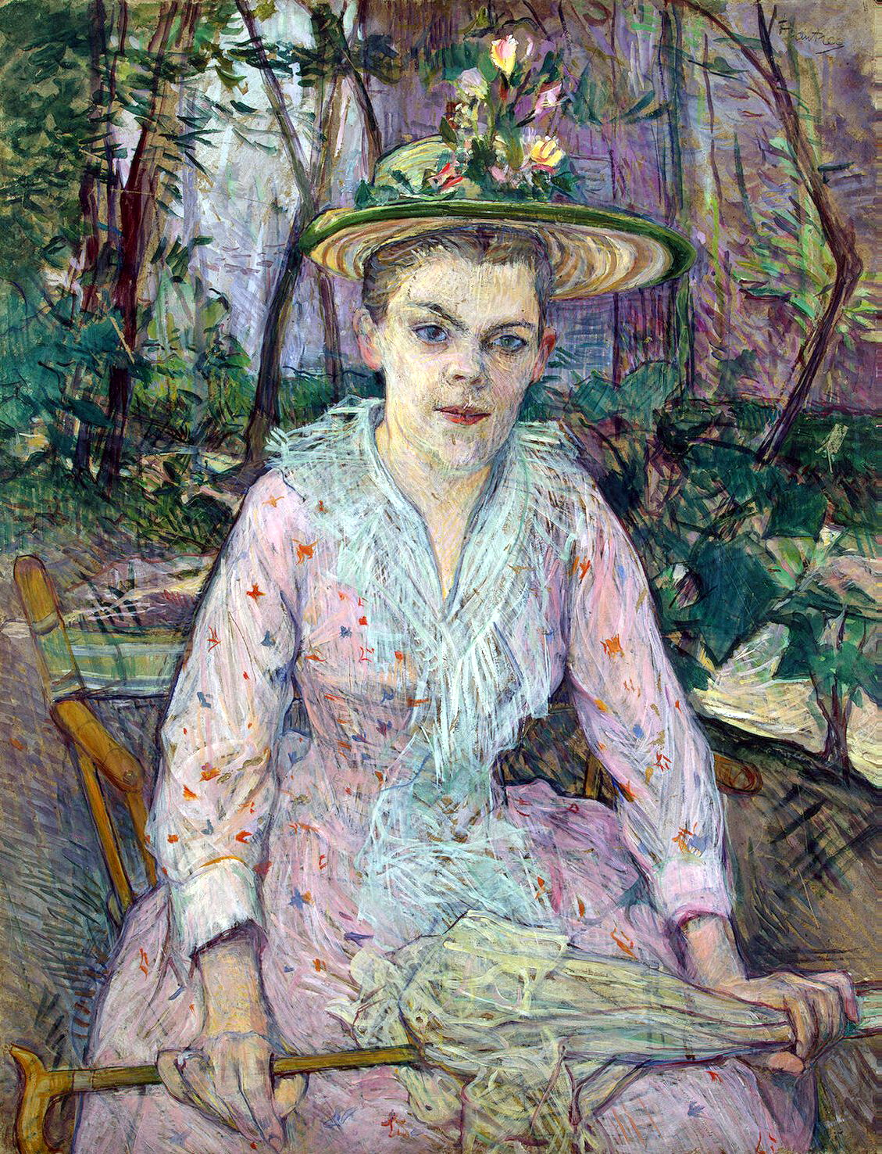
Woman with a parasol, 1889, 76.6x57.5 cm, Hermitage Museum
Woman with a parasol, 1889, watercolour, gouache tempera on cardboard, 76.6x57.5 cm, Hermitage Museum https://commons.wikimedia.org/wiki/File:Toulouse-Lautrec_--_Femme_%C3%A0_l%27ombrelle.jpg

Slide 5
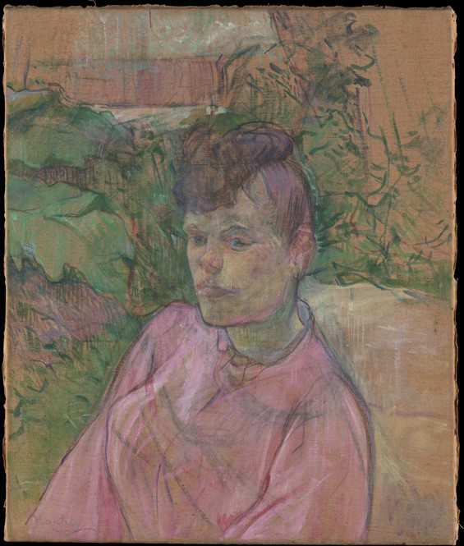
Woman in Monsieur Forest’s Garden, 1889-1891, Oil on Canvas, 55.6 x 46.4 cm, the MET, NY, USA https://www.metmuseum.org/art/collection/search/437838

Slide 6
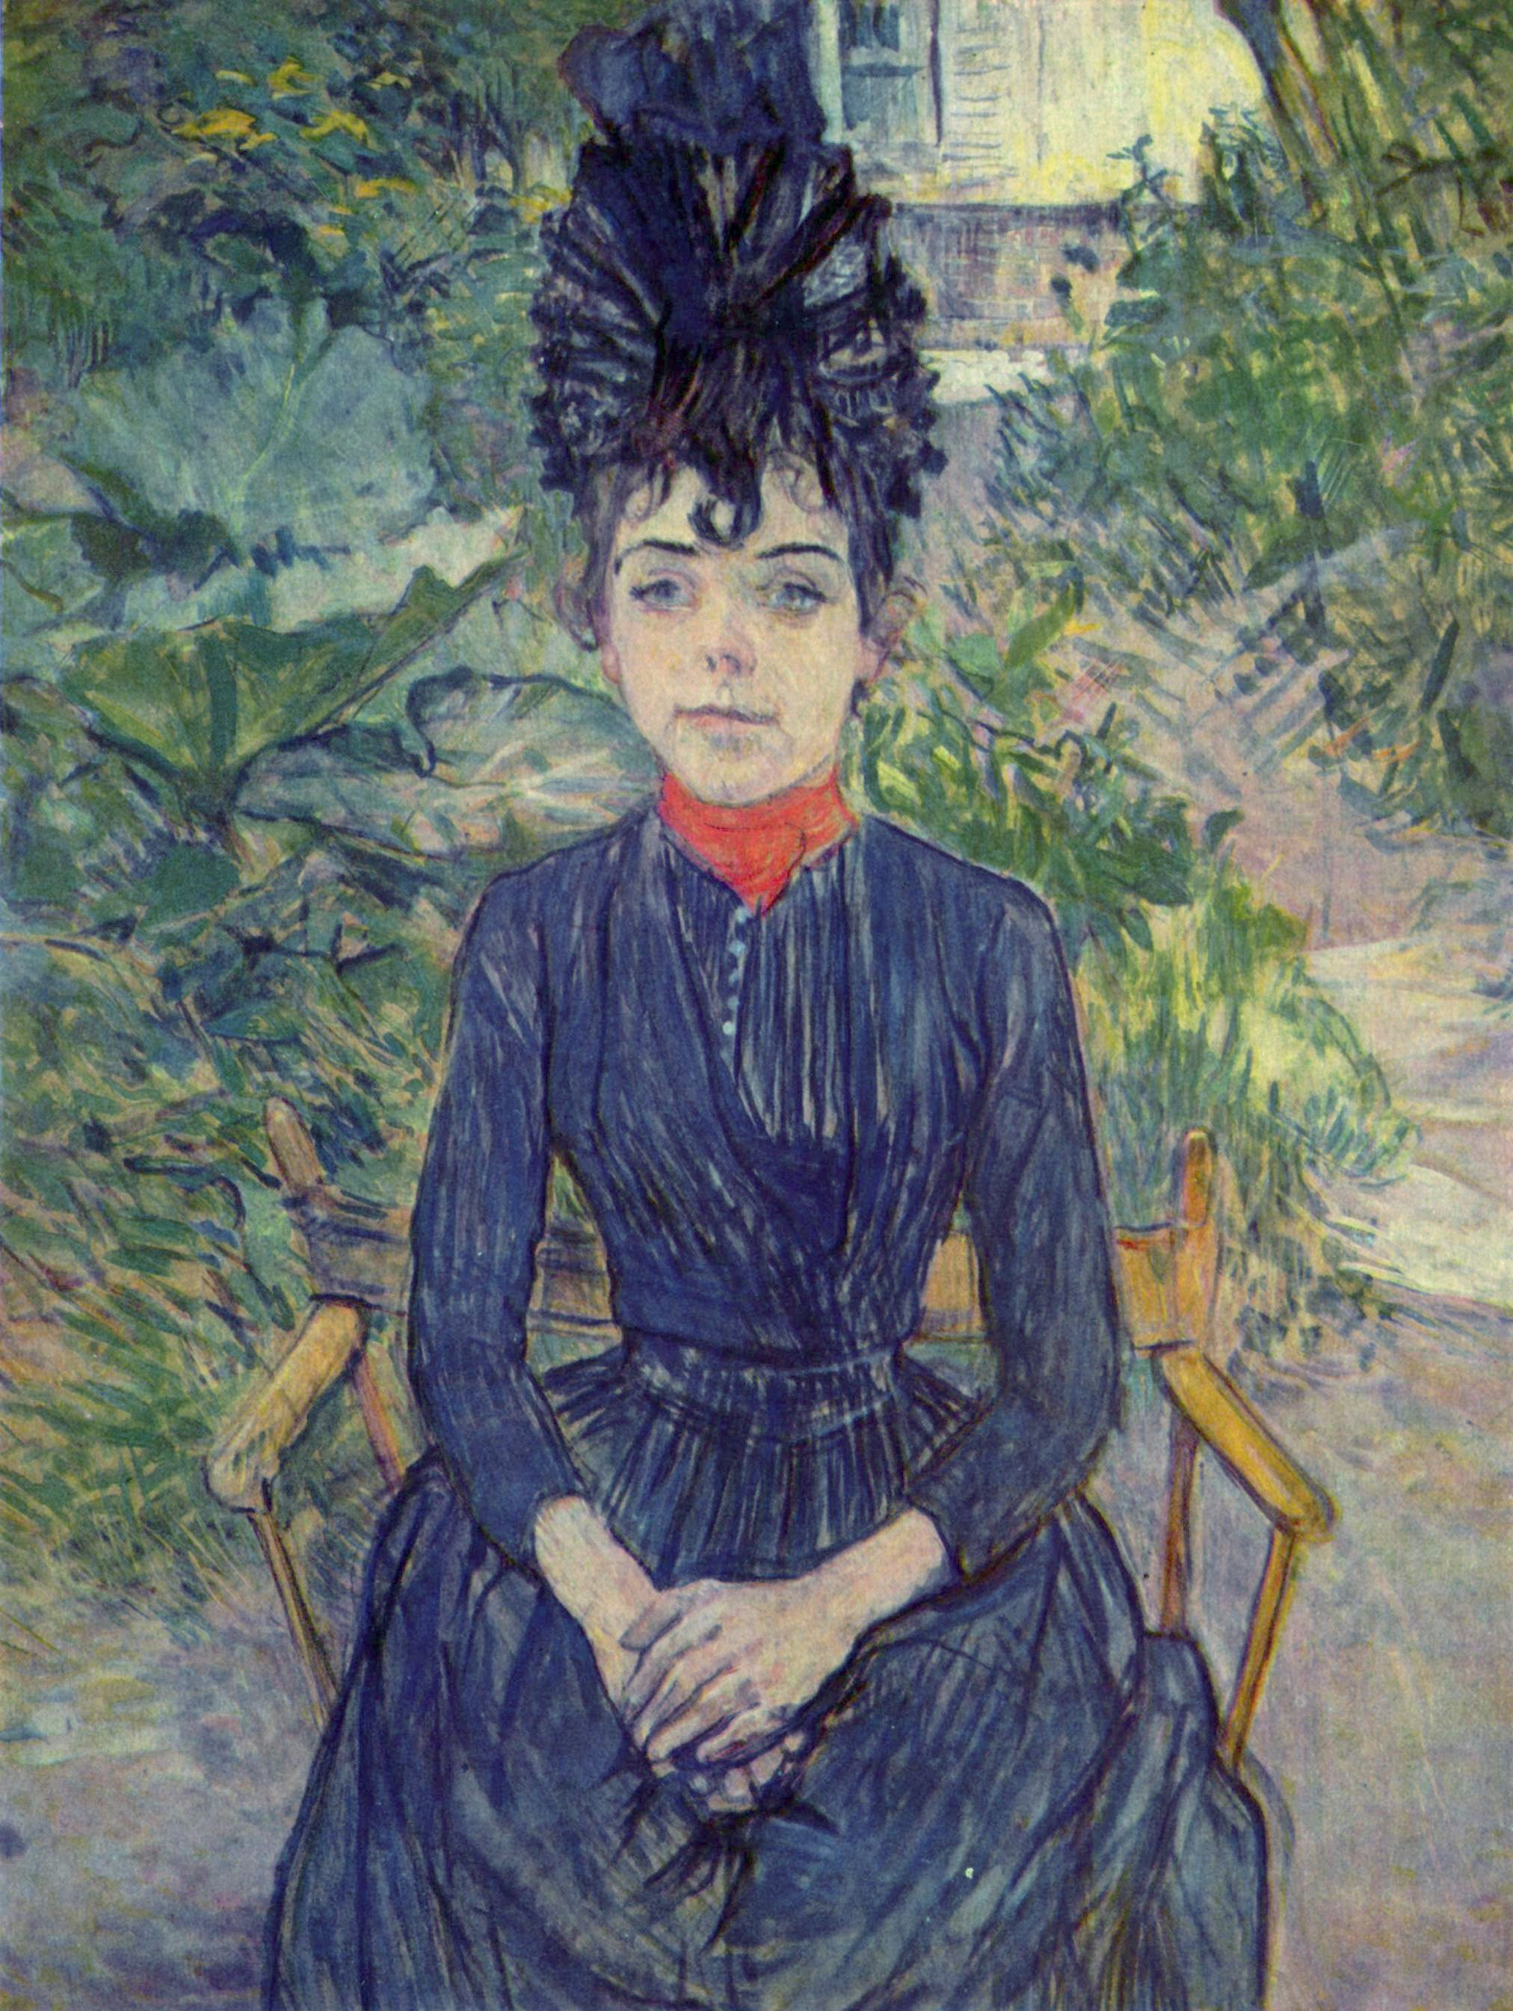
Justine Dieuhl in the Grden of Père Forest, 1890, oil on cardboard, 74x58 cm, Musée d'Orsay, Paris, France https://upload.wikimedia.org/wikipedia/commons/6/64/Henri_de_Toulouse-Lautrec_052a.jpg

Slide 7
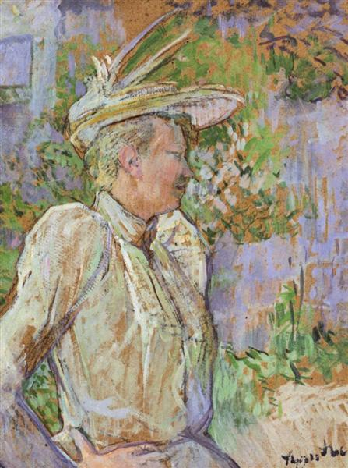
Gabrielle the Dancer, 1890, oil on cardboard, Museum Toulouse-Lautrec, Albi, France https://www.wikiart.org/en/henri-de-toulouse-lautrec/gabrielle-the-dancer-1890

Slide 8
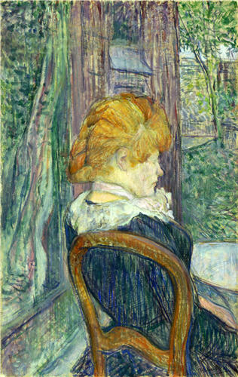
A Woman Seated in a Garden, about 1890, essence on cardboard, 49.4x31.3 cm, The Barber Institute of Fine Arts, University of Birmingham, UK https://commons.wikimedia.org/wiki/File:Toulouse-Lautrec_-_A_Woman_Seated_in_a_Garden,_about_1890.jpg

Slide 9
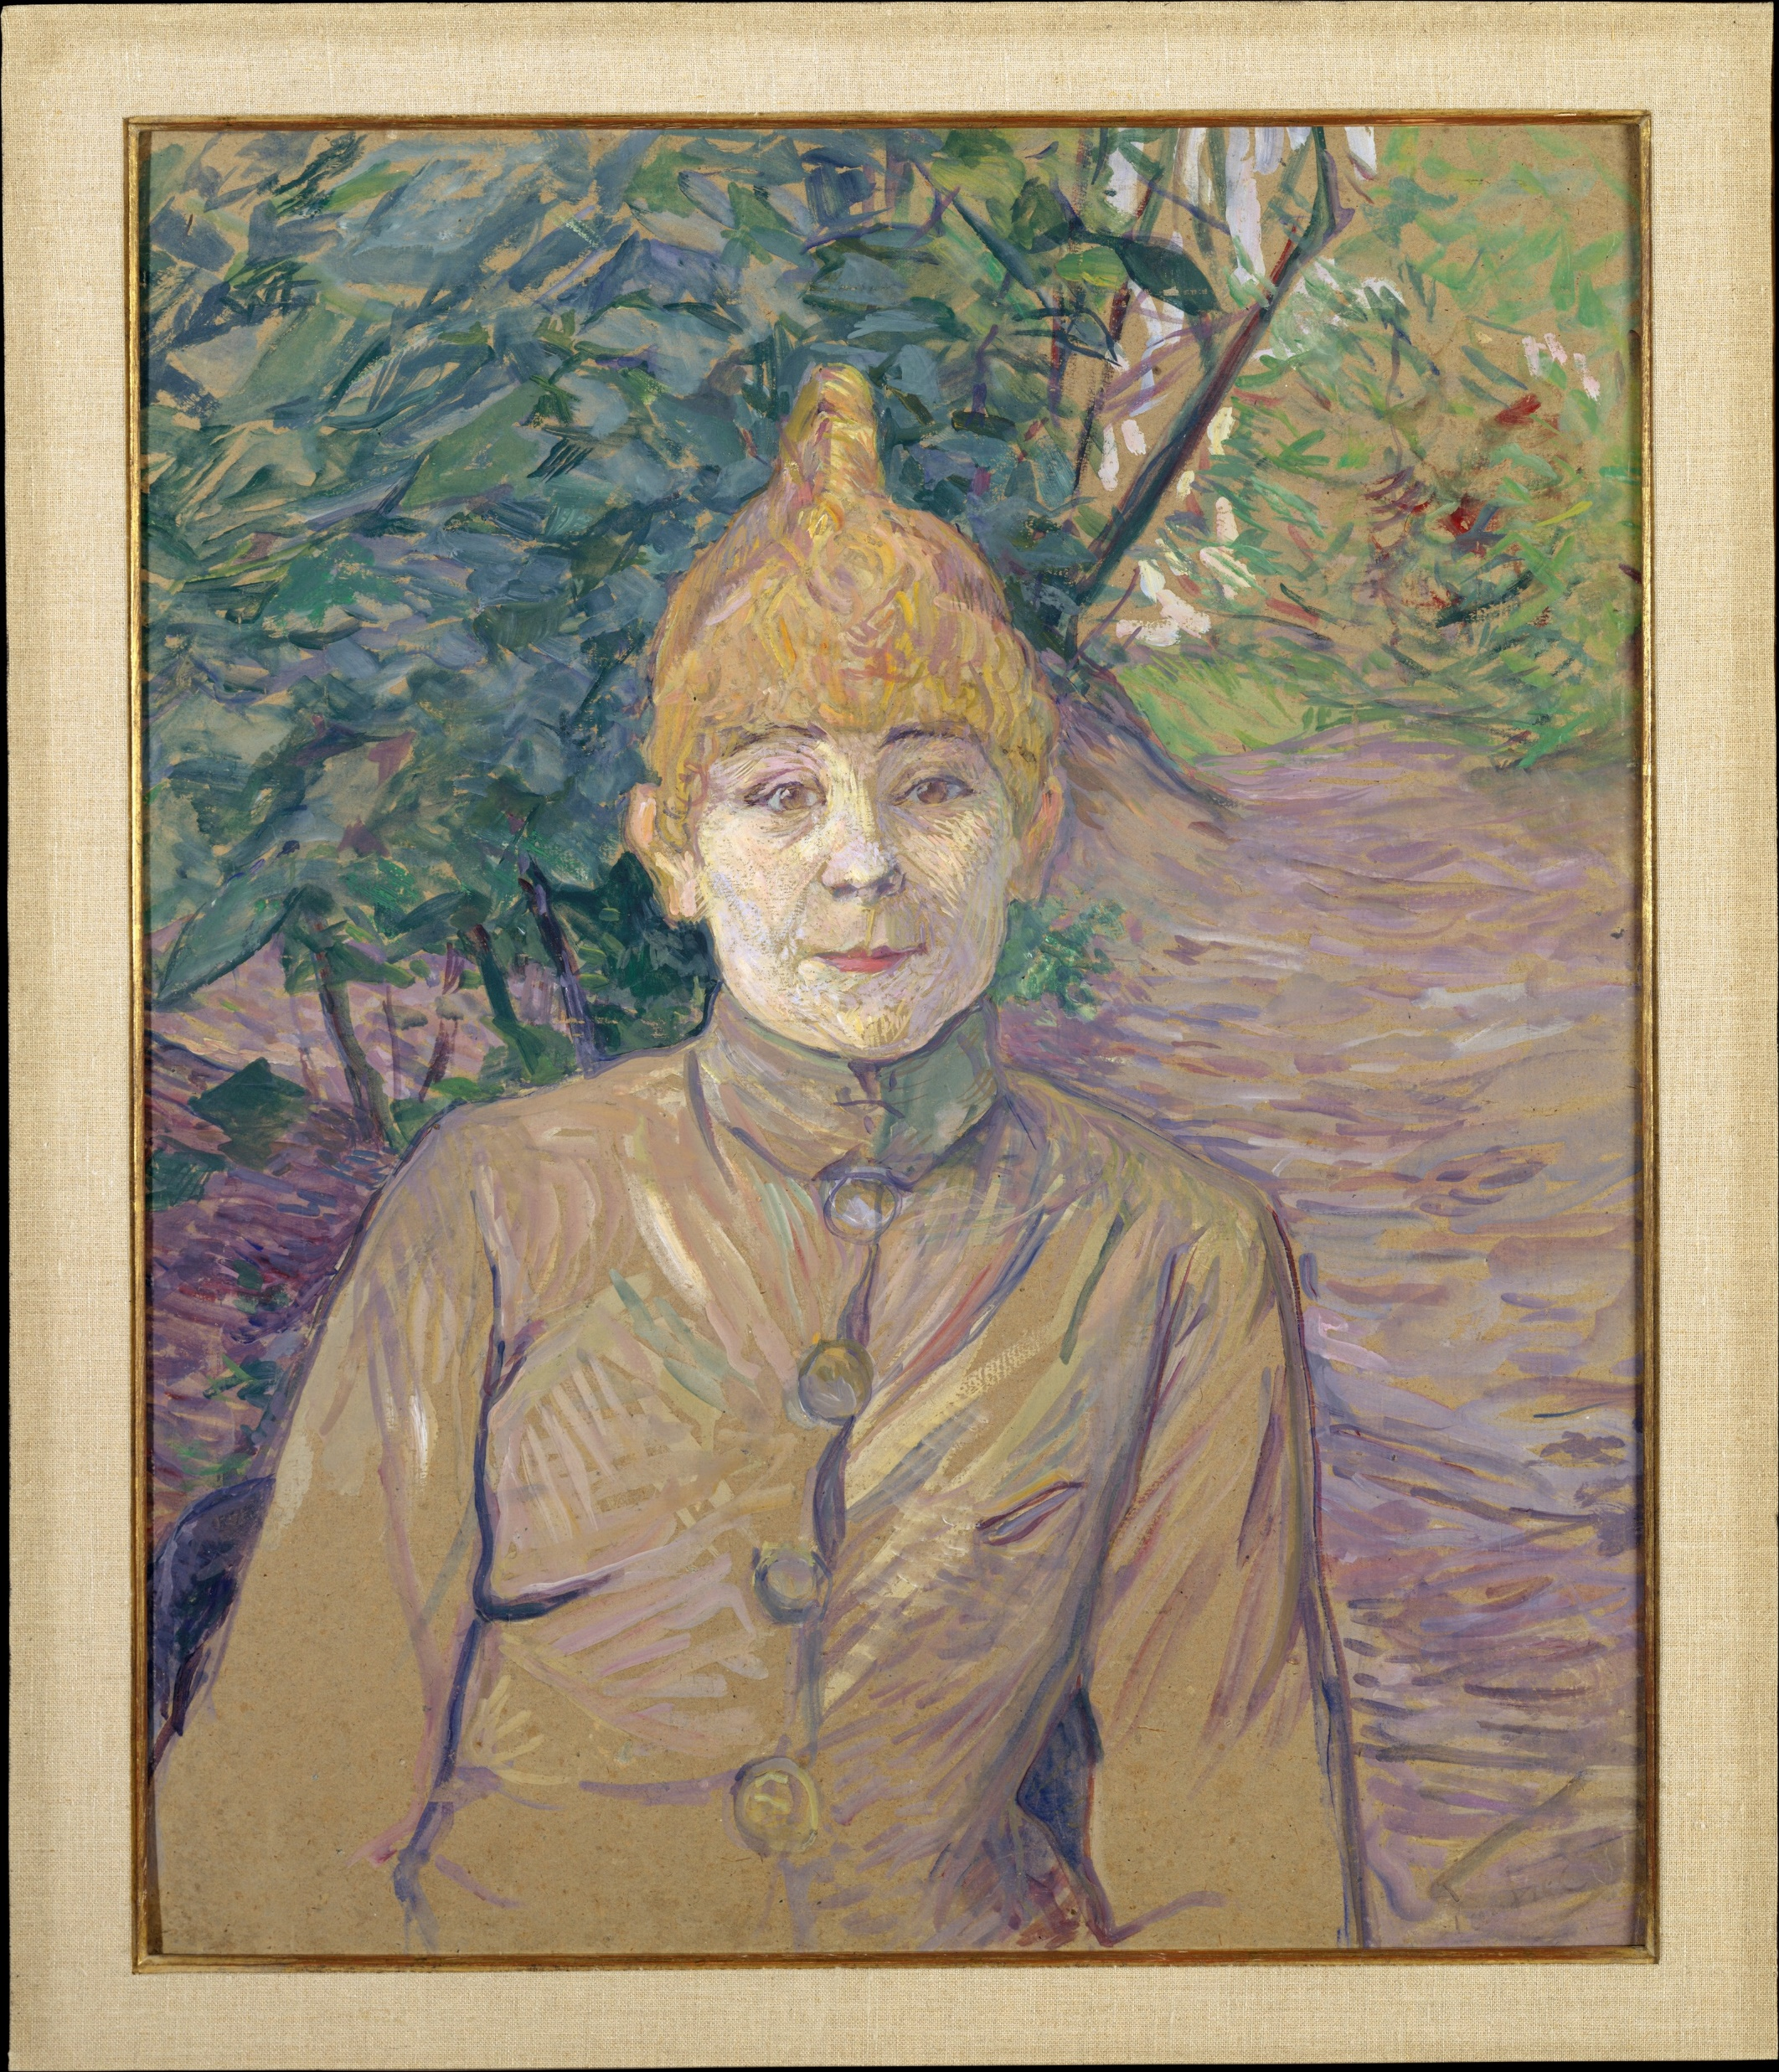
The Streetwalker, ca. 1890–91, Oil on cardboard, 64.8 x 53.3 cm, the MET, NY, USA https://www.metmuseum.org/art/collection/search/438016

Slide 10
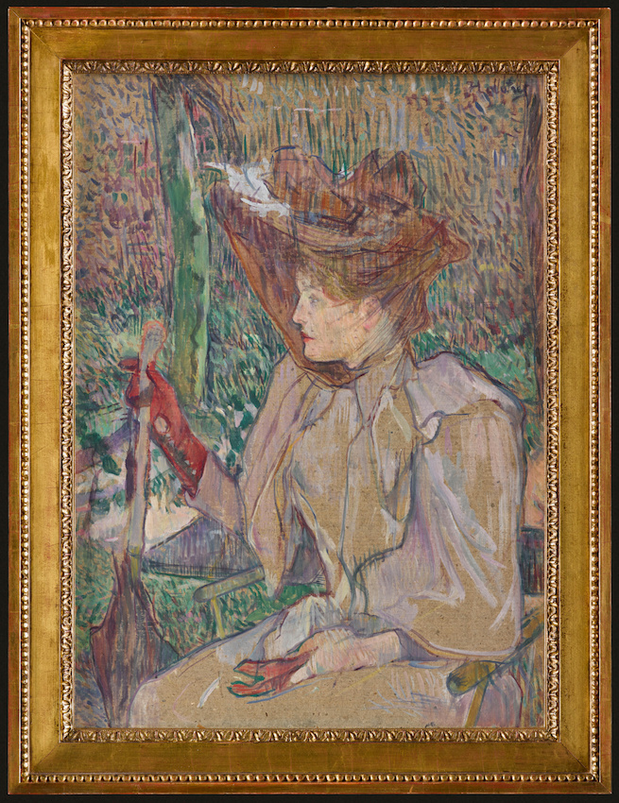
Woman with Gloves (Honorine Platzer), 1891, oil on cardboard, 54x40 cm, Musée d'Orsay , Paris, France https://www.musee-orsay.fr/en/node/89835

Slide 11
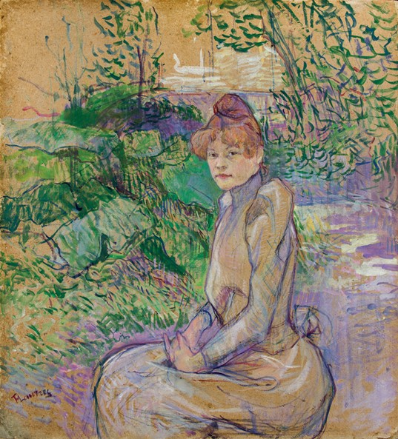
Woman in Monsieur Forest’s Garden, 1891, Oil on Board, 60,7 × 55 cm, Basil and Elise Goulandris Foundation, Athens, Greece https://goulandris.gr/el/collection/highlights

Slide 12
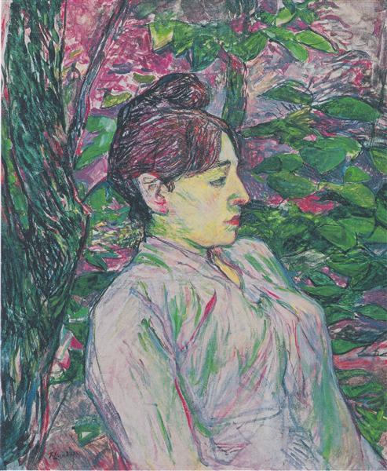
The Greens (Seated Woman in a Garden), 1891, oil on panel, 55x46 cm, Private Collection https://www.wikiart.org/en/henri-de-toulouse-lautrec/the-greens-seated-woman-in-a-garden-1891

Slide 13
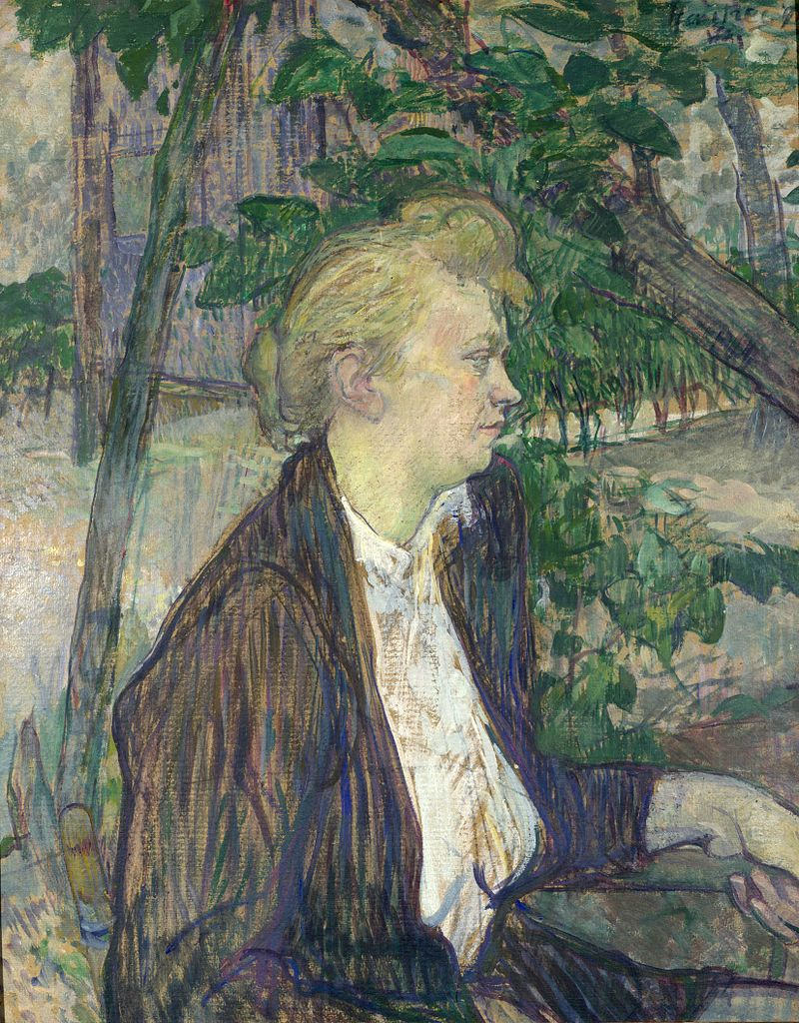
Woman seated in a Garden, 1891, oil on millboard, 66.7x52.8 cm, National Gallery, London, UK https://www.wikidata.org/wiki/Q26517145

Slide 14
The End

