Slide 1
Pablo Picasso
1881–1973
Mother and Child
1921-1922

Slide 2
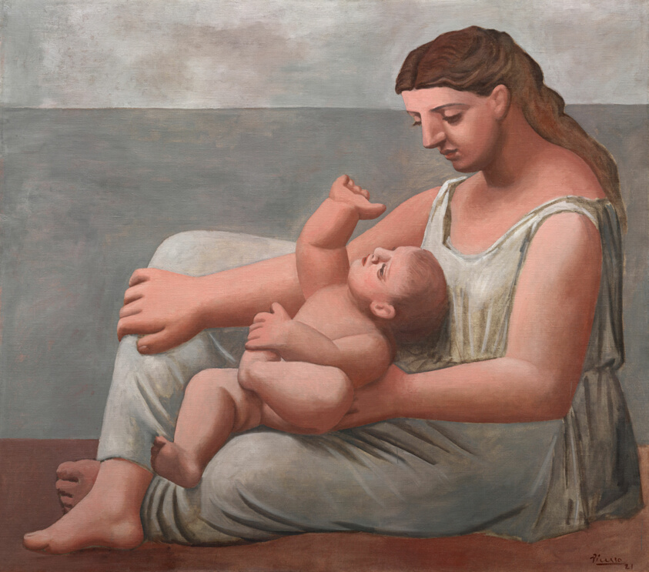
Mother and Child, ca. 1921, Oil on canvas, 142.9 × 172.7 cm, Art Institute, Chicago, IL, USA https://www.artic.edu/artworks/109275/mother-and-child

Slide 3
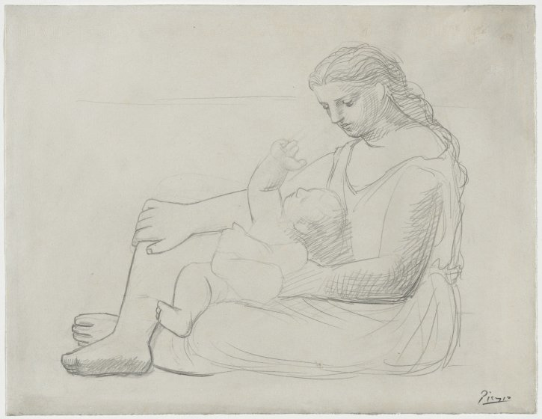
Mother and Child, 1921, Pencil on paper, 24.8 x 32.1 cm, The Cleveland Museum of Art, USA https://www.clevelandart.org/art/1949.527

Slide 4
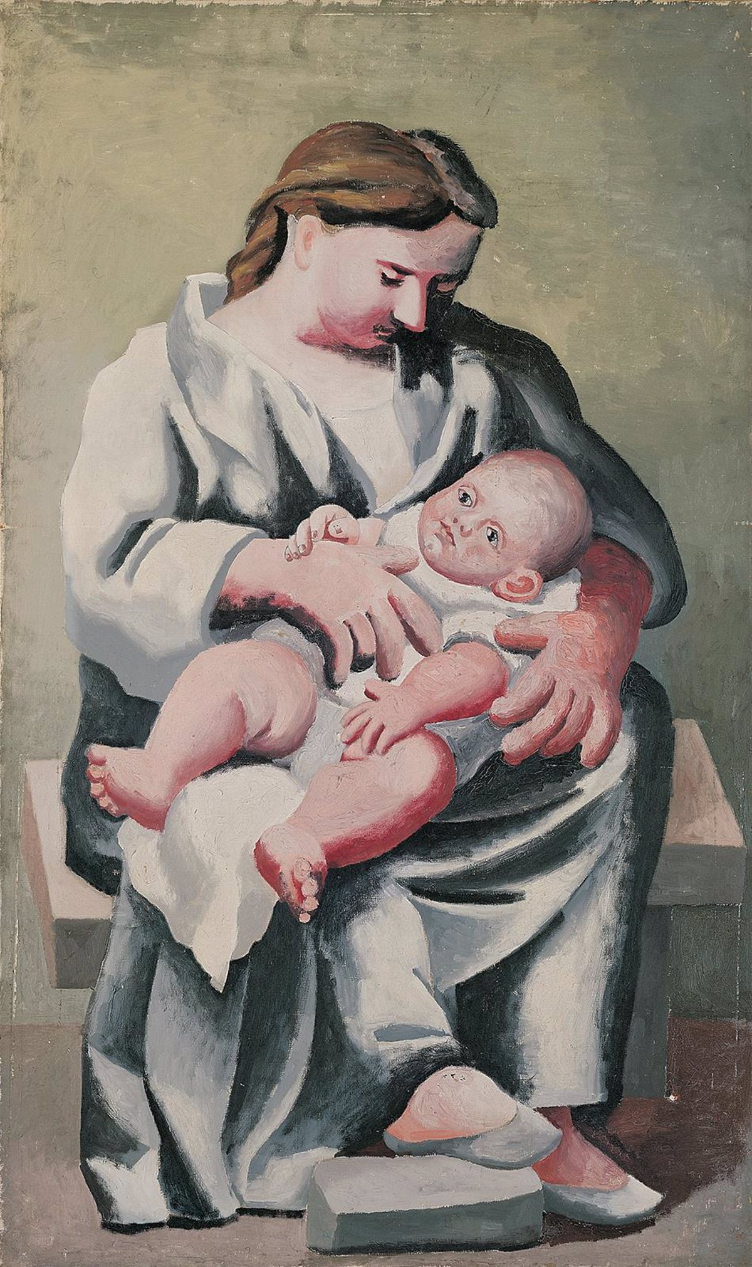
Maternity, 1921, oil on canvas, Fundación Almine y Bernard Ruiz-Picasso para el Arte - FABA, Spain
Photo Credit: Éric Baudouin https://www.pablo-ruiz-picasso.net/work-2253.php

Slide 5
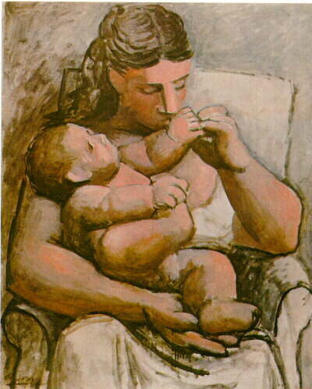
Mother and child, 1921, oil on canvas, 101x83cm, Pola Museum of Art, Hakone, Japan http://artsviewer.com/picasso-591.html

Slide 6
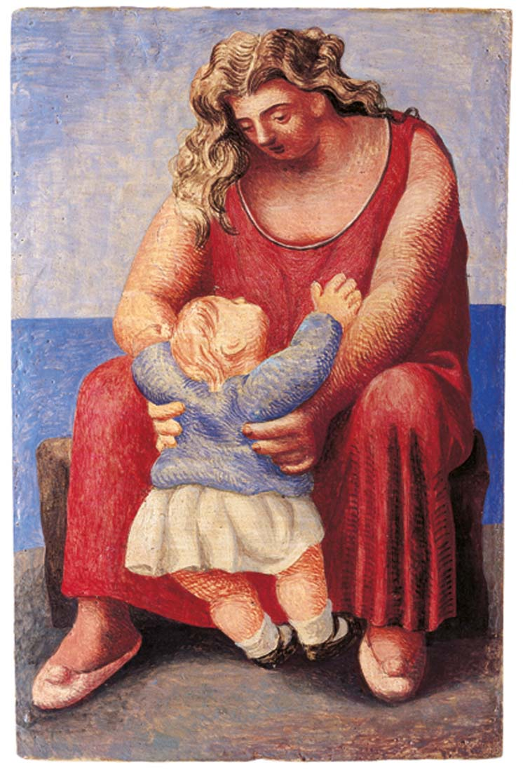
Mother and Child, 1921, oil on canvas, 14.5×9.5 cm, Private Collection
Photo Credit: Eric Baudouin https://www.museopicassomalaga.org/en/temporary-exhibitions/pablo-picassofamily-album

Slide 7
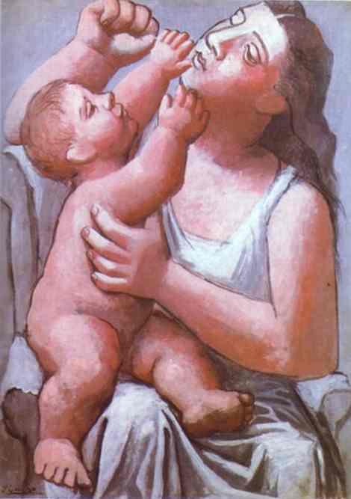
Mother and Child, 1922, oil on canvas, 97 x 71 cm, The Alex L. Hillman Family Foundation, New York, USA https://www.pablo-ruiz-picasso.net/work-121.php

Slide 8
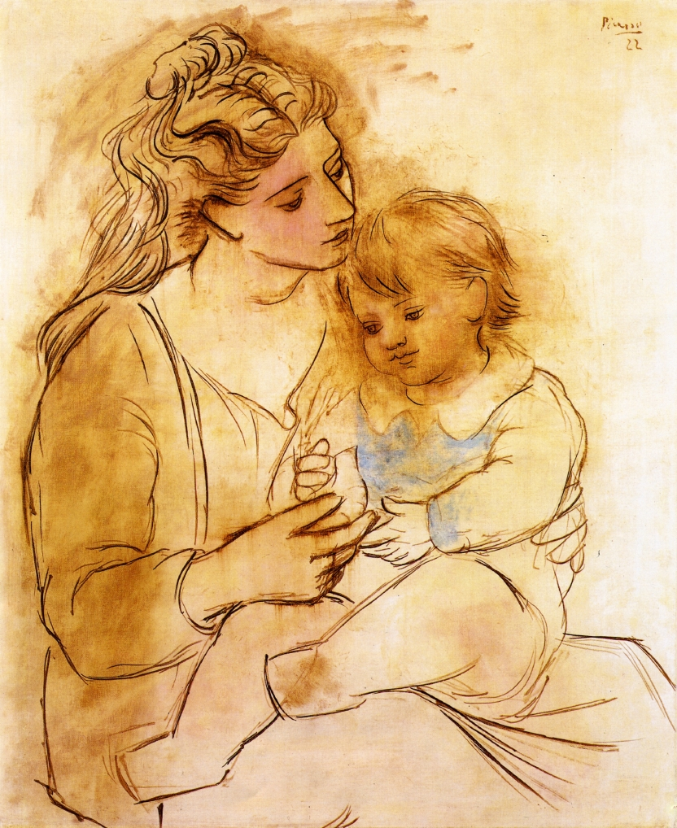
Mother and child, 1922, oil on canvas, 100x81cm, Private Collection http://artsviewer.com/picasso-618.html

Slide 9
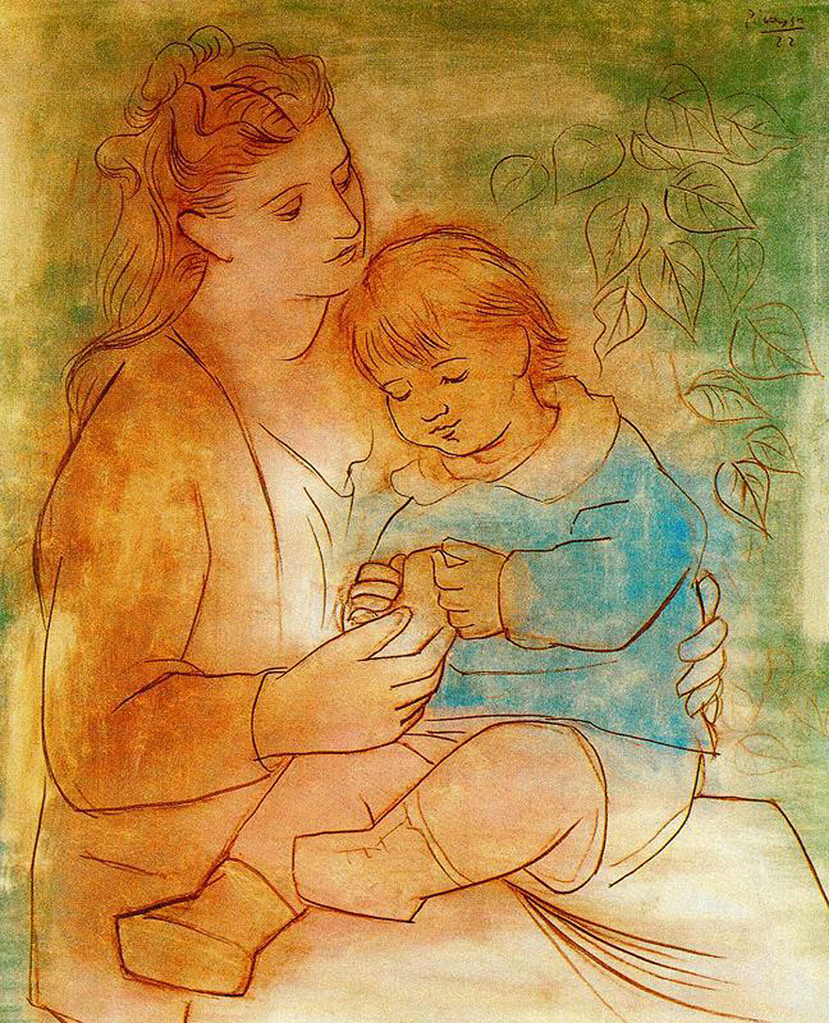
Mother and child, 1922, oil on canvas, 100x82cm, Private Collection http://artsviewer.com/picasso-619.html

Slide 10
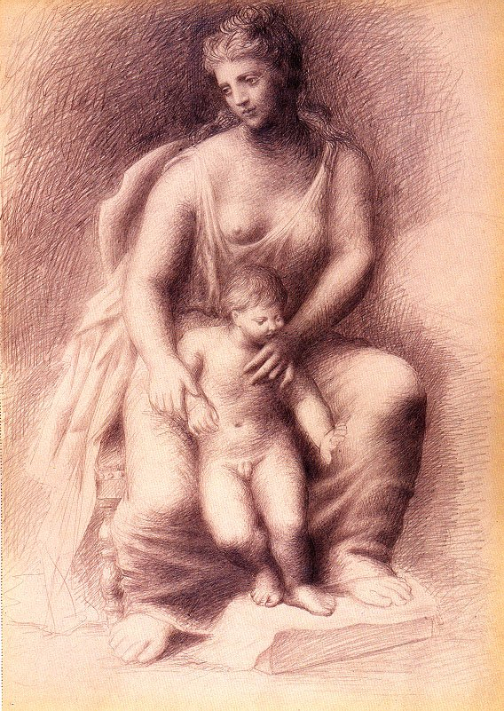
Mother and child, 1922, pencil on paper, 42x30cm, Private Collection http://artsviewer.com/picasso-617.html

Slide 11
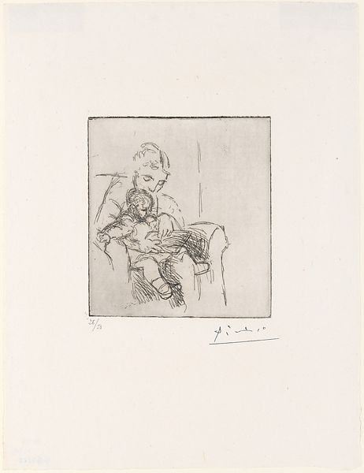
Mother and Child, 1922, Printed by Jacques Frélaut (French) in 1961, Etching on zinc plate, printed on laid paper (numbered artist's proof), 14 x 12,7 cm, the MET, NY, USA https://www.metmuseum.org/art/collection/search/369775

Slide 12
The End

