Slide 1
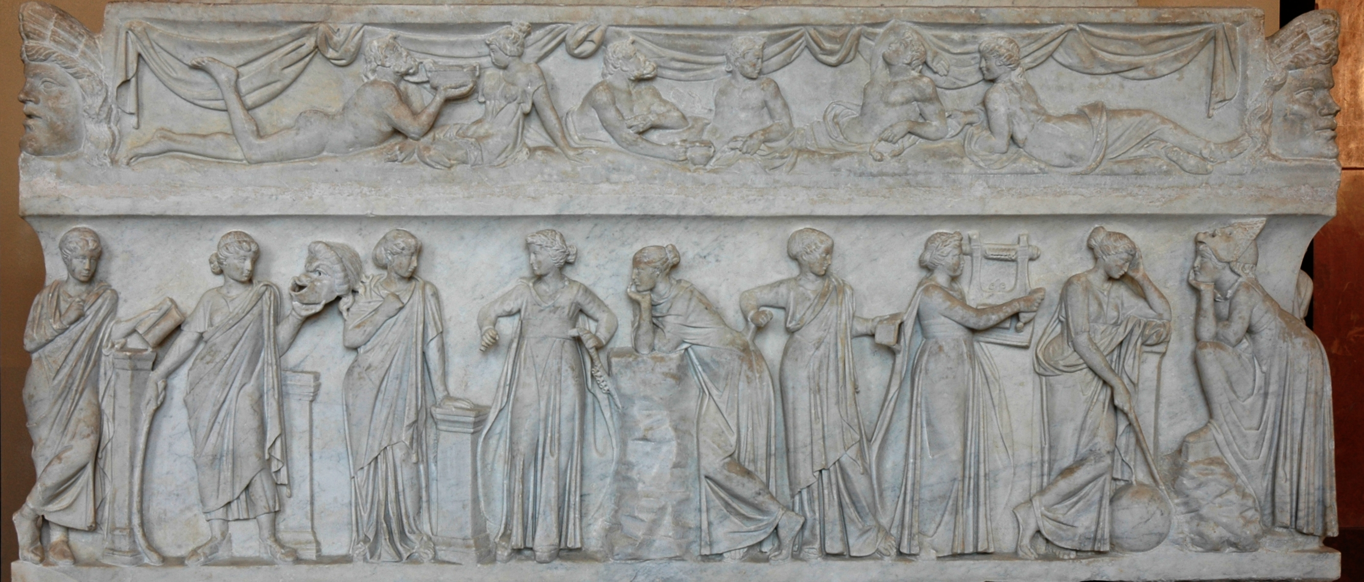
Sarcophagus of the Muses, first half of the 2nd century AD, Marble, 0.92x2.06 m, the Louvre Museum, Paris, France
Photo Credit: https://commons.wikimedia.org/wiki/File:Muses_sarcophagus_Louvre_MR880.jpg

Slide 2
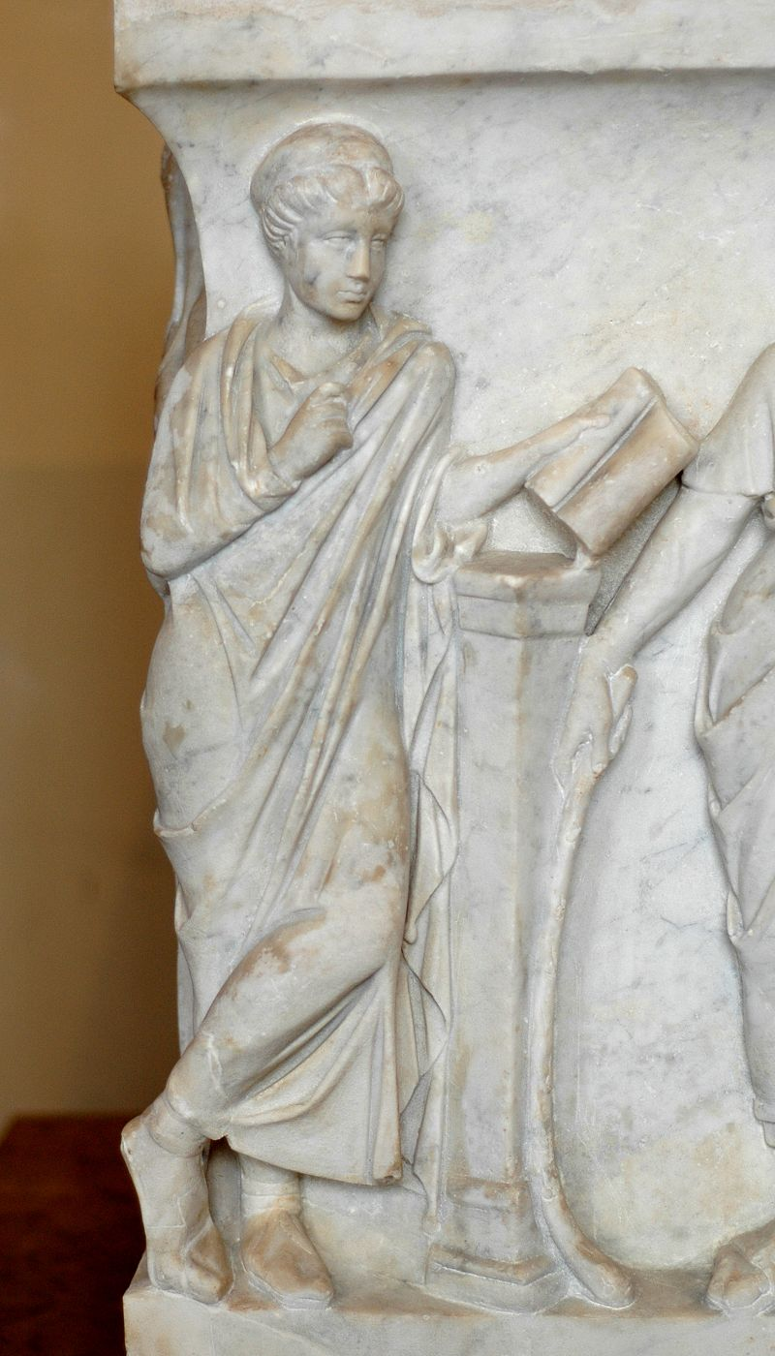
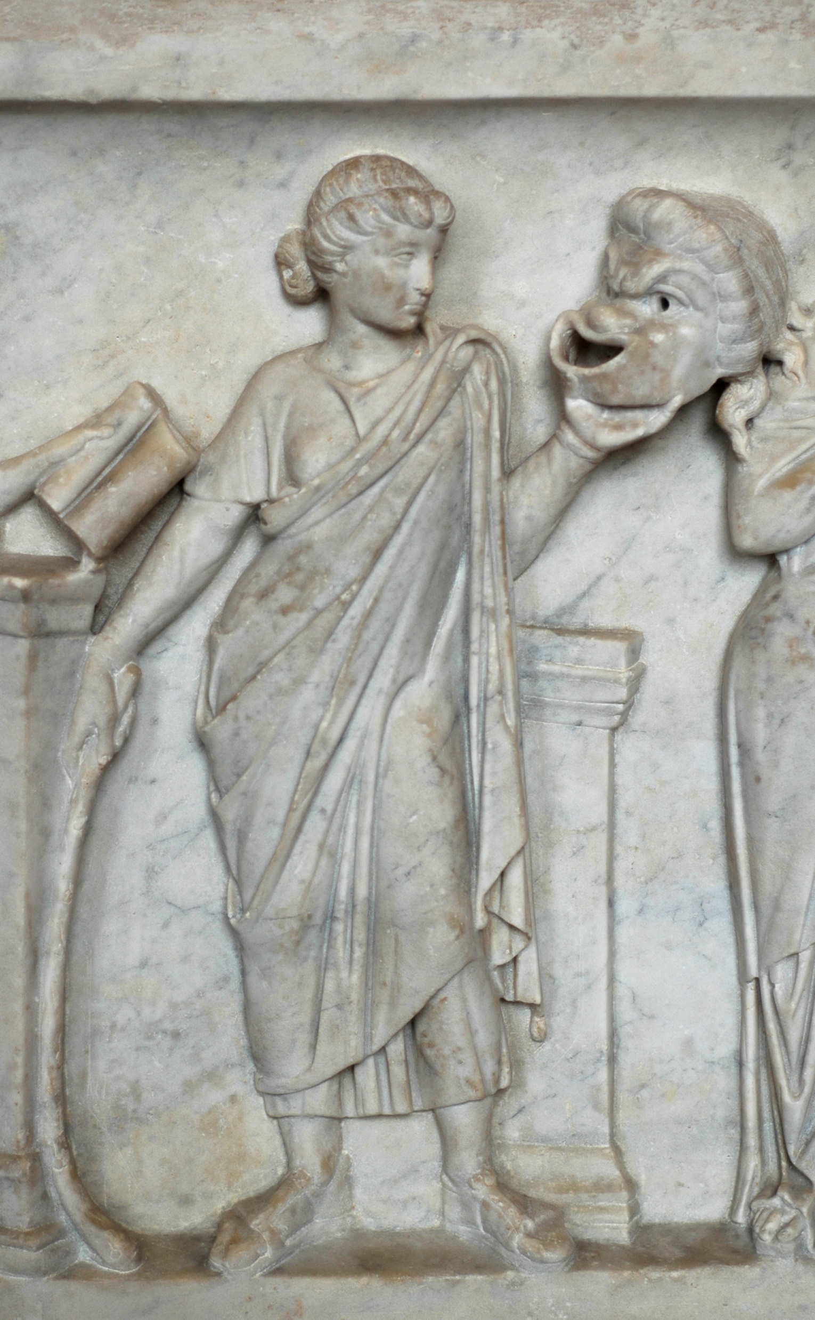
Kalliope
Thalia
Photo Credits: https://commons.wikimedia.org/wiki/File:Muses_sarcophagus_Louvre_MR880.jpg#/media/File:Calliope_sarcophagus_Louvre_Ma475.jpg https://commons.wikimedia.org/wiki/File:Muses_sarcophagus_Louvre_MR880.jpg#/media/File:Thalia_sarcophagus_Louvre_Ma475.jpg

Slide 3
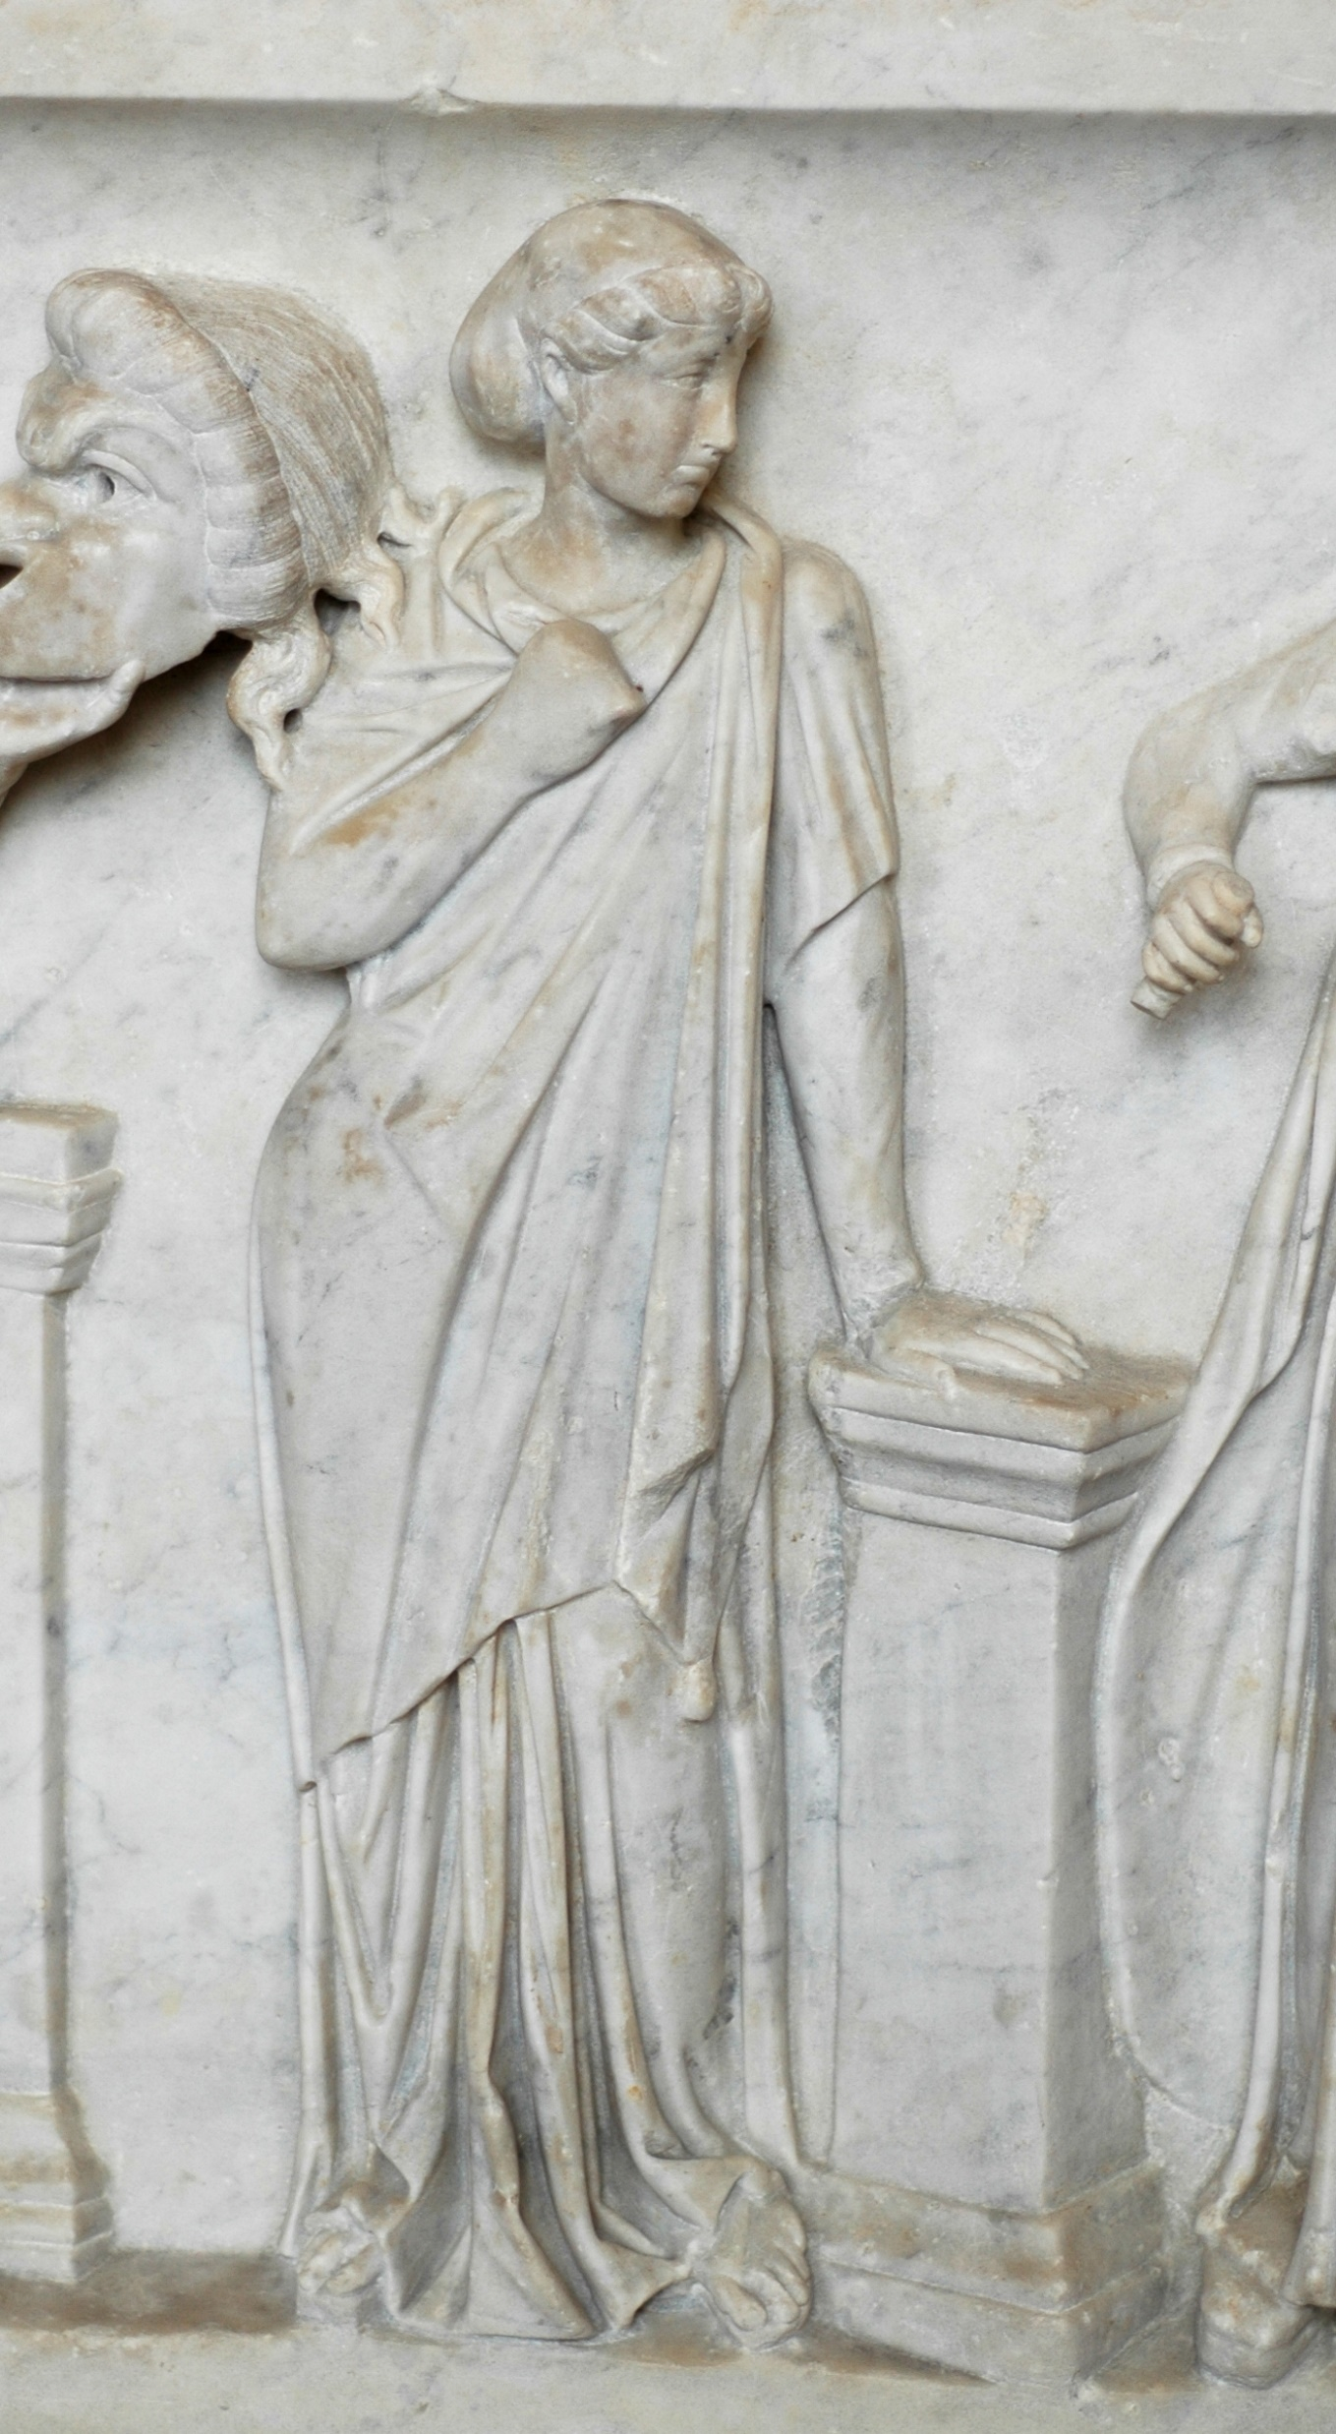
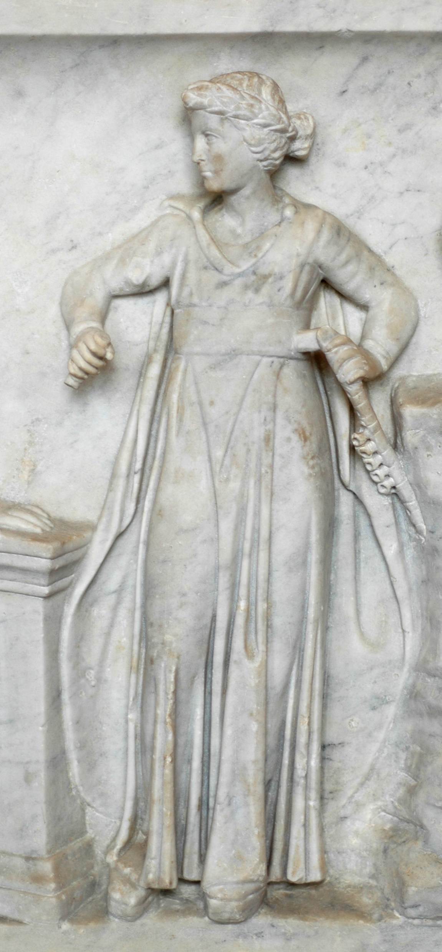
Terpsichore
Euterpe
Photo Credits: https://commons.wikimedia.org/wiki/File:Muses_sarcophagus_Louvre_MR880.jpg#/media/File:Terpsichore_sarcophagus_Louvre_Ma475.jpg https://commons.wikimedia.org/wiki/File:Muses_sarcophagus_Louvre_MR880.jpg#/media/File:Euterpe_sarcophagus_Louvre_Ma475.jpg

Slide 4
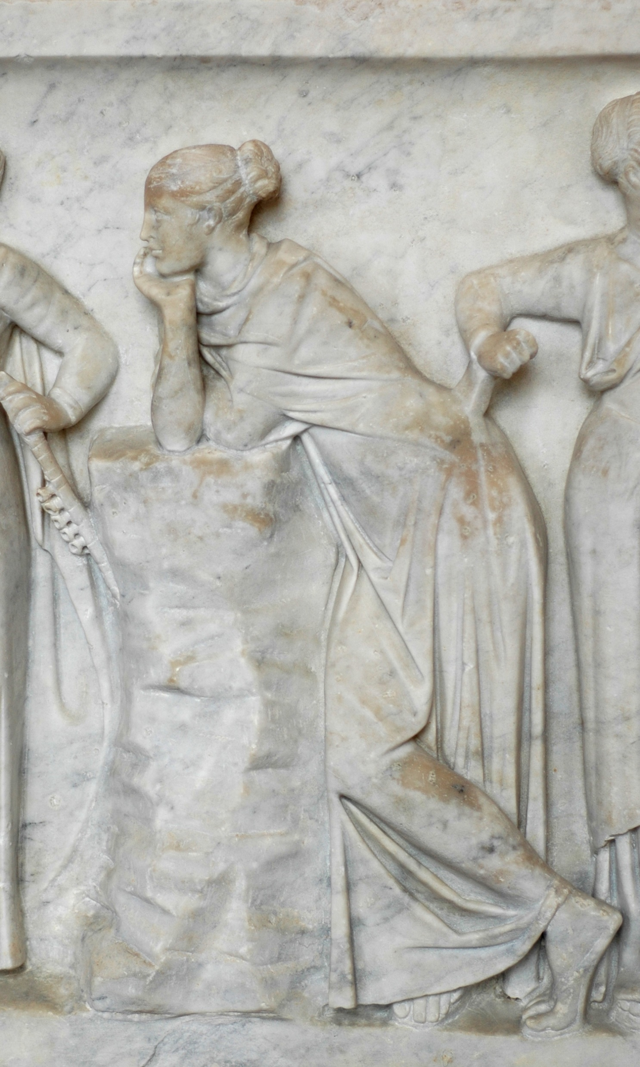
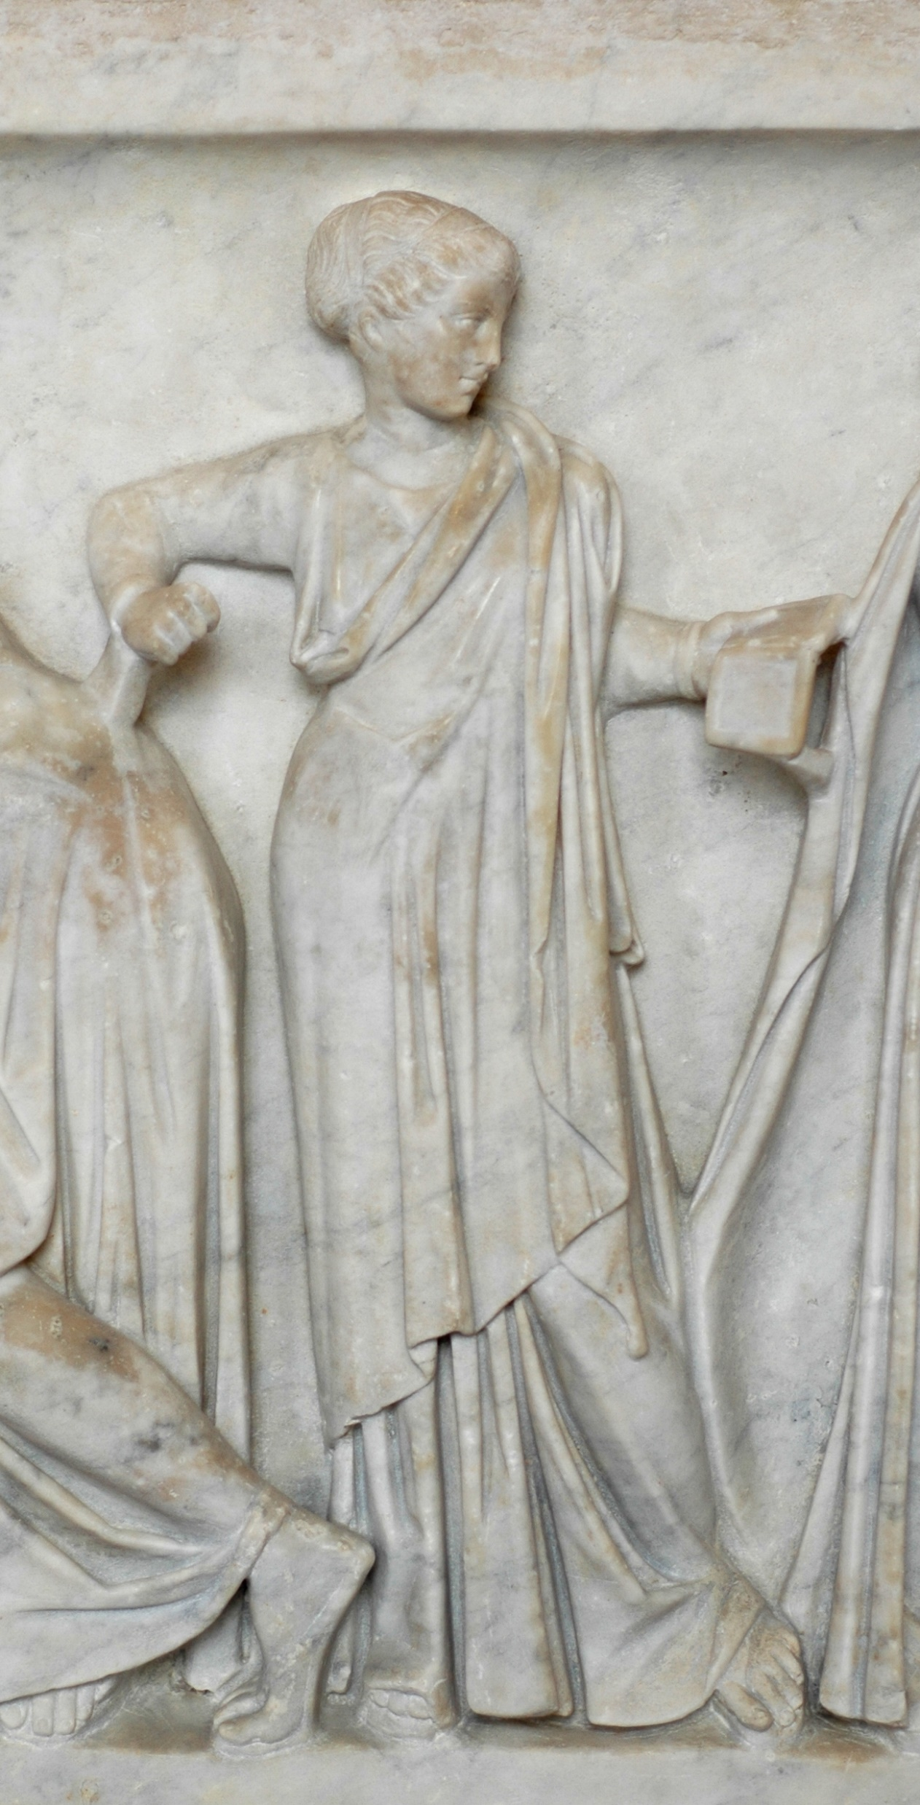
Polyhymnia
Clio
Photo Credits: https://commons.wikimedia.org/wiki/File:Muses_sarcophagus_Louvre_MR880.jpg#/media/File:Polyhymnia_sarcophagus_Louvre_Ma475.jpg https://commons.wikimedia.org/wiki/File:Muses_sarcophagus_Louvre_MR880.jpg#/media/File:Clio_sarcophagus_Louvre_Ma475.jpg

Slide 5
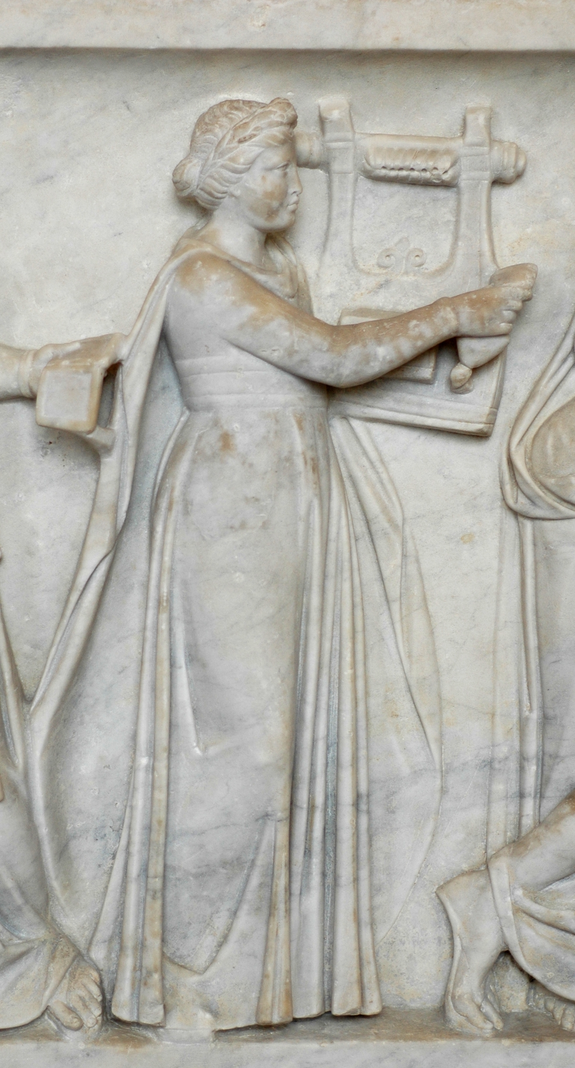
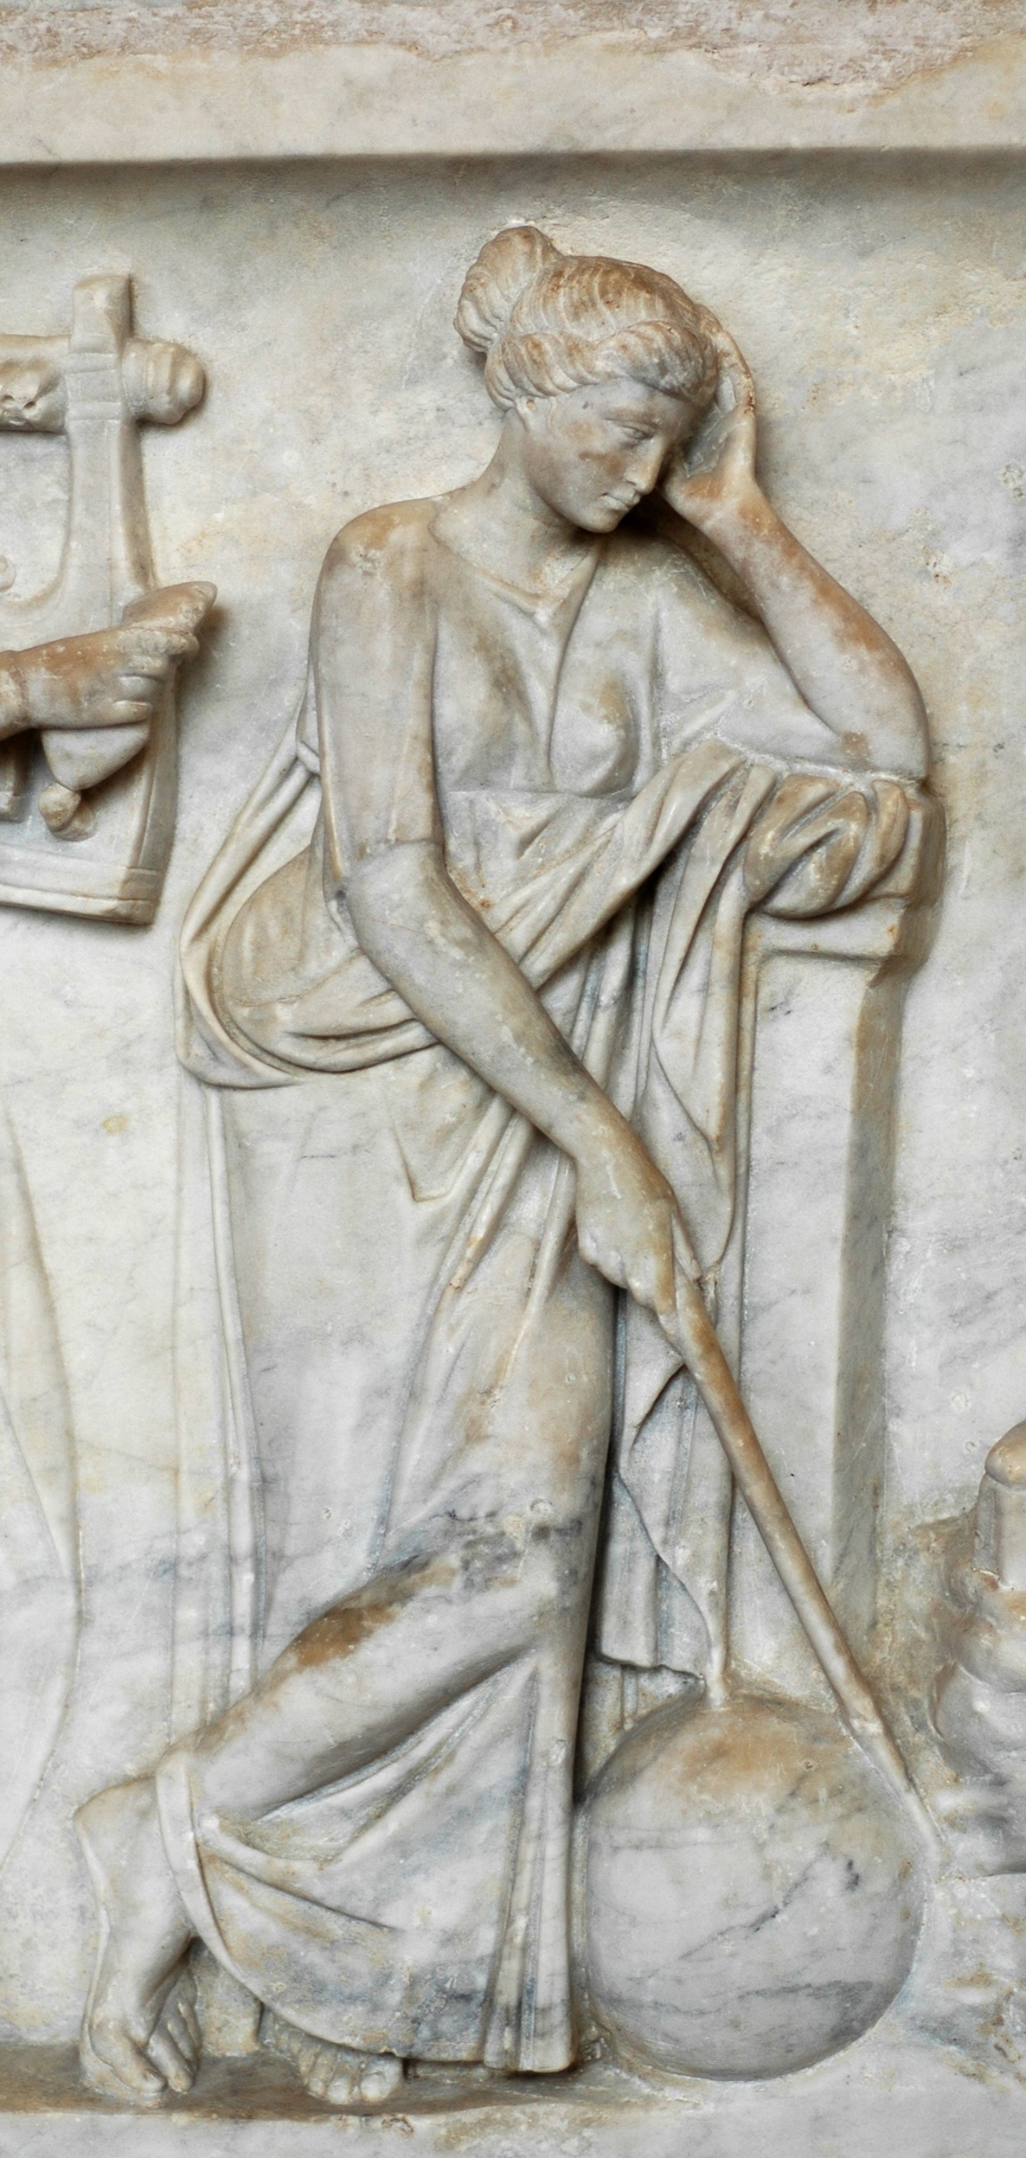
Erato
Urania
Photo Credits: https://commons.wikimedia.org/wiki/File:Muses_sarcophagus_Louvre_MR880.jpg#/media/File:Erato_sarcophagus_Louvre_Ma475.jpg https://upload.wikimedia.org/wikipedia/commons/c/cf/Urania_sarcophagus_Louvre_Ma475.jpg

Slide 6
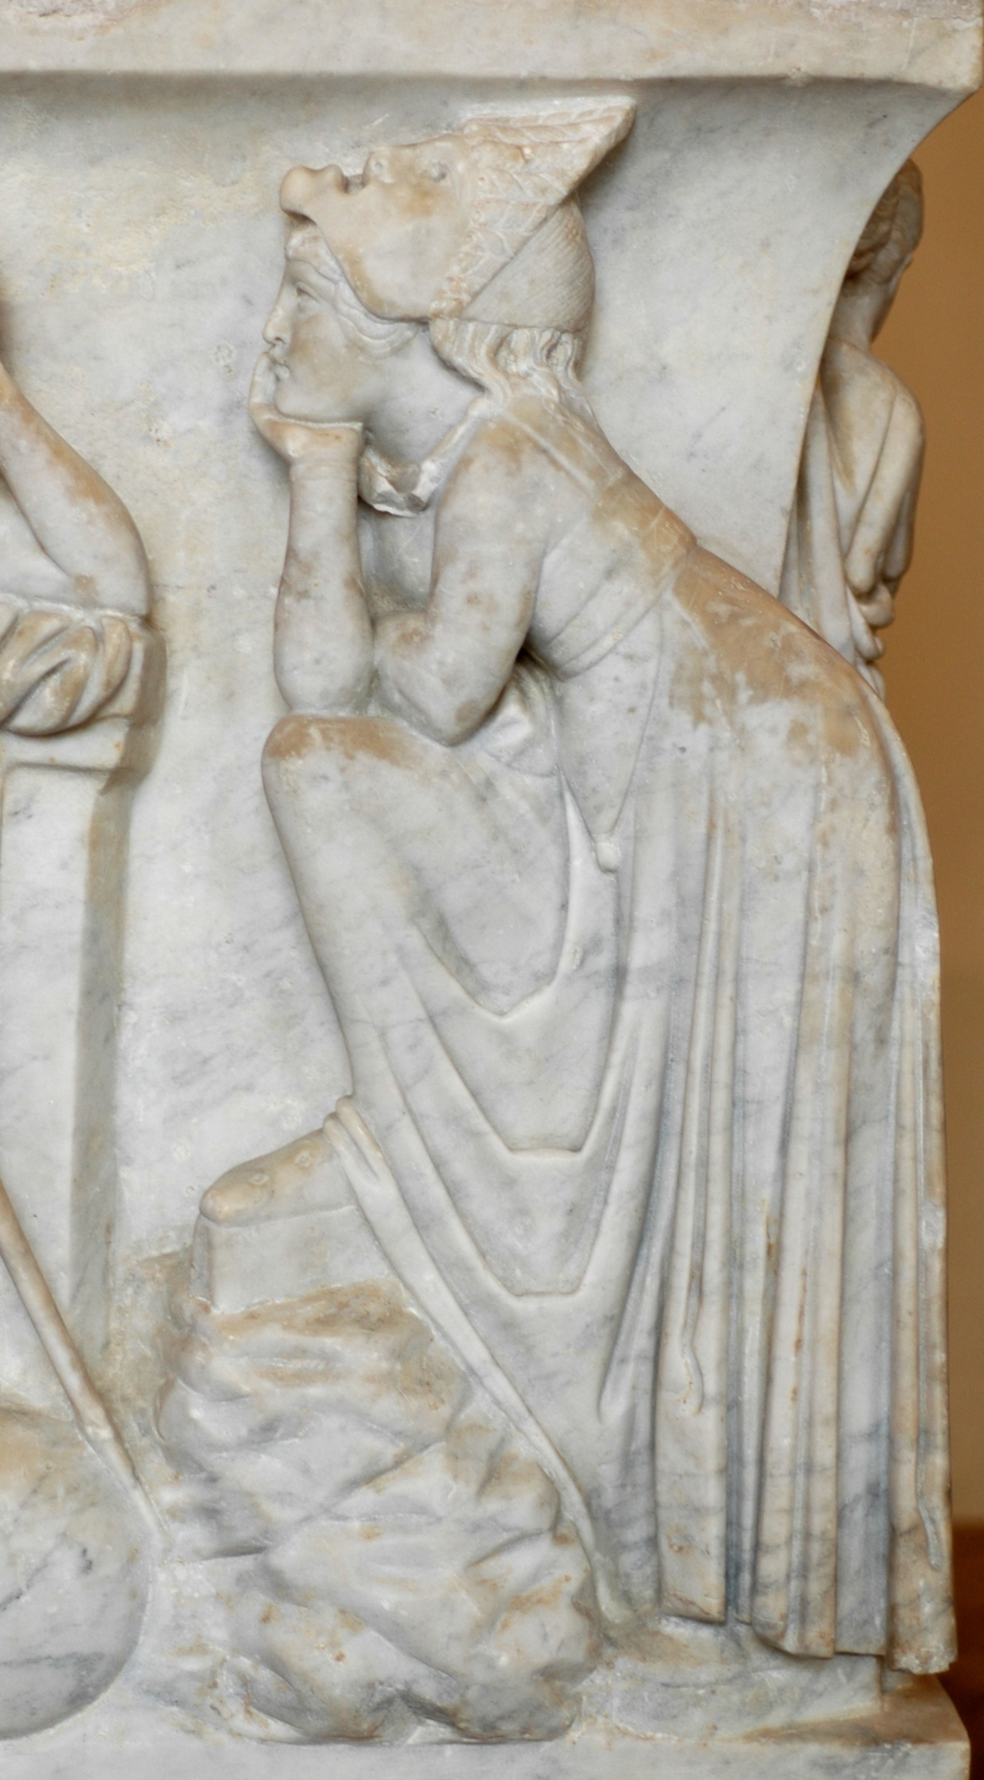
Melpomene
Photo Credit: https://upload.wikimedia.org/wikipedia/commons/8/80/Melpomene_sarcophagus_louvre_Ma475.jpg

Slide 7
The End

