Slide 1
Jacques-Louis David
1748-1825
The Death of Socrates

Slide 2
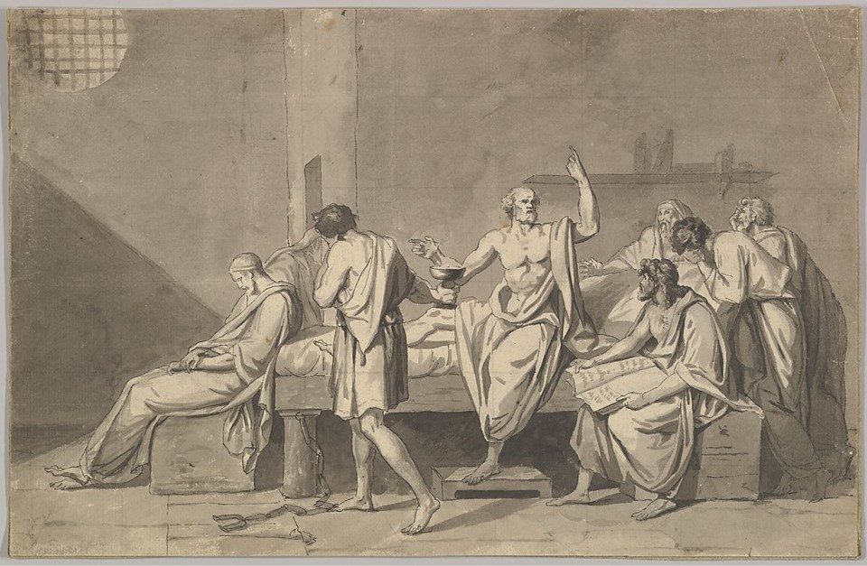
The Death of Socrates, ca. 1782, Pen and black ink, with brush and gray wash over black chalk, with light squaring in black chalk 24.4 × 37.8 cm, the MET, NY, USA https://www.metmuseum.org/art/collection/search/426600

Slide 3
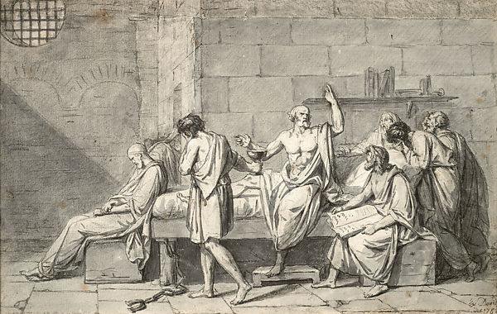
The Death of Socrates, ca. 1782, Pen and black ink, with brush and gray wash over black chalk, with light squaring in black chalk, Private Collection https://www.metmuseum.org/art/collection/search/787682

Slide 4
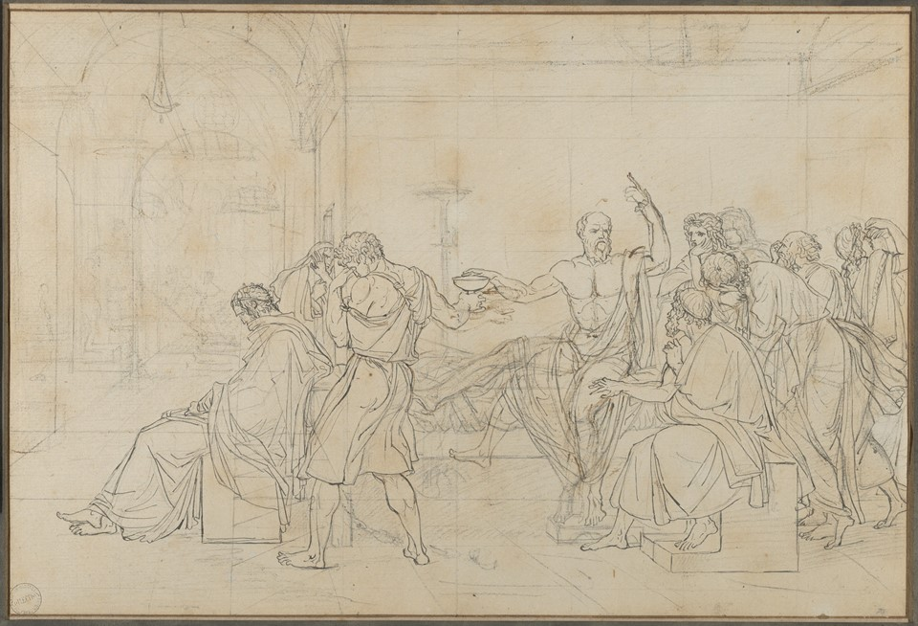
The Death of Socrates, 1786, Pen and black ink, over black chalk, touches of brown ink, squared in black chalk, 27.9 × 41.6 cm, the MET, NY, USA https://www.metmuseum.org/art/collection/search/679783?searchField=All&amp;sortBy=Relevance&amp;ft=Jacques+Louis+David&amp;offset=20&amp;rpp=20&amp;pos=40

Slide 5
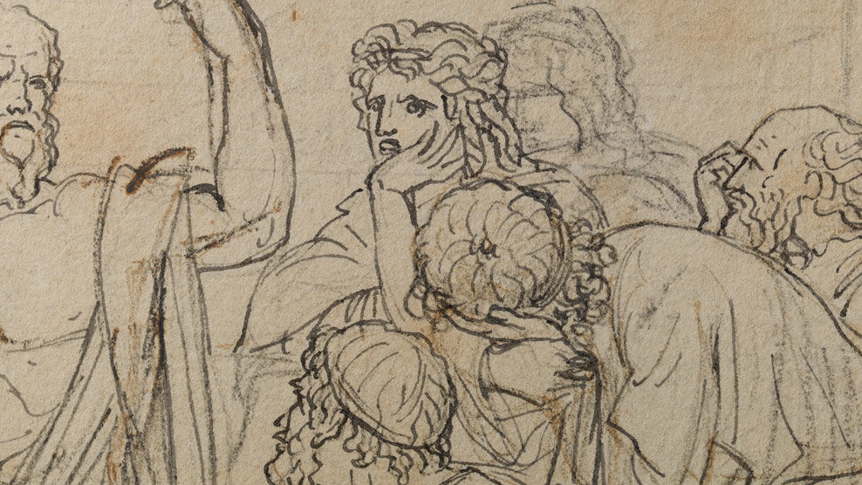
https://www.metmuseum.org/art/online-features/metcollects/the-death-of-socrates-video

Slide 6
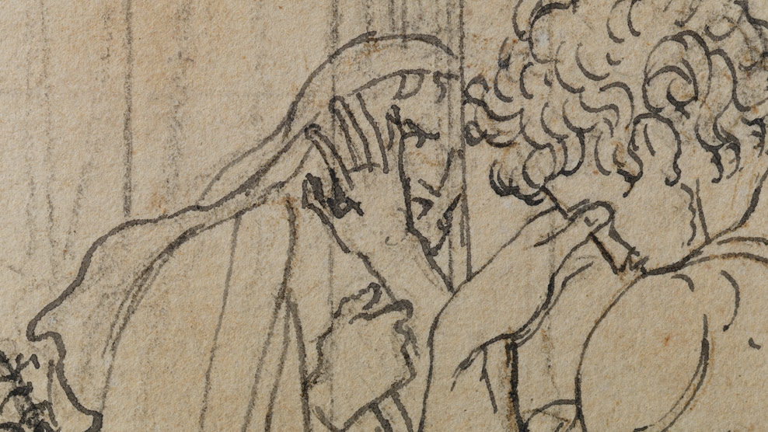
https://www.metmuseum.org/art/online-features/metcollects/the-death-of-socrates-video

Slide 7
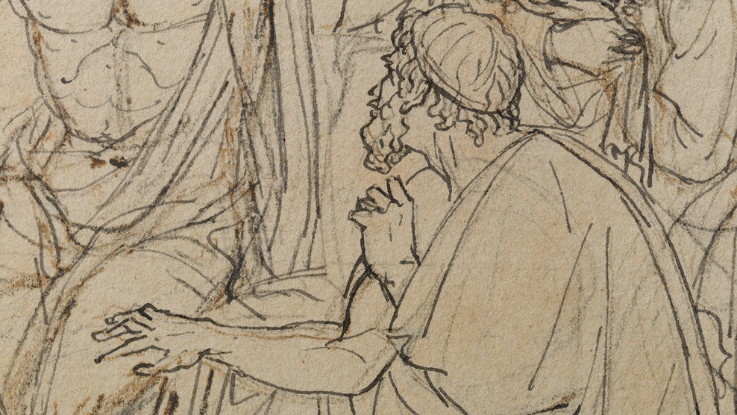
https://www.metmuseum.org/art/online-features/metcollects/the-death-of-socrates-video

Slide 8
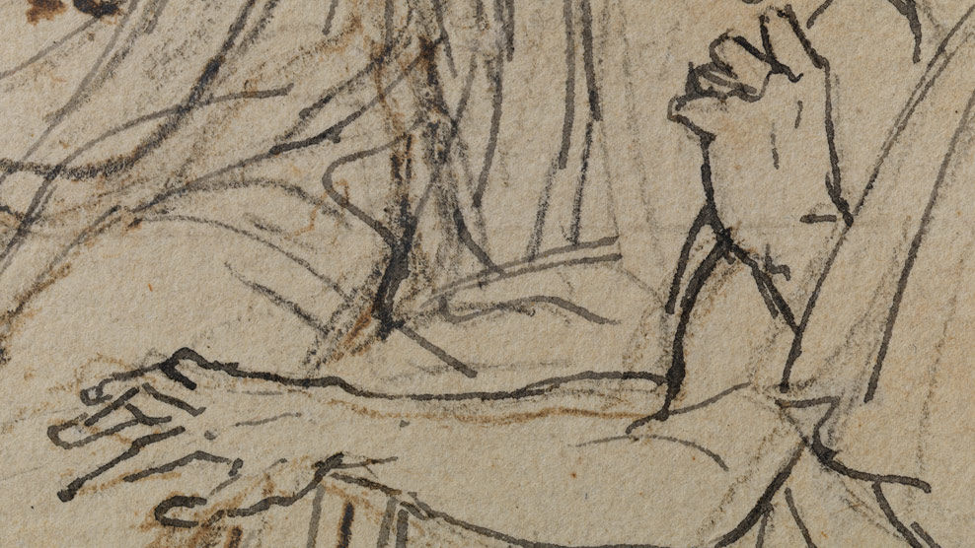
https://www.metmuseum.org/art/online-features/metcollects/the-death-of-socrates-video

Slide 9
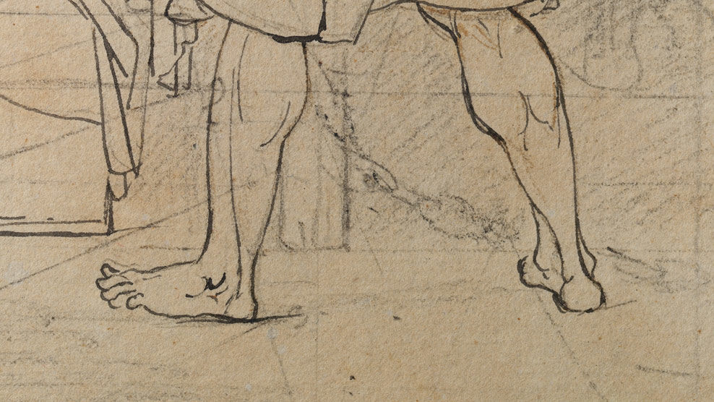
https://www.metmuseum.org/art/online-features/metcollects/the-death-of-socrates-video

Slide 10
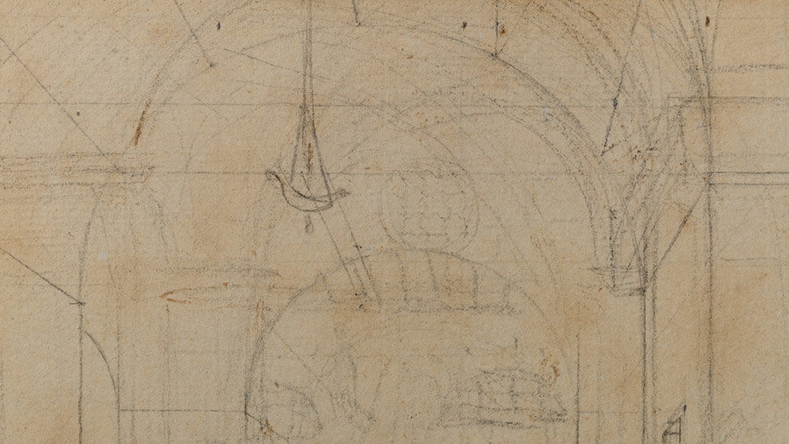
https://www.metmuseum.org/art/online-features/metcollects/the-death-of-socrates-video

Slide 11
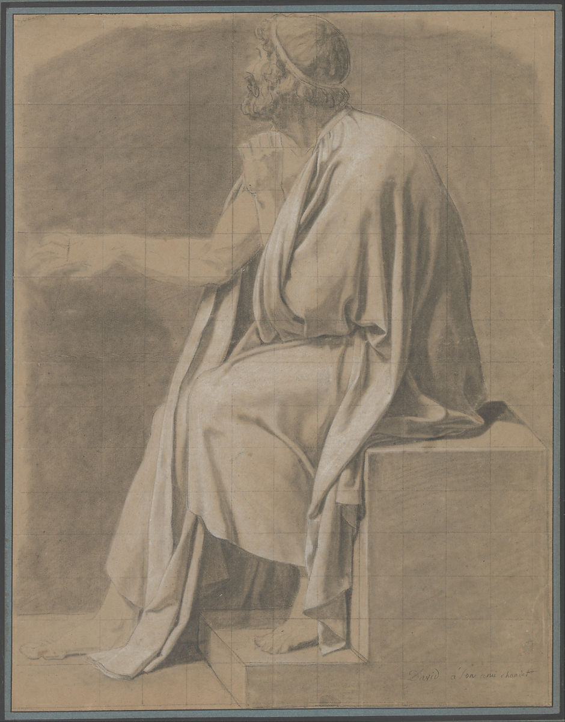
Crito, ca. 1786–87, Black chalk, stumped, heightened with white chalk, squared in black chalk, 53.6 × 41.4 cm, the MET, NY, USA https://www.metmuseum.org/art/collection/search/334226

Slide 12
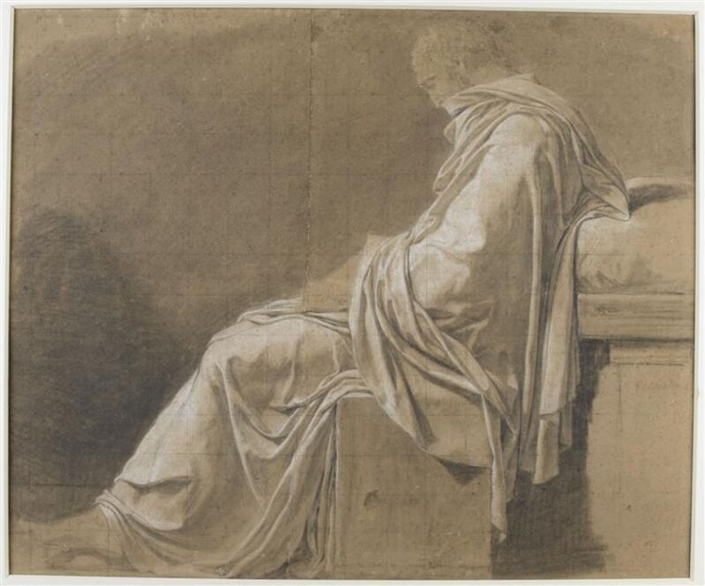
Study for the figure of Plato in The Death of Socrates, 1786, Black chalk, stumped, heightened with white chalk, squared in black chalk, Musée Magnin, Dijon, France https://www.artsy.net/artwork/jacques-louis-david-etude-pour-la-figure-de-platon-dans-la-mort-de-socrate-study-for-the-figure-of-plato-in-the-death-of-socrates

Slide 13
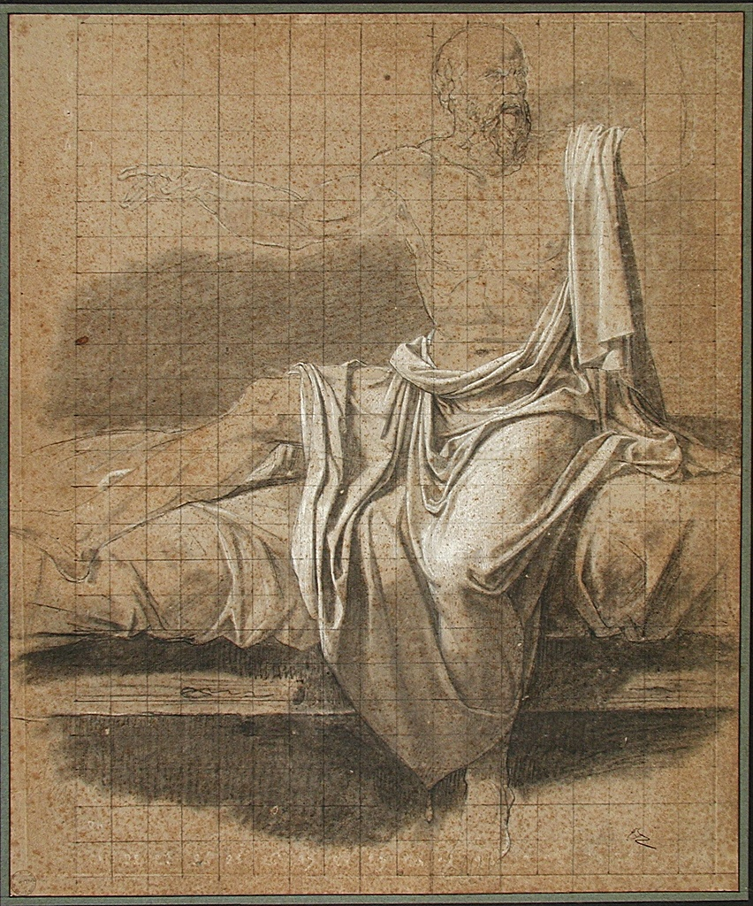
Study for the figure of Socrates in The Death of Socrates, 1786, Black chalk, stumped, heightened with white chalk, squared in black chalk, Musée Bonnat-Helleu - Musée des beaux-arts de Bayonne, France https://webmuseo.com/ws/musee-bonnat-helleu/app/collection

Slide 14
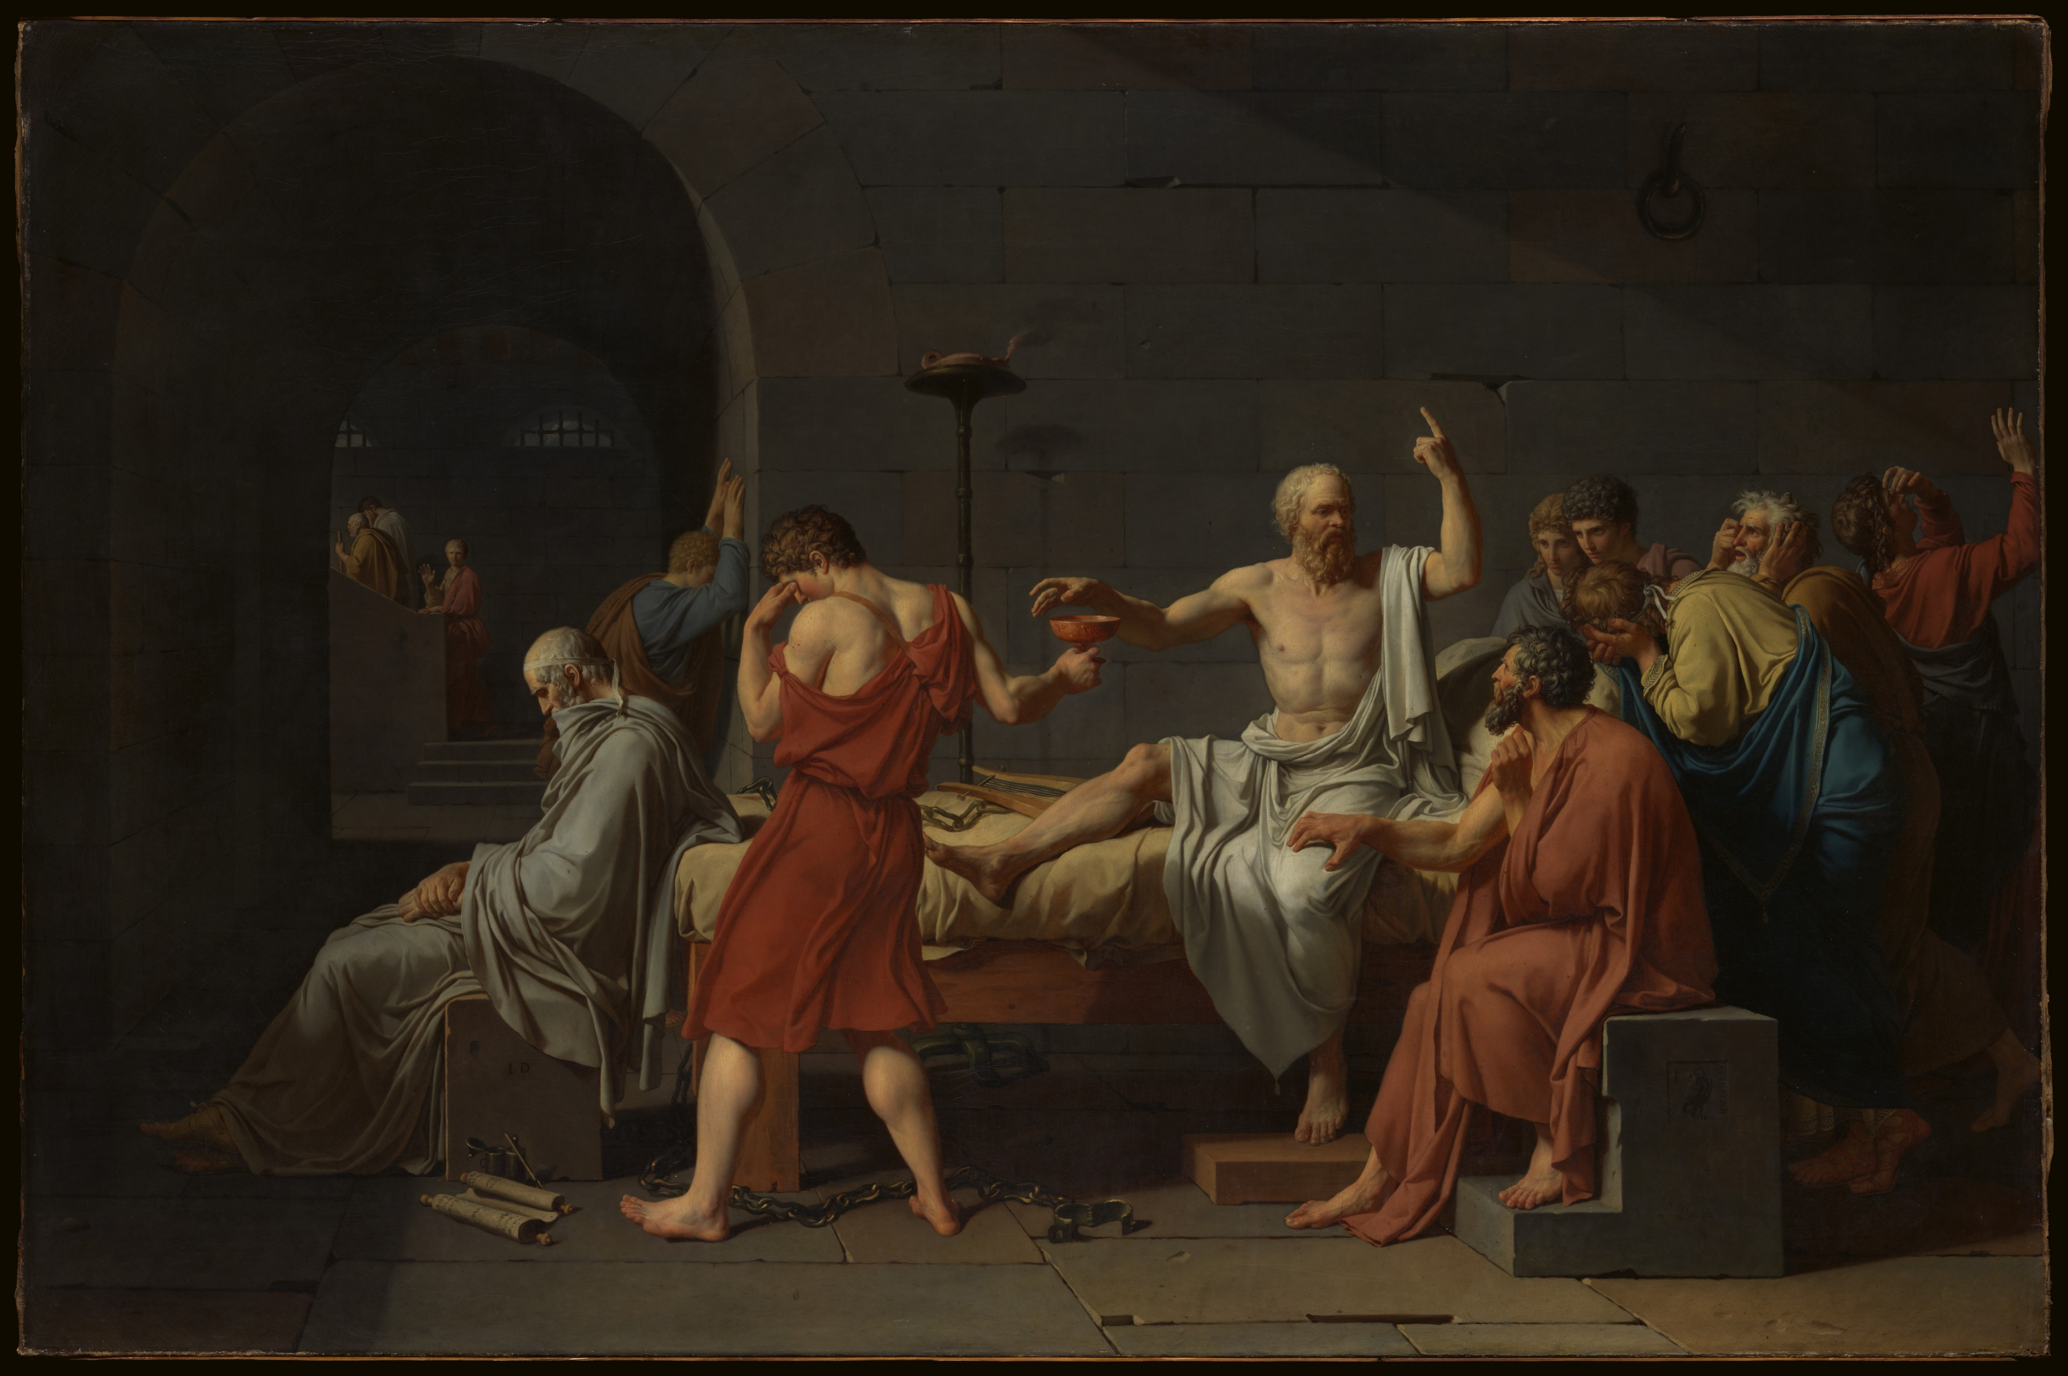
The Death of Socrates, 1787, oil on canvas, 129.5 x 196.2 cm, the MET, NY, USA https://www.metmuseum.org/art/collection/search/436105

Slide 15
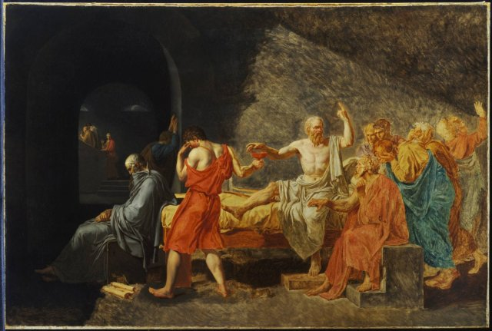
The Death of Socrates, after 1787, Oil on canvas, 133 x 196 cm, Princeton University Art Museum, NJ, USA https://puamsab.princeton.edu/2019/11/death-of-socrates-anika-yardi-21/

Slide 16
The End

