Slide 1
Holy Week in the Greek Orthodox Church, 2022

Slide 2
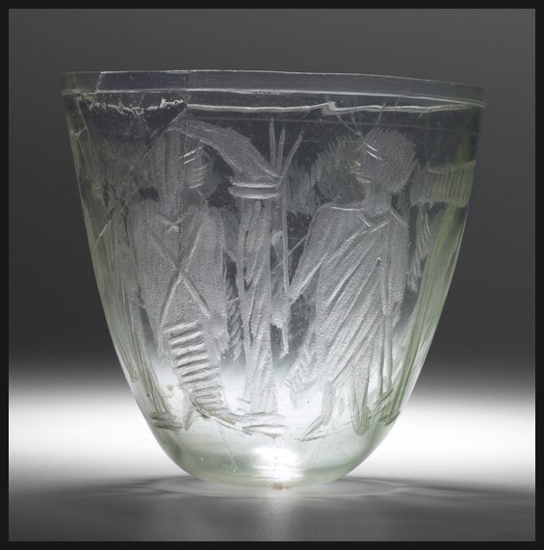
Lazarus Sunday
Cup with the Raising of Lazarus (Christ holding a staff and Lazarus still wrapped in his burial shroud, 4th century, Free-blown glass with wheel-cut decoration; very pale green, nearly colourless, 11.2 × 11.8 cm, Yale University Art Gallery https://artgallery.yale.edu/collections/objects/52562

Slide 3
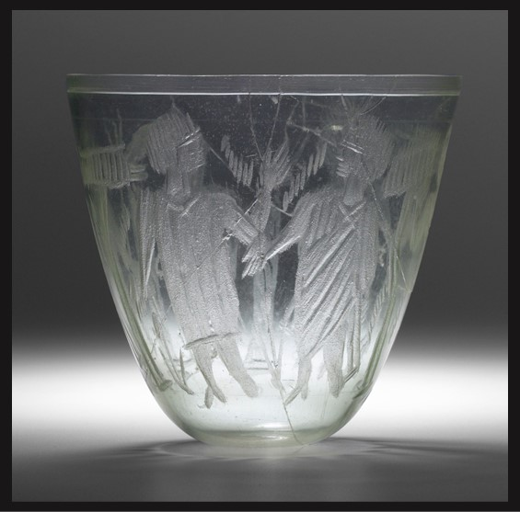
Cup with the Raising of Lazarus (anonymous onlookers), 4th century, Free-blown glass with wheel-cut decoration; very pale green, nearly colourless, 11.2 × 11.8 cm, Yale University Art Gallery https://artgallery.yale.edu/collections/objects/52562

Slide 4
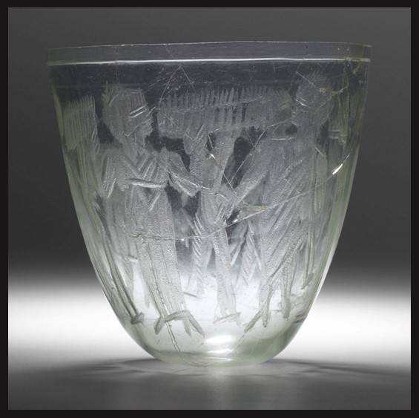
Cup with the Raising of Lazarus (anonymous onlookers), 4th century, Free-blown glass with wheel-cut decoration; very pale green, nearly colourless, 11.2 × 11.8 cm, Yale University Art Gallery https://artgallery.yale.edu/collections/objects/52562

Slide 5
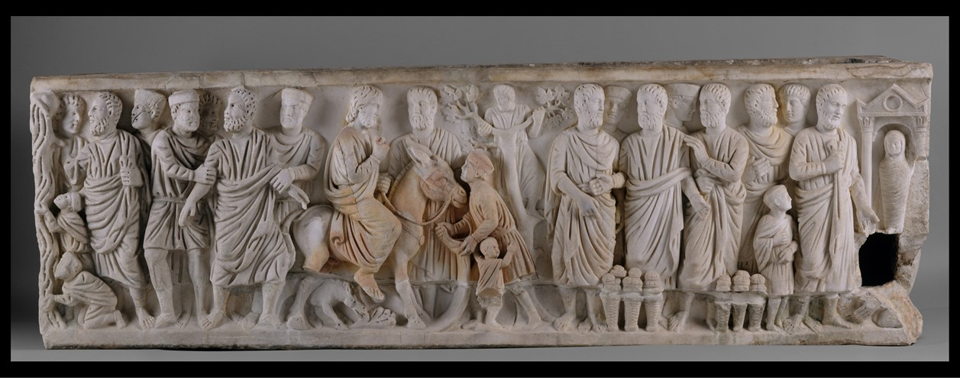
Palm Sunday
Sarcophagus with Scenes from the Lives of Saint Peter and Christ, early 300s, with modern restoration, Marble, 67.3 × 212.1 × 61.9 cm, the MET, NY, USA https://www.metmuseum.org/art/collection/search/466220

Slide 6
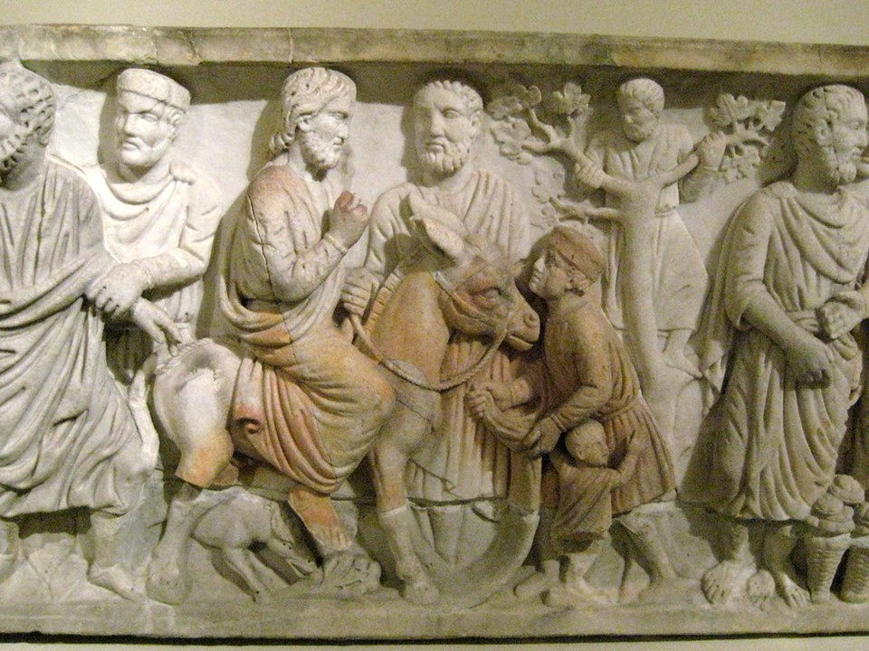
Sarcophagus with Scenes from the Lives of Saint Peter and Christ (Detail), early 300s, with modern restoration, Marble, 67.3 × 212.1 × 61.9 cm, the MET, NY, USA https://www.flickr.com/photos/wallyg/2110090818/in/photostream/

Slide 7
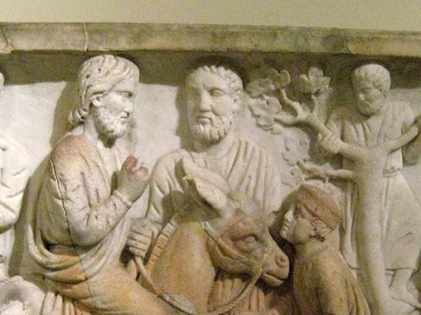
Sarcophagus with Scenes from the Lives of Saint Peter and Christ (Detail), early 300s, with modern restoration, Marble, 67.3 × 212.1 × 61.9 cm, the MET, NY, USA https://www.flickr.com/photos/wallyg/2110090818/in/photostream/

Slide 8
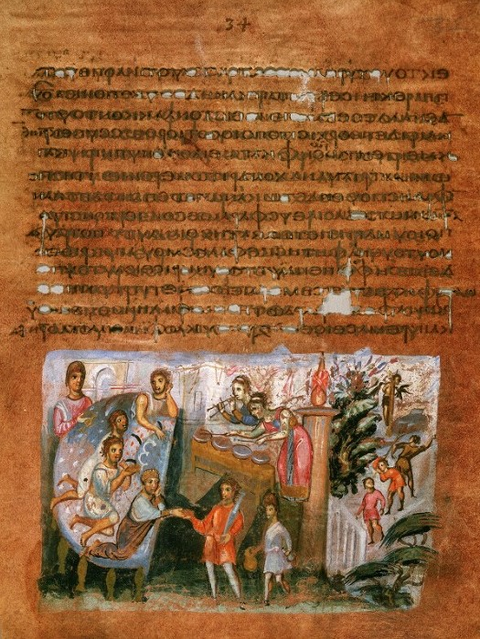
Holy Monday
Vienna Genesis, folio 17, page 34, (Cod. Theol. gr. 31), 6th century, Illuminated purple dyed parchment, heightening in shell gold, text written in silver ink, 32.0x26.5 cm, Österreichische Nationalbibliothek, Vienna, Austria https://onb.digital/result/10F14EEA

Slide 9
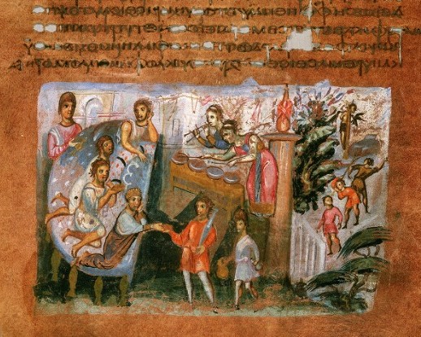
https://onb.digital/result/10F14EEA

Slide 10
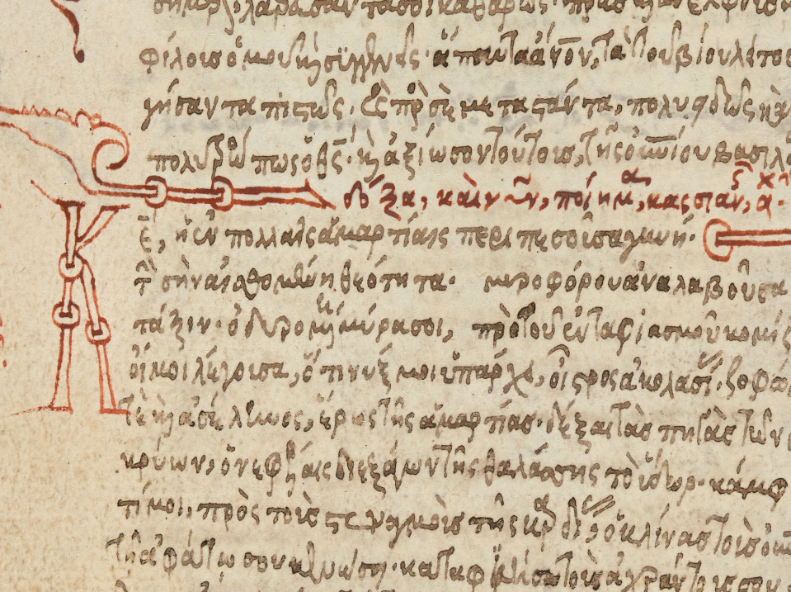
Holy Tuesday
Kassia's Hymn for Holy Wednesday, from a collection of Hymns and Canons, Eastern Mediterranean, 16th century, Paper, 140x100 mm, British Library, London, UK http://www.bl.uk/manuscripts/Viewer.aspx?ref=add_ms_39618_f008v

Slide 11
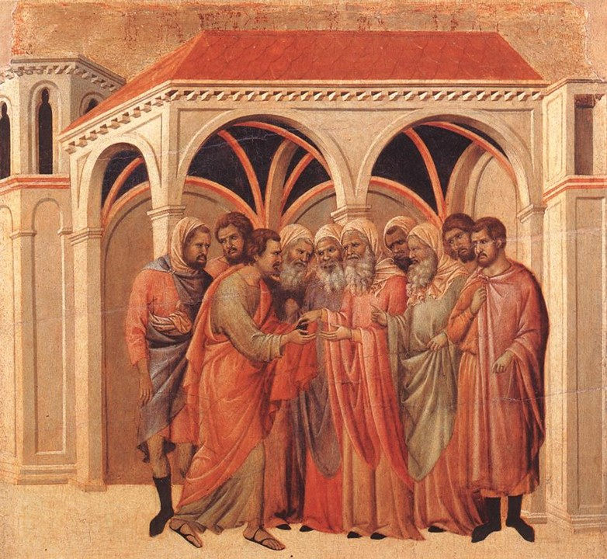
Holy Wednesday
Duccio di Buoninsegna, ca. 1255-1319
The Betrayal by Judas (scene 5), 1308-11, Tempera on wood, 50 x 53 cm, Museo dell'Opera del Duomo, Siena, Italy https://commons.wikimedia.org/wiki/File:Duccio_di_Buoninsegna_-_Pact_of_Judas_-_WGA06789.jpg

Slide 12
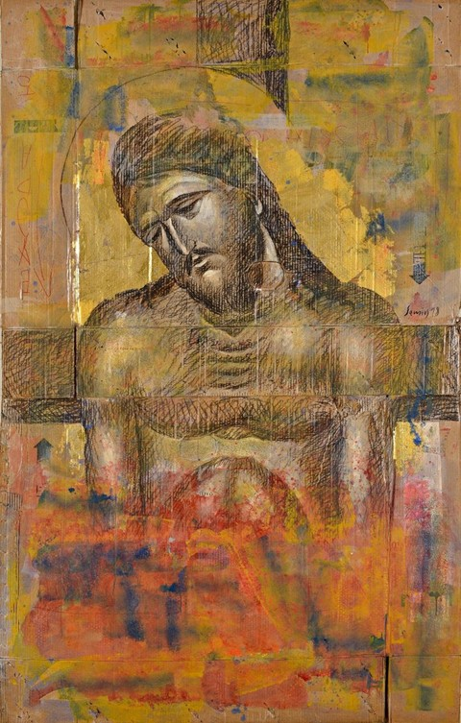
Holy Thursday
Pavlos Samios, 1948-2021
Extreme Humility, 2018, charcoal and acrylic on paper, 245x88 cm, Private Collection? https://www.thetoc.gr/politismos/article/samios-se-buzantino-mouseioekana-mia-mikri-gkernika-gia-nabaloume-mualo/

Slide 13
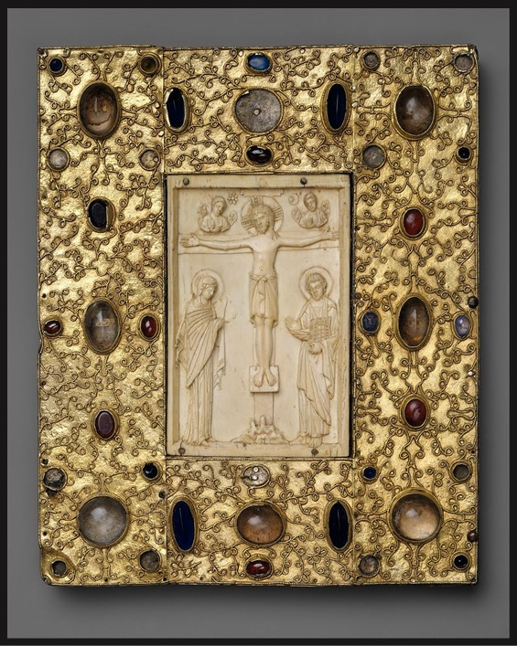
G0od Friday
Book cover with a silver-gilt Spanish setting of a Byzantine Ivory Crucifixion, 10th century (ivory); late 11th century (setting), silver-gilt with pseudo-filigree, glass, crystal, and sapphire cabochons, ivory on wood support, Overall: 26.4 × 21.9 × 2.5 cm, the MET, NY, USA https://www.metmuseum.org/art/collection/search/464015

Slide 14
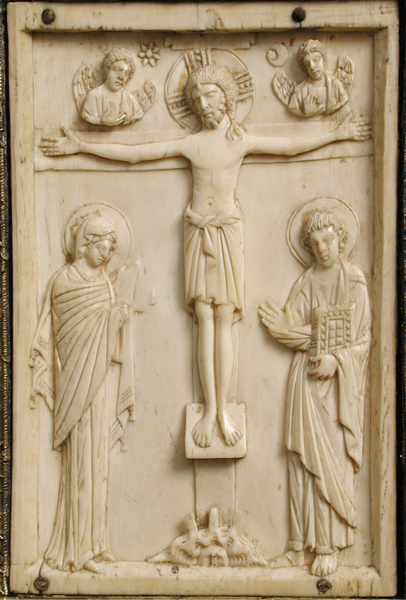
https://www.metmuseum.org/art/collection/search/464015

Slide 15
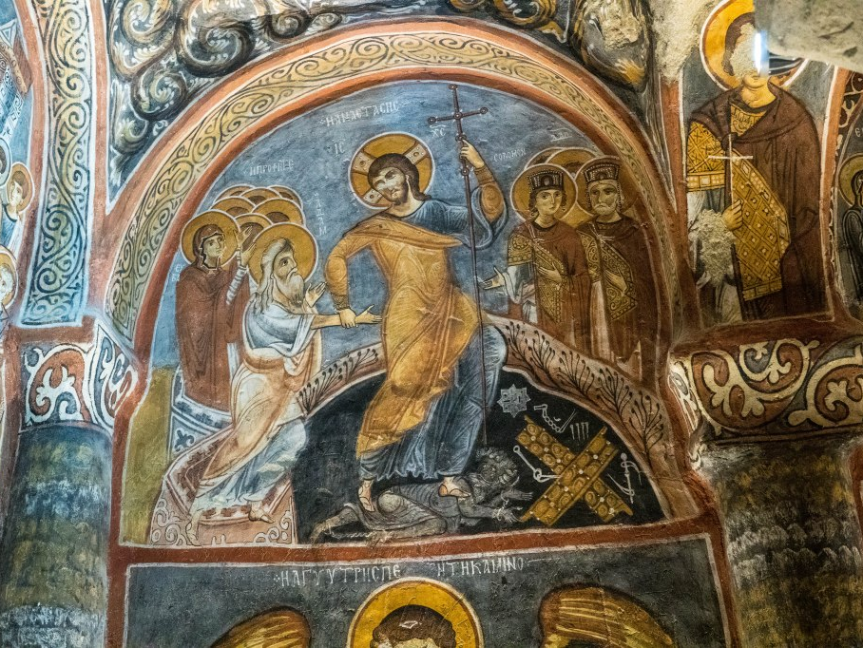
Holy Saturday
Harrowing of Hell, fresco, Karanlik Kilise, The Dark Church, early 12th century, Goreme, Cappadocia, Turkey https://johnbelovedhabib.wordpress.com/tag/harrowing-of-hades/

Slide 16


