Slide 1
“Sun” Pendant (Bulla), 1,000-800 BC, Gold, 3.6x4.7cm, British Museum, London, UK

Slide 2
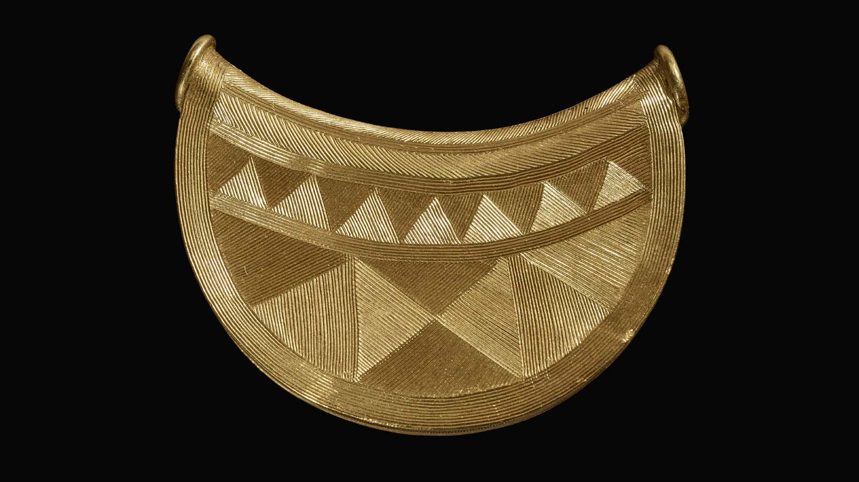
https://museumcrush.org/spectacular-bronze-age-sun-pendant-heads-to-shrewsbury-museum/

Slide 3
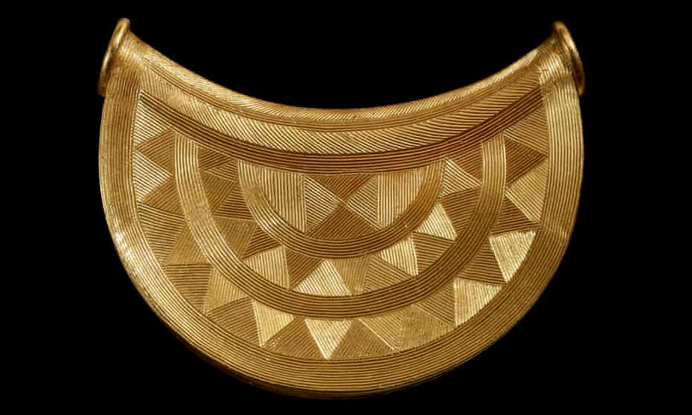
https://www.theguardian.com/culture/2020/mar/04/british-museum-acquires-3000-year-old-shropshire-sun-pendant

Slide 4
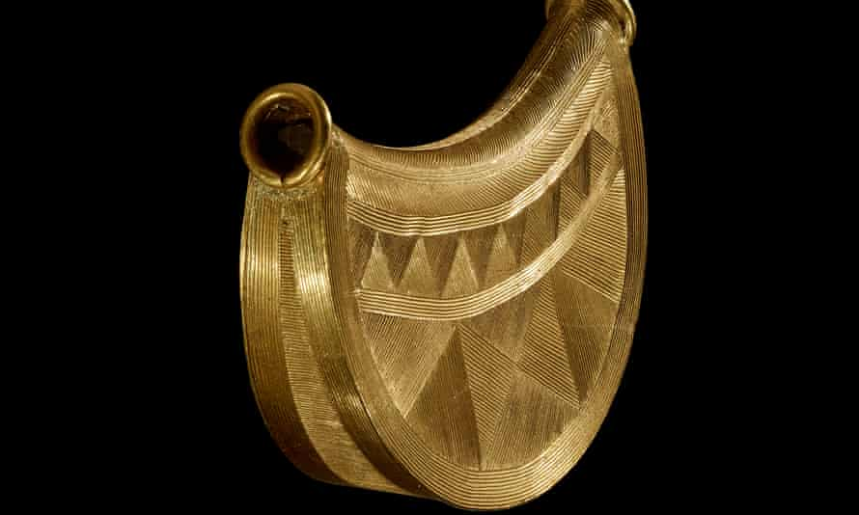
https://www.theguardian.com/culture/2020/mar/04/british-museum-acquires-3000-year-old-shropshire-sun-pendant

Slide 5
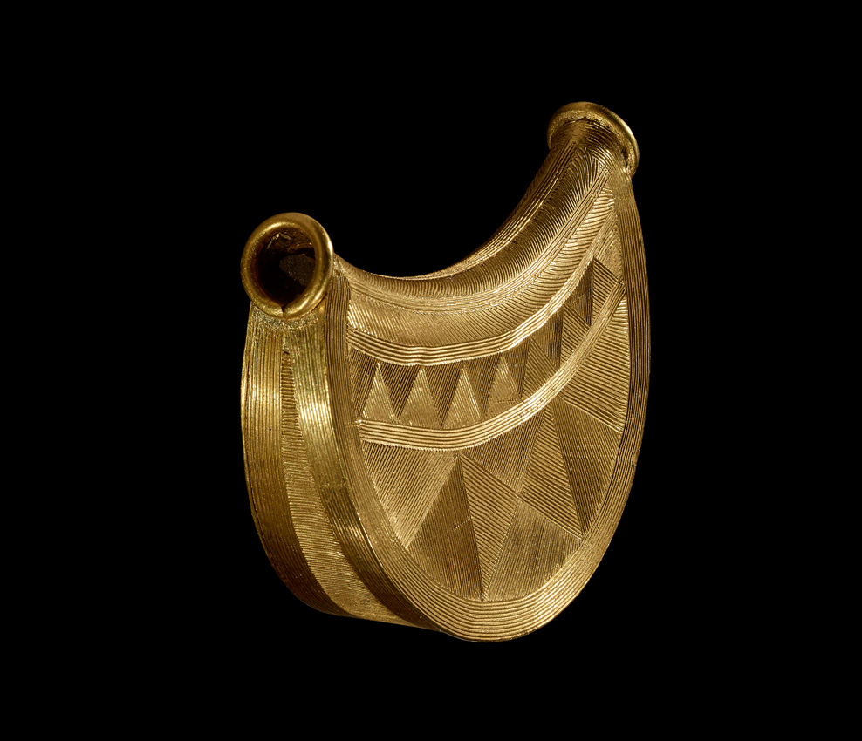
https://www.antiquestradegazette.com/news/2020/british-museum-buys-3000-year-old-bronze-age-gold-pendant/

Slide 6
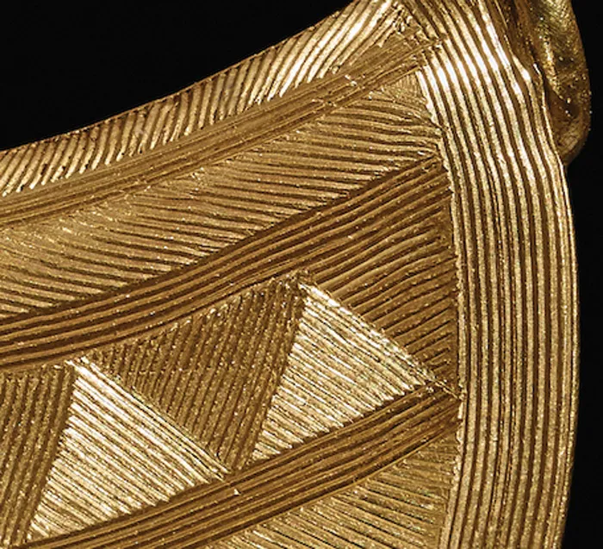
https://archaeology.co.uk/articles/features/the-shropshire-bulla-bronze-age-beauty-and-a-mystery-from-manchester.htm

Slide 7
The End

