Slide 1
Marie Spartali Stillman, 1844–1927
Delaware Art Gallery, USA

Slide 2
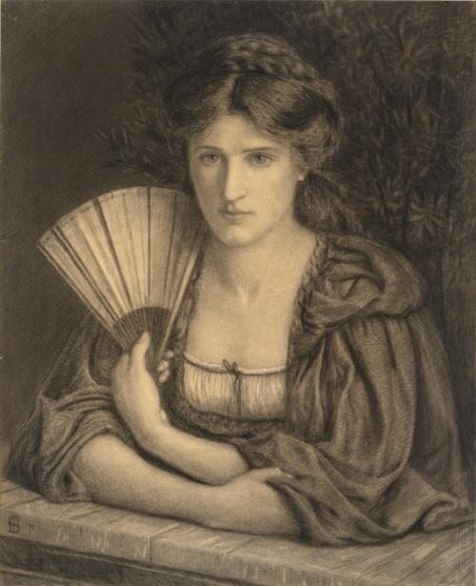
Self-Portrait, 1871, Charcoal and white chalk on paper, 64.5 × 52.4 cm, Delaware Art Museum, Wilmington, DE, USA https://emuseum.delart.org/people/1102/marie-spartali-stillman

Slide 3
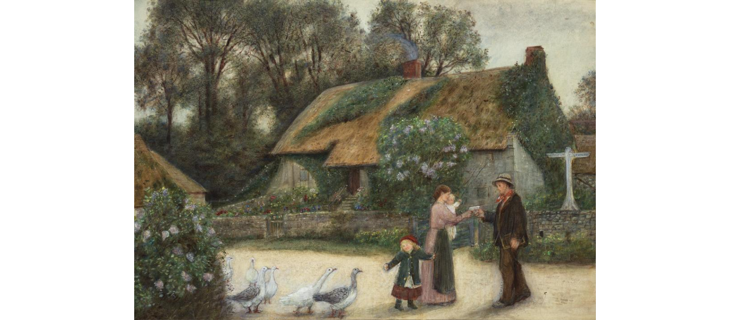
Farm Scene, not dated, Watercolour on paper, 30.8 × 44.5 cm, Delaware Art Museum, Wilmington, DE, USA https://emuseum.delart.org/objects/3424/farm-scene?ctx=fe0b6f6b7ba5d2aca255643bd7cdced8ac4738cd&idx=3

Slide 4
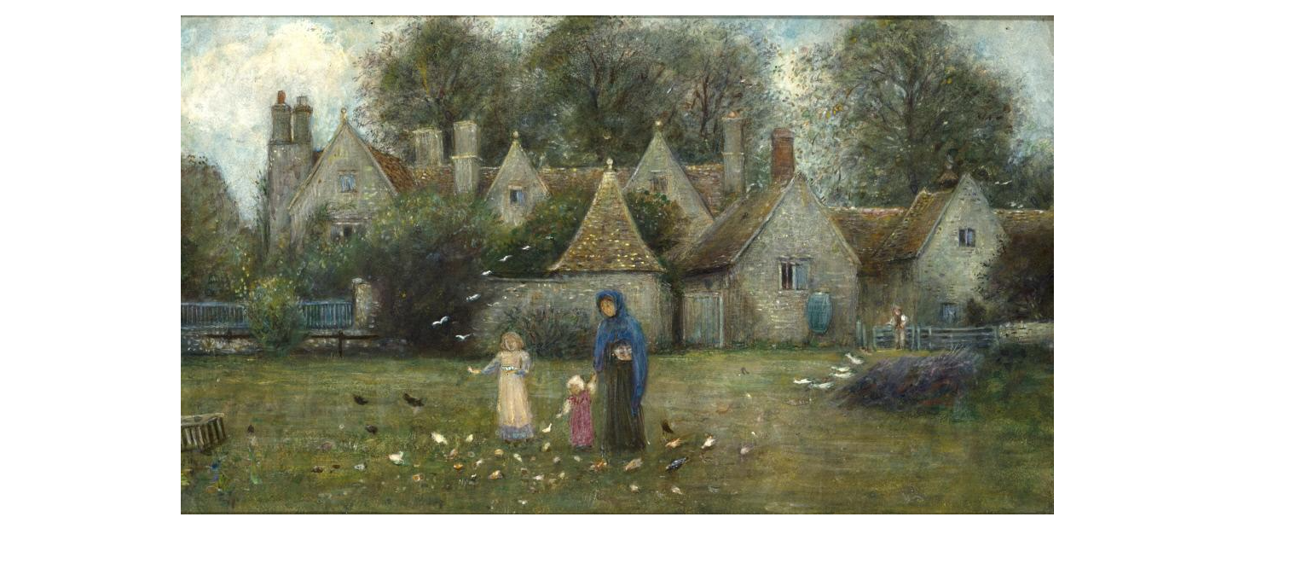
Kelmscott Manor, from the Field, not dated, Watercolor and gouache on paper laid on panel, 18.6 × 31 cm, Delaware Art Museum, Wilmington, DE, USA https://emuseum.delart.org/people/1102/marie-spartali-stillman/objects

Slide 5
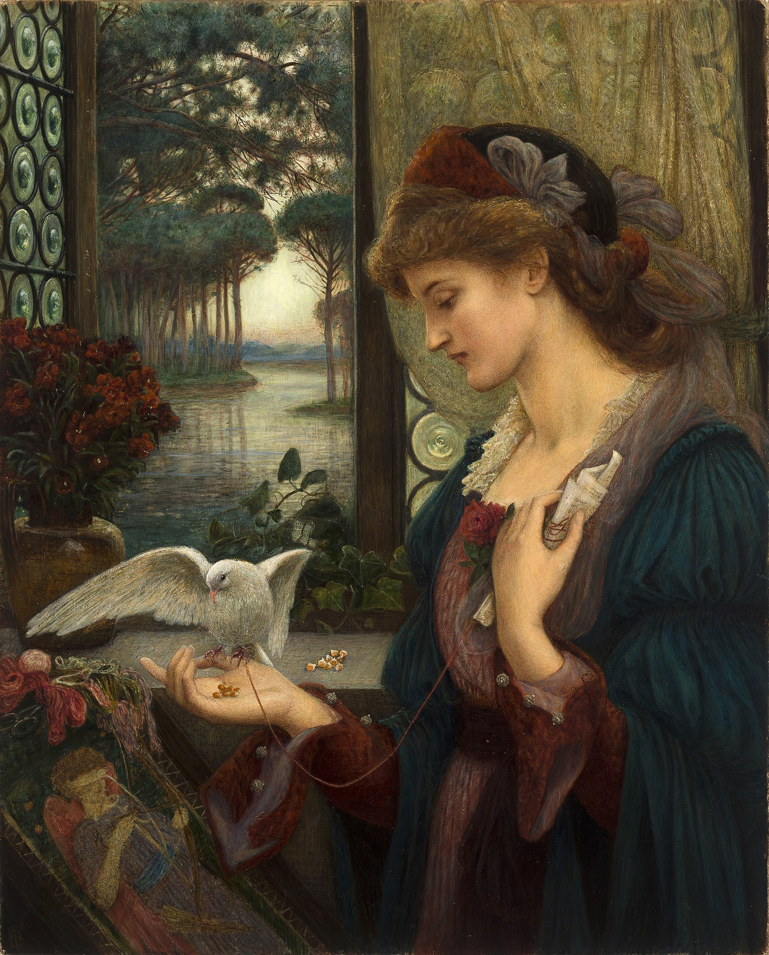
Love's Messenger, 1885, Watercolor, tempera, and gold paint on paper, 81.3 x 66 cm, Delaware Art Museum, Wilmington, DE, USA https://www.sartle.com/artwork/loves-messenger-marie-spartali-stillman

Slide 6
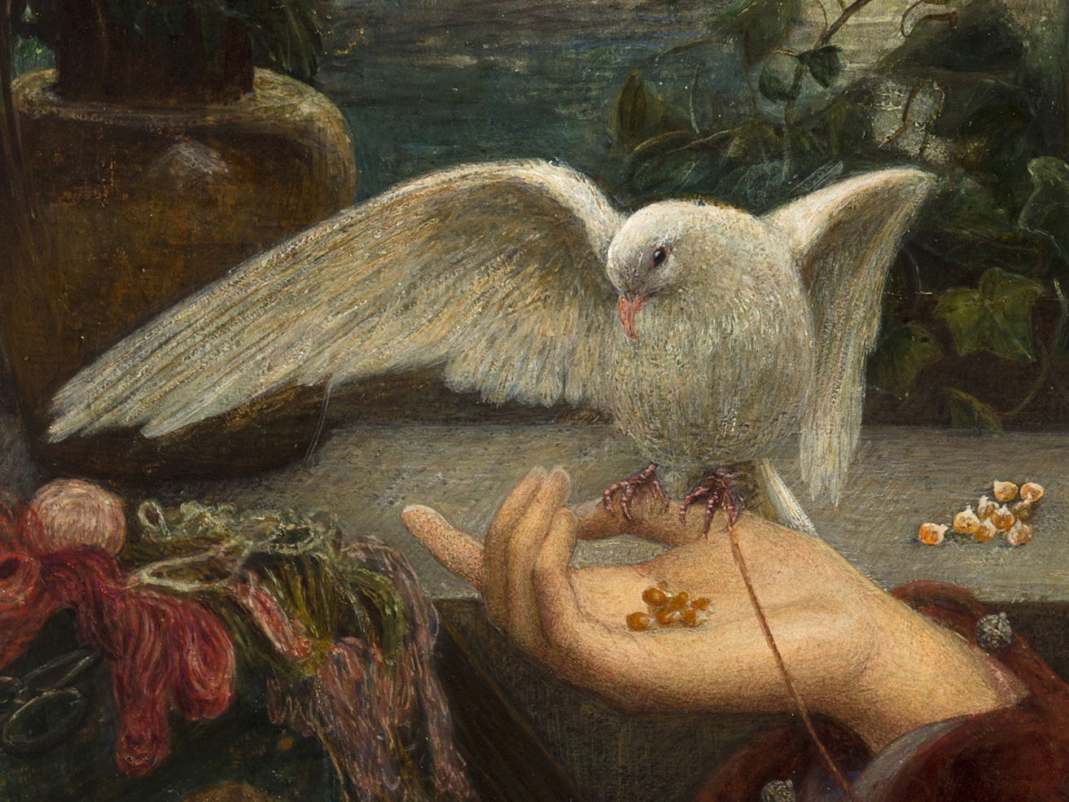
https://eclecticlight.co/2020/11/05/marie-spartali-stillman-1-loves-messenger/

Slide 7
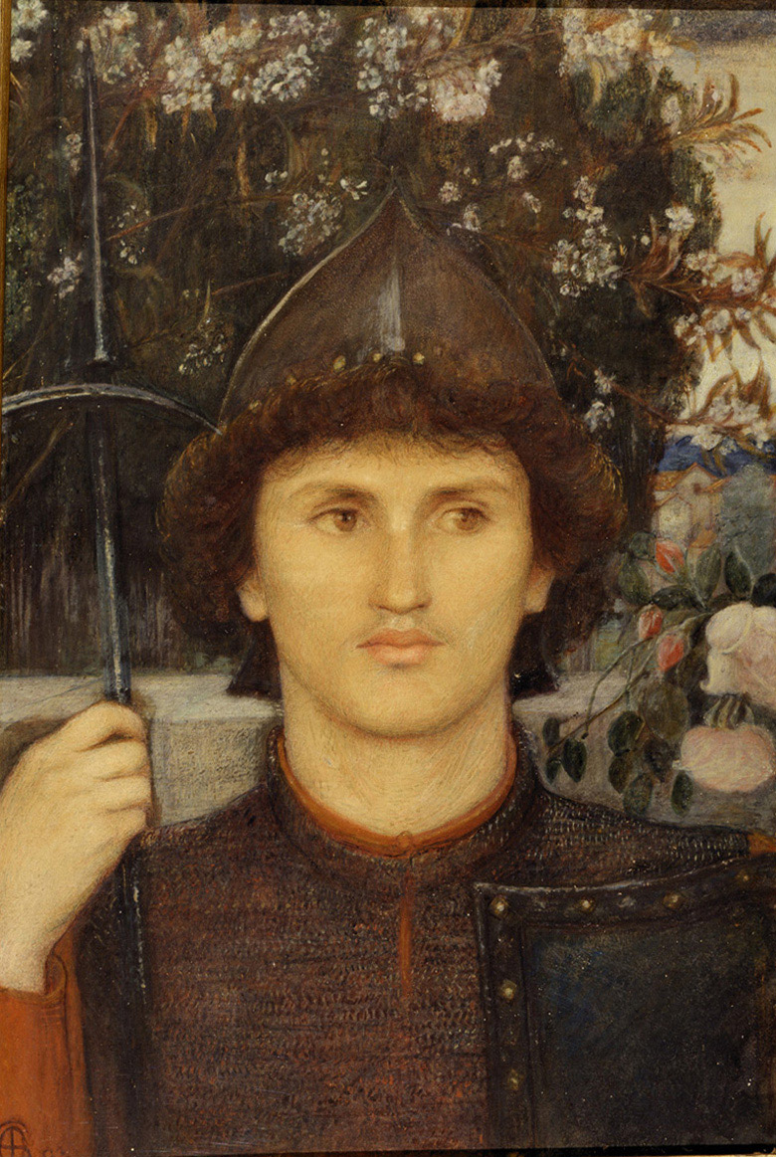
St. George, 1892, Watercolor on paper, 47 × 30.8 cm, Delaware Art Museum, Wilmington, DE, USA https://upload.wikimedia.org/wikipedia/commons/3/30/Marie_Spartali_Stillman_-_St._George.jpg

Slide 8
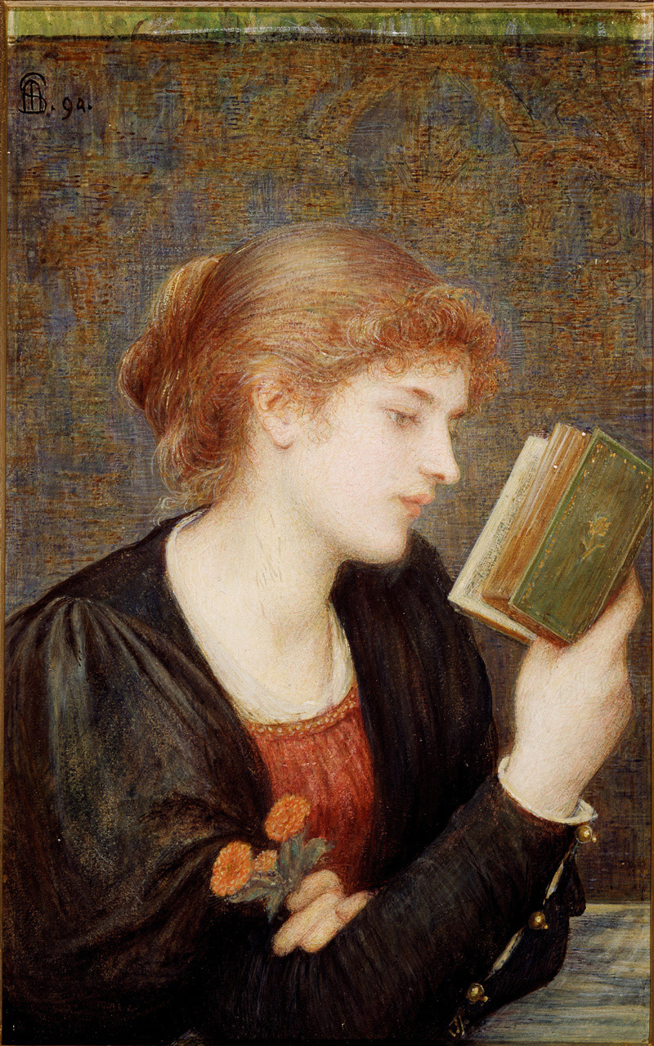
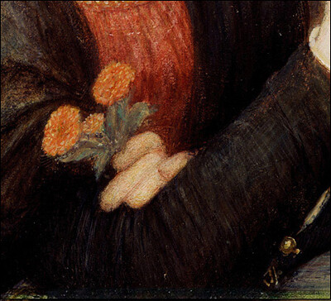
Love Sonnets, 1894, Watercolor and gouache on paper, mounted on wood panel, 44.1 × 27.9 cm, Delaware Art Museum, Wilmington, DE, USA https://upload.wikimedia.org/wikipedia/commons/c/c3/Marie_Spartali_Stillman_-_Love_Sonnets.jpg https://www.flickr.com/photos/eoskins/7986103629

Slide 9
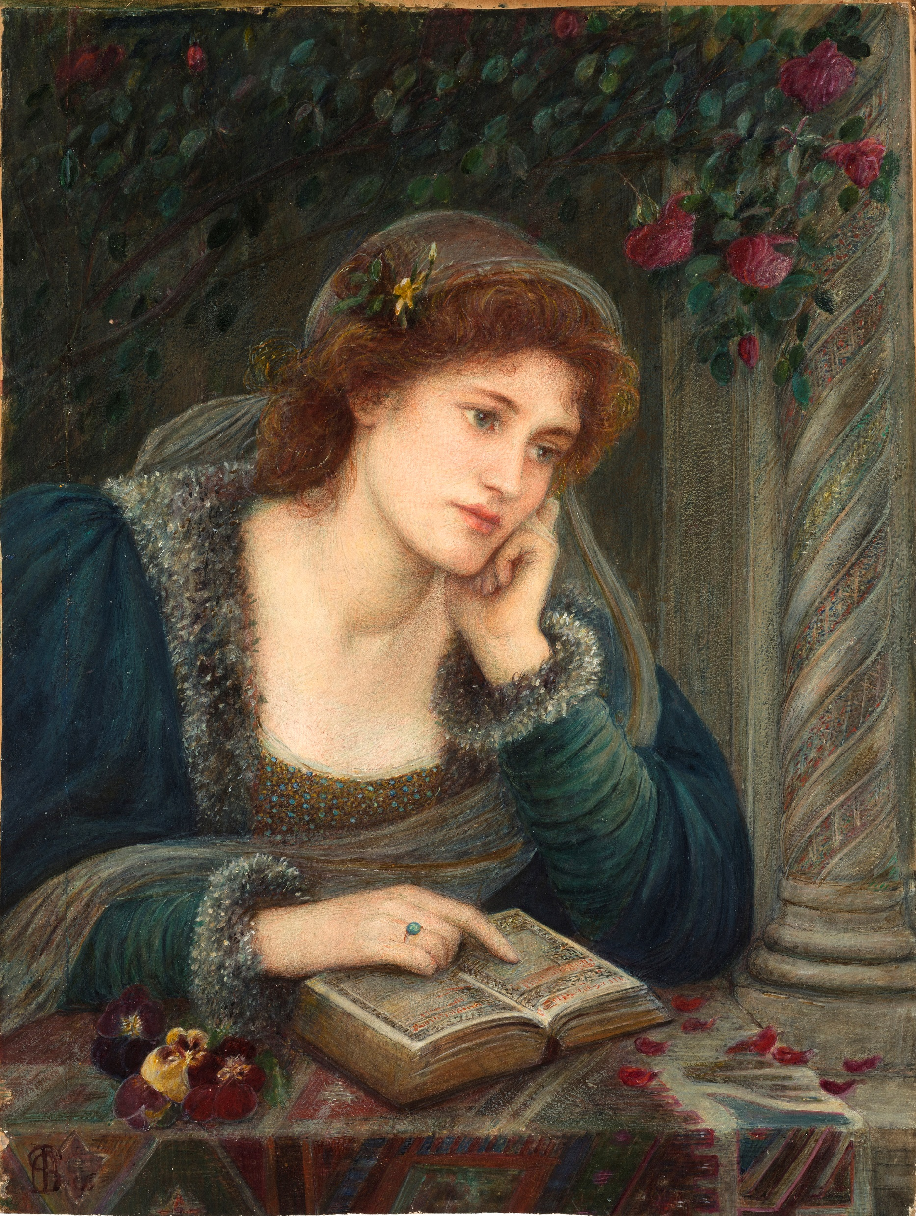
Beatrice, 1896, Watercolor and gouache on paper mounted on board, 57.6 × 43.2 cm, Delaware Art Museum, Wilmington, DE, USA https://upload.wikimedia.org/wikipedia/commons/0/0c/Marie_Spartali_Stillman_-_Beatrice_%281895%29.jpg

Slide 10
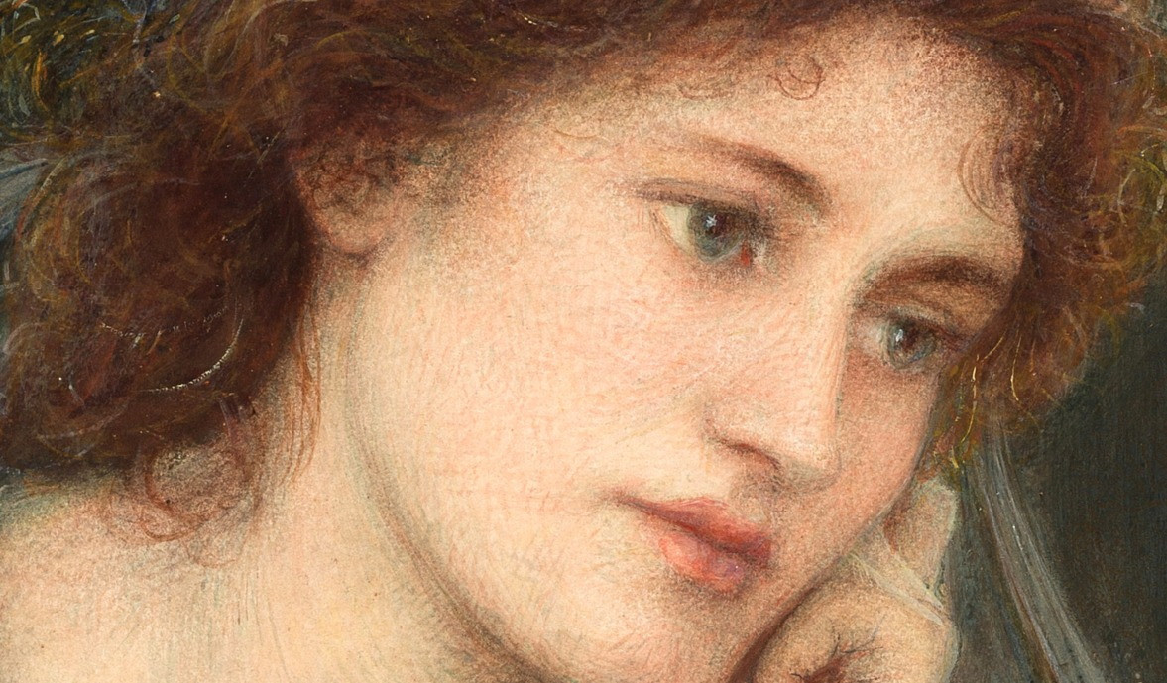
https://atsunnyside.blog/2018/11/12/marie-spartali-stillman-beatrice-1895/#jp-carousel-10386

Slide 11
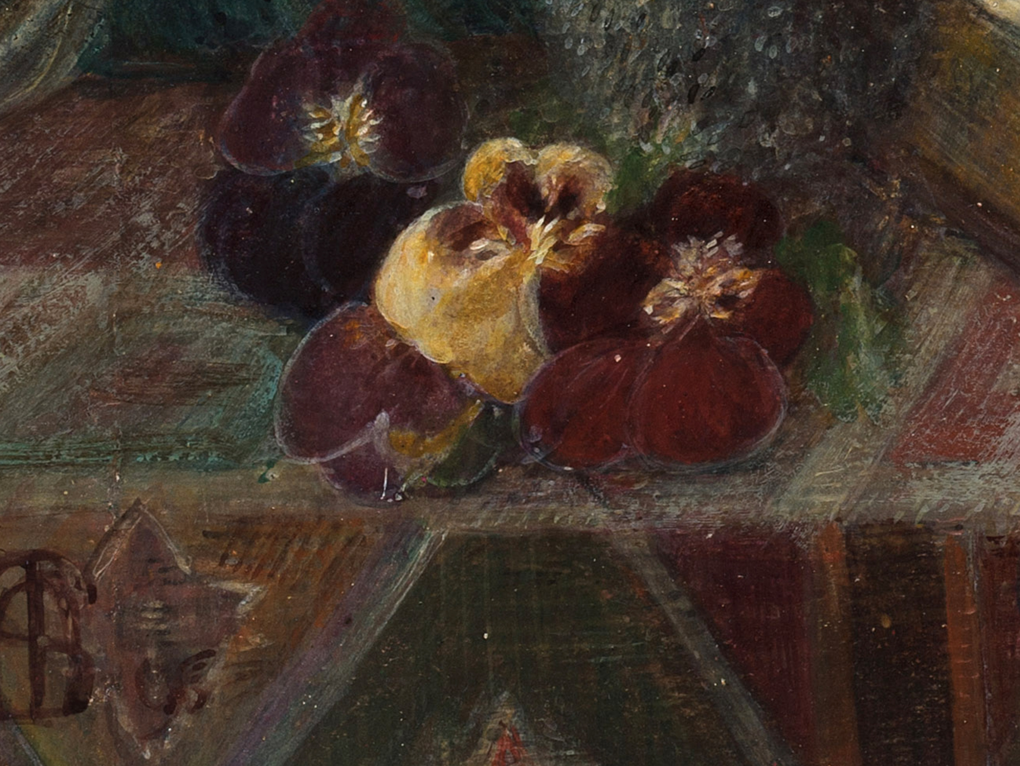
https://atsunnyside.blog/2018/11/12/marie-spartali-stillman-beatrice-1895/

Slide 12
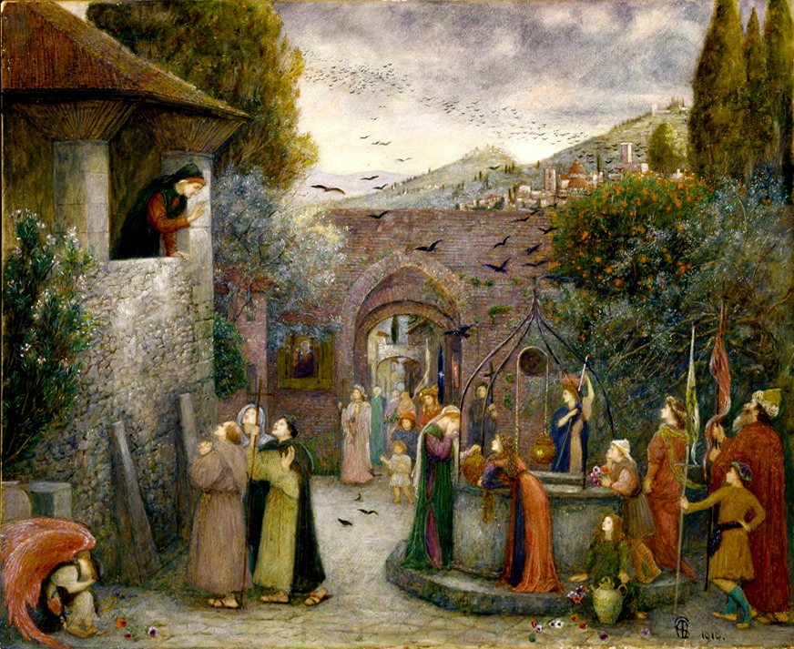
The Pilgrim Folk, 1914, Watercolor and gouache on paper, 57.8 × 70.5 cm, Delaware Art Museum, Wilmington, DE, USA https://upload.wikimedia.org/wikipedia/commons/8/81/Marie_Spartali_Stillman_-_The_Pilgrim_Folk.jpg

Slide 13
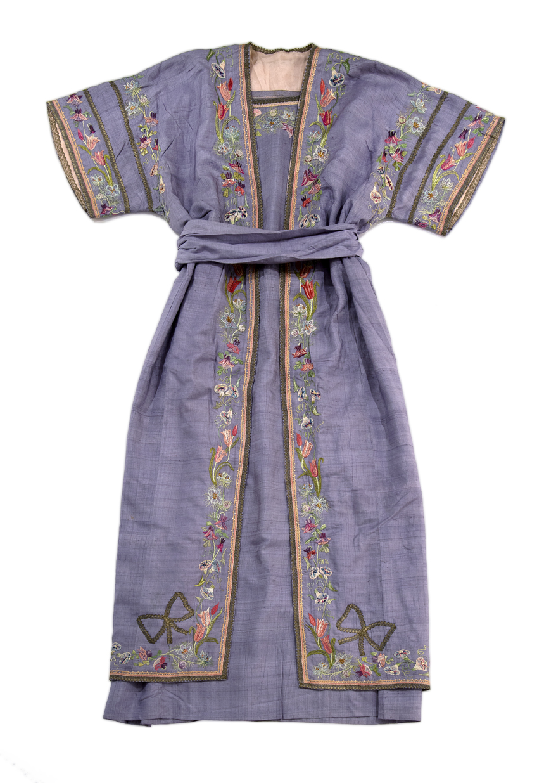
Embroidered Tunic, not dated, Embroidery on silk, 134.6 × 48.3 cm, Delaware Art Museum, Wilmington, DE, USA https://emuseum.delart.org/people/1102/marie-spartali-stillman/objects

Slide 14
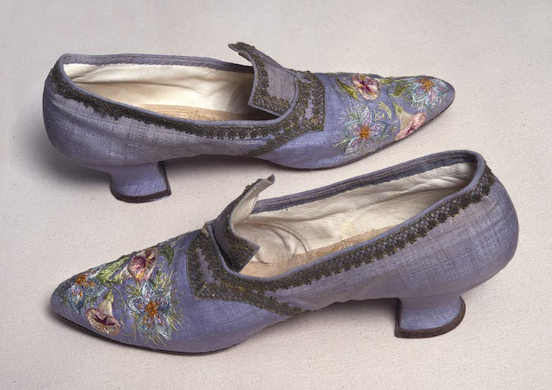
Shoes, Embroidery on silk, 11.4 × 7.6 × 26.7 cm, Delaware Art Museum, Wilmington, DE, USA https://www.apollo-magazine.com/art-diary/pre-raphaelite-sisters/

Slide 15
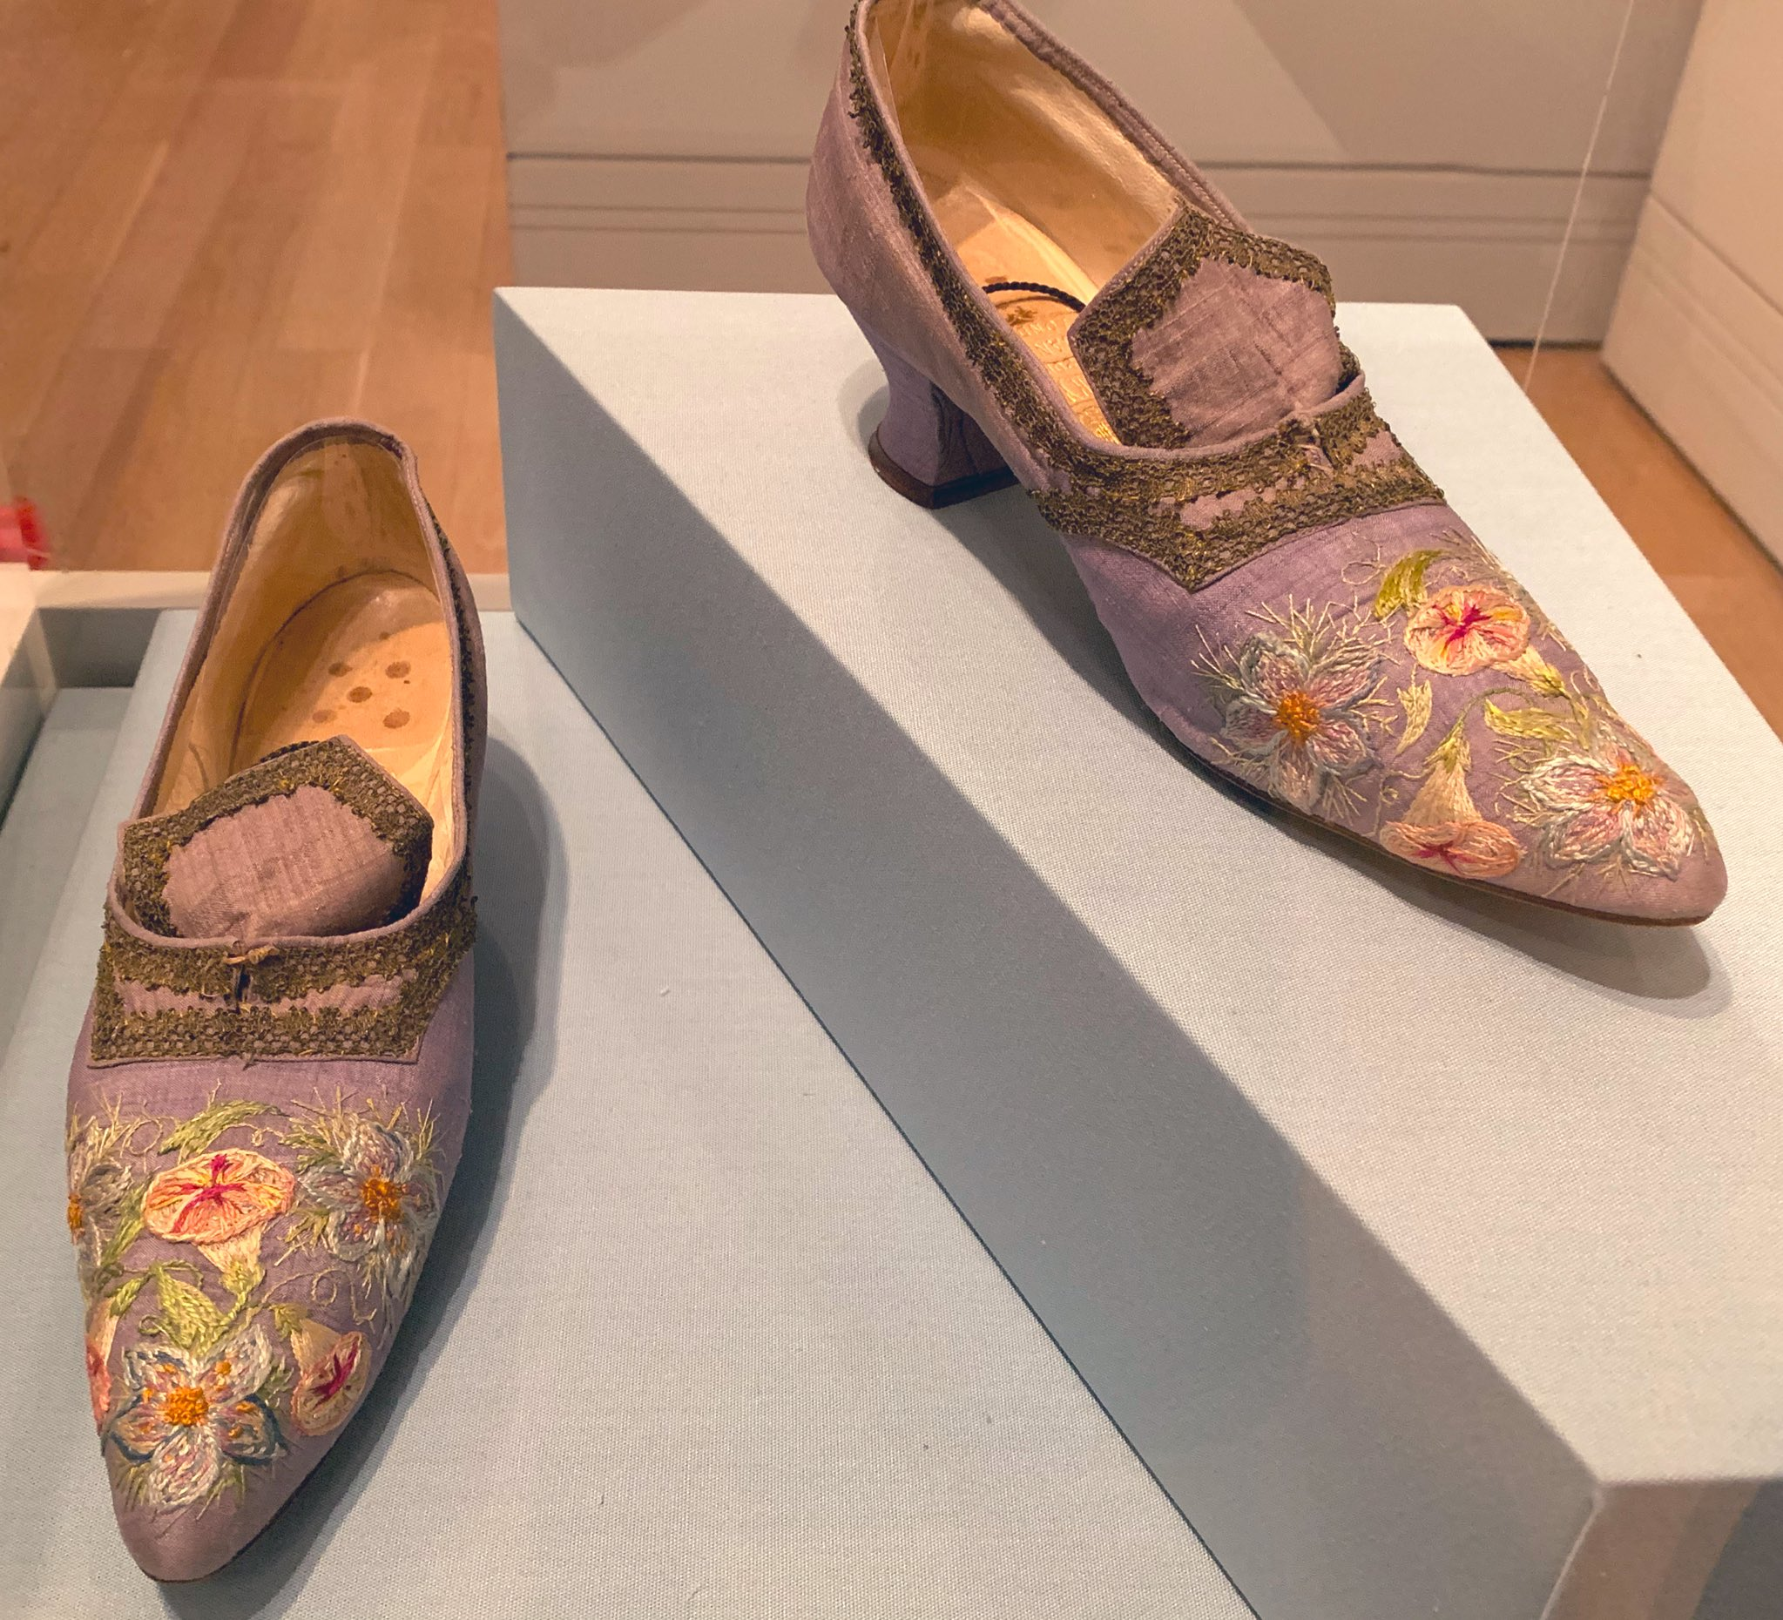
https://delart.org/event/inside-look-marie-spartali-stillmans-embroidery/2021-04-09/ https://victorianweb. https://twitter.com/Ingrid_Mida/status/1188446037704400899/photo/3

Slide 16
The End

