Slide 1
Camille Pissarro, 1830–1903
Still Life Flower Paintings

Slide 2
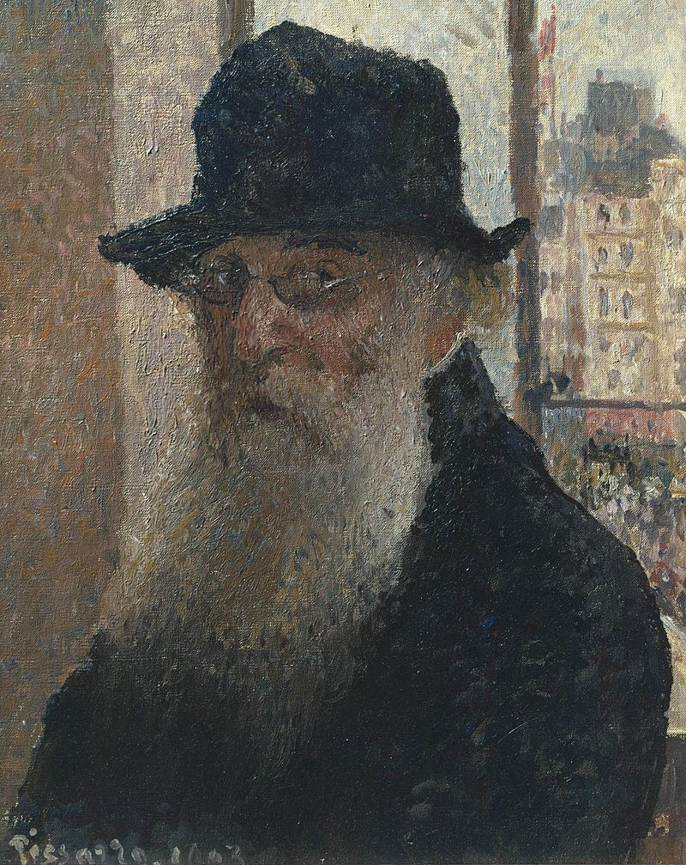
Self-Portrait with Hat, 1903, Oil on Canvas, 41x33 cm, Tate Britain, UK https://commons.wikimedia.org/wiki/File:Camille_Pissarro_-_Self-portrait2_-_Tate_Britain.jpg

Slide 3
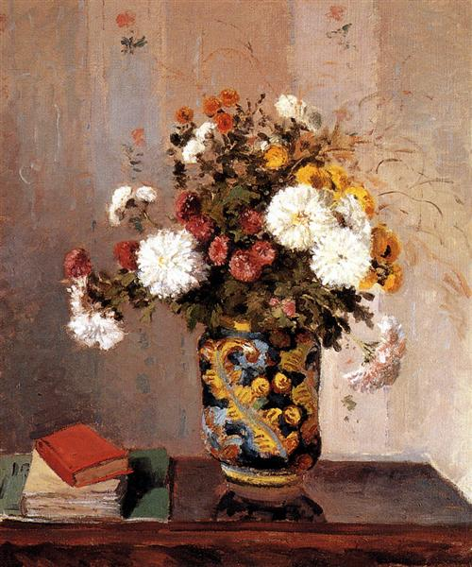
Chrysanthemums In a Chinese Vase, 1873, Oil on Canvas, 50 x 61 cm, Private Collection https://www.wikiart.org/en/camille-pissarro/chrysanthemums-in-a-chinese-vase-1873

Slide 4
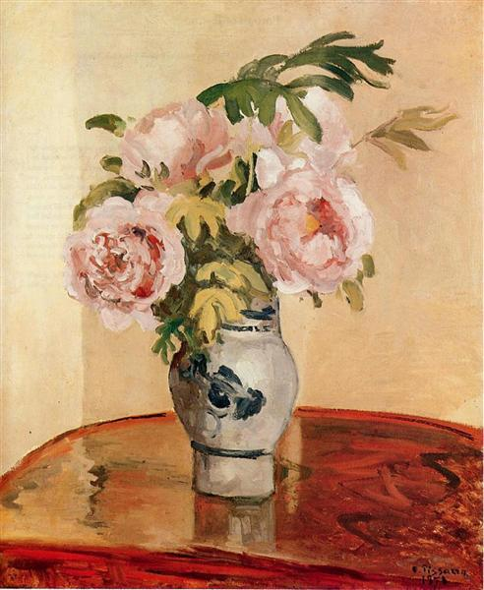
Pink Peonies, 1873, Oil on Canvas, 73 x 60 cm, Ashmolean Museum, Oxford, UK https://www.wikiart.org/en/camille-pissarro/pink-peonies-1873

Slide 5
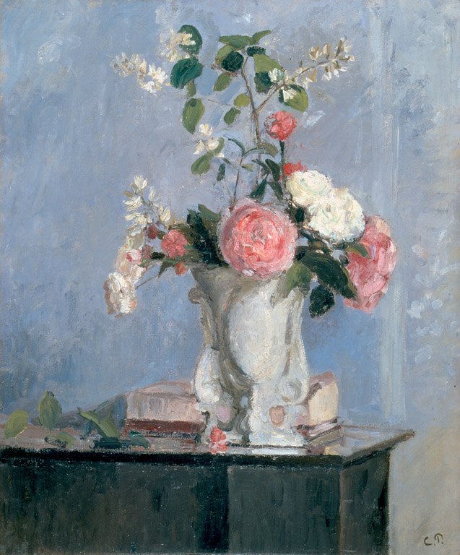
Bouquet of Flowers, circa 1873,
Oil on Canvas, 54.9x46.4 cm, High Museum of Art, Atlanta, GA, USA https://upload.wikimedia.org/wikipedia/commons/d/da/Bouquet_of_Flowers_by_Camille_Pissarro%2C_High_Museum_of_Art.jpg

Slide 6
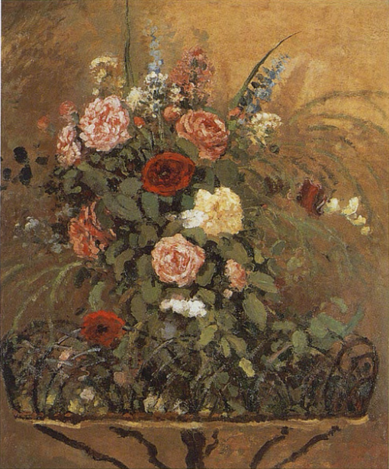
STill Life, circa 1876, Oil on Canvas, 82x65 cm, Matsuoka Museum of Art, Tokyo, Japan https://commons.wikimedia.org/wiki/File:Pissarro_-_Pissarro_and_Durand-Ruel_Snollaerts,_481.png

Slide 7
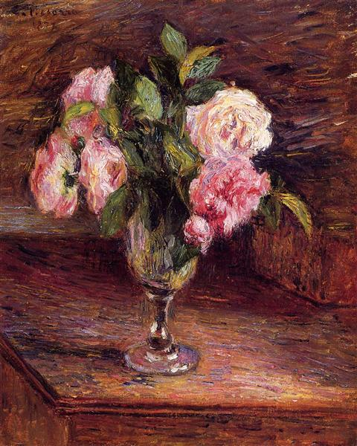
Roses in a Glass, 1877, Oil on Canvas, Private Collection https://www.wikiart.org/en/camille-pissarro/roses-in-a-glass-1877

Slide 8
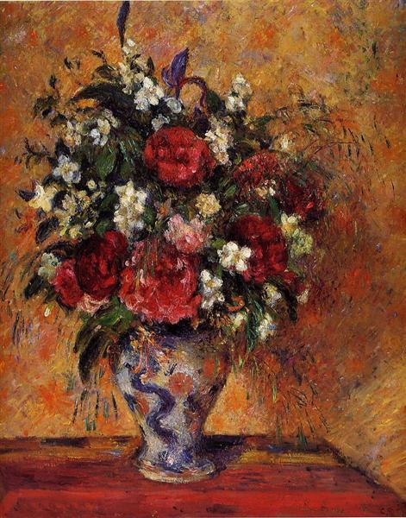
Vase of Flowers, c.1877 - c.1878,
Oil on Canvas,
81 x 64 cm,
Van Gogh Museum, Amsterdam, Netherlands https://www.wikiart.org/en/camille-pissarro/vase-of-flowers

Slide 9
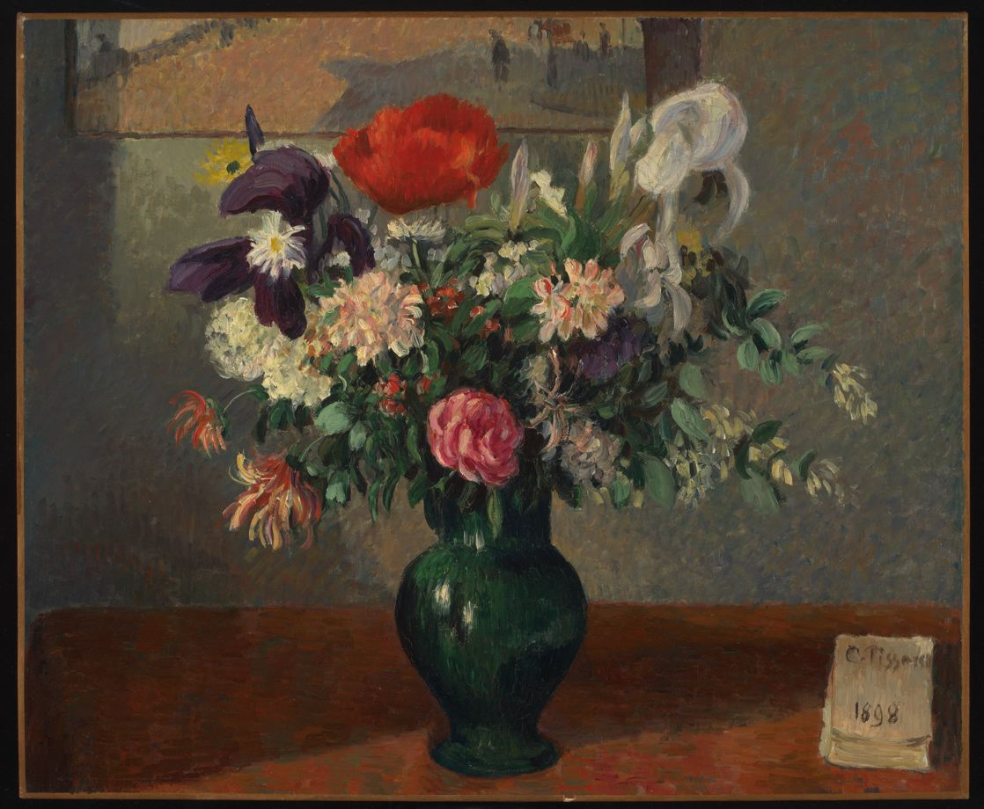
Bouquet of Flowers, 1898, Oil on Canvas, 54x65.4 cm, M. H. de Young Memorial Museum, San Francisco, CA, USA https://commons.wikimedia.org/wiki/File:Bouquet_of_Flowers_(Bouquet_de_Fleurs).jpg

Slide 10
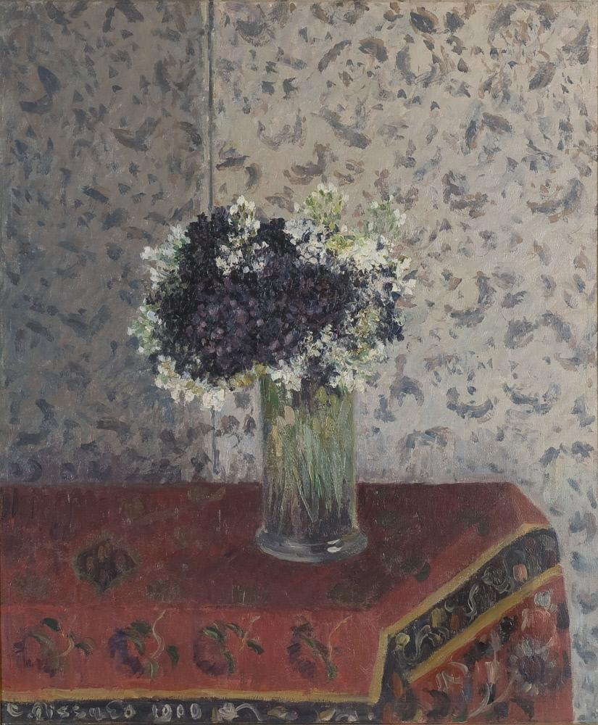
Bouquet of Violets, 1900, Oil on Canvas, 83.8 × 73.7 × 5.7 cm, Des Moines Art Center, IW, USA https://commons.wikimedia.org/wiki/File:Pissarro_-_Bouquet_of_Violets,_1900.jpg

Slide 11
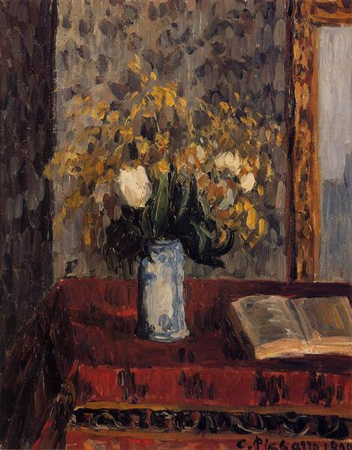
Vase of Flowers, Tulips and Garnets, 1900, Oil on Canvas, Private Collection https://www.wikiart.org/en/camille-pissarro/vase-of-flowers-tulips-and-garnets-1900

Slide 12
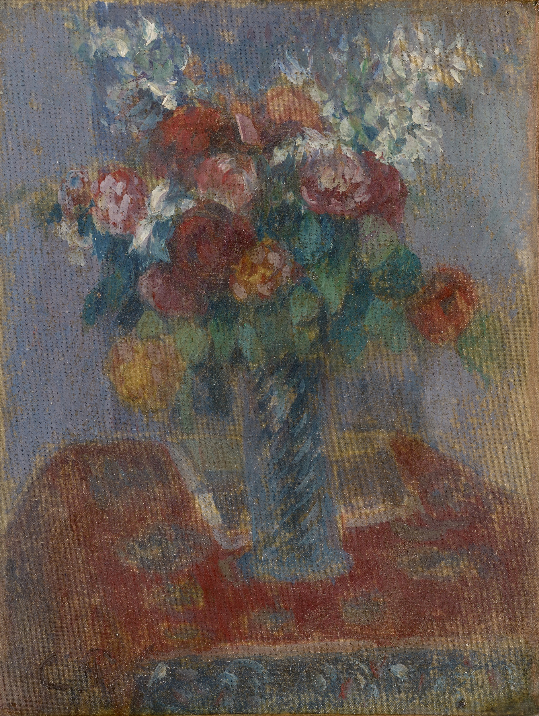
Bouquet of Flowers, 1900, Oil on Canvas, 18x14 cm, Kunstmuseum, Basel, Switzerland https://upload.wikimedia.org/wikipedia/commons/9/93/Pissarro_-_Bouquet_de_fleurs%2C_um_1900.jpg

Slide 13
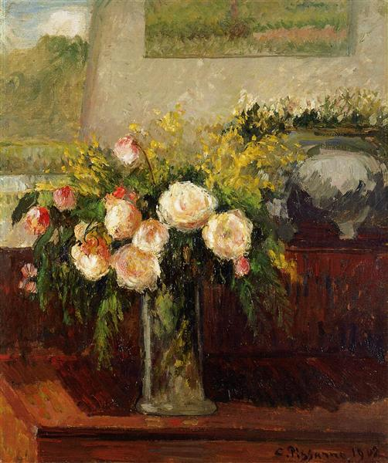
Roses of Nice,
1902, Oil on Canvas, Private Collection https://www.wikiart.org/en/camille-pissarro/roses-of-nice-1902

Slide 14
The End

