Slide 1
Ancient Greek
Gold Hairnets

Slide 2
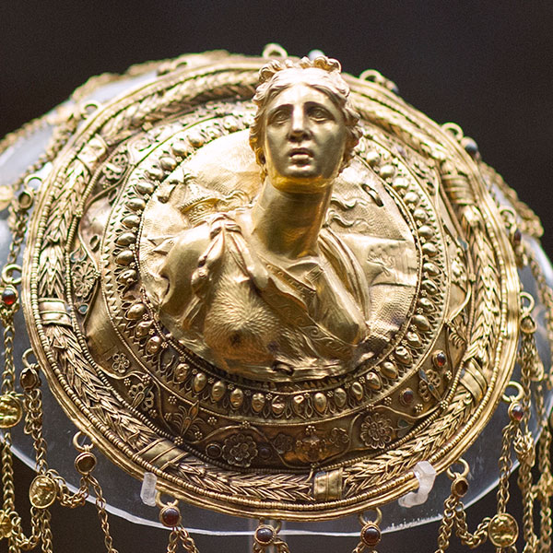
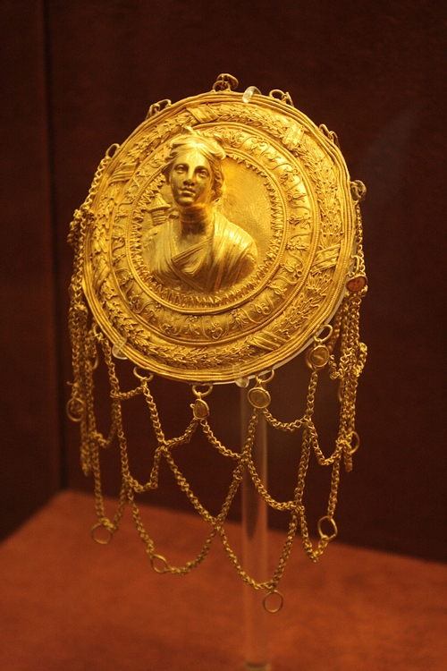
Gold Hairnet portraying a relief bust of Artemis, 3rd century BC, gold, garnets and enamel, the Stathatos Collection, National Archaeological Museum, Athens, Greece
Photo Credit: https://www.worldhistory.org/image/4353/gold-hairnet/
Photo Credit: https://www.namuseum.gr/permanent_exhibition/syllogi-stathatoy/

Slide 3
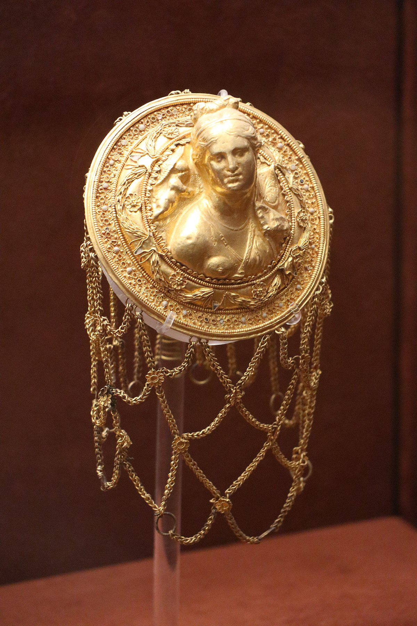
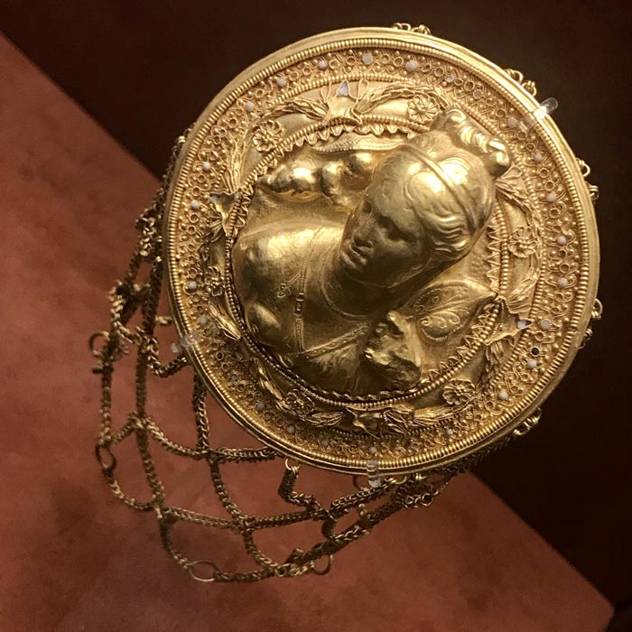
Hairnet with the relief bust of Aphrodite with fan and Eros, 3rd century BC, gold, garnets and enamel, the Stathatos Collection, National Archaeological Museum, Athens, Greece
Photo Credits: https://commons.wikimedia.org/wiki/File:Gold_hairnet_with_Aphrodite_at_the_National_Archaeological_Museum_of_Athens_on_22_July_2018.jpg

Slide 4
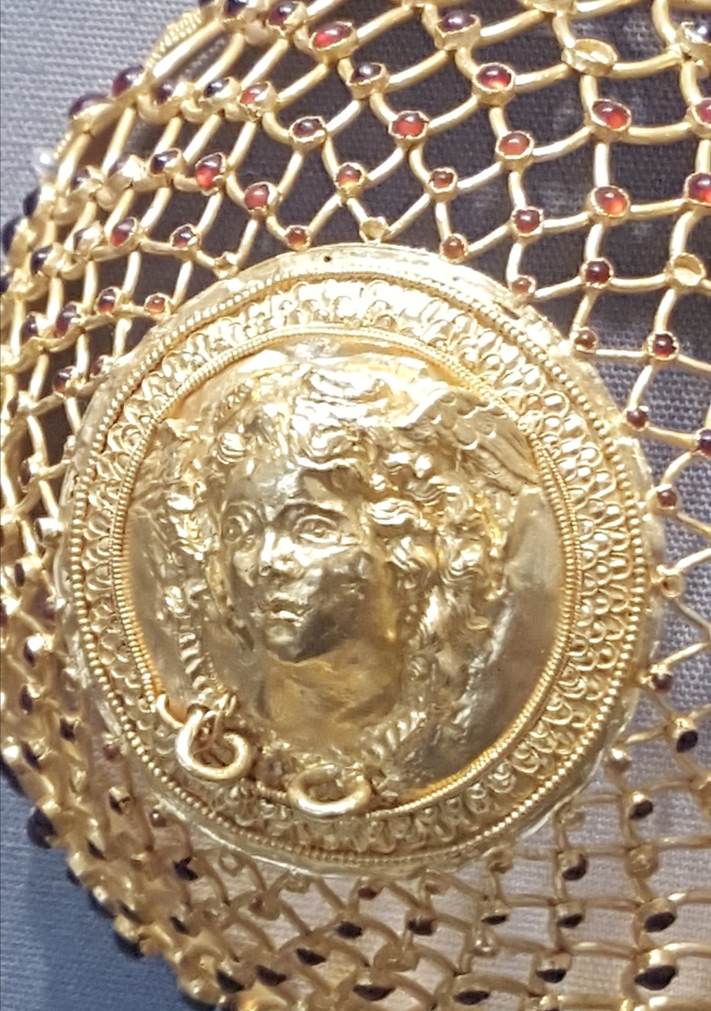
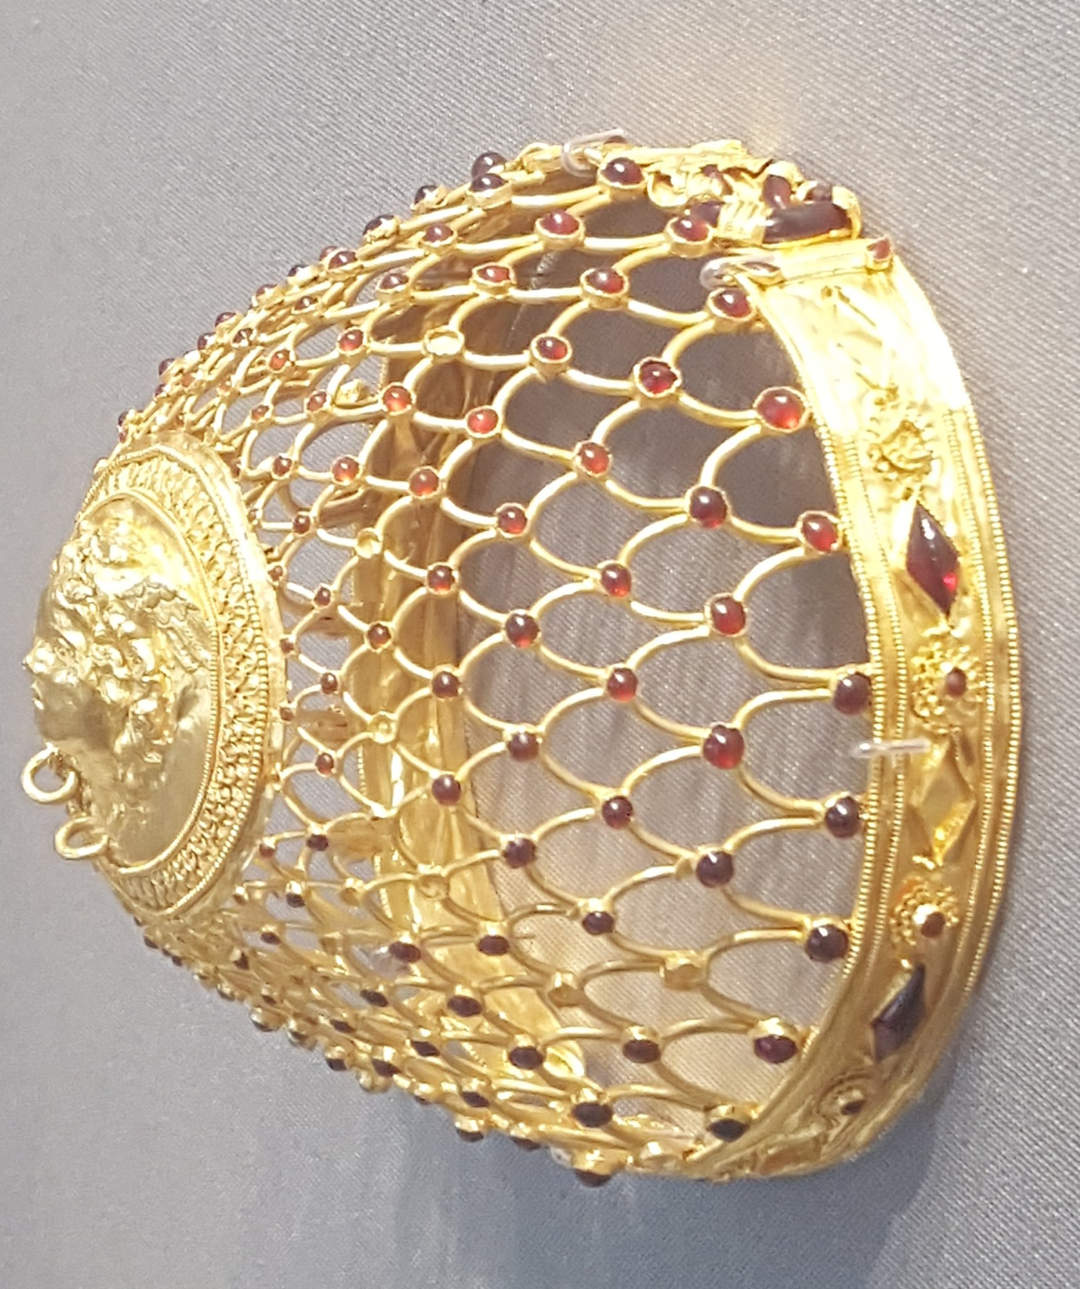
Gold Hairnet featuring a central medallion of the Medusa, 230-210 BC, gold and garnets, Altes Museum, Berlin, Germany
Photo Credits: https://twitter.com/lidongni/status/946892571946733568/photo/3 https://twitter.com/lidongni/status/946892571946733568/photo/1

Slide 5
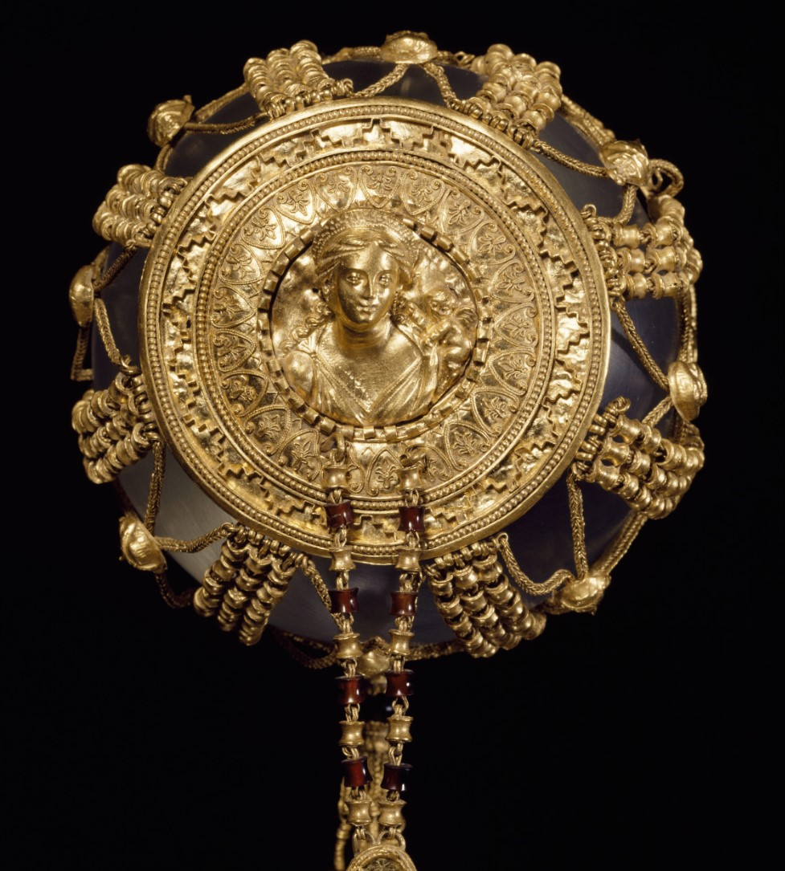
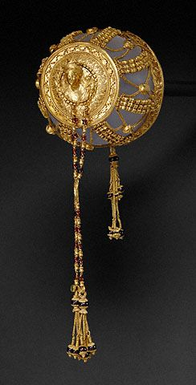
Gold Hairnet featuring the goddess of love Aphrodite, Produced c. 225 - 175 BC in Alexandria, gold, garnets, and glass paste, 21.6×7.9×7.6 cm,
J. Paul Getty Museum, CA, USA
Photo Credits: https://twitter.com/TheClassicalCo/status/1395146116140785664/photo/2

Slide 6
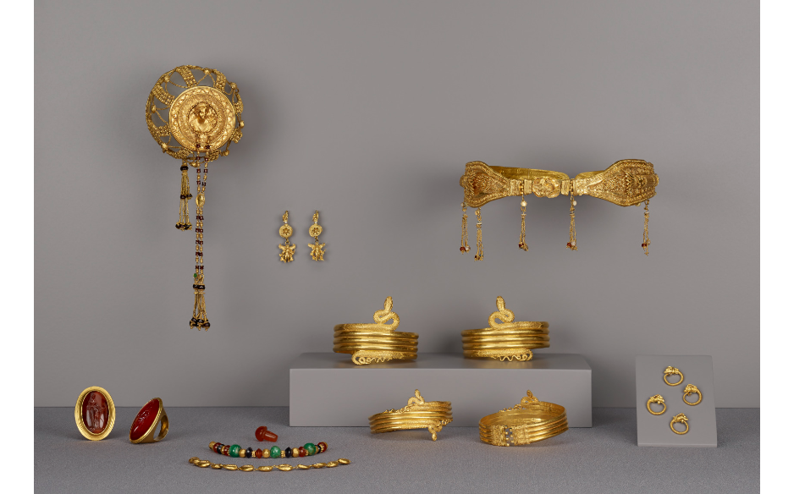
Collection of Ptolemaic Jewelry including the Gold Hairnet, 225–175 BC, Gold with various inlaid and attached stones, J. Paul Getty Museum, CA, USA
Photo Credits: http://www.getty.edu/art/collection/objects/17679/unknown-maker-collection-of-ptolemaic-jewelry-16-greek-225-175-bc/

Slide 7
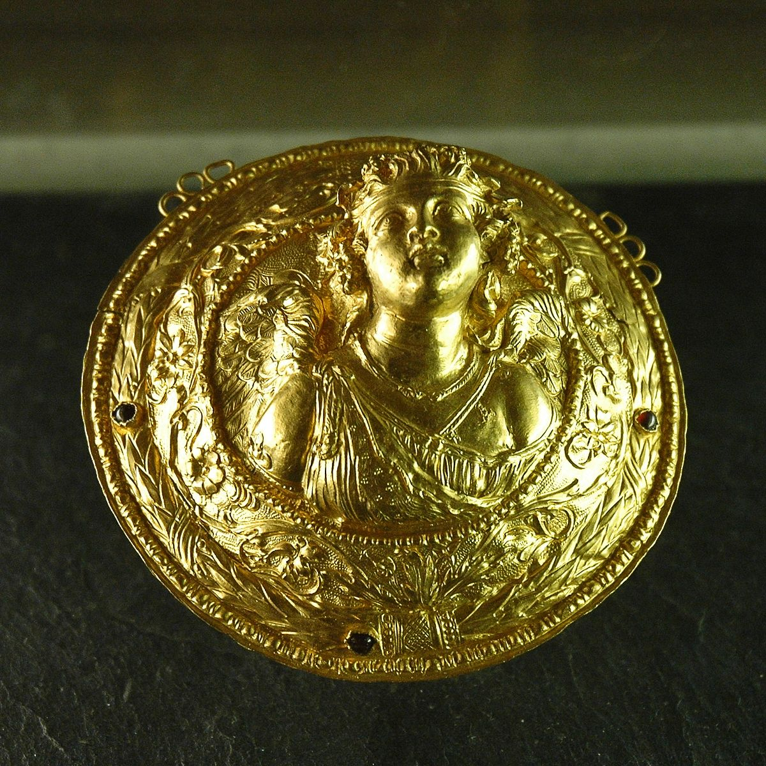
Gold Hairnet medallion featuring the head of Eros, ca. 225 - 175 BC, gold and garnet beads, D. 9,7 cm, Louvre Museum, Paris, France
Photo Credit: https://commons.wikimedia.org/wiki/File:Eros_medallion_Louvre_Bj2248.jpg

Slide 8
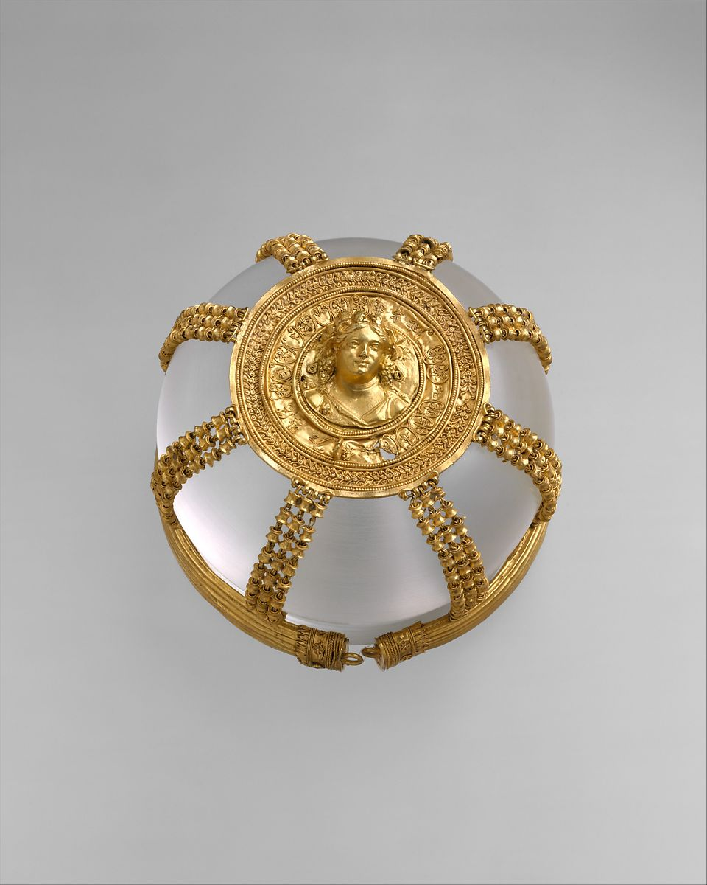
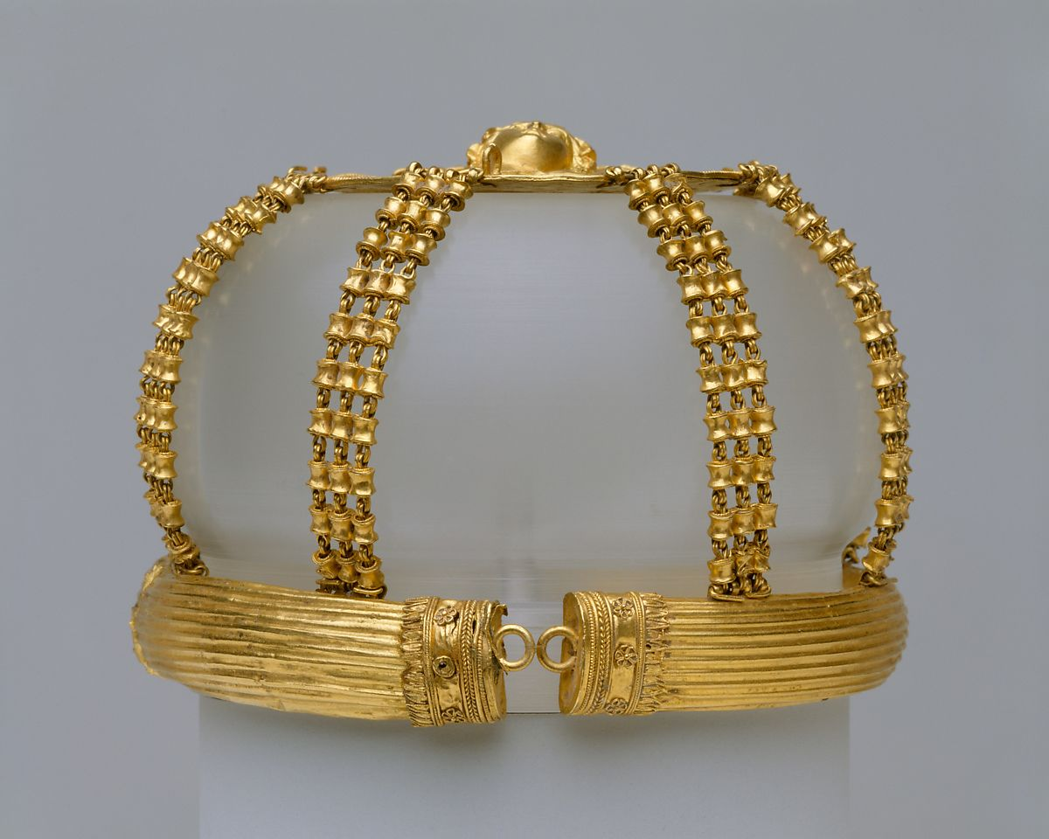
Gold Hairnet with medallion featuring the head of a Maenad, ca. 200–150 BC, gold, 6x9 cm, the MET, NY, USA
Photo Credit: https://www.metmuseum.org/art/collection/search/255890

Slide 9
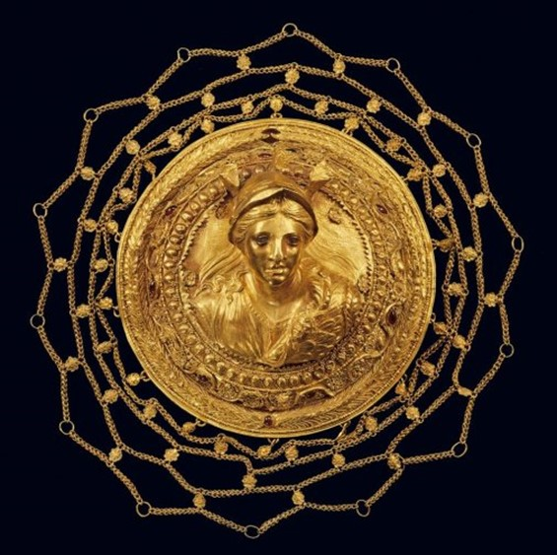
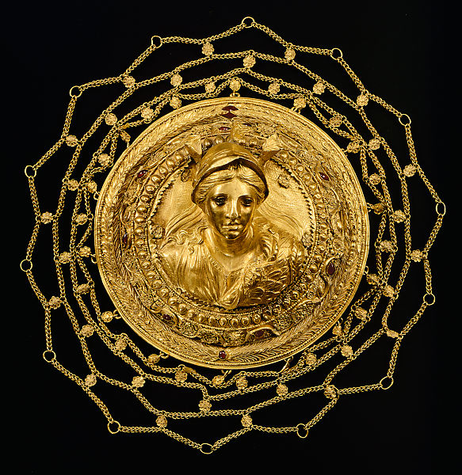
Gold Hairnet with a relief bust of Athena from Thessaly, 2nd century BC, gold, Diam. 0.111 m, Benaki Museum, Athens
Photo Credit: https://www.metmuseum.org/art/collection/search/642596

Slide 10
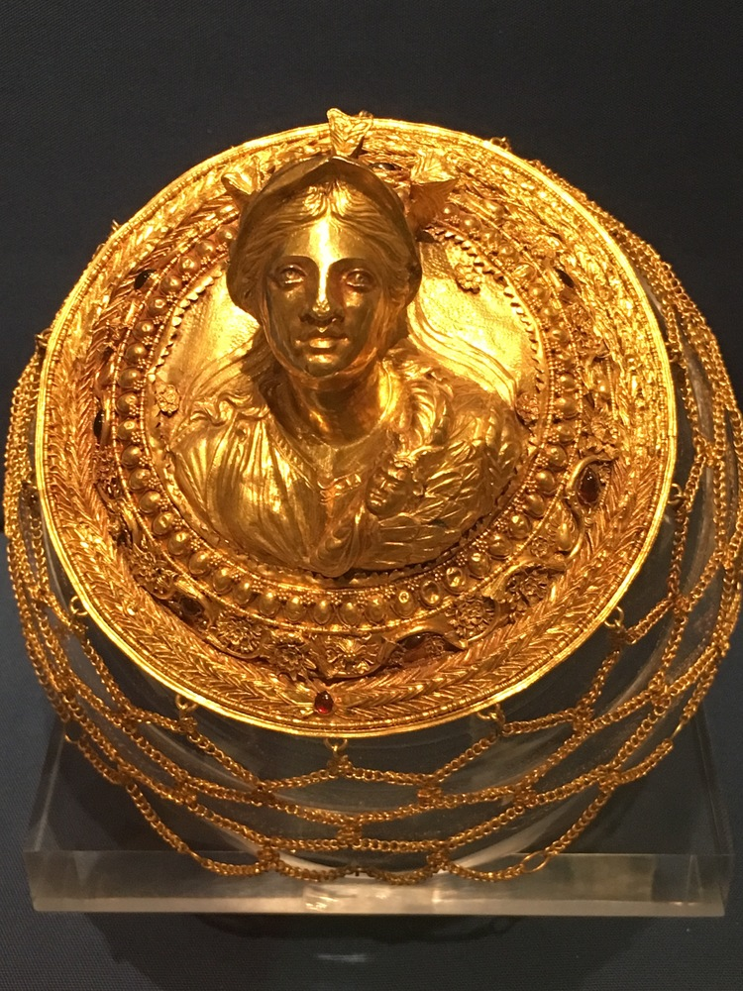
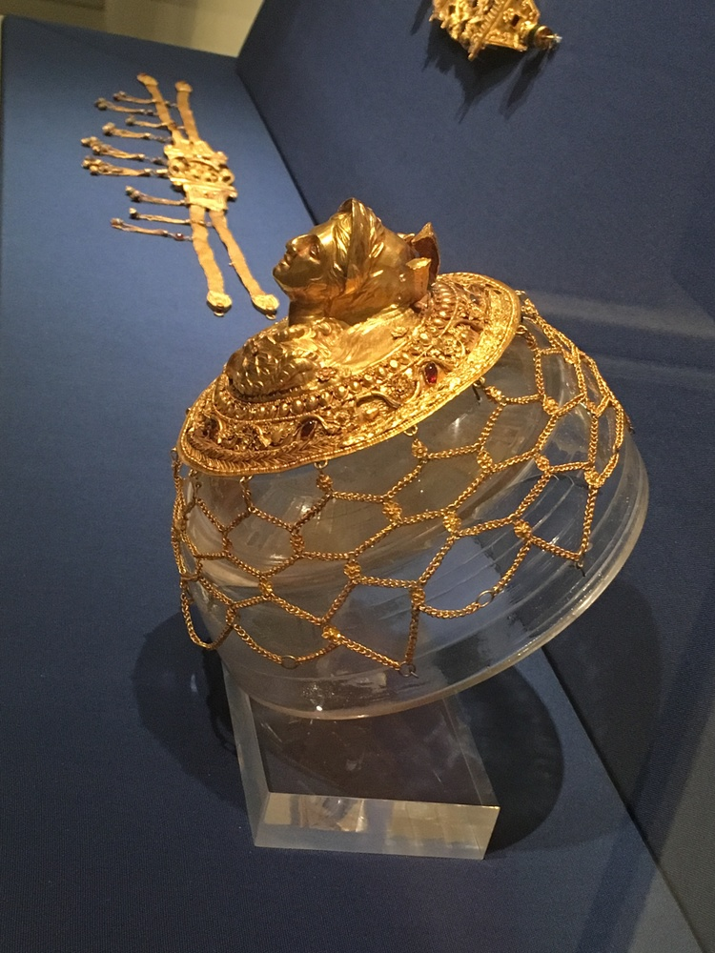
Gold Hairnet with high relief bust of Athena from Thessaly, 2nd century BC, gold, Diam. 0.111 m, Benaki Museum, Athens Greece
Photo Credits: https://www.myfaveplaces.com/contemp-galleries/2016/7/6/gold-gold-gold-plus-some-bronze-and-silver

Slide 11
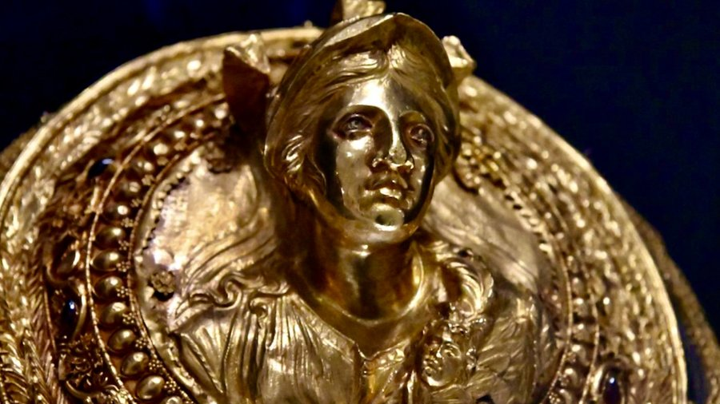
Gold Hairnet with a relief bust of Athena from Thessaly, 2nd century BC, gold, Diam. 0.111 m, Benaki Museum, Athens
Photo Credit: https://mobile.twitter.com/tzoumio/status/1413408320489144320

Slide 12
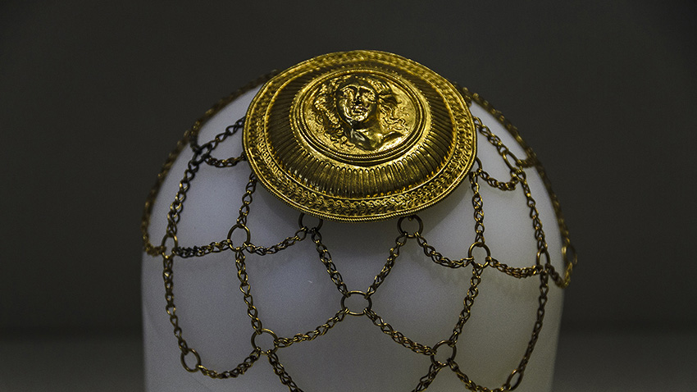
Gold Hairnet with a tondo showing the head of Gorgon Medusa from Akragas (Agrigento) in Sicily, 3rd century BC, gold, Agrigento Regional Archaeological Museum, Sicily, Italy
Photo Credit: https://rsomas.net/SicilyRS/Pages%20Desktop/Page16.html

Slide 13
The End

