Slide 1
James Abbott McNeill Whistler, 1834-1903
Women in Asian Costumes

Slide 2
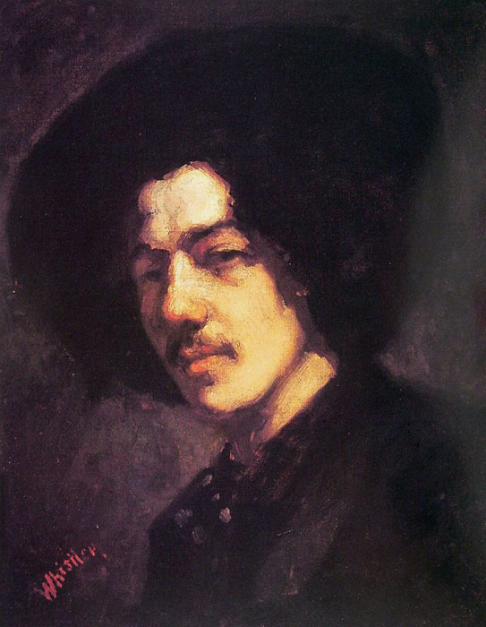
Portrait of Whistler with Hat, 1857-1858, Oil on Canvas, 46.3x38.1 cm, Freer Gallery of Art, Washington DC, USA https://www.allartclassic.com/pictures_zoom.php?p_number=144&p=&number=WHJ005

Slide 3
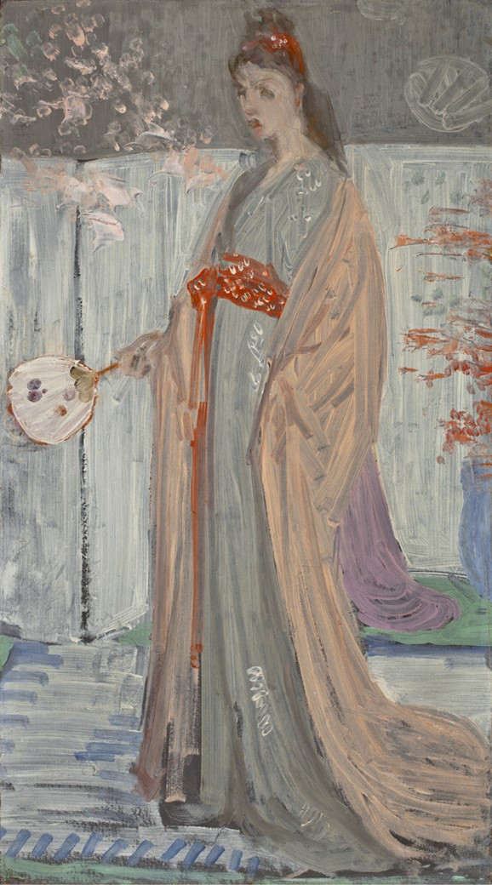
Sketch for Rose and Silver: The Princess from the Land of Porcelain, between 1863 and 1864, oil on hardboard, 61.3 × 35.1 cm, Worcester Art Museum, MA, USA https://commons.wikimedia.org/wiki/File:La_Princesse_du_Pays_de_la_Porcelaine_-_James_Abbort_McNeill_Whistler_-_Sketch.JPG

Slide 4
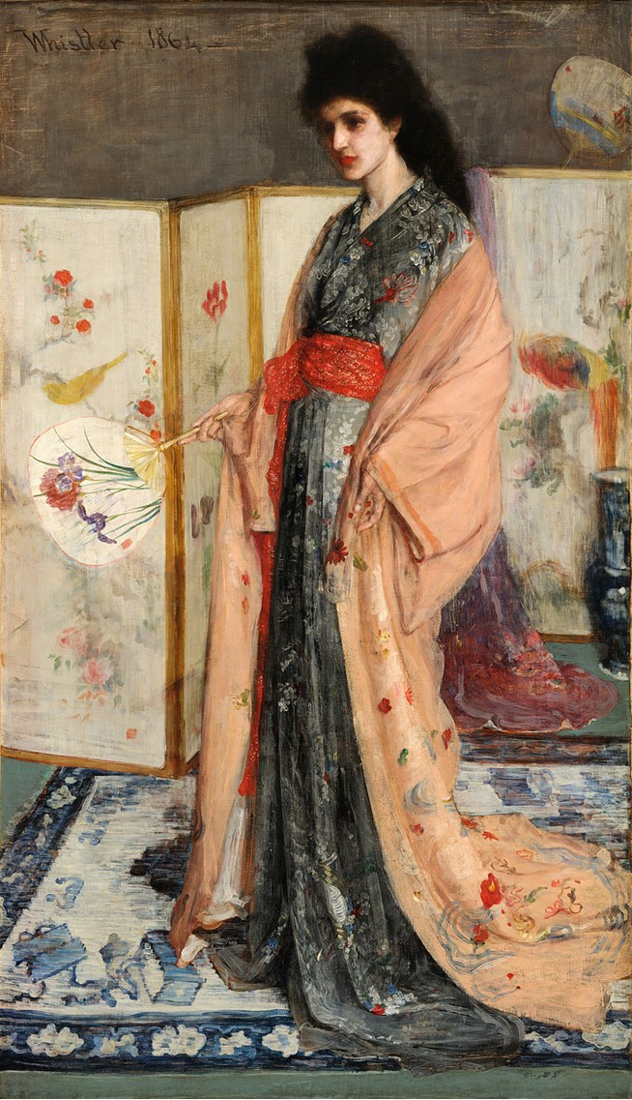
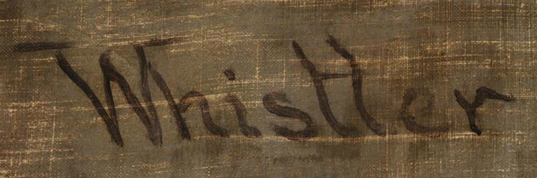
Rose and Silver: The Princess from the Land of Porcelain (Portrait of Christine Spartali), 1863-1865, Oil on Canvas, 201.5x116.1 cm, Freer Gallery of Art, Smithsonian Institution, Washington DC, USA https://en.wikipedia.org/wiki/The_Princess_from_the_Land_of_Porcelain#/media/File:James_McNeill_Whistler_-_La_Princesse_du_pays_de_la_porcelaine_-_brighter.jpg https://artofdarkness.co/post/137432960224/whistler-princess-from-land-porcelain-gigapixel-details

Slide 5
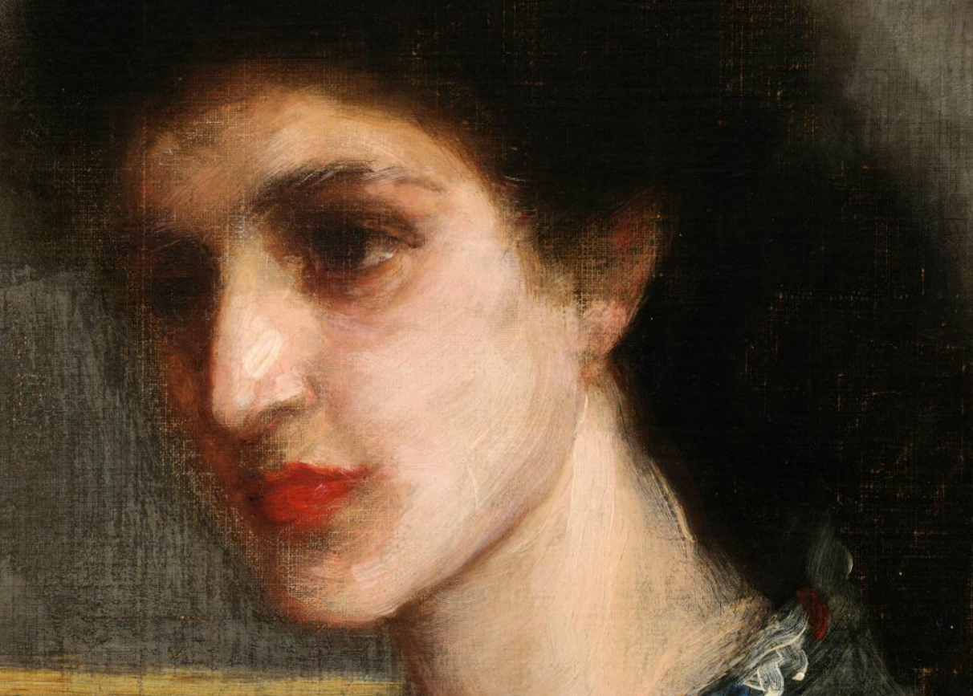
https://artofdarkness.co/post/137432960224/whistler-princess-from-land-porcelain-gigapixel-details

Slide 6
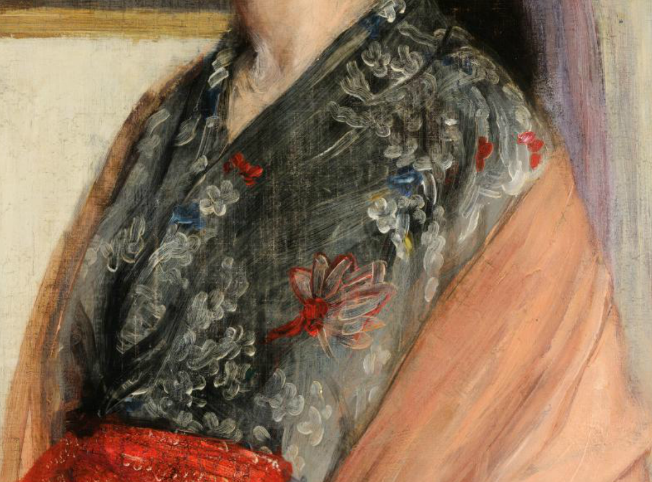
https://artofdarkness.co/post/137432960224/whistler-princess-from-land-porcelain-gigapixel-details

Slide 7
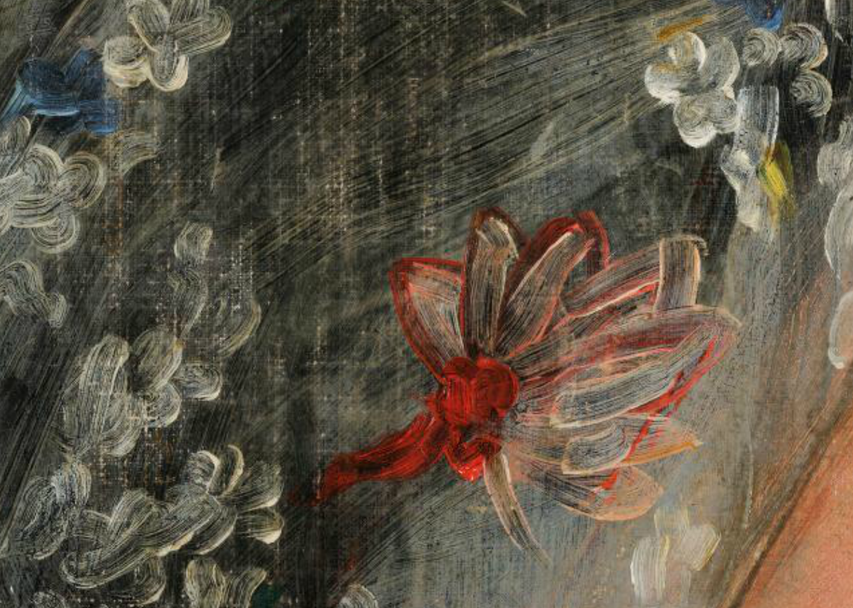
https://artofdarkness.co/post/137432960224/whistler-princess-from-land-porcelain-gigapixel-details

Slide 8
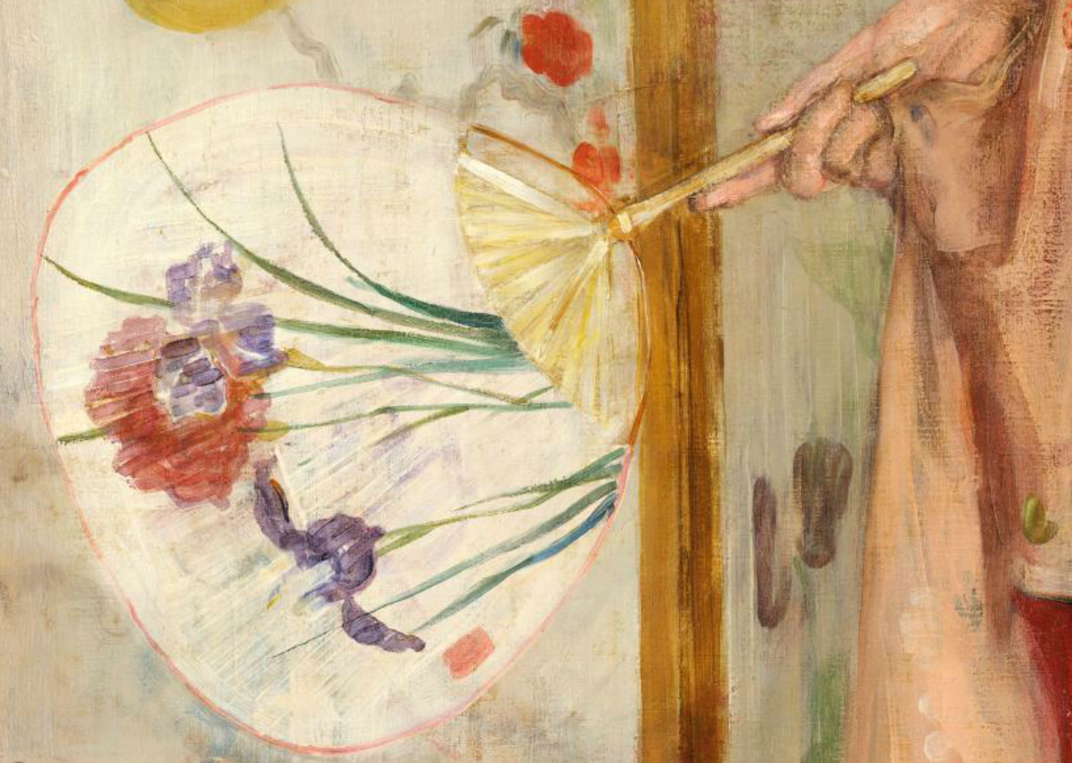
https://artofdarkness.co/post/137432960224/whistler-princess-from-land-porcelain-gigapixel-details

Slide 9
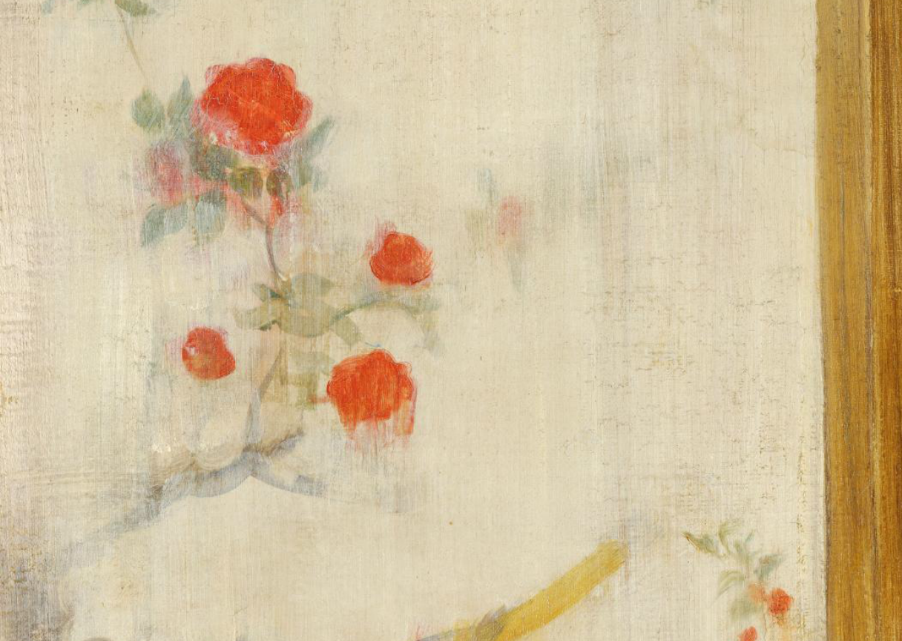
https://artofdarkness.co/post/137432960224/whistler-princess-from-land-porcelain-gigapixel-details

Slide 10
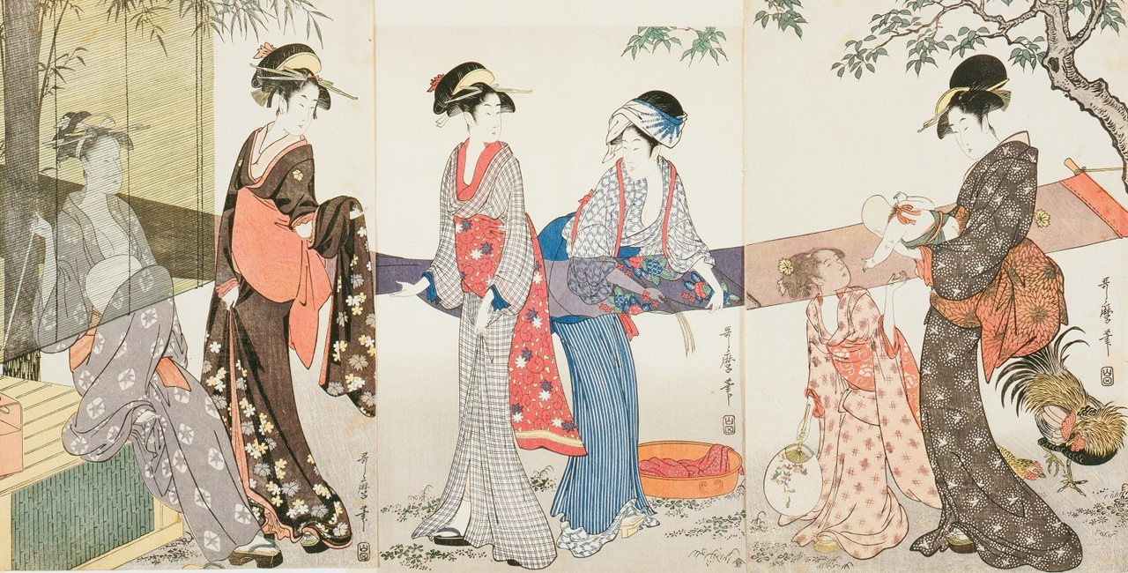
Rose and Silver: The Princess from the Land of
Porcelain (Portrait of Christine Spartali), 1863-1865, Oil on Canvas, 201.5x116.1 cm, Freer Gallery of Art, Smithsonian Institution, Washington DC, USA https://en.wikipedia.org/wiki/The_Princess_from_the_Land_of_Porcelain#/media/File:James_McNeill_Whistler_-_La_Princesse_du_pays_de_la_porcelaine_-_brighter.jpg
Kitagawa Utamaro, 1753-1806
Washing and stretching cloth, 1796-1797, Color woodblock print on paper, Triptych: each sheet 38.1 x 25.4 cm, NY Public Library, USA https://artvee.com/dl/drying-and-stretching-cloth/

Slide 11
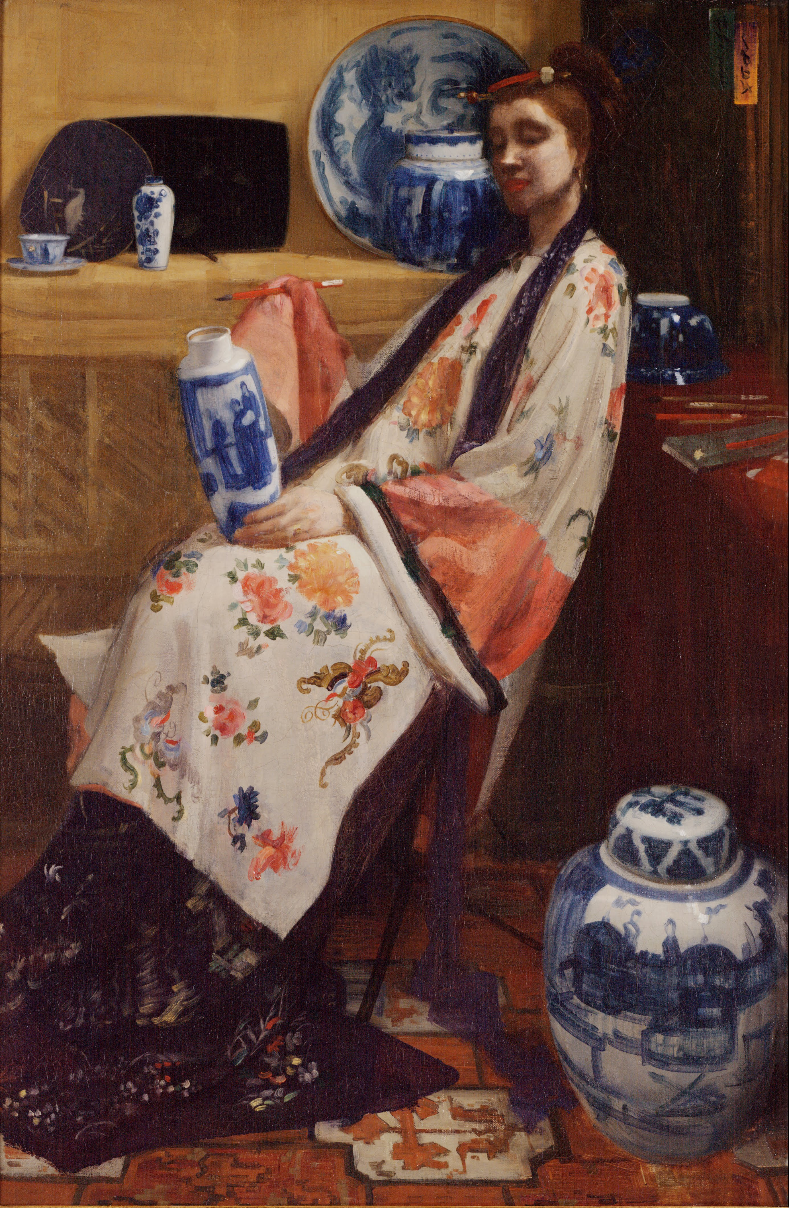
Purple and Rose: The Lange Leizen of The Six Marks, 1864, Oil on Canvas, 91.5x61.5 cm, Philadelphia Museum of Art, PA, USA https://upload.wikimedia.org/wikipedia/commons/e/ed/James_Abbott_McNeill_Whistler_-_Purple_and_Rose-_The_Lange_Leizen_of_the_Six_Marks_-_Google_Art_Project.jpg

Slide 12
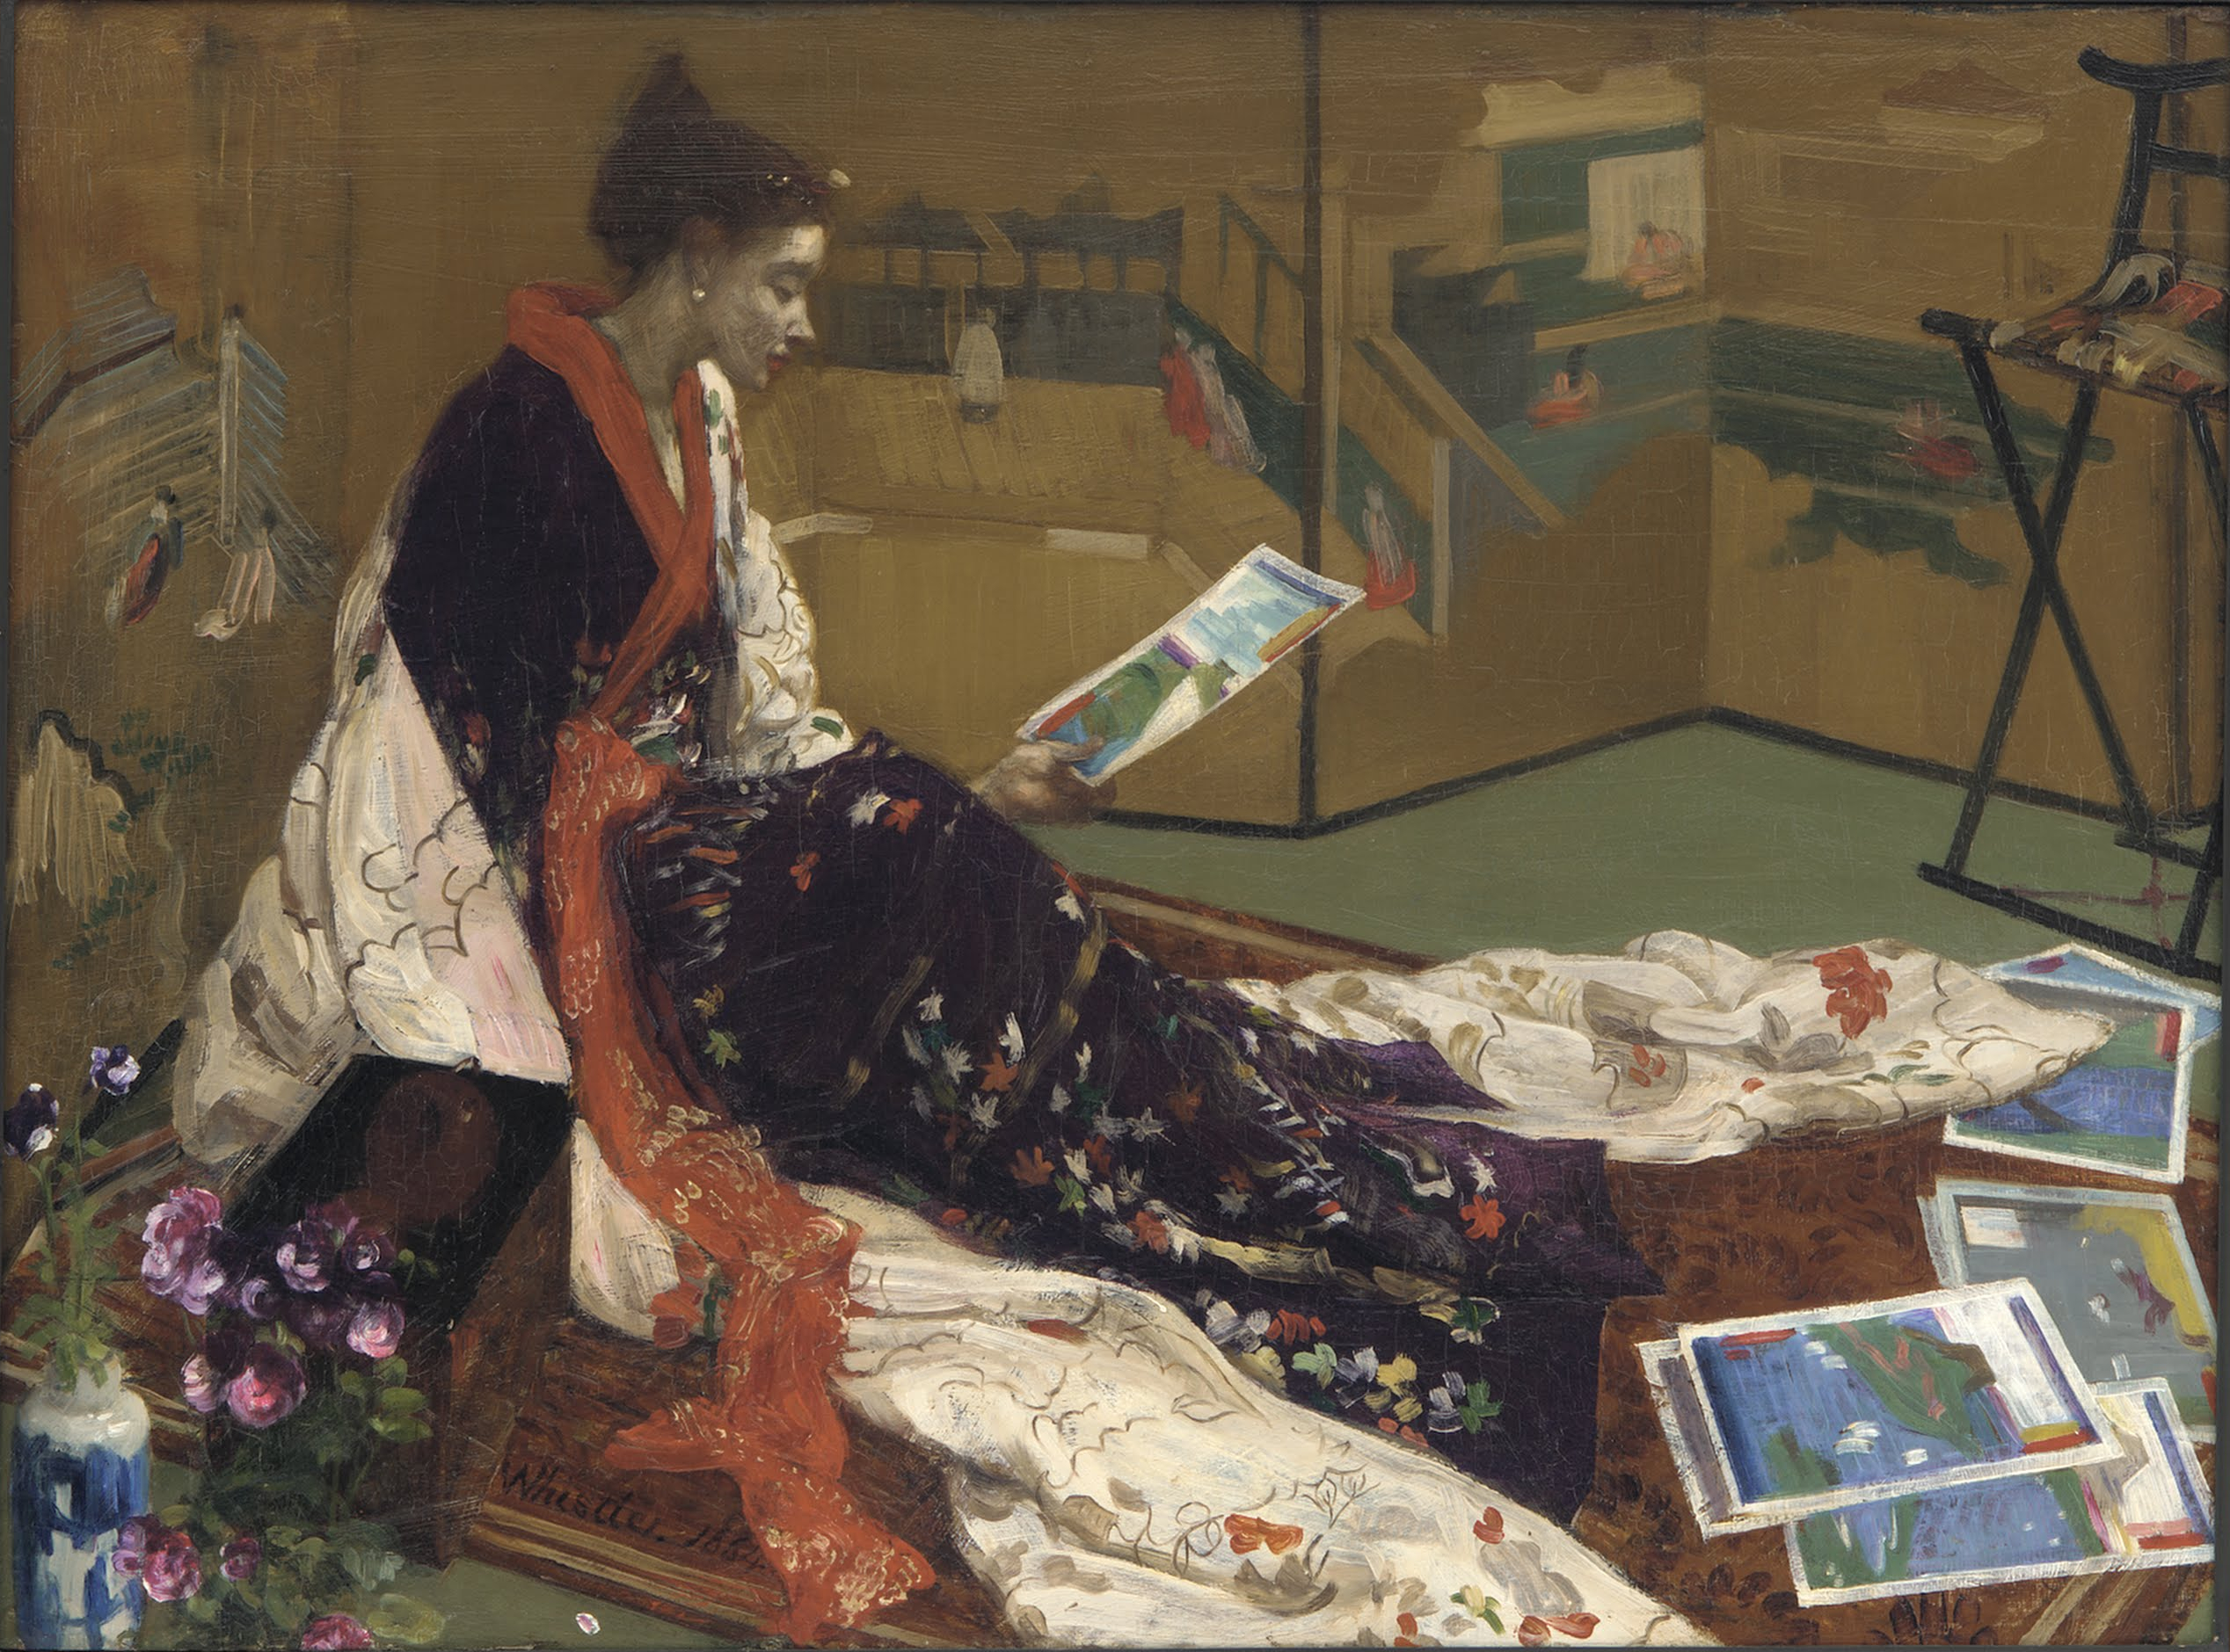
Caprice in Purple and Gold: The Golden Screen, 1864, Oil on Board, 50.2x68.7 cm, Freer Gallery of Art, Washington DC, USA https://upload.wikimedia.org/wikipedia/commons/0/0a/James_McNeill_Whistler_-_Caprice_in_Purple_and_Gold-_The_Golden_Screen_-_Google_Art_Project.jpg

Slide 13
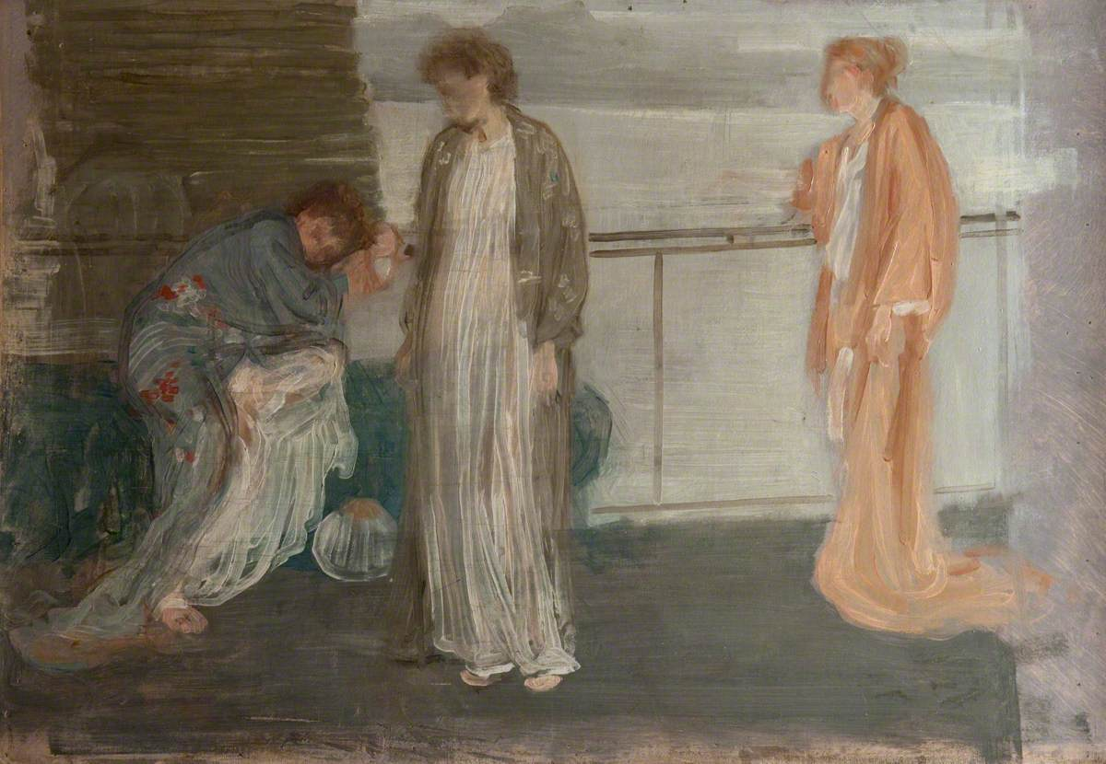
Study of Draped Figures, c.1864–1865, Oil on Canvas, 39.7x57.5 cm, Hunterian Art Gallery, Glasgow, Scotland https://artuk.org/discover/artworks/study-of-draped-figures-139094

Slide 14
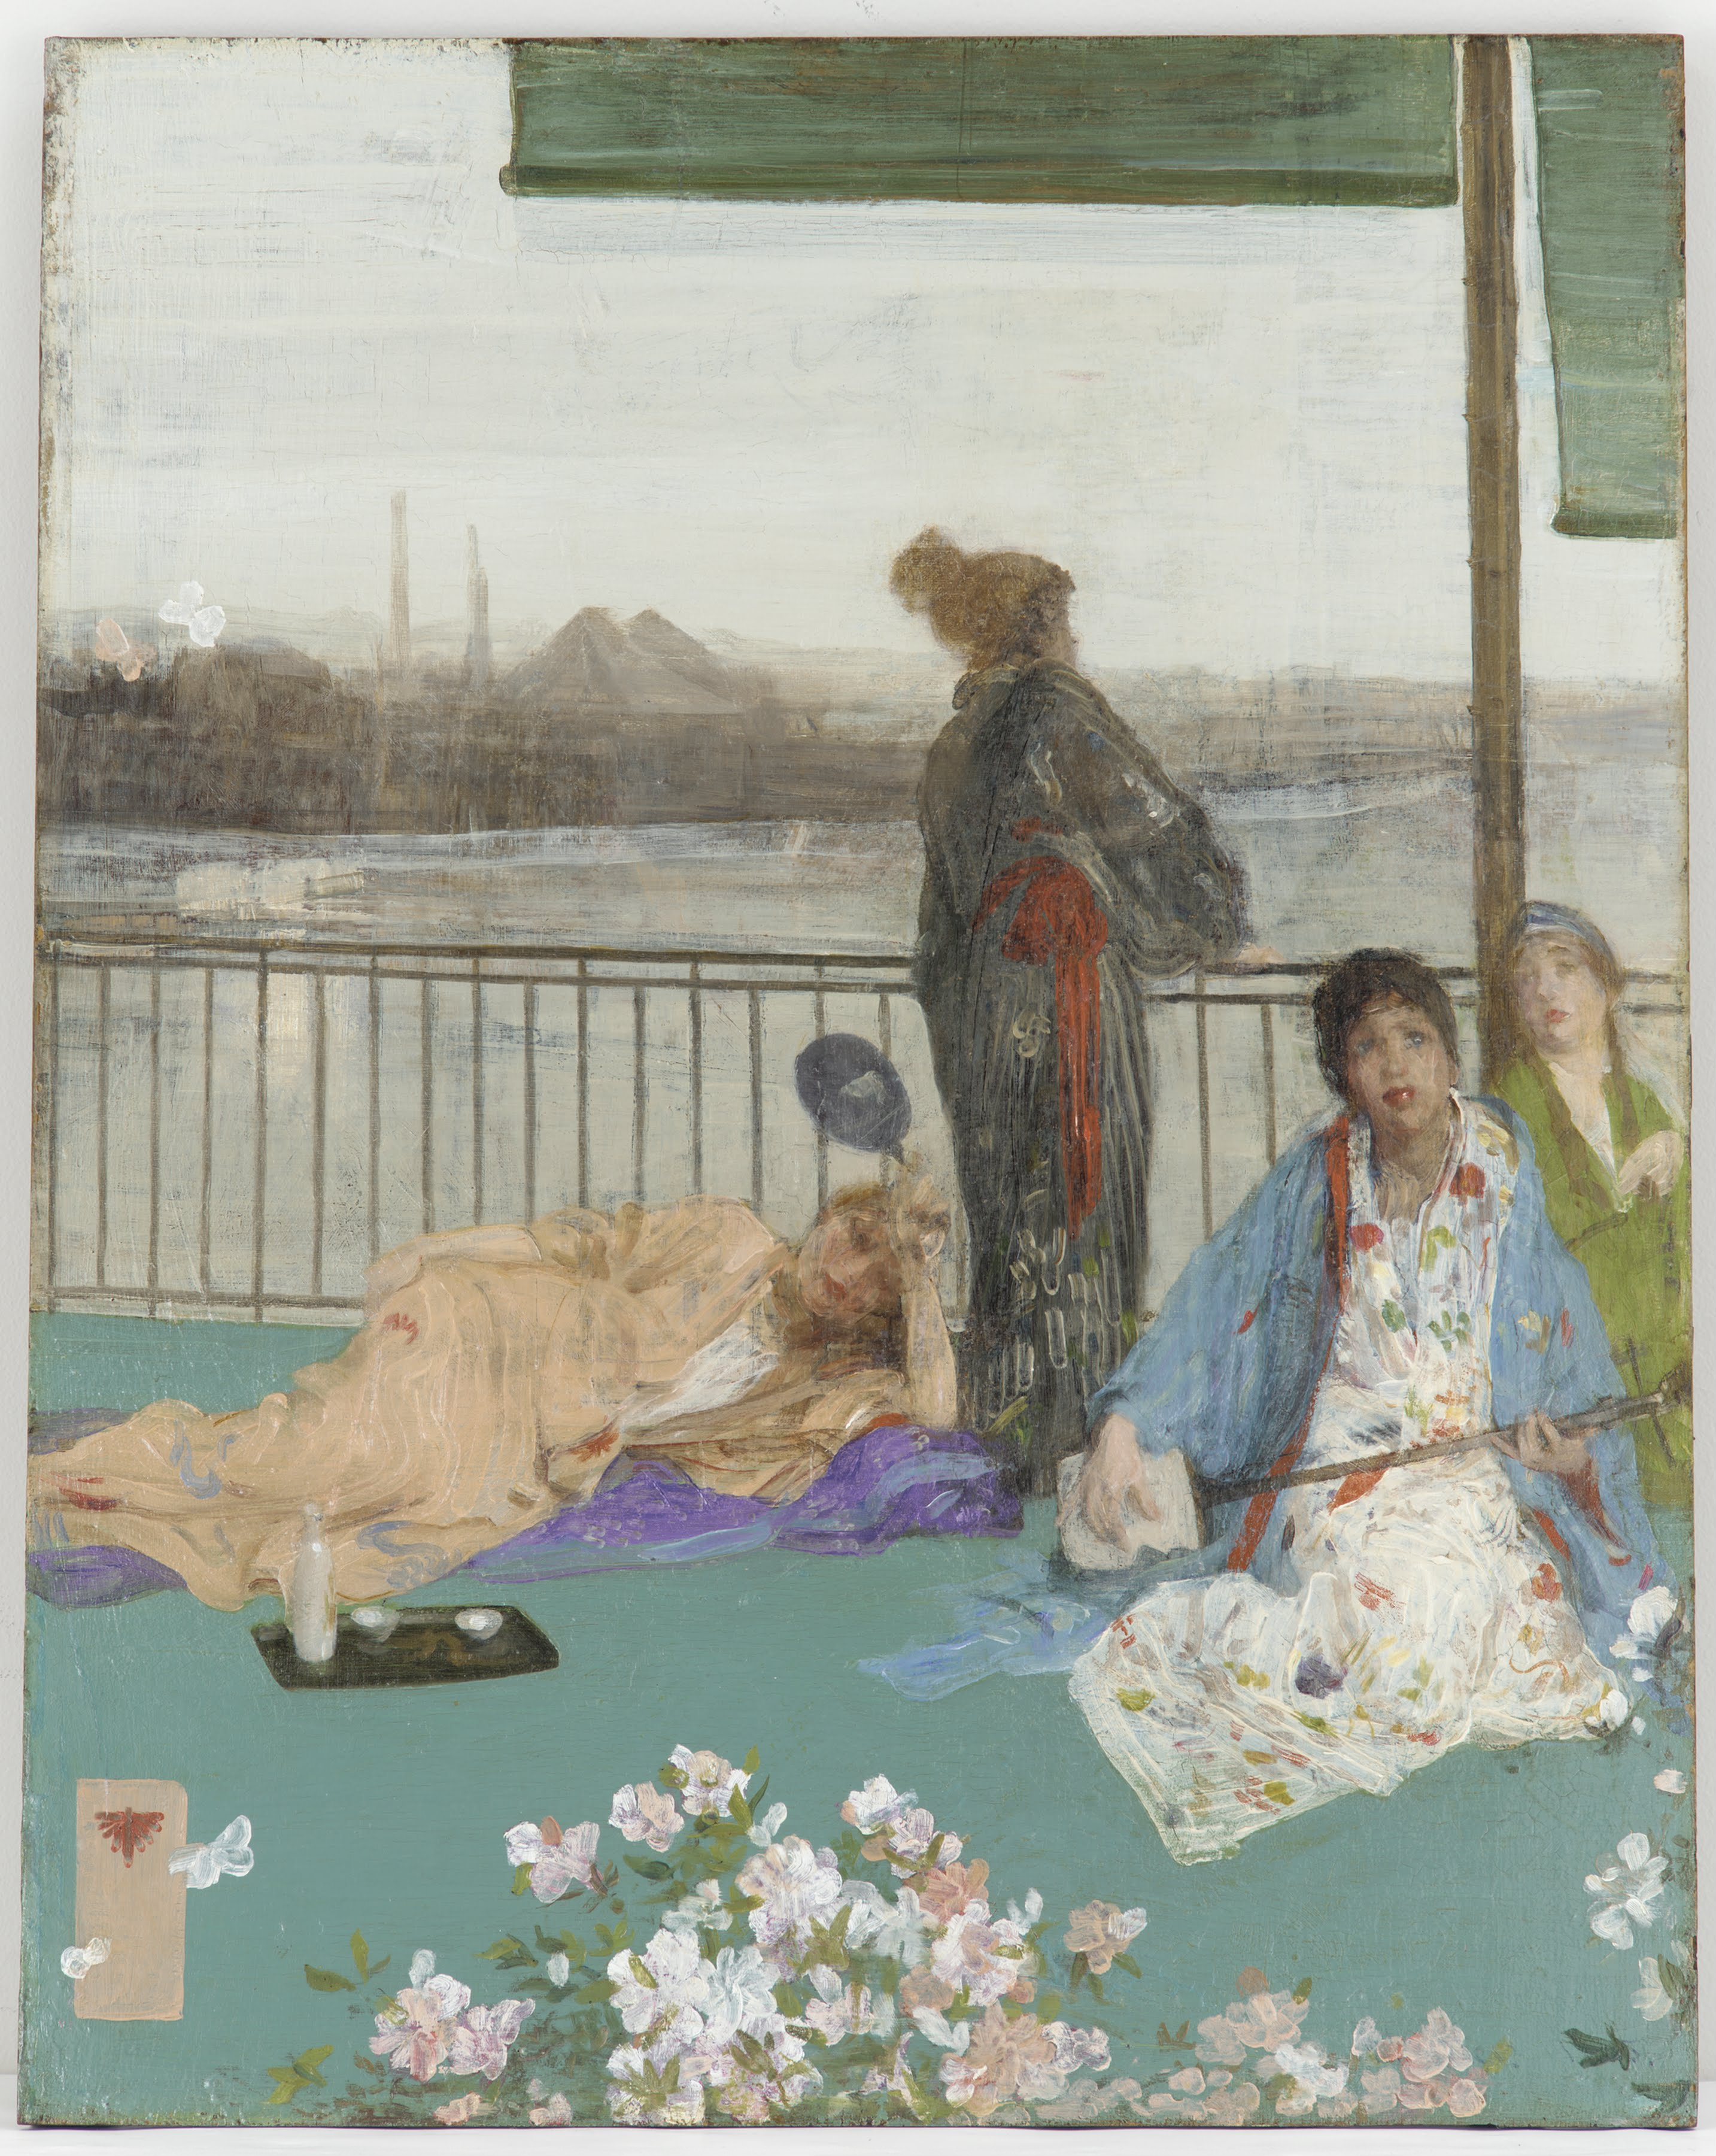
Variations in Flesh Colour and Green: The Balcony, 1865, Oil on Board, 61.4x48.8 cm, Freer Gallery of Art, Washington DC, USA https://upload.wikimedia.org/wikipedia/commons/1/1b/James_McNeill_Whistler_-_Variations_in_Flesh_Colour_and_Green%E2%80%94The_Balcony_-_Google_Art_Project.jpg

Slide 15
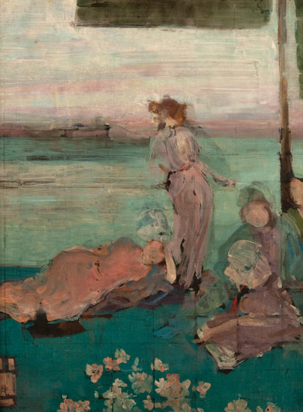
Sketch for “The Balcony,” circa 1867-1870, Oil on Panel, 61x48.2 cm, Hunterian Art Gallery, Glasgow, Scotland https://www.gla.ac.uk/hunterian/about/news/pressimages/whistlerartandlegacy/

Slide 16
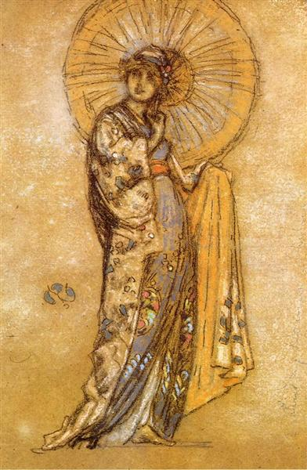
The Japanese Dress, 1888-1890, Pencil, chalk and pastel on Paper, 26.6x17.9 cm, Davison Art Center, Middletown CT, USA https://www.wikiart.org/en/james-mcneill-whistler/the-japanese-dress-1890

Slide 17
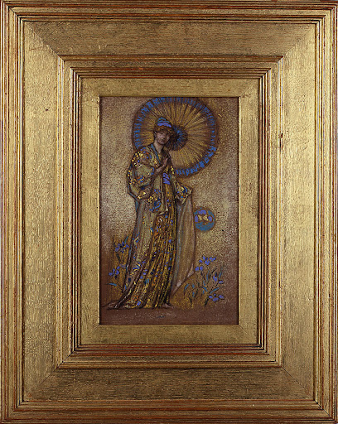
Design for a Mosaic, 1888-1891, Pastel on brown Paper, 28x17.5 cm, MuMa Le Havre Museum, Hélène Senn-Foulds Collection, France https://secure-pages-muma.lehavre.fr/fr/eugene-boudin/les-influences

Slide 18
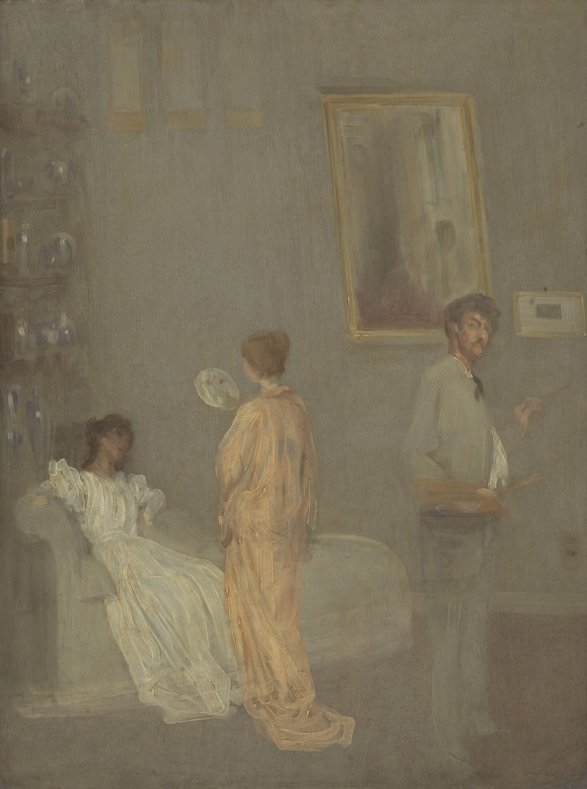
The Artist's Studio, circa 1865, Oil on Millboard, 62.2x46.3 cm, Hugh Lane Municipal Gallery of Modern Art, Dublin 1, Ireland https://www.whistlerpaintings.gla.ac.uk/catalogue/names/display/?nid=SickW&mid=y063&xml=tec

Slide 19
The End

