Slide 1
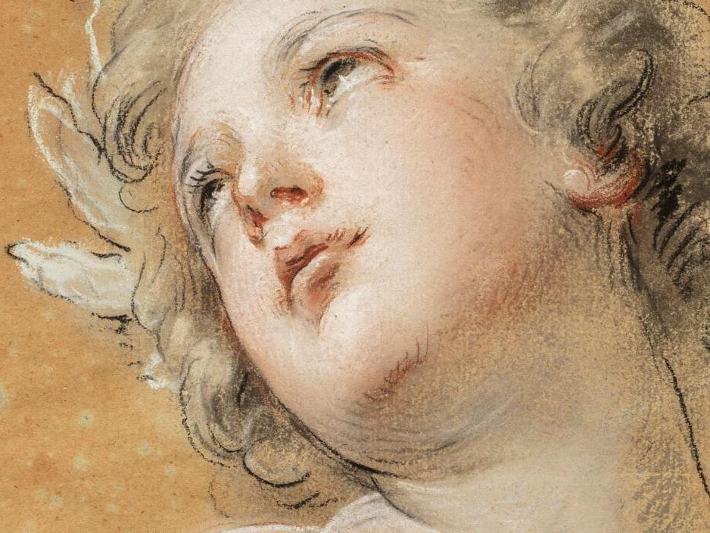
François Lemoyne
1688-1737

Slide 2
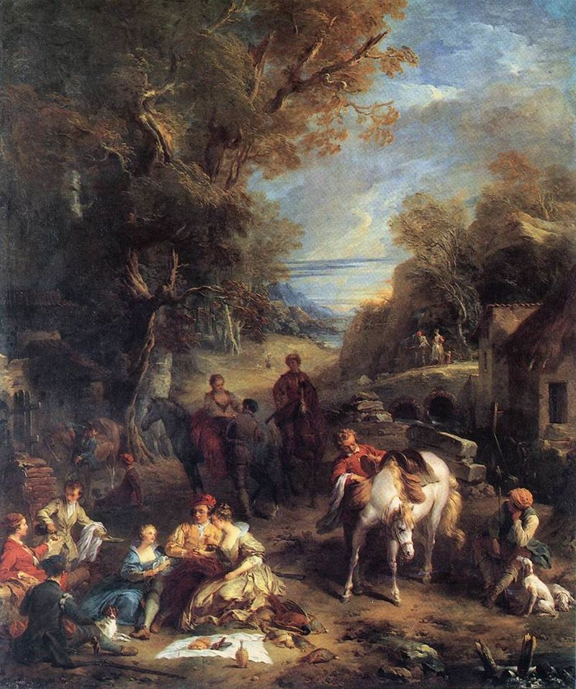
Hunting Picnic, 1723, oil on canvas, 233x185 cm, São Paulo Museum of Art, Brazil https://commons.wikimedia.org/wiki/File:Fran%C3%A7ois_Lemoyne_-_Hunting_Picnic_-_WGA12657.jpg

Slide 3
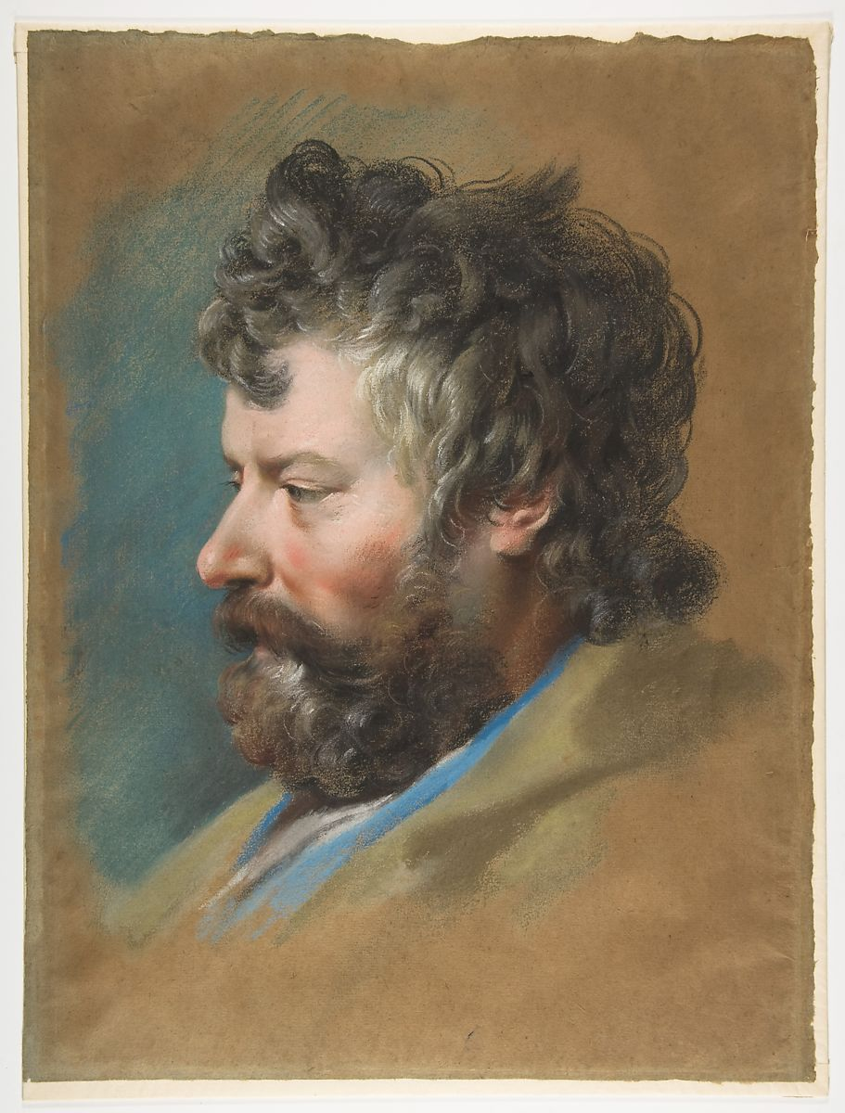
Head of a Bearded Man in Profile to Left, early 18th century, Pastel on brown paper, 43x32.5 cm, the MET, NY, USA https://www.metmuseum.org/art/collection/search/337677

Slide 4
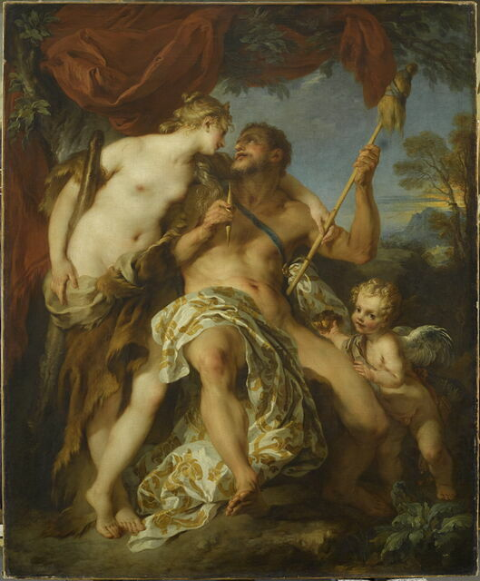
Hercules and Omphale, 1724, oil on canvas, 184x149 cm, Louvre Museum, Paris, France https://collections.louvre.fr/ark:/53355/cl010059541

Slide 5
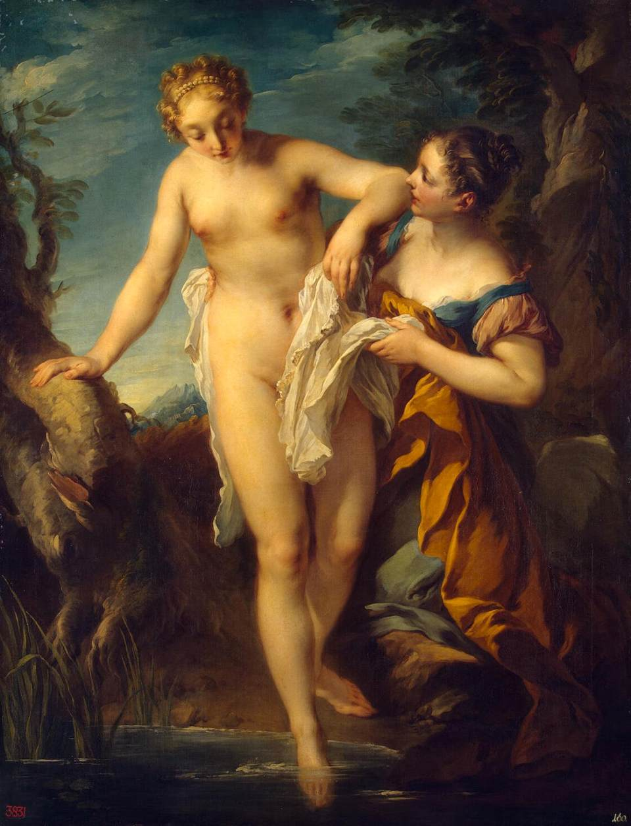
Woman Bathing, after 1724, oil on canvas, 137x105 cm, Hermitage Museum, Saint Petersburg, Russia https://upload.wikimedia.org/wikipedia/commons/d/da/Fran%C3%A7ois_Lemoyne_-_Woman_Bathing_-_WGA12659.jpg

Slide 6
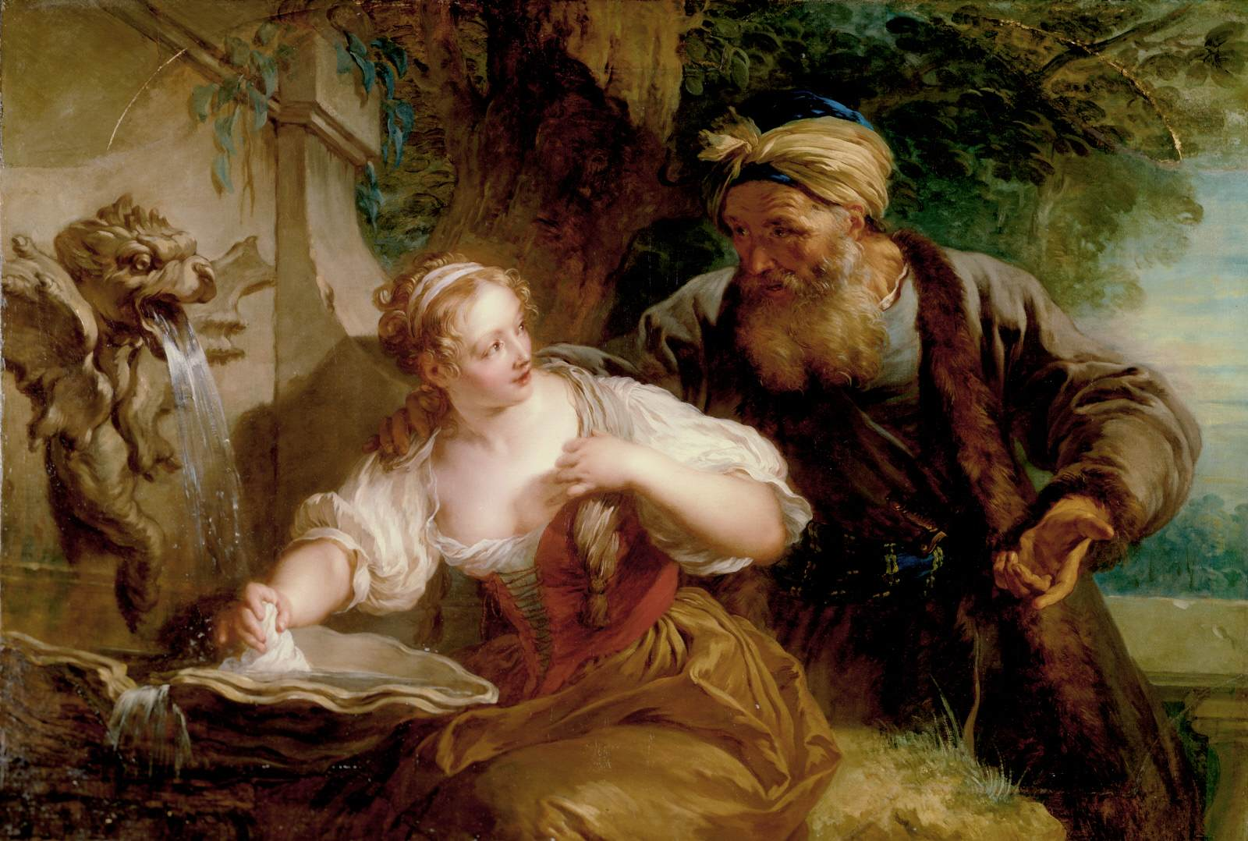
Amorous Proposal, c. 1725, Oil on canvas, 99 x 145 cm, The Clark Art Institute, Williamstown https://www.wga.hu/frames-e.html?/html/l/lemoyne1/index.html

Slide 7
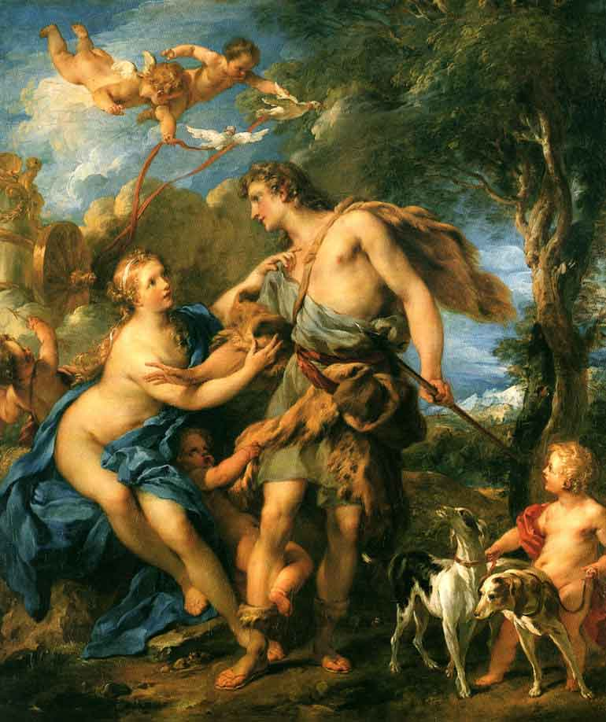
Venus and Adonis, 1729, oil on canvas, 94x74 cm, Nationalmuseum, Stockholm, Sweden https://upload.wikimedia.org/wikipedia/commons/8/80/Venus_and_Adonis._Francois_Lemoyne.jpg

Slide 8
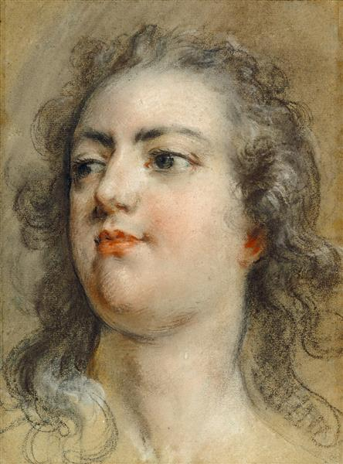
Head of King Louis XV, about 1729, Black chalk and pastel on faded blue paper, 29.5x21 cm, The J. Paul Getty Museum, CA, USA https://www.wikiart.org/en/francois-lemoyne/head-of-king-louis-xv-1729

Slide 9
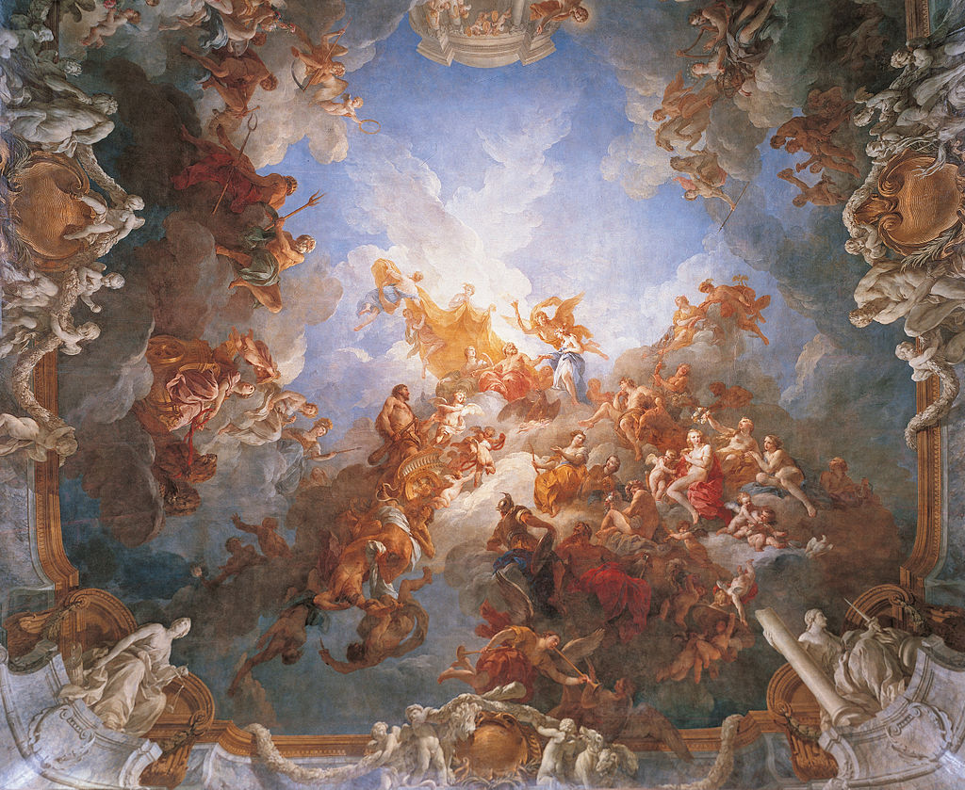
The Apotheosis of Hercules, The Hercules Room, 1728-1736, oil on canvas, Palace of Versailles, France https://el.wikipedia.org/wiki/%CE%A6%CF%81%CE%B1%CE%BD%CF%83%CE%BF%CF%85%CE%AC_%CE%9B%CE%B5%CE%BC%CE%BF%CF%85%CE%AC%CE%BD#/media/%CE%91%CF%81%CF%87%CE%B5%CE%AF%CE%BF:Fran%C3%A7ois_Lemoyne_-_L'Apoth%C3%A9ose_d'Hercule_-_Google_Art_Project.jpg

Slide 10
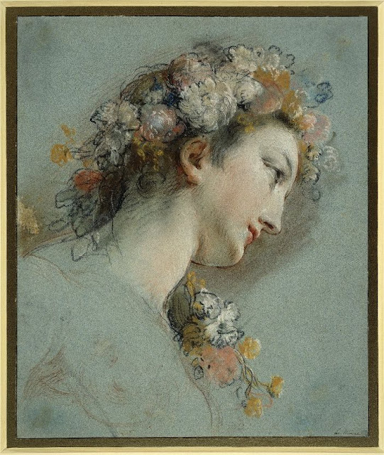
Head of the Hebe, Study for the Apotheosis of Hercules, c. 1733, Pastel over red, black and white chalk on blue paper - framing lines in pen and black chalk, 309x256 millimetres, British Museum, London, UK https://elle-belle10.livejournal.com/1789159.html

Slide 11
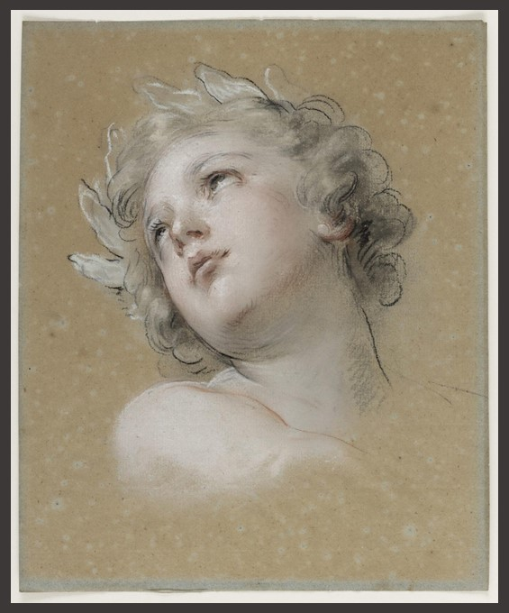
Study of a head for Love of Virtue in The Apotheosis of Hercules, circa 1733, Pastel, trois crayons and stump blending on formerly blue paper, © château de Versailles, France https://en.chateauversailles.fr/news/exhibitions/drawings-versailles-20-years-acquisitions#the-exhibition

Slide 12
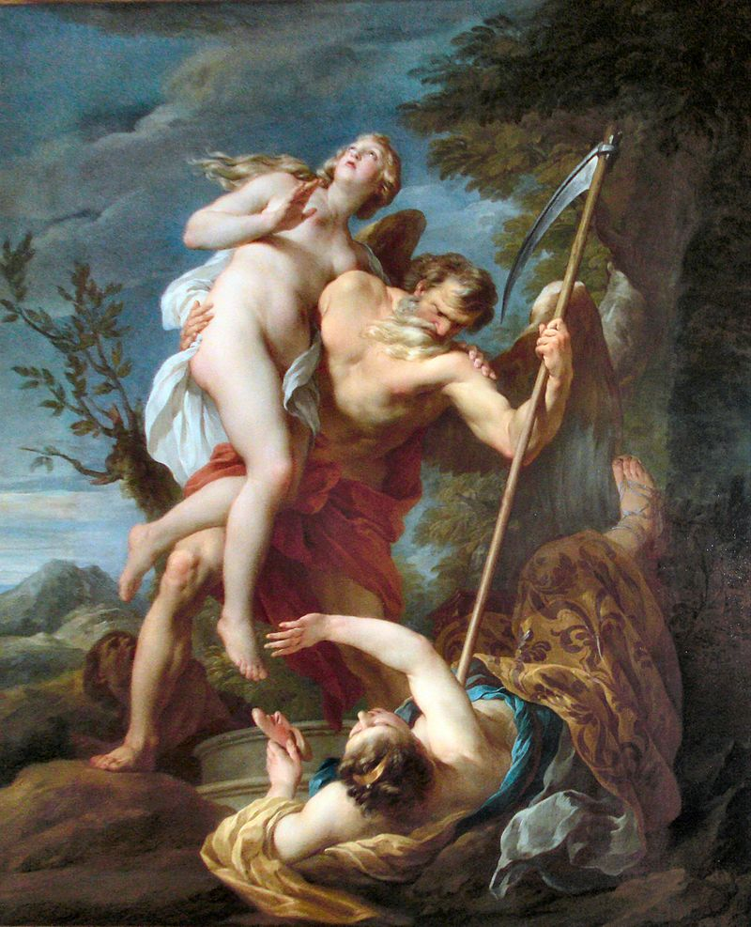
Time Saving Truth from Falsehood and Envy, 1737, oil on canvas, 180.5x148 cm, The Wallace Collection, London, UK https://commons.wikimedia.org/wiki/File:Time_Saving_Truth_from_Falsehood_and_Envy.jpg

Slide 13
The End

