Slide 1
Paolo Veronese 1528–1588
Portraits
of Renaissance Women

Slide 2
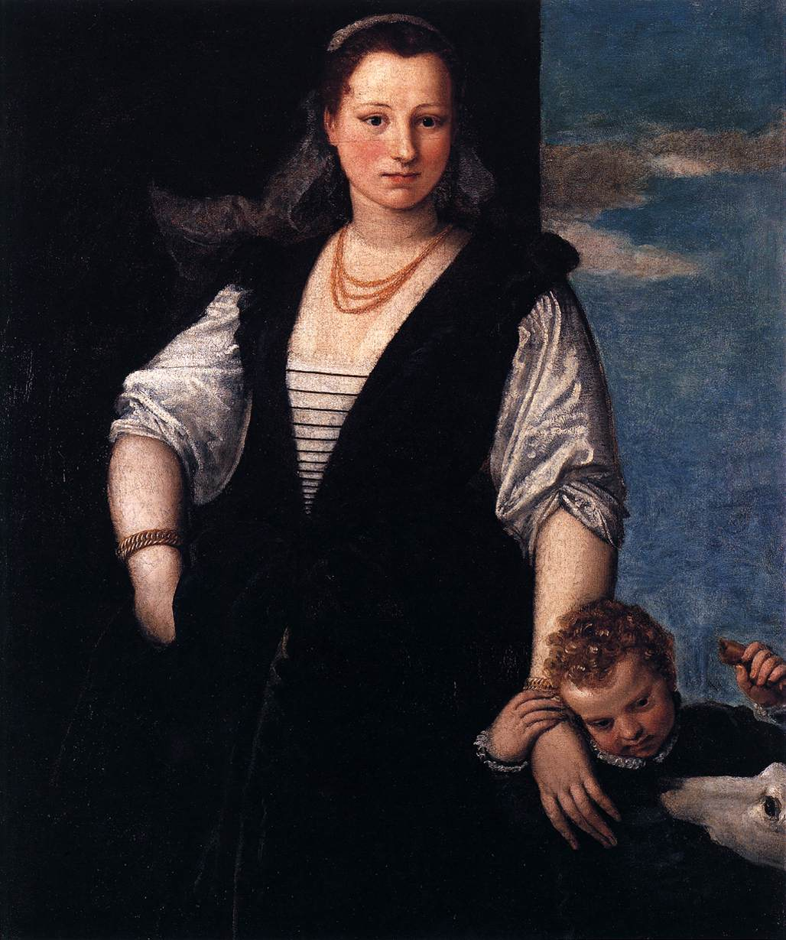
Isabella Guerrieri Gonzaga Canossa, 1547-48, Oil on canvas, 115 x 95 cm, Musée du Louvre, Paris, France https://www.wga.hu/frames-e.html?/html/v/veronese/index.html

Slide 3
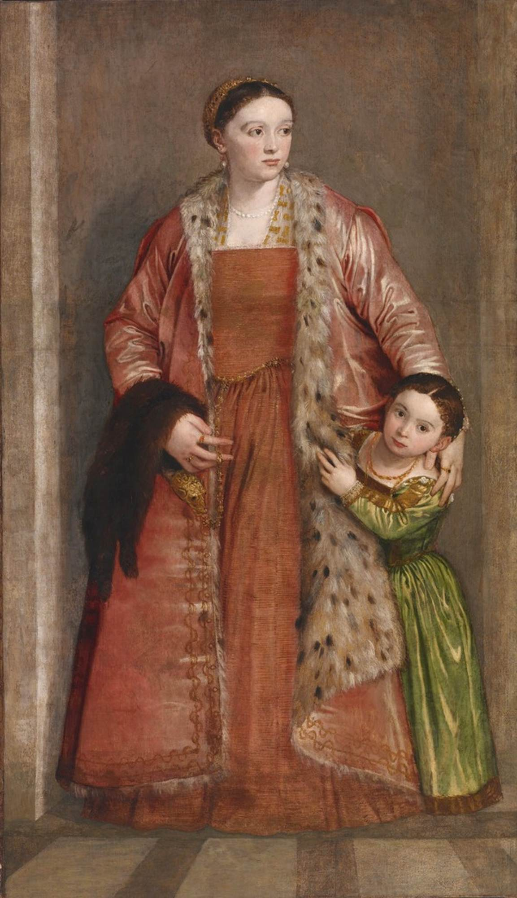
Livia da Porto Thiene and her Daughter Deidamia, 1552, Oil on canvas, 208 x 121 cm, Walters Art Museum, Baltimore, USA https://www.wga.hu/frames-e.html?/html/v/veronese/index.html

Slide 4
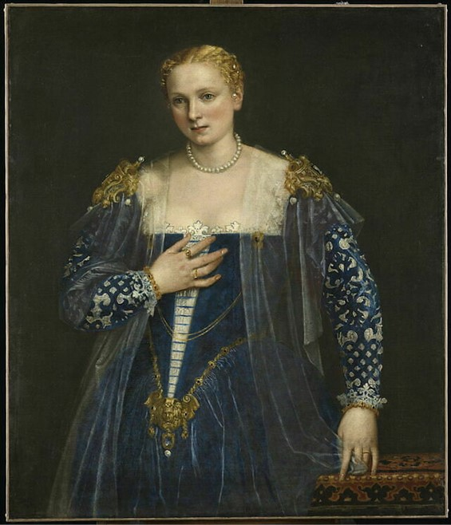
Portrait of a Venetian Woman - La Belle Nani, circa 1560, oil on canvas, 119x103 cm, Louvre Museum, Paris, France https://collections.louvre.fr/en/ark:/53355/cl010065927

Slide 5
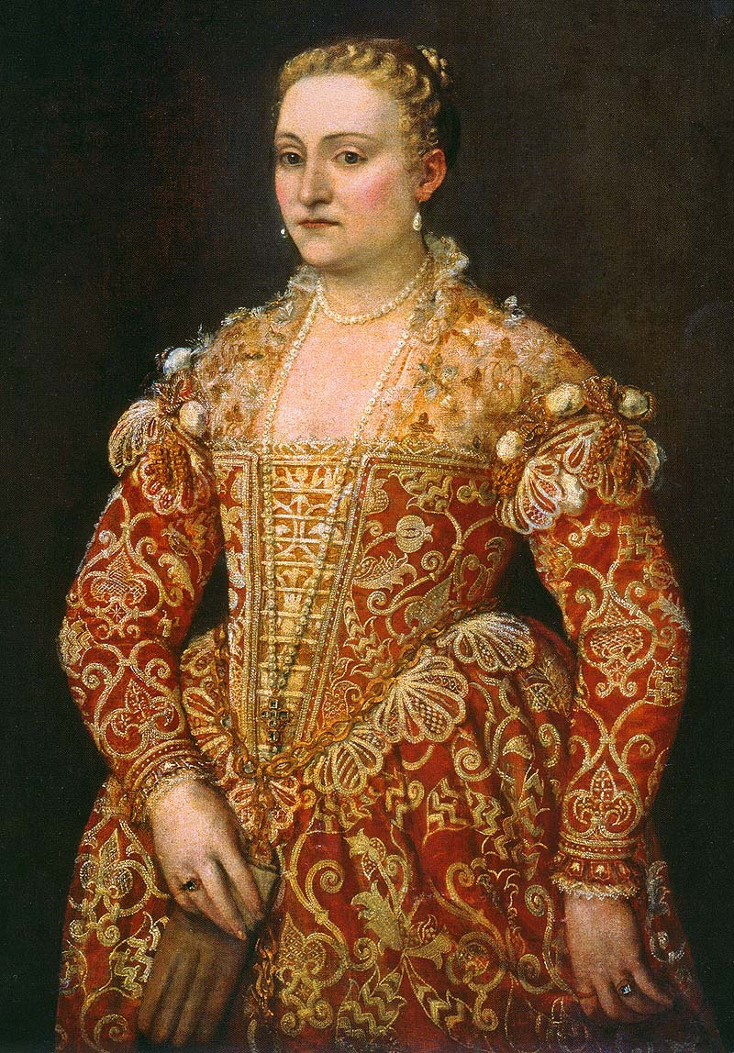
Portrait of a Lady Holding Gloves, circa 1560, Oil on canvas, 112x90 cm, National Gallery of Ireland, Republic of Ireland https://commons.wikimedia.org/wiki/File:Paolo_Veronese_-_Portrait_of_a_Woman_Holding_Gloves_-_National_Gallery_of_Ireland,_Dublino.jpg

Slide 6
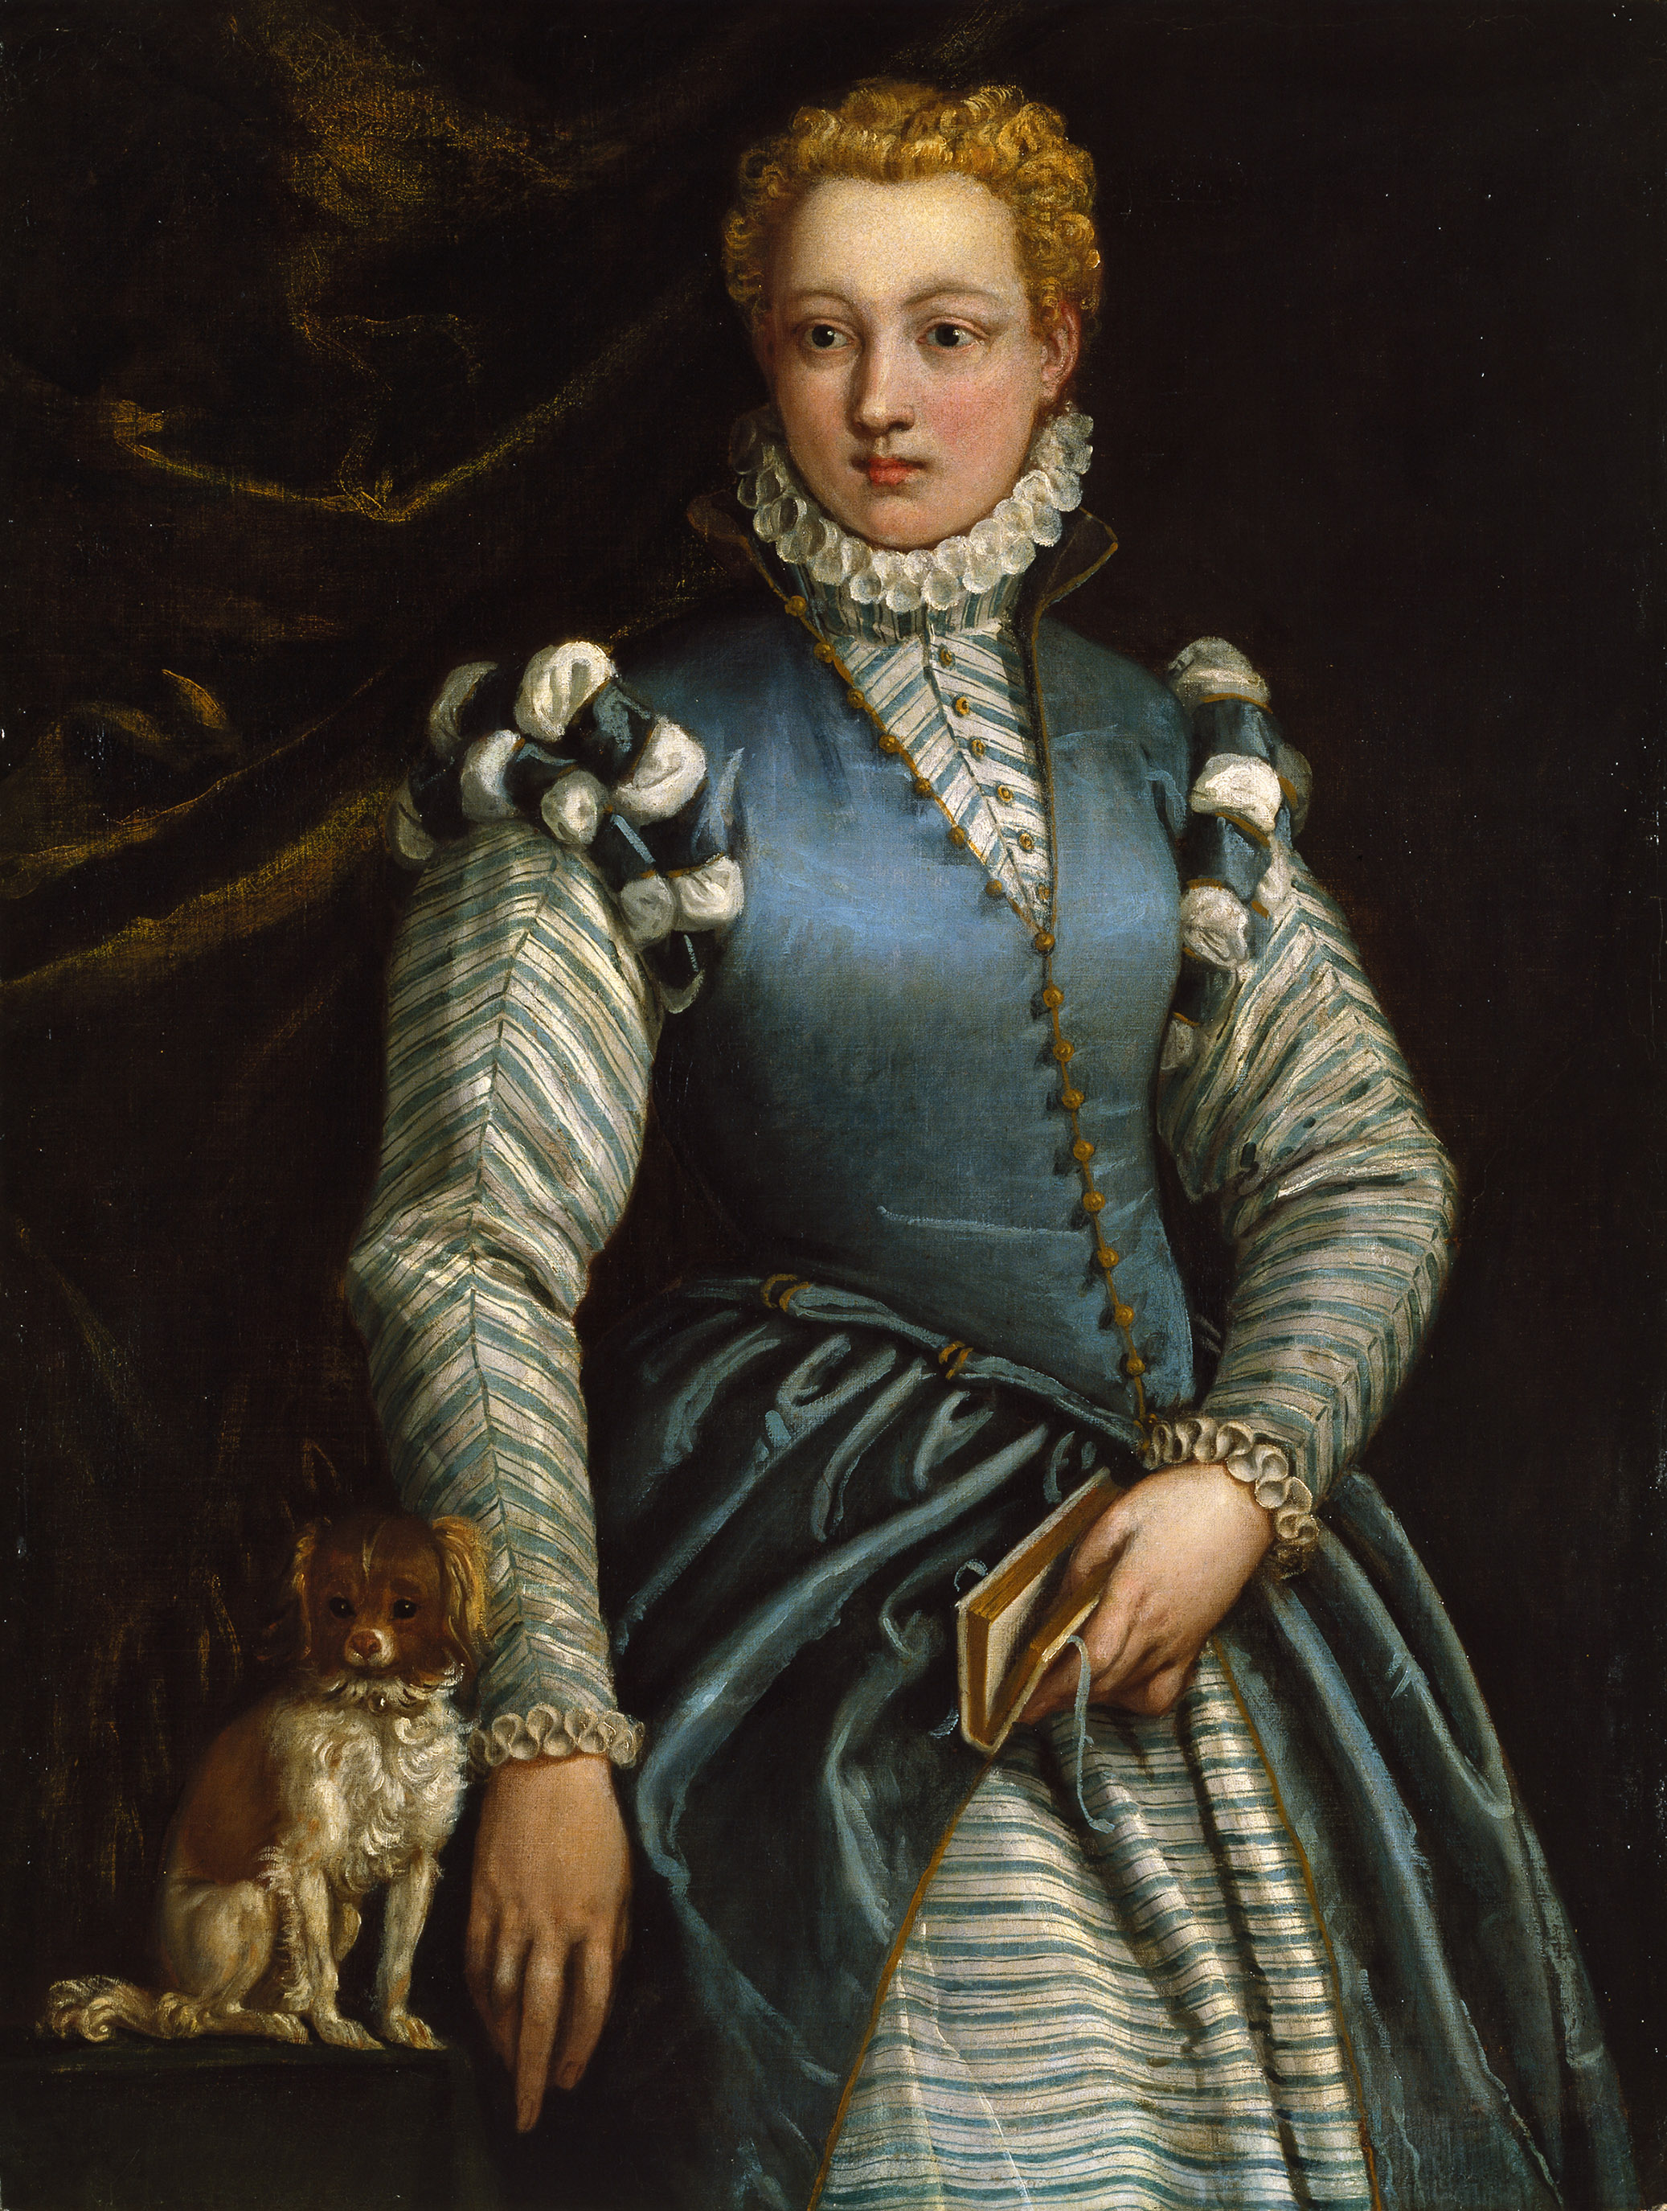
Portrait of a Woman with a Dog, between 1560 and 1570, Oil on canvas, 105x79 cm,
Thyssen-Bornemisza Museum, Madrid, Spain https://upload.wikimedia.org/wikipedia/commons/5/54/Portrait_of_a_Woman_with_a_Dog_-_Veronese_-_Museo_Thyssen.jpg

Slide 7
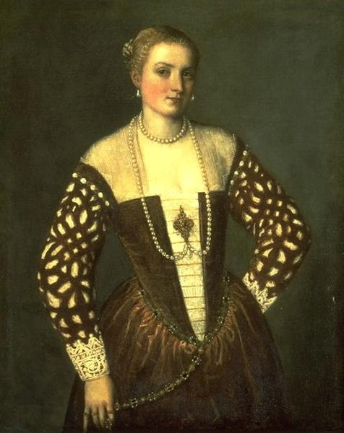
Portrait of a Woman, circa 1565, Oil on canvas, 106x87 cm, Musée de la Chartreuse de Douai, France https://commons.wikimedia.org/wiki/File:Veronese-portrait_de_femme-Douai.jpg

Slide 8
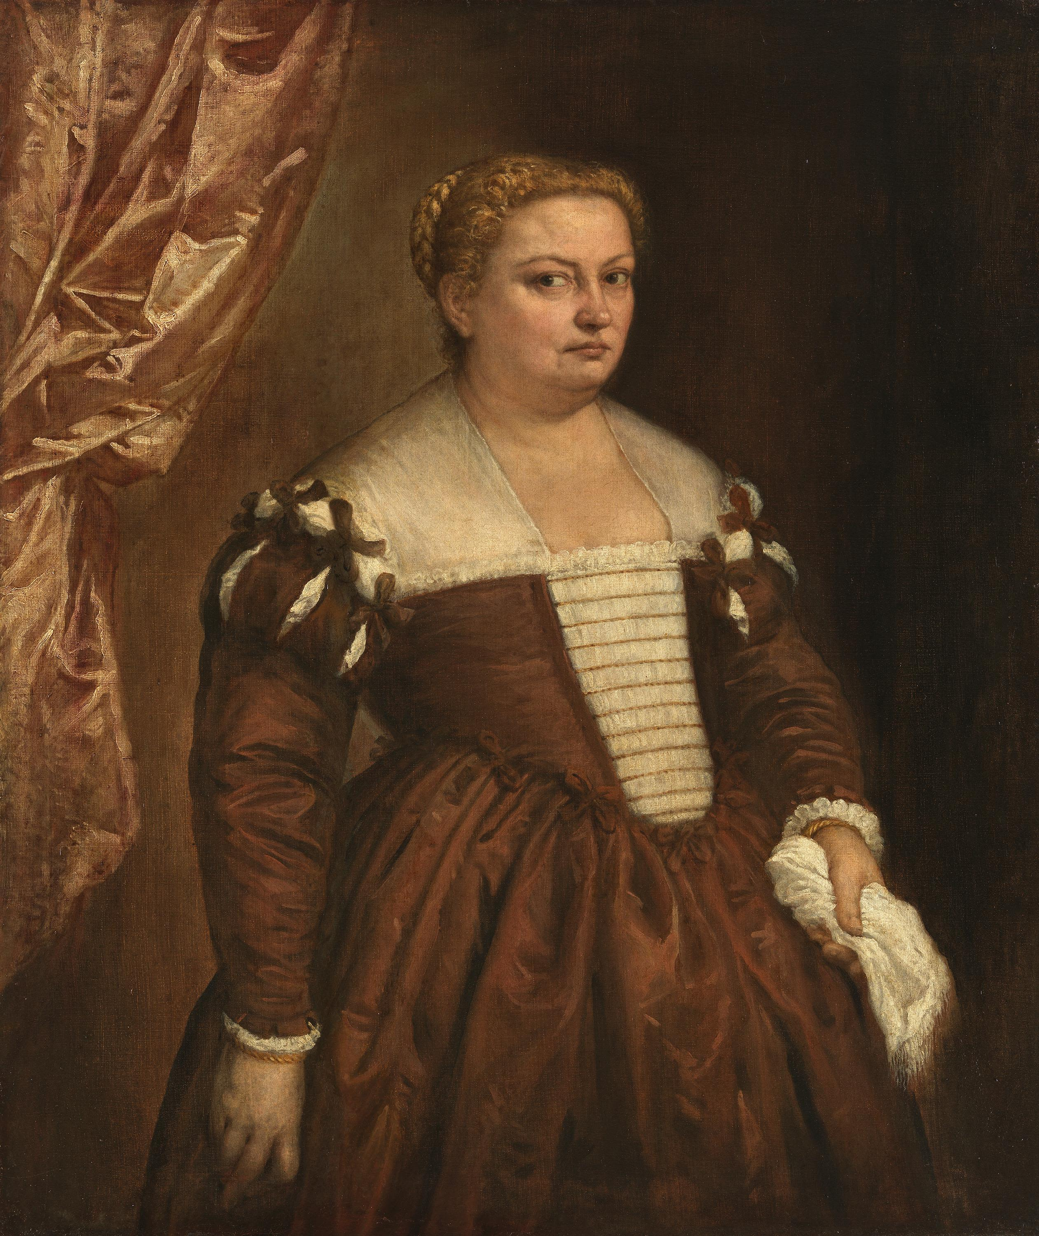
Portrait of a Venetian Woman, circa 1570, Oil on canvas, 118x101 cm, Alte Pinakothek, Munich, Germany https://www.sammlung.pinakothek.de/de/artwork/QKGBPPnxBb/paolo-veronese-paolo-caliari/bildnis-einer-dame

Slide 9
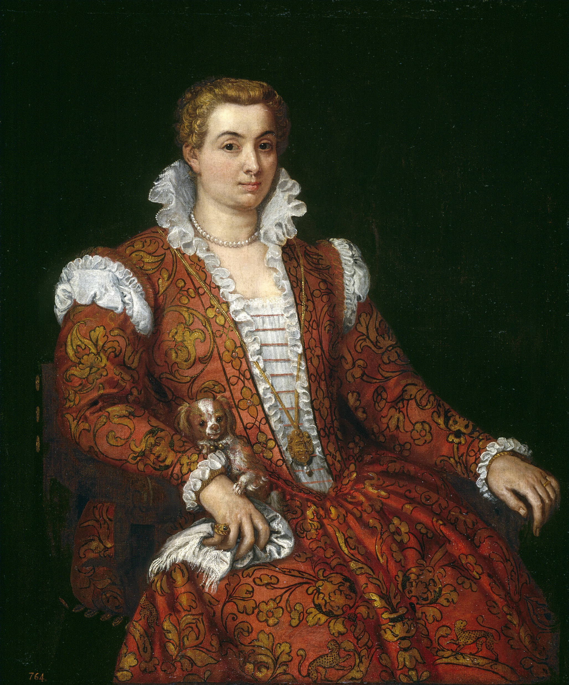
Portrait of Livia Colonna, between 1570 and 1572, Oil on canvas, 121x98 cm, Museo del Prado, Madrid, Spain https://commons.wikimedia.org/wiki/File:Livia_Colonna.jpg

Slide 10
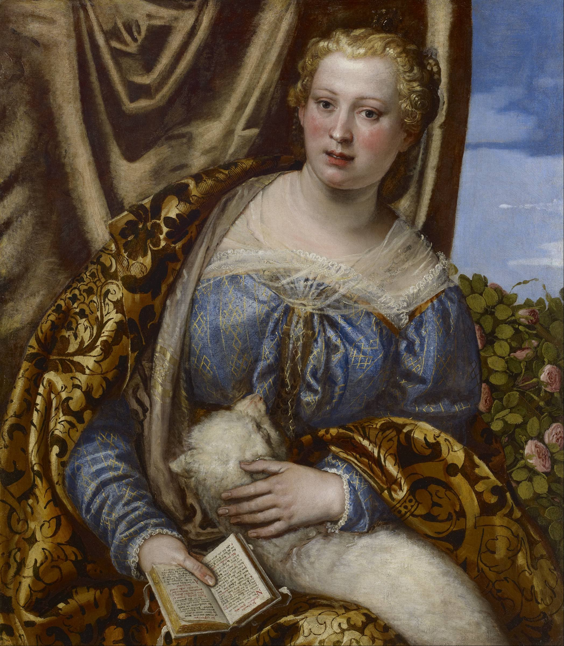
Portrait of a Lady as Saint Agnes, 1580s, Oil on canvas, 86.40x74.90 mm, Museum of Fine Arts, Houston, USA https://upload.wikimedia.org/wikipedia/commons/7/75/Paolo_Veronese_-_Portrait_of_a_Lady_as_Saint_Agnes_-_Google_Art_Project.jpg

