Slide 1
Camille Pissarro, 1830–1903
Still Life Paintings

Slide 2
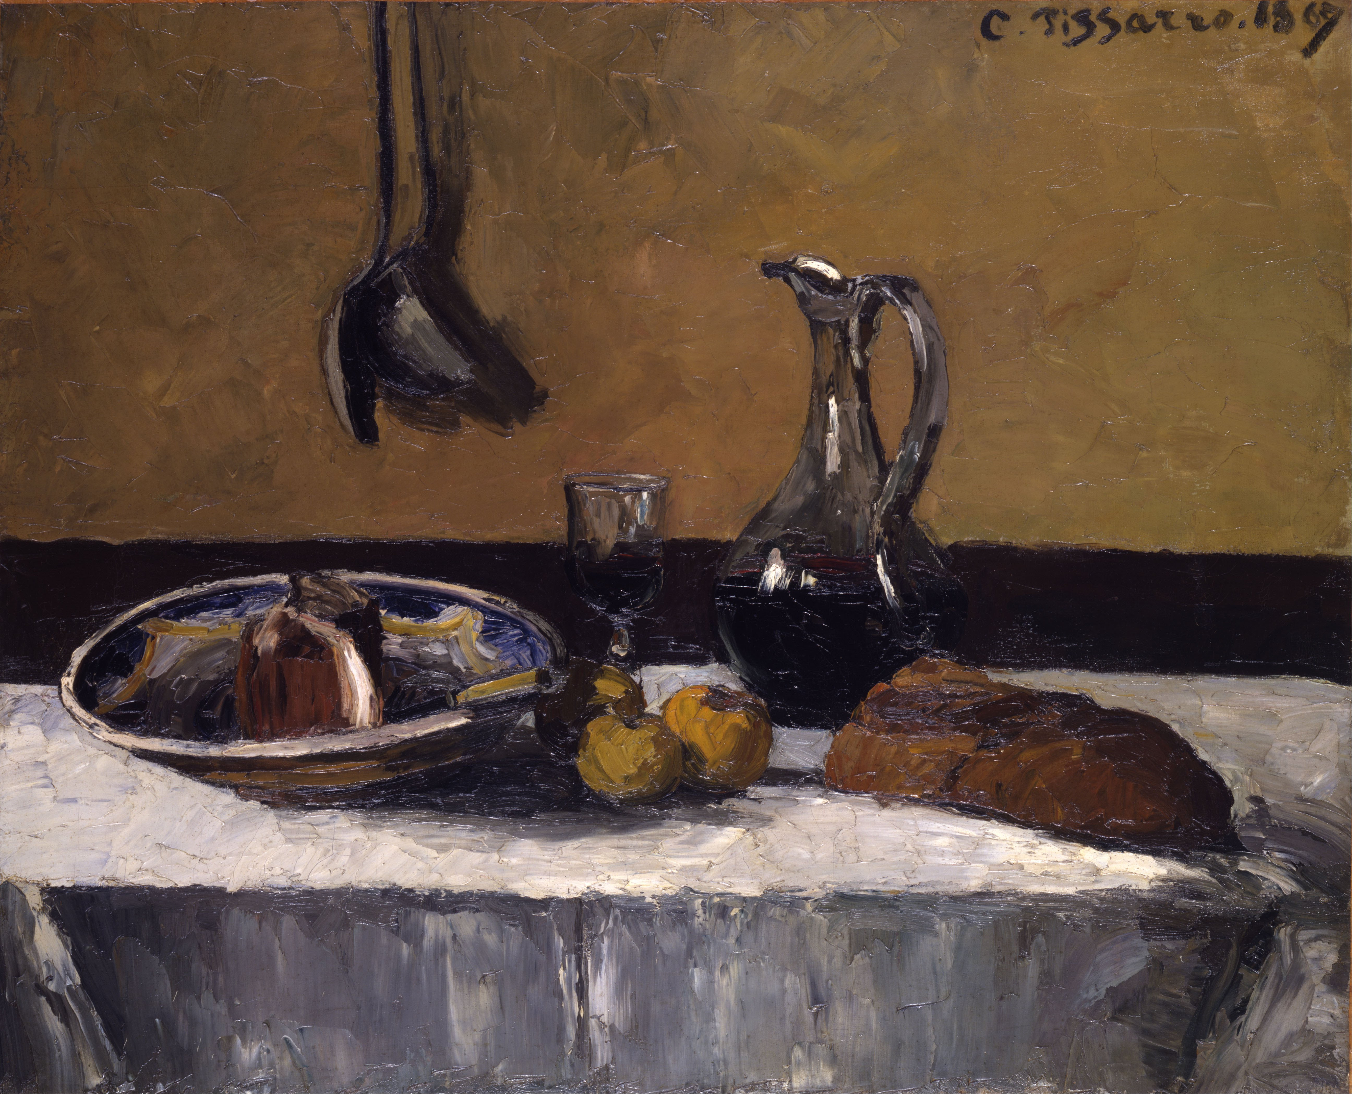
Still Life,
1867, Oil on Canvas, 810x997 mm, Toledo Museum of Art, OH, USA https://upload.wikimedia.org/wikipedia/commons/3/3f/Camille_Pissarro_-_Still_Life_-_Google_Art_Project.jpg

Slide 3
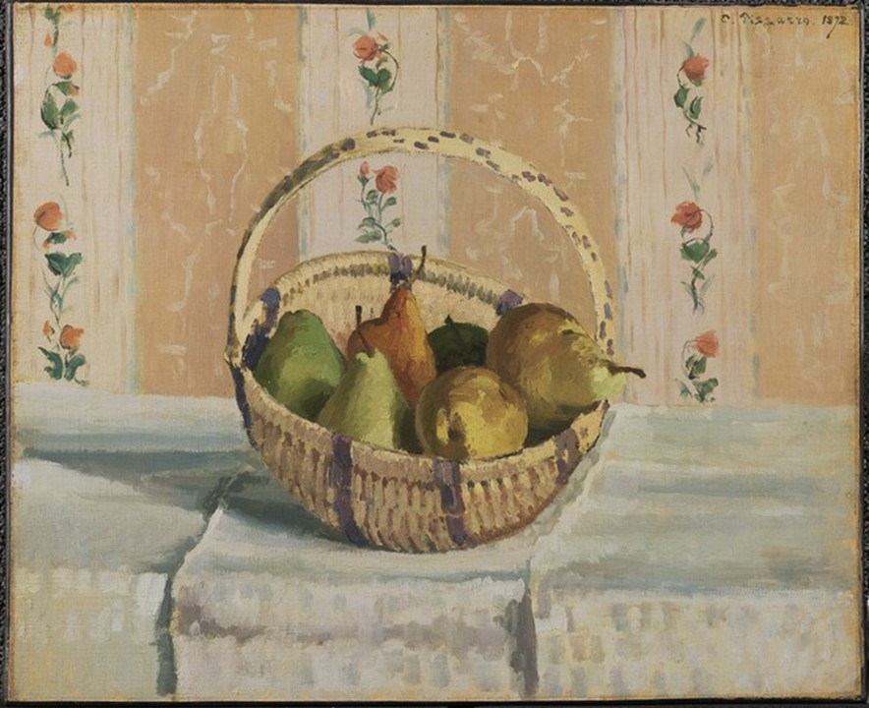
Still Life: Apples and Pears in a Round Basket, 1872, Oil on Canvas,
45.7 x 55.2 cm, Princeton University Art Museum https://artmuseum.princeton.edu/collections/objects/21437

Slide 4
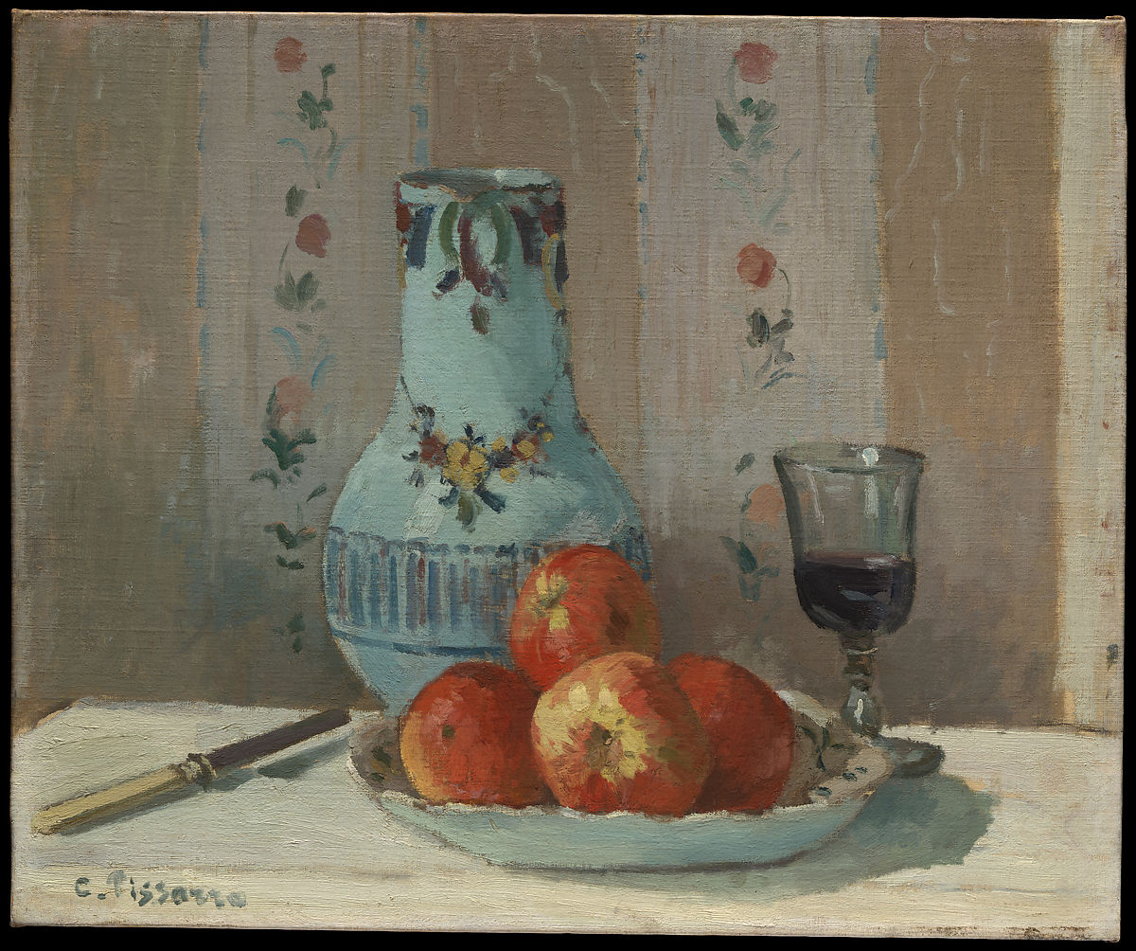
Still Life with Apples and Pitcher,
1872, Oil on Canvas,
46.4 x 56.5 cm, the MET, NY, USA https://www.metmuseum.org/art/collection/search/437317

Slide 5
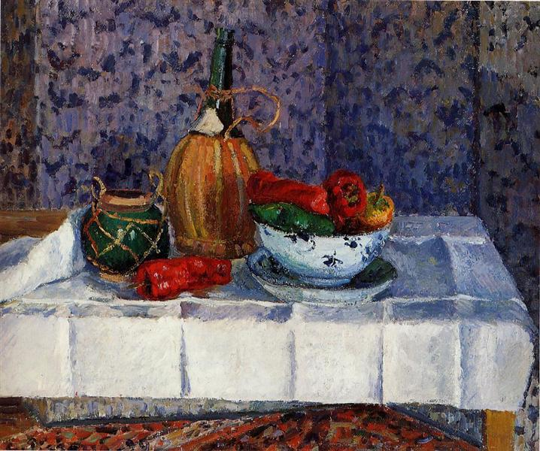
Still Life with Peppers,
1899, Oil on Canvas, 54.5 x 65.5 cm, Private Collection https://www.wikiart.org/en/camille-pissarro/still-life-with-peppers-1899

Slide 6
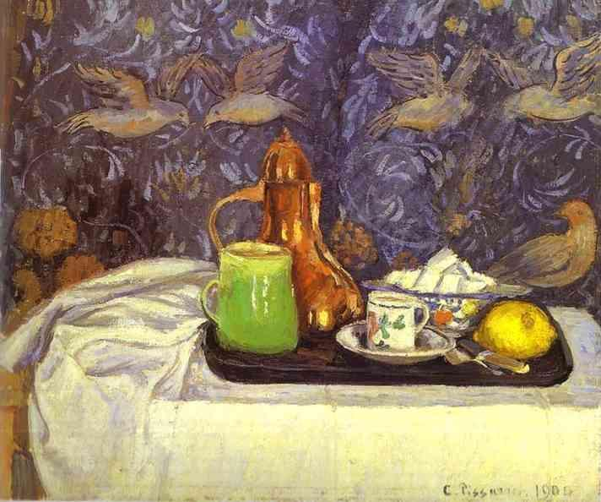
Still Life with a Coffee Pot,
1900, Oil on Canvas, Hermitage Museum, Saint Petersburg, Russia https://www.wikiart.org/en/camille-pissarro/still-life-with-a-coffee-pot-1900

Slide 7
The End

