Slide 1
Theseus and Antiope

Slide 2
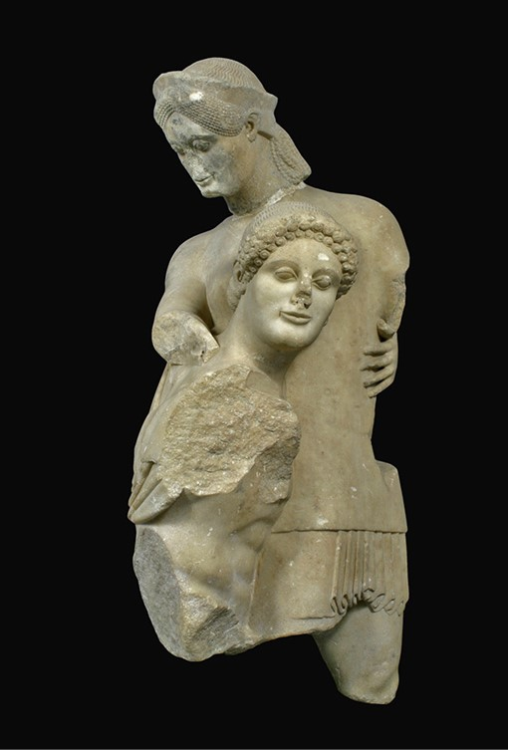
Theseus and Antiope, sculpture from the West Pediment of the Temple of Apollo Daphnephorus in ancient Eretria, late 6th century, Marble, 110 cm, Archaeological Museum of Eretria, Greece https://www.esag.swiss/eretria/museum/

Slide 3
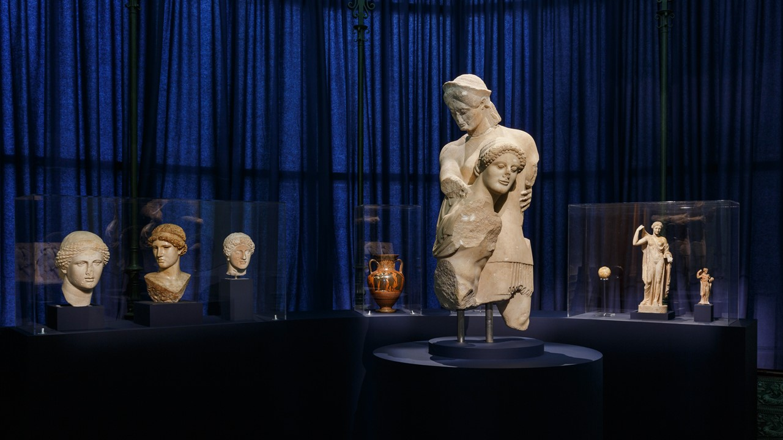
KALLOS. The Ultimate Beauty Exhibition Photo, Museum of Cycladic Art, Athens, Greece
Photo Credit: Paris Tativian, Museum of Cycladic Art, thens, Greece https://cycladic.gr/page/kallos-i-ipertati-omorfia?slide=1

Slide 4
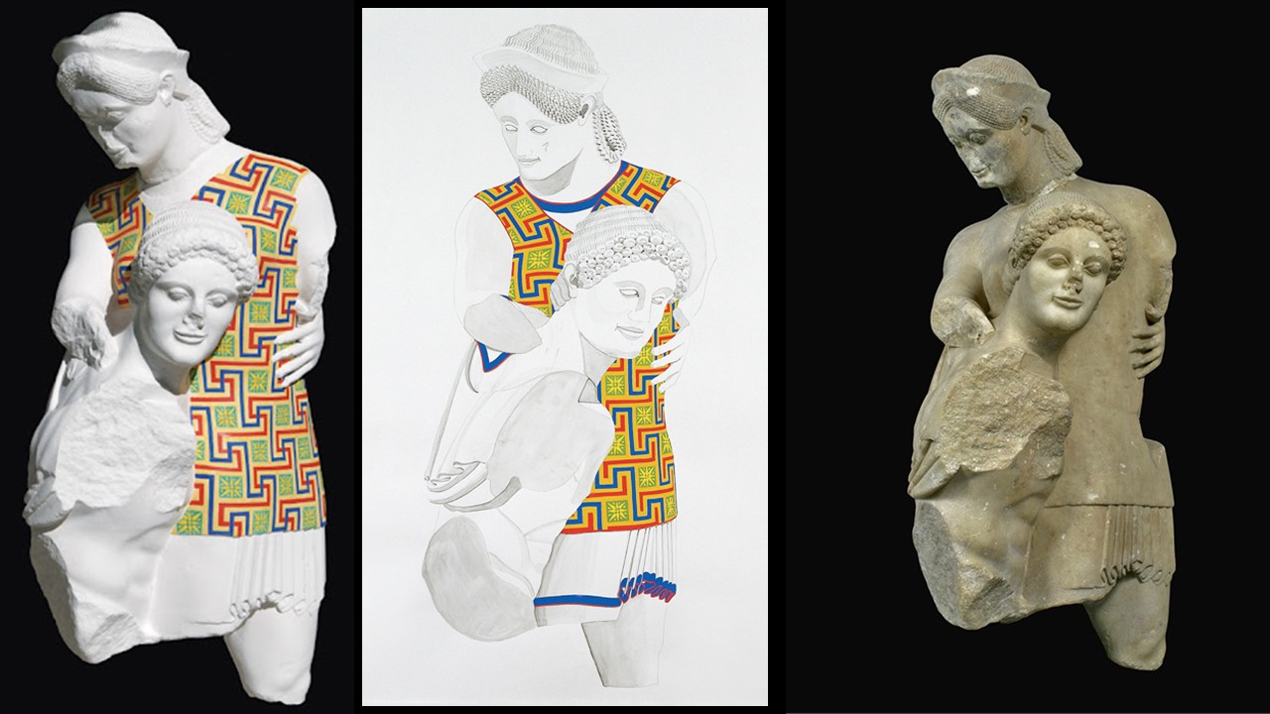
Theseus and Antiope… In colour reconstruction on plaster and on paper, Investigations by Vinzenz Brinkmann, executed by Ulrike Koch-Brinkmann, 1992 https://www.wikiart.org/en/ancient-greek-painting/reconstruction-of-antiope-and-theseus--490
(c) Vinzenz Brinkmann 2018 & Ulrike Koch-Brinkmann, Polychromy Research Project http://www.stiftung-archaeologie.de/Theseus_Antiope_ApollDahnephorosEretria.html https://www.esag.swiss/eretria/museum/

Slide 5
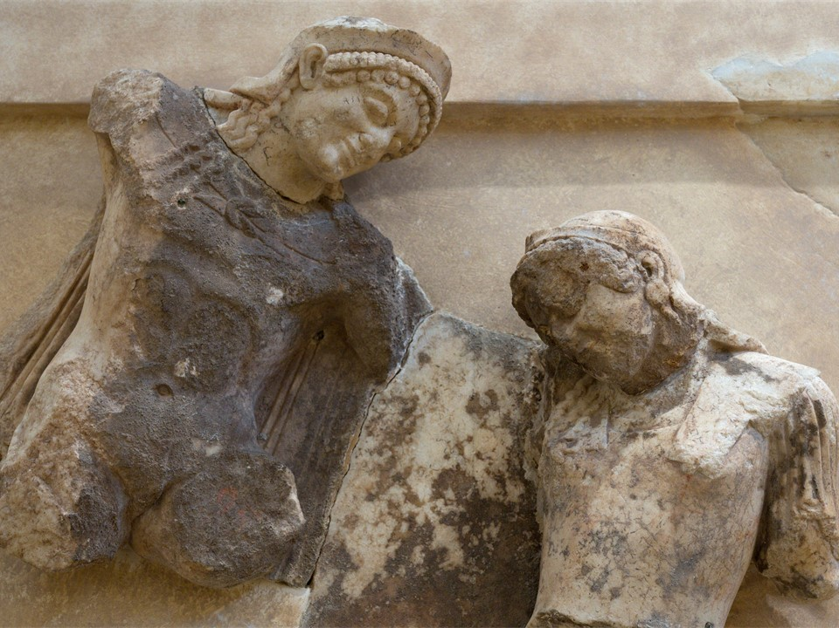
Metope from the southern side of the Treasury of Athenians at Delphi depicting Theseus and Antiope (detail), between 510 and 480 BC, Parian marble, Archaeological Museum of Delphi, Greece https://commons.wikimedia.org/wiki/File:Treasury_of_Athenians,_Theseus_and_Antiope,_500_BC,_AM_Delphi,_201402.jpg

Slide 6
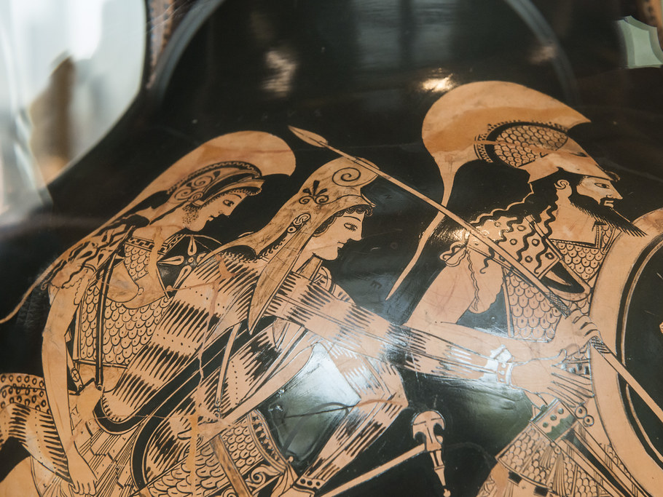
Theseus carrying off Antiope with Peirithoos, Attic Red-Figure Amphora attributed to Myson, c. 490 BC, Musée du Louvre, Paris, France https://www.flickr.com/photos/69716881@N02/12000636506

Slide 7
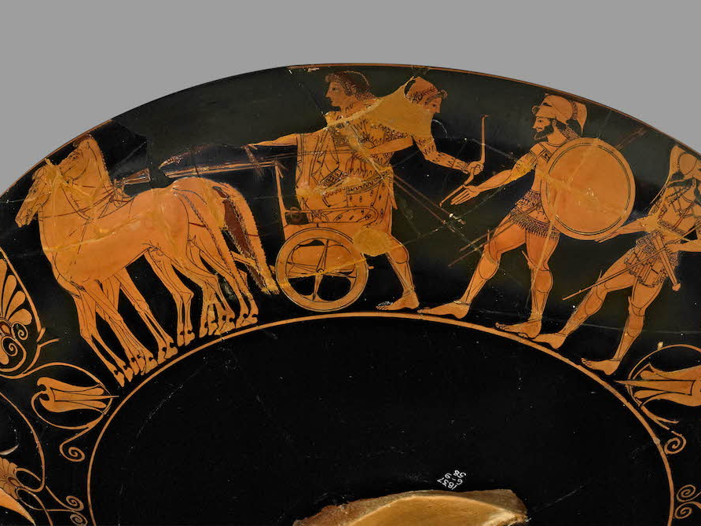
Theseus carrying off Antiope, Attic Red-Figure Kylix by Kachrylion (potter) and Euphronios (painter), c. 520-500 BC, 33.02x15.24 cm, The British Museum, London, UK https://classical-inquiries.chs.harvard.edu/a-sampling-of-comments-on-pausanias-1-1-1-1-2-1/

Slide 8
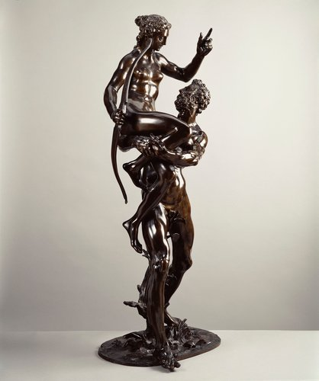
Adriaen De Vries, c. 1556-1626
Antiope and Theseus, c. 1600-1, Bronze,
95.0 x 36.8 x 35.6 cm,
Royal Collection Trust, UK https://www.rct.uk/collection/57961/antiope-and-theseus

Slide 9
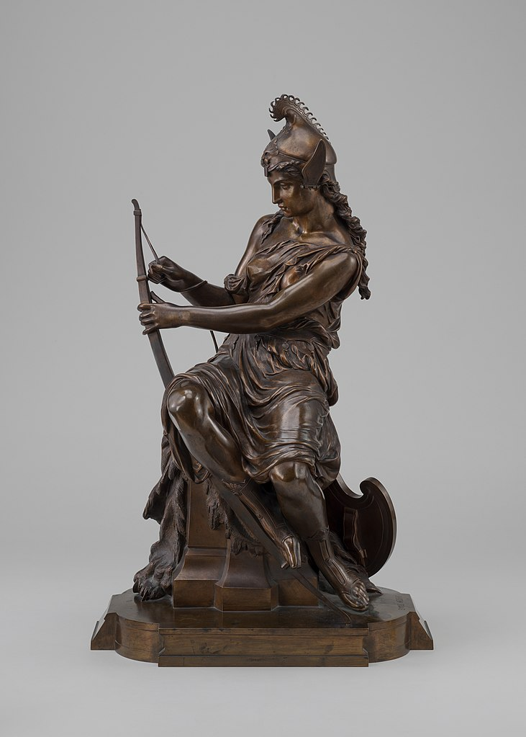
Pierre-Eugène-Émile Hébert, 1823-1893
Antiope preparing for battle, 1860, Bronze, 65.3 x 40.6 x 26.6 cm, NGA, Washington DC, USA https://commons.wikimedia.org/wiki/File:Pierre-Eug%C3%A8ne-Emile_H%C3%A9bert,_Amazon_Preparing_for_Battle_(Queen_Antiope_or_Hippolyta%3F),_or_Armed_Venus,_model_c._1860-1872,_cast_by_1882,_NGA_69968.jpg

Slide 10
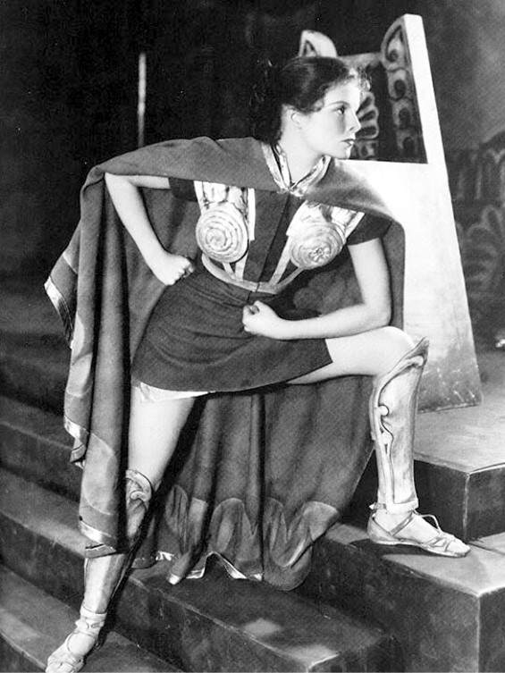
Photograph of the actress Katharine Hepburn in the 1932 Broadway production of The Warrior's Husband,
March 1932 https://commons.wikimedia.org/wiki/File:Katharine_Hepburn_in_The_Warriors_Husband.jpg

Slide 11
The End

