Slide 1
Santa Maria foris portas at Castelseprio Nativity Scene

Slide 2
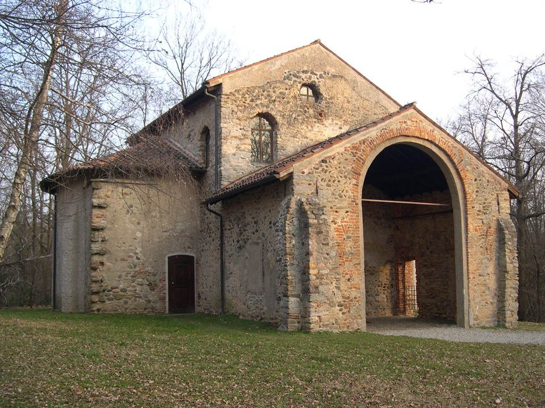

Slide 3
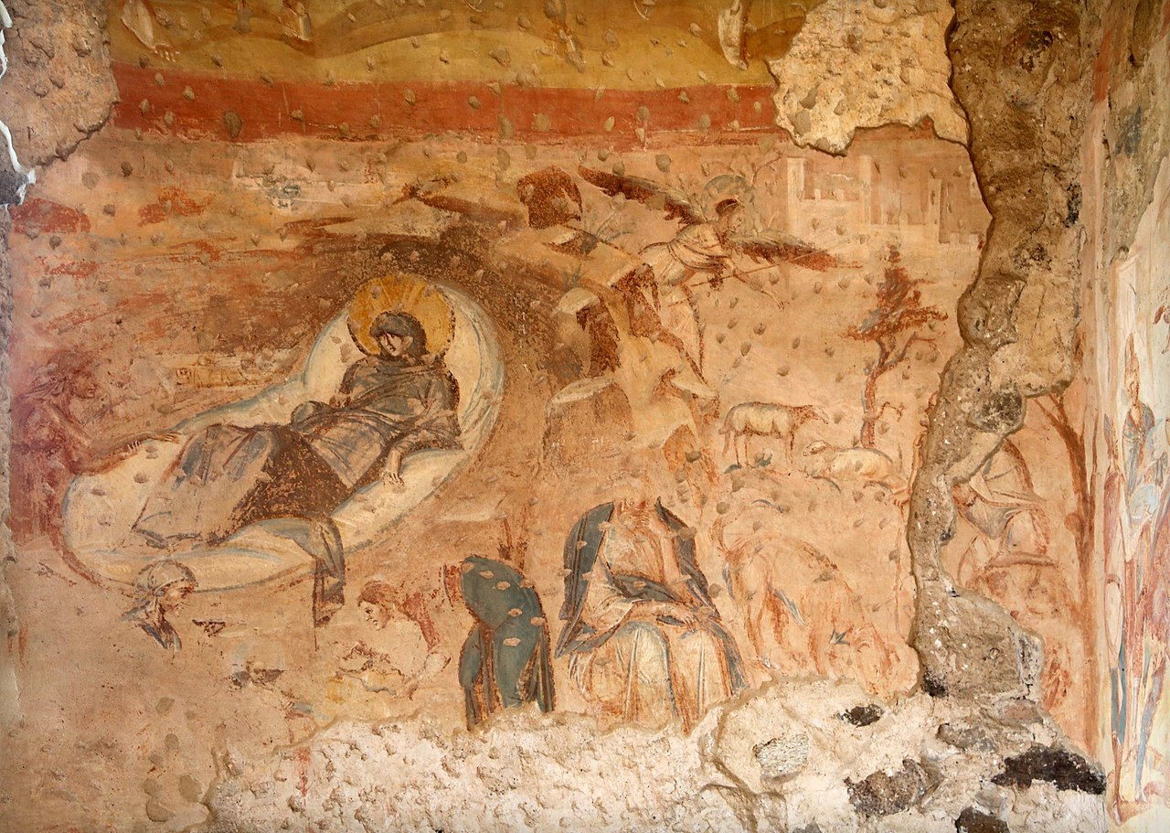

Slide 4
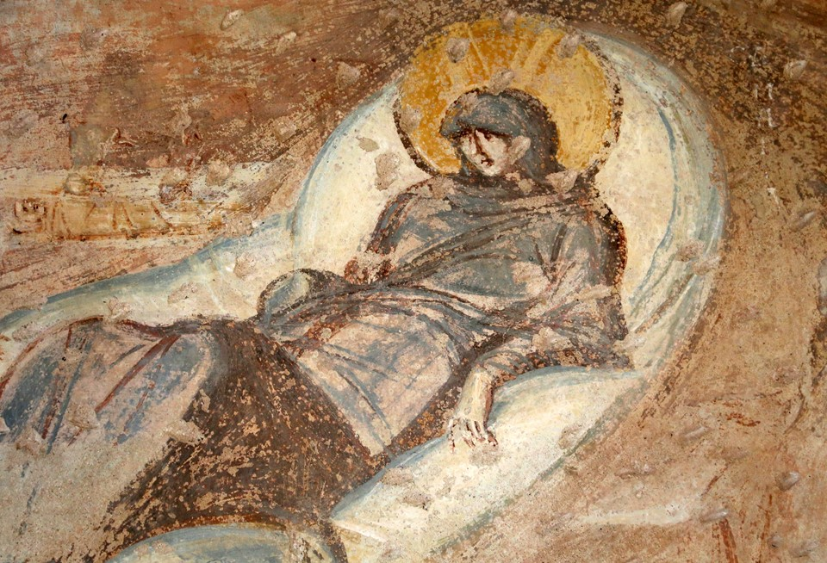

Slide 5
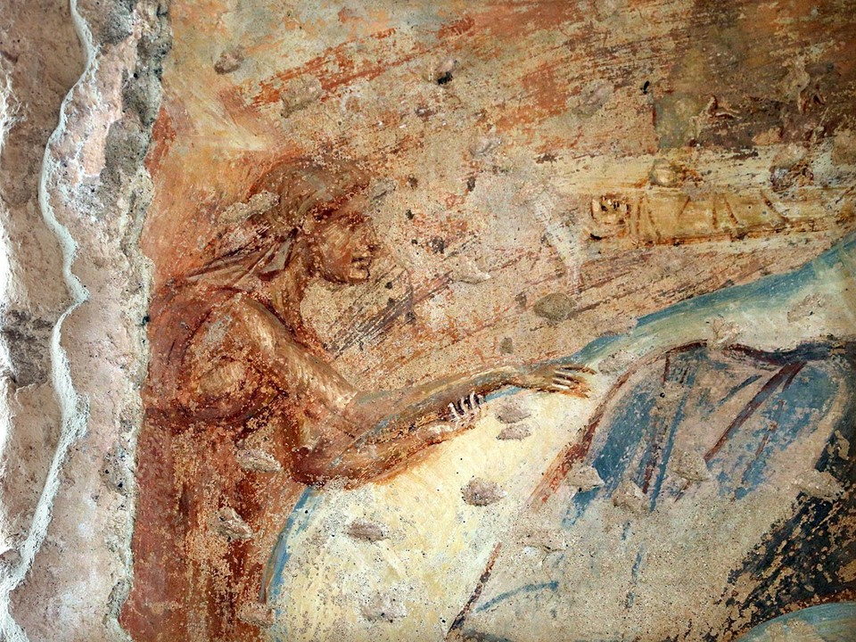

Slide 6
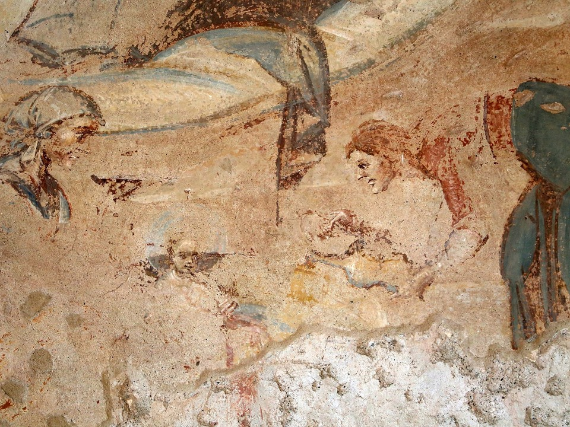

Slide 7
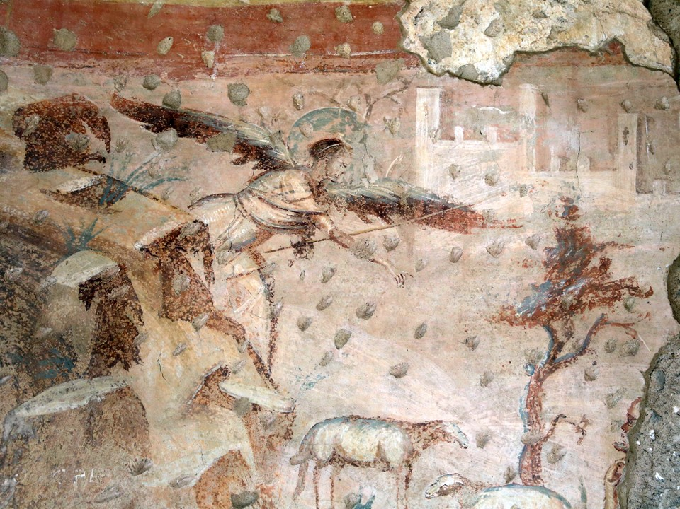

Slide 8
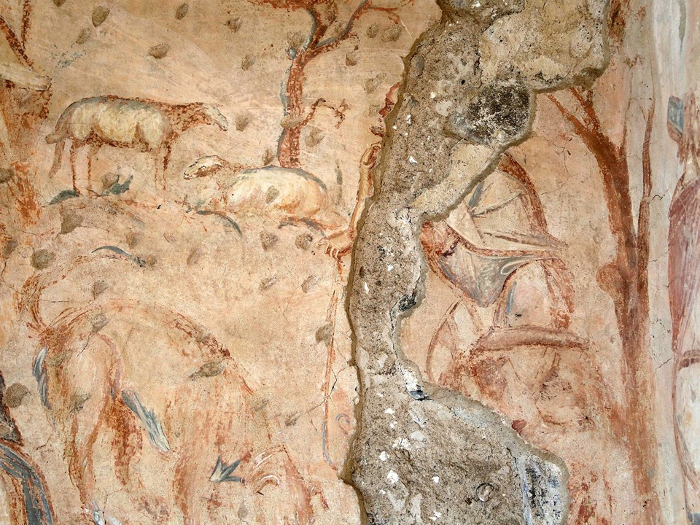

Slide 9
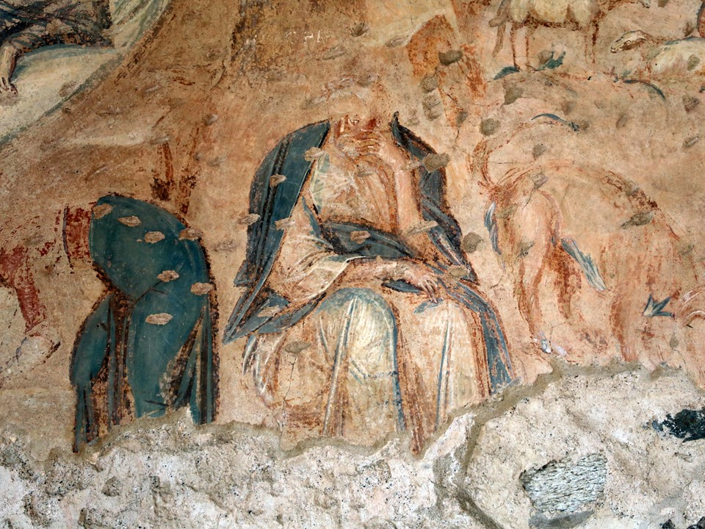

Slide 10
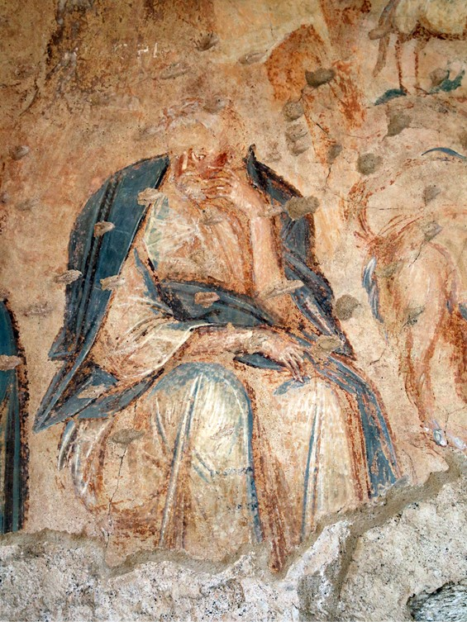

Slide 11
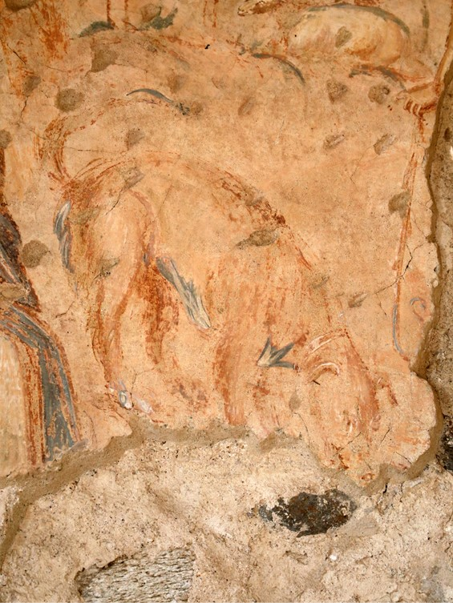

Slide 12
Photo Credits:
Slide 2: https://commons.wikimedia.org/wiki/File:Santa_Maria_foris_portas2.JPG
Slides 3-11:
https://commons.wikimedia.org/wiki/Category:Santa_Maria_foris_portas_in_Castelseprio_-_Frescos

Slide 13
The End

