Slide 1
Andrea del Castagno,
c. 1419-1457

Slide 2
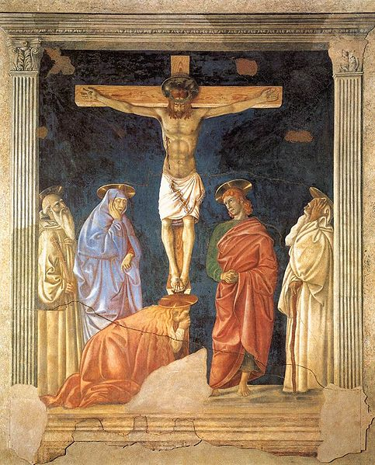
Andrea del Castagno, c. 1419-1457
Crucifixion and Saints,
1440-41, Fresco, 355,0x285,0 cm, Ospedale Santa Maria Nuova, Florence https://el.m.wikipedia.org/wiki/%CE%91%CF%81%CF%87%CE%B5%CE%AF%CE%BF:Del_Castagno_Andrea_Crucifixion_and_Saints.jpg

Slide 3
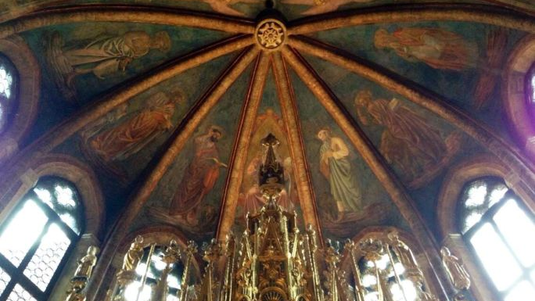
Andrea del Castagno, c. 1419-1457
Frescoes of the St. Tarasio Chapel depicting God the Father, Saints and Evangelists, 1442, San Zaccaria, Venice https://arsartisticadventureofmankind.wordpress.com/tag/del-castagnos-equestrian-monument-of-niccolo-da-tolentino/

Slide 4
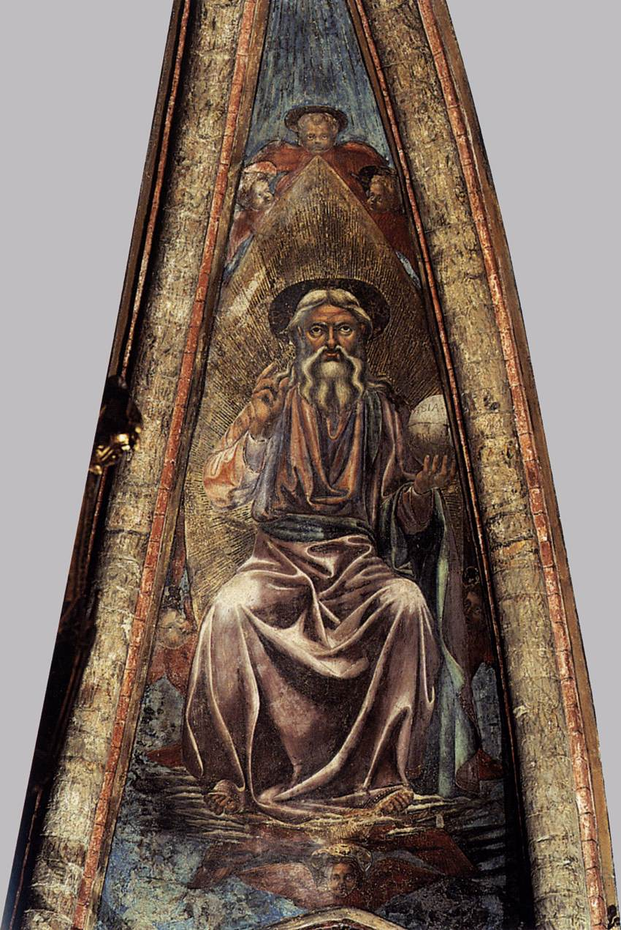
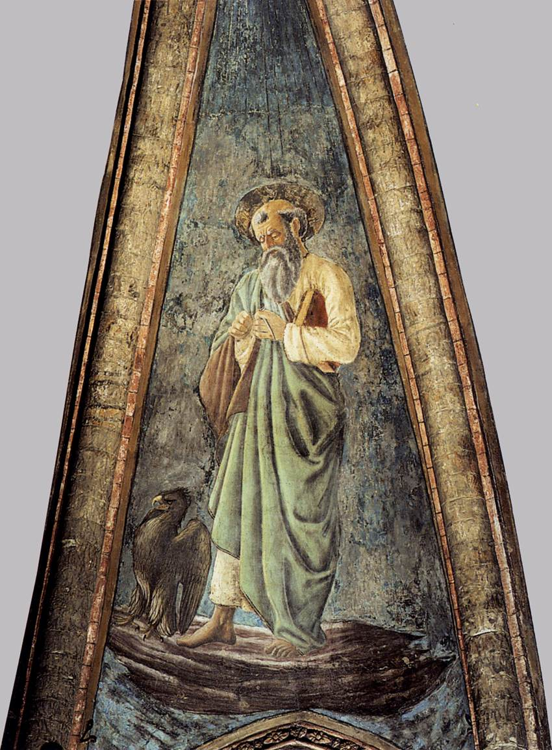
Andrea del Castagno, c. 1419-1457
God the Father and
St John the Evangelist,
1442,
Fresco, Height of both figures: 176 cm,
San Zaccaria, Venice https://www.wga.hu/frames-e.html?/html/a/andrea/castagno/index.html

Slide 5
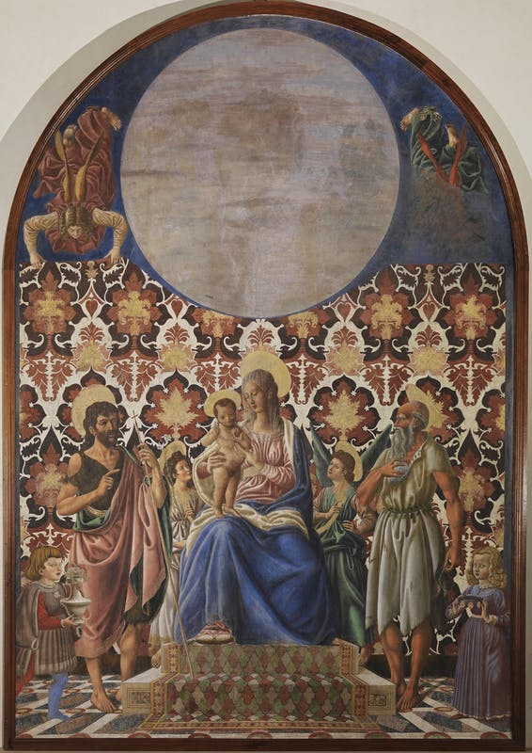
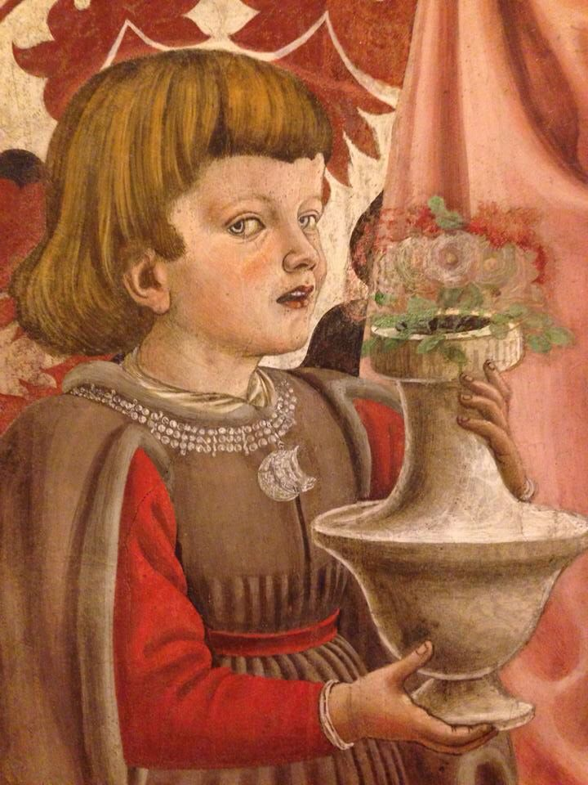
Andrea del Castagno, c. 1419-1457
Madonna and Child with Saints and detail, c. 1445,
Detached fresco, 290 x 212 cm,
Contini Bonacossi Collection, Florence https://www.uffizi.it/en/artworks/madonna-and-child-enthroned-with-saints-jerome-and-john-the-baptist-two-angels-and-two-children-from-the-pazzi-family and https://ro.pinterest.com/pin/565905509401869786/

Slide 6
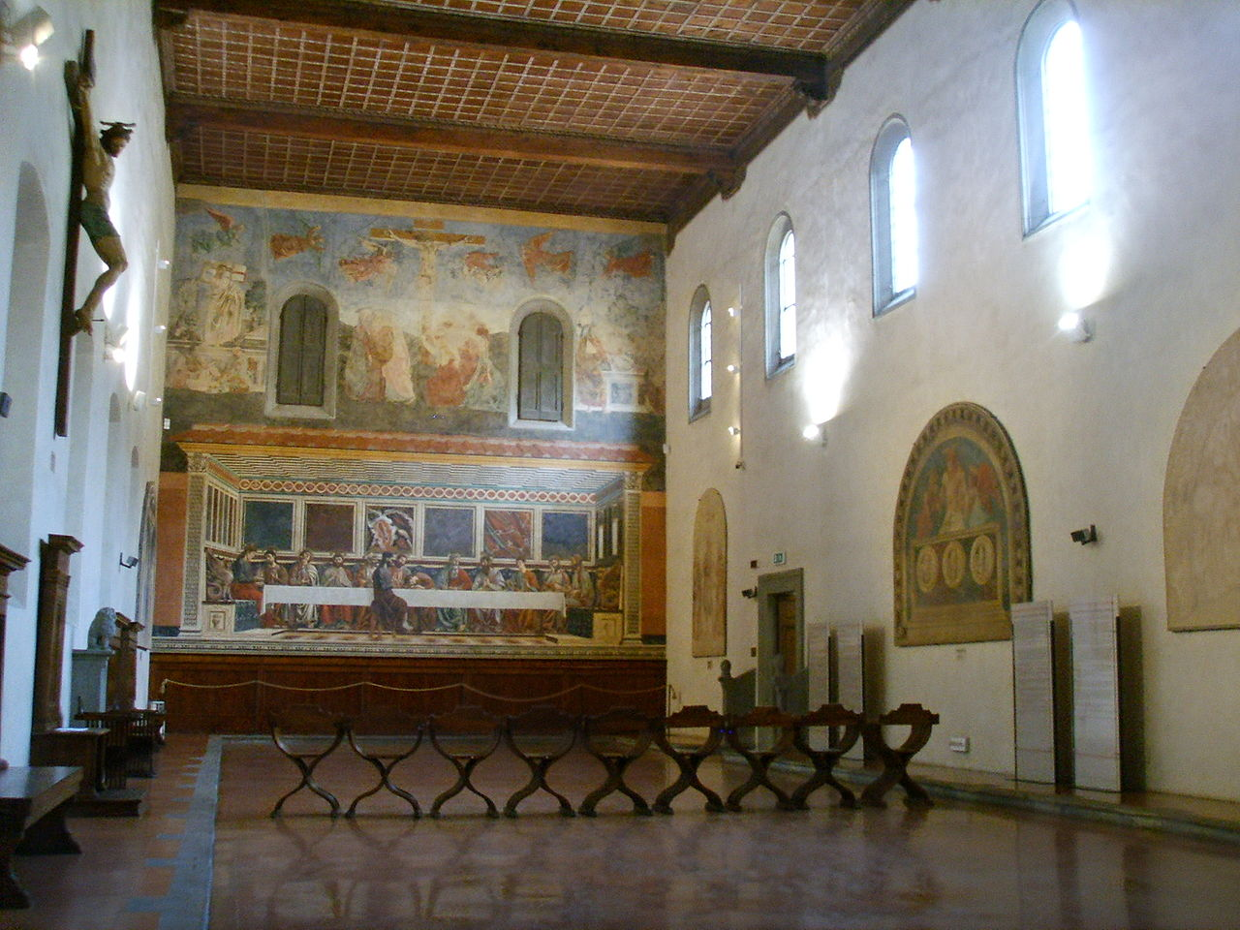
Andrea del Castagno, c. 1419-1457
Last Supper and Stories of Christ's Passion, 1447, Fresco, 453 x 975 cm (each fresco),
Refectory of Sant'Apollonia, Florence https://en.wikipedia.org/wiki/Last_Supper_(del_Castagno)#/media/File:Cenacolo_di_sant'apollonia,_interno_01.JPG

Slide 7
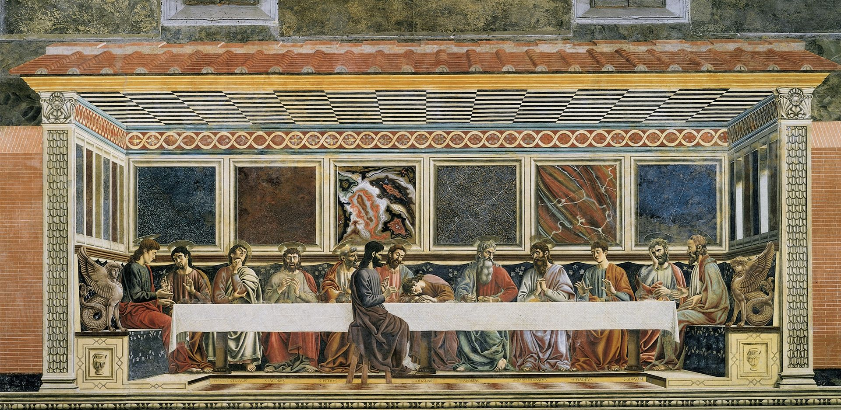
Last Supper, 1447, Fresco, 453 x 975 cm, Refectory of Sant'Apollonia, Florence https://en.wikipedia.org/wiki/Last_Supper_(del_Castagno)#/media/File:Andrea_del_Castagno_001.jpg

Slide 8
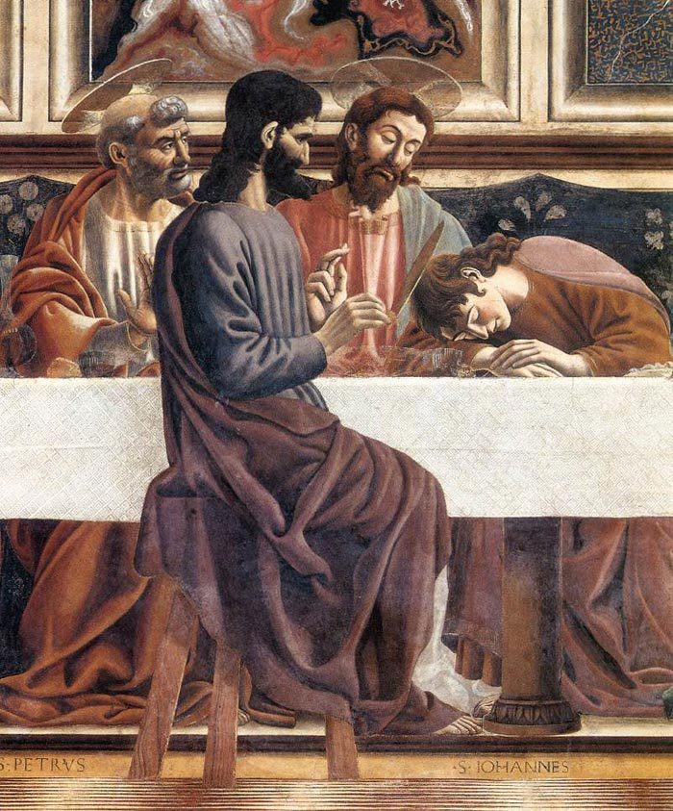
Last Supper (detail), 1447, Fresco, 453 x 975 cm, Refectory of Sant'Apollonia, Florence http://www.travelingintuscany.com/images/art/andreadelcastagno/lastsupper3700.jpg

Slide 9
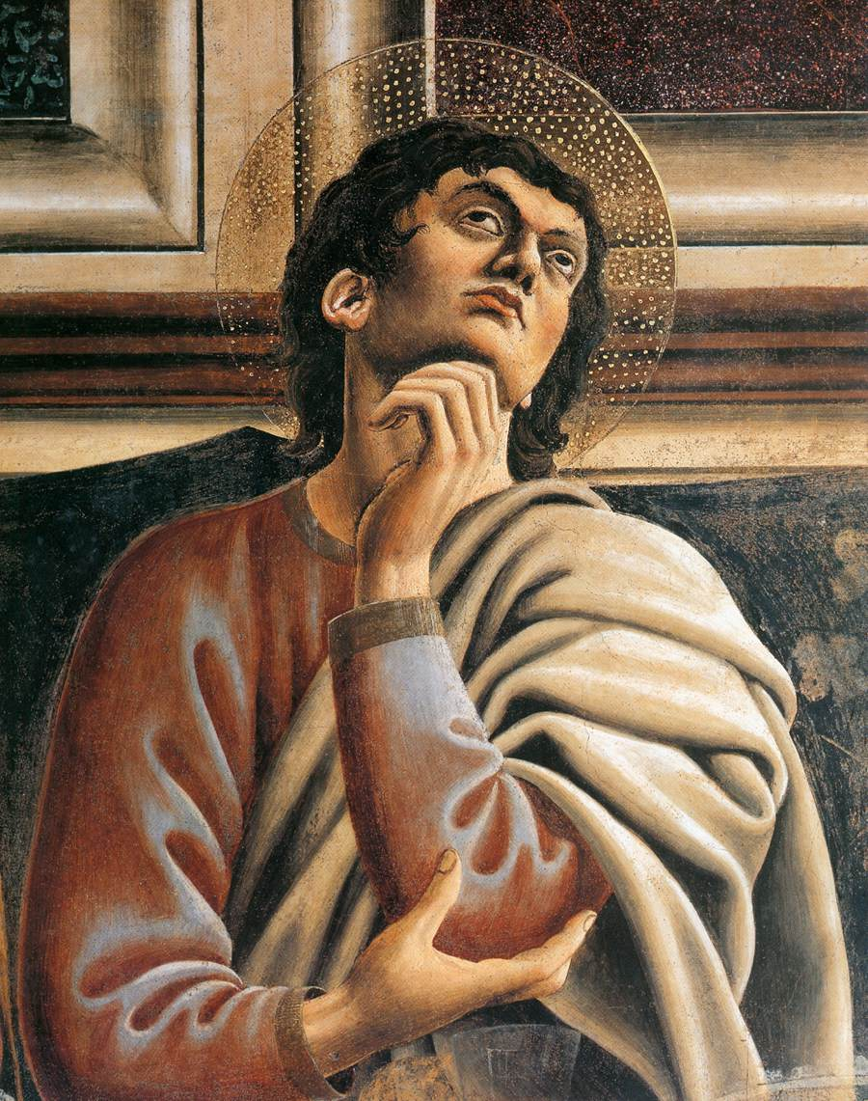
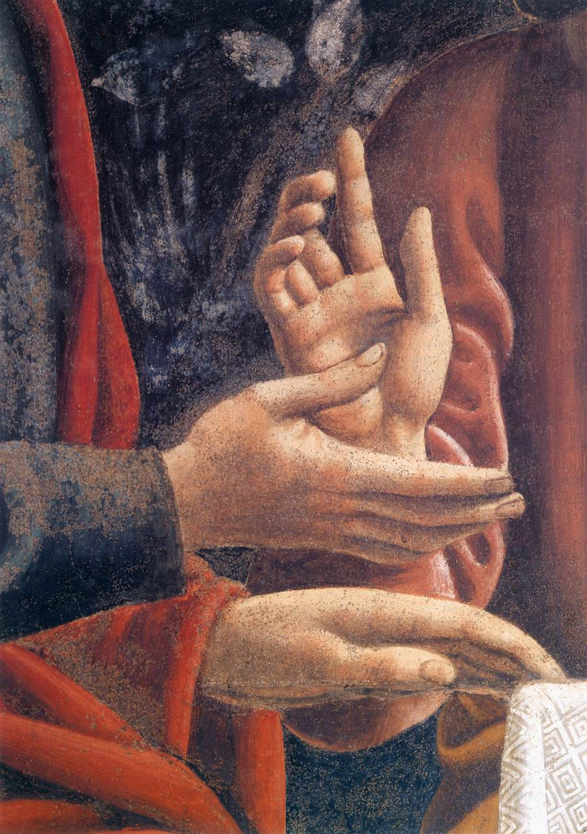
Last Supper (details), 1447, Fresco,
Refectory of Sant’
Apollonia, Florence https://www.wga.hu/frames-e.html?/html/a/andrea/castagno/index.html

Slide 10
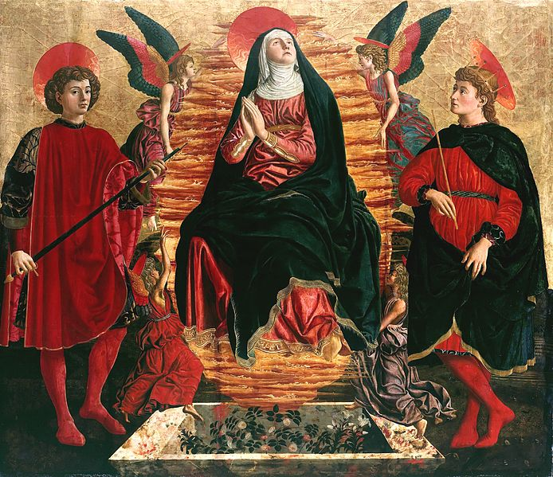
Andrea del Castagno, c. 1419-1457
Our Lady of the Assumption with Sts Miniato and Julian,
1450, Poplar Panel, 150 x 158 cm, Staatliche Museen, Berlin https://el.m.wikipedia.org/wiki/%CE%91%CF%81%CF%87%CE%B5%CE%AF%CE%BF:Del_Castagno_Andrea_Our_Lady_of_the_Assumption_with_Sts_Miniato_and_Julian.jpg

Slide 11
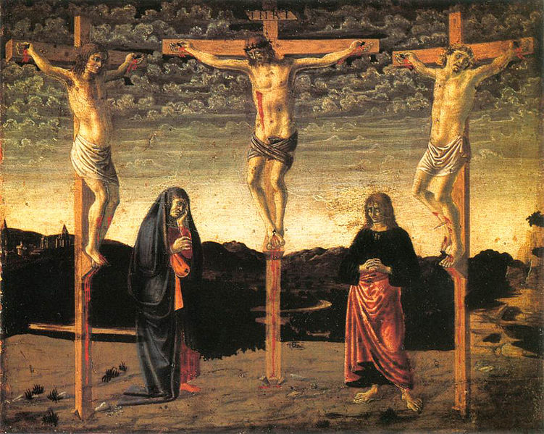
Andrea del Castagno, c. 1419-1457
Crucifixion, c. 1450,
Tempera on Panel,
29 x 35 cm,
National Gallery, London https://el.wikipedia.org/wiki/%CE%91%CF%81%CF%87%CE%B5%CE%AF%CE%BF:Andrea_del_castagno,_crocefissione_londra.jpg

Slide 12
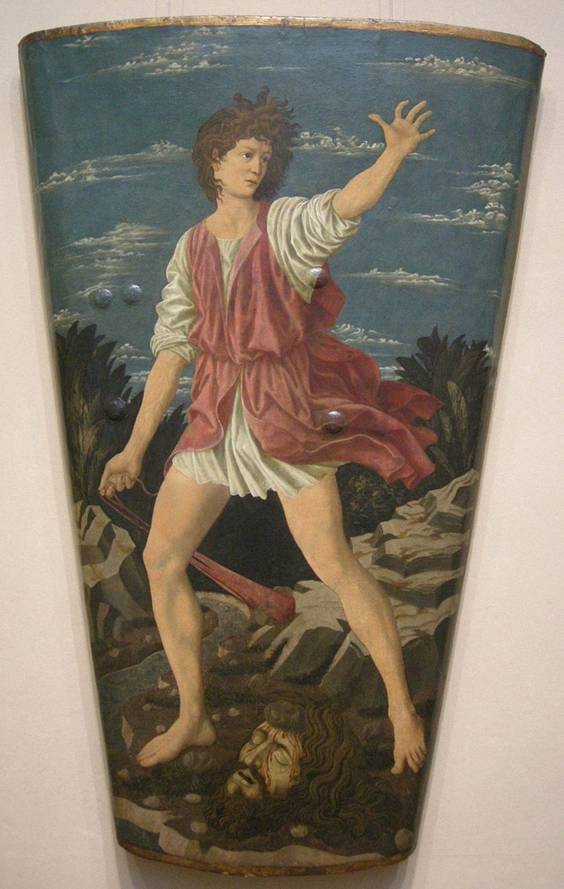
Andrea del Castagno, c. 1419-1457
David with the Head of Goliath, c. 1450/1455, Tempera on Leather on Wood, H. 115.5 cm, Width at top: 76.5 cm, Width at bottom: 40.6 cm, NGA, Washington DC, USA https://upload.wikimedia.org/wikipedia/commons/8/86/Andrea_del_castagno%2C_scudo_di_david_con_la_testa_di_golia%2C_1450-55_circa%2C_02.JPG

Slide 13
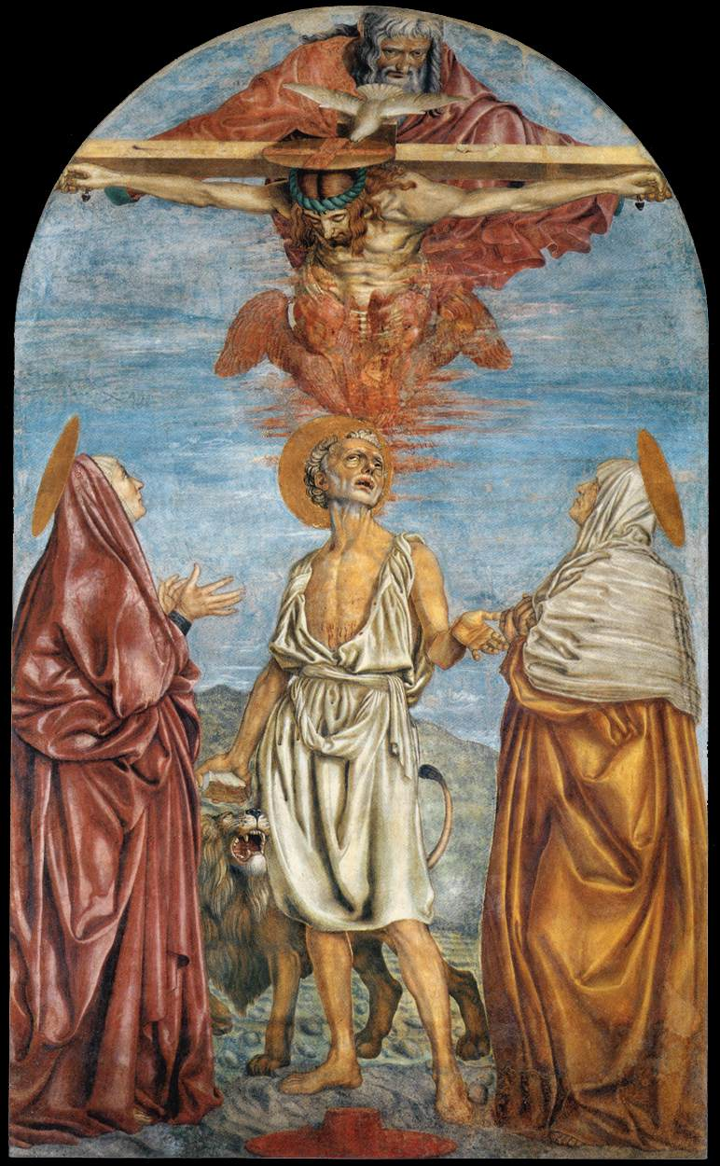
Andrea del Castagno, c. 1419-1457
The Holy Trinity, St Jerome and Two Saints, c. 1453, Fresco, 285x173 cm,
Santissima Annunziata, Florence https://commons.wikimedia.org/wiki/File:Andrea_del_Castagno,_The_Holy_Trinity.jpg

Slide 14
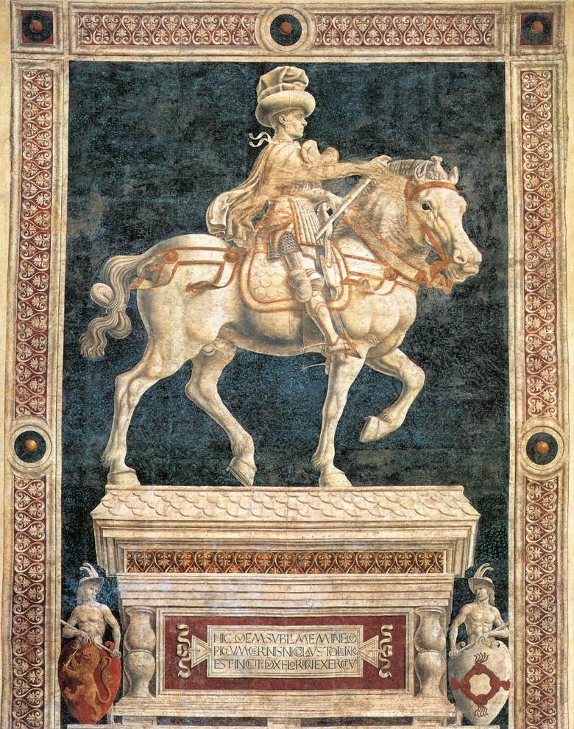
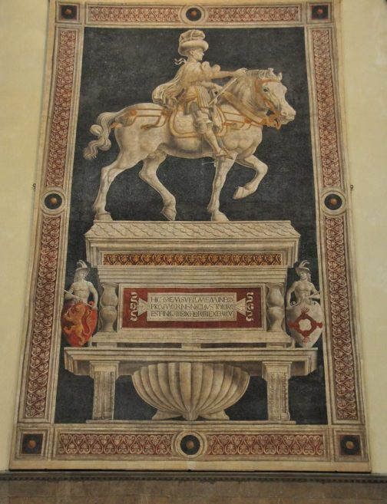
Andrea del Castagno, c. 1419-1457
Monument to Niccolò da Tolentino, 1456,
Fresco, 833x512 cm, Duomo, Florence https://www.wga.hu/frames-e.html?/html/a/andrea/castagno/index.html

Slide 15
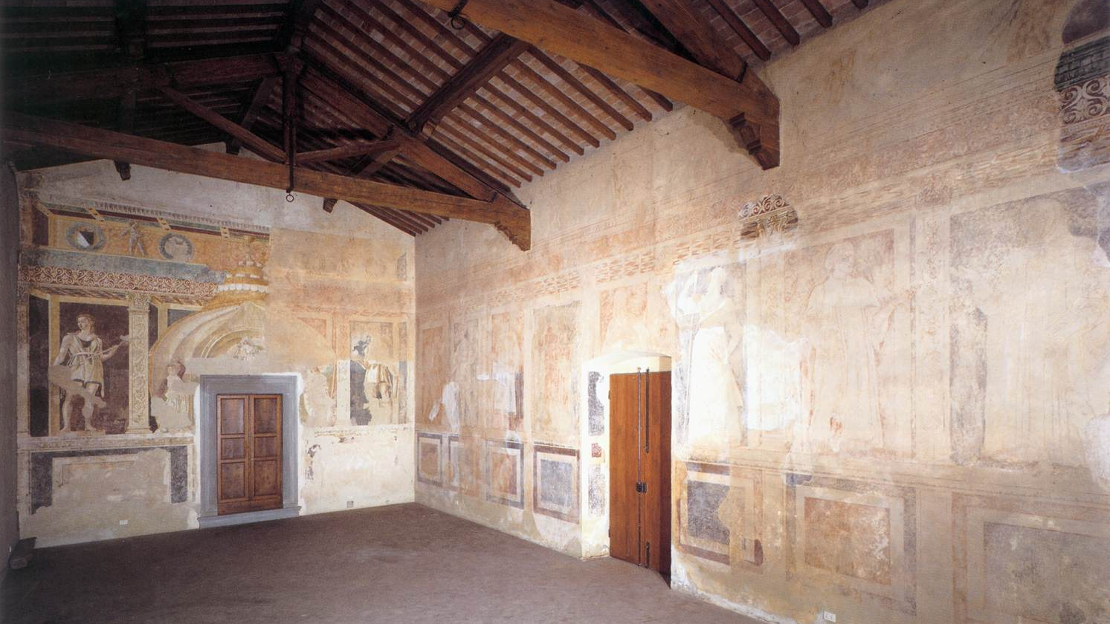
Andrea del Castagno, c. 1419-1457
Famous Persons Cycle, Viewo the former Loggia, c. 1450, Fresco, Villa Carducci, Legnaia https://www.wga.hu/frames-e.html?/html/a/andrea/castagno/index.html

Slide 16
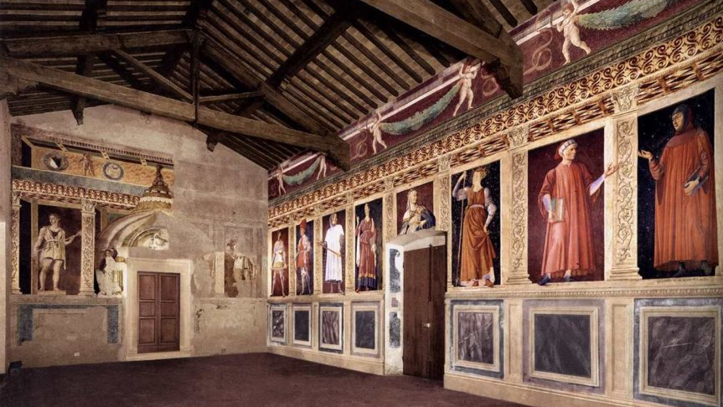
Andrea del Castagno, c. 1419-1457
Famous Persons Cycle (reconstruction), c. 1450, Fresco, Villa Carducci, Legnaia https://www.wga.hu/frames-e.html?/html/a/andrea/castagno/index.html

Slide 17
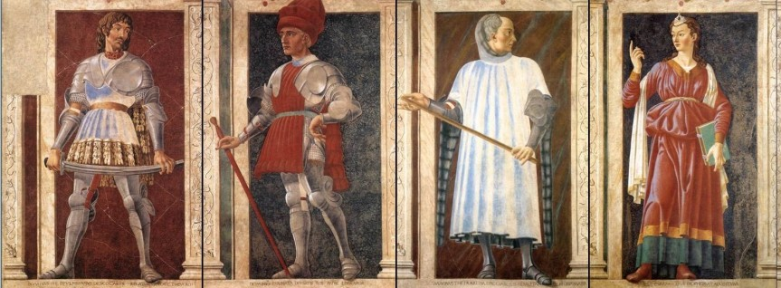
Andrea del Castagno, c. 1419-1457
Famous Persons Cycle, From left to right: Pippo Spano, Farinata degli Uberti, Niccolò Acciaiuoli and one of the three Cumean Sibyls, c. 1450, Frescoes transferred to Wood, 250 x 154 cm each, from Villa Carducci, Legnaia, Galleria degli Uffizi, Florence https://arsartisticadventureofmankind.wordpress.com/tag/del-castagnos-equestrian-monument-of-niccolo-da-tolentino/

Slide 18
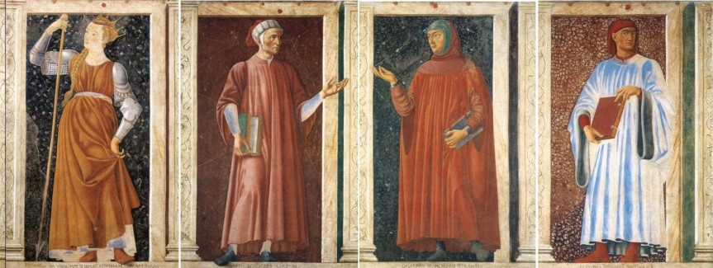
Andrea del Castagno, c. 1419-1457
Famous Persons Cycle, From left to right: Queen Tomyris, Dante Allighieri, Francesco Petrarca and Giovanni Boccaccio, c. 1450, Frescoes transferred to Wood, 250 x 154 cm each, from Villa Carducci, Legnaia, Galleria degli Uffizi, Florence https://arsartisticadventureofmankind.wordpress.com/tag/del-castagnos-equestrian-monument-of-niccolo-da-tolentino/

Slide 19
The End…

